Slide 1
Tonelli-Shanks Algorithm
Group 6
Taoyue Xia

Slide 2
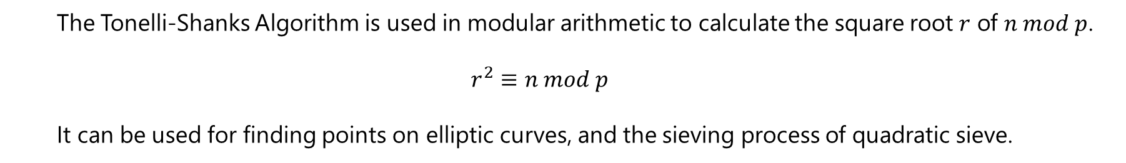
Introduction
The Tonelli-Shanks Algorithm is used in modular arithmetic to calculate the square root $r$ of $n mod p$.
$$r^{2}≡n mod p$$
It can be used for finding points on elliptic curves, and the sieving process of quadratic sieve.

Slide 3
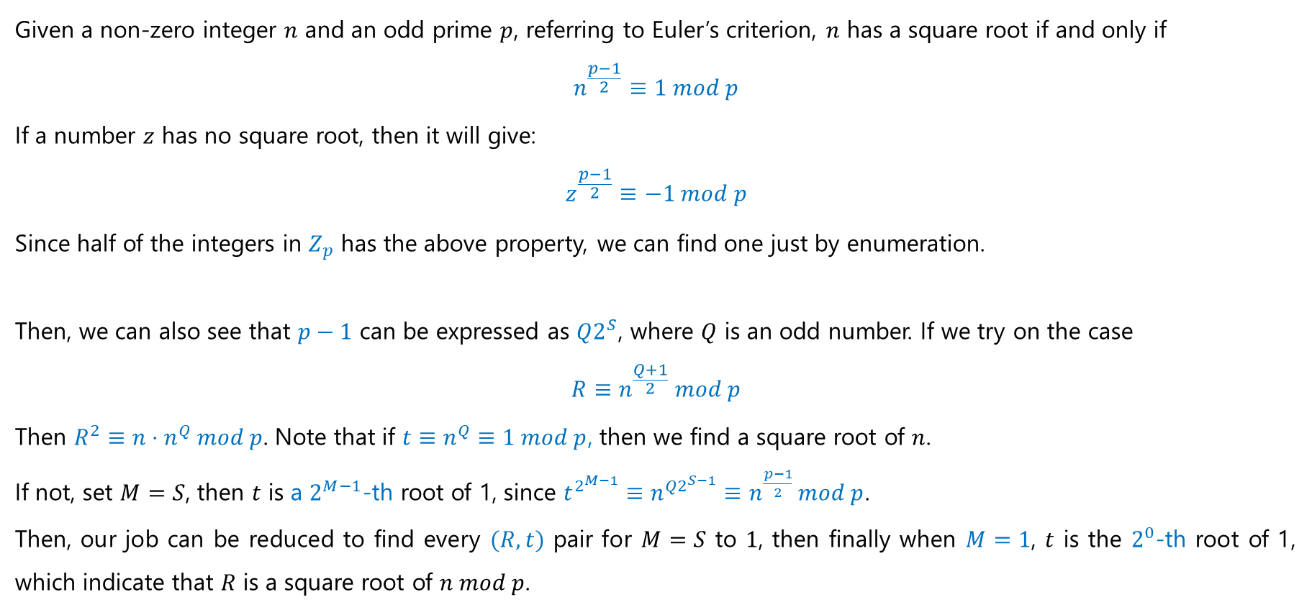
Method
Given a non-zero integer $n$ and an odd prime $p$, referring to Euler’s criterion, $n$ has a square root if and only if
$$n^{\frac{p−1}{2}}≡1 mod p$$
If a number $z$ has no square root, then it will give:
$$z^{\frac{p−1}{2}}≡−1 mod p$$
Since half of the integers in $Z_{p}$ has the above property, we can find one just by enumeration.
Then, we can also see that $p−1$ can be expressed as $Q2^{S}$, where $Q$ is an odd number. If we try on the case
$$R≡n^{\frac{Q+1}{2}} mod p$$
Then $R^{2}≡n⋅n^{Q} mod p$. Note that if ${t≡n}^{Q}≡1 mod p$, then we find a square root of $n$.
If not, set $M=S$, then $t$ is a $2^{M−1}$-th root of 1, since $t^{2^{M−1}}≡n^{Q2^{S−1}}≡n^{\frac{p−1}{2}} mod p$.
Then, our job can be reduced to find every $(R, t)$ pair for $M=S$ to $1$, then finally when $M=1$, $t$ is the $2^{0}$-th root of 1, which indicate that $R$ is a square root of $n mod p$.

Slide 4
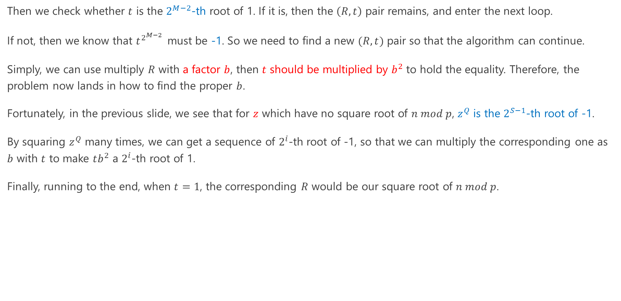
Method (Continued)
Then we check whether $t$ is the $2^{M−2}$-th root of 1. If it is, then the $\left(R, t\right)$ pair remains, and enter the next loop.
If not, then we know that $t^{2^{M−2} }$ must be -1. So we need to find a new $(R, t)$ pair so that the algorithm can continue.
Simply, we can use multiply $R$ with a factor $b$, then $t$ should be multiplied by $b^{2}$ to hold the equality. Therefore, the problem now lands in how to find the proper $b$.
Fortunately, in the previous slide, we see that for $z$ which have no square root of $n mod p$, $z^{Q}$ is the $2^{S−1}$-th root of -1.
By squaring $z^{Q}$ many times, we can get a sequence of $2^{i}$-th root of -1, so that we can multiply the corresponding one as $b$ with $t$ to make $tb^{2}$ a $2^{i}$-th root of 1.
Finally, running to the end, when $t=1$, the corresponding $R$ would be our square root of $n mod p$.

Slide 5
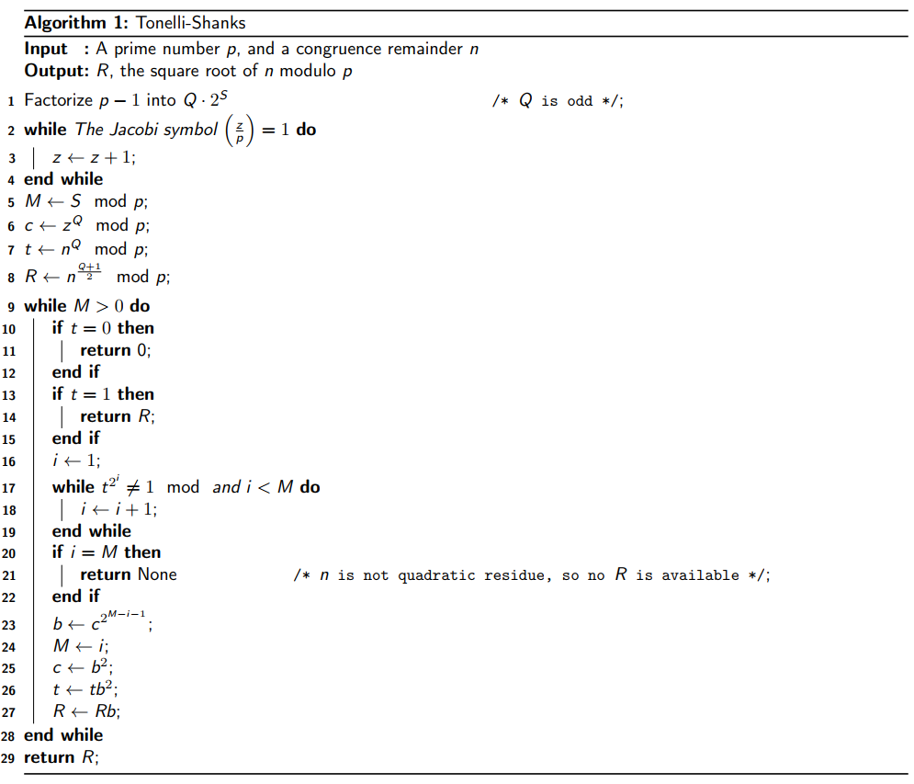
Pseudocode

Slide 6
Program

Slide 7
Thank You

