Slide 1
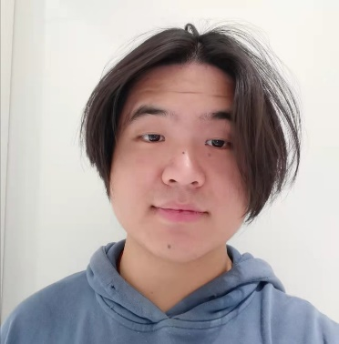
Education Background Phd, Delft University of Technology Msc, KTH Royal Institute of Technology Msc, Eindhoven University of Technology Integrated Program, Esade Business School Bsc, Ocean University of China

