Slide 1
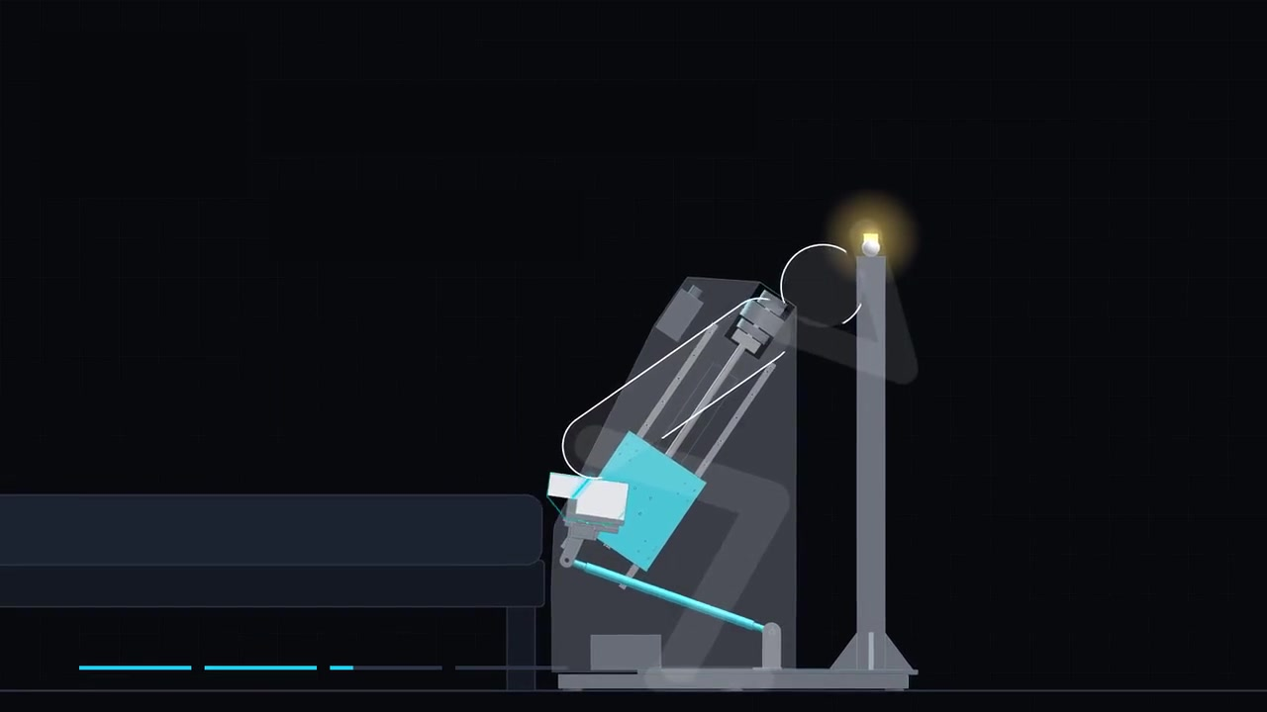
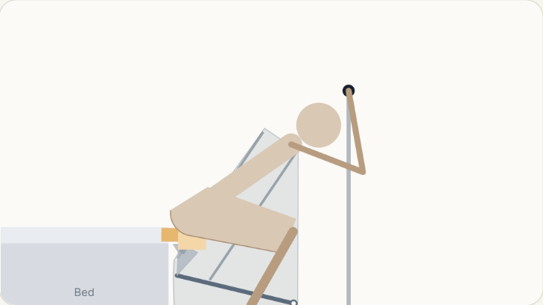
3 · MECHANISM DESIGN
Motion Overview: Seat Trajectory During Sit-to-Stand
Four steps:
slide on→ grip → rise → release(stop)
Ergonomics Path:
18 cm forward + 27 cm up
Lean ≤ 16°:
supports hips first, then thighs
Notes:
[~28 s · ends at 0:28] (Click the video to play.)
Before the details, let's watch the mechanism move. One use has four steps: slide on, grip the switch, rise together, and release to stop. Notice the seat does not go straight up. It moves about 18 centimetres forward and 27 up, and leans at most 16 degrees, like a natural rise. The cushion supports the hips first, then the thighs.

Slide 2
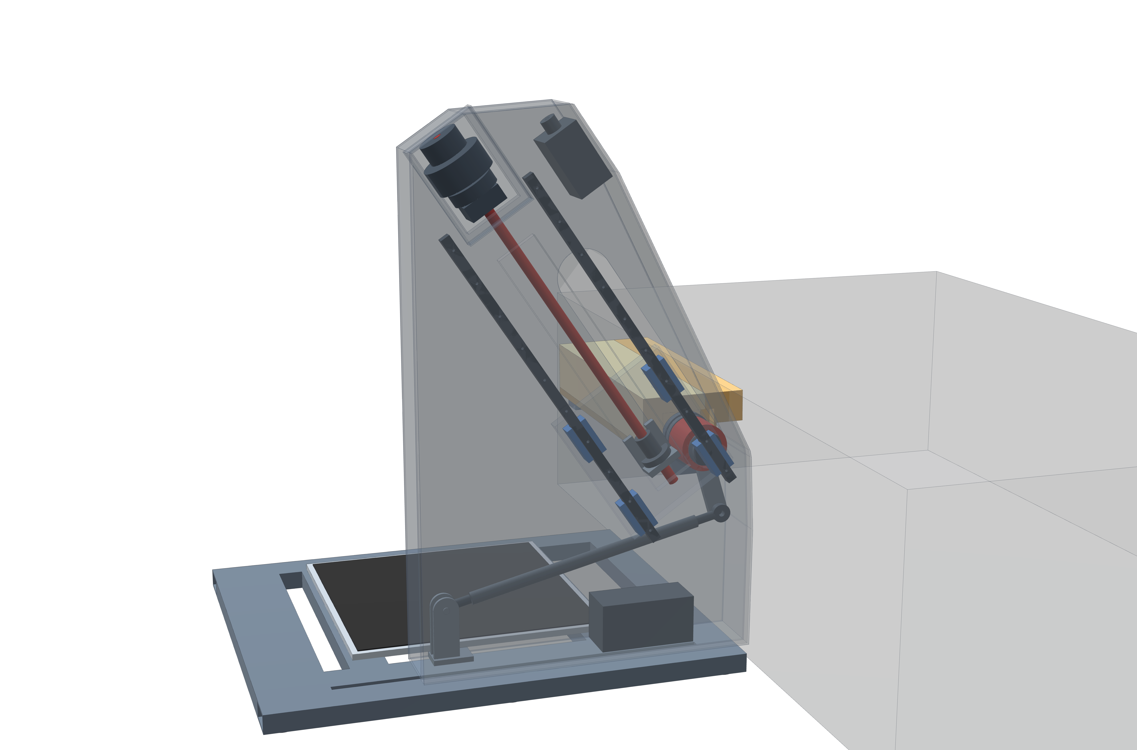
3 · MECHANISM DESIGN
Mechanism Synthesis: Inclined Guide with Tilt Link
Goal: reproduce ergonomics path
Method: trace seat point along the path
Straight-line point : inclined guide rail
Arc point : swinging tilt link
Result:
1 degree of freedom;
one motor;
foot end left open
Motor
Straight-line point · path
Inclined guide rail
Arc point · path
Tilt link
Notes:
[~27 s · ends at 0:57]
Here is our CAD model with a see-through housing. To find a structure for this path, we traced every point on the seat. One point moves almost in a straight line, so it rides a guide rail. Another moves on an arc, so a swinging link holds it. One motor drives it, and the foot end stays open.
[CLICK → zoom to the guide and link]

Slide 3
3 · MECHANISM DESIGN
Kinematic Sizing: Guide Angle and Link Length
Belt + pulley (motor above) ↑
Key idea guide angle sets the rise, link length sets the tilt
Guide 34° from vertical; link 465 mm
Path error ≤ 8 mm tilt error ≤ 0.8°
Stroke 331 mm →
seat 18.5 cm forward, 27.4 cm up
Drive:
motor → belt → ball screw → carriage
Guide 34° from vertical
Ball screw
Pivot 1 · straight line
Carriage
Link 465 mm
Fixed centre B
Pivot 2 · arc
Notes:
[~27 s · ends at 1:26]
Zooming in: the guide leans 34 degrees from vertical, and the link is 465 millimetres. We optimised four geometry values, and the seat stays within 8 millimetres of the ideal path, about a finger's width. Over a 331-millimetre screw stroke, the seat moves 18.5 centimetres forward and 27.4 up, driven by a motor, belt, ball screw and carriage.
[CLICK → zoom to pivot 1]

Slide 4
3 · MECHANISM DESIGN
Structural Check: Load Path of the One-Sided Seat
Stiffness check · edge sag ≈ 4 mm
① 150 kg at the seat edge
(100 kg user × 1.5)
Design load: 150 kg , 10 cm off-centre
Resulting moment: 586 N·m at pivot 1
Bearing choice: tapered roller pair 3.2× stronger
Rail check: 5.2 kN per carriage 2.5× stronger
Stiffness check: seat edge sags ≈ 4 mm → FEA next
③ Rail check · 5.2 kN
≈ 530 kg · 2.5× stronger
② Pivot 1 · moment 586 N·m
≈ 60 kg on a 1 m bar
Tapered roller pair
bearings 3.2× stronger
Notes:
[~34 s · ends at 2:02]
The seat is held on one side only, so how does it carry the load? Our worst case is 150 kilograms near the open edge. That puts 586 newton-metres on pivot one, like hanging 60 kilograms on a one-metre bar. The tapered roller bearings are 3.2 times stronger than needed, and the guide rails, at 5.2 kilonewtons, still have 2.5 times margin. The seat edge sags only about 4 millimetres. Hand calculations; FEA next.

Slide 5
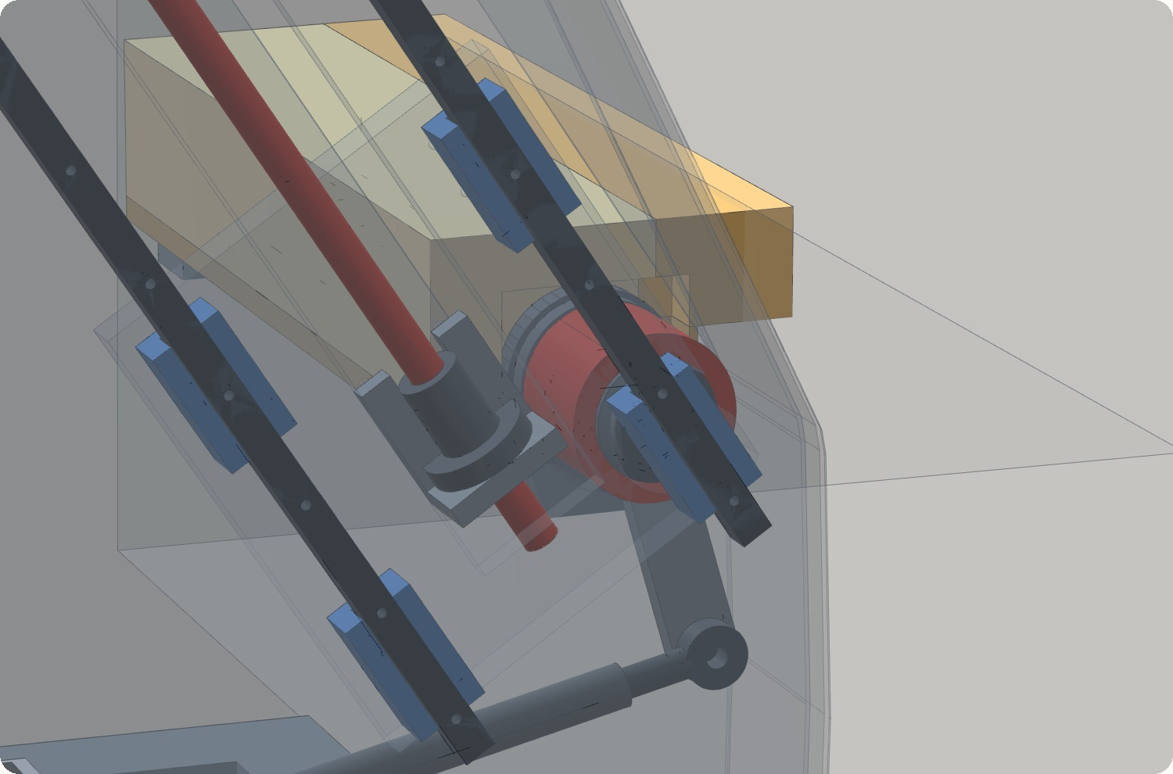
3 · STABILITY
Frame Stability: Tipping Analysis
Key idea: verify tip-over stability under user loads and external pushes
User loads: at maximum design load, the CoG stays within the base(≥ 9 cm margin)
External push: 156 N (≈ 16 kg) at the grab bar exceeds the tipping threshold
Design decision: anchor to the bed to resist external loads
Notes:
[~2 s · ends at 2:04] (Auto-plays, no click. Say this while the camera turns.)
"Now, is the whole frame stable?"

Slide 6
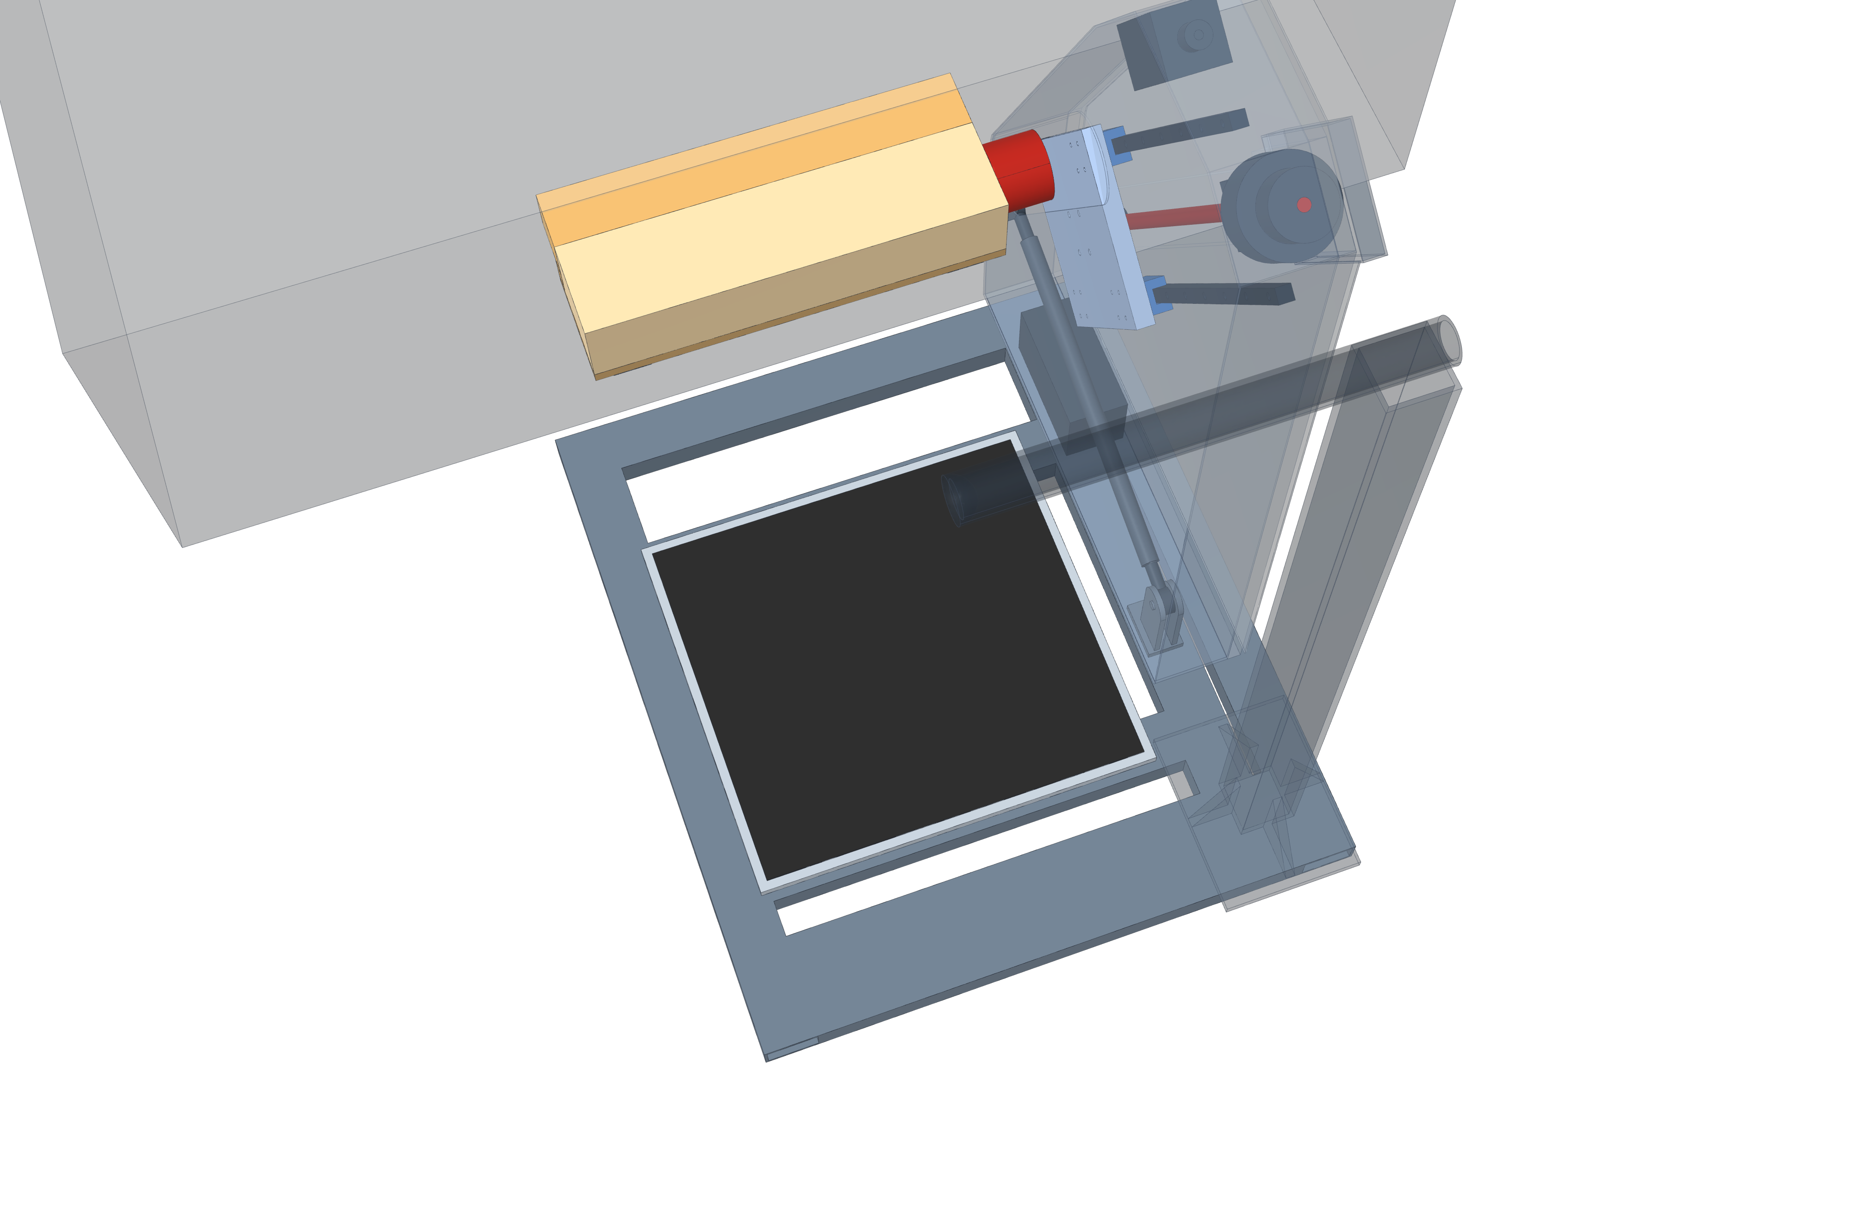
3 · STABILITY
Frame Stability: Tipping Analysis
Key idea: verify tip-over stability under user loads and external pushes
User loads: at maximum design load, the CoG stays within the base(≥ 9 cm margin)
External push: 156 N (≈ 16 kg) at the grab bar exceeds the tipping threshold
Design decision: anchor to the bed to resist external loads
Push at grab bar 156 N
(≈ 16 kg) → tips
150 kg loads: CoG stays 9 cm inside
Frame only ≈ 85 kg
Notes:
[~33 s · ends at 2:38]
From above, the dashed outline is the base. The frame is stable as long as the ground-reaction point stays inside it. A seated user cannot tip it: a 100-kilogram hard sit stays 9 centimetres inside, and hanging on the bar, 23. The danger is someone on the floor pushing the bar. The frame is only 85 kilograms, and a 16-kilogram push tips it. So it must be fixed to the bed.
[CLICK → zoom to the bed anchors]

Slide 7
3 · STABILITY
Frame Stability: Anchoring to the Bed
Objective: transfer external loads into the bed
Design load: grab-bar load 1112N× 1.5 = 1668N
Anchor load: lever effect raises this to 2211 N
Rejected option: under-mattress plate cannot resist
Design decision: two anchors clamped to the bed frame or legs
Anchor
Anchor
Notes:
[~21 s · ends at 3:01]
Two anchors, one at each end of the base, lock the frame to the bed frame or legs. Using the grab-bar design load with a 1.5 safety factor, each must hold 2211 newtons, about 225 kilograms of pull. A plate under the mattress is not enough.

Slide 8
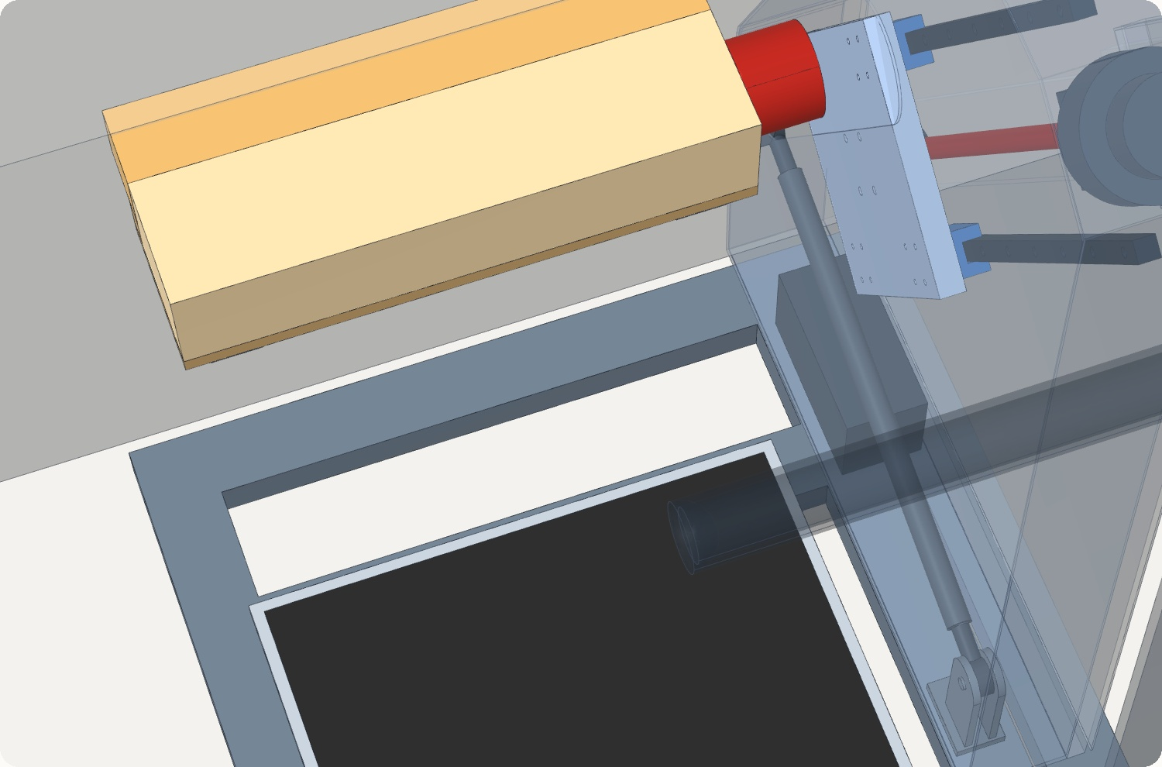
3 · STABILITY
Lateral Fall Risk: Hip Drop on the Open Side
Worst case: hips drop 63 cm
Comparison: only 6 cm more than a raised bed (57 cm)
Bed-head side: blocked by the housing (3 cm gap)
Options: fold-down side guard, or auto-stop on sideways shift
Notes:
[~2 s · auto, no click] (Say this while the camera turns and the seat rises:)
"And what if the user falls sideways at the top?"

Slide 9
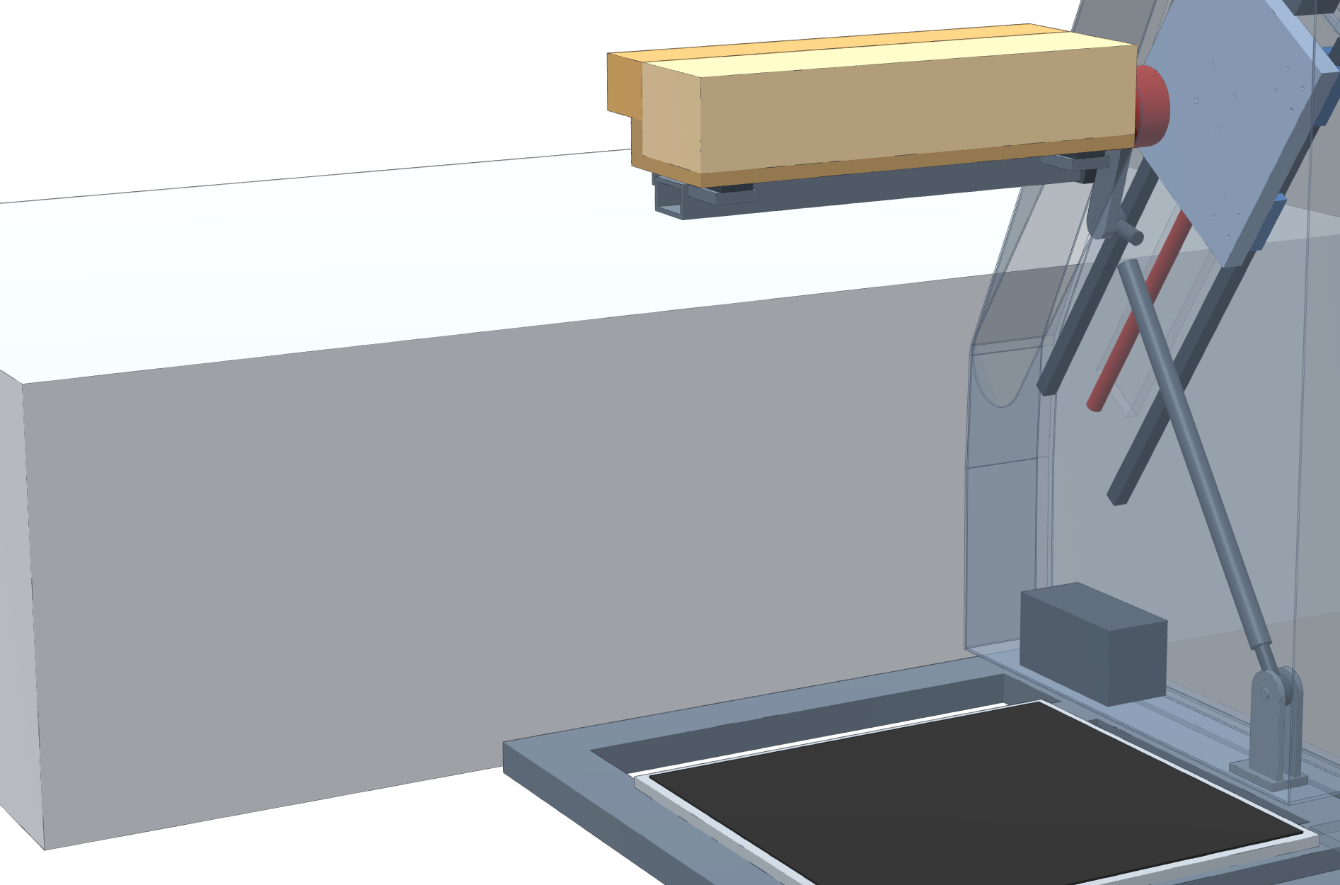
3 · STABILITY
Lateral Fall Risk: Hip Drop on the Open Side
Worst case: hips drop 63 cm
Comparison: only 6 cm more than a raised bed (57 cm)
Bed-head side: blocked by the housing (3 cm gap)
Options: fold-down side guard, or auto-stop on sideways shift
Bed-head side
3 cm gap, blocked by housing
Open side: hips drop 63 cm
Hip drop in a sideways fall
Low bed
41 cm
Raised bed
57 cm
Our seat, top
63 cm
+6 cm vs a raised bed
Notes:
[~26 s · ends at about 3:31]
Our extra risk is the open side. At the top of the stroke, a sideways fall drops the hips 63 centimetres, only 6 more than from a raised bed. The bed-head side is blocked by the housing. For the open side, we are choosing between a fold-down guard and an automatic stop when the sensors detect a sideways shift.
[CLICK → how hard it is to tip a user sideways]

Slide 10
3 · STABILITY
Lateral Stability: Push Needed to Tip the User Sideways
Sideways push needed to tip over (× an everyday bump) — longer = harder to tip
1× = everyday bump: ≈ 10 kgf push on a 70 kg adult
On our seat: 2.7–2.8× to tip, close to a bed (3.0×)
Weakest: standing (1.6×), same as from a bed
Improvements: hands on bar 4.2×; side guard 8.0×
Limitation: simplified model, for comparison only
Sitting on a bed edge (reference)
3.0×
Our seat · seated, start
2.8×
Our seat · weakest seated point
2.7×
Standing, after leaving the seat
1.6×
Seated, both hands on bar
4.2×
Seated + side guard (option)
8.0×
everyday bump
≤ 1× (≈ 10 kgf)
Notes:
[~38 s · ends at about 4:11]
How likely is such a fall? The chart shows how hard a sideways push must be to tip a person, in multiples of an everyday bump. One times is a light bump or small trip, roughly a 10-kilogram push on a 70-kilogram adult. Tipping a user off our seat takes about 2.8 times that, close to a bed edge at 3. The weakest moment is standing after leaving the seat, 1.6 times, the same as rising from a bed. A simplified model, for comparison only.
(If asked: an everyday bump moves the body sideways at about 0.3 m/s. For a 70 kg adult over about 0.2 s, that is 70 × 0.3 ÷ 0.2 ≈ 105 N ≈ 10 kgf, a rough estimate. Tipping thresholds in the model: bed 0.91, seat 0.80–0.85, standing 0.47, hands on bar 1.27, side guard 2.40 m/s; each divided by 0.3 gives the multiples.)

