Slide 1
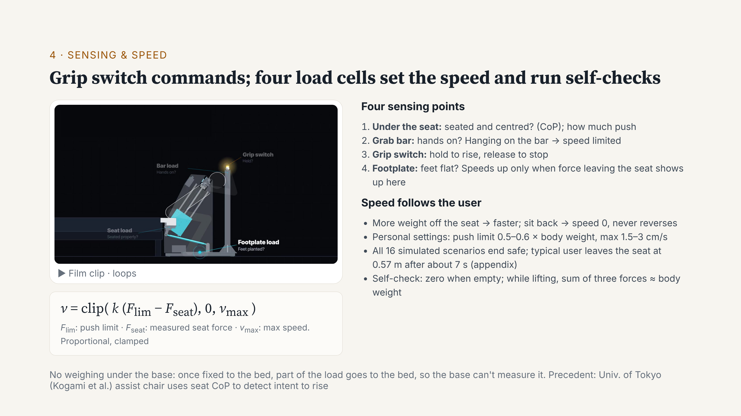
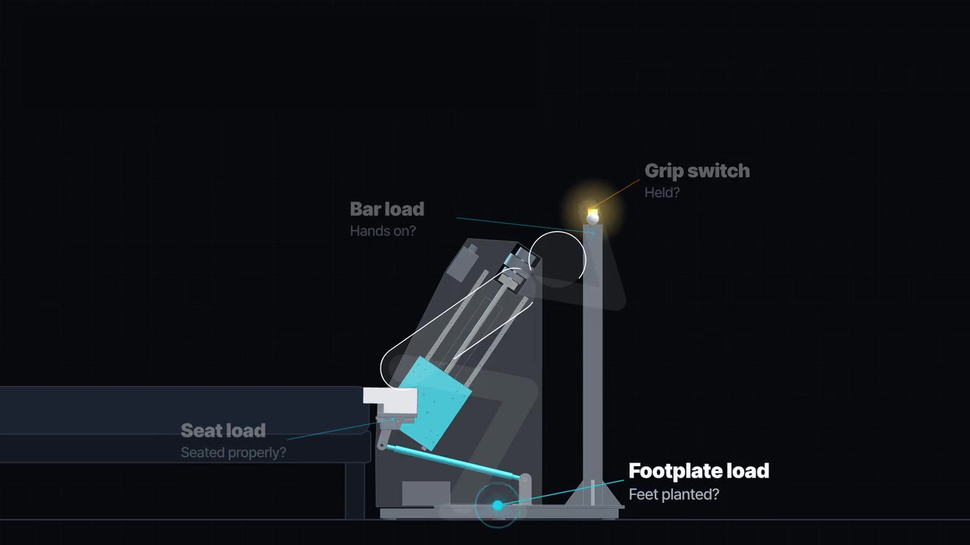
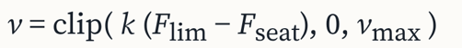
Four sensing points:
Seat
Grab bar
Grip switch
Footplate
01 USER COMMAND
02 ADAPTIVE SPEED
03 FORCE CHECK
Hold to rise
Release to stop
Follow the user
Confirm load transfer
More weight on feet → faster
Sit back → stop
Hanging on bar → speed limited
Footplate confirms unloading
Seat + footplate + bar
≈ body weight
Release switch
↓
Stop + brake
SIMULATION 16 scenarios · Typical seat-off: ~7 s · Prototype validation pending
Notes:
Control has two parts. The command: hold the switch on the bar to rise; let go to stop. Force sensing does two jobs. One, speed: k times the push limit minus the seat force. The more the user pushes, the faster it rises; sitting back drops it to zero. It speeds up only when force leaving the seat shows up on the footplate, and hanging on the bar limits it. Two, self-check: the three forces should add up to about body weight. All 16 simulated scenarios end safe. A typical user leaves the seat at 0.57 metres after about 7 seconds.

Slide 2
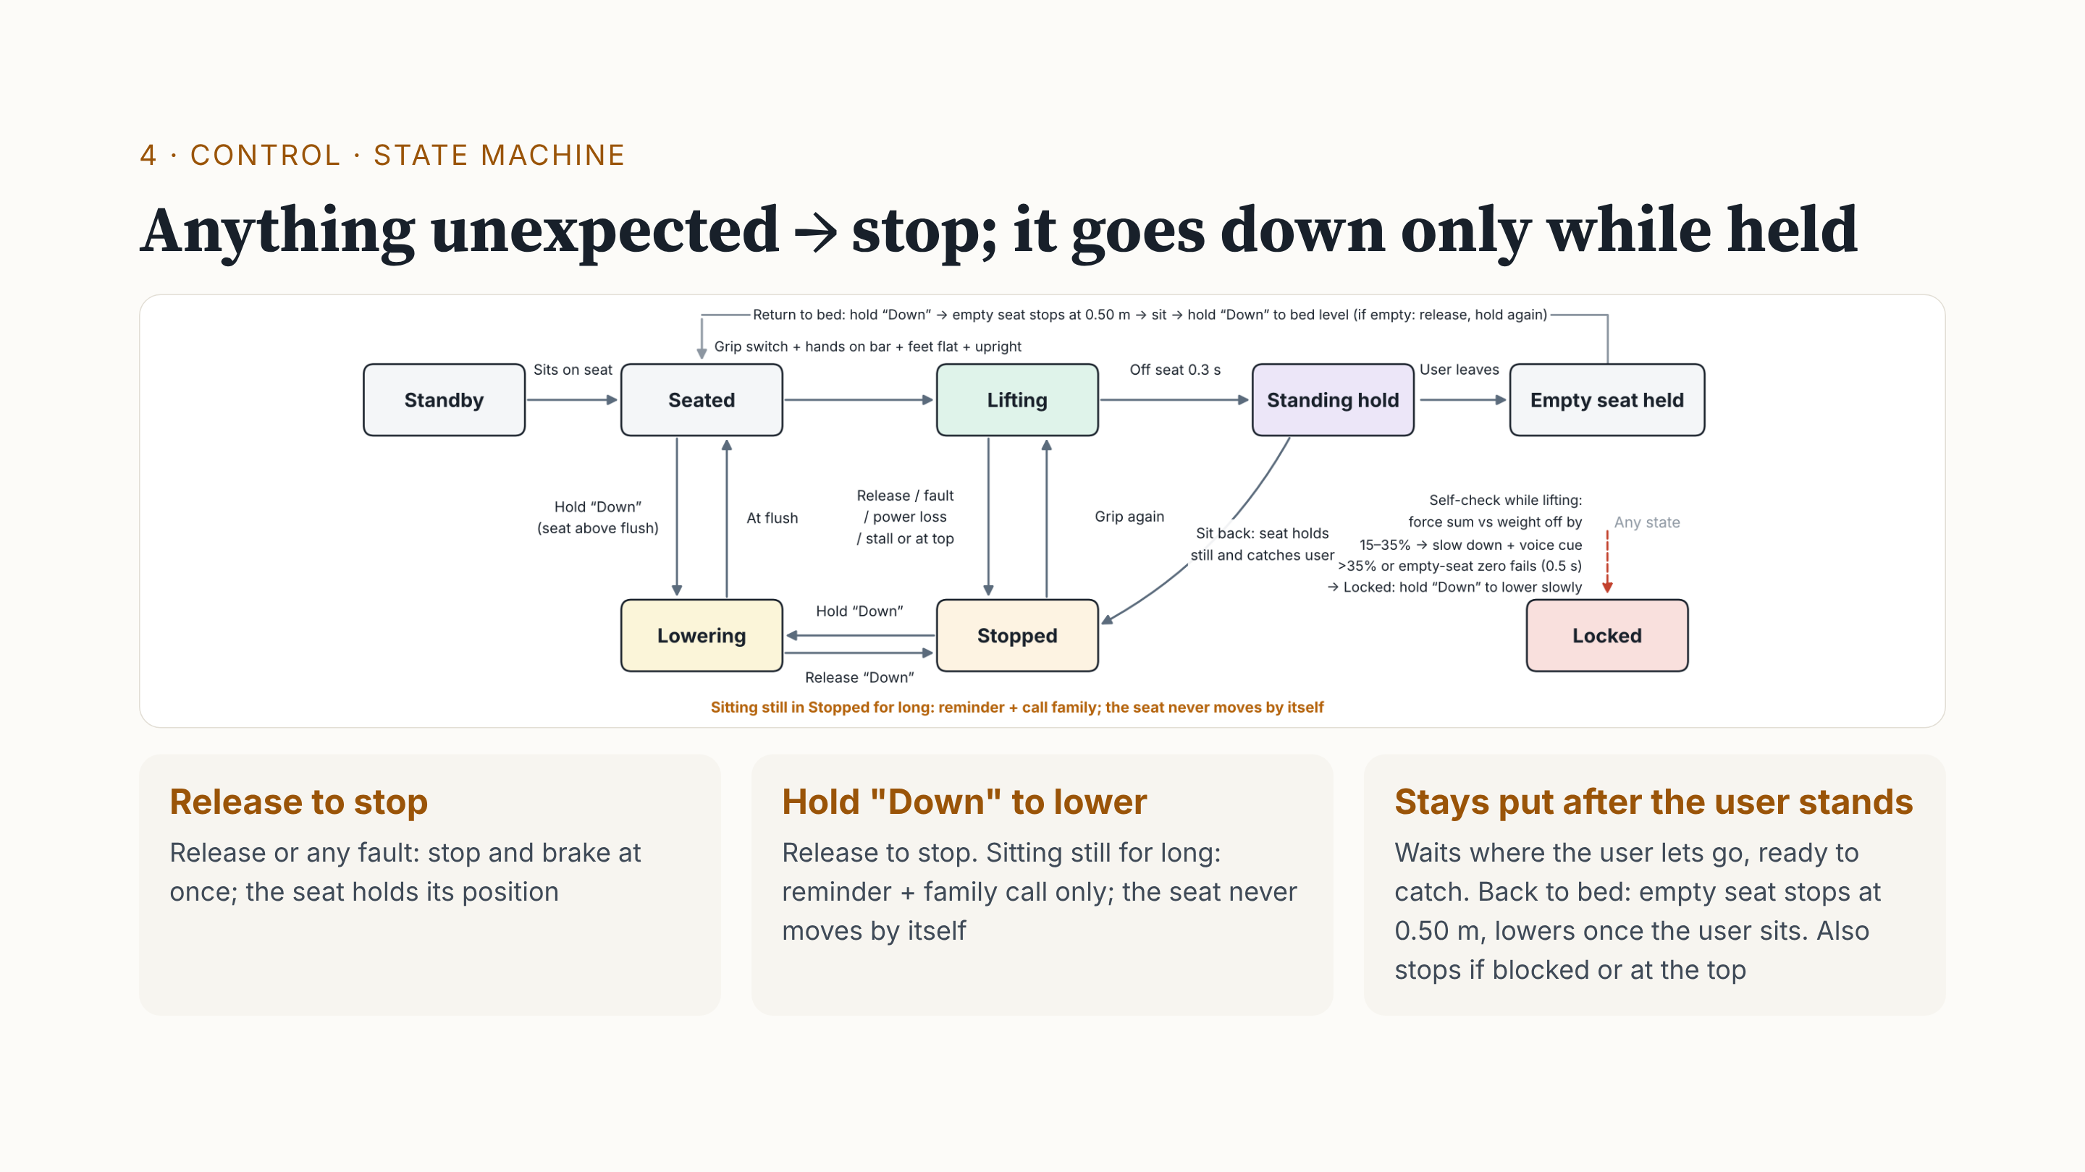
FORCE-CHECK RESPONSE
15–35% mismatch → slow + warn
>35% for 0.5 s → lockout
Notes:
Three rules. One: release, or any fault, and it stops and brakes at once. Two: it moves down only while someone holds "Down". Sitting still for long only gives a reminder and calls family; it never lowers by itself, because a weak person slips off a moving seat more easily. Three: after you stand, the seat stays put, so it can still catch you. To return to bed, the empty seat stops at 0.50 metres; once seated, hold "Down" to reach the bed. Note: release-to-stop is a user command. Lock-out is the sensor self-check: forces 15 to 35% off body weight mean slow down and warn; above 35% for half a second, it locks. Legs giving way is different: the speed rule stops the seat to catch you.

Slide 3
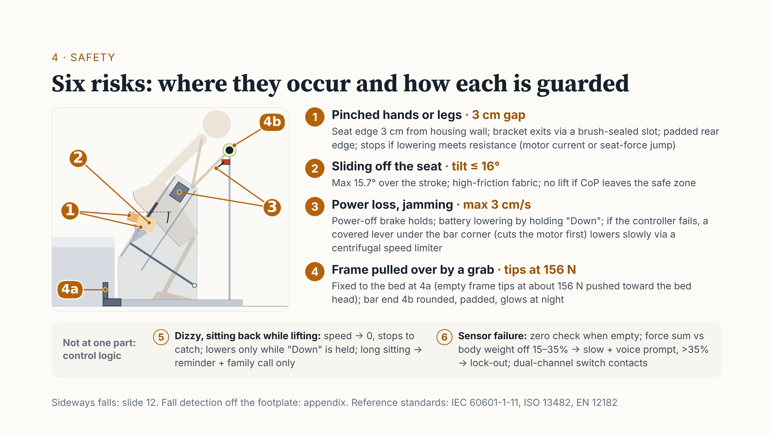
01 PINCH / OBSTRUCTION
02 SLIDING
Padded edge
Stop on obstruction
Limited tilt
High-friction cover
03 POWER LOSS
04 TIPPING / COLLISION
Power-off brake
Backup / manual lowering
Fixed to bed
Padded, glowing bar end
05 DIZZINESS / SIT-BACK
06 SENSOR MISMATCH
Stop movement
Hold support in position
Reduce speed + warn
Lock out if persistent
Notes:
The numbers match the side view. One: the seat edge is 3 centimetres from the housing wall, with a padded rear edge; it stops if blocked. Two: tilt under 16 degrees, high-friction fabric. Three: a power-off brake; without power, a battery or the lever under the bar lowers it slowly. Four: fixed to the bed; the bar end is padded and glows. Five, dizziness, and six, sensor failure, are control logic: stop and catch; if the self-check fails, slow down, then lock out.

