Slide 1
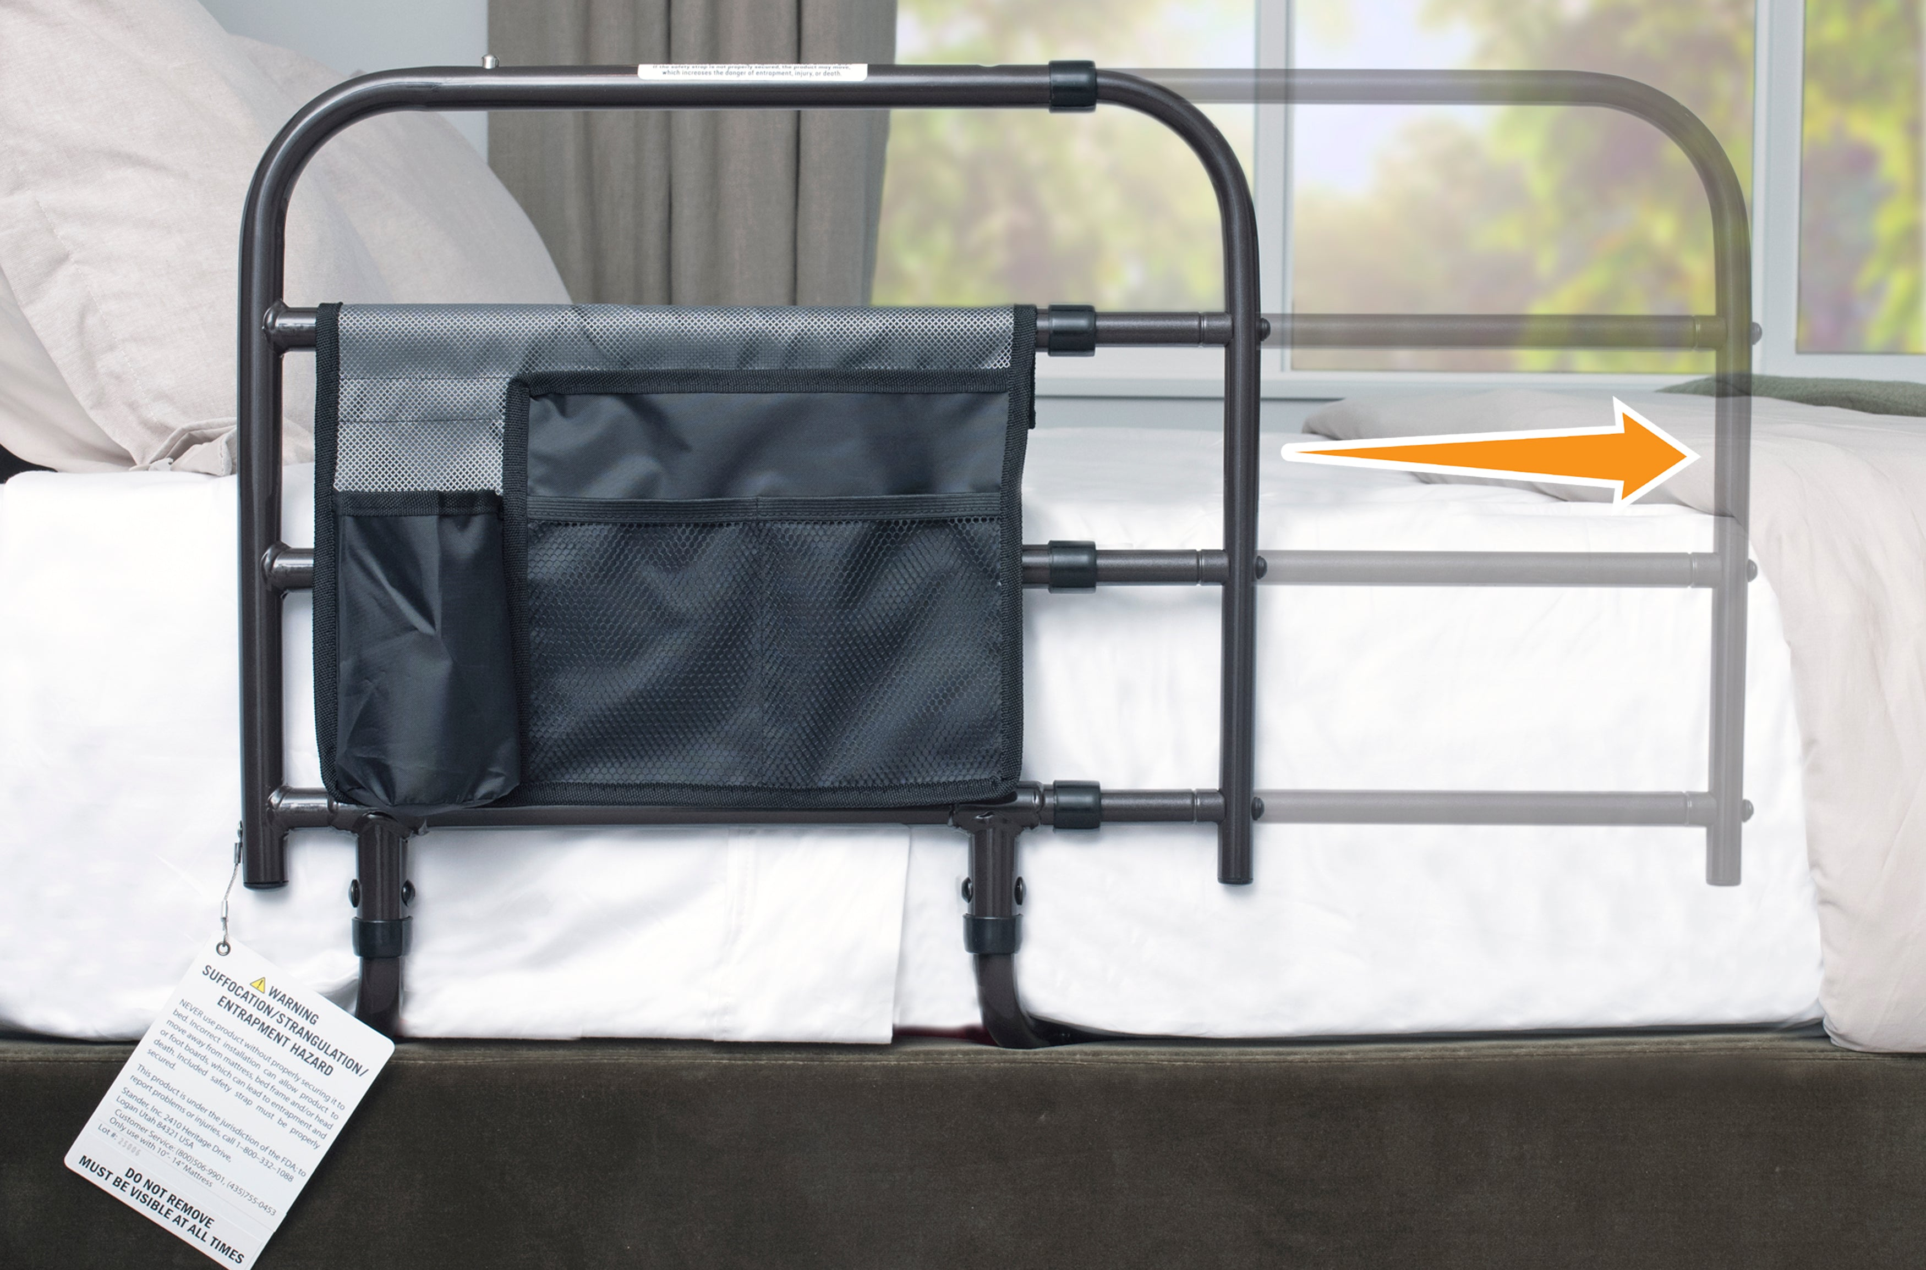
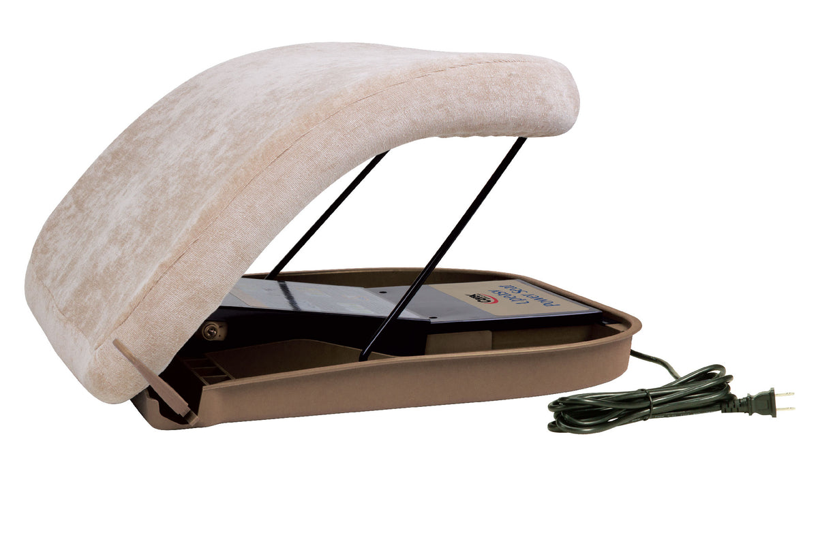
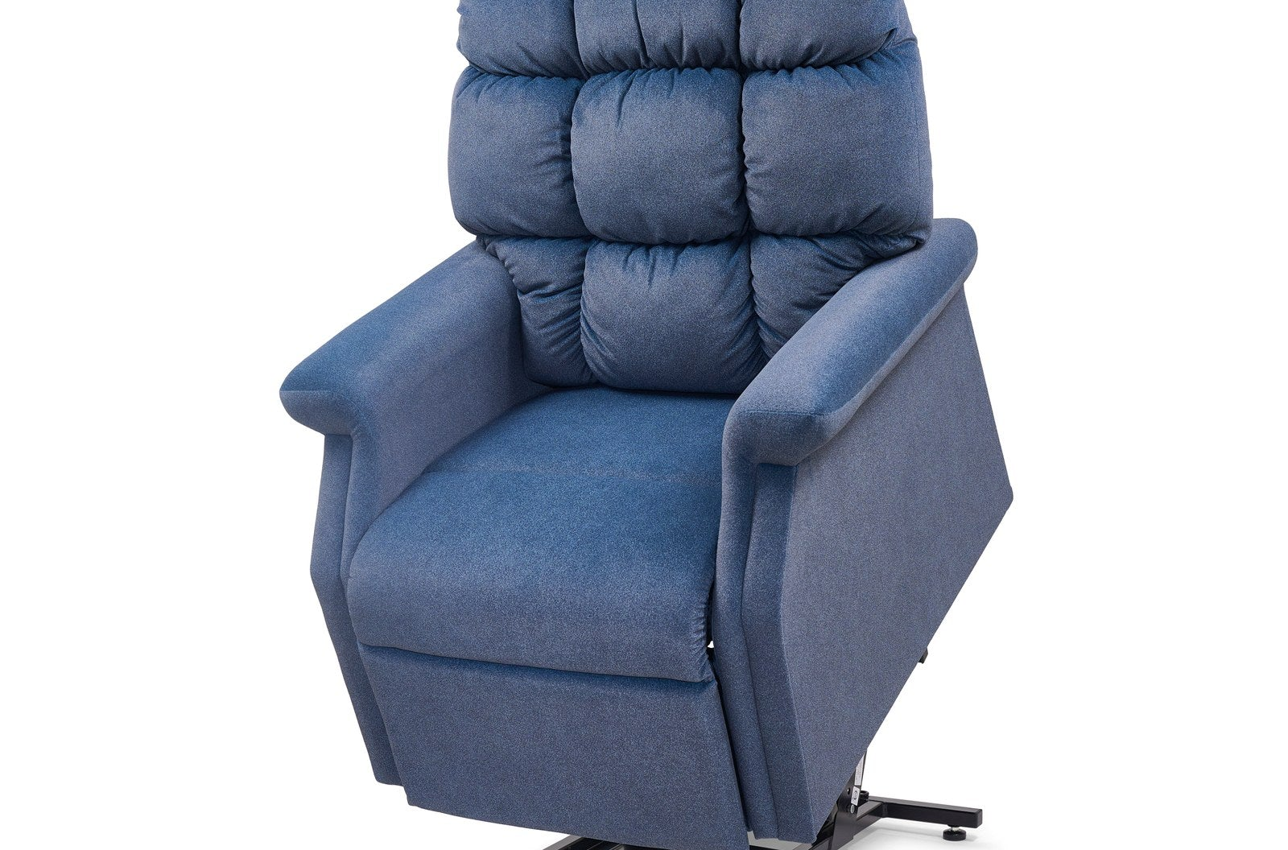
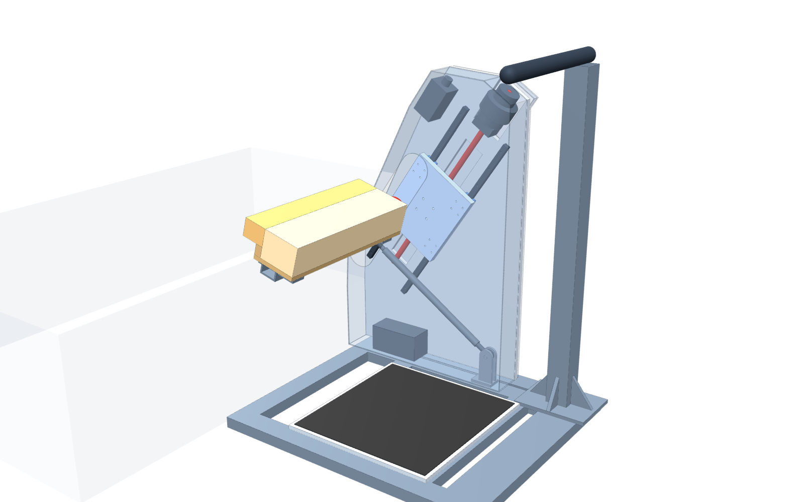
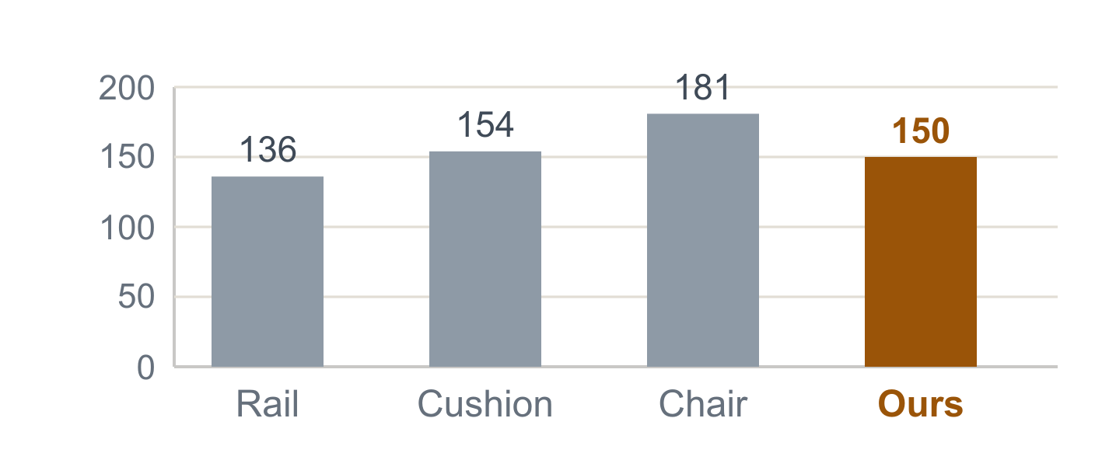
PRODUCT COMPARISON · ONE SAME RULER
Load, Lift, Follow — One Ruler for All Four
Bed rail (no motor)
Lift cushion (spring / electric)
Power lift chair (whole chair)
Bedside lift (our design)
Motion: fixed, does not move
Motion: seat goes straight up
Motion: whole chair tilts up
Motion: slides first, then lifts
136 kg · Δh 0 · Δx 0
100/154 kg · Δh 203 · Δx 0
181 kg · Δh ≈200* · Δx ≈50*
150 kg checked · Δh 274 · Δx 185
Weak: hands only, no lift
Weak: you must stand up first to put it under you
Weak: works in this one chair only
Plus: used at the bed; seat follows the hips
No help at other seats or at the bed
No real help, more work; hard to sit on for long
Same ruler: Δh = lift travel (up) | Δx = forward travel (sideways) | full travel from maker data; * = estimated from the tilt angle
① Max user weight (kg, axis from 0)
Use alone?
✓ Yes
△ Hard — must stand first
✓ One button
✓ Yes
Works at the bed?
✓ Yes
△ Must place it first
✗ This chair only
✓ Yes

Slide 2
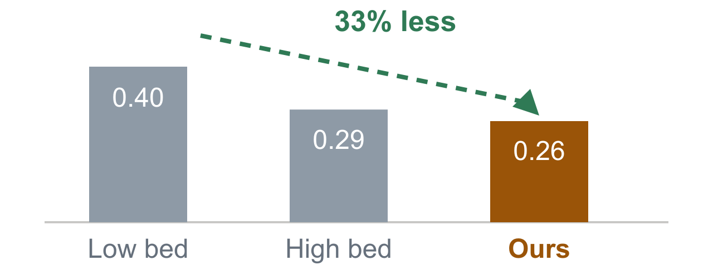
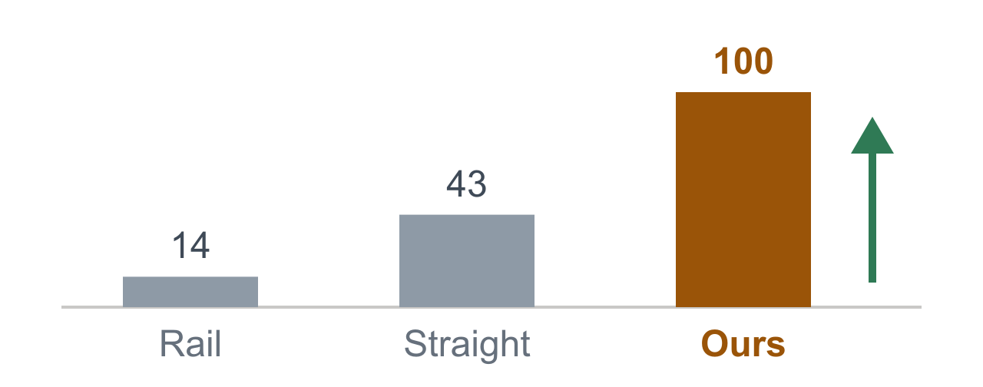
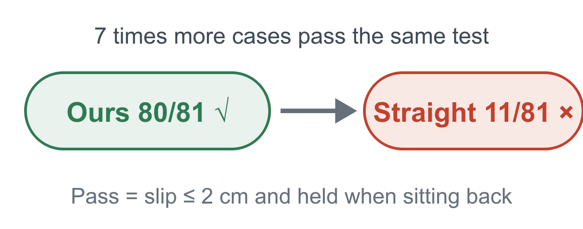
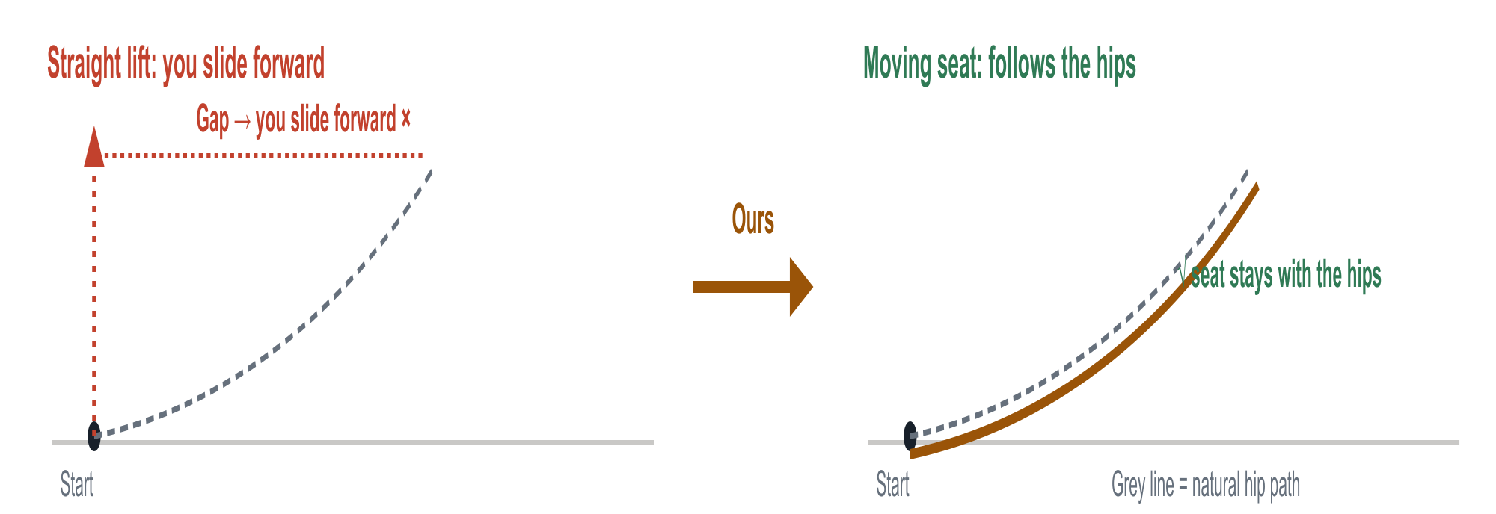
KEY ADVANTAGES · THREE NUMBERS
Less Effort, Full Support, Bed-Ready
STRENGTH 1
Less effort
STRENGTH 2
Full support
STRENGTH 3
Fits more users
−33%
100%
80/81
Peak push ÷ body weight; mid value of 81 cases
Share of the move where the seat still holds you

Slide 3
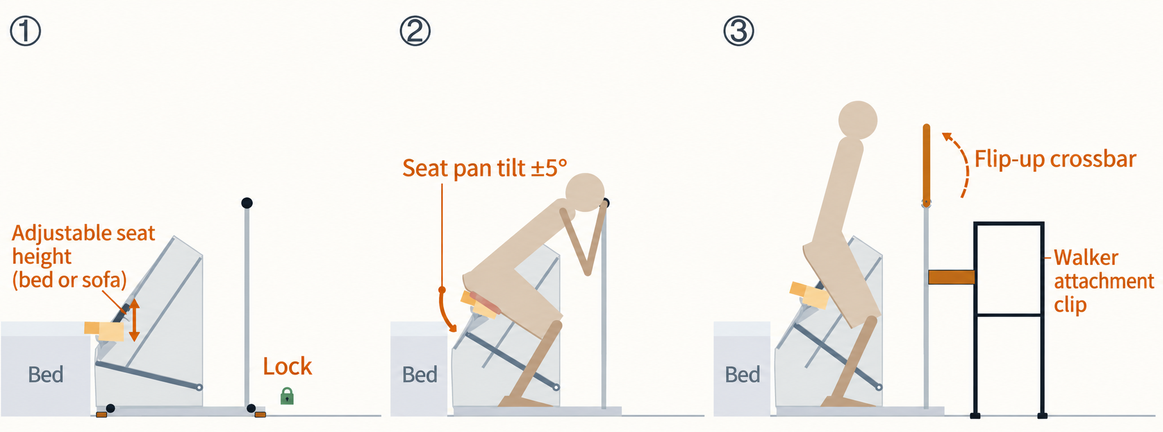



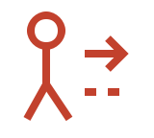
5·LIMITS → NEXT STEPS · ONE TO ONE
Four limits, four fixes
Sketch for 1，2，3: how to walk away after standing
4. Models only
Limits not tested
↓
Real tests
·Healthy subjects,
·Calibrate thresholds
1. Heavy and Bed-fixed
2. Fixed path
3. How to walk away?
85 kg frame; Additional fixation
One path cannot fit every body
Fixed bar blocks the walker
↓
↓
↓
Height adjustable + base lock
Floating seat pad
Flip-up bar + walker Latch
·Wheels stop slip.
·Feet extend 0.3 m stop tip
·±5° spring float
·Bar must lock before lift;
·Bar flips open,;
·Walker latches to frame

