Slide 1
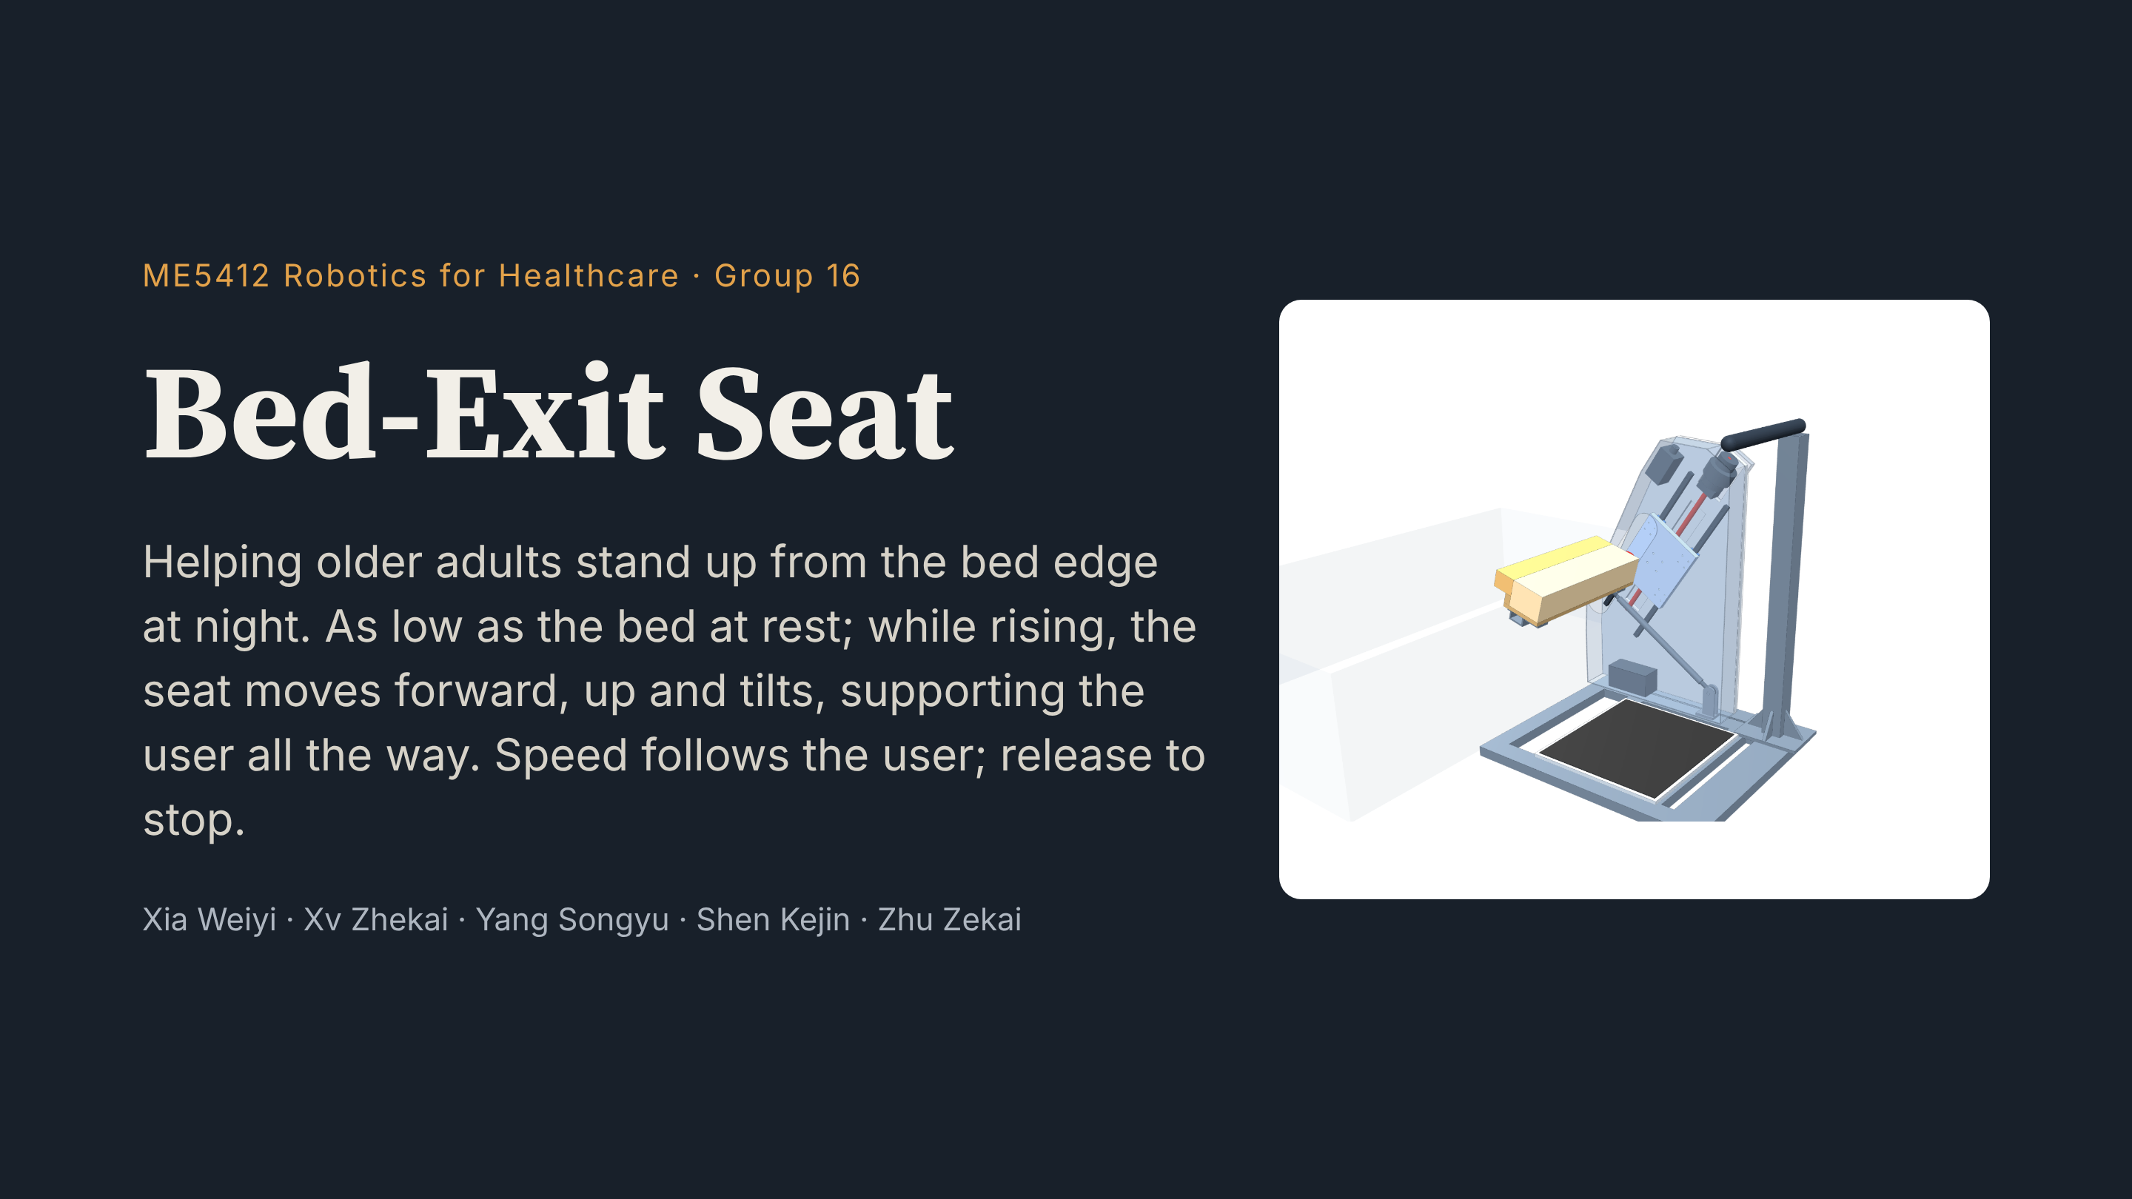
Notes:
Hello everyone, we are Group 16. Our project is the Bed-Exit Seat. It helps older adults with weaker legs stand up from the bed edge at night. First, please watch a 46-second film.

Slide 2
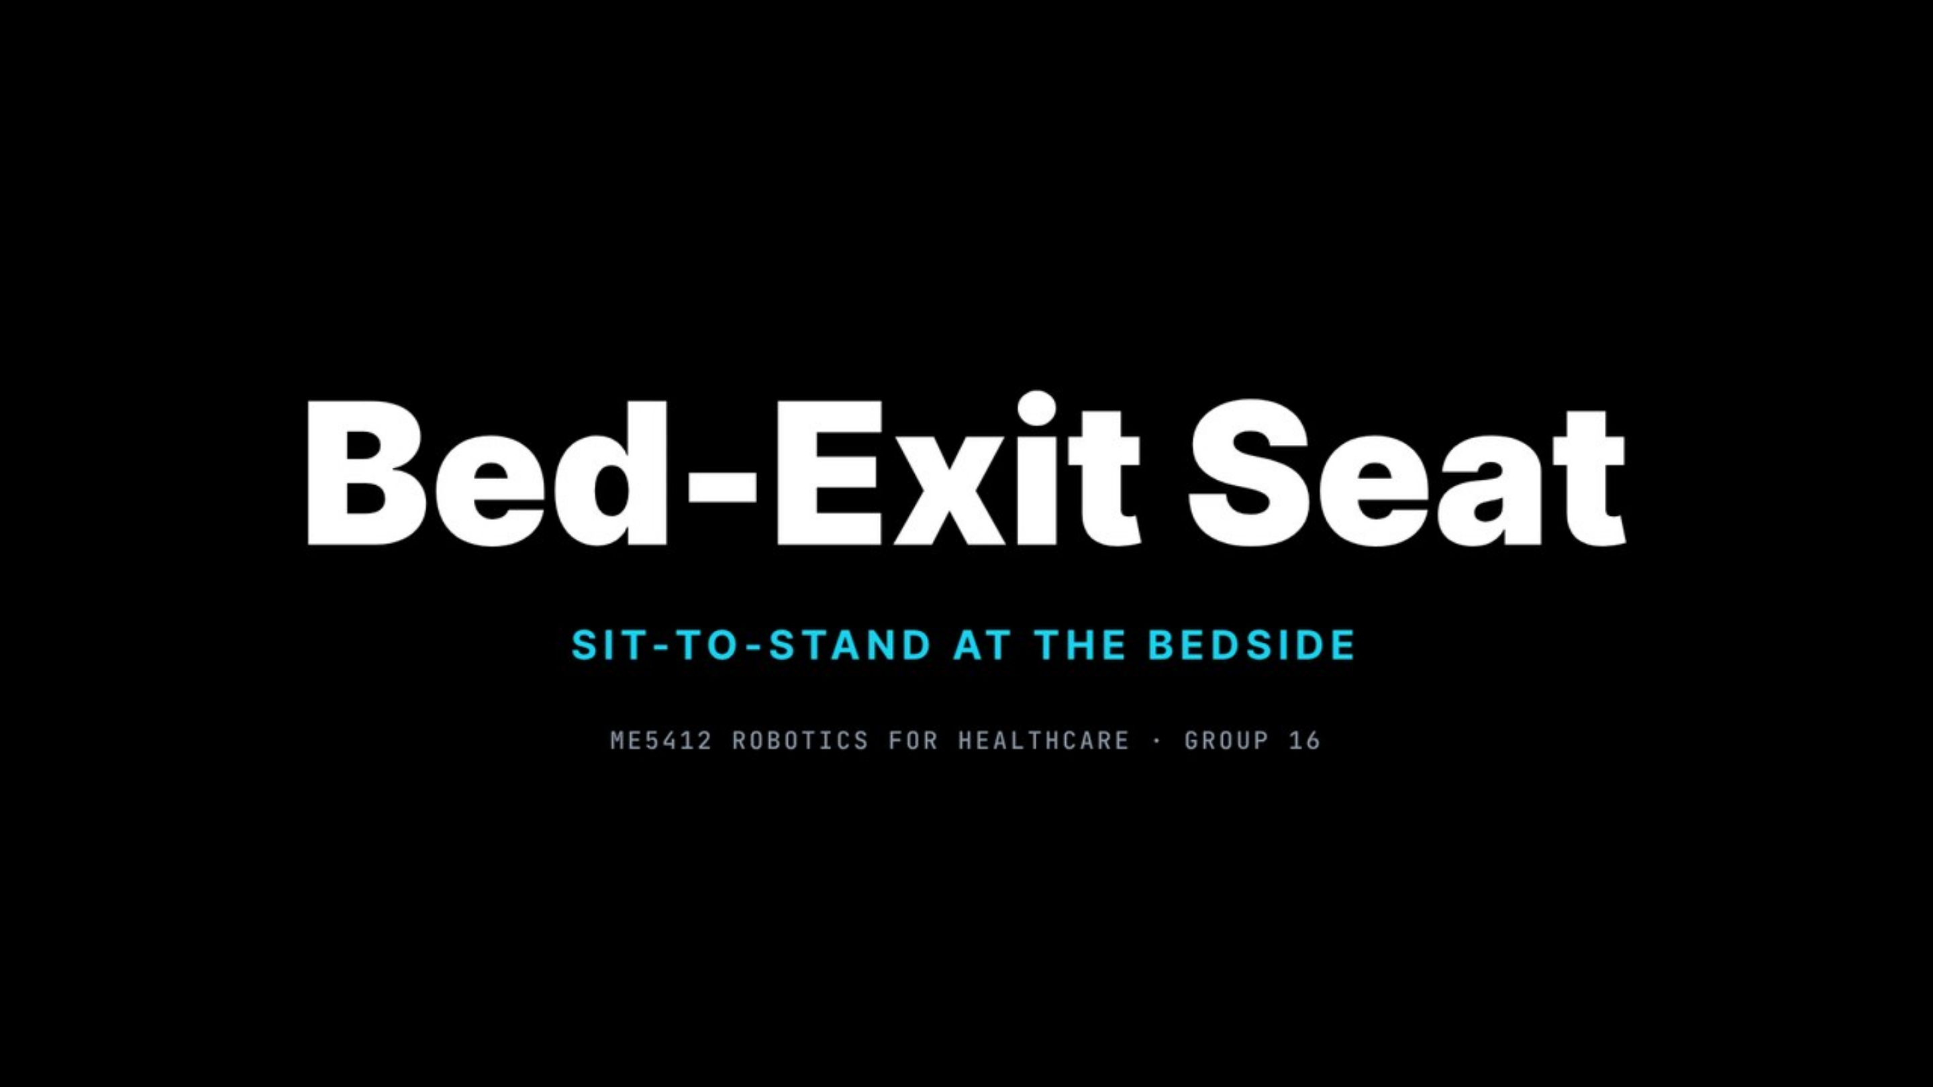

Notes:
(Click to play — 46 s with sound. Don't speak during the film.) Afterwards: Now let's go through each step.

Slide 3
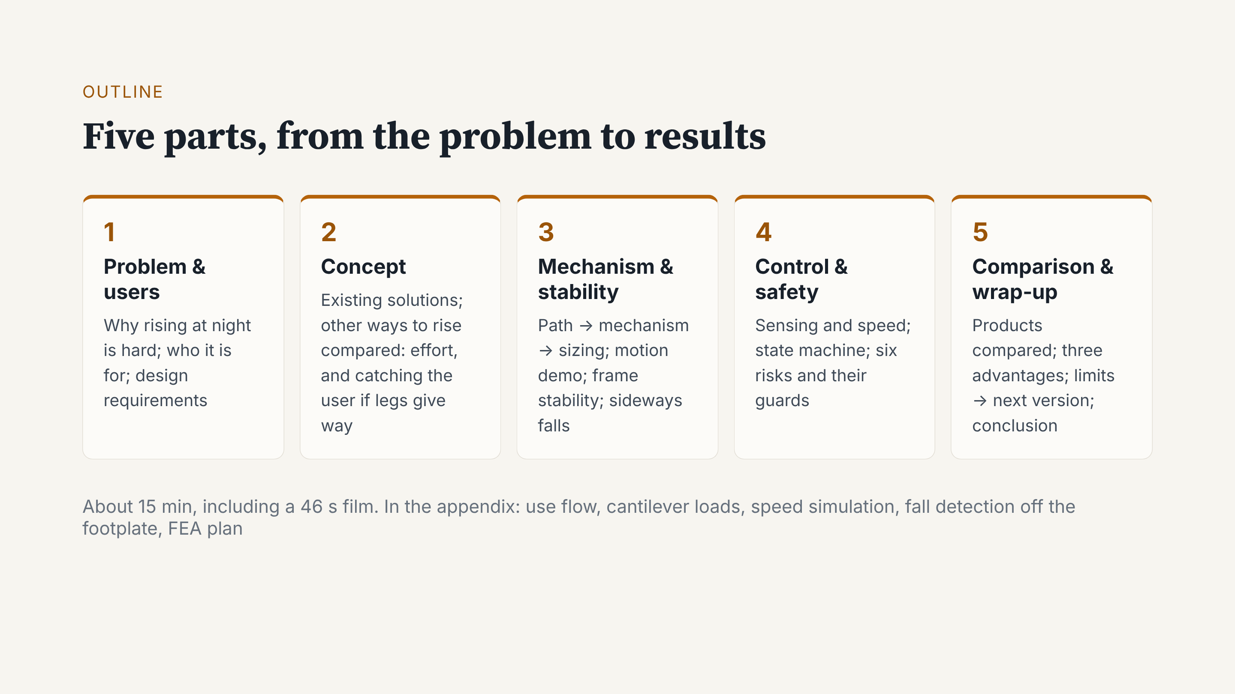
Notes:
The talk has five parts: the problem and users, a comparison of solutions, the mechanism, then control and safety. We finish with results and a short wrap-up.

Slide 4
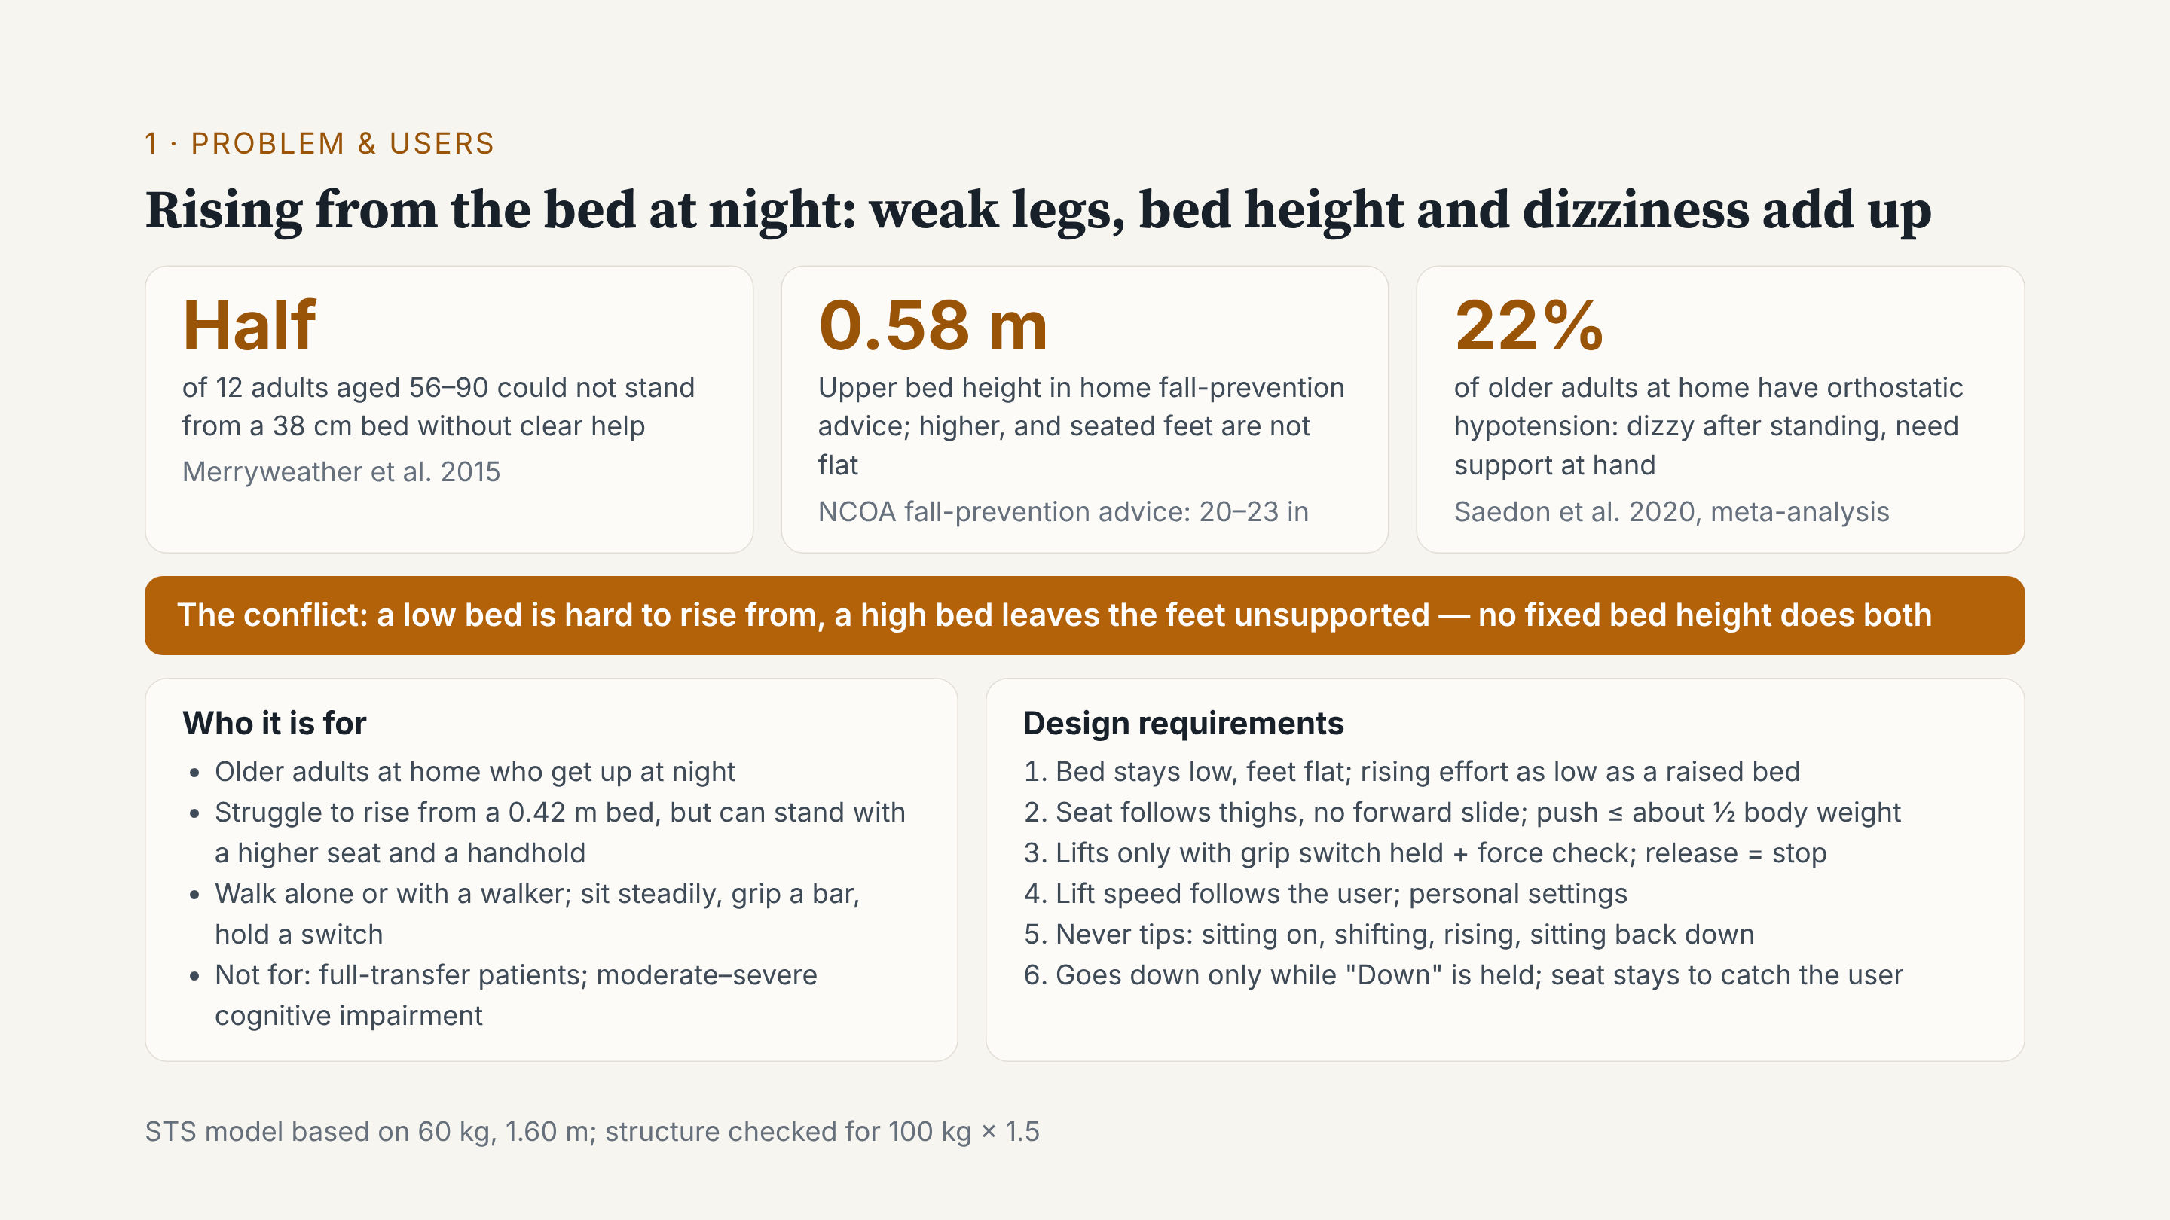
Notes:
Behind the film are three numbers. Half of 12 older adults could not stand from a 38-centimetre bed without help. Fall-prevention advice says a bed should be at most about 0.58 metres; any higher, and the feet are not flat when seated. And about 22% of older adults at home have orthostatic hypotension, so they may feel dizzy after standing. So one fixed bed height cannot do both. Our users can still walk, alone or with a walker, but find rising from a normal bed hard. Results for the six requirements come at the end.

Slide 5
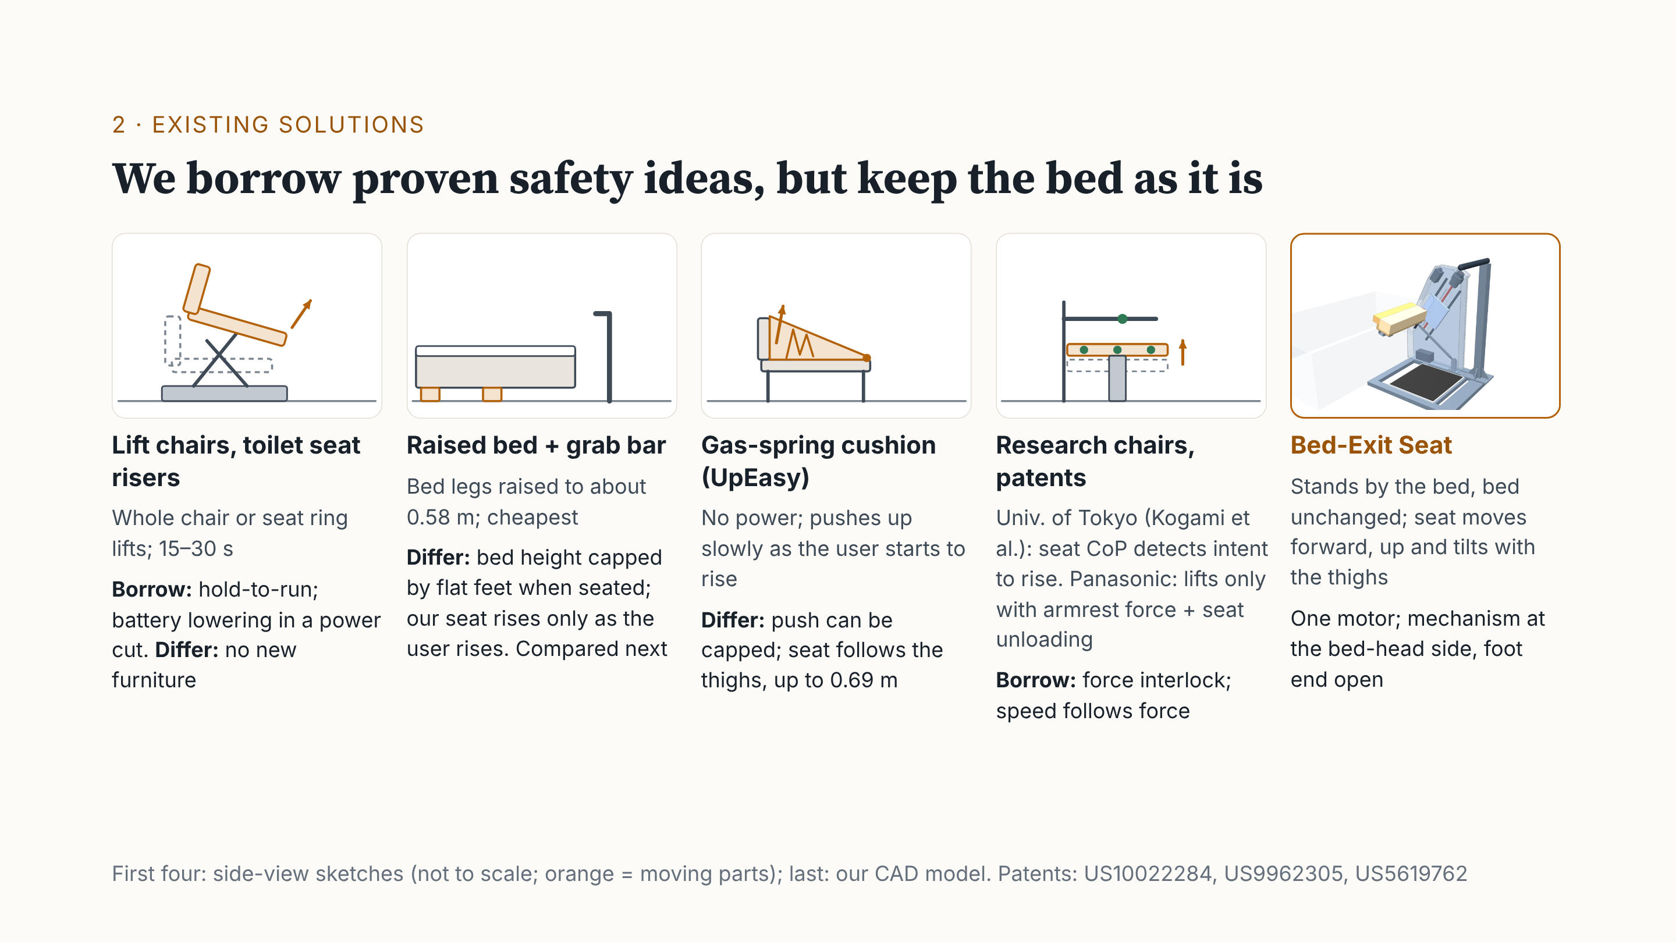
Notes:
Lift chairs and toilet seat risers can lift a person. We borrowed two ideas: it moves only while you hold the button, and a battery lowers you in a power cut. But they need new furniture. The cheapest option is a raised bed with a grab bar; we compare it next. A gas-spring cushion cannot cap its push. Research chairs and a Panasonic patent use seat and armrest forces to detect that someone wants to stand; we borrowed this force interlock. Our difference: it stands beside the bed, the bed is unchanged, and the seat follows the thighs.

Slide 6
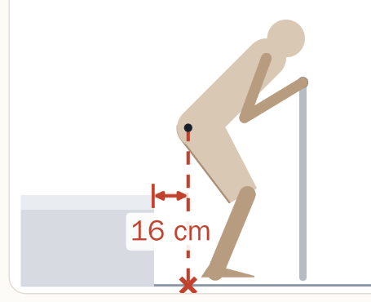
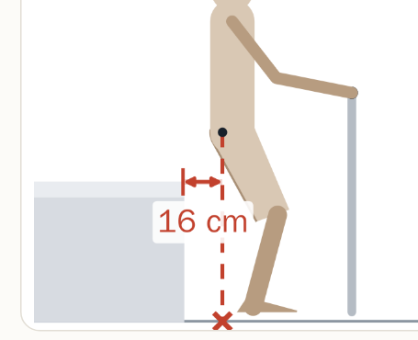
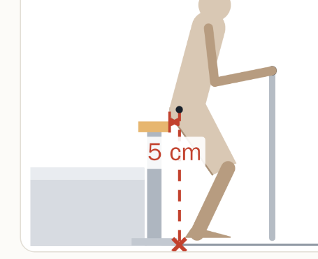
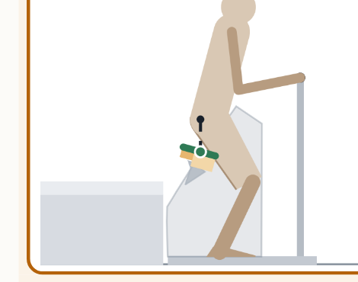
2 · COMPARISON
Same effort as a raised bed;
better support if the legs give way
If legs give way:
● lands on support
✕ misses support edge
Low bed
0.42 m + L-bar
Raised bed
0.58 m + bar
Vertical-lift
seat
Bed-Exit Seat
curved path
Key results
Effort
(lower is easier)
0.40
0.29
—
0.26
Hips drop straight
down → still supported
14%
15%
43%
100%
Takeaway: The Bed-Exit Seat needs about the same effort as a raised bed, but keeps support under the hips for more of the rise.
2D quasi-static model, median of 81 simulated user configurations.
Notes:
This is the key slide. To be honest: on effort alone, a bed raised to 0.58 metres with a grab bar works well. We need about a third less effort than a low bed, but only about 10% less than a raised bed, and 22 users find it slightly harder. So effort is about equal. The real difference is when the legs give way. At about 70% of the rise, for both beds the hips land about 16 centimetres past the edge, about 25 when upright. The vertical seat only goes up: they land 5 centimetres in front of it. Only the curved seat is still underneath. Beds catch you only in the first 15% or so, vertical lift 43%, our seat all the way; if the knees buckle, 73%. In a stiff backward fall the bed is better, so we pad the rear edge.

Slide 7
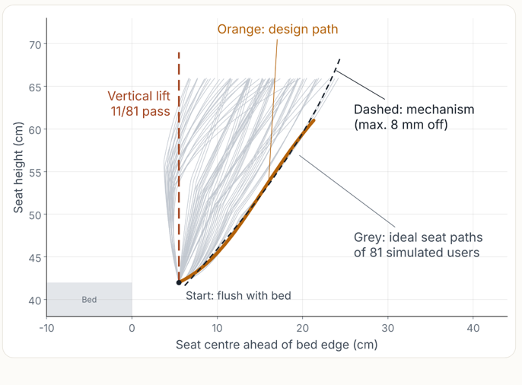
3 · MECHANISM DESIGN / 01 TRAJECTORY
Path first: follow the thigh, not just lift the seat
Seat-centre movement • schematic side view
VERTICAL LIFT
CURVED PATH
11 / 81
VERTICAL
LIFT
simulated users pass
CURVED SEAT PATH
80 / 81
Up
27.4 cm
simulated users pass
One motor → one preset path
Bed at 0.42 m
Forward +18.5 cm
Selected to keep up with users whose hips move forward earliest.
Grey paths illustrate user-to-user variation; orange is the shared design concept.
Model: 81 configurations (3 heights × 3 body sizes × 3 rising styles × 3 foot positions). Pass = ≤2 cm sliding + supported sit-back; 2D quasi-static.
Notes:
We started with the required motion rather than a mechanism. In the 2D quasi-static sit-to-stand model, the hip moves forward as well as upward, so a purely vertical seat loses contact with the thigh. Only 11 of 81 modeled configurations pass with vertical lifting. The 81 cases combine three heights, three buttock thicknesses, three rising styles, and three foot positions. Each person's ideal trajectory keeps support near the hip–thigh junction. The initial tilt constraint was no more than 15 degrees; the final mechanism animation reaches about 15.7 degrees, so distinguish the design target from the result if asked. With one motor, the seat follows one predefined path. The reference was chosen among 18 early-forward-moving cases to support the most forward users. It passes 80 of 81 modeled cases, defined as no more than 2 cm of forward sliding plus sufficient support when sitting back. The reference trajectory ends around 0.61 m and is extended along the guide to 0.69 m for cushion compression. Illustration is schematic, not a numerical plot of all 81 trajectories. Exact trajectories were shown in the previous source version.

Slide 8
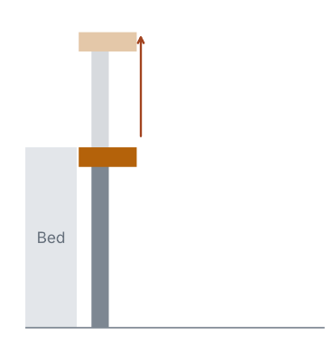
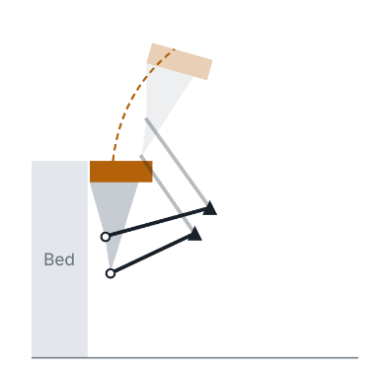
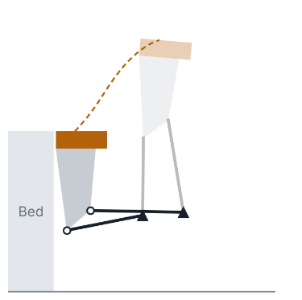
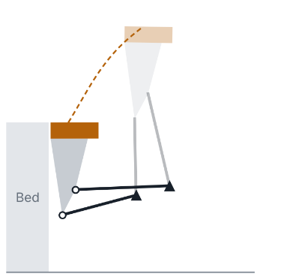
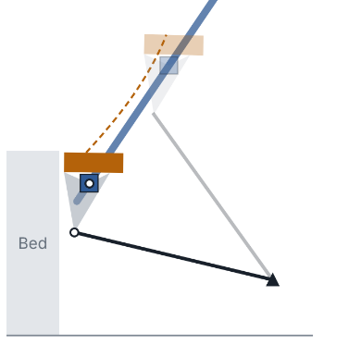
3 · MECHANISM DESIGN / 02 SELECTION
Why we chose the inclined guide + tilt link
Five candidates assessed for trajectory fit, mechanical clearance, and actuator loading.
CANDIDATE
CANDIDATE
CANDIDATE
CANDIDATE
SELECTED
Vertical lift
Under-seat four-bar
Bilateral four-bar
Single-side four-bar
Inclined rail + link
11 / 81
55* / 81
81* / 81
70 / 81
80 / 81
Loses thigh support
Shin interference
Blocks return to bed
High bearing load
Chosen: open foot end
SELECTED DESIGN
8 mm
Max. trajectory deviation
1.8 kN
Actuator static load
0.89 m
Housing height (trade-off)
* Earlier four-bar pass counts were not rerun after the final path correction. Static-load comparison: 100 kg × 1.5 body weight.
Notes:
We compared five mechanisms using the same overall design requirements and the 81 modeled users. The five concepts were vertical lift, an under-seat four-bar, a four-bar on both sides, a four-bar on the bed-head side, and an inclined guide rail plus tilt link. A vertical lift cannot follow the thighs, while an under-seat four-bar risks shin interference. The bilateral four-bar blocks the return to bed and needs two synchronized actuators. The unilateral four-bar has very high concentrated bearing loads, about 25 kN. The inclined guide plus tilt link achieved 80/81 users passing, 8 mm maximum seat-centre deviation from the reference path, and 1.8 kN static actuator loading in the comparison. It also keeps the bed-foot side open and uses one actuator. Its compromise is the tall 0.89 m housing. Important caveat: 55* and 81* are results before the final whole-rise path correction; those alternatives were rejected for other reasons and were not rerun. Loads in the comparison are based on a 100 kg user with a 1.5 factor.

Slide 9
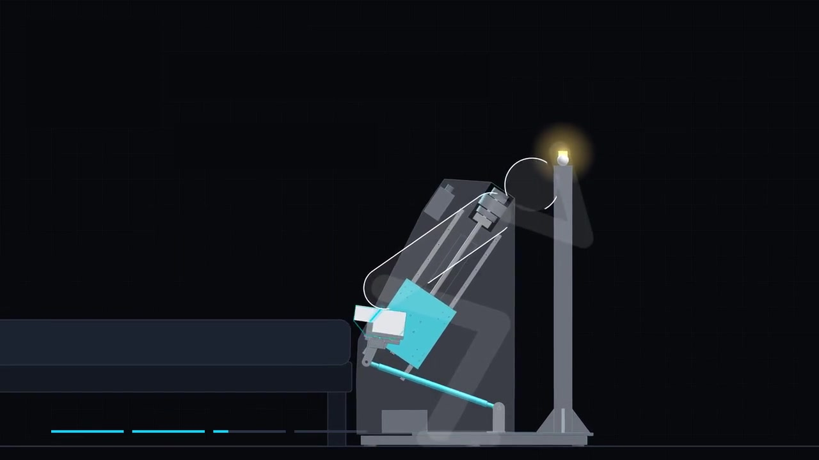
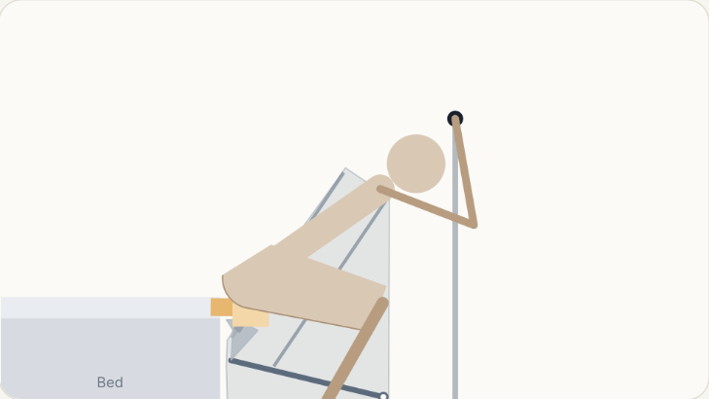
3 · MECHANISM DESIGN
Motion Overview: Seat Trajectory During Sit-to-Stand
Four steps:
slide on→ grip → rise → release(stop)
Ergonomics Path:
18 cm forward + 27 cm up
Lean ≤ 16°:
supports hips first, then thighs
Notes:
[~28 s · ends at 0:28] (Click the video to play.)
Before the details, let's watch the mechanism move. One use has four steps: slide on, grip the switch, rise together, and release to stop. Notice the seat does not go straight up. It moves about 18 centimetres forward and 27 up, and leans at most 16 degrees, like a natural rise. The cushion supports the hips first, then the thighs.

Slide 10
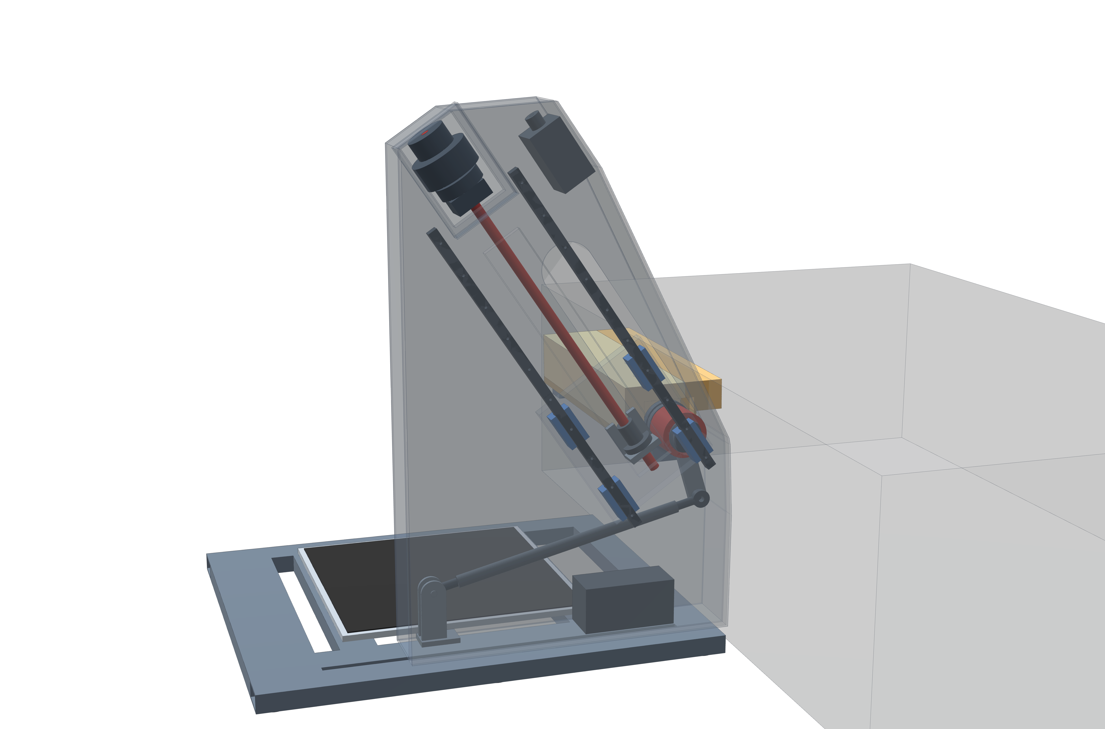
3 · MECHANISM DESIGN
Mechanism Synthesis: Inclined Guide with Tilt Link
Goal: reproduce ergonomics path
Method: trace seat point along the path
Straight-line point : inclined guide rail
Arc point : swinging tilt link
Result:
1 degree of freedom;
one motor;
foot end left open
Motor
Straight-line point · path
Inclined guide rail
Arc point · path
Tilt link
Notes:
[~27 s · ends at 0:57]
Here is our CAD model with a see-through housing. To find a structure for this path, we traced every point on the seat. One point moves almost in a straight line, so it rides a guide rail. Another moves on an arc, so a swinging link holds it. One motor drives it, and the foot end stays open.
[CLICK → zoom to the guide and link]

Slide 11
3 · MECHANISM DESIGN
Kinematic Sizing: Guide Angle and Link Length
Belt + pulley (motor above) ↑
Key idea guide angle sets the rise, link length sets the tilt
Guide 34° from vertical; link 465 mm
Path error ≤ 8 mm tilt error ≤ 0.8°
Stroke 331 mm →
seat 18.5 cm forward, 27.4 cm up
Drive:
motor → belt → ball screw → carriage
Guide 34° from vertical
Ball screw
Pivot 1 · straight line
Carriage
Link 465 mm
Fixed centre B
Pivot 2 · arc
Notes:
[~27 s · ends at 1:26]
Zooming in: the guide leans 34 degrees from vertical, and the link is 465 millimetres. We optimised four geometry values, and the seat stays within 8 millimetres of the ideal path, about a finger's width. Over a 331-millimetre screw stroke, the seat moves 18.5 centimetres forward and 27.4 up, driven by a motor, belt, ball screw and carriage.
[CLICK → zoom to pivot 1]

Slide 12
3 · MECHANISM DESIGN
Structural Check: Load Path of the One-Sided Seat
Stiffness check · edge sag ≈ 4 mm
① 150 kg at the seat edge
(100 kg user × 1.5)
Design load: 150 kg , 10 cm off-centre
Resulting moment: 586 N·m at pivot 1
Bearing choice: tapered roller pair 3.2× stronger
Rail check: 5.2 kN per carriage 2.5× stronger
Stiffness check: seat edge sags ≈ 4 mm → FEA next
③ Rail check · 5.2 kN
≈ 530 kg · 2.5× stronger
② Pivot 1 · moment 586 N·m
≈ 60 kg on a 1 m bar
Tapered roller pair
bearings 3.2× stronger
Notes:
[~34 s · ends at 2:02]
The seat is held on one side only, so how does it carry the load? Our worst case is 150 kilograms near the open edge. That puts 586 newton-metres on pivot one, like hanging 60 kilograms on a one-metre bar. The tapered roller bearings are 3.2 times stronger than needed, and the guide rails, at 5.2 kilonewtons, still have 2.5 times margin. The seat edge sags only about 4 millimetres. Hand calculations; FEA next.

Slide 13
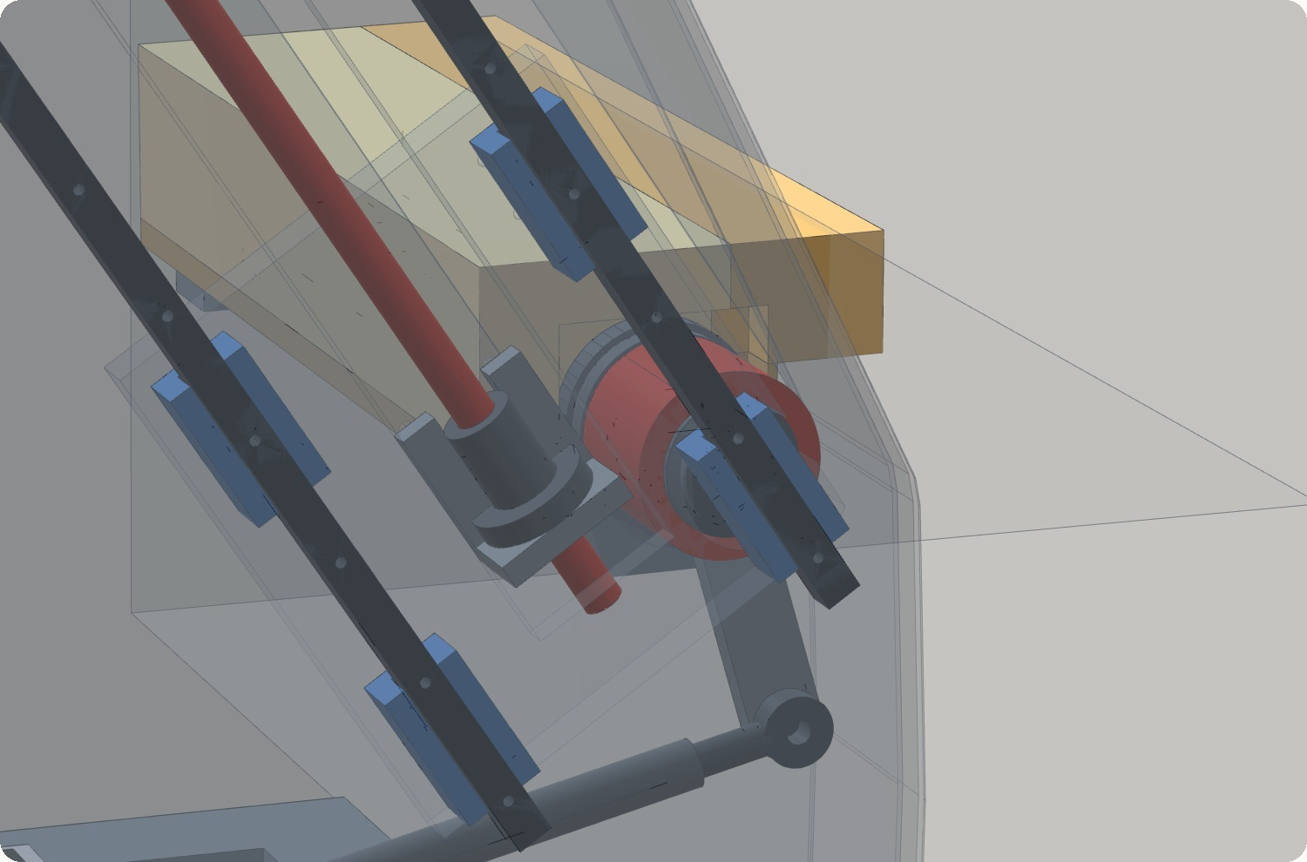
3 · STABILITY
Frame Stability: Tipping Analysis
Key idea: verify tip-over stability under user loads and external pushes
User loads: at maximum design load, the CoG stays within the base(≥ 9 cm margin)
External push: 156 N (≈ 16 kg) at the grab bar exceeds the tipping threshold
Design decision: anchor to the bed to resist external loads
Notes:
[~2 s · ends at 2:04] (Auto-plays, no click. Say this while the camera turns.)
"Now, is the whole frame stable?"

Slide 14
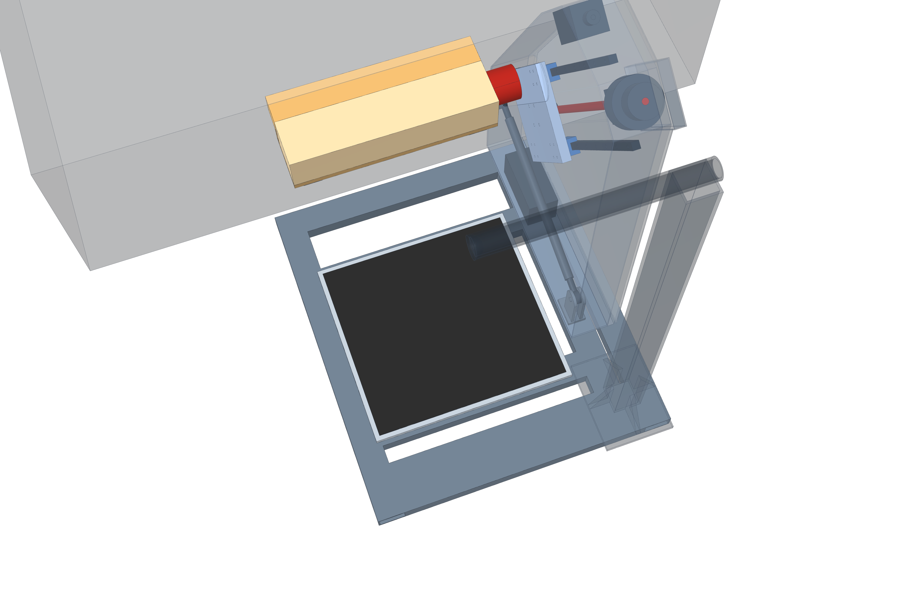
3 · STABILITY
Frame Stability: Tipping Analysis
Key idea: verify tip-over stability under user loads and external pushes
User loads: at maximum design load, the CoG stays within the base(≥ 9 cm margin)
External push: 156 N (≈ 16 kg) at the grab bar exceeds the tipping threshold
Design decision: anchor to the bed to resist external loads
Push at grab bar 156 N
(≈ 16 kg) → tips
150 kg loads: CoG stays 9 cm inside
Frame only ≈ 85 kg
Notes:
[~33 s · ends at 2:38]
From above, the dashed outline is the base. The frame is stable as long as the ground-reaction point stays inside it. A seated user cannot tip it: a 100-kilogram hard sit stays 9 centimetres inside, and hanging on the bar, 23. The danger is someone on the floor pushing the bar. The frame is only 85 kilograms, and a 16-kilogram push tips it. So it must be fixed to the bed.
[CLICK → zoom to the bed anchors]

Slide 15
3 · STABILITY
Frame Stability: Anchoring to the Bed
Objective: transfer external loads into the bed
Design load: grab-bar load 1112N× 1.5 = 1668N
Anchor load: lever effect raises this to 2211 N
Rejected option: under-mattress plate cannot resist
Design decision: two anchors clamped to the bed frame or legs
Anchor
Anchor
Notes:
[~21 s · ends at 3:01]
Two anchors, one at each end of the base, lock the frame to the bed frame or legs. Using the grab-bar design load with a 1.5 safety factor, each must hold 2211 newtons, about 225 kilograms of pull. A plate under the mattress is not enough.

Slide 16
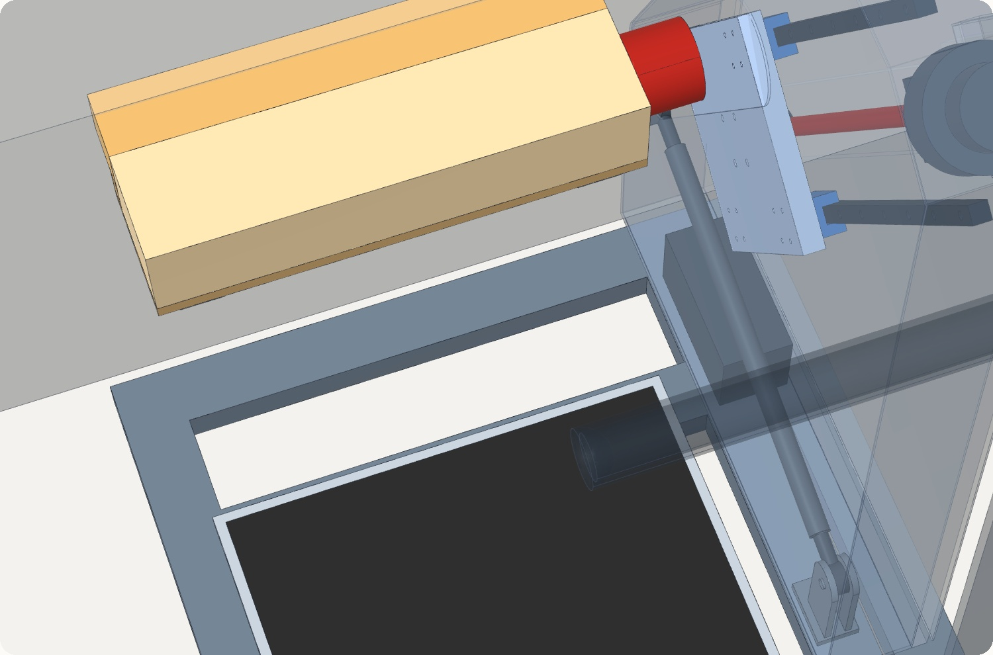
3 · STABILITY
Lateral Fall Risk: Hip Drop on the Open Side
Worst case: hips drop 63 cm
Comparison: only 6 cm more than a raised bed (57 cm)
Bed-head side: blocked by the housing (3 cm gap)
Options: fold-down side guard, or auto-stop on sideways shift
Notes:
[~2 s · auto, no click] (Say this while the camera turns and the seat rises:)
"And what if the user falls sideways at the top?"

Slide 17
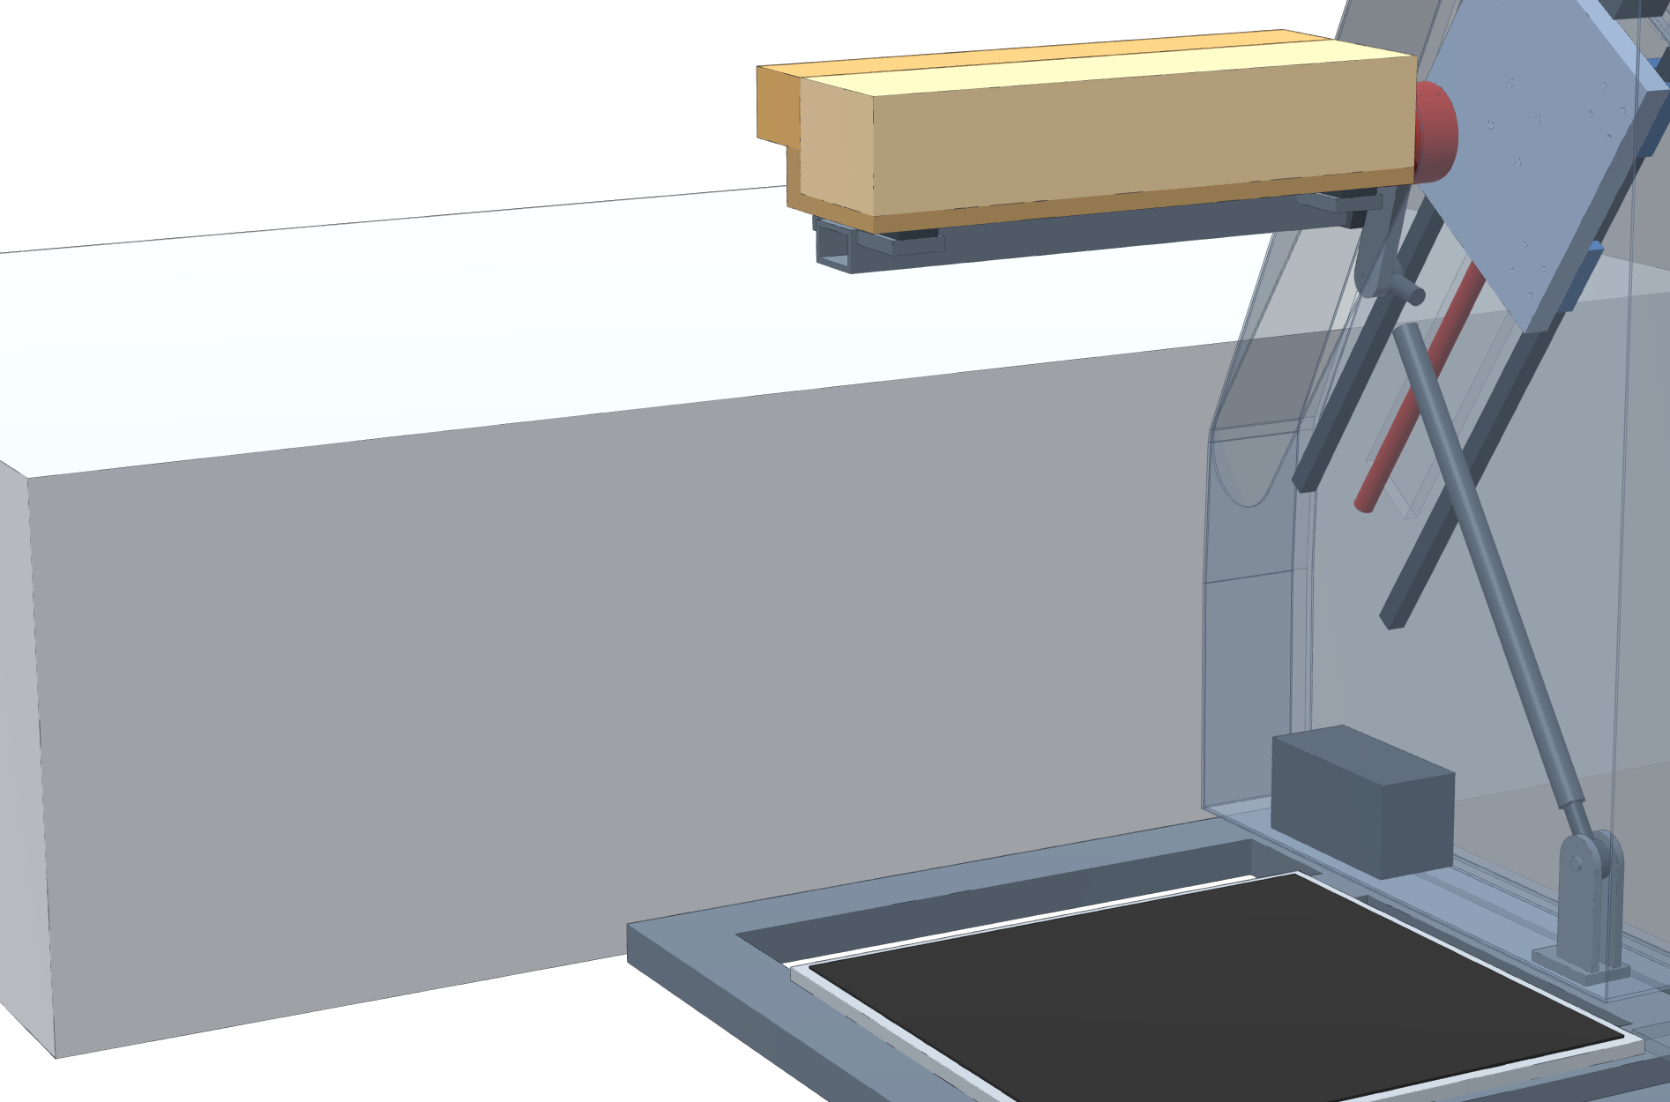
3 · STABILITY
Lateral Fall Risk: Hip Drop on the Open Side
Worst case: hips drop 63 cm
Comparison: only 6 cm more than a raised bed (57 cm)
Bed-head side: blocked by the housing (3 cm gap)
Options: fold-down side guard, or auto-stop on sideways shift
Bed-head side
3 cm gap, blocked by housing
Open side: hips drop 63 cm
Hip drop in a sideways fall
Low bed
41 cm
Raised bed
57 cm
Our seat, top
63 cm
+6 cm vs a raised bed
Notes:
[~26 s · ends at about 3:31]
Our extra risk is the open side. At the top of the stroke, a sideways fall drops the hips 63 centimetres, only 6 more than from a raised bed. The bed-head side is blocked by the housing. For the open side, we are choosing between a fold-down guard and an automatic stop when the sensors detect a sideways shift.
[CLICK → how hard it is to tip a user sideways]

Slide 18
3 · STABILITY
Lateral Stability: Push Needed to Tip the User Sideways
Sideways push needed to tip over (× an everyday bump) — longer = harder to tip
1× = everyday bump: ≈ 10 kgf push on a 70 kg adult
On our seat: 2.7–2.8× to tip, close to a bed (3.0×)
Weakest: standing (1.6×), same as from a bed
Improvements: hands on bar 4.2×; side guard 8.0×
Limitation: simplified model, for comparison only
Sitting on a bed edge (reference)
3.0×
Our seat · seated, start
2.8×
Our seat · weakest seated point
2.7×
Standing, after leaving the seat
1.6×
Seated, both hands on bar
4.2×
Seated + side guard (option)
8.0×
everyday bump
≤ 1× (≈ 10 kgf)
Notes:
[~38 s · ends at about 4:11]
How likely is such a fall? The chart shows how hard a sideways push must be to tip a person, in multiples of an everyday bump. One times is a light bump or small trip, roughly a 10-kilogram push on a 70-kilogram adult. Tipping a user off our seat takes about 2.8 times that, close to a bed edge at 3. The weakest moment is standing after leaving the seat, 1.6 times, the same as rising from a bed. A simplified model, for comparison only.
(If asked: an everyday bump moves the body sideways at about 0.3 m/s. For a 70 kg adult over about 0.2 s, that is 70 × 0.3 ÷ 0.2 ≈ 105 N ≈ 10 kgf, a rough estimate. Tipping thresholds in the model: bed 0.91, seat 0.80–0.85, standing 0.47, hands on bar 1.27, side guard 2.40 m/s; each divided by 0.3 gives the multiples.)

Slide 19
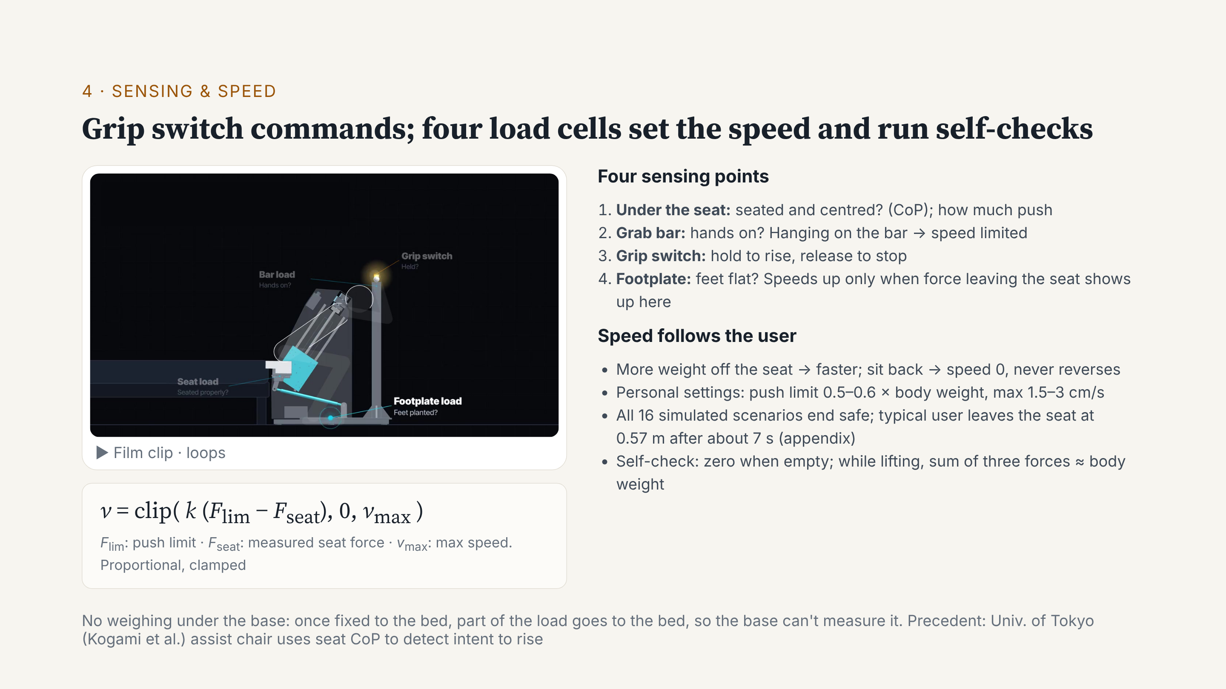
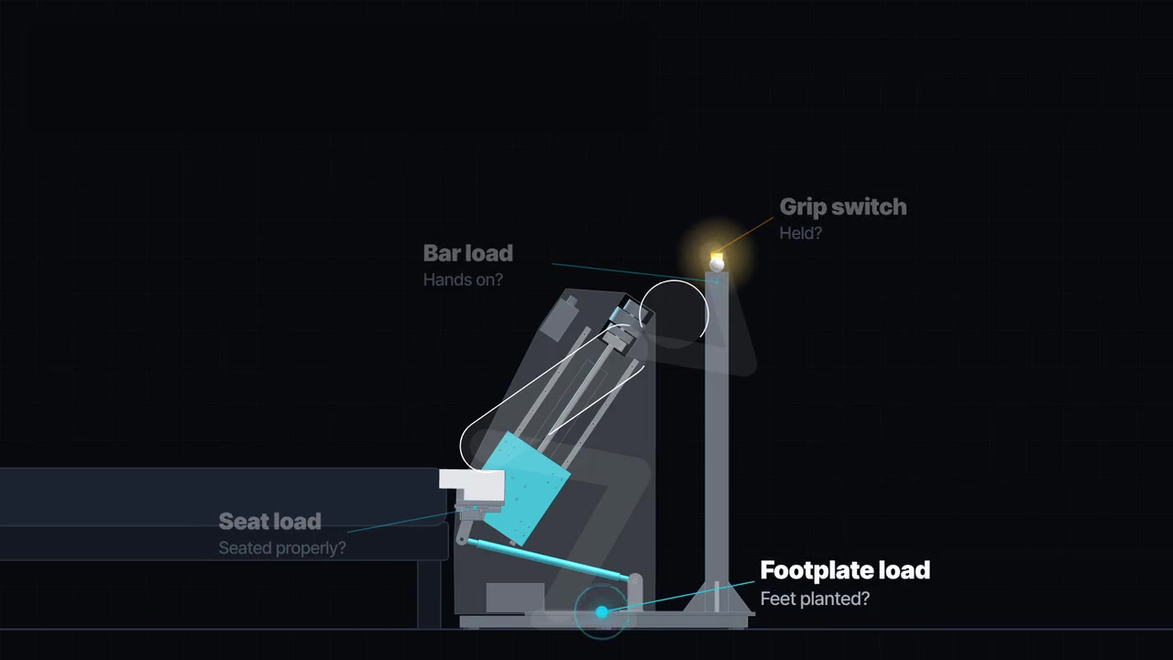
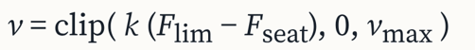
Four sensing points:
Seat
Grab bar
Grip switch
Footplate
01 USER COMMAND
02 ADAPTIVE SPEED
03 FORCE CHECK
Hold to rise
Release to stop
Follow the user
Confirm load transfer
More weight on feet → faster
Sit back → stop
Hanging on bar → speed limited
Footplate confirms unloading
Seat + footplate + bar
≈ body weight
Release switch
↓
Stop + brake
SIMULATION 16 scenarios · Typical seat-off: ~7 s · Prototype validation pending
Notes:
Control has two parts. The command: hold the switch on the bar to rise; let go to stop. Force sensing does two jobs. One, speed: k times the push limit minus the seat force. The more the user pushes, the faster it rises; sitting back drops it to zero. It speeds up only when force leaving the seat shows up on the footplate, and hanging on the bar limits it. Two, self-check: the three forces should add up to about body weight. All 16 simulated scenarios end safe. A typical user leaves the seat at 0.57 metres after about 7 seconds.

Slide 20
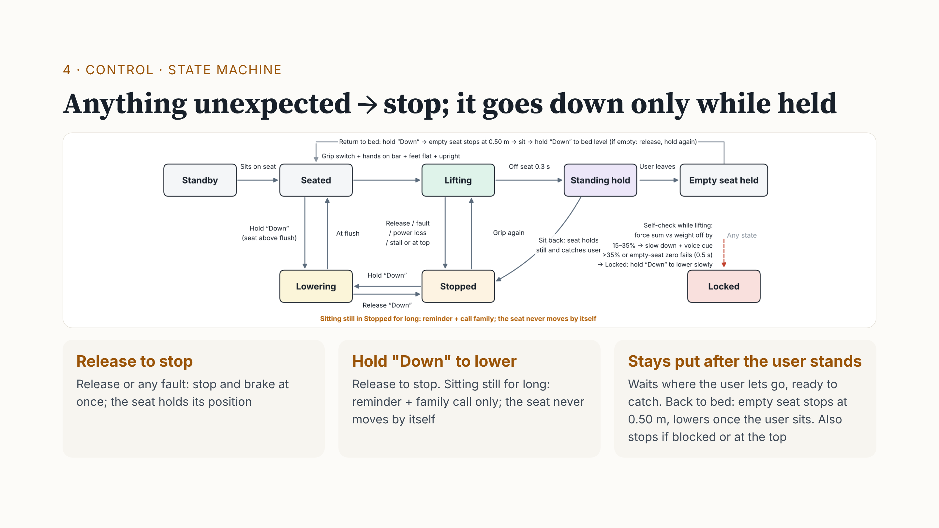
FORCE-CHECK RESPONSE
15–35% mismatch → slow + warn
>35% for 0.5 s → lockout
Notes:
Three rules. One: release, or any fault, and it stops and brakes at once. Two: it moves down only while someone holds "Down". Sitting still for long only gives a reminder and calls family; it never lowers by itself, because a weak person slips off a moving seat more easily. Three: after you stand, the seat stays put, so it can still catch you. To return to bed, the empty seat stops at 0.50 metres; once seated, hold "Down" to reach the bed. Note: release-to-stop is a user command. Lock-out is the sensor self-check: forces 15 to 35% off body weight mean slow down and warn; above 35% for half a second, it locks. Legs giving way is different: the speed rule stops the seat to catch you.

Slide 21
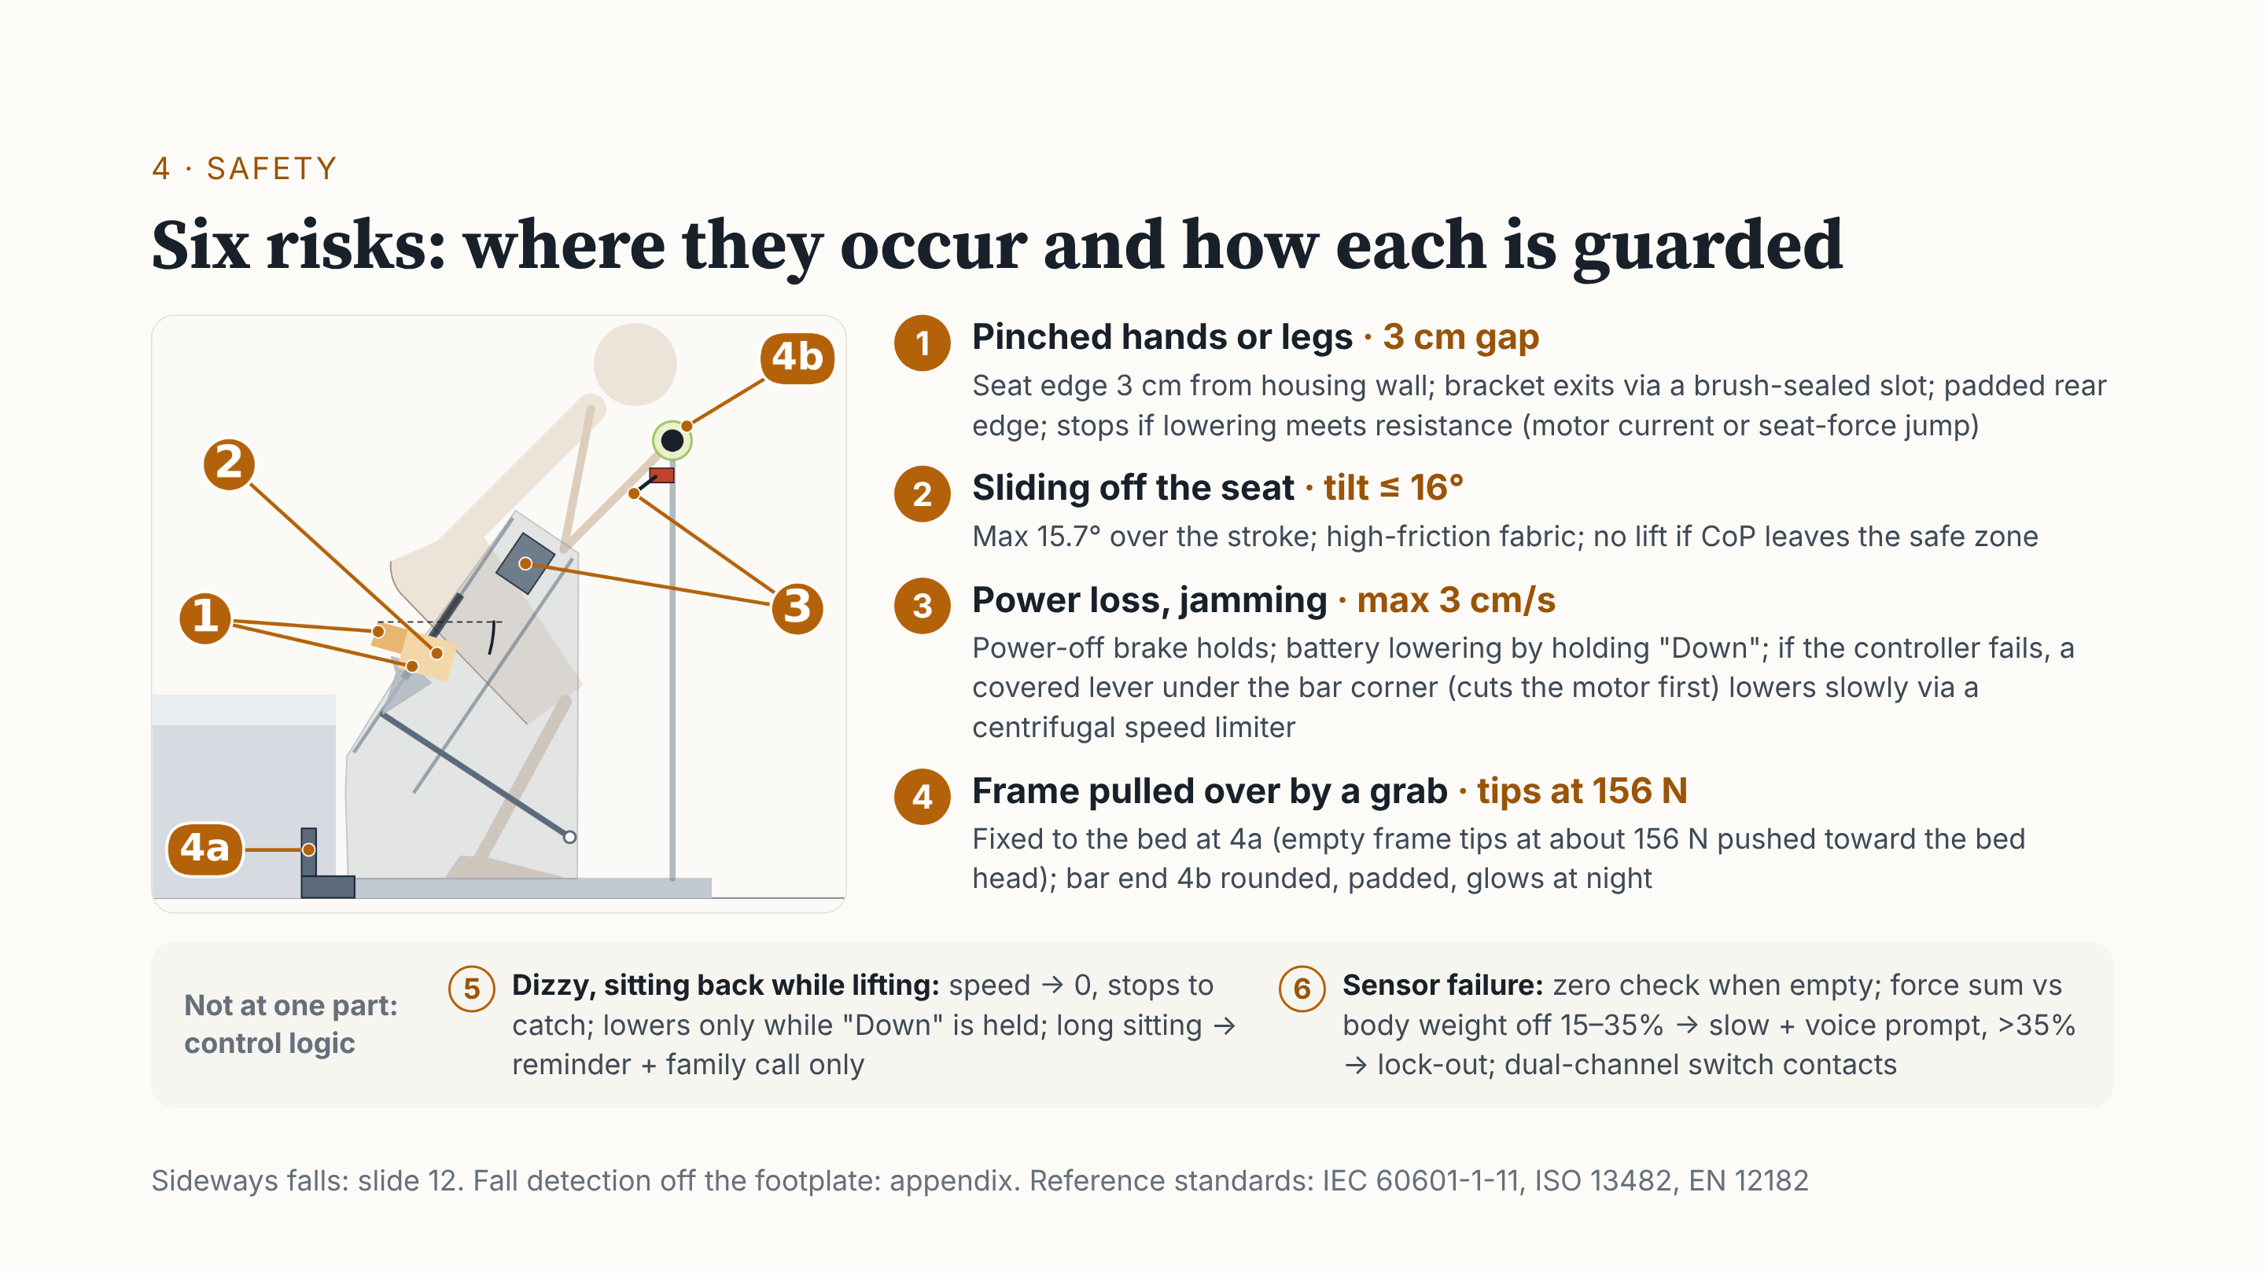
01 PINCH / OBSTRUCTION
02 SLIDING
Padded edge
Stop on obstruction
Limited tilt
High-friction cover
03 POWER LOSS
04 TIPPING / COLLISION
Power-off brake
Backup / manual lowering
Fixed to bed
Padded, glowing bar end
05 DIZZINESS / SIT-BACK
06 SENSOR MISMATCH
Stop movement
Hold support in position
Reduce speed + warn
Lock out if persistent
Notes:
The numbers match the side view. One: the seat edge is 3 centimetres from the housing wall, with a padded rear edge; it stops if blocked. Two: tilt under 16 degrees, high-friction fabric. Three: a power-off brake; without power, a battery or the lever under the bar lowers it slowly. Four: fixed to the bed; the bar end is padded and glows. Five, dizziness, and six, sensor failure, are control logic: stop and catch; if the self-check fails, slow down, then lock out.

Slide 22
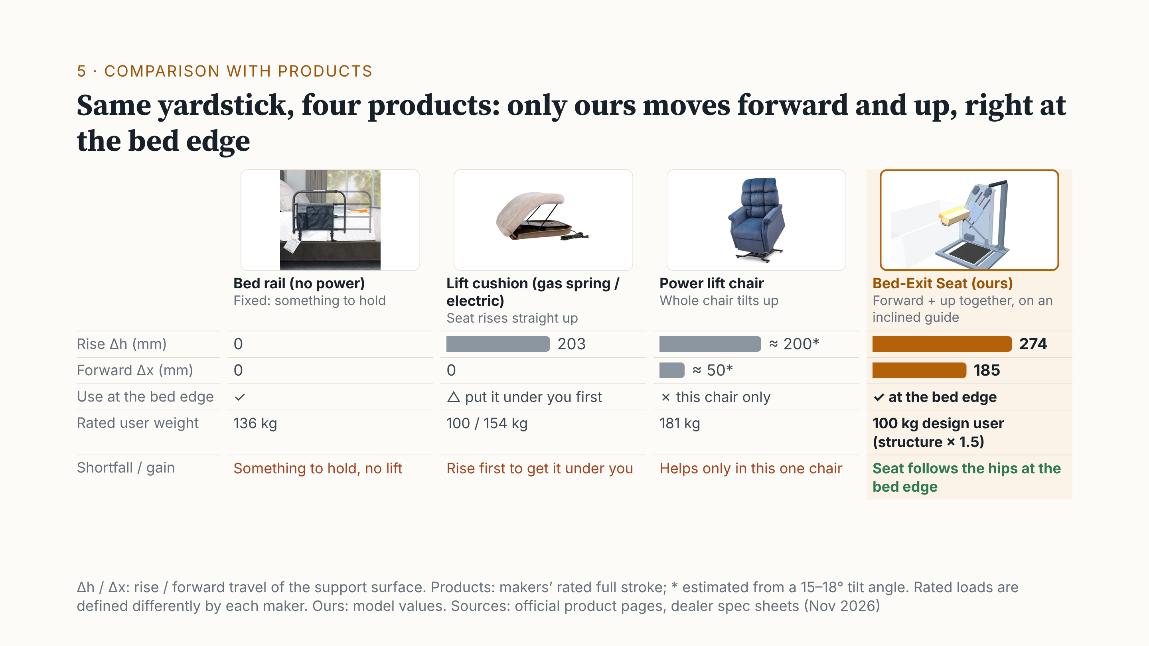
Notes:
We compared three products with ours on the same yardstick: can it be used at the bed edge, how far does the support surface rise, and does it move forward with the body. A bed rail works at the bed edge, but it does not move; it only gives something to hold. A lift cushion raises the seat, mainly on chairs or sofas. A power lift chair tilts the whole chair, but the help belongs to that one chair. Our seat works at the bed edge: on an inclined guide it moves forward and up together, about 185 millimetres forward and 274 millimetres up over the whole stroke. The lift chair's numbers with a star are estimated from its published tilt angle, not measured by the maker. Rated loads are defined differently by each maker; ours is a 100 kilogram design user, with the structure checked at one and a half times that. So the point here is where each one is used and how it moves.

Slide 23
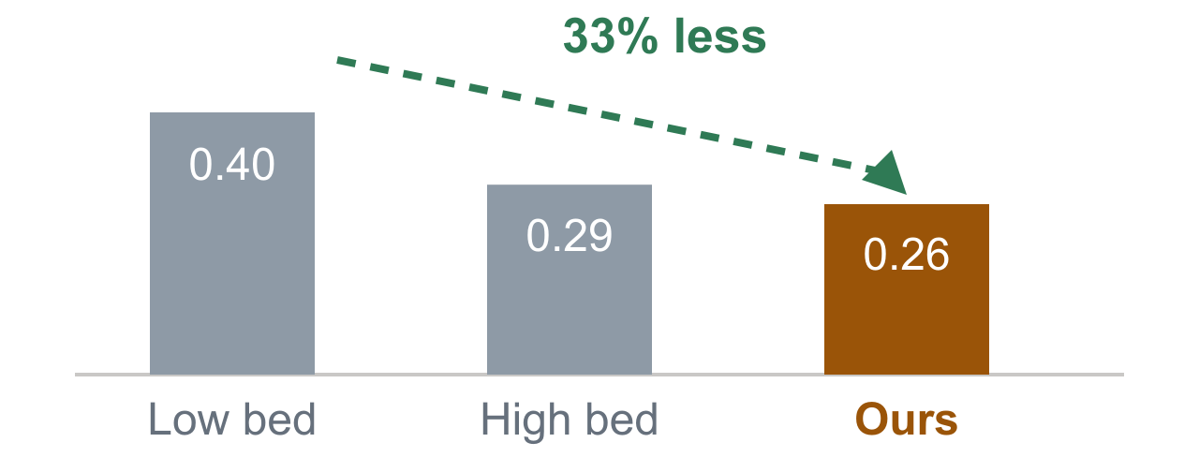
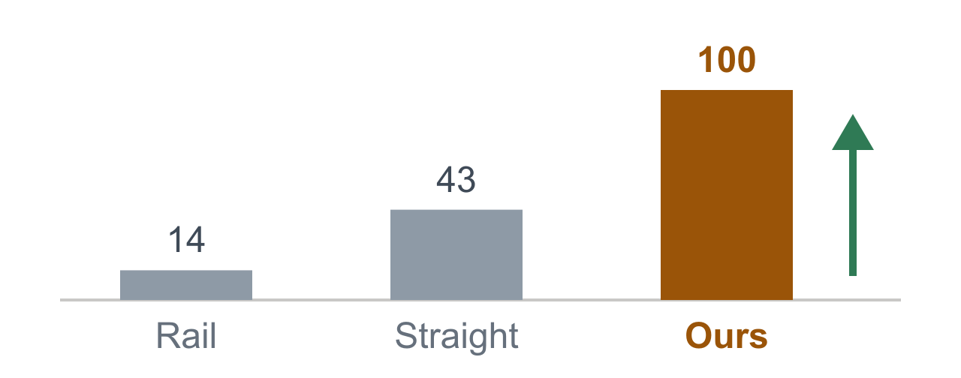
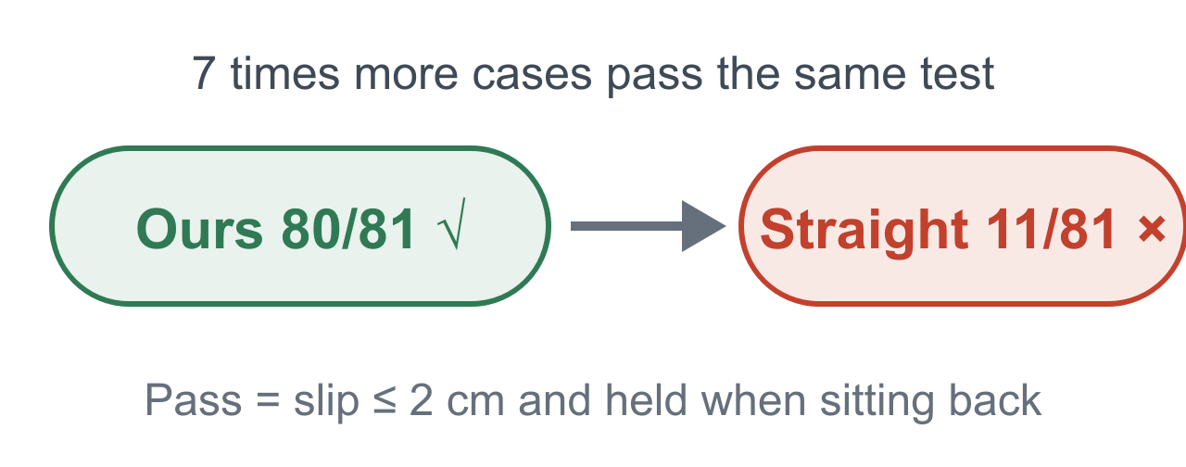
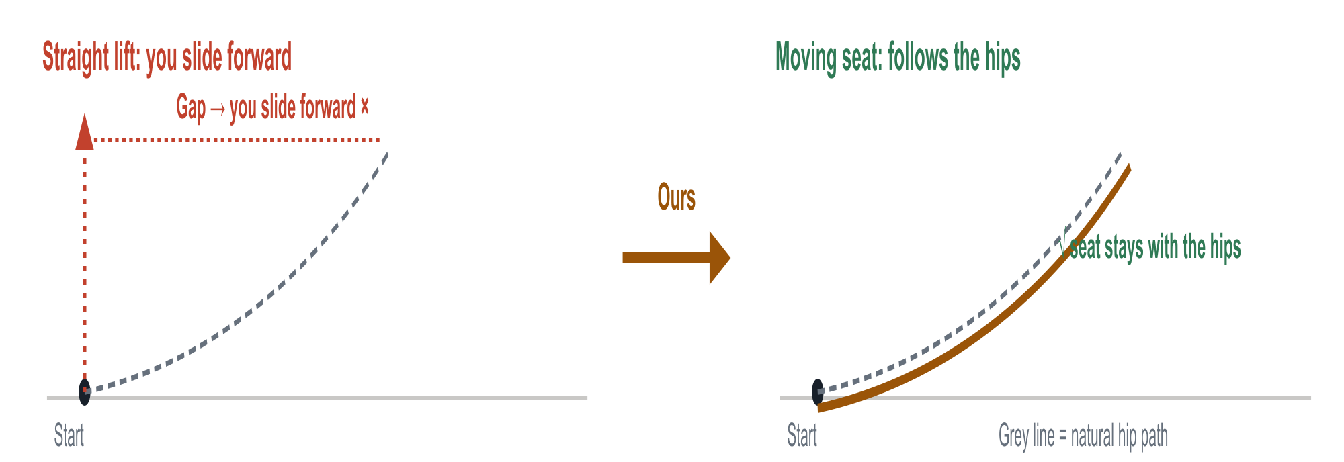
KEY ADVANTAGES · THREE NUMBERS
Less Effort, Full Support, Bed-Ready
STRENGTH 1
Less effort
STRENGTH 2
Full support
STRENGTH 3
Fits more users
−33%
100%
80/81
Peak push ÷ body weight; mid value of 81 cases
Hips dropping straight down still land on the seat (falling backward: 73%)
Notes:
The three products each solve one part: something to hold, a push from a seat, or a whole chair that lifts. Our design puts together use at the bed edge, support under the hips and thighs, and motion forward and up. When an older adult rises from the bed edge, the hips first move forward, then rise; the seat moves along that direction. That is our main ergonomic idea. The model gives first evidence. Effort: peak leg effort divided by body weight, median over 81 parameter sets, is about a third lower than from a low bed, about the same as a raised bed. Catch: if the legs give way and the hips drop straight down, the seat is under them for the whole rise; falling backward, 73 percent. Fit: 80 of 81 parameter sets pass the path check, against 11 for a vertical lift. The 81 are parameter sets, not 81 people, and all of this comes from a 2D quasi-static model; it still has to be tested on a prototype with people.

Slide 24
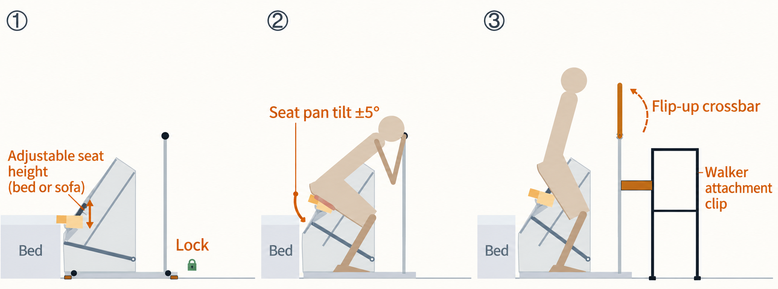



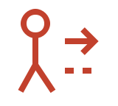
5·LIMITS → NEXT STEPS · ONE TO ONE
Four limits, four fixes
Sketch for 1，2，3: how to walk away after standing
4. Models only
Limits not tested
↓
Real tests
·Healthy subjects,
·Calibrate thresholds
1. Heavy and Bed-fixed
2. Fixed path
3. How to walk away?
85 kg frame; Additional fixation
One path cannot fit every body
Fixed bar blocks the walker
↓
↓
↓
Height adjustable + base lock
Floating seat pad
Flip-up bar + walker Latch
·Wheels stop slip.
·Feet extend 0.3 m stop tip
·±5° spring float
·Bar must lock before lift;
·Bar flips open,;
·Walker latches to frame
Notes:
Last, our limits and how the next version answers each one. One: the frame weighs about 85 kilograms and is clamped to one bed. Next: casters to move it, and a floor lock; the seat start height is set to the bed, or even a sofa. One caution from our own check: a wheel lock stops rolling, not tipping. With nobody on it, a push of about 156 newtons at the bar toward the bed head tips the frame. So the lock should also put out a foot about 30 centimetres toward the bed head, which raises that to roughly 400 newtons. Two: one fixed path and a rigid seat. Next: a floating seat, about plus or minus five degrees on springs with hard stops, so the cushion fits the hips, while total tilt stays under 16 degrees. Three: after standing, the fixed bar leaves no room for a walker. Next: a flip-up bar, latched and sensed before any lift, and a clip that holds the walker. Four: so far everything is 2D, quasi-static models. Next: a dynamic model and a prototype tested with healthy volunteers.

Slide 25
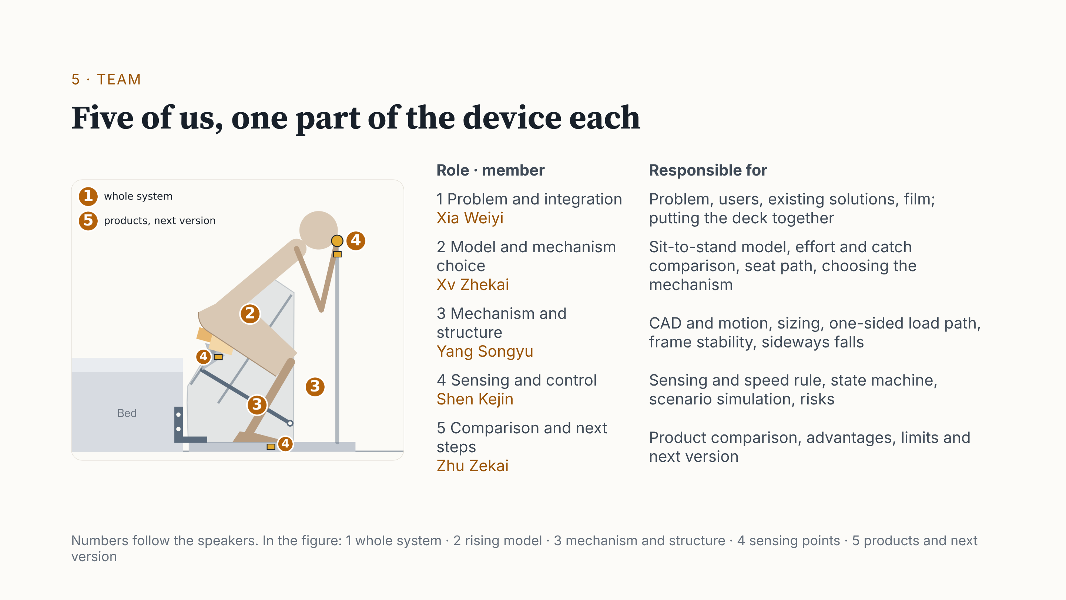
Notes:
Before the conclusion, the team. Five of us, in the order you heard: Xia Weiyi, problem and integration; Xv Zhekai, the model and the choice of mechanism; Yang Songyu, mechanism and structure; Shen Kejin, sensing and control; Zhu Zekai, the comparison and next steps. The numbers in the figure show each part.

Slide 26
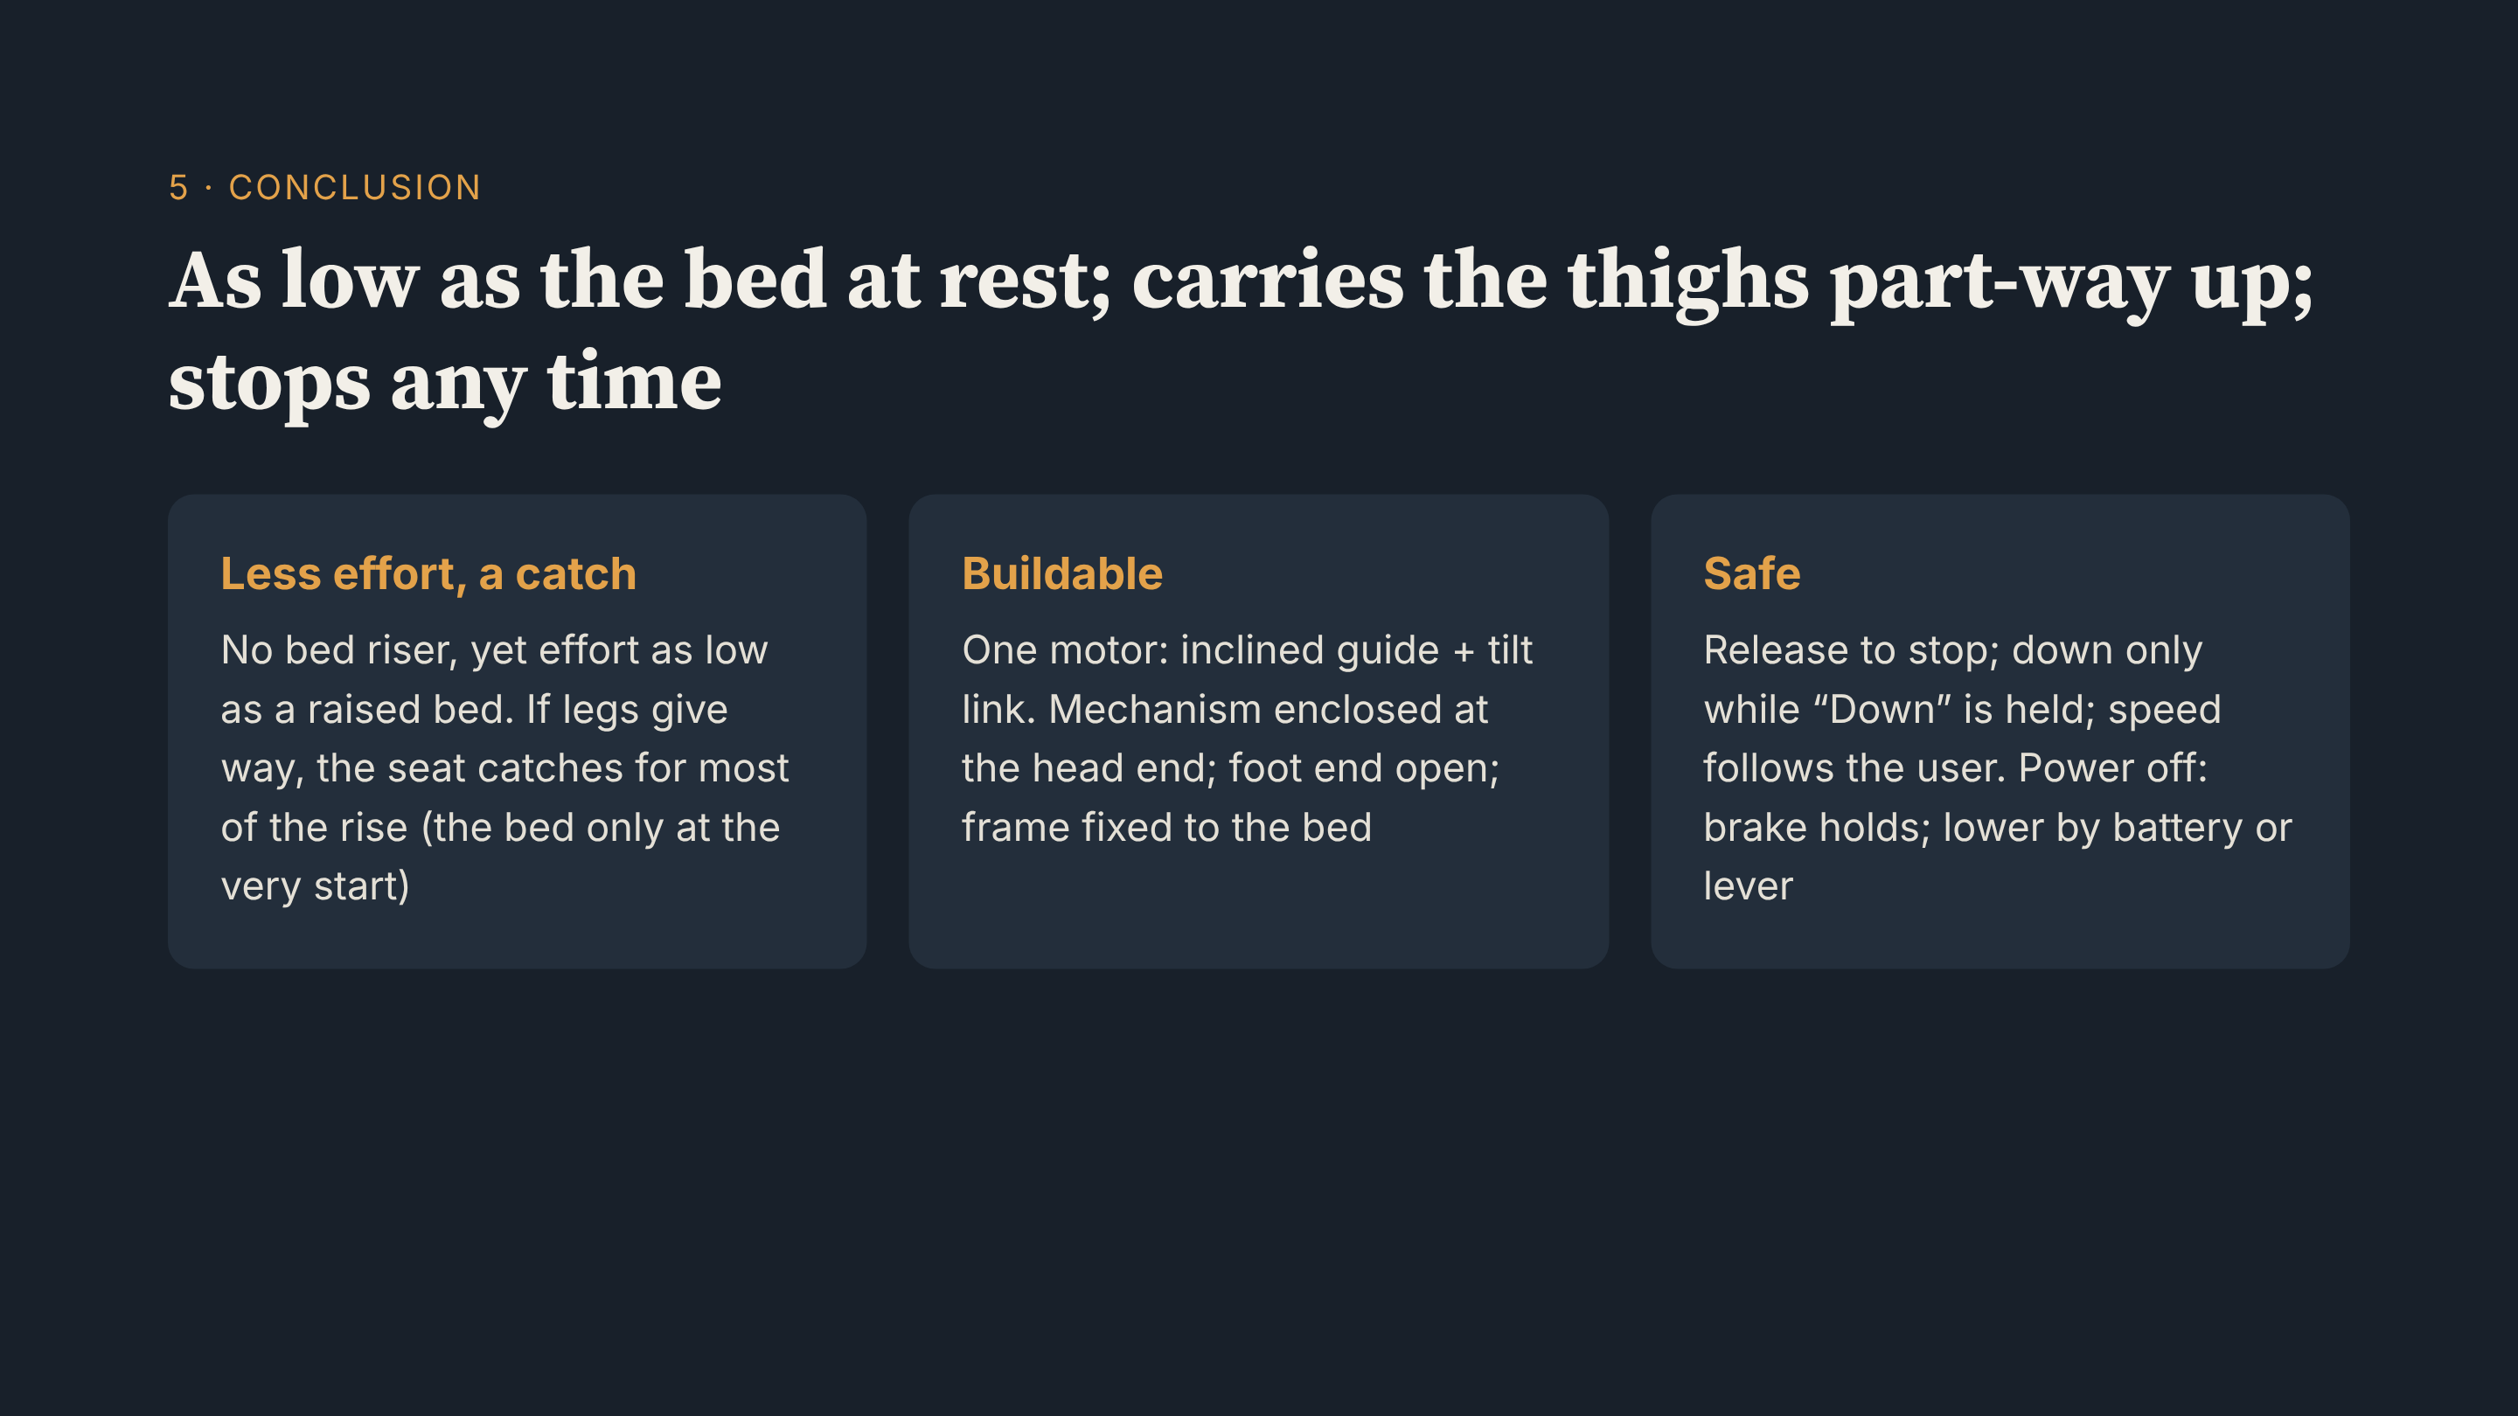
Notes:
To sum up: at rest, the seat is as low as the bed; during the rise, it carries the thighs part of the way. Effort is like a raised bed. More important, if the legs give way, the seat is under the hips for most of the rise. One motor drives an inclined guide and tilt link at the head end. Release to stop; down only while held; speed follows the user. Thank you.

Slide 27
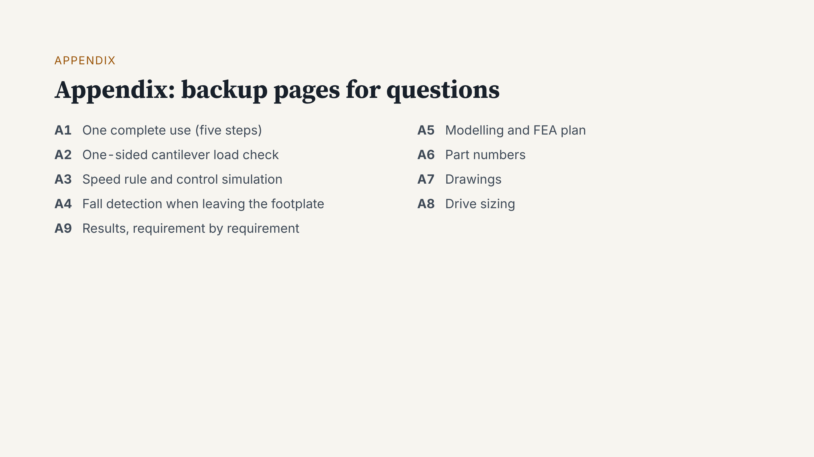
Notes:
We do not present the appendix. We open it when someone asks.

Slide 28
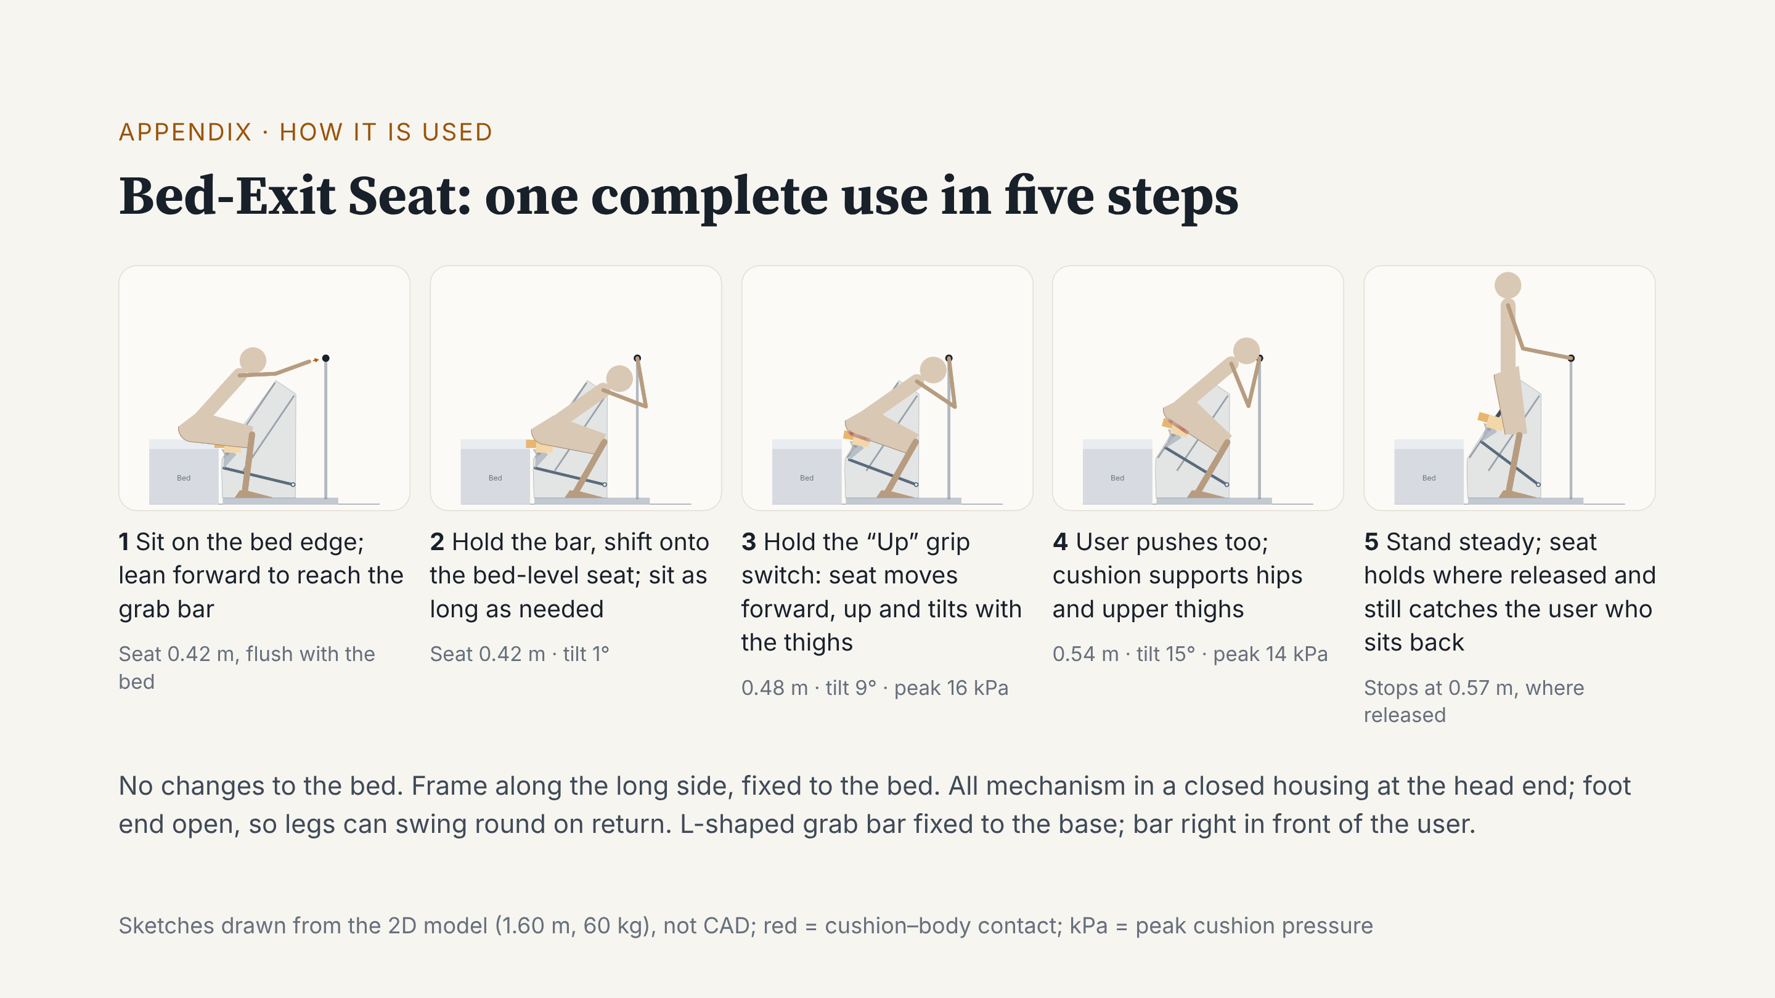
Notes:
Our design is the Bed-Exit Seat. It stands along the long side of the bed. The bed is not changed, and the frame is fixed to it. One use has five steps. First, sit on the bed edge and lean forward to hold the grab bar. Second, pull on the bar, shift onto a seat level with the bed, and sit as long as you need. Third, hold the “Up” grip switch. The seat does not push straight up: it moves forward and up with the thighs, and tilts forward a little. Fourth, the user also pushes, and the cushion supports the hips and upper thighs. Fifth, once standing, the seat stops where you let go, so it still catches a dizzy sit-back. The mechanism sits in a closed housing at the head end, and the foot end is open for the legs.

Slide 29
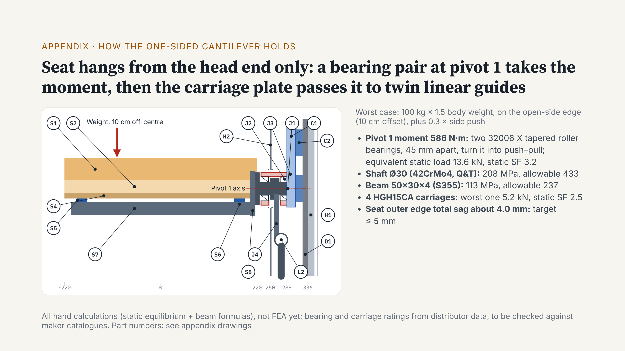
Notes:
Reviewers often ask: the seat hangs from one side only, so will it bend or twist? This page answers that. On the left is a section, seen from the foot end. A user sitting on the open-side edge is far from the support. This makes a moment of about 586 newton-metres at pivot 1. At pivot 1 we use a back-to-back pair of tapered roller bearings, 45 millimetres apart, in a 75 millimetre bearing housing welded to the carriage plate. The pair turns the moment into a push and a pull. The worst bearing sees about 13.6 kilonewtons, static safety factor 3.2. We first looked at a crossed roller bearing. But one strong enough is 120 millimetres across and leaves only 0.9 centimetres to the mattress, so we changed to the tapered pair. The shaft, beam and carriages all pass the same worst case. Total edge sag is about 4 millimetres. These are hand calculations; next, our CAD and FEA members will check them.

Slide 30
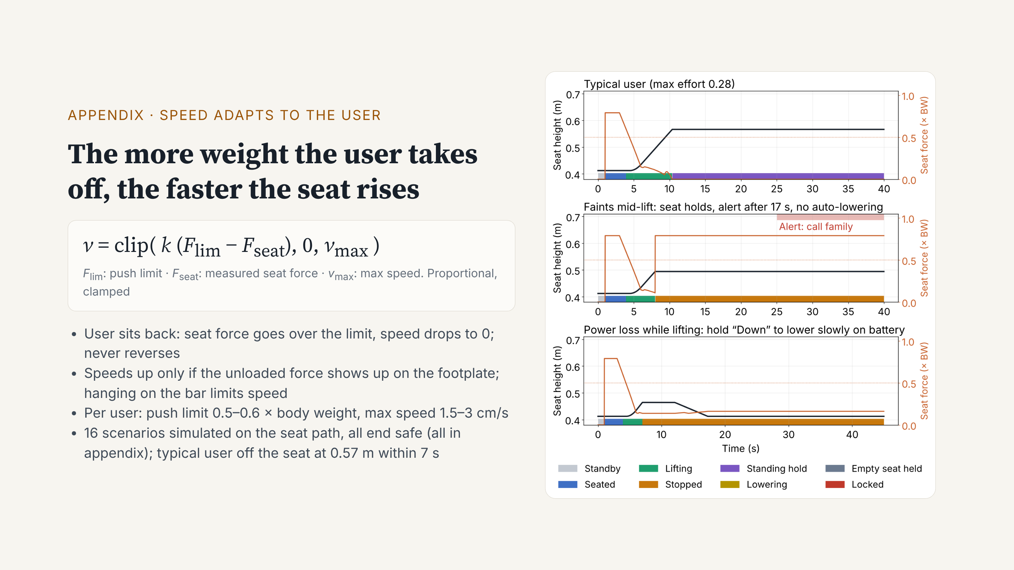
Notes:
How do we set the lift speed? We use one rule: speed equals k times the push limit minus the force the seat measures, kept between zero and the maximum speed. The more weight the user takes off, the faster the seat rises. If the user sits back, the speed goes to zero, and the seat never moves back. The unloaded force must also show up on the footplate before the seat speeds up, so leaning back onto the mattress does not lift the seat. The seat tilts, so the controller uses the tilt angle from the screw encoder to get the vertical force. If the user hangs on the grab bar, speed is limited. On the right are three of 16 simulated scenarios. A typical user leaves the seat at 0.57 metres in about 7 seconds. If the user faints and lets go, the seat stops and holds them, alerts and calls family after 17 seconds, and does not lower by itself. With a power loss, the brake holds, and holding “Down” lowers it slowly on battery.

Slide 31
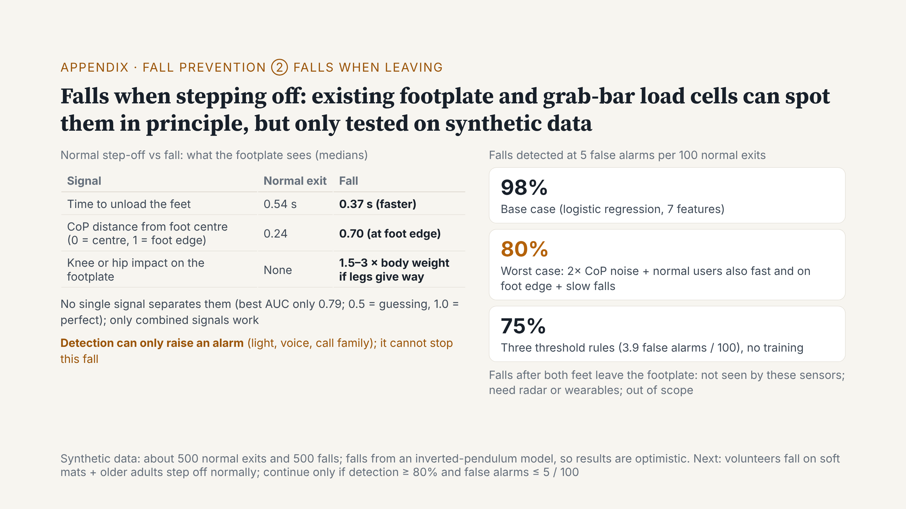
Notes:
Second fall question: if someone falls while stepping off the footplate after use, can we tell? We add no new sensors. We only use the four load cells in the footplate and the force sensing in the grab bar. In a normal step-off, the force leaves the feet slowly, and the centre of pressure stays in the middle of the standing foot. In a fall, the force goes faster, the centre of pressure first moves to the foot edge, and if the legs give way, the knees hit the footplate. No single signal is enough. Combined, on our generated data, at five false alarms per hundred normal exits, we detect about 98% of falls. Under very bad conditions, about 80%. Two points. First, we made this data with a model, so the result is optimistic. We must test real people: volunteers falling on soft mats, and older adults stepping off normally. We continue only at 80% detection and at most five false alarms per hundred. Second, detection can only raise an alarm, turn on lights and call family. It cannot stop this fall. A fall after the user has left the footplate is not seen, and is out of our scope.

Slide 32
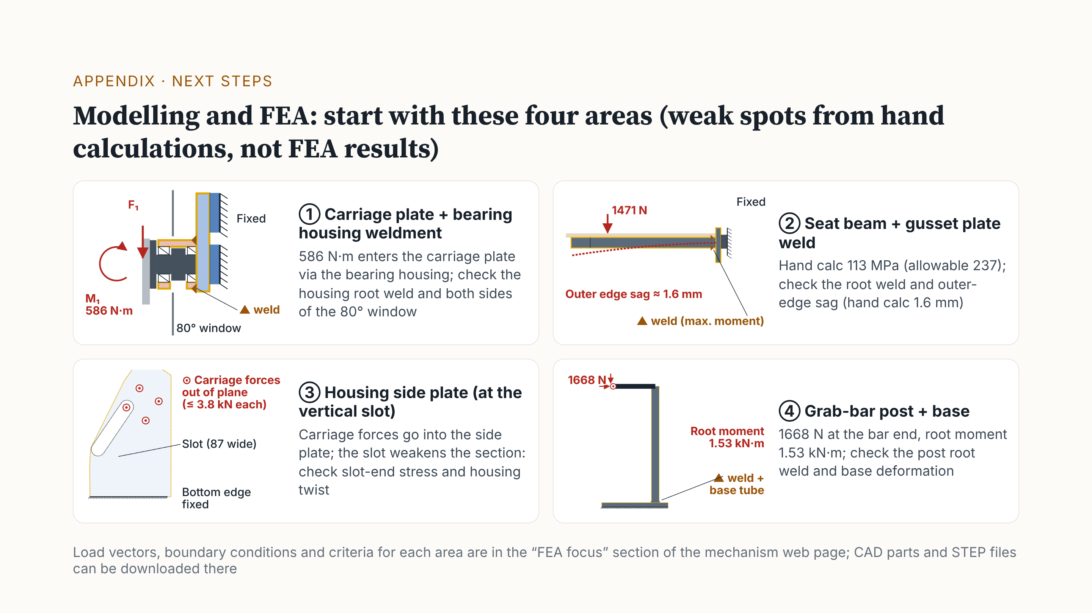
Notes:
Next, we hand over to our modelling and FEA members. Hand calculations found four areas to analyse first. Note: these are not FEA results yet. One: the carriage plate and bearing housing weldment. The seat moment enters the carriage plate here, so we check the weld at the housing root and both sides of the 80 degree window. Two: the weld between the seat beam and the gusset plate. The hand calculation gives 113 megapascals; we check the weld and the edge sag. Three: the housing side plate. It has a vertical slot for the arm, so we check stress at the slot ends and twist of the whole housing. Four: the grab-bar post and base. When a user hangs fully on the bar, the root moment is about 1.5 kilonewton-metres. Loads, boundary conditions and criteria are on the mechanism web page, with the part models and STEP files.

Slide 33
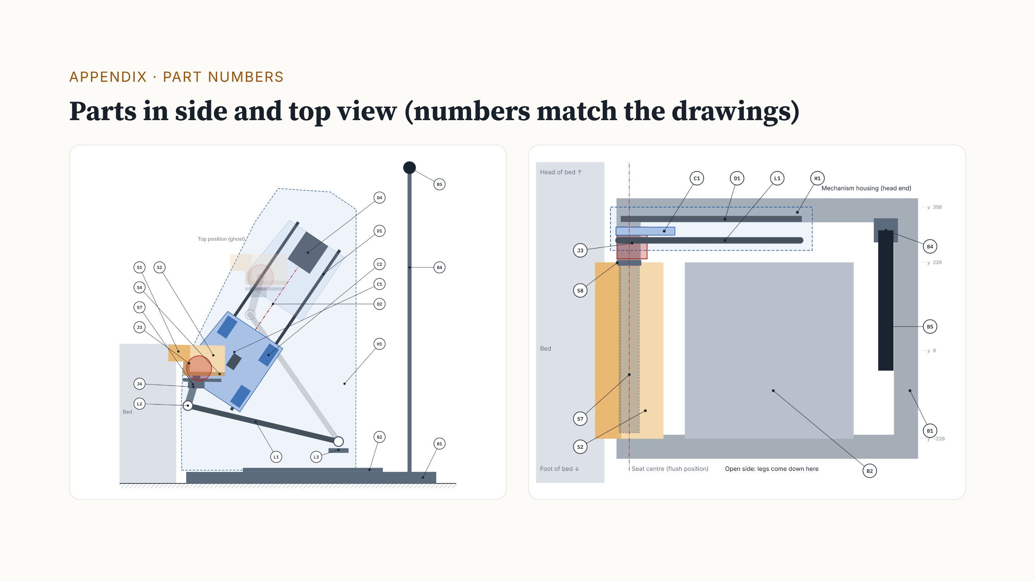
Notes:
Appendix: part numbers. S parts are on the seat, J are the pivots, C is the carriage plate, L is the tilt link, D is the drive, H is the mechanism housing, and B is the base. When asked about a part, we use this page to find it.

Slide 34
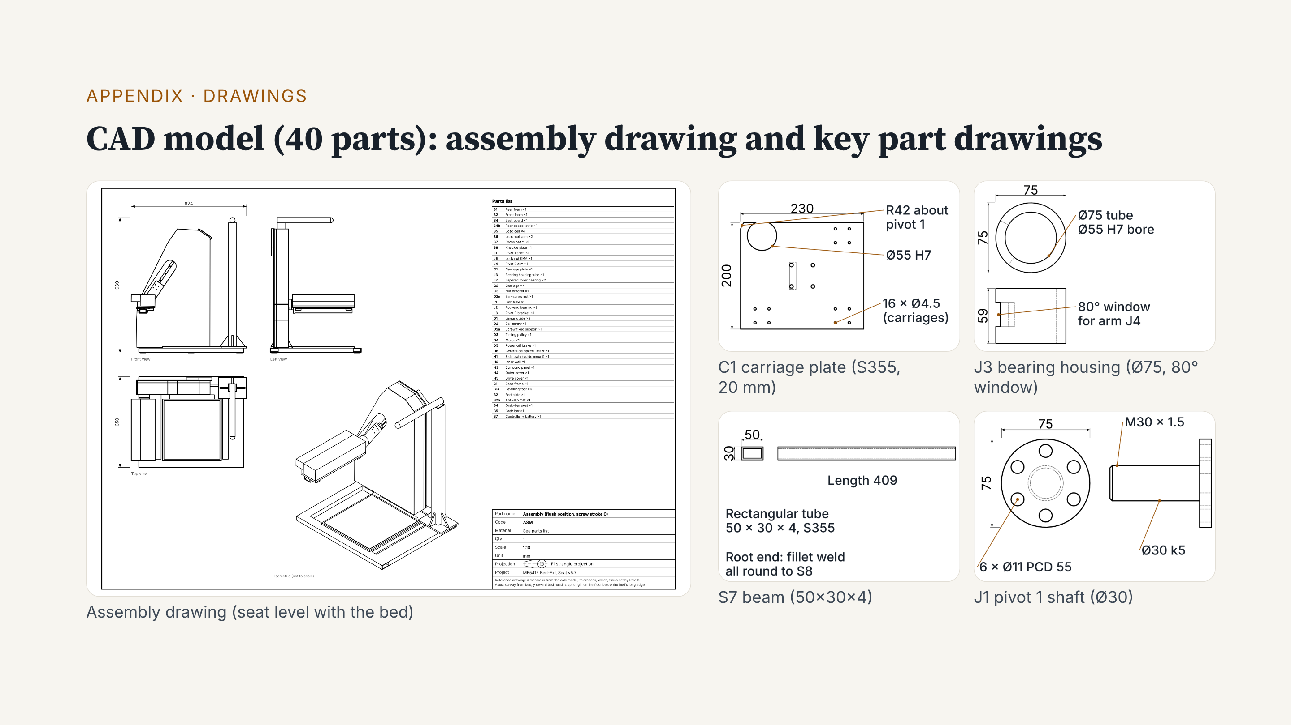
Notes:
Appendix: this is the assembly drawing of the CAD model and four key part drawings. All 23 part drawings, the STEP files and the 3D model are on the mechanism web page for download.

Slide 35
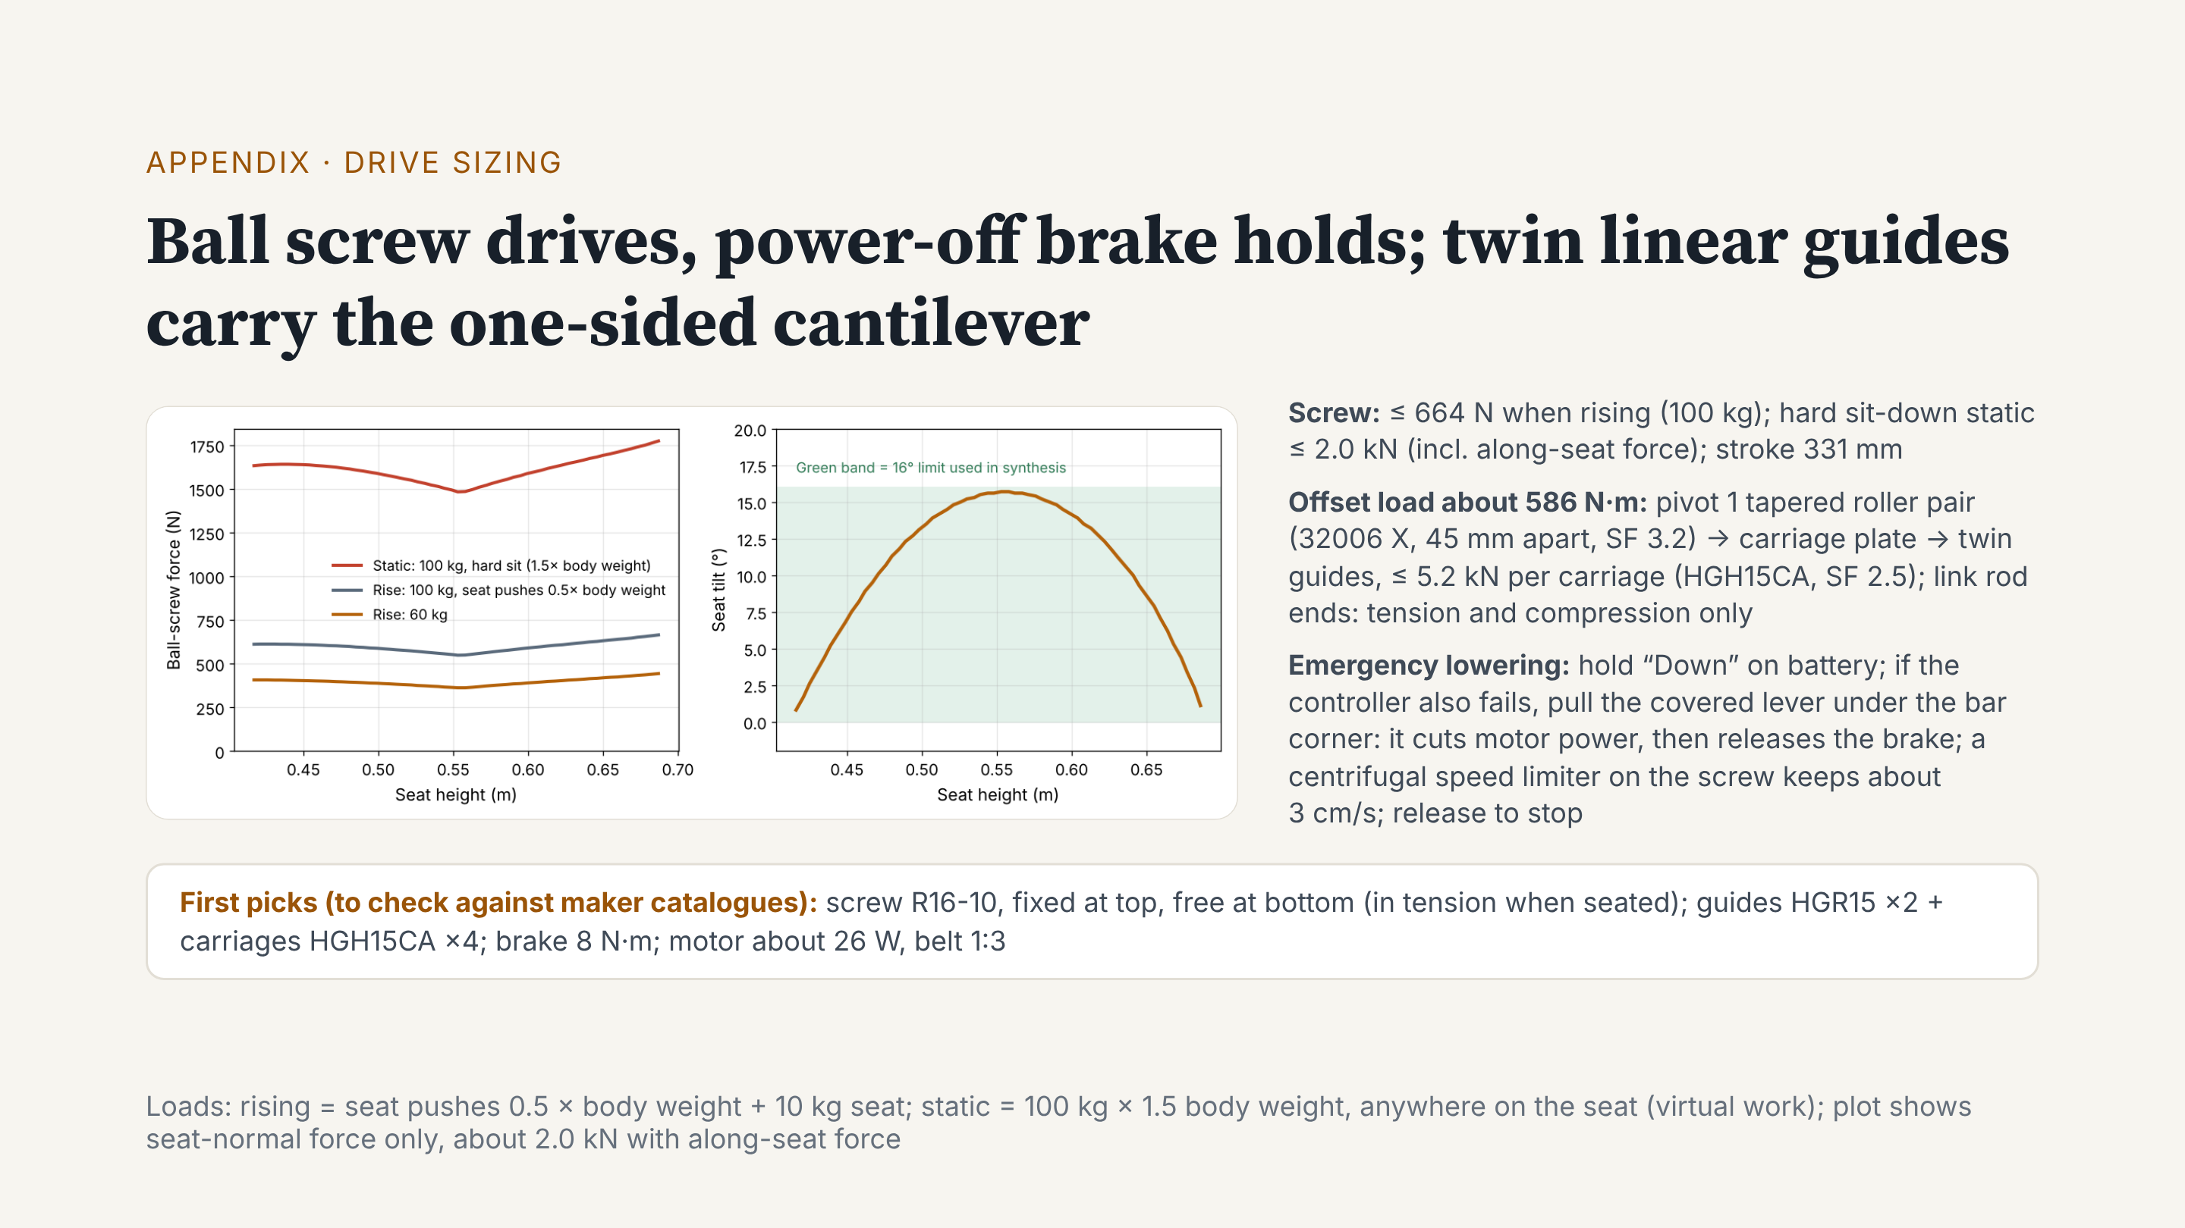
Notes:
This is our first drive sizing. A ball screw drives the carriage. The left plot is screw force: at most about 664 newtons when rising. If a 100 kilogram user sits down hard, with the force along the seat, it is about 2.0 kilonewtons. The right plot is seat tilt: never above 16 degrees. A ball screw is efficient but does not self-lock, so we add a power-off brake. It holds in normal use and when power fails. With no power, first hold “Down” to lower slowly on battery. If the controller also fails, pull the covered lever under the bar corner; you can reach it while seated. First it cuts motor power, then it releases the brake. The user’s weight lowers the seat, and a centrifugal limiter on the screw keeps the speed at about 3 centimetres per second, about 11 seconds in total. Let go and it stops. The seat is a cantilever, so the offset load gives about 586 newton-metres. This goes through pivot 1, with two tapered roller bearings 45 millimetres apart, then to twin guides with four carriages. The link has rod-end bearings, so it only sees tension and compression. Next, we check all parts against maker catalogues.

Slide 36
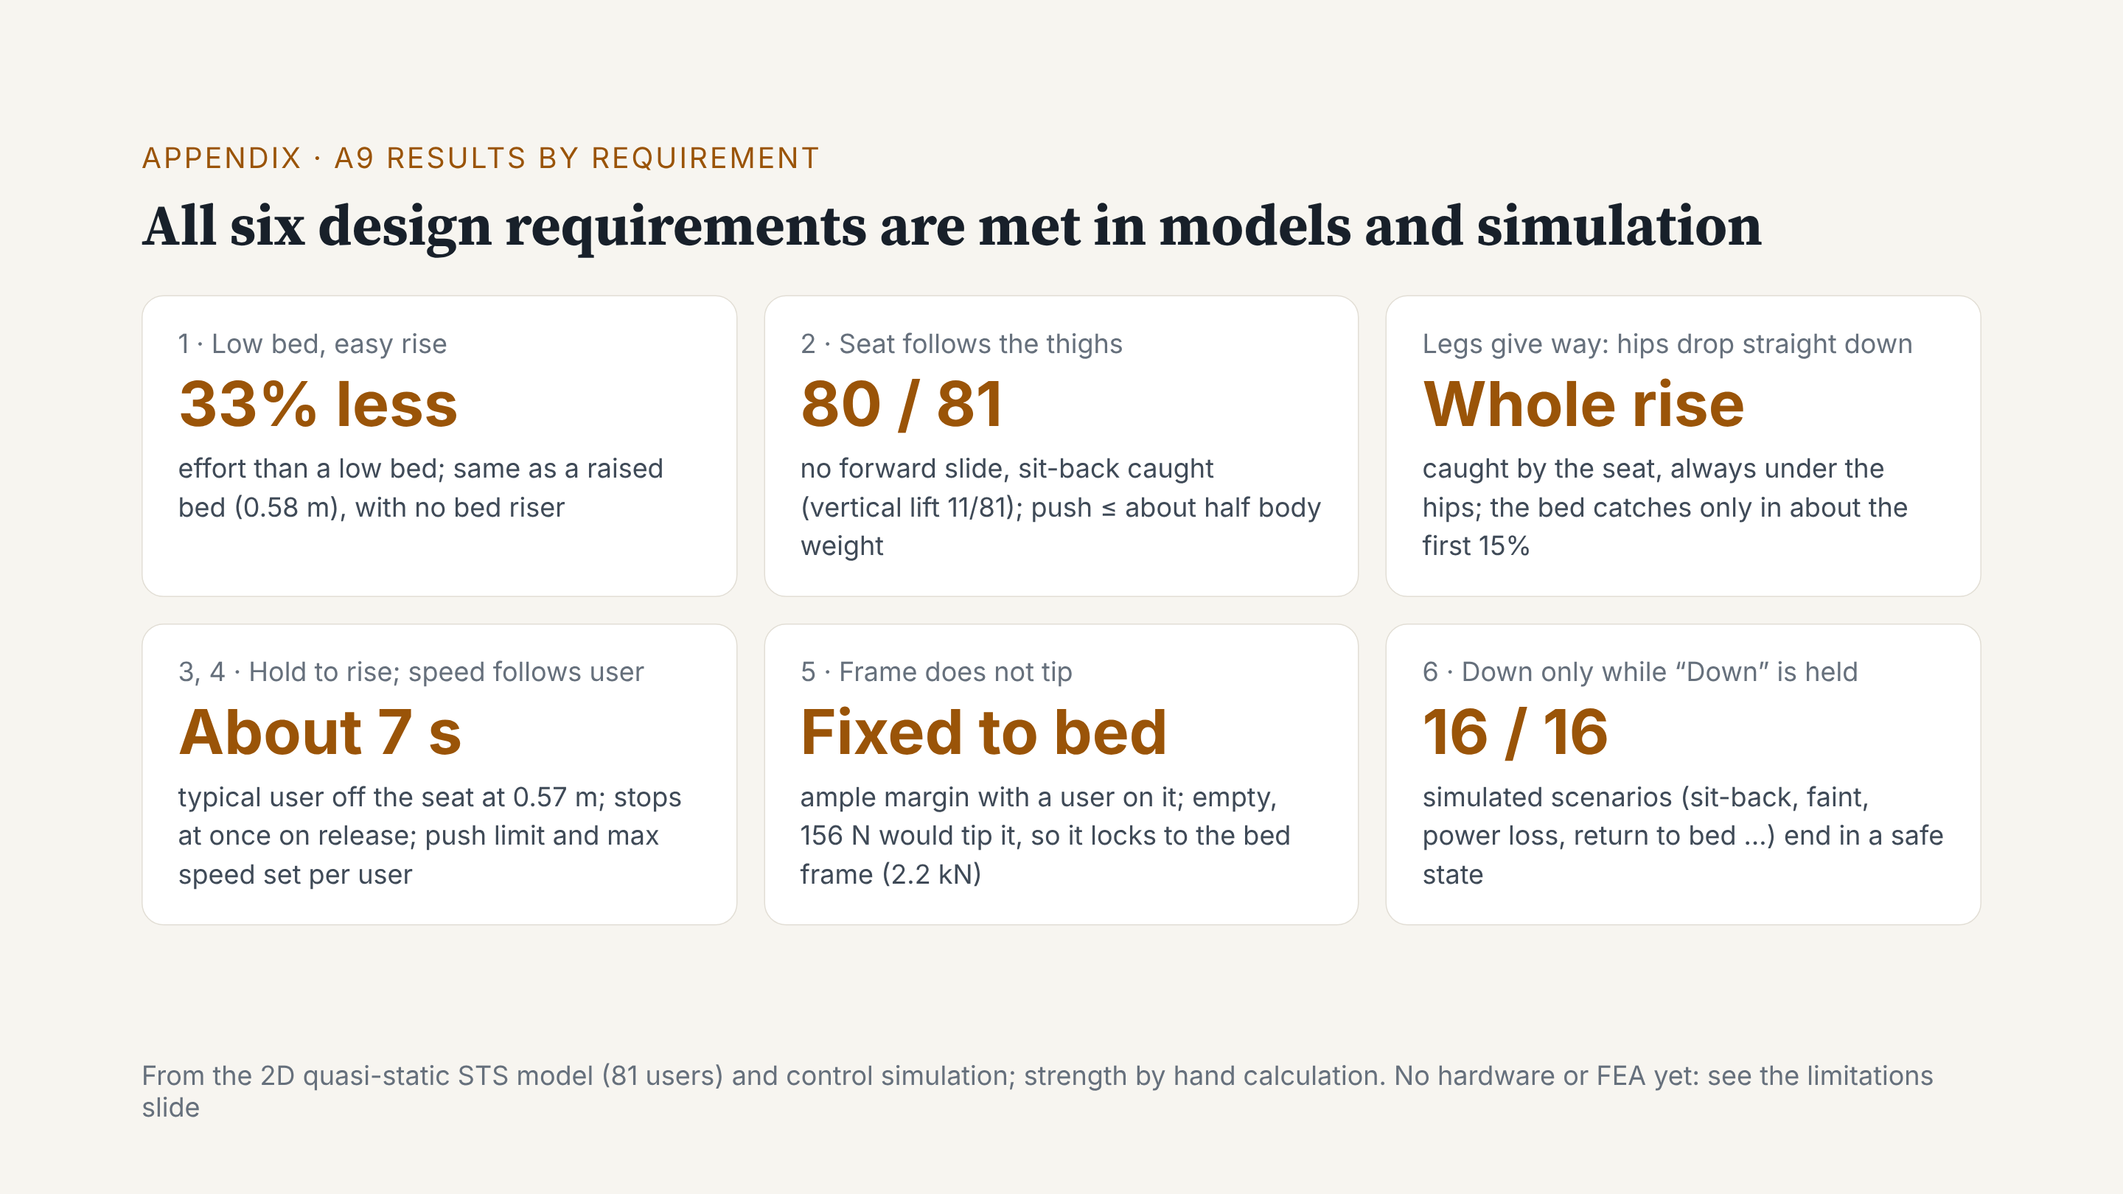
Notes:
Backup for questions: results by requirement. All six requirements are met in our models and simulation. Rising takes one third less effort than from a low bed, like a raised bed, but the bed stays low. For 80 of 81 users, the seat follows the thighs and catches a sit-back. If the legs give way, the seat catches the hips the whole way. A typical user is up in about 7 seconds, and the seat stops on release. Fixed to the bed, the frame does not tip. All 16 scenarios end safe.

