Slide 1
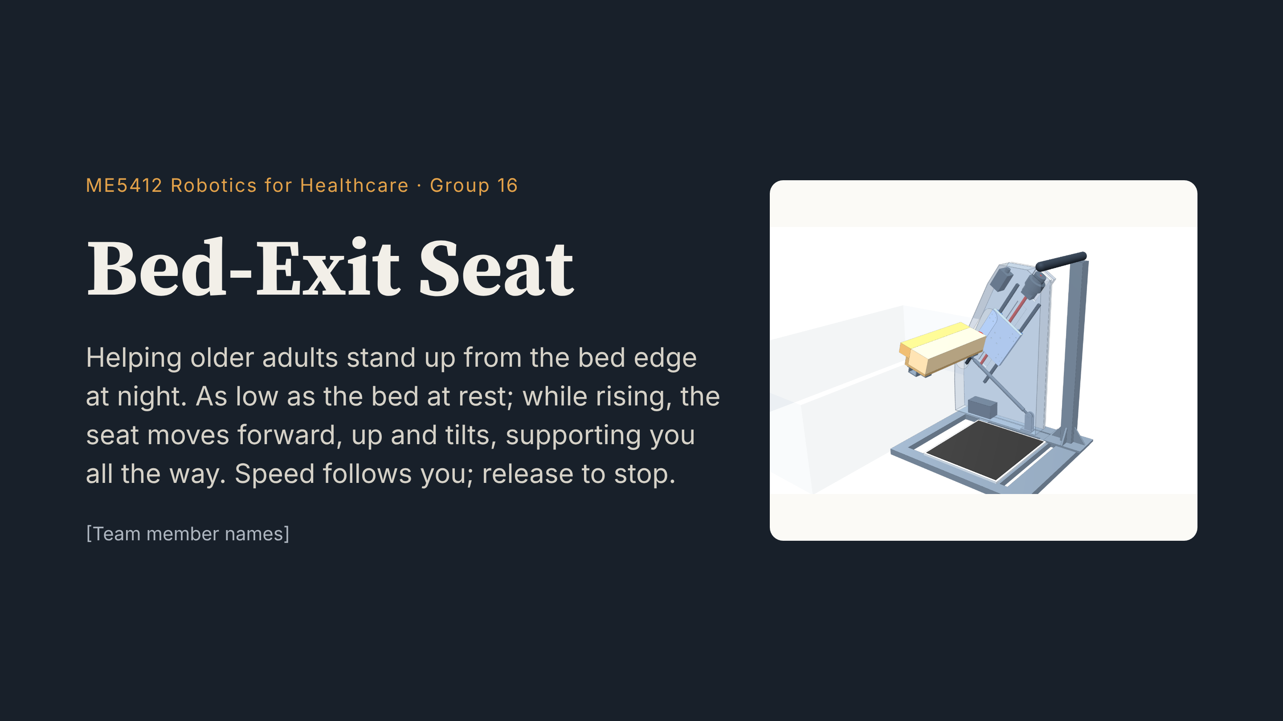
Notes:
Hello everyone, we are Group 16. Our project is the Bed-Exit Seat. It helps older adults with weaker legs stand up from the bed edge at night. First, please watch a 46-second film.

Slide 2
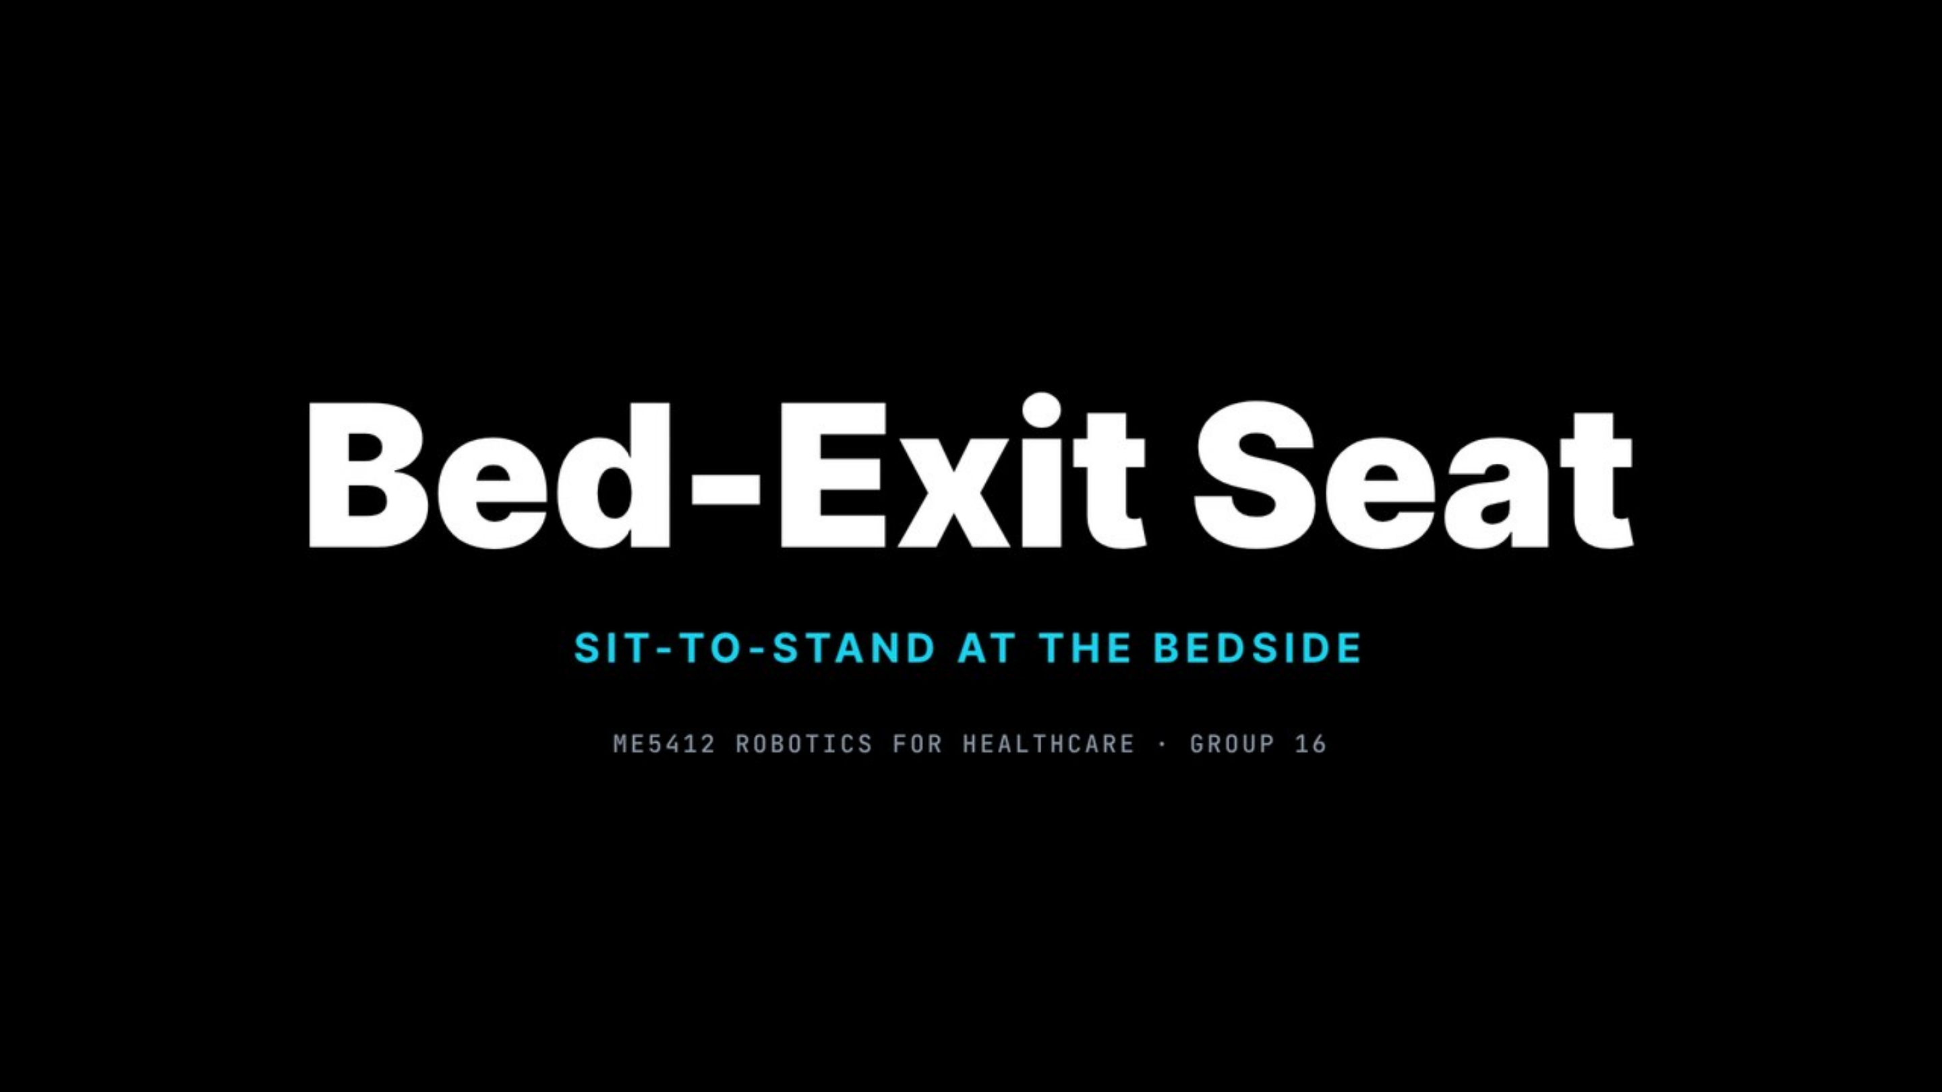

Notes:
(Click to play — 46 s with sound. Don't speak during the film.) Afterwards: Now let's go through each step.

Slide 3
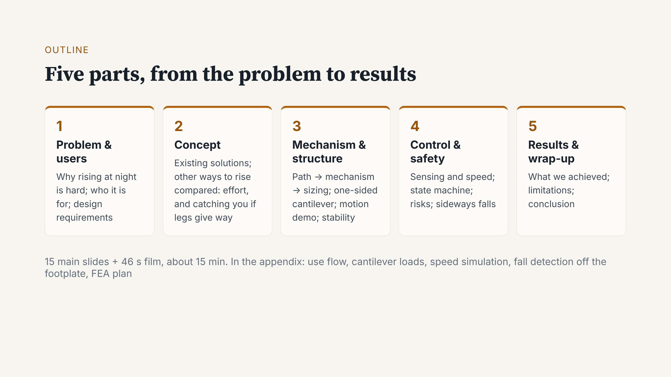
Notes:
The talk has five parts: the problem and users, a comparison of solutions, the mechanism, then control and safety. We finish with results and a short wrap-up.

Slide 4
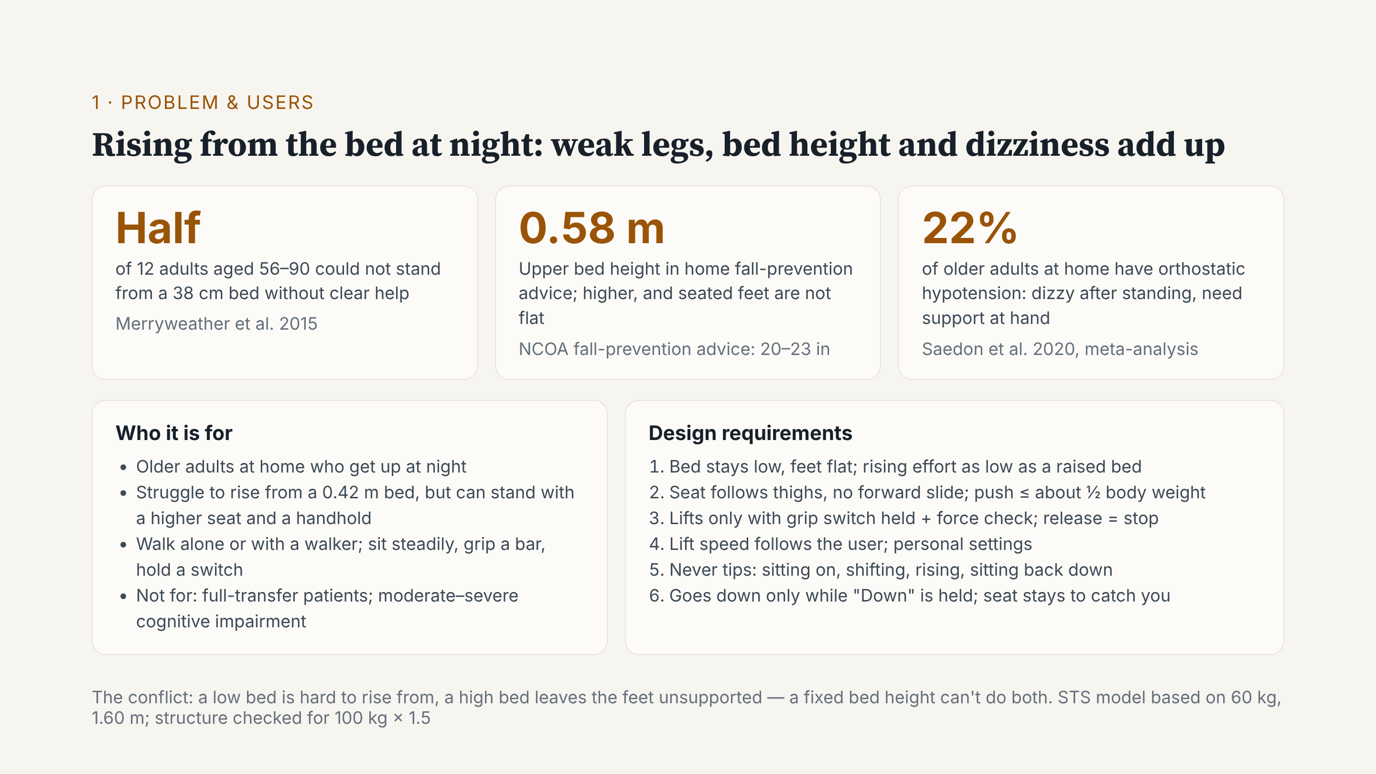
Notes:
Behind the film are three numbers. Half of 12 older adults could not stand from a 38-centimetre bed without help. Fall-prevention advice says a bed should be at most about 0.58 metres; any higher, and the feet are not flat when seated. And about 22% of older adults at home have orthostatic hypotension, so they may feel dizzy after standing. So one fixed bed height cannot do both. Our users can still walk, alone or with a walker, but find rising from a normal bed hard. Results for the six requirements come at the end.

Slide 5
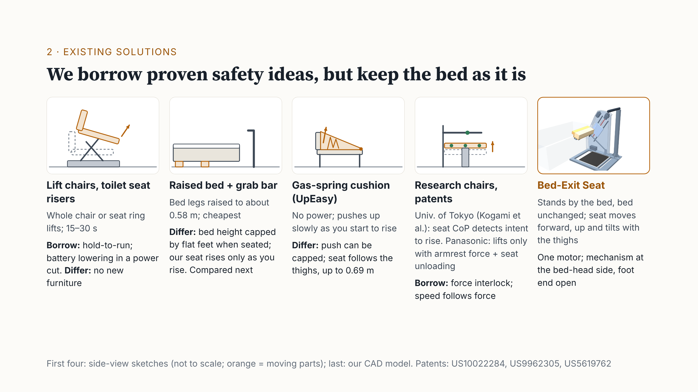
Notes:
Lift chairs and toilet seat risers can lift a person. We borrowed two ideas: it moves only while you hold the button, and a battery lowers you in a power cut. But they need new furniture. The cheapest option is a raised bed with a grab bar; we compare it next. A gas-spring cushion cannot cap its push. Research chairs and a Panasonic patent use seat and armrest forces to detect that someone wants to stand; we borrowed this force interlock. Our difference: it stands beside the bed, the bed is unchanged, and the seat follows the thighs.

Slide 6
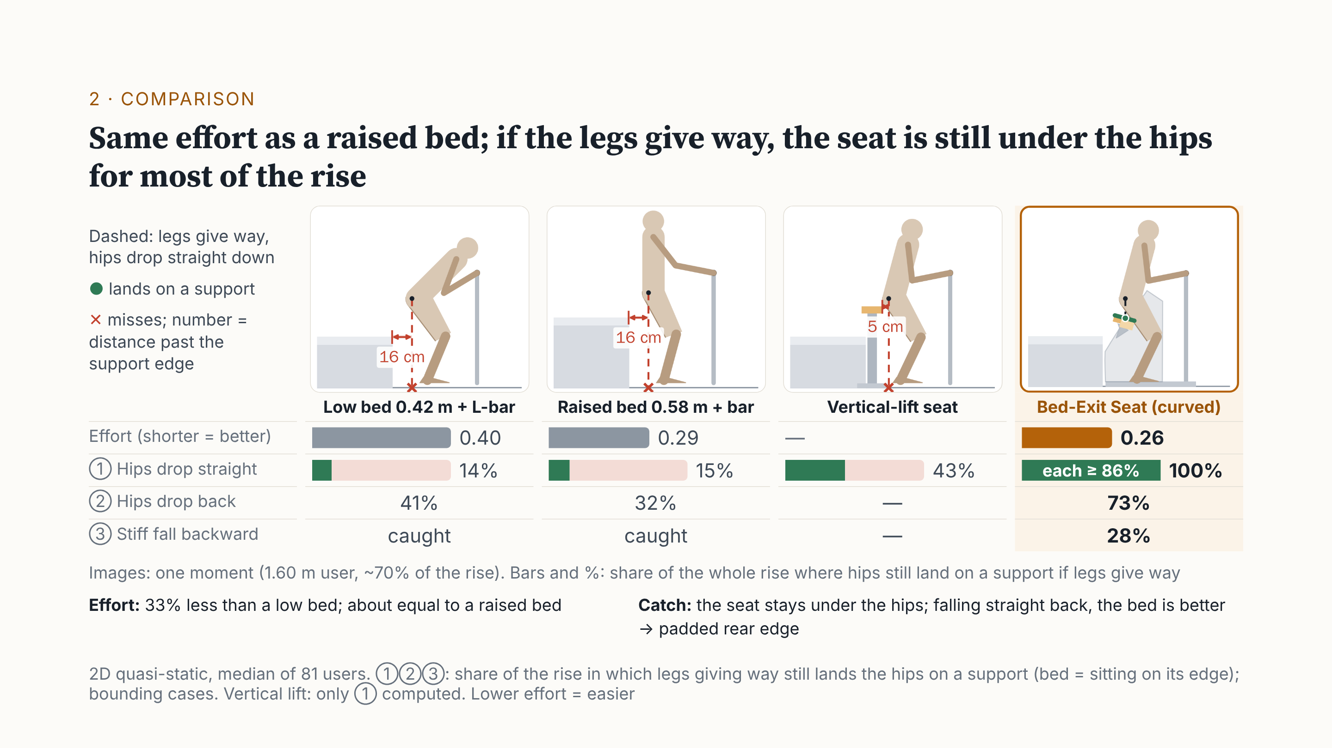
Notes:
This is the key slide. To be honest: on effort alone, a bed raised to 0.58 metres with a grab bar works well. We need about a third less effort than a low bed, but only about 10% less than a raised bed, and 22 users find it slightly harder. So effort is about equal. The real difference is when the legs give way. At about 70% of the rise, for both beds the hips land about 16 centimetres past the edge, about 25 when upright. The vertical seat only goes up: they land 5 centimetres in front of it. Only the curved seat is still underneath. Beds catch you only in the first 15% or so, vertical lift 43%, our seat all the way; if the knees buckle, 73%. In a stiff backward fall the bed is better, so we pad the rear edge.

Slide 7
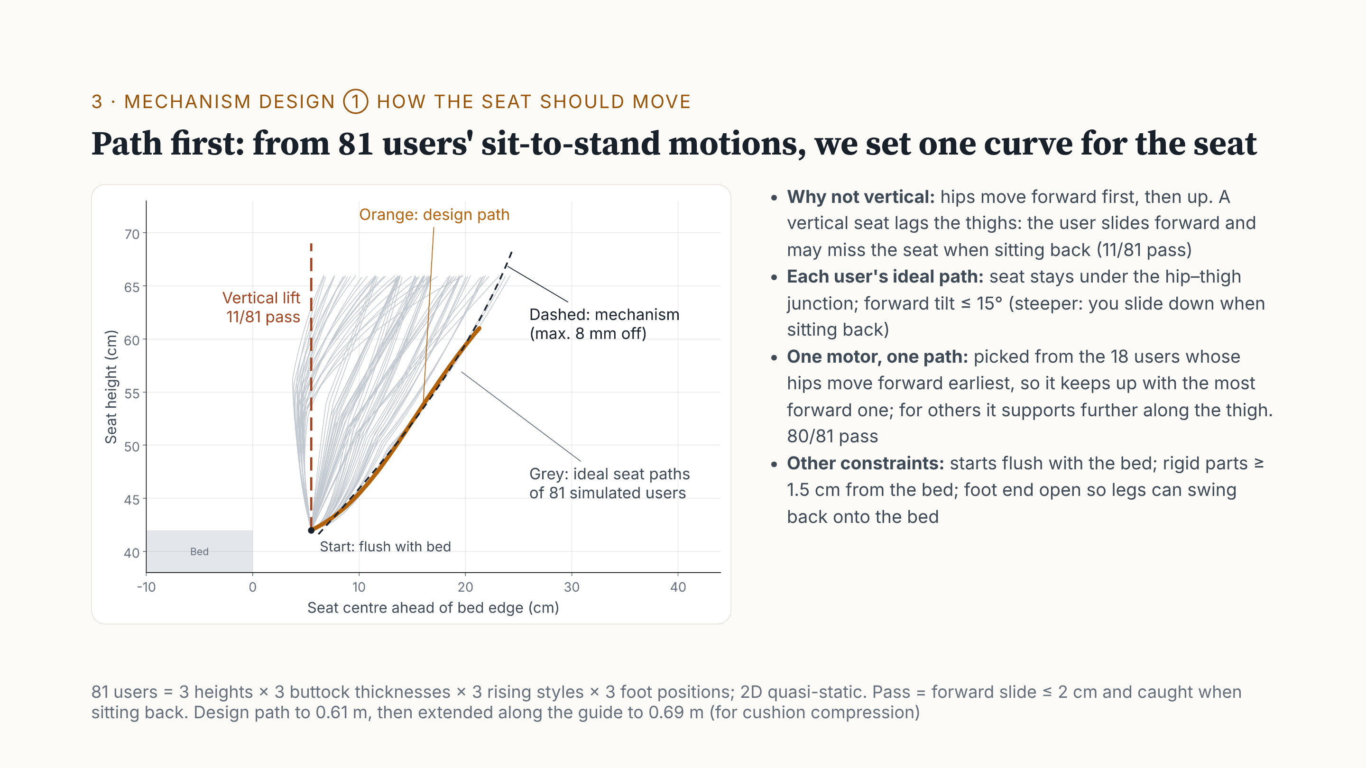
Notes:
Mechanism design has three steps. Step one: how should the seat move? We used 81 simulated users: three heights, body sizes, rising styles and foot positions. For each one, we found the ideal seat path: under the hip–thigh junction, with forward tilt of 15 degrees at most; any steeper, and you slide down when sitting back. Everyone moves forward first, then up, so a vertical lift cannot keep up: only 11 pass. One motor can follow only one path. We chose the one that keeps up with the most forward user: this orange curve. 80 of 81 users pass.

Slide 8
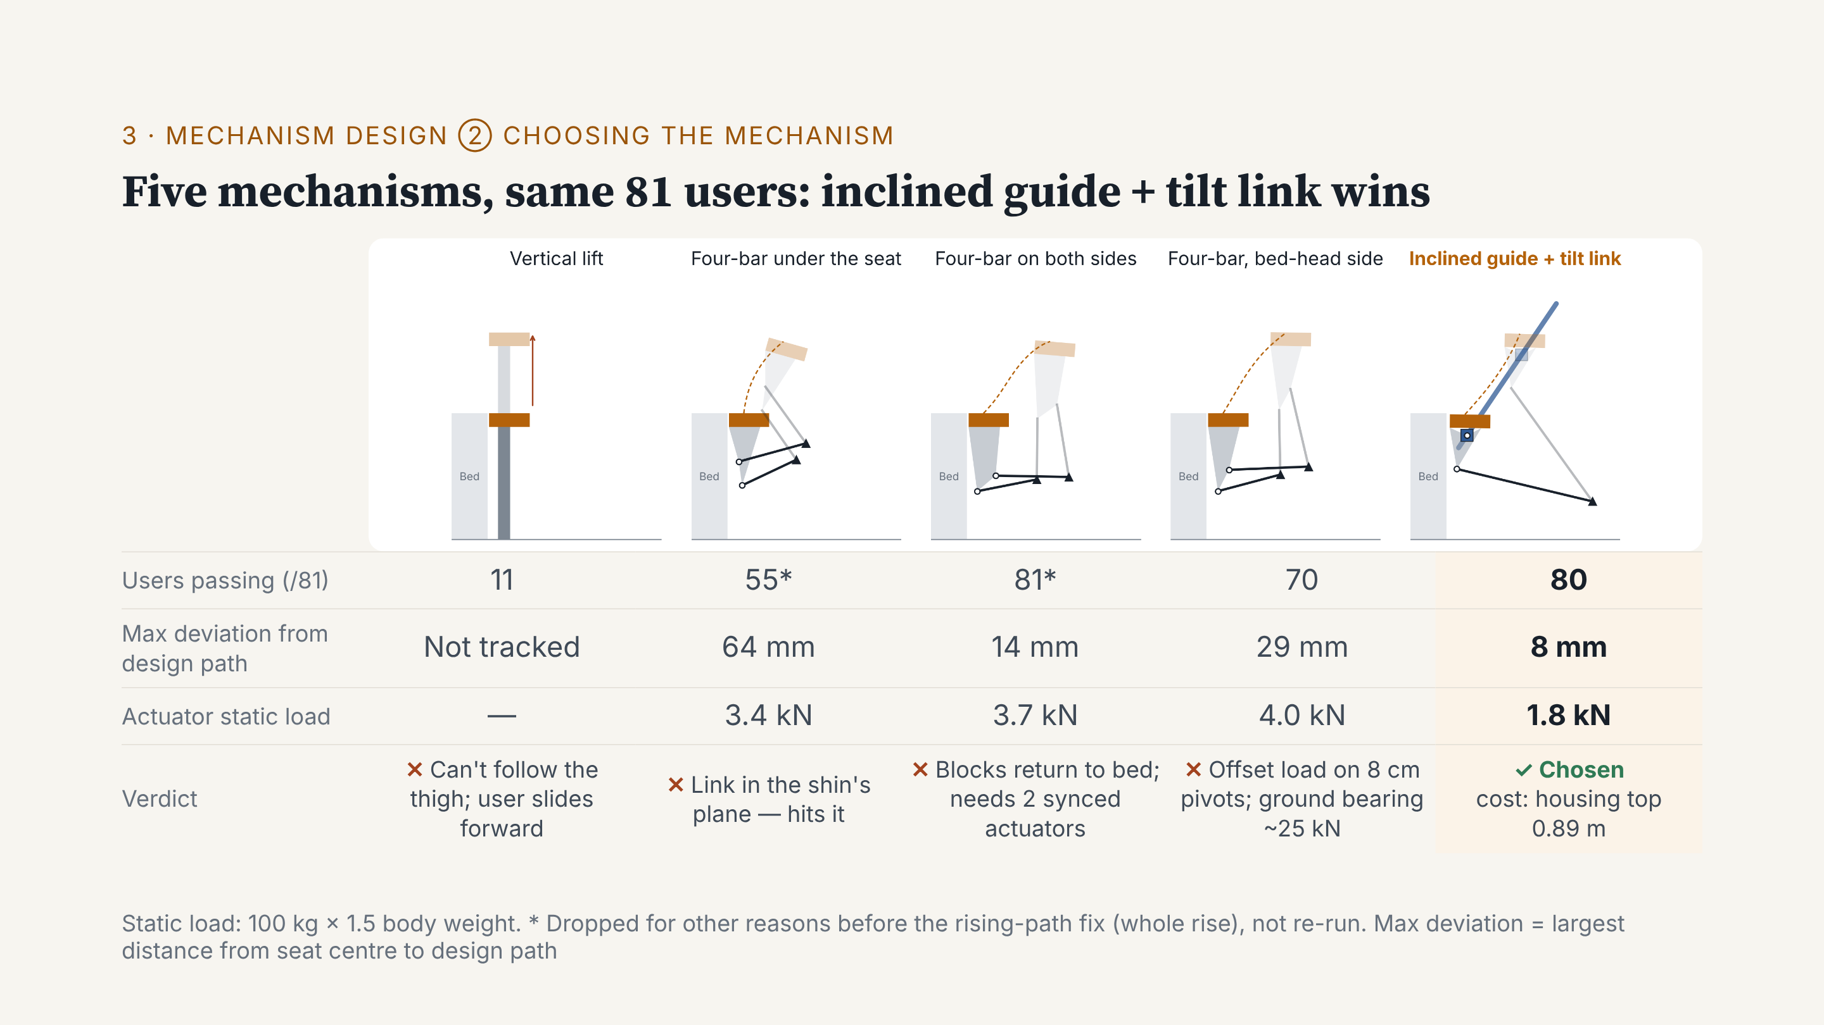
Notes:
Step two: five mechanisms, same constraints, same 81 users. A vertical lift cannot follow the thigh. A four-bar under the seat hits the shins. Outside both legs, it blocks the way back to bed and needs two synced actuators. On the bed-head side only, it cannot carry the offset load: about 25 kilonewtons on the ground bearing. The inclined guide with tilt link is off by only 8 millimetres, needs the least force, and keeps the foot end open. The cost: a tall housing.

Slide 9
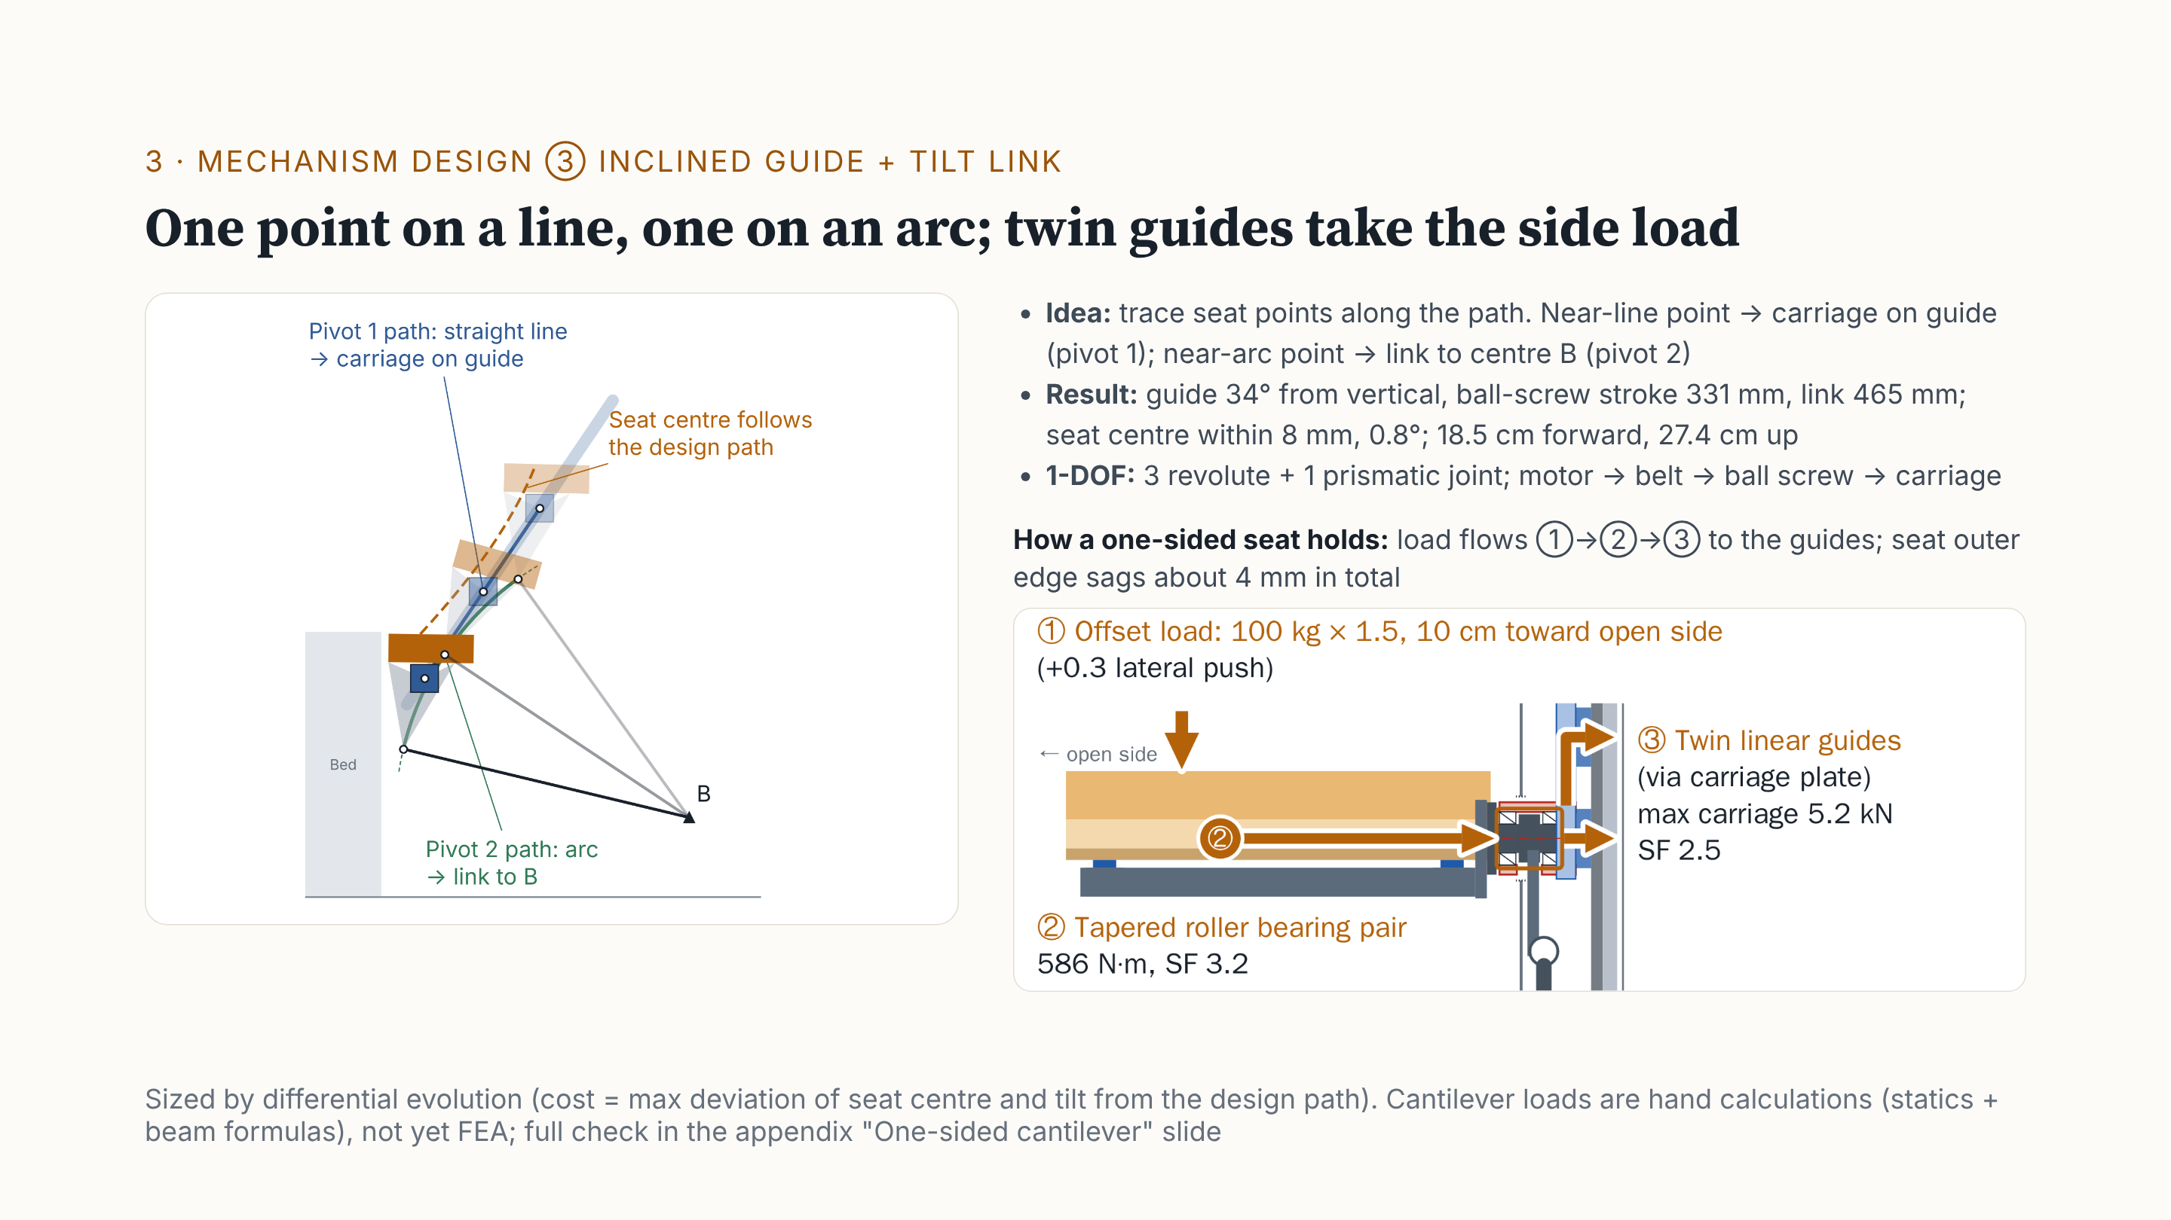
Notes:
Step three is sizing. We move the seat along the design path and trace every point on it. A point moving almost in a line rides a carriage on a guide. A point moving almost on an arc is held by a link to centre B. So we search only 4 numbers. Result: guide 34 degrees from vertical, link 465 millimetres, error at most 8 millimetres. Three revolute joints and one prismatic: one degree of freedom. How does a one-sided seat carry the load? Worst case, pivot 1 takes about 586 newton-metres. Tapered roller bearings pass it to the two guides: safety factors 3.2 and 2.5. The outer edge sags about 4 millimetres. These are hand calculations; FEA comes next.

Slide 10
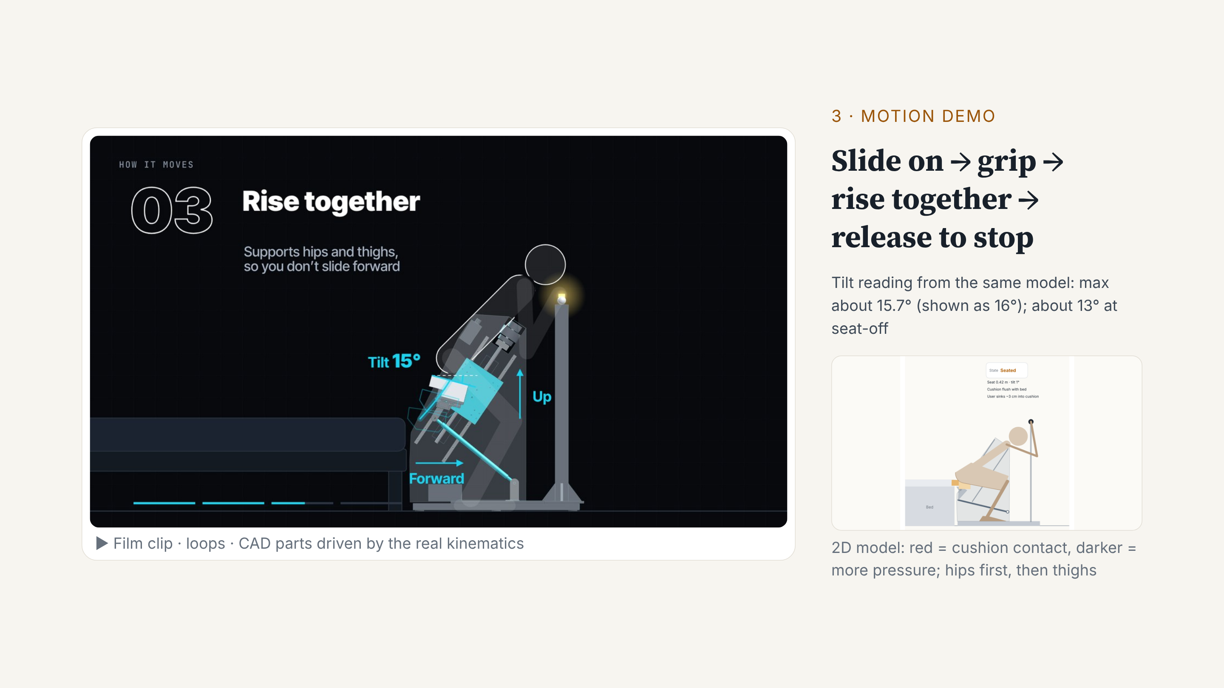
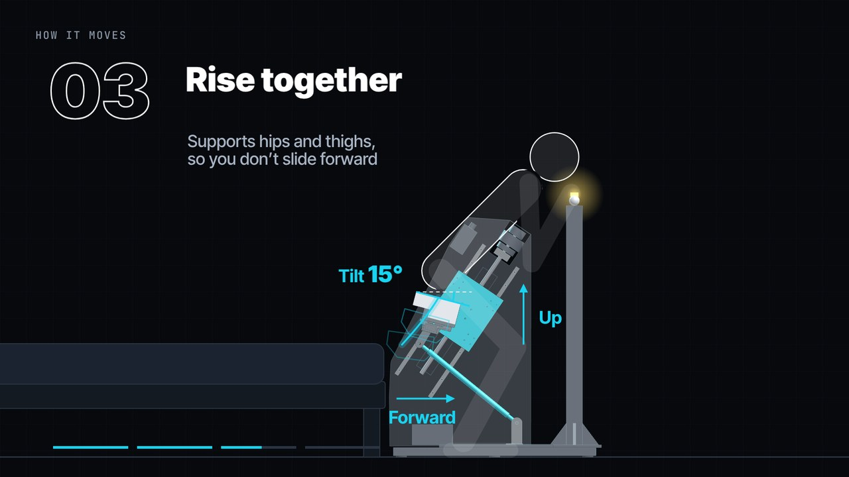
Notes:
These are the four steps from the film, with real kinematics: slide on, grip the switch, rise together, release to stop. The seat moves forward, up, and tilts. The tilt peaks at about 16 degrees, and is about 13 at seat-off. Bottom right is the 2D model: red is the cushion contact. It supports the hips first, then the thighs, so the user does not slide forward.

Slide 11
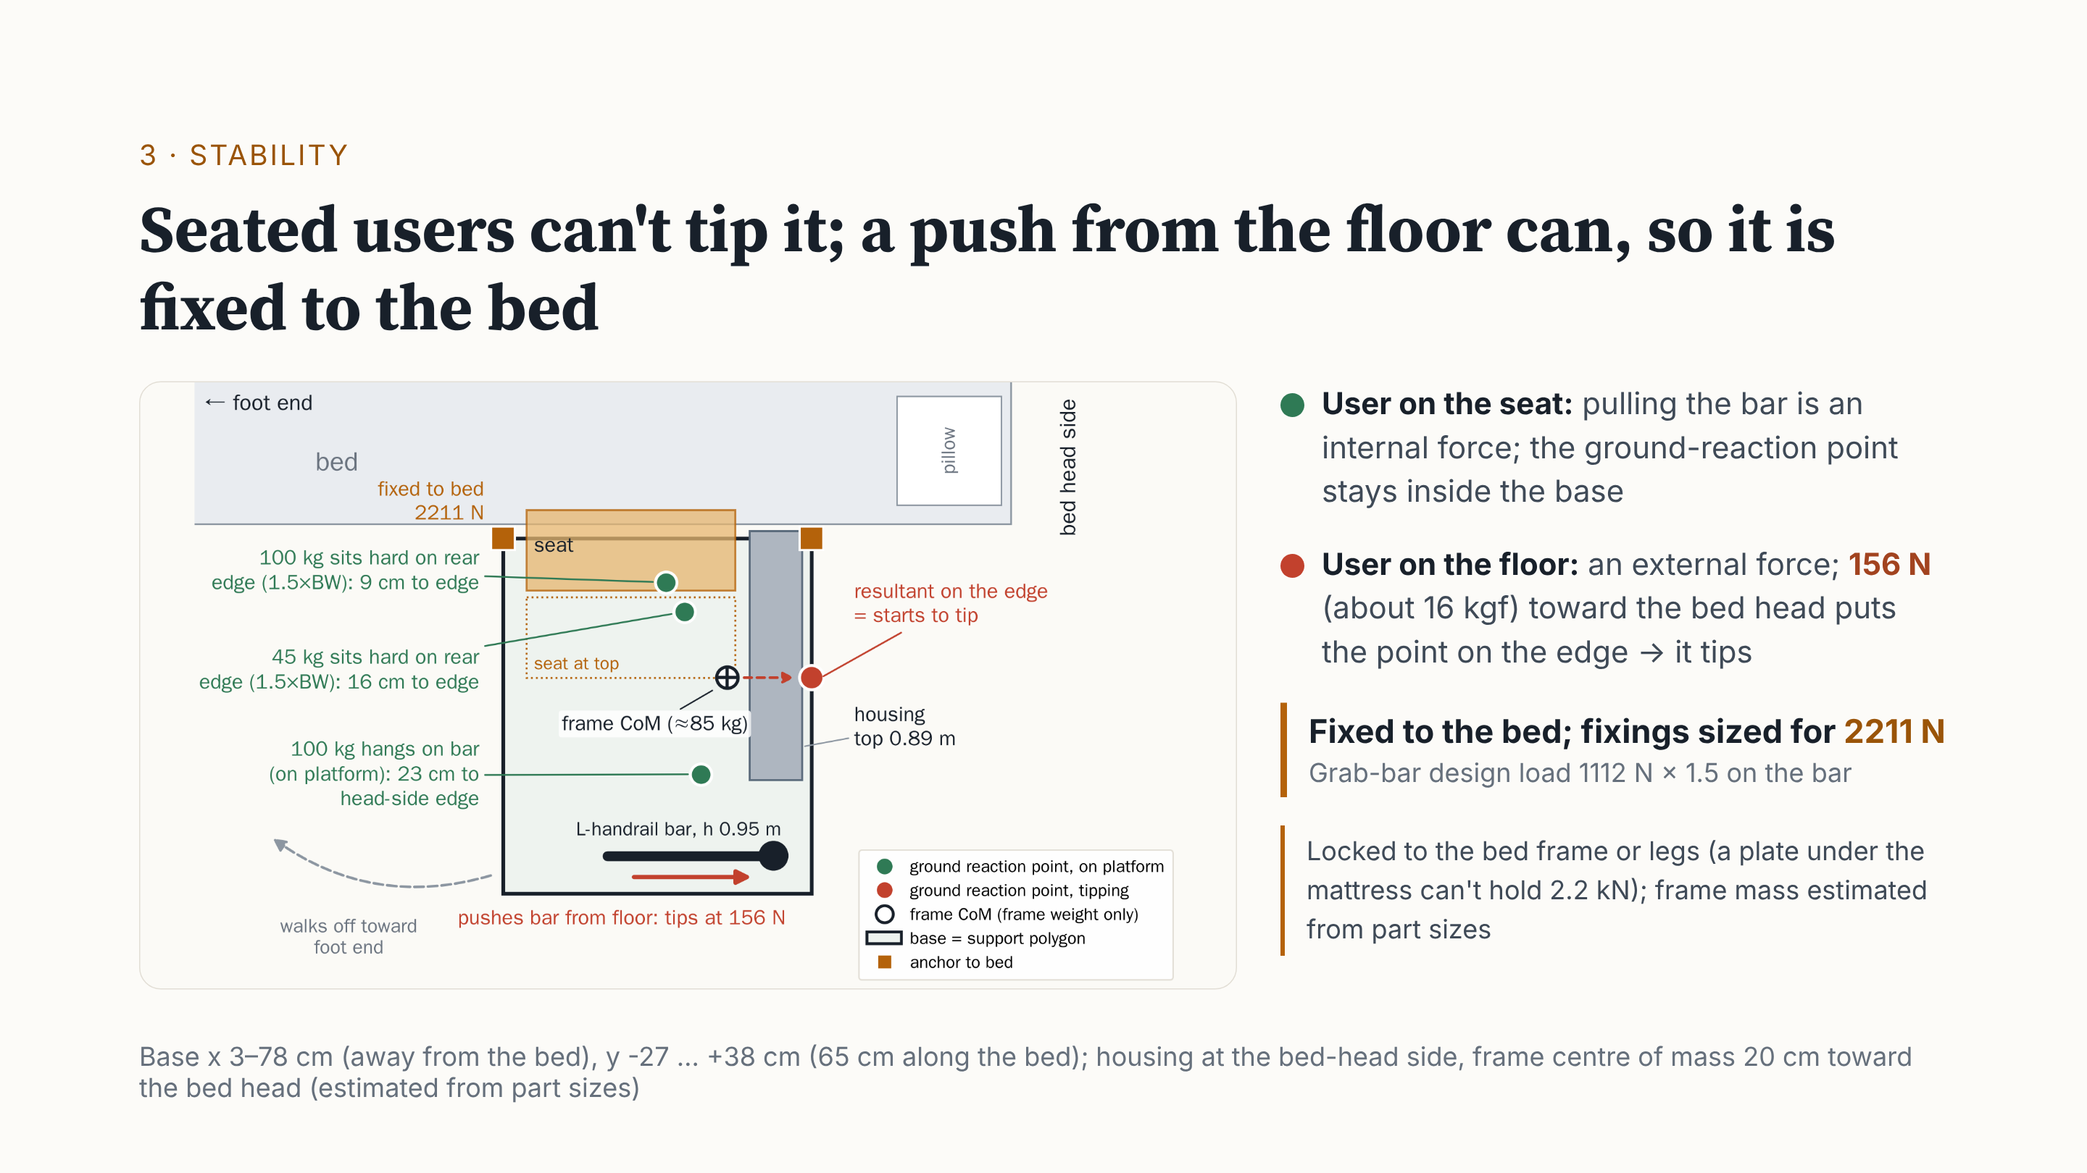
Notes:
This is the top view. The black outline is the base, the support polygon. The dots are ground-reaction points, not the centre of mass. With the user on the frame, pulling the bar is an internal force. A 100 kg user dropping onto the seat's rear: still 9 centimetres from the rear edge. 45 kg: 16 centimetres. The whole body hanging on the bar: 23 centimetres from the bed-head side. All inside. The danger is a person on the floor holding the bar. The frame is only about 85 kg. Push 156 newtons toward the bed head, about 16 kilograms of force, and it starts to tip. So we fix it to the bed. With the grab-bar design load, 1112 newtons times 1.5, the fixings take 2211 newtons, locked to the bed frame or legs.

Slide 12
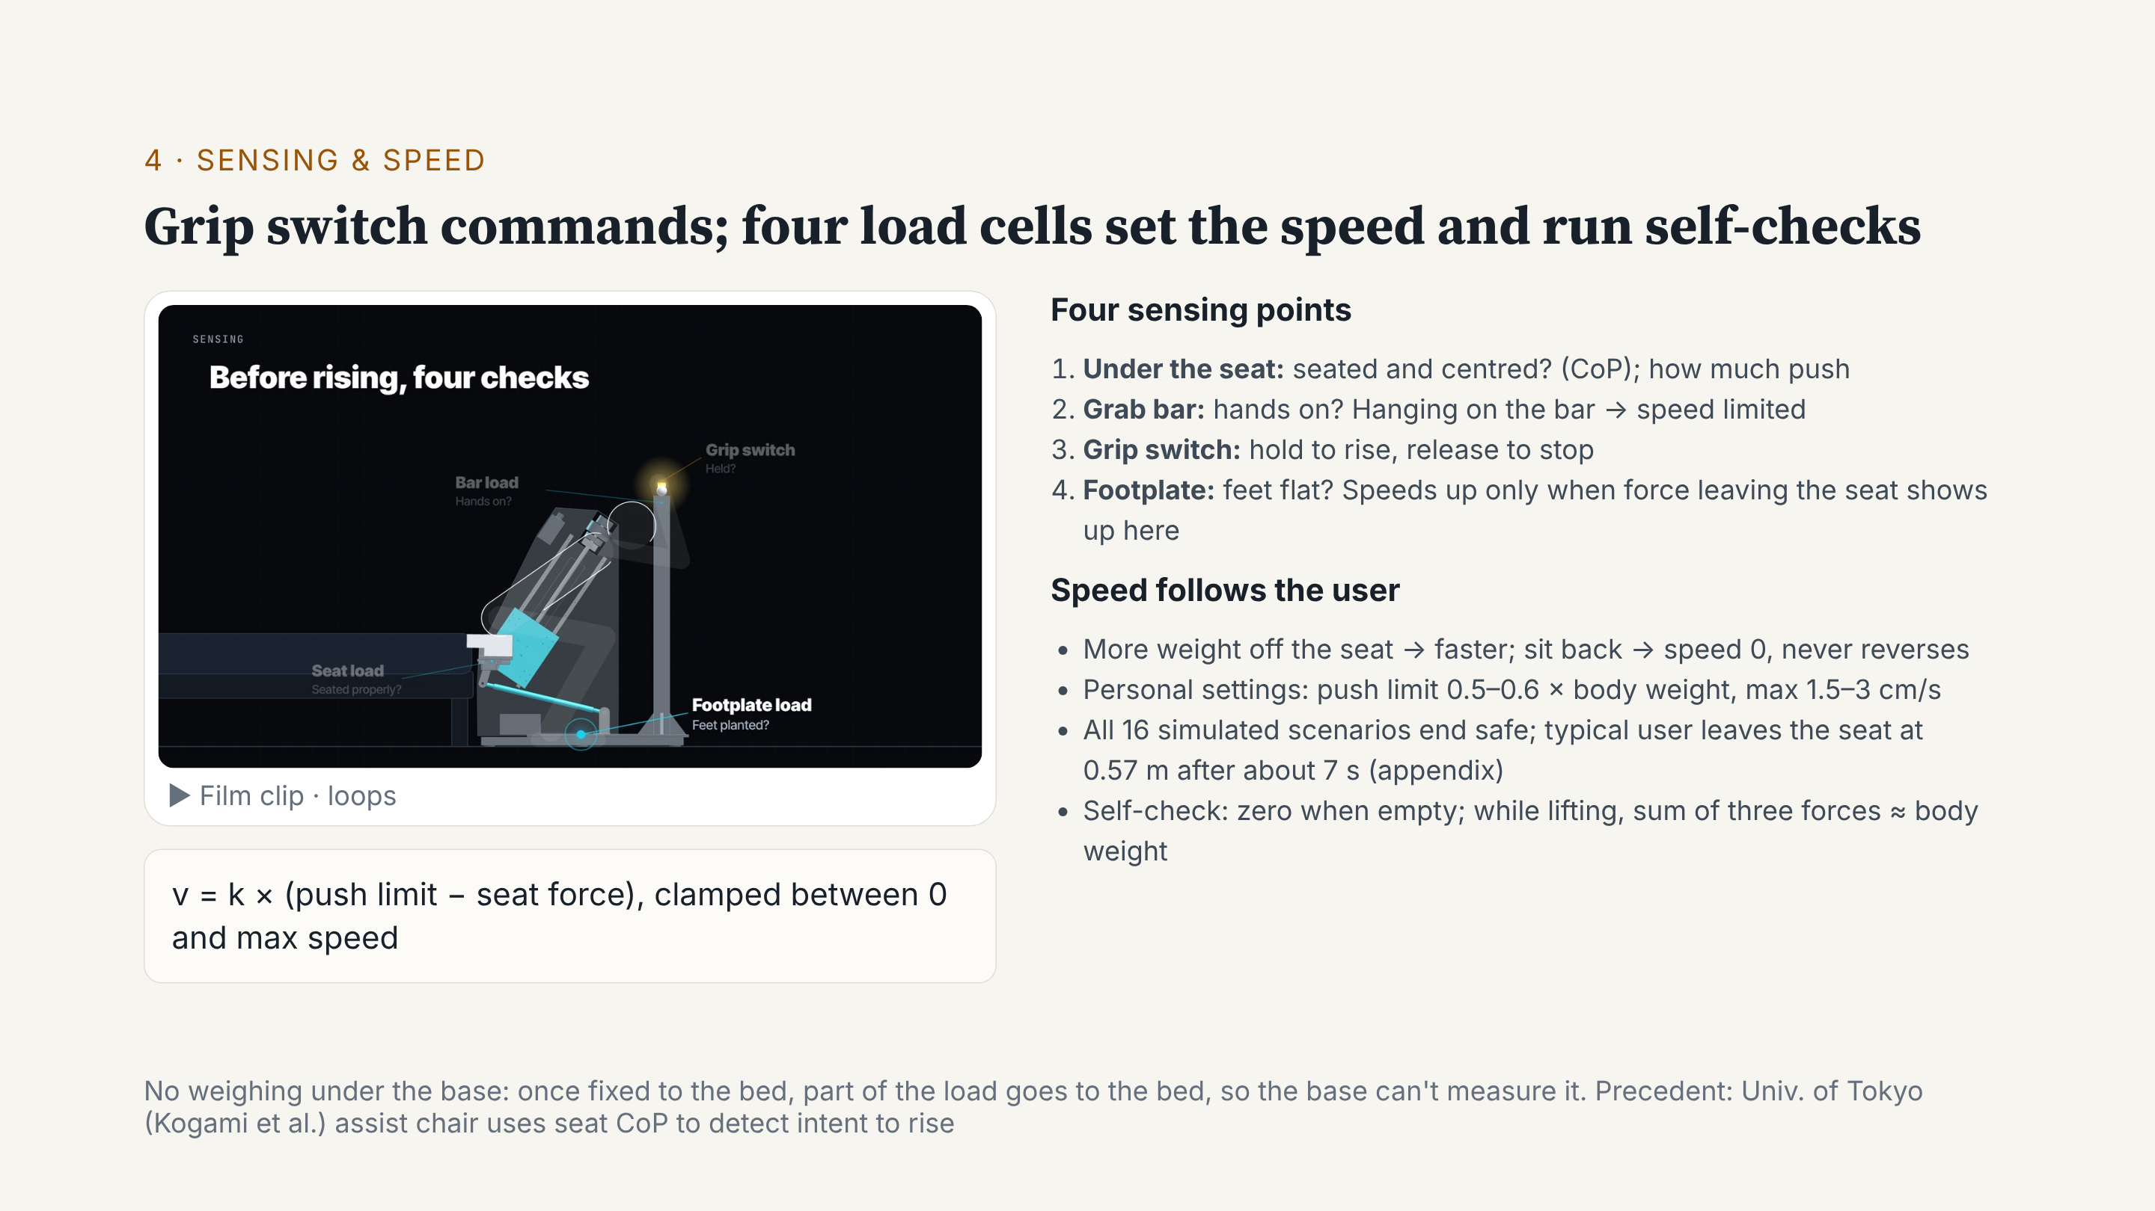
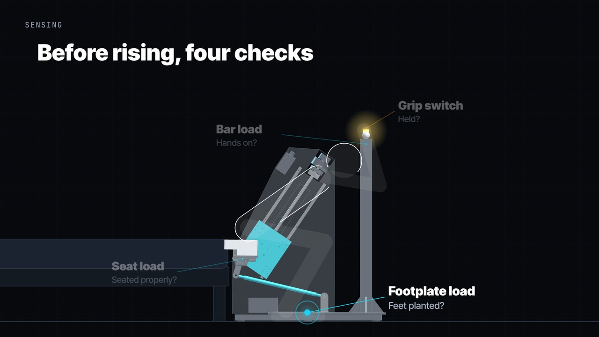
Notes:
Control has two parts. The command: hold the switch on the bar to rise; let go to stop. Force sensing does two jobs. One, speed: k times the push limit minus the seat force. The more the user pushes, the faster it rises; sitting back drops it to zero. It speeds up only when force leaving the seat shows up on the footplate, and hanging on the bar limits it. Two, self-check: the three forces should add up to about body weight. All 16 simulated scenarios end safe. A typical user leaves the seat at 0.57 metres after about 7 seconds.

Slide 13
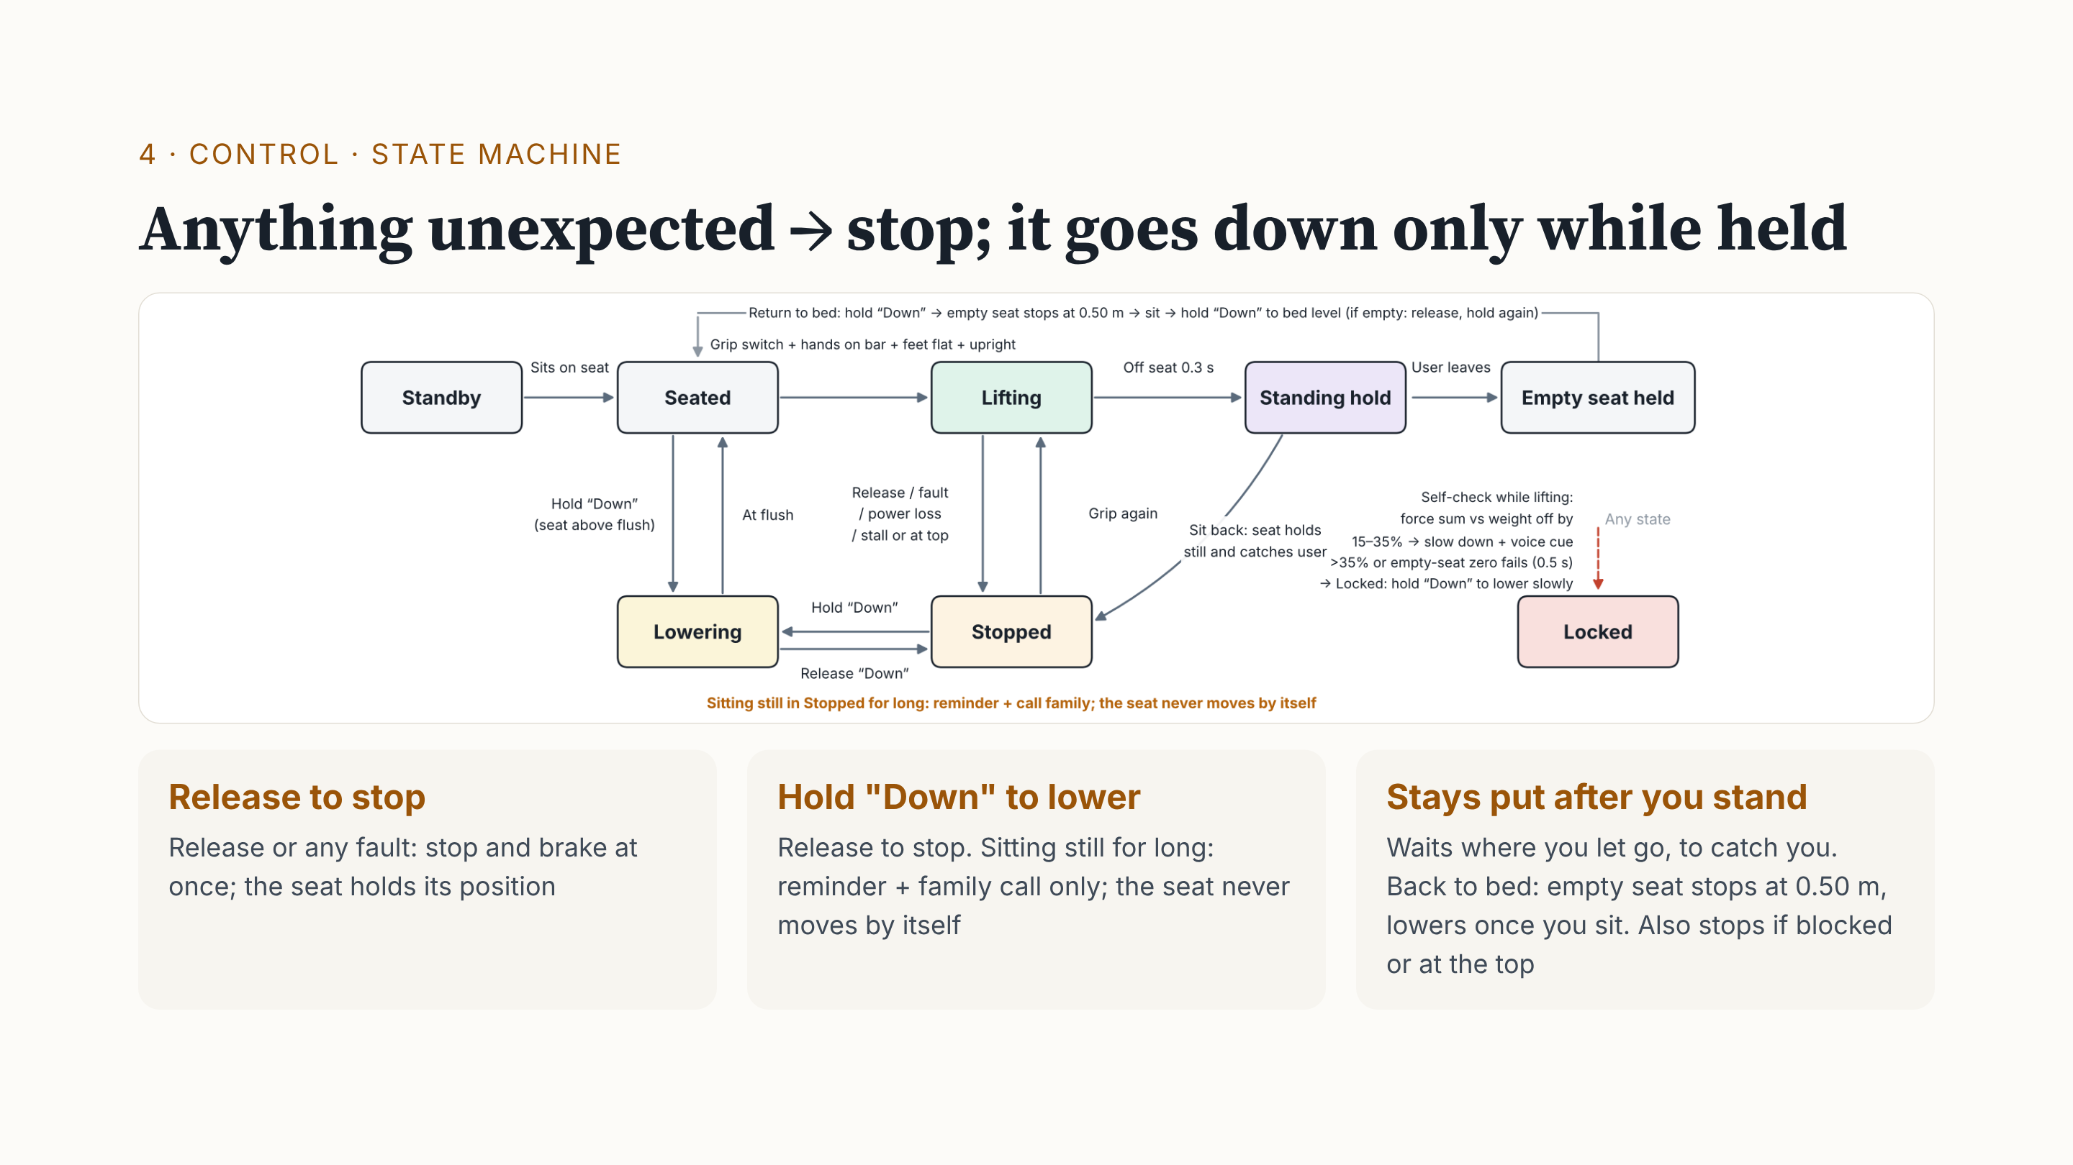
Notes:
Three rules. One: release, or any fault, and it stops and brakes at once. Two: it moves down only while someone holds "Down". Sitting still for long only gives a reminder and calls family; it never lowers by itself, because a weak person slips off a moving seat more easily. Three: after you stand, the seat stays put, so it can still catch you. To return to bed, the empty seat stops at 0.50 metres; once seated, hold "Down" to reach the bed. Note: release-to-stop is a user command. Lock-out is the sensor self-check: forces 15 to 35% off body weight mean slow down and warn; above 35% for half a second, it locks. Legs giving way is different: the speed rule stops the seat to catch you.

Slide 14
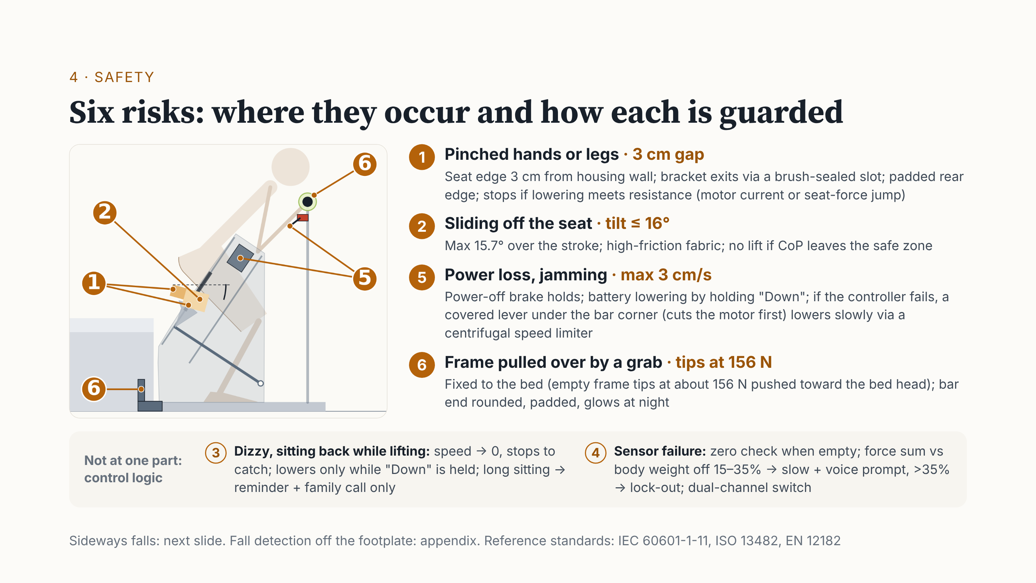
Notes:
The numbers match the side view. One: the seat edge is 3 centimetres from the housing wall, with a padded rear edge; it stops if blocked. Two: tilt under 16 degrees, high-friction fabric. Five: a power-off brake; without power, a battery or the lever under the bar lowers it slowly. Six: fixed to the bed; the bar end is padded and glows. Three, dizziness, and four, sensor failure, are control logic: stop and catch; if the self-check fails, slow down, then lock out.

Slide 15
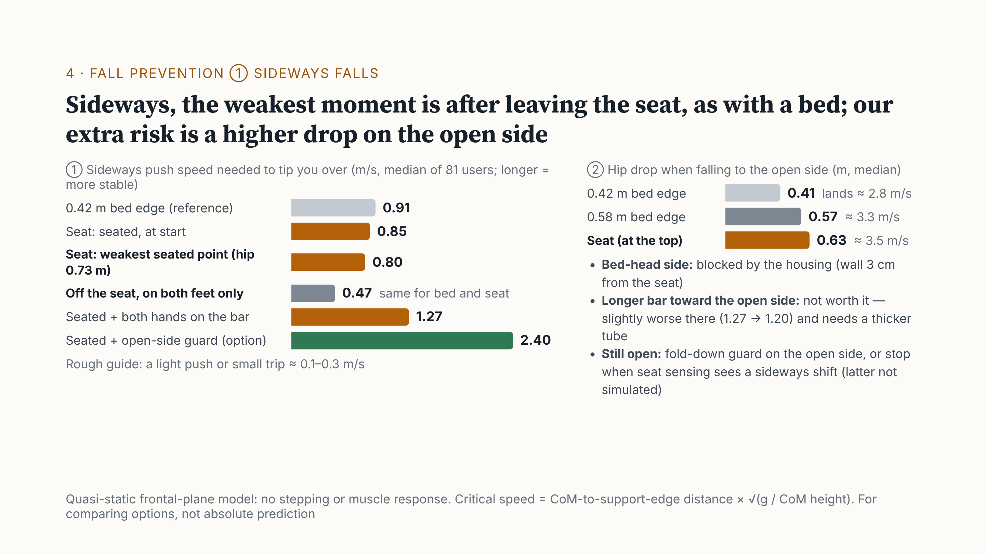
Notes:
What about sideways falls? On the left: how fast a sideways push must be to tip someone over; longer is more stable. Sitting on our seat is about the same as on a low bed edge. The weakest moment is after leaving the seat, on the feet only: the same as rising from a bed, not caused by our seat. Our extra risk is on the right: falling to the open side from the top, the drop is about 0.63 metres, like a 0.58 metre bed. Options: a fold-down guard, or stop when seat sensing sees a sideways shift; not decided yet. The model is quasi-static, for comparison only.

Slide 16
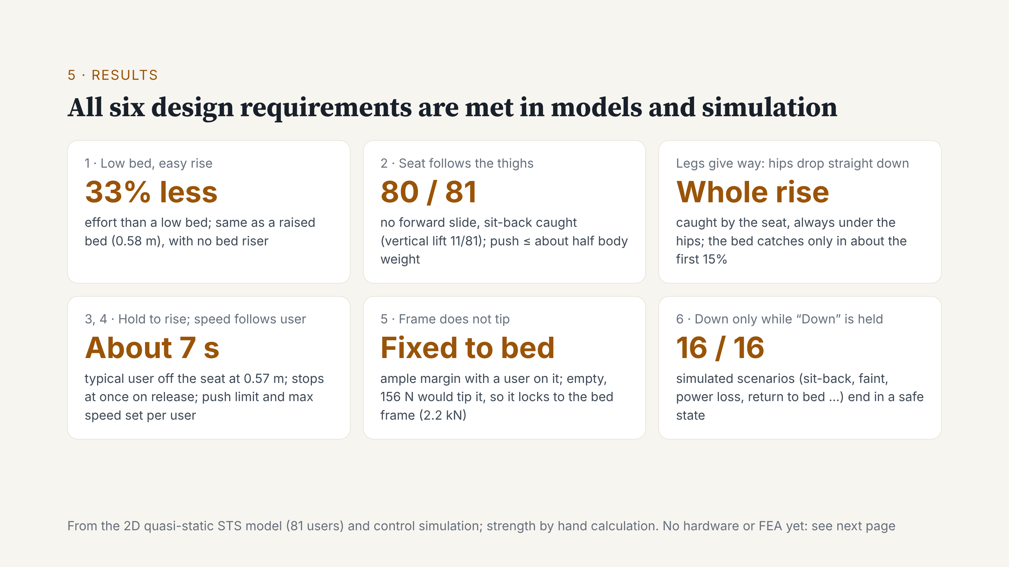
Notes:
Now the results. All six requirements are met in our models and simulation. Rising takes one third less effort than from a low bed, like a raised bed, but the bed stays low. For 80 of 81 users, the seat follows the thighs and catches a sit-back. If the legs give way, the seat catches the hips the whole way. A typical user is up in about 7 seconds, and the seat stops on release. Fixed to the bed, the frame does not tip. All 16 scenarios end safe. Next: what is not done yet.

Slide 17
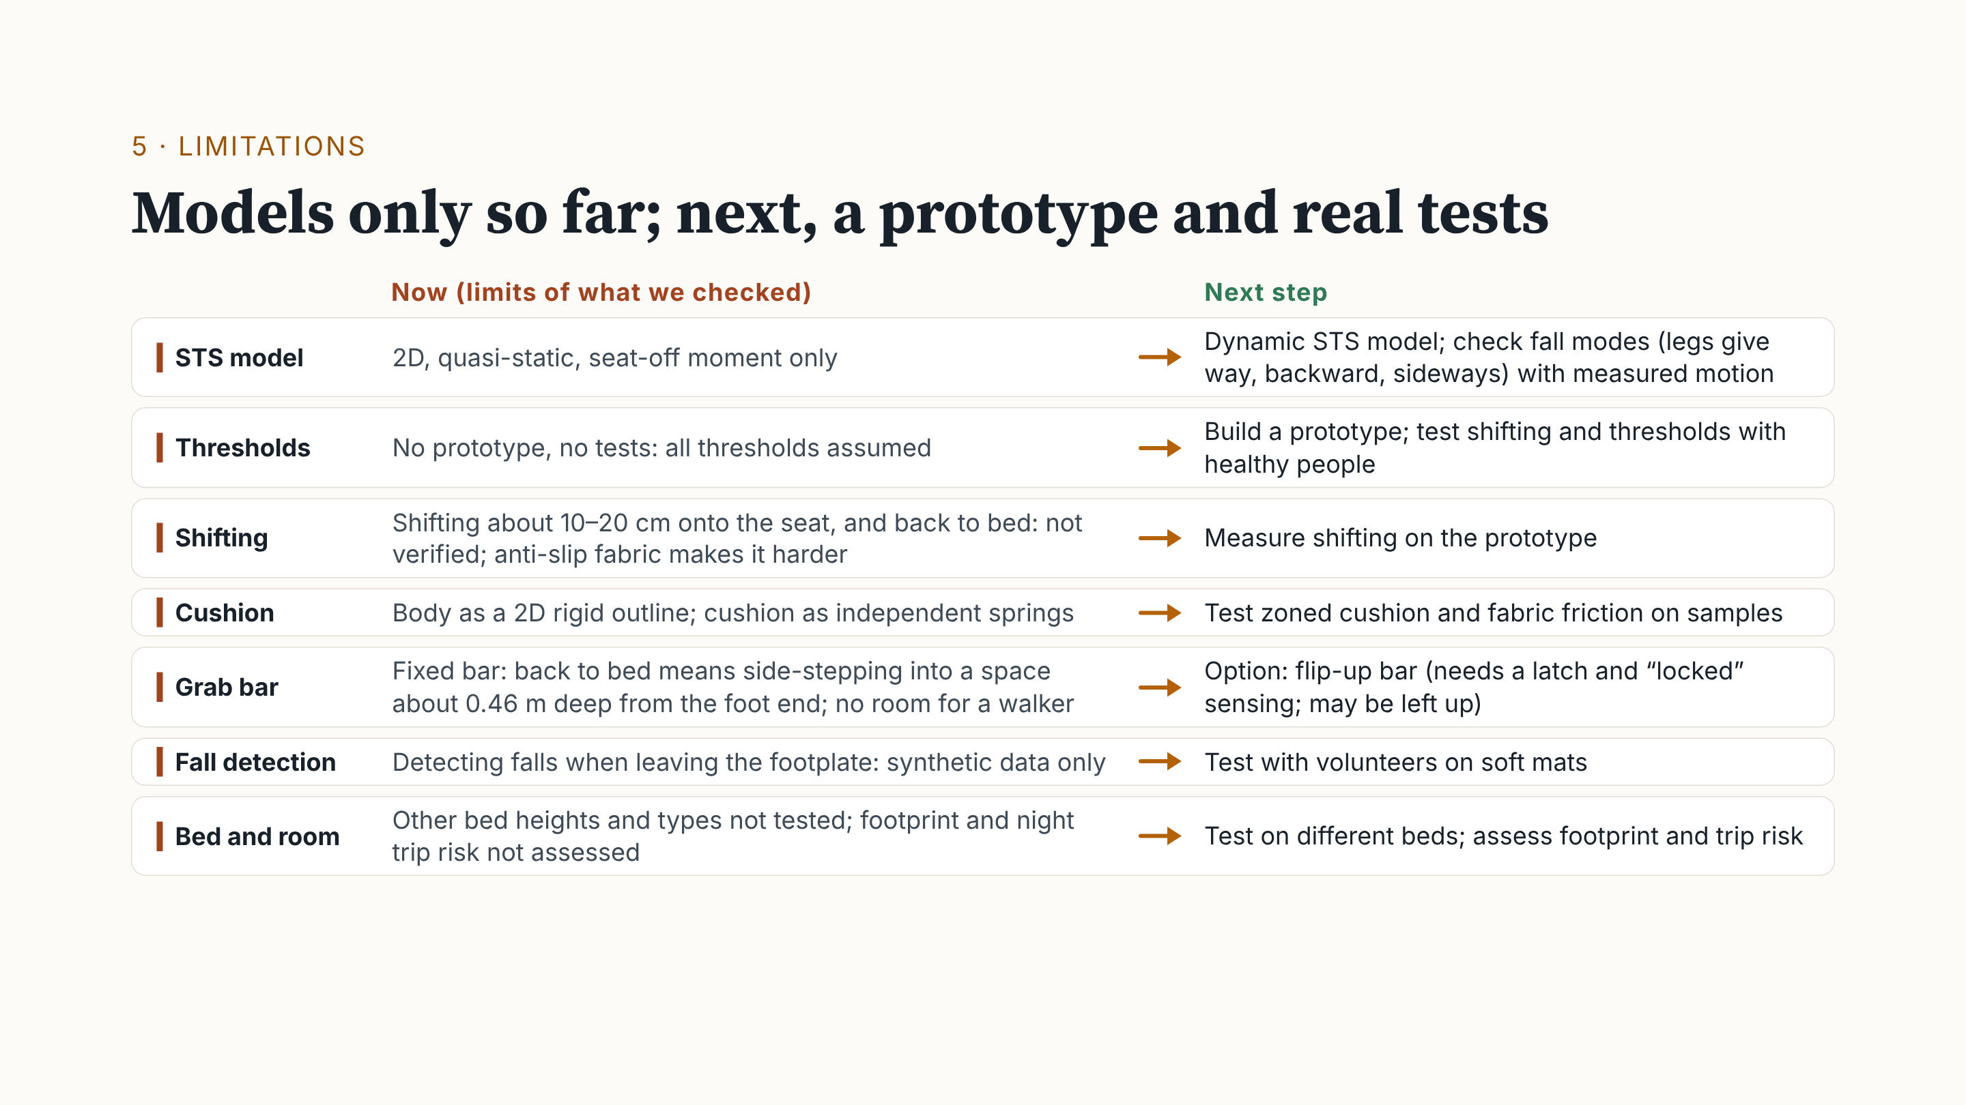
Notes:
On the left is where our checking stops. The STS model is 2D and quasi-static. With no prototype, every threshold is assumed. Shifting onto the seat and back to bed is not verified. On the right, the next steps: a dynamic model, a prototype tested with healthy people, cushion samples, a flip-up bar option, fall tests on soft mats, and different beds.

Slide 18
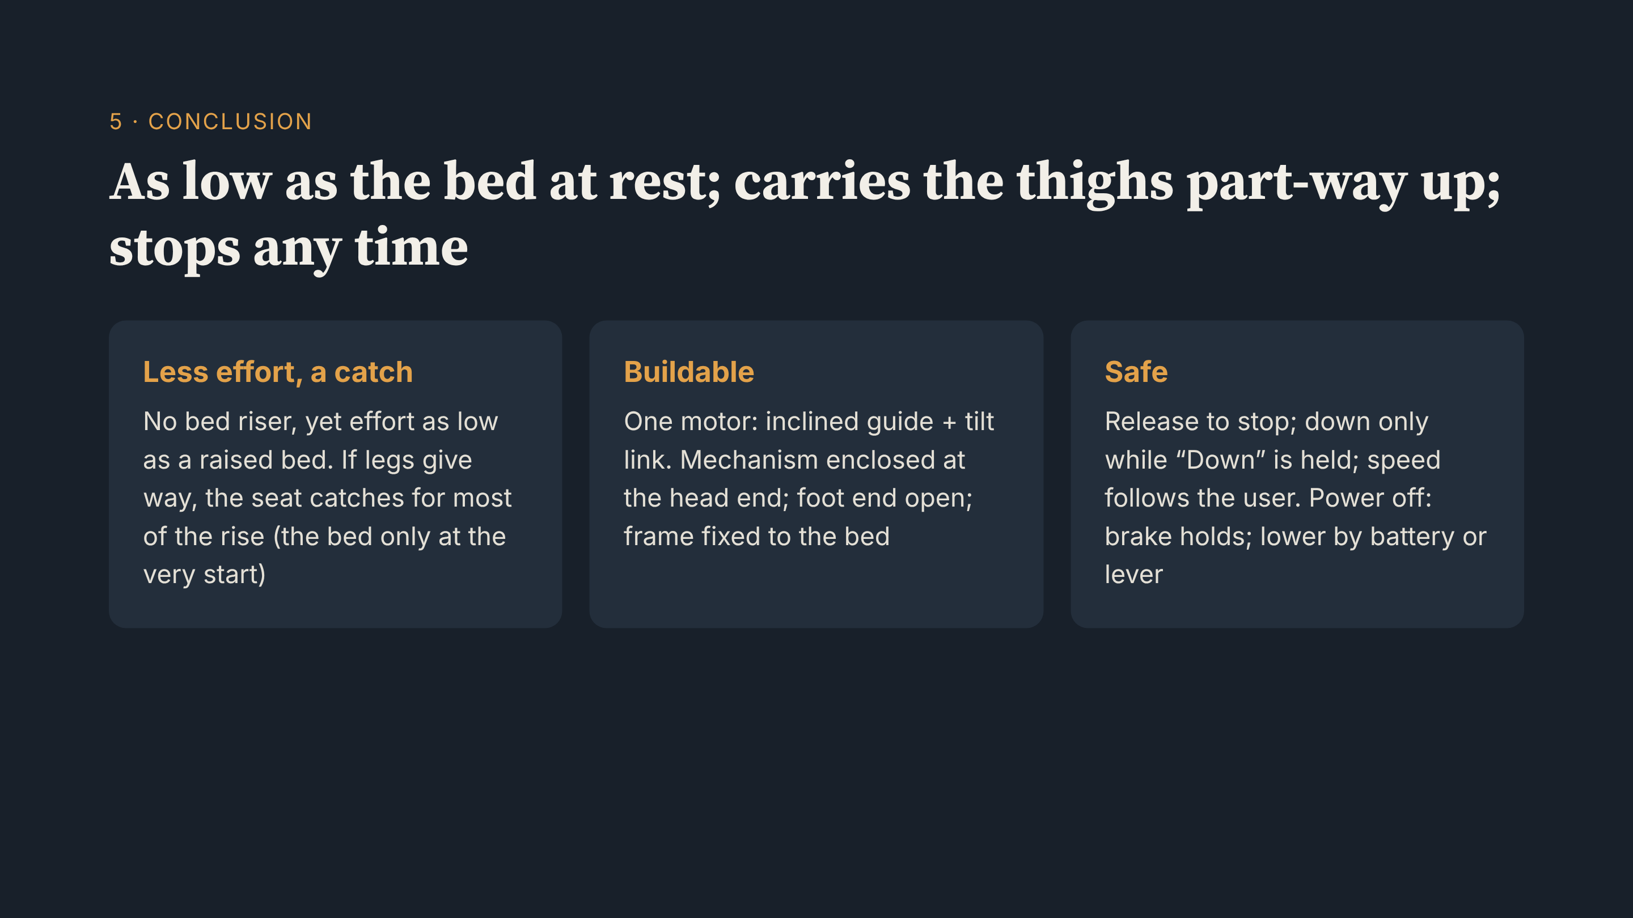
Notes:
To sum up: at rest, the seat is as low as the bed; during the rise, it carries the thighs part of the way. Effort is like a raised bed. More important, if the legs give way, the seat is under the hips for most of the rise. One motor drives an inclined guide and tilt link at the head end. Release to stop; down only while held; speed follows the user.

Slide 19
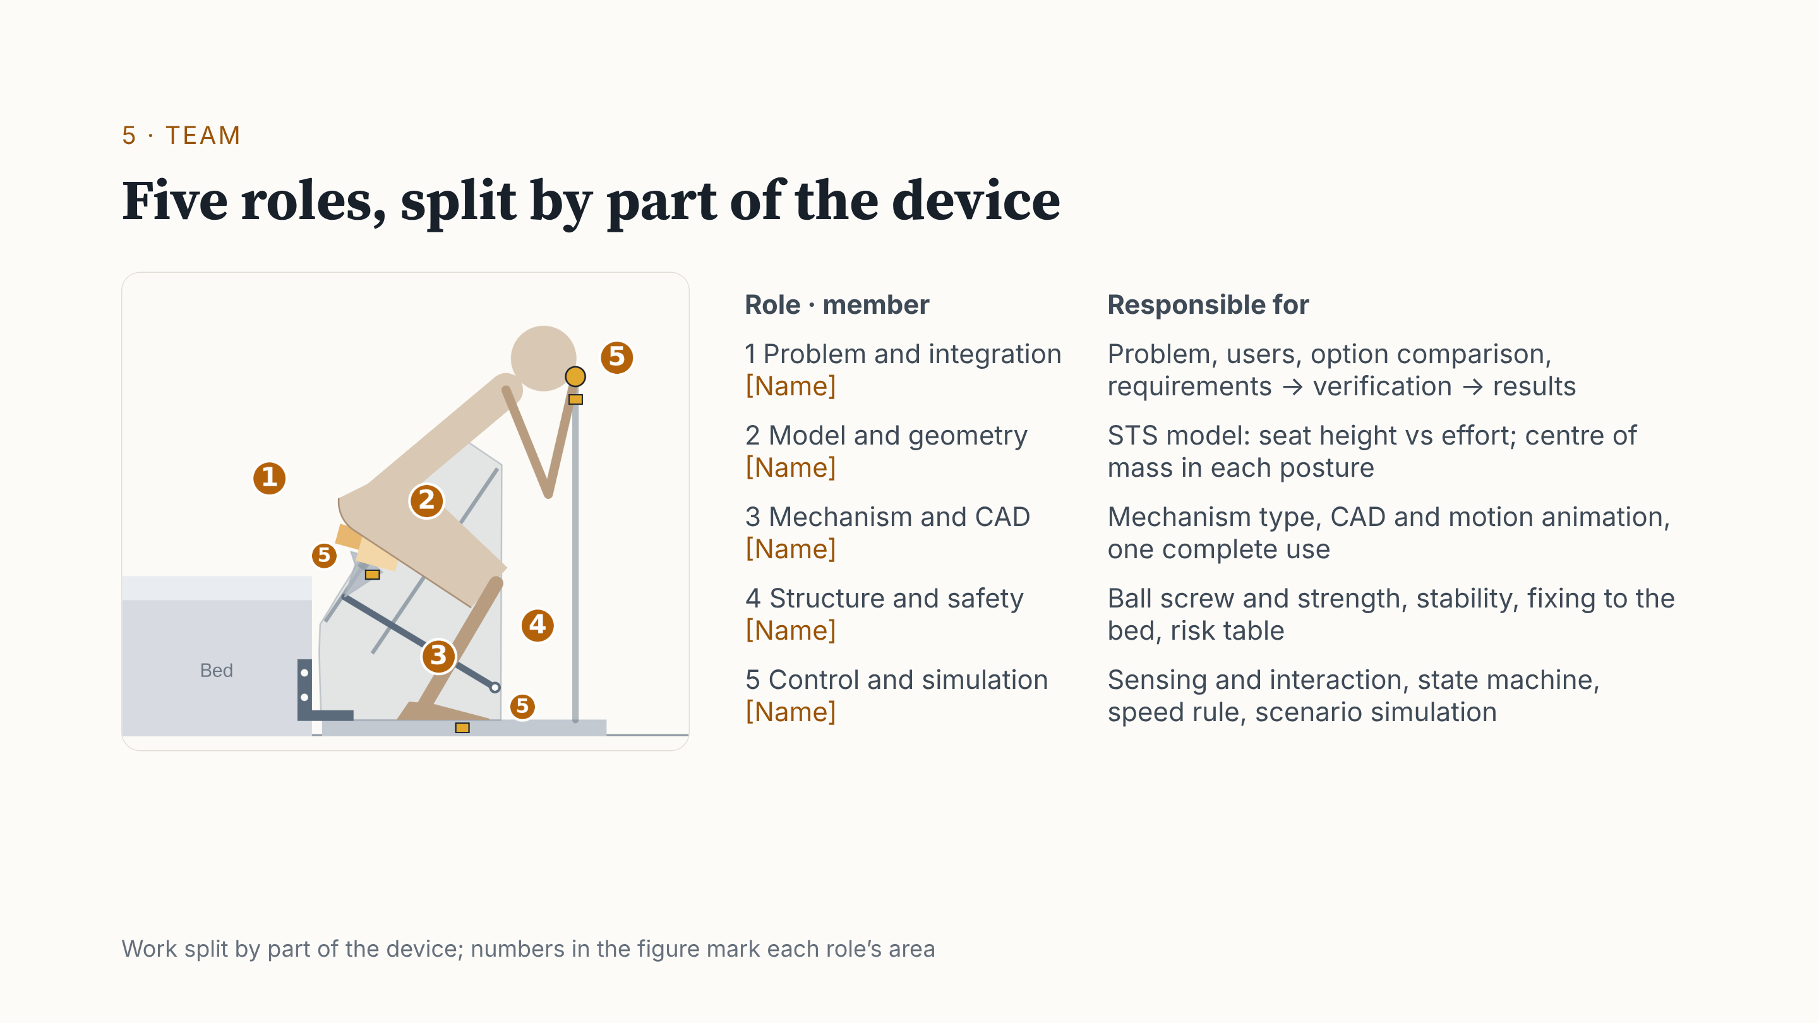
Notes:
Finally, the team. We split the work by part of the device: problem and integration, the STS model, mechanism and CAD, structure and risk, and sensing and control. The figure shows each role's area. Thank you.

Slide 20
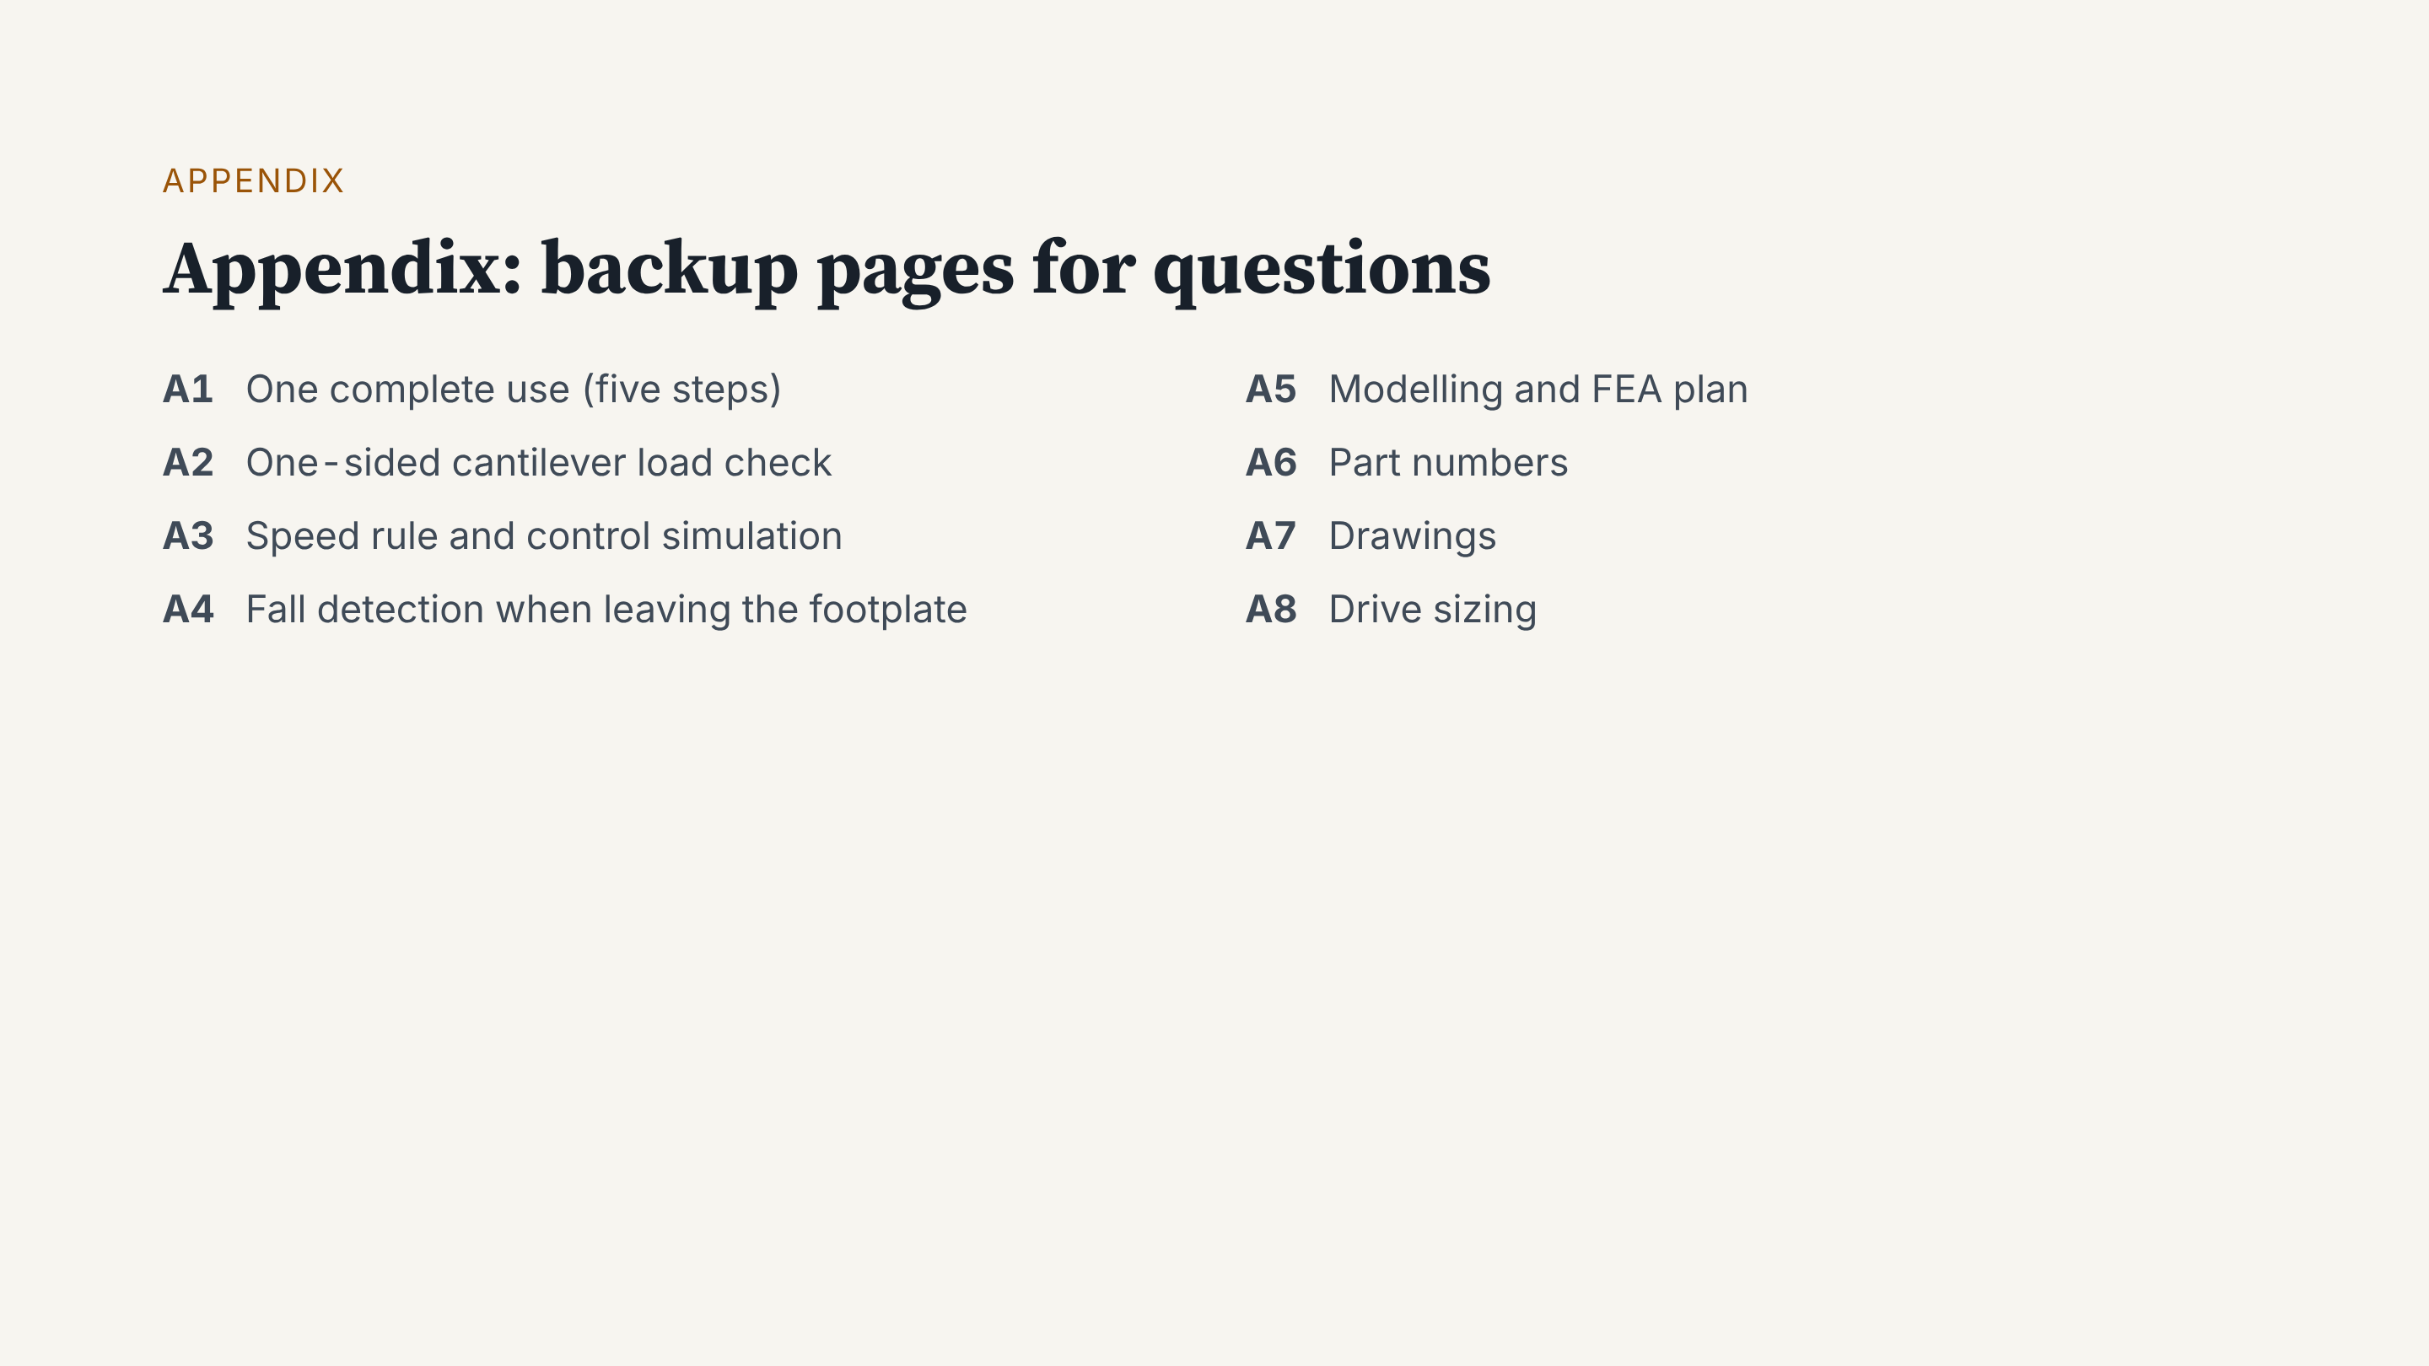
Notes:
We do not present the appendix. We open it when someone asks.

Slide 21
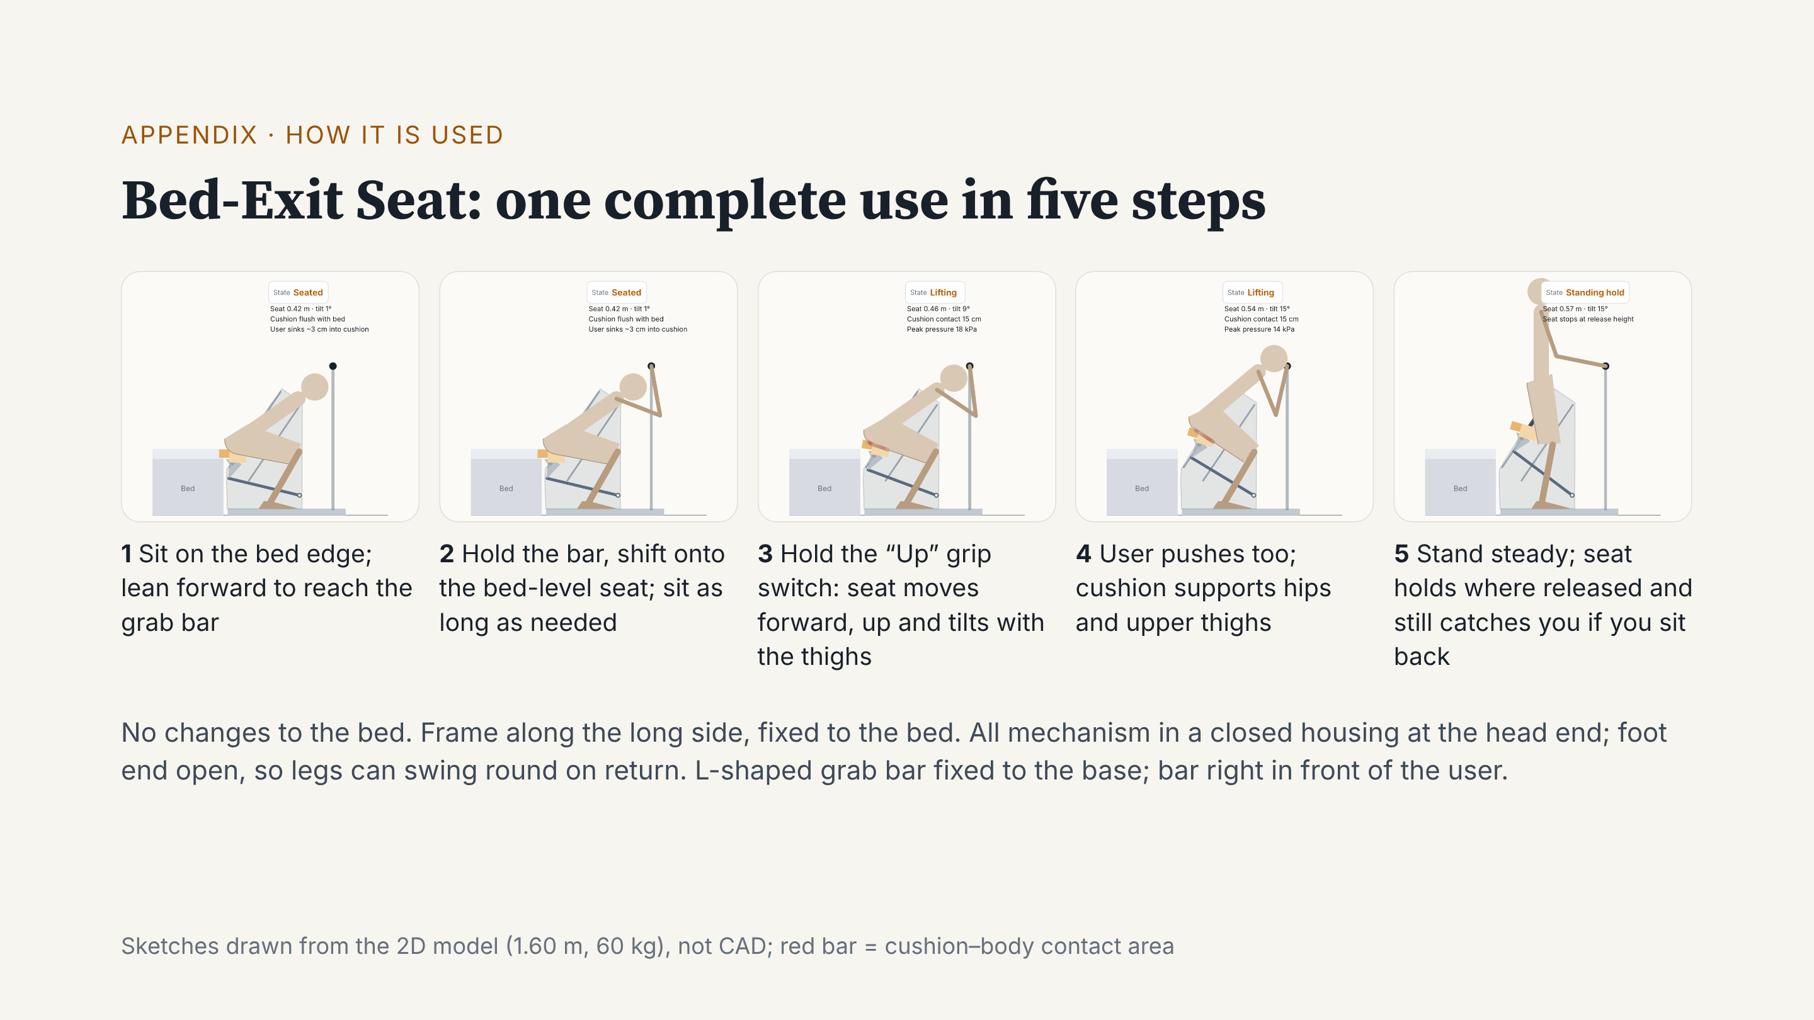
Notes:
Our design is the Bed-Exit Seat. It stands along the long side of the bed. The bed is not changed, and the frame is fixed to it. One use has five steps. First, sit on the bed edge and lean forward to hold the grab bar. Second, pull on the bar, shift onto a seat level with the bed, and sit as long as you need. Third, hold the “Up” grip switch. The seat does not push straight up: it moves forward and up with the thighs, and tilts forward a little. Fourth, the user also pushes, and the cushion supports the hips and upper thighs. Fifth, once standing, the seat stops where you let go, so it still catches a dizzy sit-back. The mechanism sits in a closed housing at the head end, and the foot end is open for the legs.

Slide 22
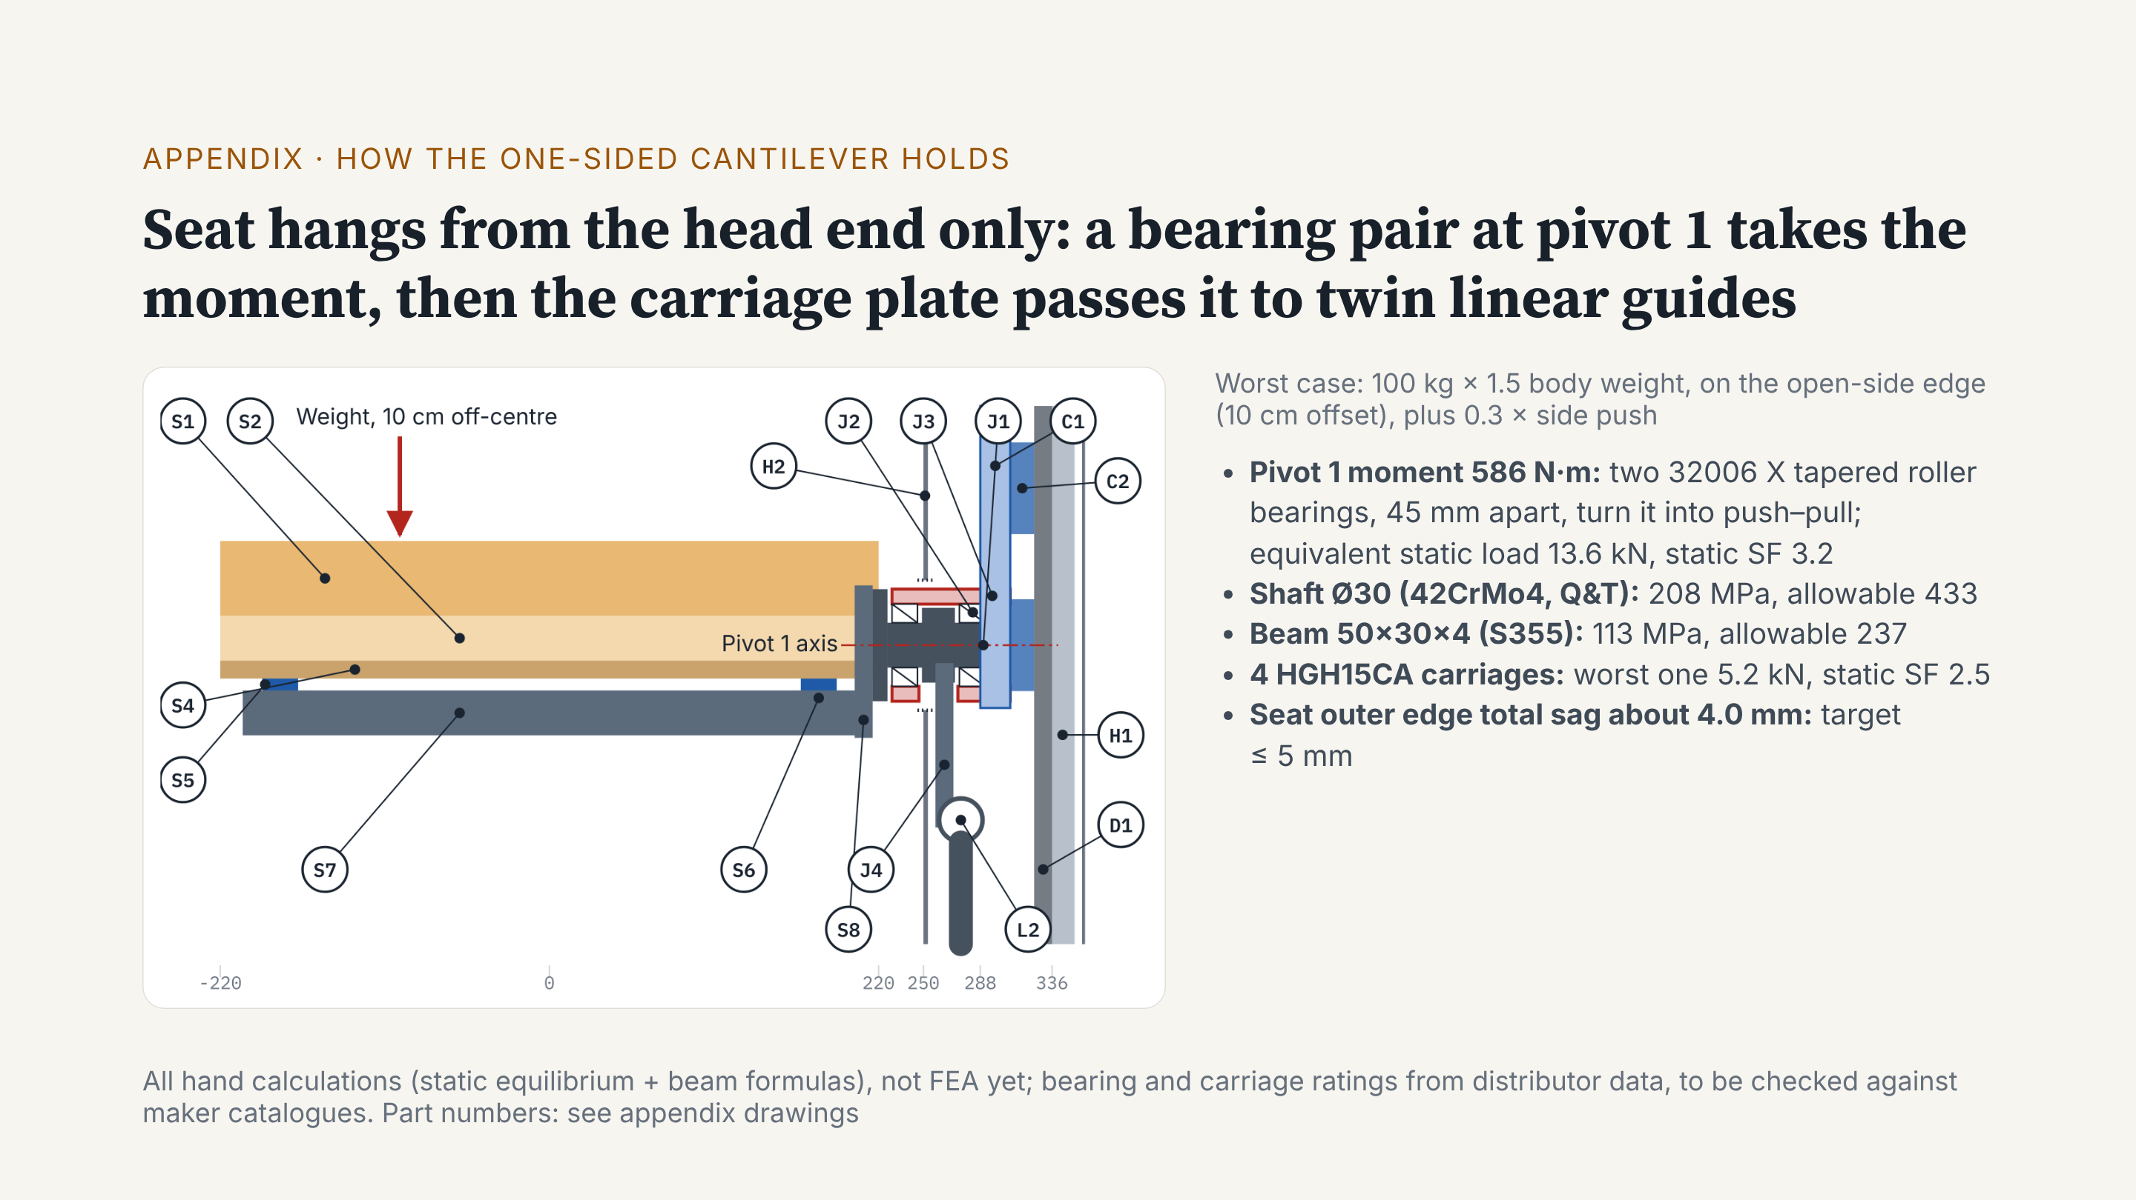
Notes:
Reviewers often ask: the seat hangs from one side only, so will it bend or twist? This page answers that. On the left is a section, seen from the foot end. A user sitting on the open-side edge is far from the support. This makes a moment of about 586 newton-metres at pivot 1. At pivot 1 we use a back-to-back pair of tapered roller bearings, 45 millimetres apart, in a 75 millimetre bearing housing welded to the carriage plate. The pair turns the moment into a push and a pull. The worst bearing sees about 13.6 kilonewtons, static safety factor 3.2. We first looked at a crossed roller bearing. But one strong enough is 120 millimetres across and leaves only 0.9 centimetres to the mattress, so we changed to the tapered pair. The shaft, beam and carriages all pass the same worst case. Total edge sag is about 4 millimetres. These are hand calculations; next, our CAD and FEA members will check them.

Slide 23
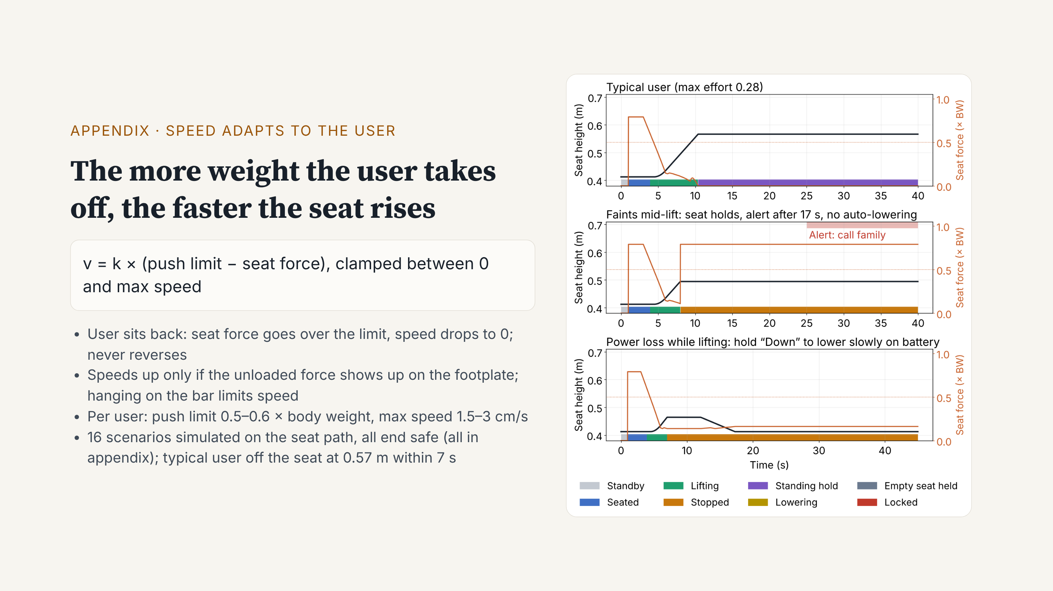
Notes:
How do we set the lift speed? We use one rule: speed equals k times the push limit minus the force the seat measures, kept between zero and the maximum speed. The more weight the user takes off, the faster the seat rises. If the user sits back, the speed goes to zero, and the seat never moves back. The unloaded force must also show up on the footplate before the seat speeds up, so leaning back onto the mattress does not lift the seat. The seat tilts, so the controller uses the tilt angle from the screw encoder to get the vertical force. If the user hangs on the grab bar, speed is limited. On the right are three of 16 simulated scenarios. A typical user leaves the seat at 0.57 metres in about 7 seconds. If the user faints and lets go, the seat stops and holds them, alerts and calls family after 17 seconds, and does not lower by itself. With a power loss, the brake holds, and holding “Down” lowers it slowly on battery.

Slide 24
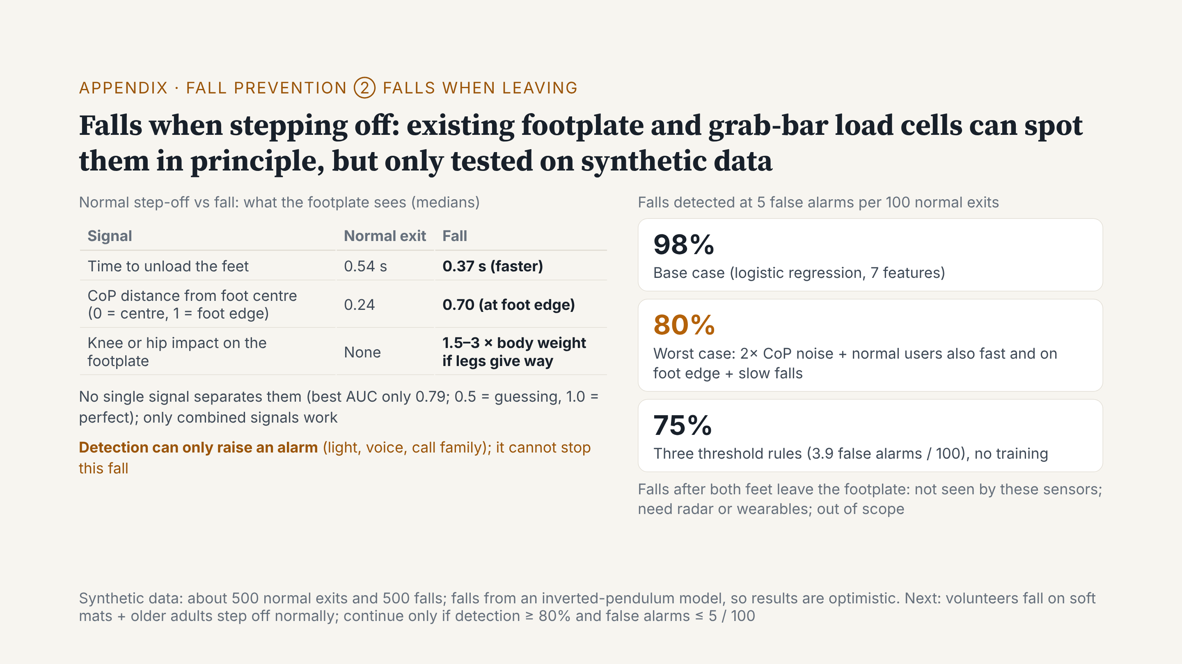
Notes:
Second fall question: if someone falls while stepping off the footplate after use, can we tell? We add no new sensors. We only use the four load cells in the footplate and the force sensing in the grab bar. In a normal step-off, the force leaves the feet slowly, and the centre of pressure stays in the middle of the standing foot. In a fall, the force goes faster, the centre of pressure first moves to the foot edge, and if the legs give way, the knees hit the footplate. No single signal is enough. Combined, on our generated data, at five false alarms per hundred normal exits, we detect about 98% of falls. Under very bad conditions, about 80%. Two points. First, we made this data with a model, so the result is optimistic. We must test real people: volunteers falling on soft mats, and older adults stepping off normally. We continue only at 80% detection and at most five false alarms per hundred. Second, detection can only raise an alarm, turn on lights and call family. It cannot stop this fall. A fall after the user has left the footplate is not seen, and is out of our scope.

Slide 25
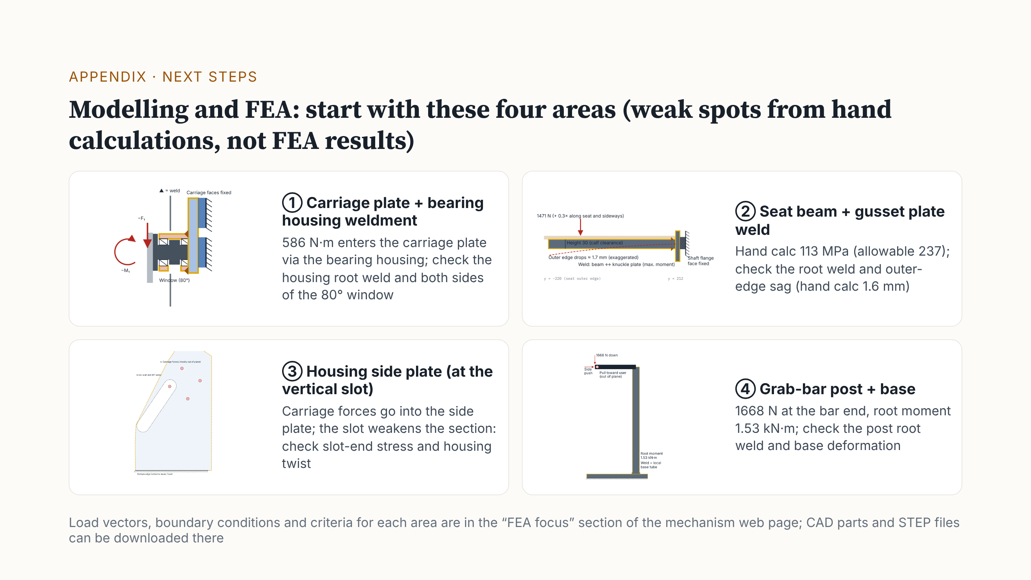
Notes:
Next, we hand over to our modelling and FEA members. Hand calculations found four areas to analyse first. Note: these are not FEA results yet. One: the carriage plate and bearing housing weldment. The seat moment enters the carriage plate here, so we check the weld at the housing root and both sides of the 80 degree window. Two: the weld between the seat beam and the gusset plate. The hand calculation gives 113 megapascals; we check the weld and the edge sag. Three: the housing side plate. It has a vertical slot for the arm, so we check stress at the slot ends and twist of the whole housing. Four: the grab-bar post and base. When a user hangs fully on the bar, the root moment is about 1.5 kilonewton-metres. Loads, boundary conditions and criteria are on the mechanism web page, with the part models and STEP files.

Slide 26
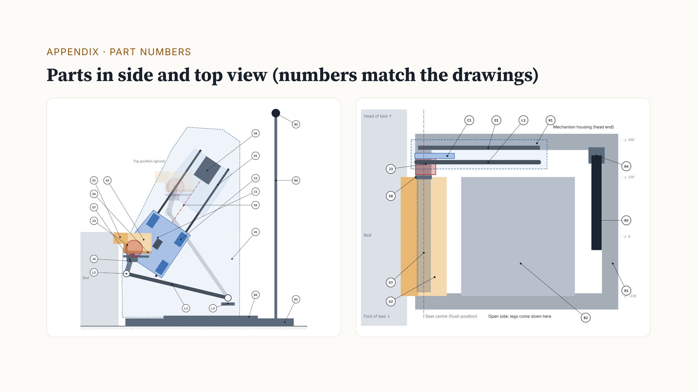
Notes:
Appendix: part numbers. S parts are on the seat, J are the pivots, C is the carriage plate, L is the tilt link, D is the drive, H is the mechanism housing, and B is the base. When asked about a part, we use this page to find it.

Slide 27
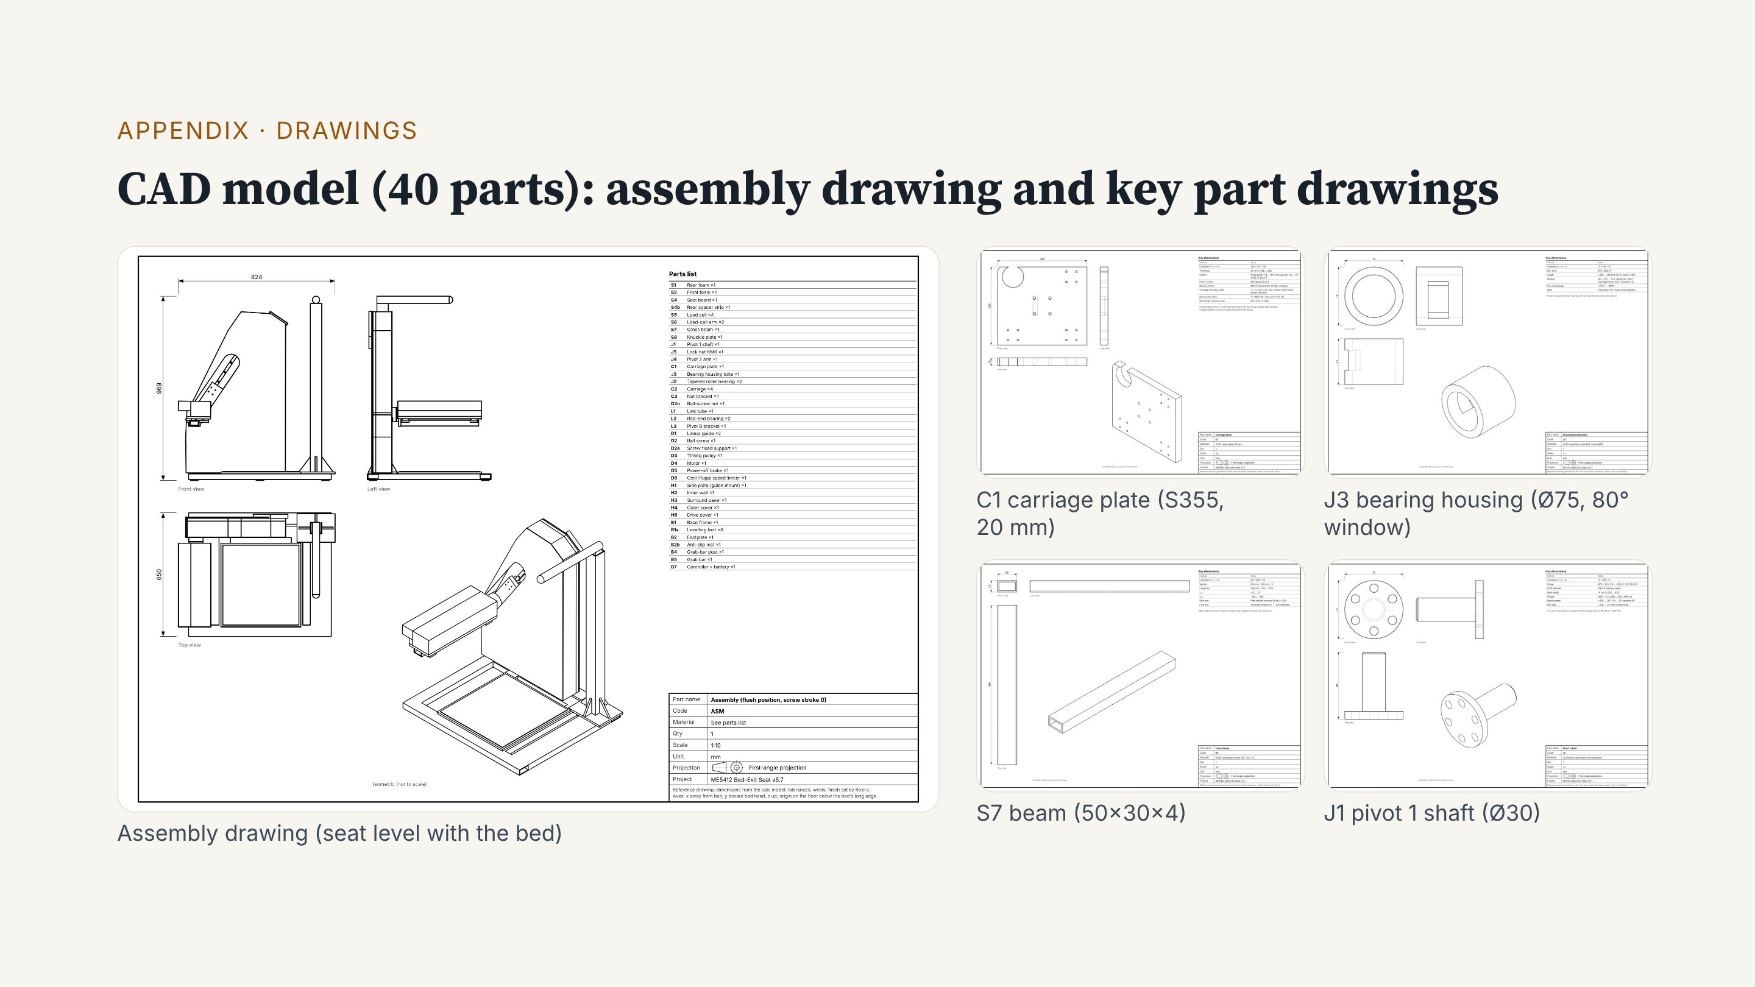
Notes:
Appendix: this is the assembly drawing of the CAD model and four key part drawings. All 23 part drawings, the STEP files and the 3D model are on the mechanism web page for download.

Slide 28
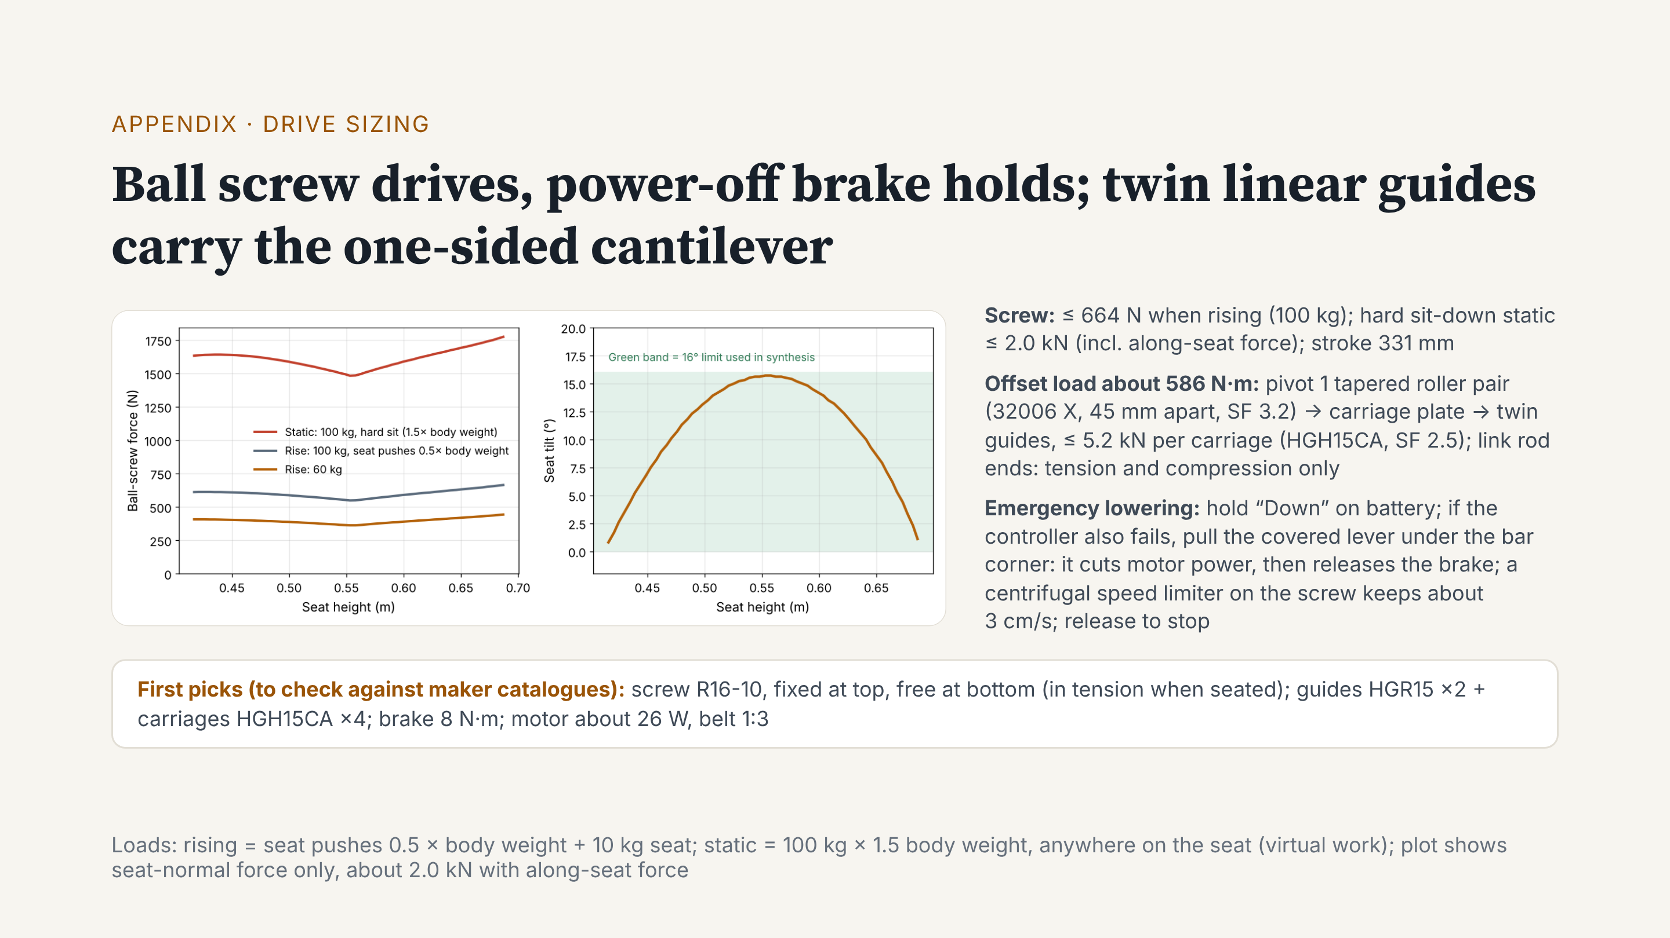
Notes:
This is our first drive sizing. A ball screw drives the carriage. The left plot is screw force: at most about 664 newtons when rising. If a 100 kilogram user sits down hard, with the force along the seat, it is about 2.0 kilonewtons. The right plot is seat tilt: never above 16 degrees. A ball screw is efficient but does not self-lock, so we add a power-off brake. It holds in normal use and when power fails. With no power, first hold “Down” to lower slowly on battery. If the controller also fails, pull the covered lever under the bar corner; you can reach it while seated. First it cuts motor power, then it releases the brake. The user’s weight lowers the seat, and a centrifugal limiter on the screw keeps the speed at about 3 centimetres per second, about 11 seconds in total. Let go and it stops. The seat is a cantilever, so the offset load gives about 586 newton-metres. This goes through pivot 1, with two tapered roller bearings 45 millimetres apart, then to twin guides with four carriages. The link has rod-end bearings, so it only sees tension and compression. Next, we check all parts against maker catalogues.

