Slide 1
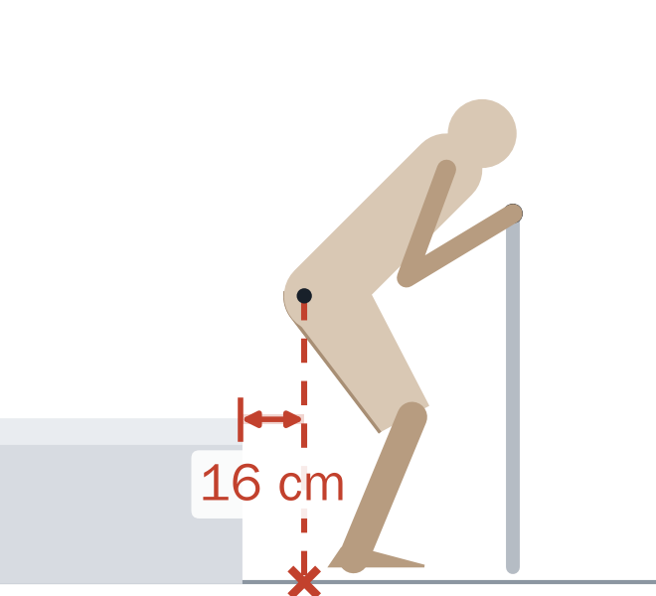
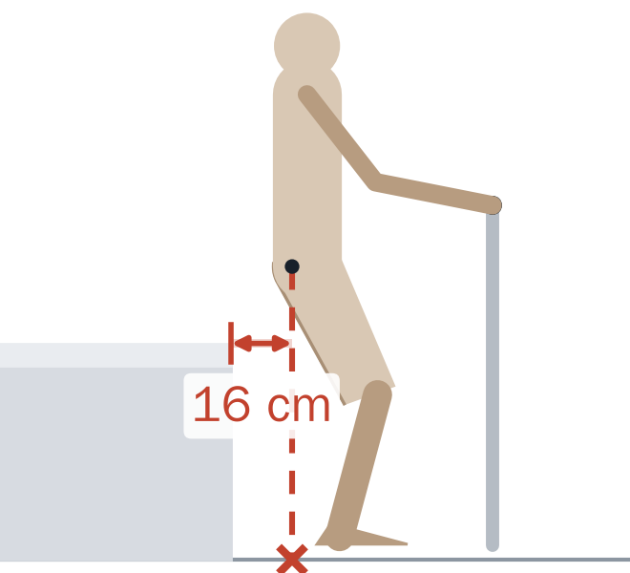
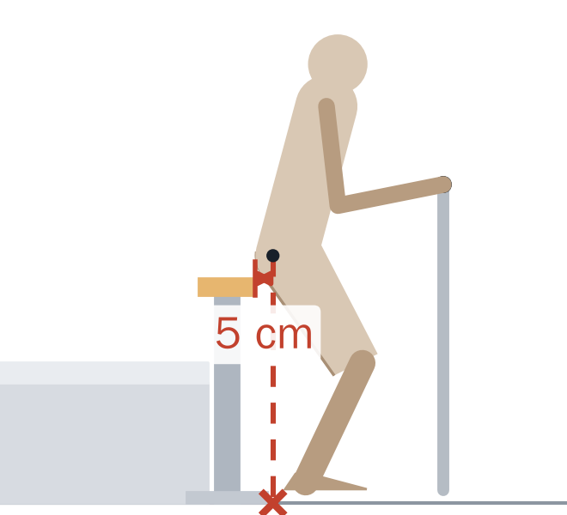
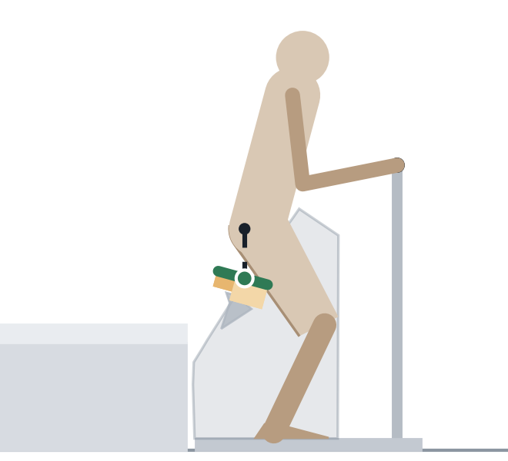
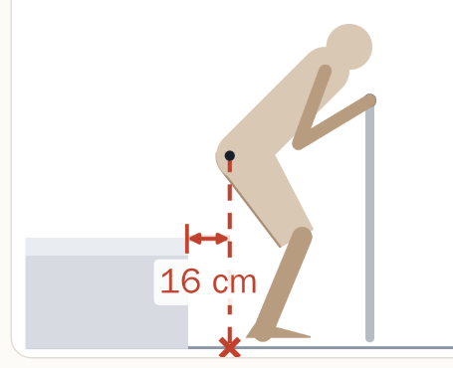
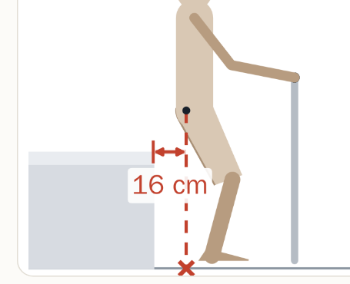
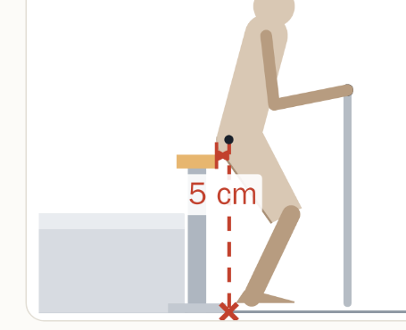
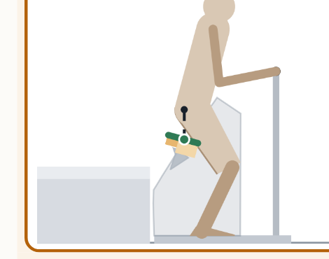
2 · COMPARISON
Same effort as a raised bed, better support if legs give way
If the legs give way:
● hips land on a support
✕ misses it; number = distance past the edge
(one moment, ~70% of the rise)
Low bed
0.42 m + L-bar
Raised bed
0.58 m + bar
Vertical-lift seat
lifts straight up
Bed-Exit Seat
curved path
Effort ÷ body weight
lower = easier
0.40
0.29
—*
0.26
Legs give way:
share of rise caught
14%
15%
43%
100%
Takeaway: about the same effort as a raised bed, but the seat stays under the hips for the whole rise.
2D quasi-static model, median of 81 simulated user configurations. * Vertical lift not rated for effort: most users slide forward off the seat (next slide: 11/81 pass).

Slide 2
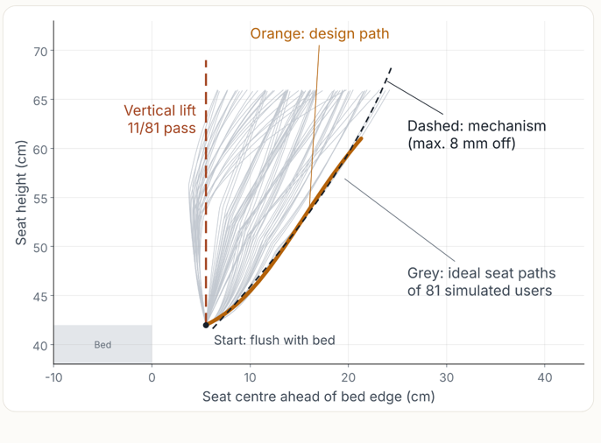
3 · MECHANISM DESIGN / 01 TRAJECTORY
Path first: follow the thigh, not just lift the seat
Seat-centre movement • schematic side view
VERTICAL LIFT
CURVED PATH
11 / 81
VERTICAL
LIFT
simulated users pass
CURVED SEAT PATH
80 / 81
Up
27.4 cm
simulated users pass
One motor → one preset path
Bed at 0.42 m
Forward +18.5 cm
Selected to keep up with users whose hips move forward earliest.
Grey paths illustrate user-to-user variation; orange is the shared design concept.
Model: 81 configurations (3 heights × 3 body sizes × 3 rising styles × 3 foot positions). Pass = ≤2 cm sliding + supported sit-back; 2D quasi-static.
Notes:
We started with the required motion rather than a mechanism. In the 2D quasi-static sit-to-stand model, the hip moves forward as well as upward, so a purely vertical seat loses contact with the thigh. Only 11 of 81 modeled configurations pass with vertical lifting. The 81 cases combine three heights, three buttock thicknesses, three rising styles, and three foot positions. Each person's ideal trajectory keeps support near the hip–thigh junction. The initial tilt constraint was no more than 15 degrees; the final mechanism animation reaches about 15.7 degrees, so distinguish the design target from the result if asked. With one motor, the seat follows one predefined path. The reference was chosen among 18 early-forward-moving cases to support the most forward users. It passes 80 of 81 modeled cases, defined as no more than 2 cm of forward sliding plus sufficient support when sitting back. The reference trajectory ends around 0.61 m and is extended along the guide to 0.69 m for cushion compression. Illustration is schematic, not a numerical plot of all 81 trajectories. Exact trajectories were shown in the previous source version.

Slide 3
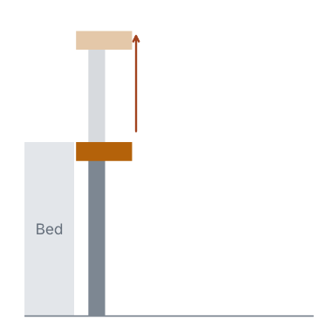
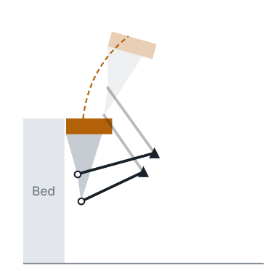
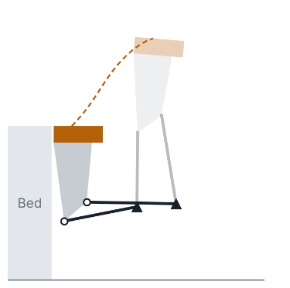
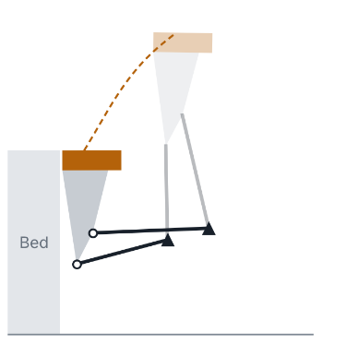
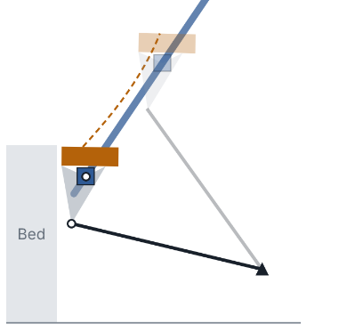
3 · MECHANISM DESIGN / 02 SELECTION
Why we chose the inclined guide + tilt link
Five candidates assessed for trajectory fit, mechanical clearance, and actuator loading.
CANDIDATE
CANDIDATE
CANDIDATE
CANDIDATE
SELECTED
Vertical lift
Under-seat four-bar
Bilateral four-bar
Single-side four-bar
Inclined rail + link
11 / 81
55* / 81
81* / 81
70 / 81
80 / 81
Loses thigh support
Shin interference
Blocks return to bed
High bearing load
Chosen: open foot end
SELECTED DESIGN
8 mm
Max. trajectory deviation
1.8 kN
Actuator static load
0.89 m
Housing height (trade-off)
* Earlier four-bar pass counts were not rerun after the final path correction. Static-load comparison: 100 kg × 1.5 body weight.
Notes:
We compared five mechanisms using the same overall design requirements and the 81 modeled users. The five concepts were vertical lift, an under-seat four-bar, a four-bar on both sides, a four-bar on the bed-head side, and an inclined guide rail plus tilt link. A vertical lift cannot follow the thighs, while an under-seat four-bar risks shin interference. The bilateral four-bar blocks the return to bed and needs two synchronized actuators. The unilateral four-bar has very high concentrated bearing loads, about 25 kN. The inclined guide plus tilt link achieved 80/81 users passing, 8 mm maximum seat-centre deviation from the reference path, and 1.8 kN static actuator loading in the comparison. It also keeps the bed-foot side open and uses one actuator. Its compromise is the tall 0.89 m housing. Important caveat: 55* and 81* are results before the final whole-rise path correction; those alternatives were rejected for other reasons and were not rerun. Loads in the comparison are based on a 100 kg user with a 1.5 factor.

