Slide 1
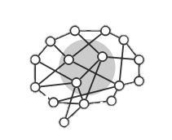
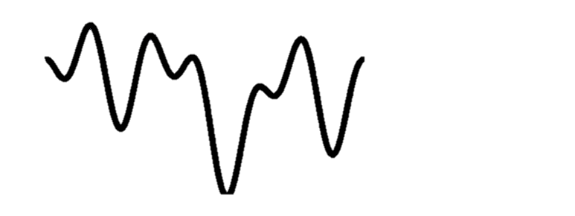
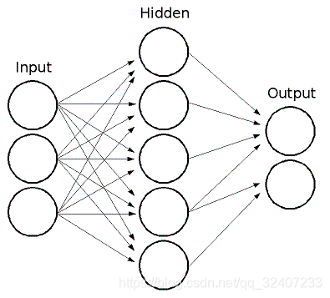
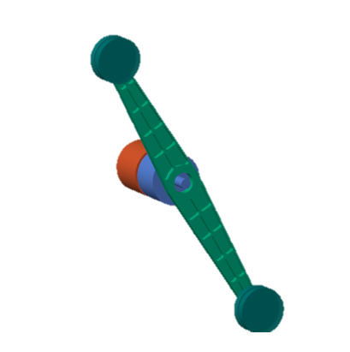
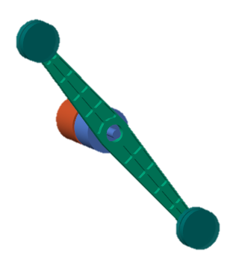
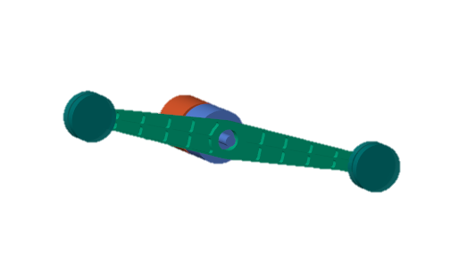
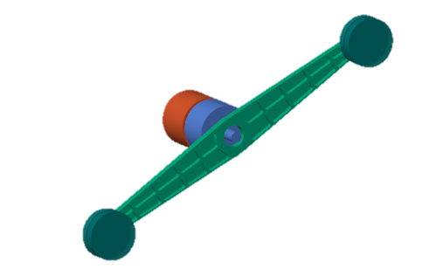
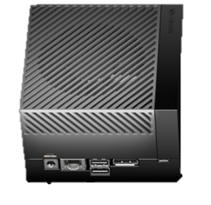

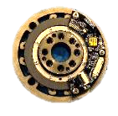
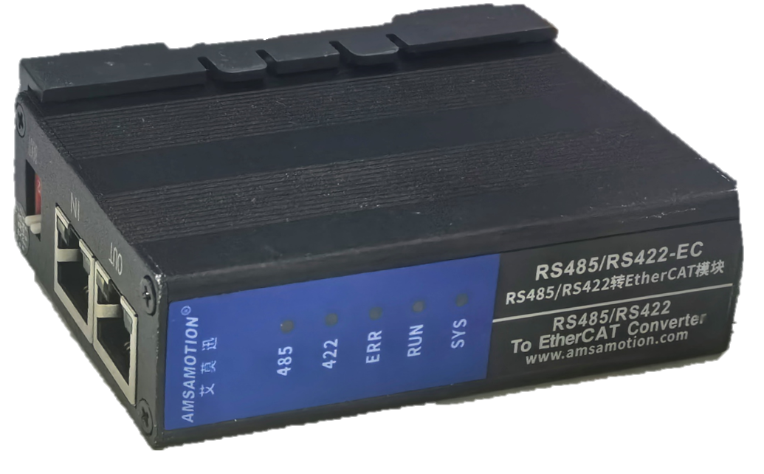
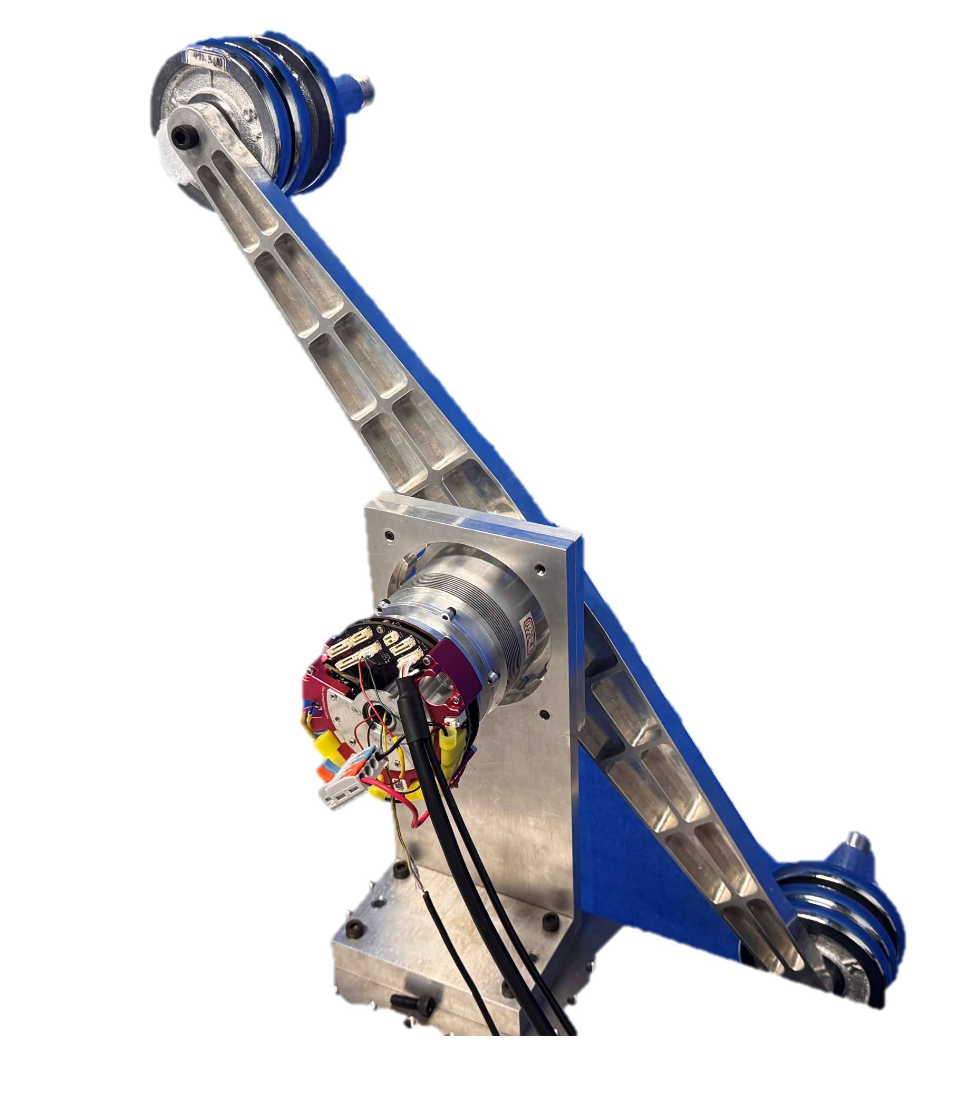
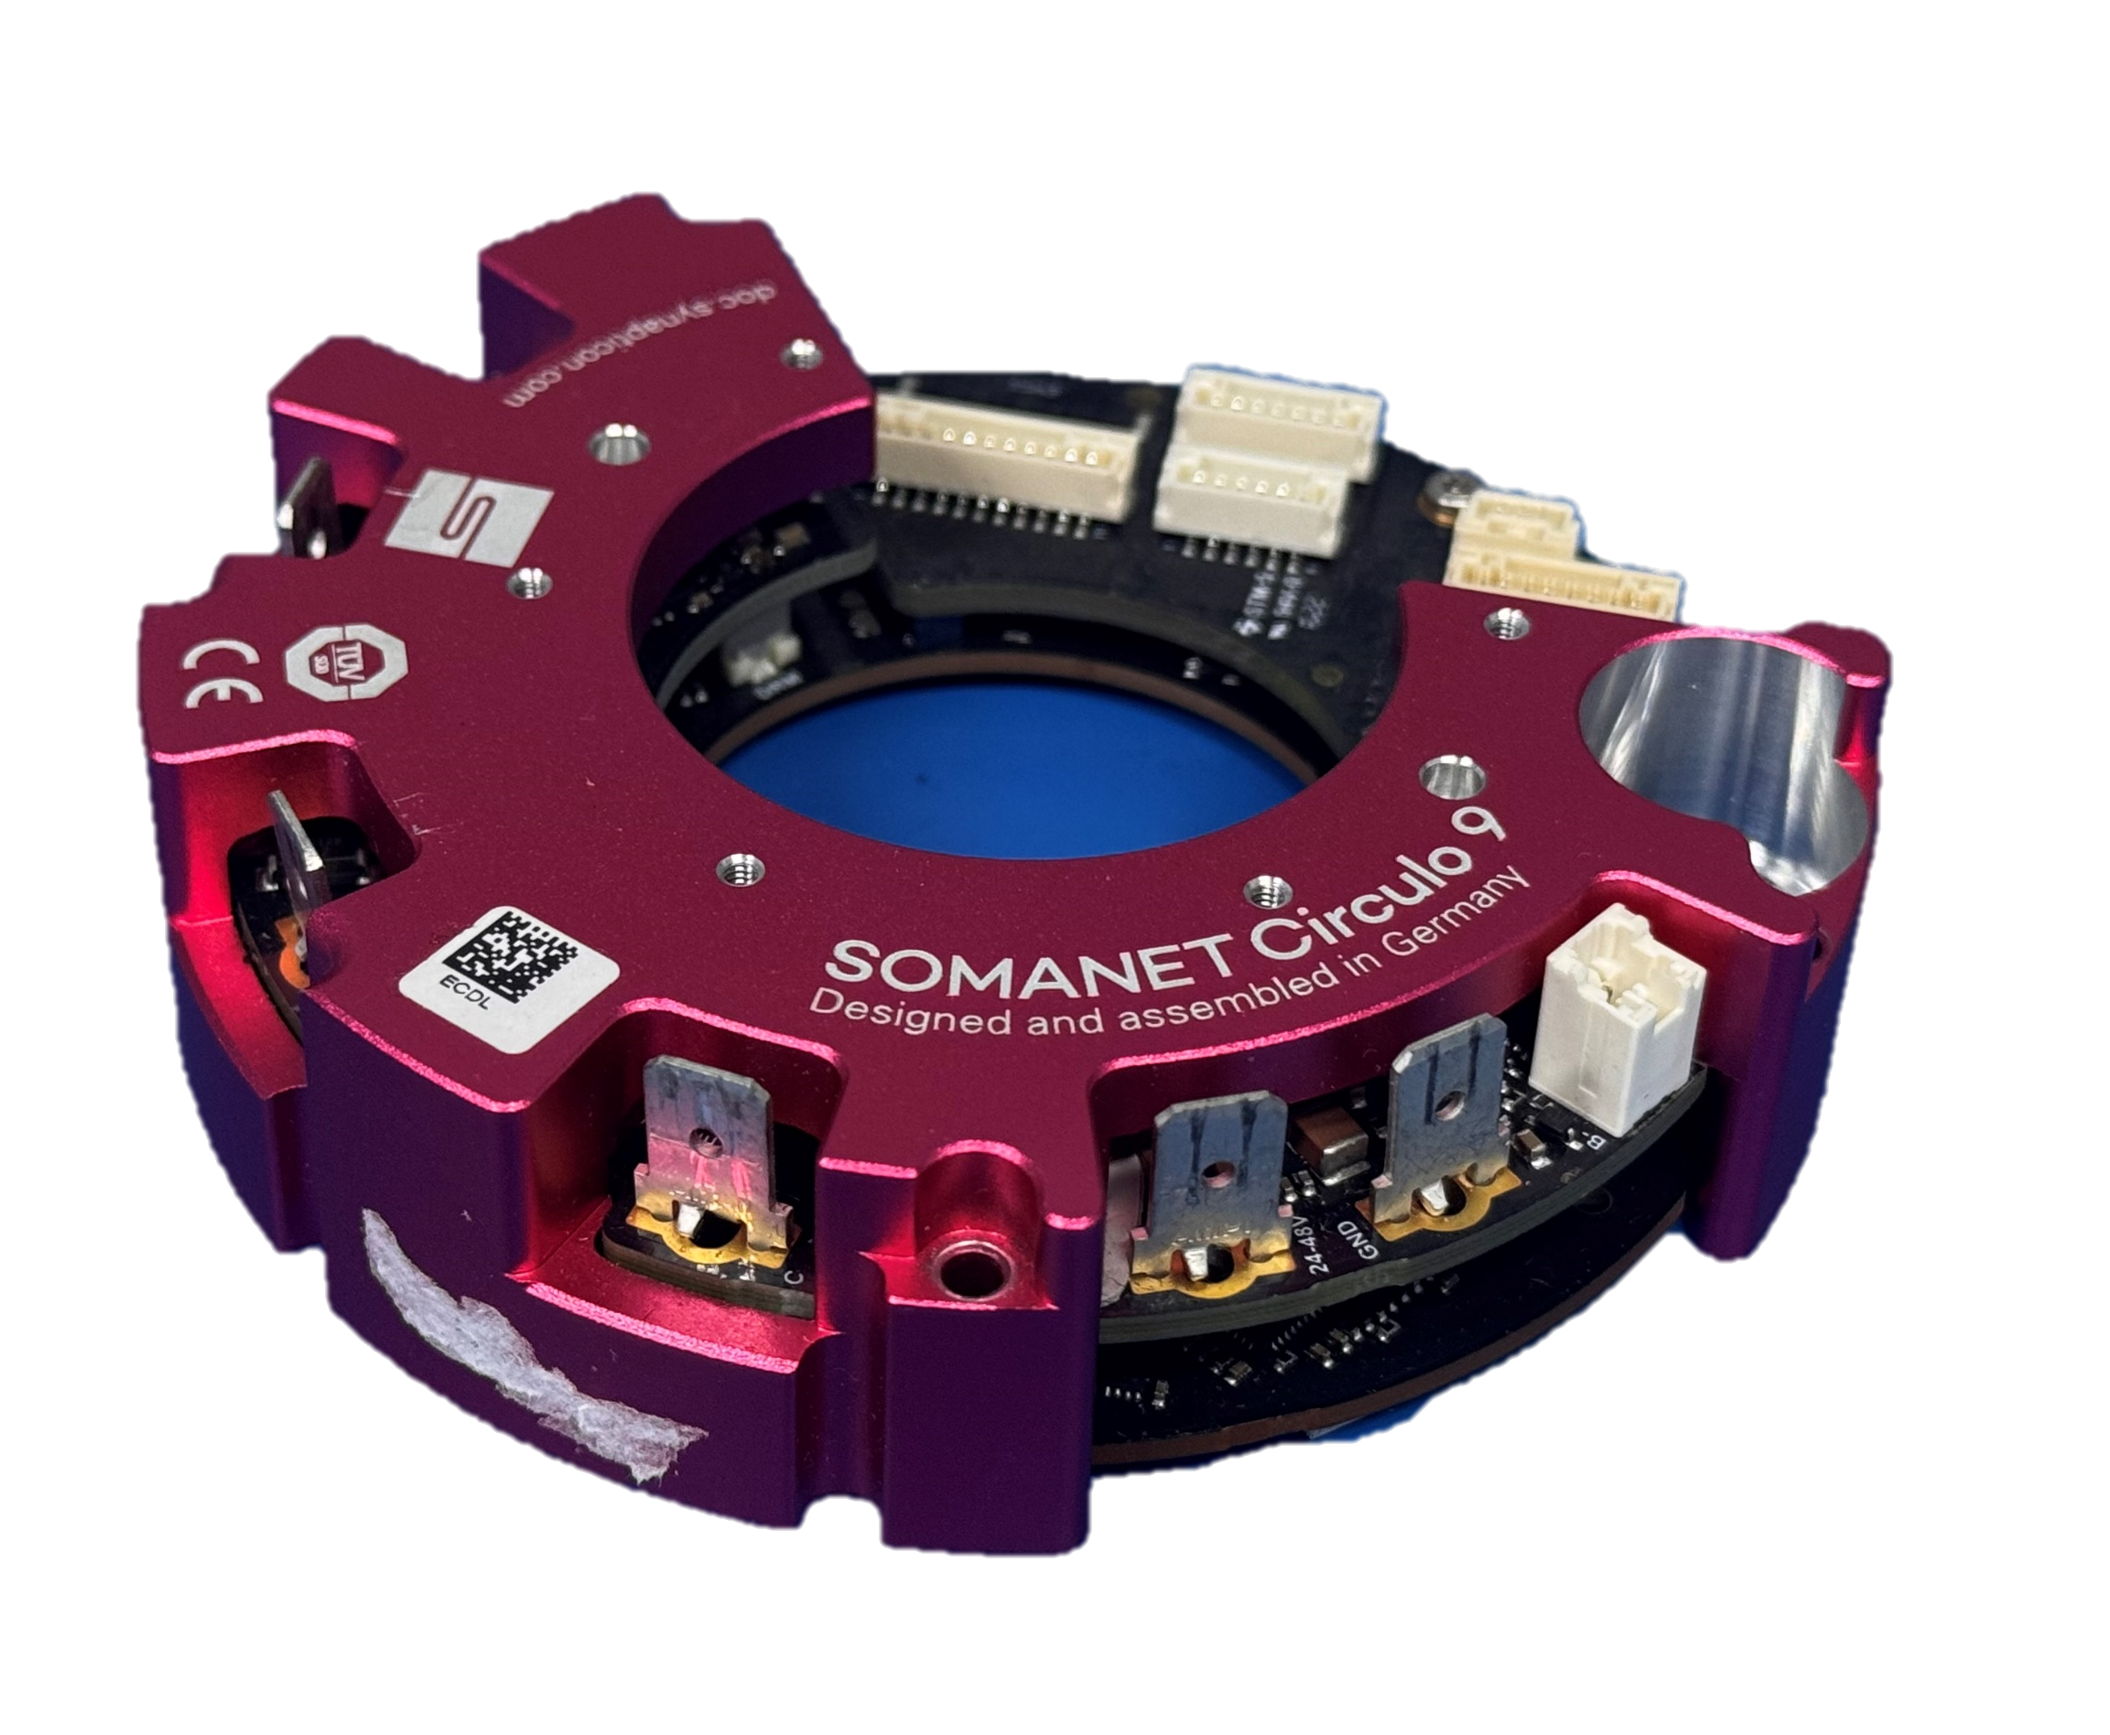
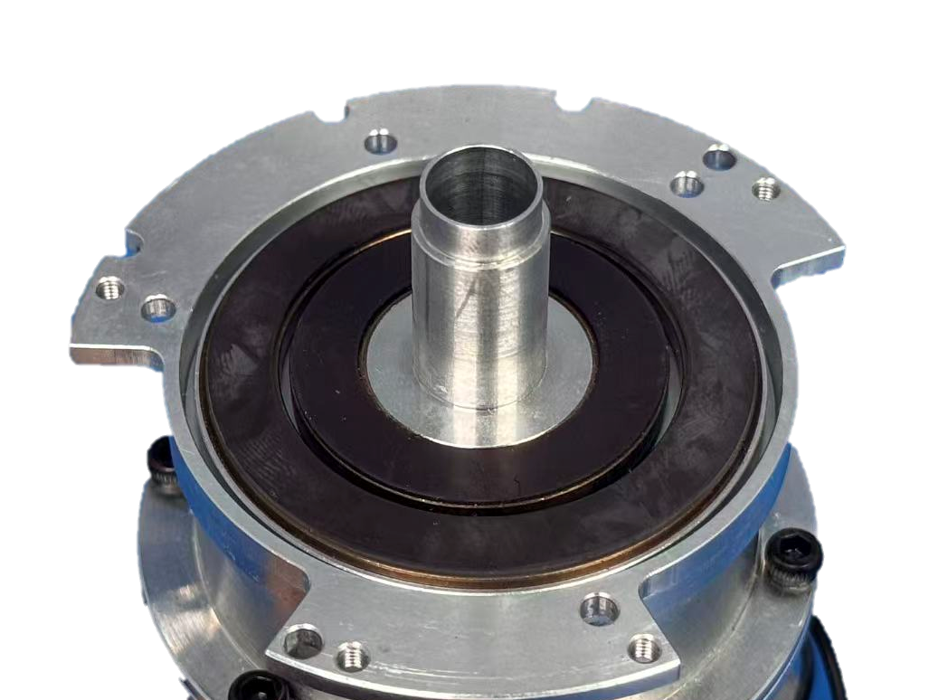
Privileged observations
$$o_{t}^{priv}=[x_{t}, J_{l}, E_{imp} ]$$
Simulation Environment
Phase 1 Privileged teacher
PPO teacher
Domain randomization
Trajectory Generation
$$x_{t}$$
Inertia variation
frictional variation
Spring stiffness fluctuation
$$J_{l}$$
$$a_{t}=τ_{m}$$
Actions
$$z_{imp}$$
$$E_{imp}$$
Parallel running
Multi workers in mujoco
SEA Joint
Loading Bar
Implicit Feature Encoder
Control Policy($$π$$)
Dataset
1,200 offline episodes
4 DAgger rounds × 240 episodes
Teacher rollouts + DAgger
H_t = [x_t, ..., x_{t-99}]
Phase 2
Student Distillation
Distillation loss
Phase 3
Inertia Disc
Fast: Attention v2
Stem | 20 / 100 steps
$$x_{t}$$
Deployment
$$x_{t}$$
20
J_s, J_l
Real-world Platform
Bounded heads
Cross-attn
Safety strategies
$${\hat{J}}_{l}$$
Torque
Monitor
Overlimit
Shutoff
Temperature
Monitor
100
J in [Jmin,Jmax]
$$𝓗_{t}$$
η_t
$$u_{t}=τ_{m}$$
Jetson AGX Orin
EtherCAT
Single real-time worker
Slow: TCN
Context: 100 steps (500 ms)
$${\hat{z}}_{imp}$$
Control policy
from Phase 1
Spring encoder
EtherCAT interface
Motor Driver
Motor/load encoders
SEA joint & loading bar
Real observations
x_t = [e_l, e_dot_l, e_m, e_dot_m, θ_s, θ_dot_s, θ_d, θ_dot_d, u_{t-1}]^T

