Slide 1
CTRIP
海外招聘页面功能
By tony

Slide 2
页面功能预览
目录
页面功能详解
页面布局展示
Contents

Slide 3
页面功能预览
国际发展战略
招聘职位
关于携程
海外招聘宣传视频

Slide 4



关于携程
公司文化
福利待遇
晋升机制
员工活动
公益宣传
携程介绍
业务介绍
发展历史
公司大事记
高管介绍
人才项目介绍
国际管理培训生
企业大学
轮岗机制
培训机制
02
01
03
CTRIP

Slide 5
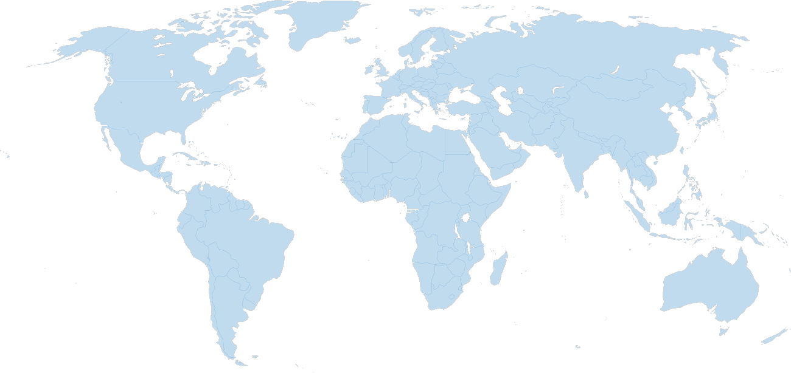
国际发展战略
国际分公司介绍
介绍携程已在海外设立的分公司及办事处，业务模式，规模及发展方向。
国际发展战略
介绍携程将要在国际哪些城市设立分公司，业务发展方向及国际化战略方向。

Slide 6

海外招聘宣传视频
海外招聘视频介绍
GLP项目介绍
国际高校宣讲及面试过程
硅谷人才交流会
海外招聘渠道签署
国际分公司视频介绍等

Slide 7
招聘职位
应聘岗位及报名：
1 简历投递方式
2 简历格式及要求
3 信息反馈介绍
海外招聘职位需求列表：
1 base海外工作外籍及国内员工
2 base总部及分公司需招聘海外人员
海外招聘人员需求
招聘流程
操作指南
岗位描述
JD：
1 岗位职责及任职资格介绍
2 工作地点及需求人数
3 汇报关系及部门情况
4 薪资范围及特殊技能要求
海外招聘流程：
1 海外招聘职位面试流程介绍
2 网申-笔试-测评-面试-Offer

Slide 8




2-1 Enter Your Title
You can click here to enter your text. You can click here to enter your text. You can click here to enter your text.
You can click here to enter your text. You can click here to enter your text. You can click here to enter your text.
You can click here to enter your text. You can click here to enter your text. You can click here to enter your text.
You can click here to enter your text. You can click here to enter your text. You can click here to enter your text.

Slide 9

2-2 Enter Your Title
Click here to add your title.
You can click here to enter your text. You can click here to enter your text. You can click here to enter your text. You can click here to enter your text. You can click here to enter your text.
Click here to add your title.
You can click here to enter your text. You can click here to enter your text. You can click here to enter your text. You can click here to enter your text. You can click here to enter your text.

Slide 10
03
Part Three
Enter Your Title

Slide 11




3-1 Enter Your Title
Add your title
Add your title
Add your title
Add your title
You can click here to enter your text.
You can click here to enter your text.
You can click here to enter your text.
You can click here to enter your text.

Slide 12



3-2 Enter Your Title
Add your title
Add your title
Add your title
Add your title
You can click here to enter your text. You can click here to enter your text. You can click here to enter your text.
You can click here to enter your text. You can click here to enter your text. You can click here to enter your text.
You can click here to enter your text. You can click here to enter your text. You can click here to enter your text.
You can click here to enter your text. You can click here to enter your text. You can click here to enter your text.

Slide 13
3-3 Enter Your Title
70%
You can click here to enter your text. You can click here to enter your text. You can click here to enter your text.
55%
Add your title
You can click here to enter your text. You can click here to enter your text. You can click here to enter your text.
40%
You can click here to enter your text. You can click here to enter your text. You can click here to enter your text.

Slide 14
04
Part Four
Enter Your Title

Slide 15


4-1 Enter Your Title
You can click here to enter your text. You can click here to enter your text. You can click here to enter your text. You can click here to enter your text. You can click here to enter your text.
Add your title
Add your title
You can click here to enter your text. You can click here to enter your text. You can click here to enter your text.
You can click here to enter your text. You can click here to enter your text. You can click here to enter your text.

Slide 16

4-2 Enter Your Title
Title
Add your title
57%
You can click here to enter your text. You can click here to enter your text. You can click here to enter your text.
You can click here to enter your text. You can click here to enter your text. You can click here to enter your text.
Title
43%

Slide 17
4-3 Enter Your Title
Add your title
You can click here to enter your text. You can click here to enter your text. You can click here to enter your text. You can click here to enter your text. You can click here to enter your text. You can click here to enter your text. You can click here to enter your text. You can click here to enter your text. You can click here to enter your text.

Slide 18
logo
Thank You
Freedom design by Jenny

Slide 19
www.51pptmoban.com 搜集整理

