Slide 1
Compiling for Vectors 15745 Discussion Sessions
Yue Yao | yueyao@andrew.cmu.edu
Biyuan Ding | biyuand@andrew.cmu.edu

Slide 2
Vectorization = Single Instruction, Multiple Data
SIMD
SSE, AVX, AVX 2...
Instruction set support
256-bit (512-bit)
wide registers, divided in lanes
Single Instruction that
load/store/operate on all lanes.
Source of massive parallelization in modern architectures (GPUs, Xeon Phi).

Slide 3
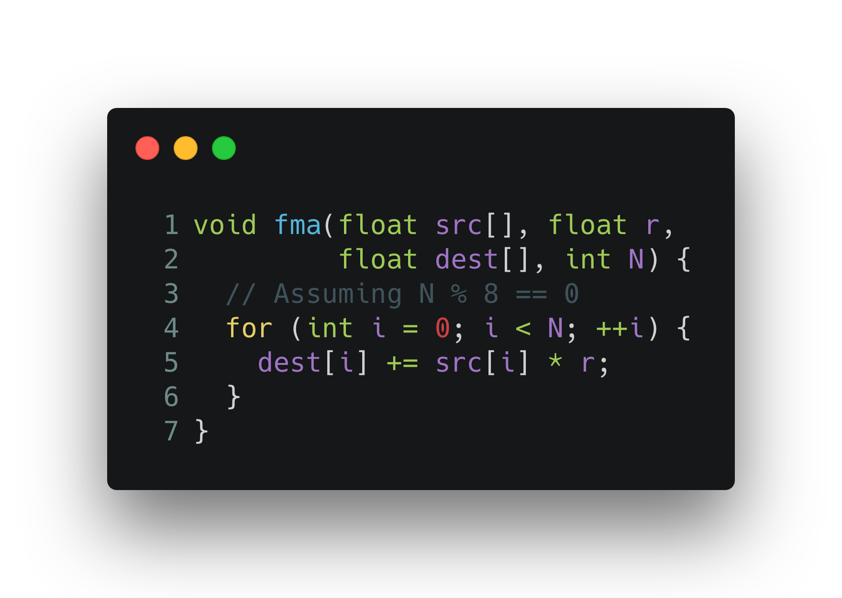
An vectorized loop body is like…
LOADV i(src), %v1
SETV r, %v2,
MULV %v1, %v2, %v1
LOADV i(dest), %v2
ADDV %v1, %v2, %v1
STOREV i(dest), %v1
ADDQ i, 32

Slide 4

SIMD: More Capabilities
*
+
+
=
=
T
T
F
F
T
F
T
F
Usual Operations
Masked Operation
Gather / Scatter
Irregular Mem Access

Slide 5
Vectorization: Opportunities & Challenges
Problem with SIMD:
Masks “serializes” branches
Scatter/gather very slow.
Usually larger latency.
Vectorization is good for:
Coherent computation
Regular memory access
Source of parallelism
Challenges:
Must identify source of parallelism from sequential source code.
Must arrange data in a way to maximize locality. Avoid divergent memory access .
As in all forms of parallelism: maintaining correctness during transformations.

Slide 6
Three Works will be Presented…
Identifying opportunities for parallelism locally:
Vasileios Porpodas, Rodrigo C. O. Rocha, and Luis F. W. G´oes. “Look-ahead SLP: Auto vectorization in the presence of commutative operations”
SIMD parallelization on application level:
Linchuan Chen, Peng Jiang, and Gagan Agrawal. “Exploiting recent SIMD architectural advances for irregular applications”
Correctness: Fixing write conflicts in scatter operation:
Peng Jiang and Gagan Agrawal. “Conflict-free vectorization of associative irregular applications with recent SIMD architectural advances”

Slide 7
Local Parallelism
Vectorizing parallelizable code with LSLP
Notes:
First, let’s try vectorizing parallelizable code in a basic block.

Slide 8
Parallelizable Code

Slide 9
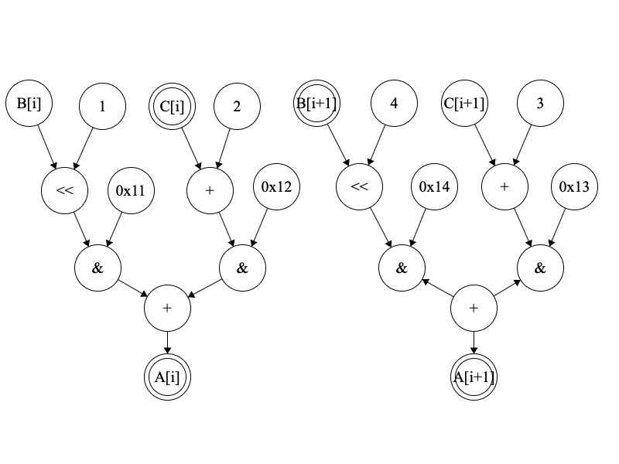

Parallelizable Code
Notes:
This is a piece of parallelizable code, represented in expression trees. Since B[i] and B[i+1] are adjacent, and the operators applied to them are the same, just like C[i] and C[i+1], A[i] and A[i+1], they can be put into vector registers and calculated at the same time. Now how can an algorithm find out they can be parallelizable?

Slide 10
Parallelizable Code
Notes:
First, we notice the two memory stores in yellow access the adjacent locations. This is the seed tuple to start with.

Slide 11
Parallelizable Code
Notes:
Then we realize the operand of the yellow instructions have the same plus operator. Hence, they can be computed at the same time.

Slide 12
Parallelizable Code
Notes:
Following this pattern, we can recursively construct the whole graph following the use-definition chains. And finally, we can generate SIMD instructions for this piece of code.

Slide 13
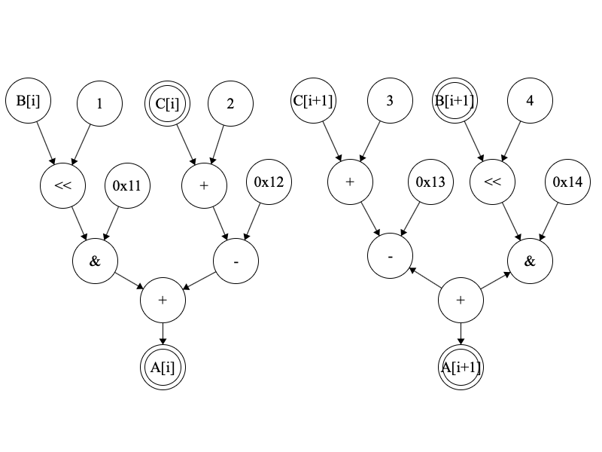
Order of Operators
Notes:
However, our algorithm is very fragile. Just swapping the order of the two operands, it cannot generate the best code, since it stops when it finds the operators of the two operands are not the same.

Slide 14
Reordering on Subtrees
Notes:
The most straightforward way to solve this problem is to sort the operands by their operators before recursively visiting the operands.
In this example, we swap the minus and binary and in advance, assuming that binary and is always before subtraction. Then we can continue constructing the rest part.

Slide 15
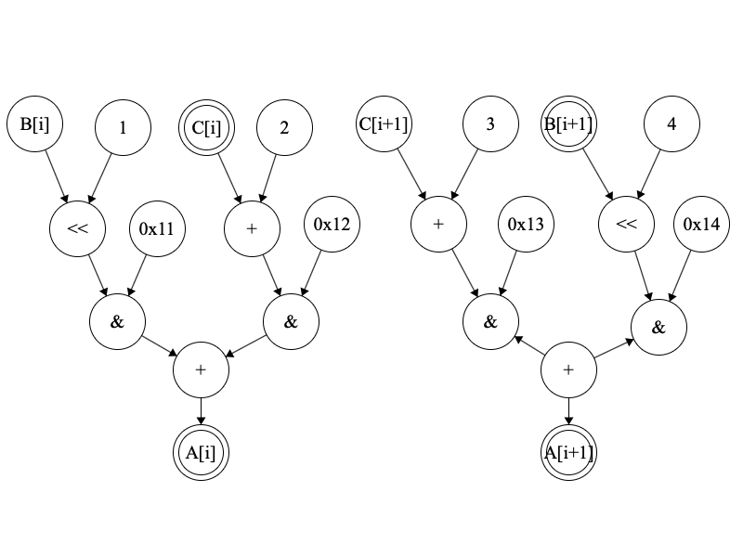
Deeper Difference
Notes:
It is still easy to trick our algorithm.
Instead of making the two operators different, we swap the two subtrees but still keep the operators the same.

Slide 16
Deeper Difference
Notes:
After visiting the green nodes, we are currently visiting the yellow ones. We cannot proceed, since the red ones have different operators.
In order to generate the best code, we need to know to swap the “binary and” in advance, when visiting the green nodes of addition.

Slide 17
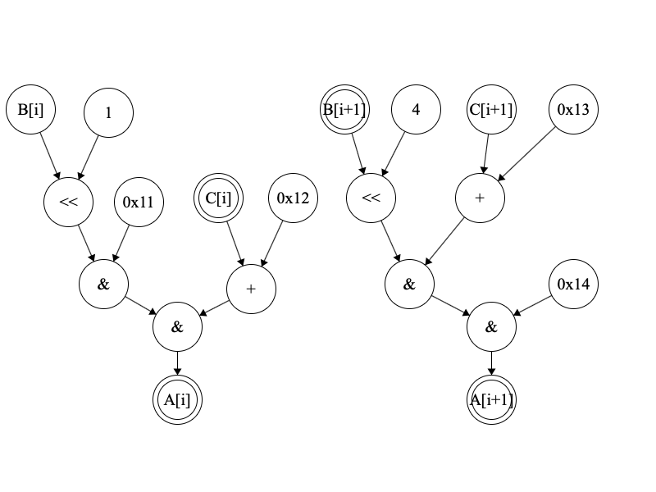
Even worse…
Notes:
But that’s not the end. We have a worse case.
In this example, we can realize that, in order to generate the most efficient code, we need to swap the red nodes, along with their subtrees.

Slide 18
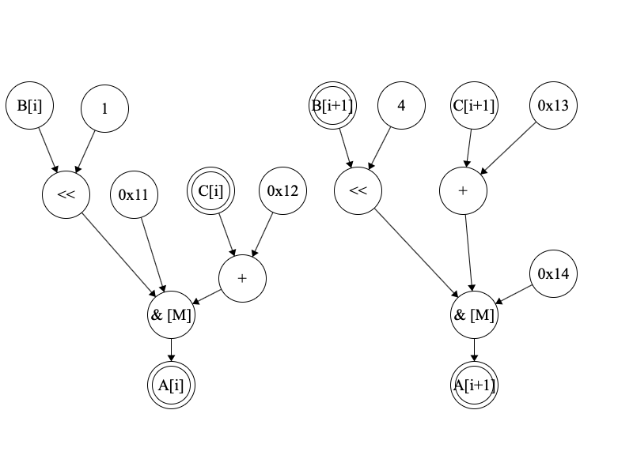
Multi-Node
Notes:
To solve this problem, we can merge the two “binary-and” operations into one node. We call it a multi-node.
We will do this for the operations that is commutative and associative.
After this simplification, we need only to swap the operands of this multi-node, which is easier than the previous situation.

Slide 19
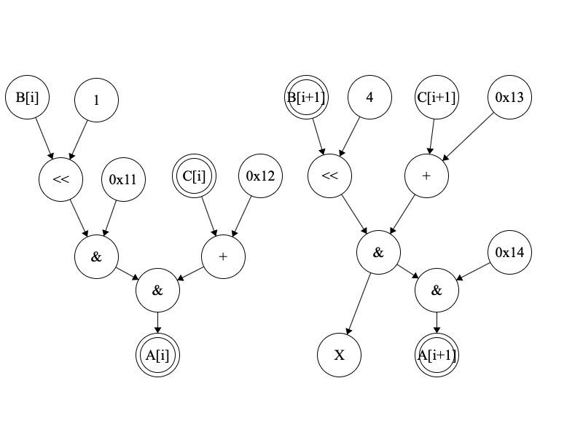
Cannot Combine With Escaped Node
Notes:
However, our solution have a limitation that if the value is used elsewhere, like the red box, then, we cannot merge it into the multi-node.

Slide 20
LSLP Algorithm
Find seed value tuple <v1, v2>, like adjacent store ops.
Construct the graph from the seed tuple…
Notes:
Now, we can summarize the algorithm that we just presented pictorially.
First, we need to find a seed value tuple, in our example, just a pair of values, like adjacent memory storing, as our starting point. We construct the graph from this seed tuple.

Slide 21
LSLP Algorithm
Find seed value tuple <v1, v2>, like adjacent store ops.
Construct the graph from the seed tuple:
If the tuple is not vectorizable, return immediately.
Add the visiting tuple to the graph.
If the operator is not commutative, visit the operand tuples recursively…
Notes:
If the tuple is not vectorizable, which is not the case for the seed tuple, but maybe true later, we return from the procedure.
If it IS vectorizable, we add the tuple to the graph and check the operand tuples.
If the operator is not commutative, we simply visit the operand tuples recursively to construct the graph, like in the first simple example.

Slide 22
LSLP Algorithm
Find seed value tuple <v1, v2>, like adjacent store ops.
Construct the graph from the seed tuple:
If the tuple is not vectorizable, return immediately.
Add the visiting tuple to the graph.
If the operator is not commutative, visit the operand tuples recursively.
If the operator is commutative,
Recursively find all commutative tuples into the multi-node.
Reorder the multi-node with respect to commutativity and associativity.
Visit the reordered tuples.
Notes:
If it is commutative, then we need to collect all the commutative tuples into a new multi-node. I’ll explain later who to find those commutative tuples.
Assuming we have done it, we need to reorder the multi-node to get the best match and then visit the reordered tuples recursively.

Slide 23
Commutative Tuples
Recursively find these tuples:
Same operator in the tuple
Same operator as the parent
Values not escaped
Add the operand tuples of these tuples to the multi-node, not themselves.
Notes:
Now let’s see what is a commutative tuple.
We recursively visit the tuples that have these three properties: first the operator must be the same for each element in the tuple, second the operator must be the same as the parent, and third, the values must not escape. Starting from the blue ones, the green ones satisfy our properties.
Then we add all the operand tuples, not themselves, into the multi-node. In this example, we add the three tuples into the multi-node.

Slide 24
Reorder the multi-node
Lane 0 | Lane 1
B[i] << 1 | B[i+1]<<4
0x11 | C[i+1]+0x13
C[i]+0x12 | 0x14
Notes:
After collecting those tuples, we swap their orders with respect to commutativity and associativity to get the best match.

Slide 25
Reorder the multi-node
Lane 0 | Lane 1
B[i] << 1 | B[i+1]<<4
0x11 | C[i+1]+0x13
C[i]+0x12 | 0x14
Lane 0 | Lane 1
B[i] << 1 | B[i+1]<<4
0x11 | 0x14
C[i]+0x12 | C[i+1]+0x13
reorder
Notes:
In this example, we swap the two values in lane1.
This is how the algorithm works.

Slide 26
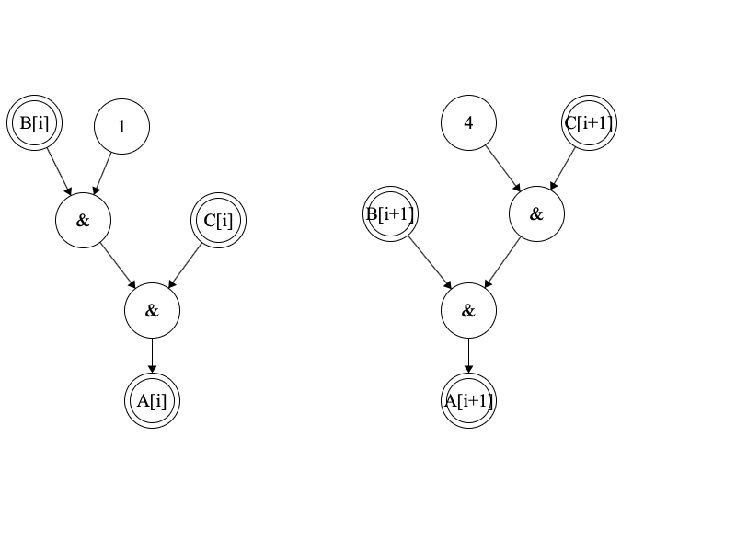
Challenge…
Notes:
However, it still has some challenges.
In this picture, to generate the best code, we need to rotate the tree at the “binary-and” nodes. In another way, we need to sort the operands before collecting the multi-node. But this step is absent in the algorithm in the paper.
The reordering process does swap the operands, but it pairs C[i+1] with B[i] instead of C[i], which is better.

Slide 27
SIMD Applications
Exploiting new SIMD features for irregular problems
Notes:
The previous section presents a method for automatic vectorization.
Now we can consider a related problem. Given an algorithm, how can we exploit the SIMD features for it?
We present three problems that is parallelizable.

Slide 28
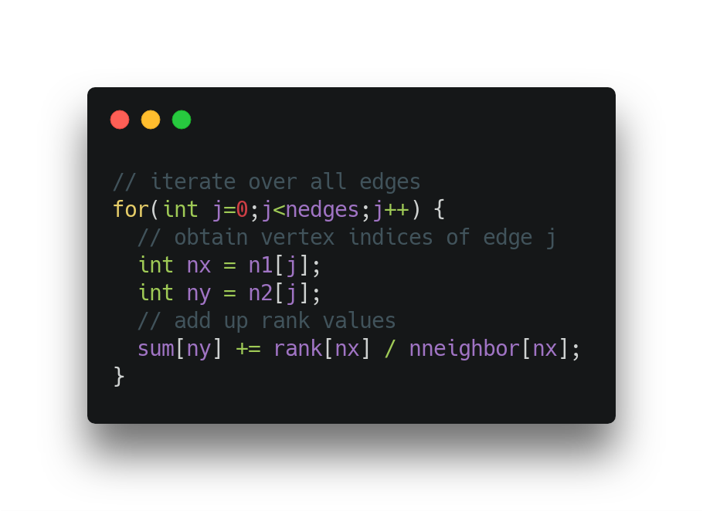
Application 1: Irregular reduction (page rank)
Notes:
The first example is irregular reduction.
Let’s first briefly read the code from page rank.
It calculates some value for each edge and updates the sum array. The loop body seems to be parallelizable after loop unrolling.

Slide 29

Application 2: Graph Algorithms
Bellman-ford Shortest Path from s to any vertex:
$d_{0}\left(s\right)=0$
$d_{0}\left(v\right)=∞ if v ≠s$
$for i=1 to n−1$
$for all edges \left(u,v\right), d_{i}\left(v\right)=min⁡(d_{i−1}\left(v\right), d_{i−1}\left(u\right)+len(u,v))$
Notes:
The second problem is a graph algorithm. Here we take the bellman-ford algorithm as an example.
The inner-most loop is to relax the distance between the chosen start vertex to any other vertex by iterating over each edge. It can be implemented in a SIMD flavor.

Slide 30

Sparse Matrix Representations
COOrdinate List Format
Matrix stored as a list of coordinate-value pairs $(row, col, val)$.
Represensented as a tuple of arrays (not array of tuples) for performance.
Compressed Row Storage:
Three array representations,
Array 1: A list of values, stored according to row major.
Array 2: For each value in Array 1, what’s the column for it.
Array 3: What range of index in array1 belongs to the same row?
Notes:
The last application is sparse matrix multiplication.
Unlike the regular matrix multiplication, the sparse problem access the matrix irregularly. And the matrix itself is stored in some compressed forms.

Slide 31
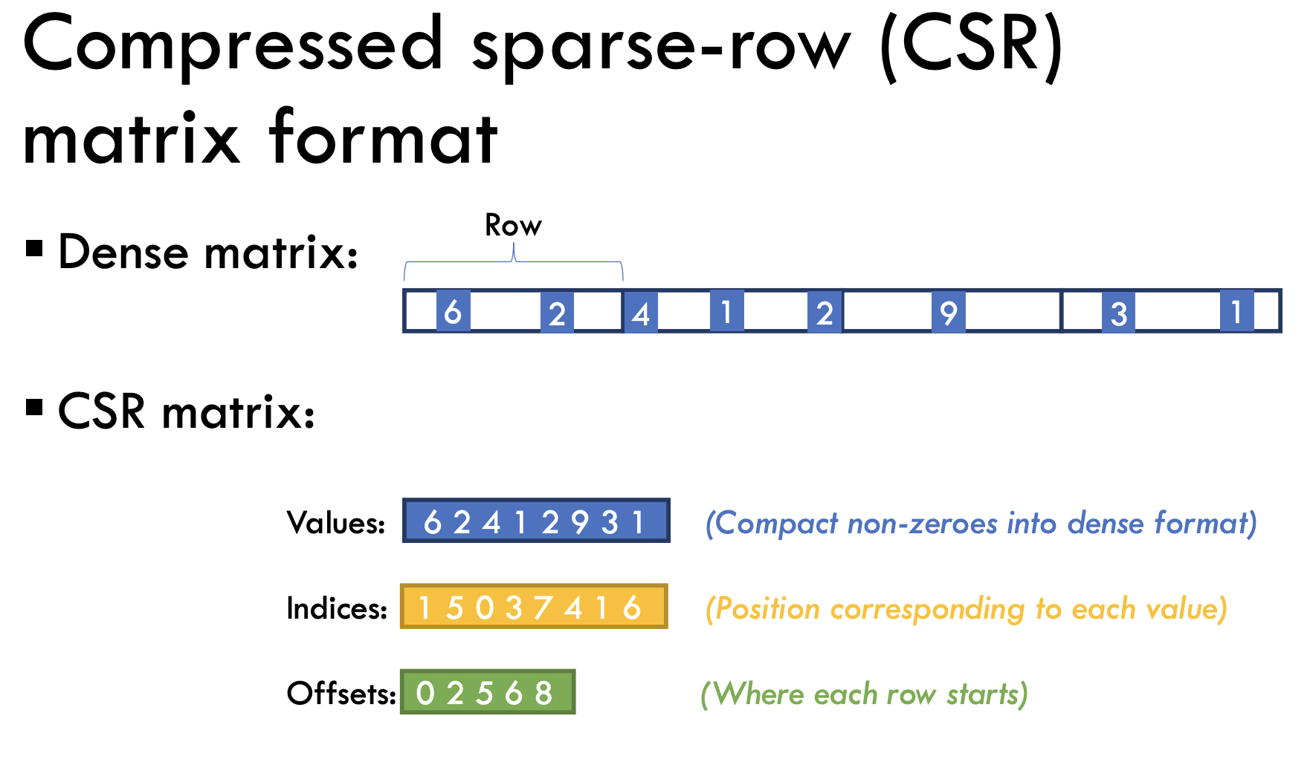
* Taken from 15618 SP19 lecture slides

Slide 32

Irregular applications can(?) be SIMDized
Consider 3 typical applications, irregular reductions, graphs algorithms, sparse matrix multiplications
All be mapped to Sparse matrix representations.
Take page rank as an example. List of edges may be thought of non-zero in a $N×N$ sparse matrix. $N$ is the number of nodes.
We have significant divergent accesses. Edges may lead us to any place in the memory.
And we have correctness issues.

Slide 33
Gather and Scatter Instructions
Memory
Vector Register
Gather
Scatter
Vector Register
Memory
Pros: allow loading from/storing to discontinuous memory locations
Cons: cache miss penalty
Notes:
Gather allows us to load from discontinuous memory locations into a vector register.
And scatter does the opposite, writing to discontinuous memory locations.
The disadvantage is that the performance can be very low if the memory locations are too far away. It will cause many cache misses.

Slide 34
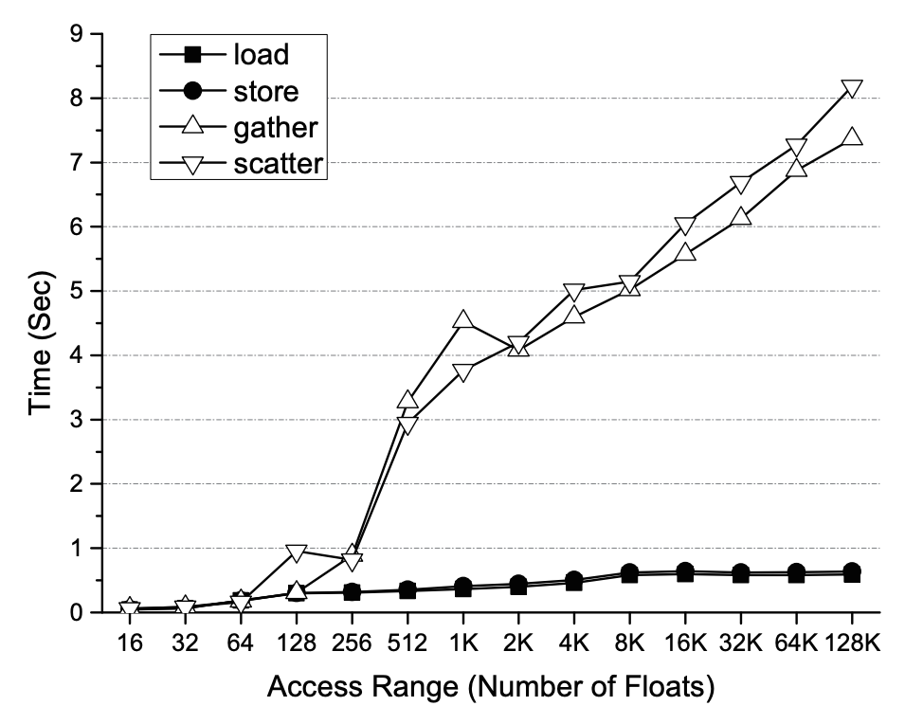
Divergent scatter/gather is very slow.

Slide 35
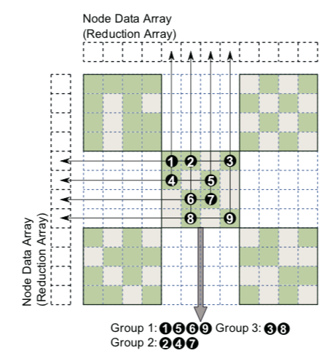
Regaining Locality: Hierarchical Tiling
Extract 128x128 tiles
At least n non-zeros per tile
Extracting most non-zeros
Extract 256x256 tiles
At least n non-zeros per tile
The remaining matrix is very sparse
Extract larger tiles
At least 1 non-zero per tile
Notes:
We solve the locality problem by what is called hierarchical tiling.
The idea is simple. We first extract small tiles from the whole matrix, each tile containing at least n non-zeros. N is a number we choose, like 32. This step extracts most of the non-zeros.
Then we extract tiles with a larger size, each still containing at least n non-zeros. After this step, the remaining matrix can be very sparse.
At last, we extract the tiles with at least 1 non-zero.

Slide 36
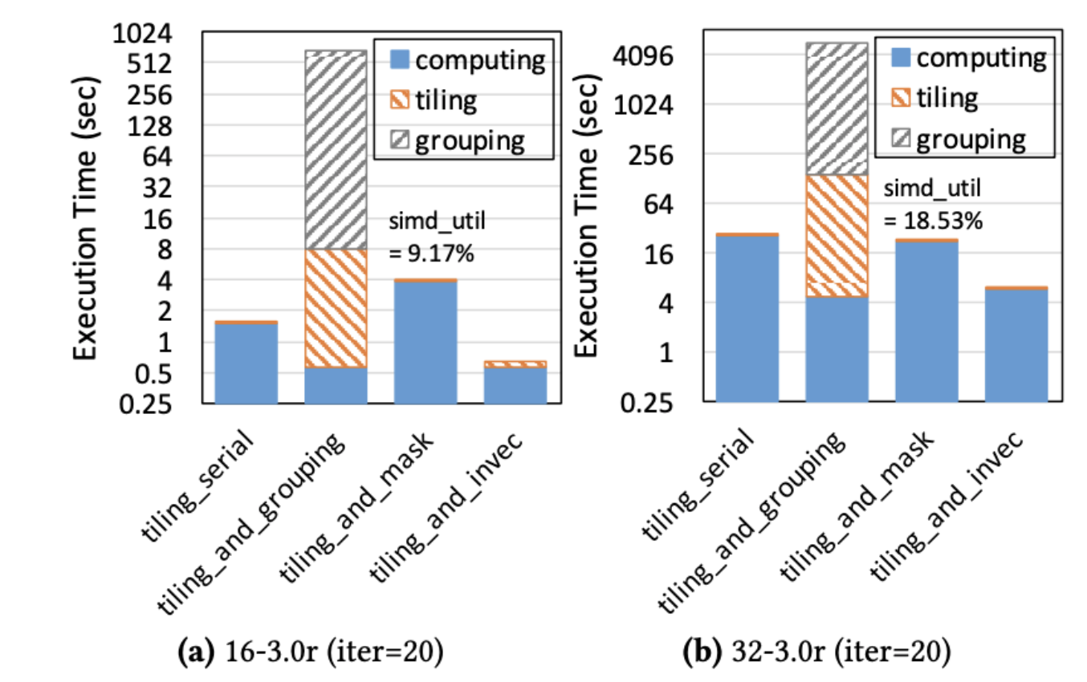
Results:
Improvement is significant.
But overhead is definitely NOT negligible*.

Slide 37
Recall page rank?

Slide 38
Parallelism => Problems.
Irregular applications update irregular locations.
Writes to aliased pointers are originally serialized (e.g., accumulator).
Now irregular writes may be vectorized using scatter.
Different lanes in a single scatter operation may write to same location.
Correctness violated.
This problem is known as write conflicts.

Slide 39
Introducing… vpconflict instruction
Usually registers store index into an array.
A[]
3
0
0
3
3
2
0
5
vpconflict selects first occurrence of each index*.
vpconflict
3
0
0
3
3
2
0
5
T
T
F
F
F
T
F
T
* It’s more complicated in reality.

Slide 40
The Usual Way, and the New Way
Usual solution:
Use vpconflict to extract conflicting indexes.
Write all non-conflicting ones.
Use a loop to serialize the conflicting writes.
New Solution:
Extract conflicts.
Aggregate in-vector conflict ones. No more conflicts.
Now it’s safe to write it out.
Works only if op is associative.

Slide 41
An example for the new solution.
Mask out conflicting lanes.
Find the rightmost non-zero mask.
Extract the conflicting index.
Mask out lanes with such index.
Aggregate in-Vector
Uncheck those lanes in conflict mask.
Iterate. Find the next rightmost non-zero conflicting lane.
…
Write out all conflict free lanes.
3
0
0
3
3
2
0
5
F
F
T
T
T
F
T
F
F
F
T
T
T
F
T
F
3
0
0
3
3
2
0
5
3
0
0
3
3
2
0
5
F
F
T
T
F
F
T
F
3
0
0
3
3
2
0
5
F
F
F
F
T
F
F
F
3
0
0
3
3
2
0
5

Slide 42

A few remarks on the new method.
It’s more of a programming trick than a “full blown” methodology.
Theoretically, the worst case may take $N/2$ iterations to converge for a vector width of $N$ elements.
In the paper, a second tricky may reduce the theoretical bound from $N/2$ to $N/3$.
In practice, due to locality of access this method works surprisingly well. (Recall the last paper we discussed…) Reported speed-up is $1×$ to $2.5×$.

Slide 43
Extra Remark on CGO’16 paper
In the CGO’16 paper, authors also proposed a technique to resolve write conflicts, named Grouping.
The idea is to group computations so that no scatter writes to identical location.
We omit that because it simply does not work.
The overhead of grouping is unacceptable, as the authors themselves commented in CGO’18 paper:
Another version in our comparison …… is a technique of reusing tiling-and-grouping proposed by Jiang et al. [11]. Despite the huge amount of overhead for grouping, the SIMD computation of this version does not even have any speedups in our evaluation.

Slide 44
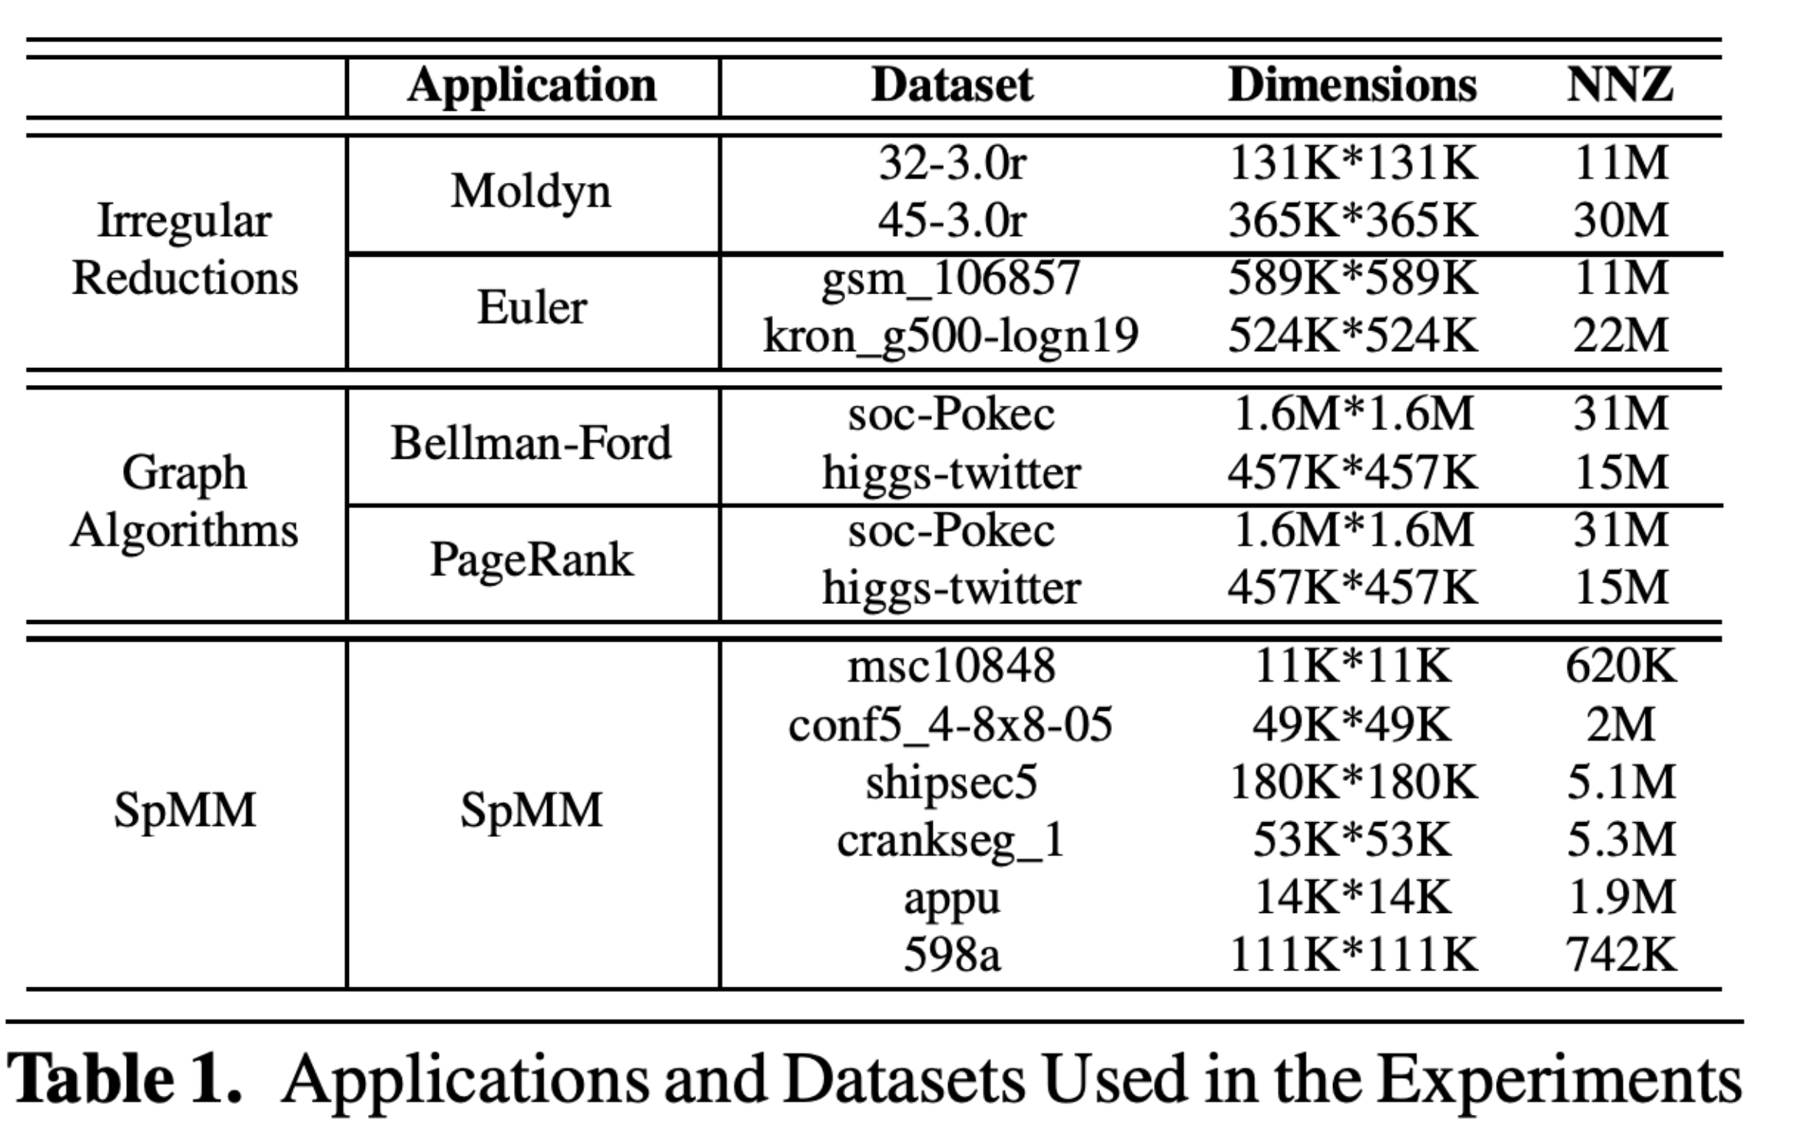
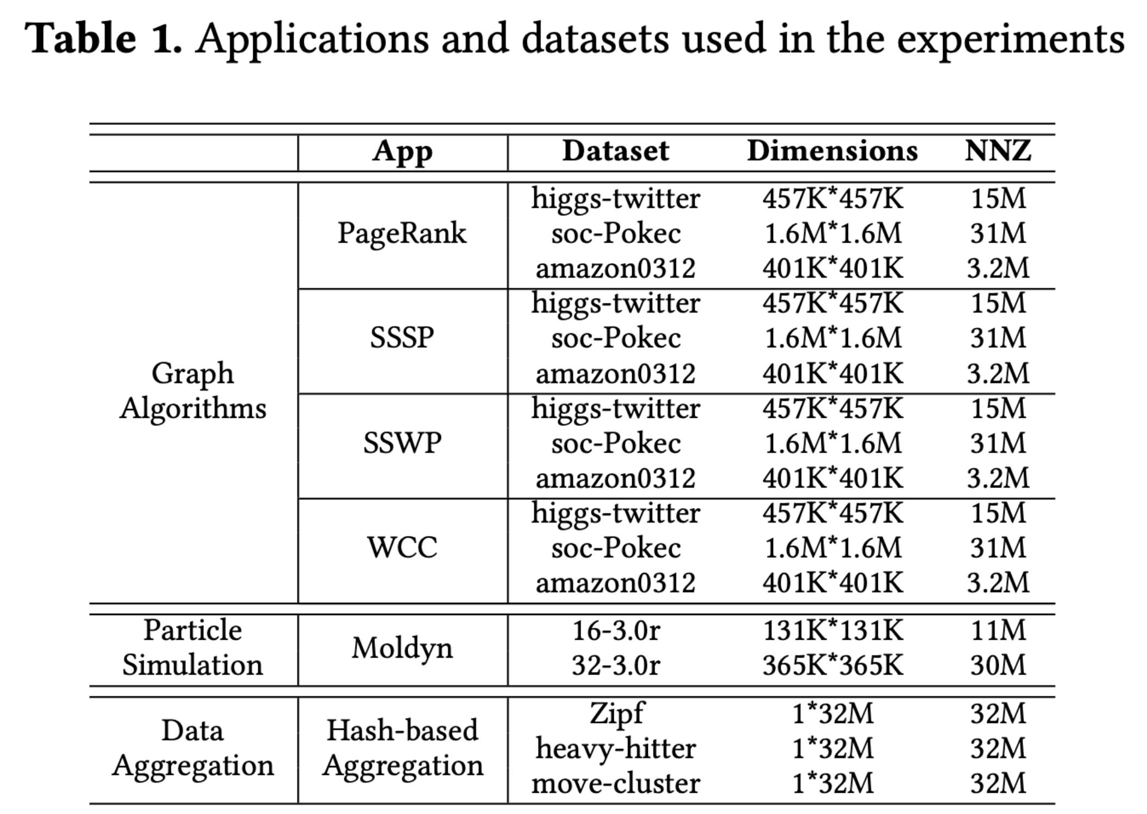
Remark II
The last two papers seems to come from same group. Two of the authors are involved in both papers.
If you read across the paper, you will find the authors are rather sloppy regarding the experimentation results.
CGO’16 Paper
CGO’18 Paper

Slide 45
Conclusion
Vectorization with SIMD
Pros
Theoretical performance improvement by 2x, 4x, even 8x
Cons
The performance penalty of discontinuous gather/scatter
Correctness due to write-conflict
Approaches to exploit SIMD features
An algorithm to find the best parallelizable pattern in code: LSLP
A methodology for irregular applications: hierarchical tiling
An algorithm to ensure correctness: conflict-free writing
Notes:
Now comes the summary.
Today, we briefly browse SIMD for practical applications. The advantage of SIMD is that we have a “theoretical” performance improvement by 2 times, 4 times, or even 8 times, depending on the number of lanes in the register. But we also need to know it comes with a price. The performance can be penalized if the locations are very far away for gather and scatter. In addition, we need to deal with write-conflicts during scattering.
To utilize SIMD, we first introduce an algorithm to find the best parallelizable pattern in the code, which is called LSLP. In brief, it swaps the operands over commutative operators to gain the best savings. Then we introduce a general methodology for irregular applications, called hierarchical tiling. We enforce locality with this method. And at last, we address the write-conflict problem.
This is our presentation for vectorization.

