Slide 1
Compiler-assisted debugging of concurrent programs
Nick Roberts
nroberts
Vijay Ramamurthy
vijayram
15-745 Spring 2019

Slide 2
We can adapt techniques from optimizing compilers to help identify likely bugs.
Pointer Analysis
Register allocation, CSE, parallelization
Detect data races, identify aliasing among locks
Inter-statement Dependence
Data dependence (parallelize/interchange loops)
"Happens-before" relationship to detect deadlock, data races
Notes:
First, give some background on the topic

Slide 3
Recent contributions refine existing algorithms or develop new models of control flow.
D4
Performance: Client-server code analyzer + incremental/parallel algorithms
Notes:
Now, let's talk about some of the recent contributions so you can see where there is still work to be done. One hot area is performance, and not just asymptotic. Some work has been done to create a client-server model for code changes where incremental algorithms update data structures based on additions and deletions. We can squeeze even more performance out of this by running it in parallel.

Slide 4
Recent contributions refine existing algorithms or develop new models of control flow.
D4
Performance: Client-server code analyzer + incremental/parallel algorithms
Async Program Analysis
Develop new techniques to model control flow and detect deadlock
Notes:
vij

Slide 5
Recent contributions refine existing algorithms or develop new models of control flow.
D4
Performance: Client-server code analyzer + incremental/parallel algorithms
Predictable Race Detection
Completeness: Detect every possible race* *detect every possible race detectable under the rules of this analysis
Async Program Analysis
Develop new techniques to model control flow and detect deadlock
Notes:
Another way that existing algorithms are refined is increasing their precision: a recent paper devised a sound* and complete* analysis for predictable race detection, and I'm using air quotes on both of these for good reason. But it still shows that there are great opportunities for refining existing algorithms in this field.

Slide 6
D4
(concurrency analysis framework)

Slide 7
Three main ideas allow D4 to analyze code quickly.
A client-server architecture decouples the machine the IDE runs on from the machine the code is analyzed on.
Common artifacts (e.g. pointer analysis graph) can be built incrementally, using additions and deletions, instead of on the whole program at once.
The incremental update algorithm can be run massively in parallel.

Slide 8
Three main ideas allow D4 to analyze code quickly.
(But the most interesting idea is probably the incremental algorithms.)
A client-server architecture decouples the machine the IDE runs on from the machine the code is analyzed on.
Common artifacts (e.g. pointer analysis graph) can be built incrementally, using additions and deletions, instead of on the whole program at once.
The incremental update algorithm can be run massively in parallel.

Slide 9
Example: thinking about Andersen's algorithm, incrementally.
o₁
x
w
points to
x | { o₁ }
y, z | { o₂ }
w | { o₁, o₂ }
o₂
y
z

Slide 10
Example: thinking about Andersen's algorithm, incrementally.
o₁
x
w
points to
x | { o₁ }
y, z | { o₁, o₂ }
w | { o₁, o₂ }
o₂
y
z
Addition: easy, handled by existing analyses.
Update along nodes reachable from new edge.
Notes:
Imagine, if you add a line of code that introduces an edge between x and y, how you would update the points-to sets.

Slide 11
Example: thinking about Andersen's algorithm, incrementally.
o₁
x
w
points to
x | { o₁ }
y, z | { o₁, o₂ }
w | { o₁, o₂ }
o₂
y
z
Deletion: harder, have to know provenance of facts.
Notes:
With deletion, you notice that even though w is "reachable" from the deleted edge, it retains the o1 edge. Obviously, this could be recovered by re-running the analysis completely, or even with re-running the analysis along all nodes reachable from the original node, but we'd like to make a single pass (hopefully even in parallel?) This is the interesting algorithmic contribution of this paper: doing incremental deletion updates.

Slide 12
Here's the algorithm, details handwaved.
(Detail) Collapse the points-to graph into its SCCs to make it a dag.
Define runOn(y, Δ): # edge to consider; change set to apply.
For any incoming edge (z, y), remove pts(z) from Δ to yield Δ'.
Update pts(y) based on Δ'.
For any outgoing edge (y, z), call runOn(z, Δ').
Overall input: deleted edge (x, y)
To run the overall algorithm, call runOn(y, pts(x)).
Notes:
Relies on the fact that a change will eventually reach a node, even if it doesn't reach it the first time it is visited.

Slide 13
Here's the algorithm, details handwaved.
(Detail) Collapse the points-to graph into its SCCs to make it a dag.
Define runOn(y, Δ):
For any incoming edge (z, y), remove pts(z) from Δ to yield Δ'.
Update pts(y) based on Δ'.
For any outgoing edge (y, z), call runOn(z, Δ') IN PARALLEL.
Overall input: deleted edge (x, y)
To run the overall algorithm, call runOn(y, pts(x)).

Slide 14
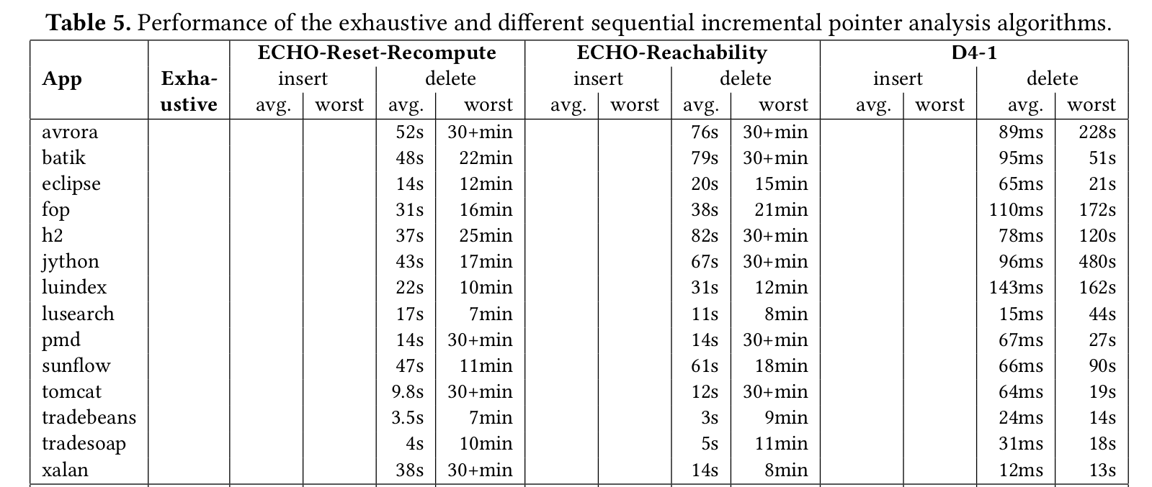
Results are very, very, very good.
See: smallness of numbers under D4-1.

Slide 15
deadlock detection for async C# programs

Slide 16
Deadlock Detection for Asynchronous Programs
Explicate Control Flow
Construct “Continuation Scheduling Graph”
Construct “Deadlock Detection Graph”

Slide 17
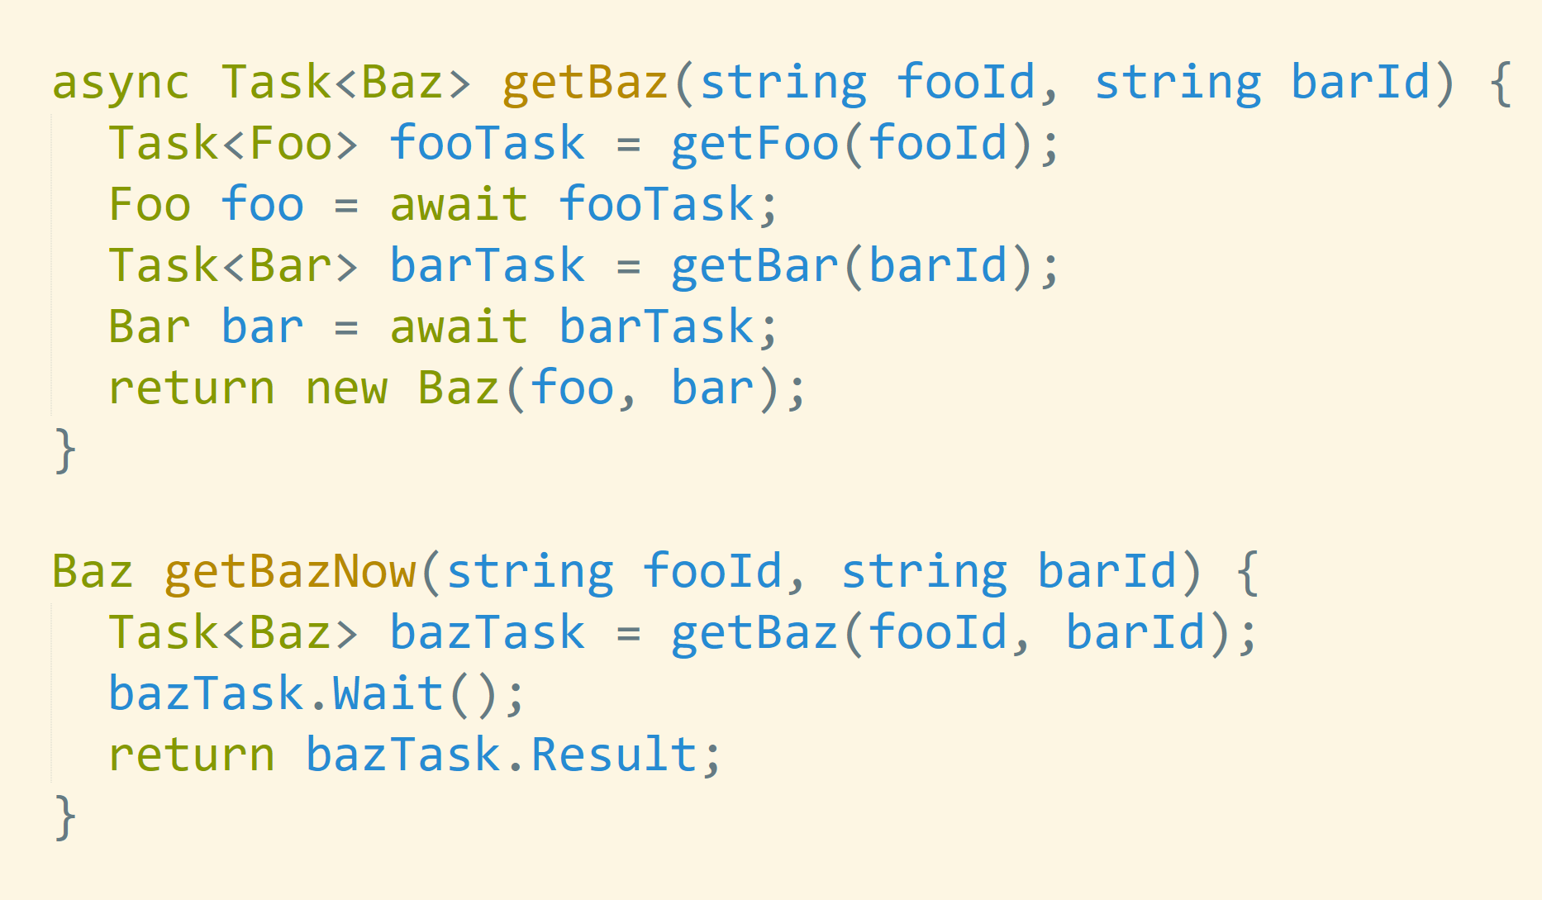
Deadlock Detection: An Asynchronous Program
ASYNCHRONOUS
DOESN’T BLOCK THREAD
SYNCHRONOUS
BLOCKS THREAD

Slide 18
Deadlock Detection: An Asynchronous Program
CONTINUATIONS

Slide 19
Deadlock Detection: An Asynchronous Program
STATE 1
STATE 2
STATE 3

Slide 20
Deadlock Detection:
Continuation Scheduling Graph
Nodes:
Synchronous procedures
States of asynchronous procedures
Edges:
Synchronous calls
State machine edges
Callback edges
getBazNow
getBaz
Wait
STATE 1
getFoo
Blocks
STATE 2
getBar
STATE 3
setResult
Signals

Slide 21
Deadlock Detection:
Deadlock Detection Graph
Nodes:
Threads
Blocking and Signaling Procedures
Edges:
Thread to procedure which may block the thread
Blocking procedure to procedure which signals it
Signaling procedure to thread it can get scheduled on
MAIN THREAD
Wait
setResult
Blocks
Signals
CYCLE=DEADLOCK

Slide 22
Results
On average, analysis takes 20 minutes (not including computing points-to relations and call graph)
Ran on 11 asynchronous C# libraries (around 90k lines of code)
Reported 66 deadlock bugs
After human inspection, 47 were real
43 have been confirmed by developers of library
40 have been fixed

Slide 23
automatic predictable race detection
(data)
Notes:
This technique completes predictable race detection, with some important caveats.
...but before we talk about the caveats, let's understand the game.

Slide 24
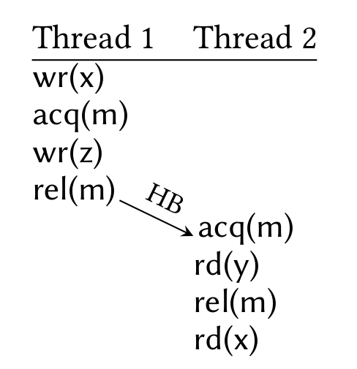
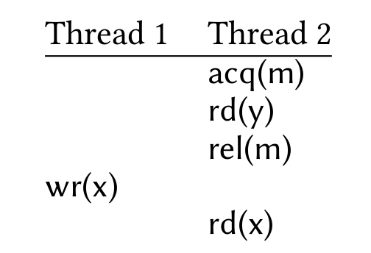
"Predictable race detection" is a dynamic analysis for a particular observed trace.
Question: does the observed trace allow a reordering (obeying some rules) with a data race?
can reorder to

Slide 25
Goal: figure out if a racy tr' exists, efficiently.
Past strategy: come up with an order on events in tr such that conflicting, unordered events race.
Happens-before (HB) is incomplete (orders too many events).
Weak-causally-precedes (WCP) is less incomplete, but is the weakest known sound order.

Slide 26
This paper analyzes the doesn't-commute order.
Doesn't-commute (DC) is complete but unsound: it never orders two conflicting events that race, but two unordered events could possibly never race.
Soundness-salvaging algorithm constructs a trace that exhibits the race, but:
It can't always construct such a trace.
Only a very informal proof is provided.

Slide 27
Promising leads? Future investigations?
(Near future, if you want to make that happen.)

Slide 28
Promising leading questions about deadlock detection.
A source of unsoundness and inefficiency is the points-to analysis. How could changes to the configuration of the points-to analysis affect the results of the overall algorithm?
This algorithm was designed for C#, but could be applied to other languages with multithreading and asynchronous primitives. What other languages could we apply this to?
The expensive points-to analysis is necessary because C# has higher-order functions. How could we restrict a language’s use of higher-order functions to make deadlock analysis easier?

Slide 29
Promising leading questions about D4.
What other analyses can be adapted into the D4 framework?
What bug detection tools can be built on top of the D4 analysis?
Other directions forward:
handle dynamically-linked libraries,
don't rebuild whole graph when importing packages, or
use Language-Server Protocol (LSP).

Slide 30
Promising leading questions about race detection.
This algorithm can be sound, but it requires an exponential search to try all possible ways of reconstructing a trace. How can we make steps toward soundness while avoiding exponential blowup?
Note: linear would be good, since there are potentially millions of events in a trace.
The paper mentions that the analysis used in another recent paper seems unsound. Who wants to look into this?
Can we leverage the runtime tracking of the DC relation to do other interesting analyses? (Beyond just race detection.)

Slide 31
References
Bozhen Liu, and Jeff Huang. D4: fast concurrency debugging with parallel differential analysis, in Proceedings of the 39th ACM SIGPLAN Conference on Programming Language Design and Implementation (PLDI ’18), June 2018.
Jake Roemer, Kaan Gen, and Michael D. Bond. High-coverage, unbounded sound predictive race detection, in Proceedings of the 39th ACM SIGPLAN Conference on Programming Language Design and Implementation (PLDI ’18), June 2018.
Anirudh Santhiar and Aditya Kanade. Static deadlock detection for asynchronous C# programs, in Proceedings of the 38th ACM SIGPLAN Conference on Programming Language Design and Implementation (PLDI ’17), June 2017.

