Slide 1
Cache Optimizations
Elliott Binder, Mark Blanco
15-745
4 March 2019
Notes:
Elliott

Slide 2
Role of cache locality in programs
Motivation:
Memory wall
Spatial locality
Use of data in nearby memory locations (e.g. elements in the same cache line)
Temporal locality
Data that is loaded should be used to the fullest
Notes:
Elliott
Caches are in computer systems to decrease the average latency impact of accessing memory. Programs will little computational intensity may be memory bound and fully utilizing caches is necessary for high performance programs.
Two patterns in programs can be exploited to make use of caches: Spatial locality - since memory is often separated into contiguous chunks, accessing data in nearby memory locations can often be cheap. Temporal locality - using data while it’s in higher levels of cache reduces the amount of times that data will have to traverse the memory hierarchy.

Slide 3
Two Approaches to Improve Locality
Data layout
Data access pattern may result in poor cache utilization
Execution order
Operate on data as much as possible while it’s in cache
Notes:
Elliott
The papers we looked at focus on two approaches to improving locality. In some cases, caches may be poorly utilized so changing the layout of data can provide some benefit.
In other cases, computation may be spread out in time such that data that could be reused is no longer in cache.
Changing the execution order of such programs enables better use of the cache.

Slide 4
Improved Locality Through Data Padding
Lightweight Detection of Cache Conflicts, Roy et al.
Effective Padding of Multidimensional Arrays to Avoid Cache Conflict Misses, Hong et al.

Slide 5
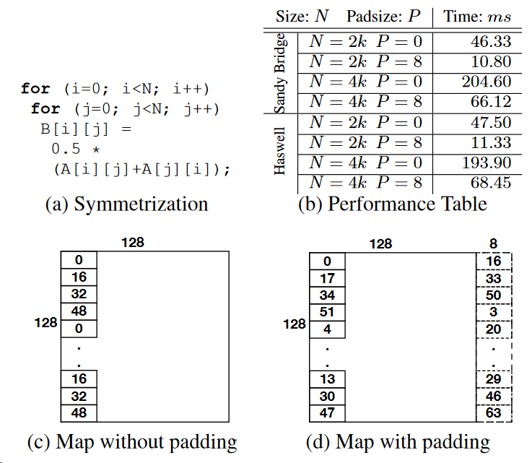
The issue of cache conflicts
Strided access patterns can cause conflict misses in the cache
Padding
E.g. add length to the rows of a matrix → Elements in a columns are spread across sets
Can be applied to higher dimension tensors
64 cache sets, 8-way associative,
64 bytes/line
Notes:
ELLIOTT
Accessing memory at strides that are a multiple of the cache width results in elements landing in the same set.
With limited cache set associativity, strided accesses will cause conflict misses and result in the rest of the cache being
poorly utilized.
[go over example]
Padding is a technique used to push elements to to different cache sets so that more of the cache can be used in case
those elements are to be used at a later time.

Slide 6
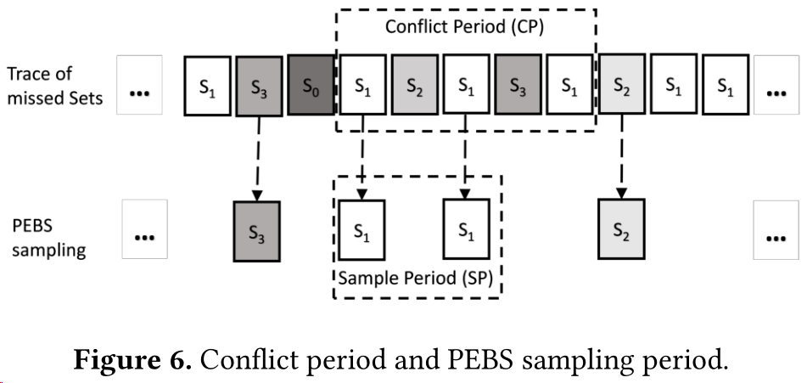
Finding the conflicts (Roy et al.)
Present CCProf, a profiler for conflict misses
Conflicts characterized by Re-Conflict Distance
Results show ~100x reduction in profiling overhead and F1 score of ~0.82
...once conflicts are found, what padding parameters should we use?
Notes:
MARK
Current hardware performance counters do not distinguish between cold, conflict, and capacity misses.
Possibly as a consequence, many cache miss profilers also do not distinguish conflict and capacity misses.
[Animate text to start appearing]
CCProf sets out to change this with a performance counter and address-sampling approach and a metric to characterize conflicts (RCD).
Conflicts are characterized by Re-Conflict Distance (RCD)
Measured by sampling addresses at cache-misses
Statistical model identifies cache conflicts
Note: PEBS = Precise Event-Based Sampling
RCD and cache-miss-contribution-factor (proportion of misses in some period attributed to a particular set) are used in a logistic regression model to determine if that set is having conflicts or just capacity misses.
Both program locations and data structures that encounter high levels of conflict can be tagged.
Caveats: threshold for ‘small’ and ‘large’ RCB have to be tuned empirically. So does frequency for sampling performance counters.
Logitstic regression model is trained on 16 ‘representative’ loops with manually identified cache misses.
Validated against profiled access data through Pin and cache simulation via Dinero IV. Simulation has 100x the overhead of this approach, so this seems like a useful tool.

Slide 7
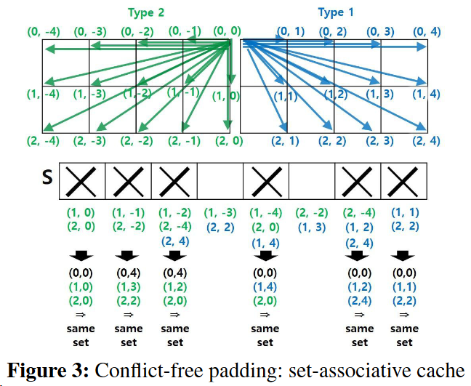
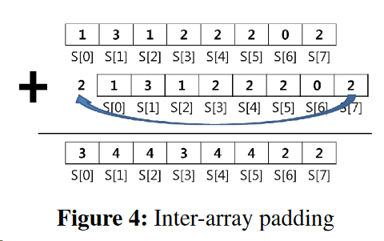
How to pad data? (Hong et al.)
Optimal padding of arrays for set-associative caches and arbitrary tile sizes
Uses modulo arithmetic to eliminate array padding extents that cause conflict
Notes:
MARK
This paper builds on Li and Song’s approach for automatic tiling of iterative loop stencils,
which only considered the case for direct-mapped cache and data footprints fixed to the cache capacity.
Hong et al provide a method for optimal padding for set-associative caches and arbitrary tile sizes. Essentially what is done: given the cache parameters, array and tile dimensions, conflict vectors can be enumerated for varying amounts of padding. Conflicts are detected when []
In the case of a direct-mapped cache, there can be no conflicts between a tile []

Slide 8
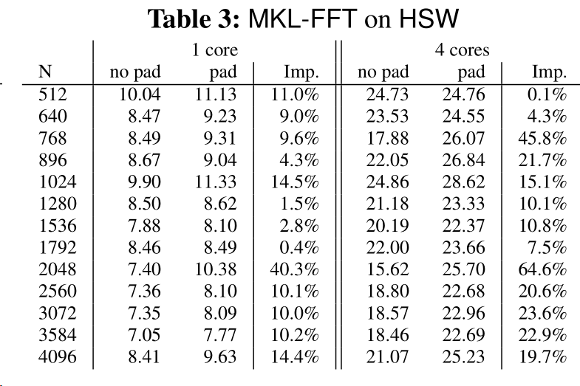
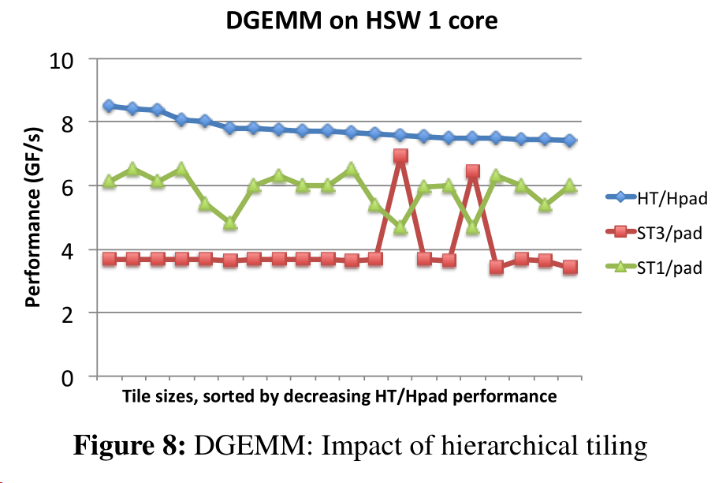
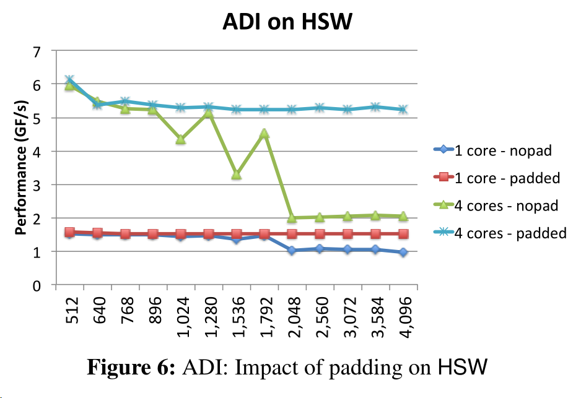
Evaluation and Results
Evaluated on stencil applications (FFT), matmul, and 2D PDE solver (ADI)
Tested on two Intel architectures (SB, HSW)
FFT GFlops/S and Speedup
(Hong et al.)
Notes:
ELLIOTT
Evaluated effects of dimension padding, inter-array padding, and padding with hierarchical tiles on several kernels (see slide text).
Results show that padding improves all cases, and in particular improves parallel scalability on one machine.

Slide 9
Strengths
Weaknesses
Theorems and proofs for analytical model are provided
Model-based padding can be applied across architectures, cache parameters, and data dimensionalities
Can reduce conflicts in opaque library methods by padding the input data
Conflicts can be quickly detected by CCProf
Ideal padding is non-stationary over different tile sizes
DGEMM results are unconvincing
Padding requires the user to pad the data structure across complete functions or programs
Increases memory allocation footprint
Notes:
ELLIOTT
Some strengths of the papers:
The authors provide a mathematical model for guaranteeing conflict-free padding (or the existence of no such solution)
for multidimensional arrays and multi-level cache hierarchies.
The approach is adaptable to different array, tile, and cache parameters.
When changing the access pattern is not an option (for example, due to using closed source libraries) padding can result in better cache behaviour of the program.
And Conflicts can be quickly detected with the help of performance counters. Some weaknesses of the papers
The optimal padding and tiling parameters cannot be tuned independently, which increases the search space and time to find optimal parameters
when using an autotuner.
The DGEMM results were far from peak throughput even after padding, but no explanation was provided as to what the bottleneck might be.
Data must be padded across complete functions or programs, which
May help for some algorithms but may not be necessary for others.
Additionally, padding increases the size of virtually-allocated memory footprint.

Slide 10
Improved Locality Through Reordered Execution
Cache Locality Optimization for Recursive Programs, Lifflander et al.
Notes:
MARK

Slide 11
Data Reuse in recursive programs
First function call creates ‘leading’ and ‘trailing’ threads
Threads are spliced to execute concurrently
Upon function sub-invocation, current thread enters and switches to alt
Effects are checked upon invocations to determine overlap and interference
Upon return, based on thread stack depths:
current thread switches
Otherwise returns
Work-stealing hardware threads execute in parallel (Cilk)
Notes:
MARK
Recursive function definitions are annotated with effects that define read and write data ranges.
Effects are written by the programmer and have an interference operator.
The runtime then uses effect annotations to determine effect of each statement (step) or function invocation.
Leading and trailing threads operate on lightweight threads within a HW thread, with a stack maintained for each.
Effects of sub-invocations are unioned (augmented) with inherited effects of previous calls in that chain.
Note on return: trailing thread blocks on return if leader’s stack is larger or equal, whereas leader only blocks for trailing thread if trailing stack is strictly deeper.
Hardware threads steal work from other HW threads (parallel extension, with load balancing)
Note: dependency checking in work-stealing requires inheritance of effects from victims by theives.

Slide 12
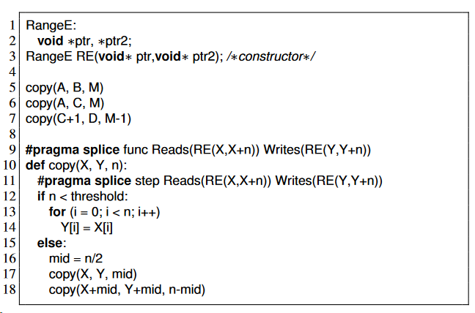
Toy example (how it works)
Notes:
MARK
Here’s a simple recursive copy function.
We can see the user defined RangeE effect class which would have an associated interference operator.
In this case, the operator would look for overlap between the ranges of two pointer pairs.
We can also see that the copy function is annotated with its read and write effects using
the RangeE class.
Function invocations of copy can check for interference depending on whether
one invocation writes to the same region that another invocation reads from or writes to.

Slide 13
Toy example (how it works)
// Splicing example with dependence
copy(A, C, 8) // Leading invocation
copy(A, D, 8) // Continuation
def copy(src, dst, n):
if n < 5:
for i .. n:
dst[i] = src[i]
else:
mid = n/2
copy(src, dst, mid)
copy(src+mid, dst+mid, n-mid)
T1
Leading Thread (T1)
Trailing Thread (T2)
c(A,C,8)
Stack 1 | Stack 2
A:
C:
D:
Step 1: initial function invocation on leading thread (T1)
Notes:
MARK

Slide 14
Toy example (how it works)
// Splicing example with dependence
copy(A, C, 8) // Leading invocation
copy(A, D, 8) // Continuation
def copy(src, dst, n):
if n < 5:
for i .. n:
dst[i] = src[i]
else:
mid = n/2
copy(src, dst, mid)
copy(src+mid, dst+mid, n-mid)
Leading Thread (T1)
Trailing Thread (T2)
T2
c(A,C,4)
T1
c(A,C,8)
c(A,D,8)
Stack 1 | Stack 2
A:
C:
D:
Step 2: T1 calls sub-invocation and switches to trailing thread (T2)
Notes:
MARK

Slide 15
Toy example (how it works)
// Splicing example with dependence
copy(A, C, 8) // Leading invocation
copy(A, D, 8) // Continuation
def copy(src, dst, n):
if n < 5:
for i .. n:
dst[i] = src[i]
else:
mid = n/2
copy(src, dst, mid)
copy(src+mid, dst+mid, n-mid)
Leading Thread (T1)
Trailing Thread (T2)
c(A,C,4)
c(A,D,4)
T1,T2
c(A,C,8)
c(A,D,8)
Stack 1 | Stack 2
A:
C:
D:
Step 3: T2 calls sub-invocation and switches to T1
Notes:
MARK

Slide 16
Toy example (how it works)
// Splicing example with dependence
copy(A, C, 8) // Leading invocation
copy(A, D, 8) // Continuation
def copy(src, dst, n):
if n < 5:
for i .. n:
dst[i] = src[i]
else:
mid = n/2
copy(src, dst, mid)
copy(src+mid, dst+mid, n-mid)
Leading Thread (T1)
Trailing Thread (T2)
c(A+4,C+4,4)
c(A,C,4)
c(A,D,4)
c(A,C,8)
c(A,D,8)
T2
T1
Stack 1 | Stack 2
A:
C:
D:
Step 4: T1 sub-invocation completes, continues to next invocation, and switches to T2
Notes:
MARK

Slide 17
Toy example (how it works)
// Splicing example with dependence
copy(A, C, 8) // Leading invocation
copy(A, D, 8) // Continuation
def copy(src, dst, n):
if n < 5:
for i .. n:
dst[i] = src[i]
else:
mid = n/2
copy(src, dst, mid)
copy(src+mid, dst+mid, n-mid)
Leading Thread (T1)
Trailing Thread (T2)
c(A+4,C+4,4)
c(A+4,D+4,4)
c(A,C,4)
c(A,D,4)
c(A,C,8)
c(A,D,8)
T1,T2
Stack 1 | Stack 2
A:
C:
D:
Step 5: T2 sub-invocation completes, continues to next invocation, and switches to T1
Notes:
MARK

Slide 18
Toy example (how it works)
// Splicing example with dependence
copy(A, C, 8) // Leading invocation
copy(A, D, 8) // Continuation
def copy(src, dst, n):
if n < 5:
for i .. n:
dst[i] = src[i]
else:
mid = n/2
copy(src, dst, mid)
copy(src+mid, dst+mid, n-mid)
Leading Thread (T1)
Trailing Thread (T2)
c(A+4,C+4,4)
c(A+4,D+4,4)
c(A,C,4)
c(A,D,4)
c(A,C,8)
c(A,D,8)
T2
T1
Stack 1 | Stack 2
A:
C:
D:
Step 5: Second T1 invocation completes and returns, then before second return, switches to T2
Notes:
MARK

Slide 19
Toy example (how it works)
// Splicing example with dependence
copy(A, C, 8) // Leading invocation
copy(A, D, 8) // Continuation
def copy(src, dst, n):
if n < 5:
for i .. n:
dst[i] = src[i]
else:
mid = n/2
copy(src, dst, mid)
copy(src+mid, dst+mid, n-mid)
Leading Thread (T1)
Trailing Thread (T2)
c(A+4,C+4,4)
c(A+4,D+4,4)
c(A,C,4)
c(A,D,4)
c(A,C,8)
c(A,D,8)
T1,T2
Stack 1 | Stack 2
A:
C:
D:
Step 6: Second T2 invocation completes and returns, then before last return, switches to T1
Notes:
MARK

Slide 20
Toy example (how it works)
// Splicing example with dependence
copy(A, C, 8) // Leading invocation
copy(A, D, 8) // Continuation
def copy(src, dst, n):
if n < 5:
for i .. n:
dst[i] = src[i]
else:
mid = n/2
copy(src, dst, mid)
copy(src+mid, dst+mid, n-mid)
Leading Thread (T1)
Trailing Thread (T2)
T1
c(A+4,C+4,4)
c(A+4,D+4,4)
c(A,C,4)
c(A,D,4)
c(A,C,8)
c(A,D,8)
T2
Stack 1 | Stack 2
A:
C:
D:
Step 7: T1 returns and switches to T2
Notes:
MARK

Slide 21
Toy example (how it works)
// Splicing example with dependence
copy(A, C, 8) // Leading invocation
copy(A, D, 8) // Continuation
def copy(src, dst, n):
if n < 5:
for i .. n:
dst[i] = src[i]
else:
mid = n/2
copy(src, dst, mid)
copy(src+mid, dst+mid, n-mid)
Leading Thread (T1)
Trailing Thread (T2)
T2
T1
c(A+4,C+4,4)
c(A+4,D+4,4)
c(A,C,4)
c(A,D,4)
c(A,C,8)
c(A,D,8)
Stack 1 | Stack 2
A:
C:
D:
Step 8: T2 returns and T1 continues execution of the program
Notes:
MARK

Slide 22
Experimental setup
Comparison of stencil benchmarks
Significant data reuse potential between multiple iterations
Competition
Pluto
Pochoir
Cilk/CilkN
Notes:
ELLIOTT
Pluto
Parallelizes and optimizes locality for affine loop nests
Uses OpenMP
Pochoir
Domain specific language for stencil operations that performs cache-oblivious parallelization
Uses Cilk
Cilk/CilkN
Program just uses Cilk for parallelism.
No concept of annotated effects as contributed in this paper.
The N version of Cilk provides an option for improved non-uniform memory access performance

Slide 23
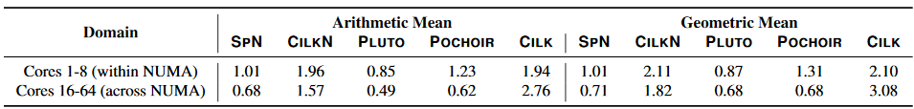
Results
Splicing performed 2x-3x better overall compared to Cilk
Performance counters showed fewer L2 and L3 cache misses
Implies better use of memory hierarchy
Comparable (not much better) than Pluto, Pochoir
Execution time ratio against splicing scheduler (lower is better).
Table 2, Lifflander et al.
Notes:
Elliott

Slide 24
Strengths
Weaknesses
Outperforms standard Cilk runtime
Allows annotation of data-use footprints which static analysis do not have
Enables developer to create step ‘slices’ to increase granularity of task threads
Often falls behind static optimization frameworks such as Pluto
Requires annotating programs manually
Context-switching overheads inhibit fine-grained optimizations for L1 reuse
Notes:
MARK
Strengths
[]
Weaknesses
Generally, Pluto and Pochoir extract reuse at all levels of cache, but
the overhead of executing a user-defined kernel makes it difficult
to optimize well for L1 cache reuse.
This includes the possibility of performing many complex loop
boundary conditions [to check for dependencies?]
[]

Slide 25
Discussion Prelude
Data Padding
Reduction in conflict misses and improvements in performance via padding on multiple array dimensions
Execution Reordering
Splicing recursive calls with manually annotated data effects in parallel work-stealing runtime environment
A brief recap
Notes:
MARK

Slide 26
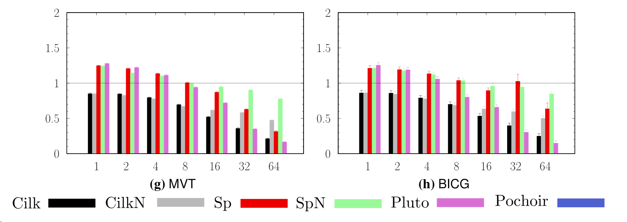
Discussion - Recursions Splicing
Does the idea of a splicing runtime require recursion?
Could architectural information be provided to automate slice granularities?
Would this address cache capacity and conflict misses?
Could effects address shared cache lines with disjoint data footprints?
Pluto can’t detect reduction-like pattern, but OpenMP has reduction pragma…so are the results fair? (below)
Fig 7: Speedup over single core Sp (Lifflander et al.)
Notes:
MARK

Slide 27
Discussion - Array Padding
How does padding data compare to packing?
Are the data layout costs comparable?
What type of kernel programs benefit most from padding vs packing?
How should other optimizations affect data access patterns be taken into account with automatic padding?
Loop tiling, loop reordering, loop fusion, vectorization?
Ideas:
Incorporating this into autotuning systems (e.g. ATLAS)
Automatically applying this upon compilation
(adding padding routines on inputs to kernel codes)
Can inter-array padding be made more useful?
Notes:
Elliott

Slide 28
References
P. Roy, S. L. Song, S. Krishnamoorthy, and X. Liu, “Lightweight detection of cache conflicts,” presented at the Proceedings of the 2018 International Symposium on Code Generation and Optimization, 2018, pp. 200–213.
J. Lifflander, S. Krishnamoorthy, J. Lifflander, and S. Krishnamoorthy, “Cache locality optimization for recursive programs,” ACM SIGPLAN Notices, vol. 52, no. 6, pp. 1–16, Jun. 2017.
C. Hong et al., “Effective padding of multidimensional arrays to avoid cache conflict misses,” ACM SIGPLAN Notices, vol. 51, no. 6, pp. 129–144, Jun. 2016.

