Slide 1
Optimizations for Dynamic Languages
Chuta Sano, Axel Feldmann
15-745 Presentation

Slide 2
Dynamic Languages
Replace any “common static checks” with runtime checks
Types
Syntax
Eval
Box-ing functions
etc.
Most common: types (partial, full, etc.)

Slide 3
The Set of all “Useful” Programs
The set of all programs
Some untyped C-like language
C
Useful

Slide 4
Consider the Identity Function
Static type:
Int id(int x) { return x; }
Float id(float x) { return x; }
...
Dynamic type:
Func id(x) { return x; }
Generics:
Templates (C++)
Parametric polymorphism (SML)

Slide 5
Type Theory Club
Rule 1 : Never trust programmers

Slide 6
Motivation
Lots of people write lots of code in dynamically typed languages
They expect their code to be fast
Dynamically typed languages are often run through interpreters (not fast)
One of the big selling points of dynamically typed languages is generic code
The same function can work on both widgets and gadgets
Often, these types are not conclusively known until runtime
Machine code is the opposite of generic
The x86 addl instruction works on 32 bit integers exclusively
No widgets, no gadgets
How can we bridge this gap?

Slide 7
Simple Example (in Javascript)
Foo = { a : 1 }
Bar = { b : 2, a : 3 }
Fn = (x, y) => (x.a + y.a)
All of the following are valid calls to Fn
Fn(Foo, Bar), Fn(Foo, Foo), Fn(Bar, Foo), Fn(Bar, Bar)
However, the position of the “a” field in memory is not the same for all objects!

Slide 8
A Tempting Solution (very abstract asm)
// Recall: Fn = (x, y) => (x.a + y.a)
// Assume %rdi = x, %rsi = type of x, %rdx = y, %rcx = type of y
a1, typeof_a1 = get_field(x, typeof_x, “a”)
a2, typeof_a2 = get_field(y, typeof_y, “a”)
r, typeof_r = add(a1, typeof_a1, a2, typeof_a2)
return r, typeof_r
Just imagine how long this would be in x86 assembly. It also includes THREE expensive function calls.
However, if we want to allow for x and y to be generic, we need code like this!

Slide 9
Removing Checks in Dynamically Typed Languages Through Efficient Profiling
Gem Dot, Alejandro Martinez, Antonio González

Slide 10
Introduction
Specialized code is much faster than generic code
We want as much of it as possible
Specialization requires assumptions about types
These assumptions must be checked
Checks are expensive
Most programs use relatively few classes
The type of most variables, class attributes, and arrays is monomorphic
Types mostly remain constant!
Therefore, in the typical case our assumptions about types mostly hold
It would be nice if we didn’t have to constantly check this in software
Hardware can help!

Slide 11
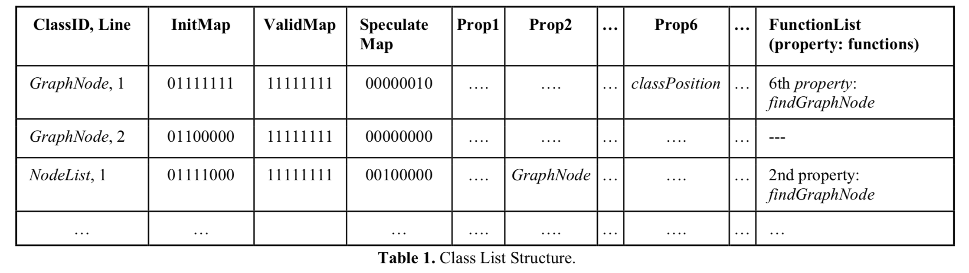
The Class List
All in software
Has fixed 2^16 entries
Class List base is stored in a new hardware register
Cached in a Class Cache
Notes:
ClassID is 8 bits, line is 8 bits
InitMap/ValidMap describe properties of “any object of the class”
Speculate Map - has any speculative optimization been applied for this property
7 properties
Class Cache is to Class List as TLB is to Page Table
List of speculatively optimized functions

Slide 12
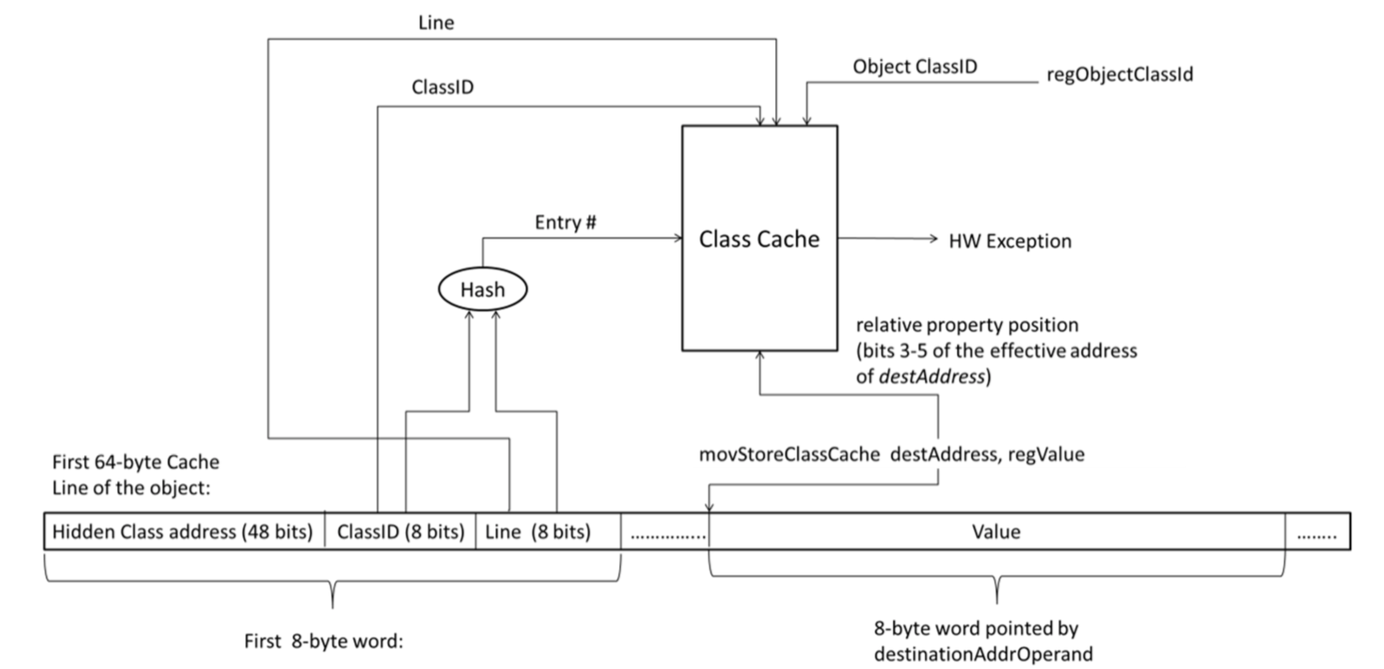
Hardware Changes
Architecture is augmented with movStoreClassCache and movStoreClassCacheArray
Similar to x86 mov instructions, except they also hit the classCache
If speculation goes wrong, a HW exception is generated allowing the runtime to “fix up” any incorrect state.

Slide 13
Key takeaway:
Dynamic languages are tough, hardware can help.
Also, the paper’s title was pretty misleading.

Slide 14
HHVM JIT: a profile-guided, region-based compiler for PHP and Hack
Ottoni, Guillherme (Facebook)

Slide 15
Background
Php/Hack
Hack: dialect of Php
Fast Development Cycle
HipHop Compiler (2012)
Php -> C++ w/ static types
HHVM JIT v1 (2014)
Tracelet-based compilation
“Maximal bytecode that can be type-specialized given the state of the VM”
Type guards

Slide 16
HHVM JIT 2.0
Ensemble of known/common optimizations
Four Principles:
Type specialization
Side exits / On-Stack Replacement
Profile-guided optimizations
Region-based compilation (1995)
(as opposed to tracelet-based)

Slide 17
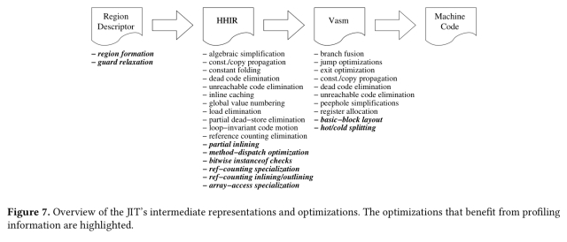

Slide 18
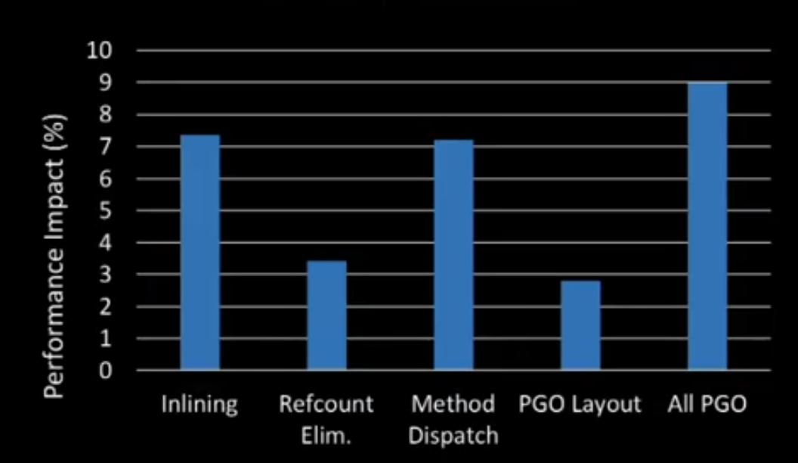
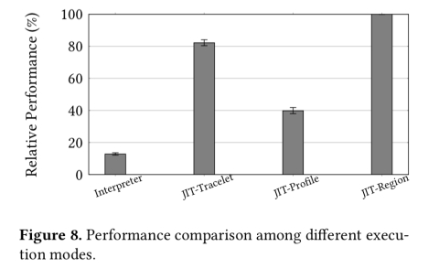
HHVM JIT 2.0

Slide 19
Practical partial evaluation for high-performance dynamic language runtimes
Thomas Wrthinger, Christian Wimmer, Christian Humer, Andreas W, Lukas Stadler, Chris Seaton, Gilles Duboscq, Doug Simon, and Matthias Grimmer (Oracle)

Slide 20
Background
GCC
C -> (preprocessed) C -> AST -> (~10+ passes) IR -> (pick a backend compiler) -> bytecode
In general
Text -> … -> AST -> … -> IR -> bytecode
Or technically,
Text -> … -> “program running”
General Scheme to go from AST interpreter to “program running” (2013) based on First Futamura Projection (1983)
Partial Evaluations!

Slide 21
Partial Evaluation
When do we stop inlining?
Boundaries (explicit annotation)
Local Speculation -- not too interesting or new
Inline fast paths with type guards and fall back to interpreter when typing checks fail
Global Speculation
Global mutable state containing “assumptions”
That’s it!

Slide 22
Three Primitives
The three primitives needed:
Partial Evaluation Boundaries
Local Assumptions
Global Assumptions
Can implement:
On-stack replacements (of loops)
Tail calls!
Hard to implement (efficiently): -- somewhat ironic
Continuations
Reflections

Slide 23
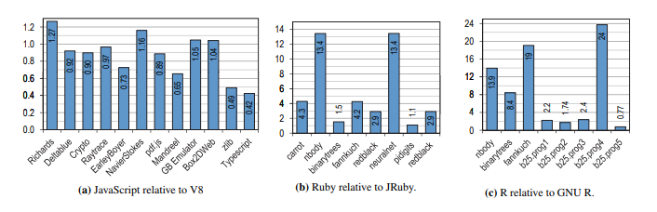
Benchmarks
V8 Javascript VM : 0.83x
JRuby : 3.8x
GNU R : 5x
Skepticism: not “full” implementations, side-effects(?)

Slide 24

Any Questions?

Slide 25
Discussion Questions
Are dynamic languages worth it? What benefits do they bring for all of these headaches?
Are there any other ways to exploit the observation that most variables/structures are actually monomorphic?
What do types provide? How much power should programmers give to types?
Can higher level information provide different opportunities for optimization compared to low level information?
Are certain higher level optimizations isomorphic to certain lower level optimizations?

