Slide 1
Compiling for GPU’s
Peter Oostema & Rajnish Aggarwal
6th March, 2019

Slide 2
Papers
gpucc: An Open-Source GPGPU Compiler
Lift: A Functional Data-Parallel IR for High-Performance GPU Code Generation
TwinKernels: An Execution Model to Improve GPU Hardware Scheduling at Compile Time

Slide 3
Gpucc Motivation
An open source “probably the first” LLVM based GPGPU compiler for CUDA
Nvidia refuses to open source the entire compiler toolchain, hampering:
Research
Data-center specific optimizations
Security of vendor proprietary code
Bug turnaround times
…
Major contributions:
Frontend supporting dual mode compilation
Opens space for LLVM based GPU optimizations
Host code generator handling PTX
Notes:
**We’ll go over the front-end and device (GPU) optimizations in some detail. Skim through most of the code generation part.

Slide 4
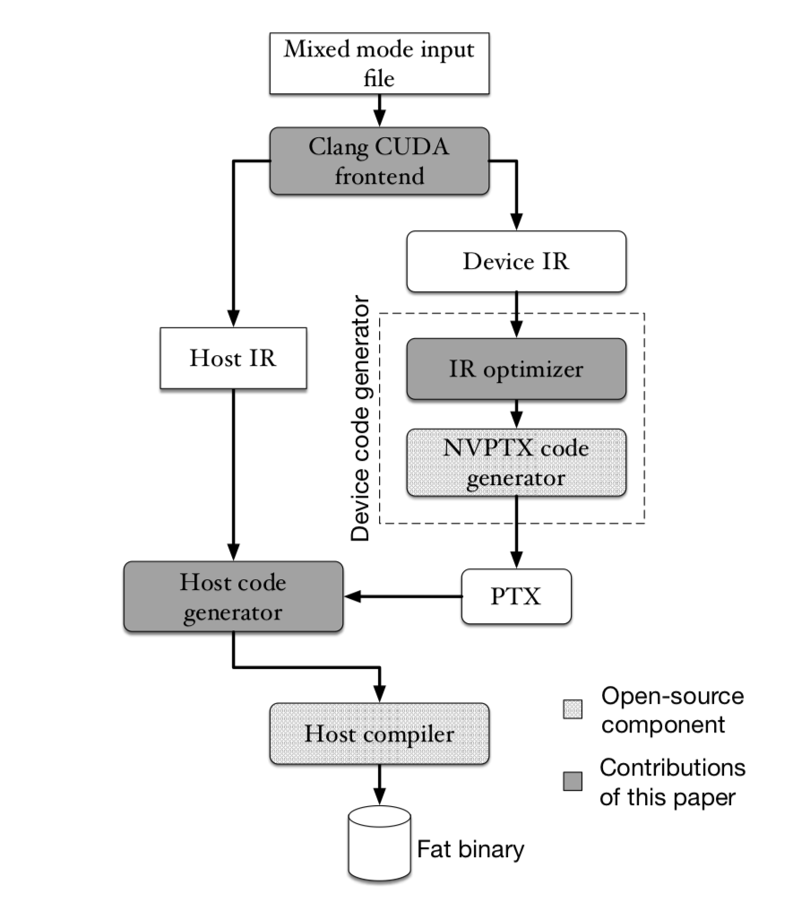
Gpucc Architecture (Frontend)
CLANG based, capable of parsing the mixed code file in two passes using dual mode compilation emitting LLVM IR for the host & device
Complications:
Target specific macros __PTX__, __SSE__
Language features (exceptions, inline assembly)
Host and device code can be interdependent and may internally call built-in functions
Notes:
The standard compilation of CUDA C/C++ program consists of compiling functions that run on the device into a virtual ISA format dubbed PTX . The PTX code is then compiled at runtime by the driver to the low-level machine instruction set called SASS (Shader ASSembler) that executes natively on NVIDIA GPU hardware.
nvcc uses separate compilation i.e. it first separates the code into device (GPU) and host (CPU) and the compiles it, needs 4 passes. This uses a splitter which is a Clang based source to source translator
Gpucc solves template issue. It includes the complete translational unit which has info of template instantiation on both host and device
Gpucc predefines all the macros (almost all are agreed upon by C++ and CUDA) which helps resolve all conflicts. Specially handles ones not agreed upon by suppressing warnings, error when compiling for the other architecture
Has certain restrictions with respect to function calls, distinguishes based on caller and callee

Slide 5
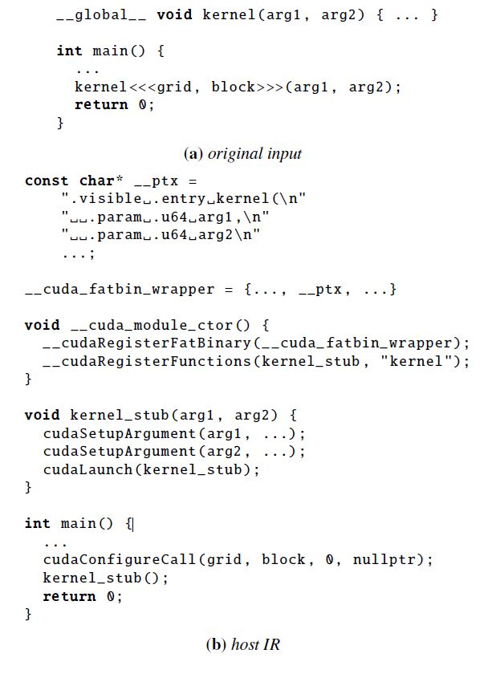
Gpucc Architecture (Code generator)
Device
After LLVM optimizations, generates PTX using NVPTX (open sourced by Nvidia)
PTX produced by device injected into host as string literal constants producing the binary
Host
Inserts CUDA runtime API calls to load & launch kernels
Notes:
Host wraps PTX in global struct __cuda_fatbin_wrapper
Inserts static initializer __cuda_module_ctor loads the PTX from fatbin_wrapper and registers kernels using __cudaRegisterFunctions
Generates a kernel stub that prepares arguments for each kernel and launches kernel.

Slide 6
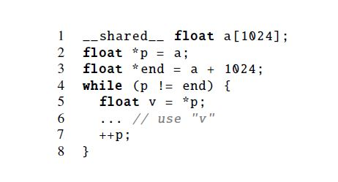
Gpucc optimizations
Loop unrolling and function inlining*
Jumps and function calls more expensive on GPU’s. No out of order execution.
More opportunities for constant propagation and improved register allocation
Inferring memory spaces
Different type of load instructions, knowing memory spaces helps emit faster instructions
Uses fixed point data flow analysis to determine shared spaces
Pointer alias analysis
Reports two pointers from different memory spaces as not aliasing
*can be harmful as well!
Notes:
Can infer p accessing shared memory space.
*can be harmful as well

Slide 7
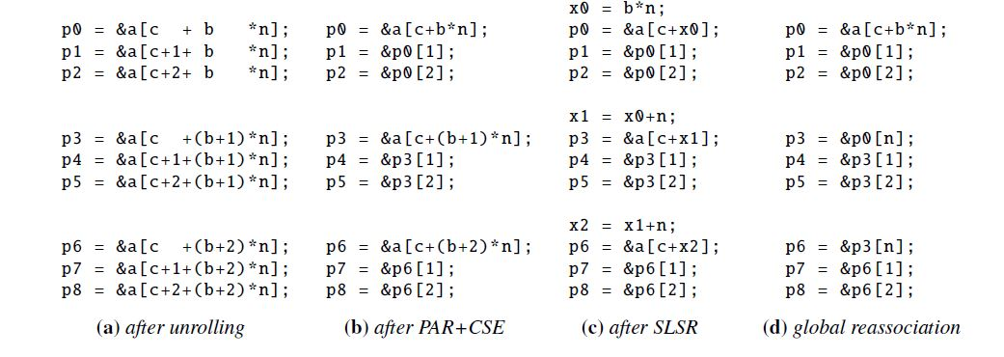
Gpucc optimizations (contd.)
Straight line scalar optimizations
Strength reduction (SLSR)
Common subexpression elimination (CSE)
Pointer arithmetic reassociation (PAR)
Global reassociation

Slide 8
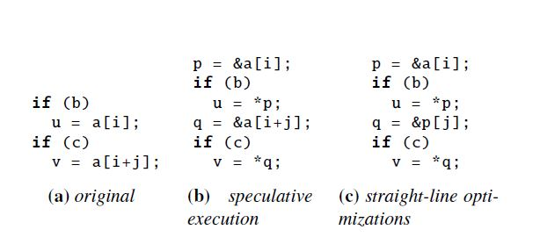
Gpucc optimizations (contd.)
Speculative execution
Bypassing 64-bit divisions
Silly but very effective. Only optimized Google’s internal benchmarks!

Slide 9
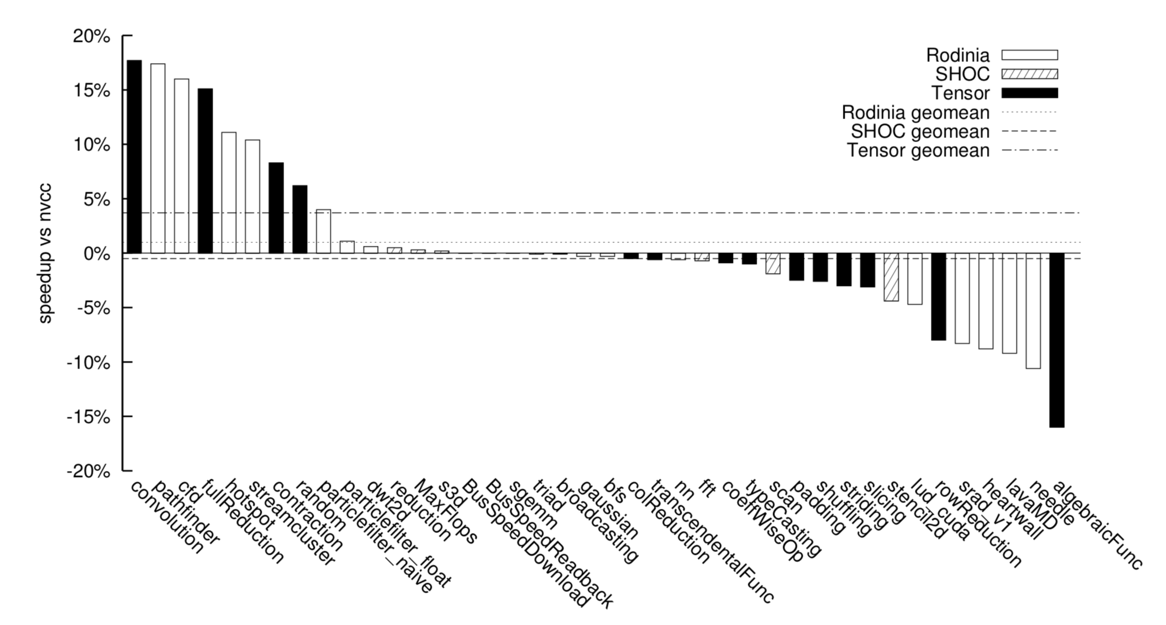
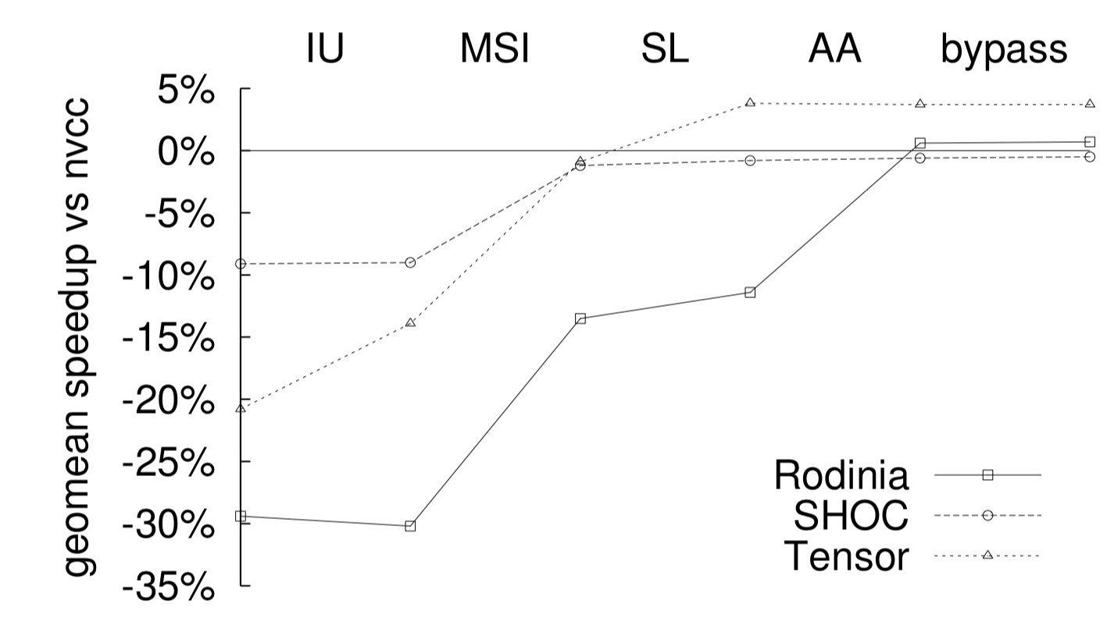
Gpucc results
On par with nvcc
All optimizations actually speed up the execution, geometric mean 21%

Slide 10
Lift: A Functional Data-Parallel IR for High-Performance GPU Code Generation
Problem: Optimizing map and reduce patterns are device specific
Solution: Internal representation for parallel patterns used in GPU programs

Slide 11
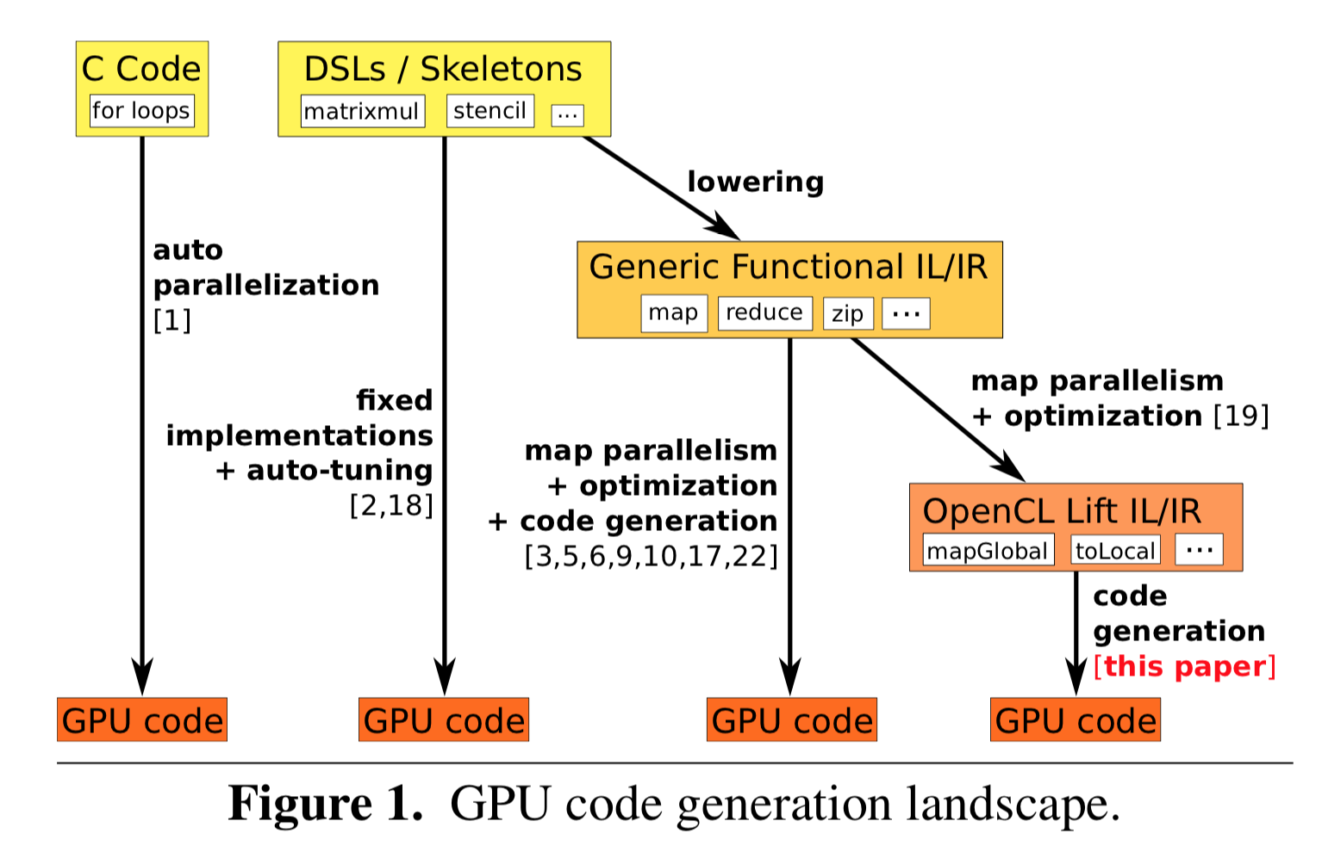
What is Lift IR?
High level representation of data-parallel programs
Compiler from the IR to OpenCL

Slide 12
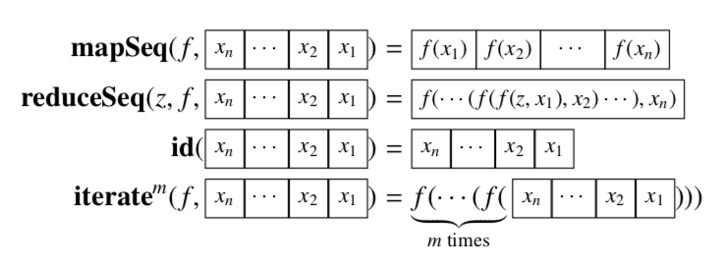
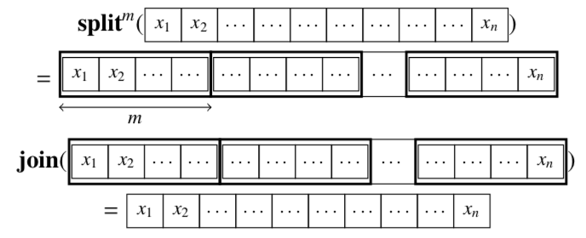
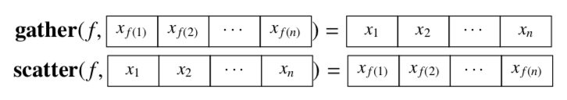
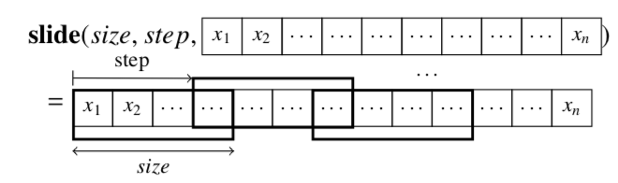
Lift Functions
Algorithm Patterns Data Patterns

Slide 13
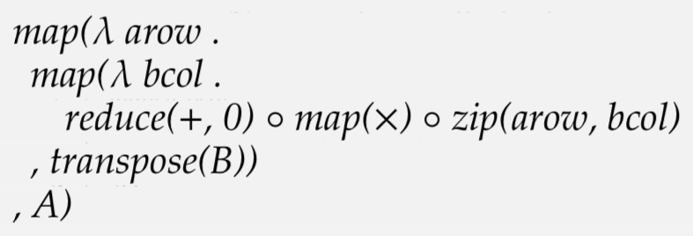
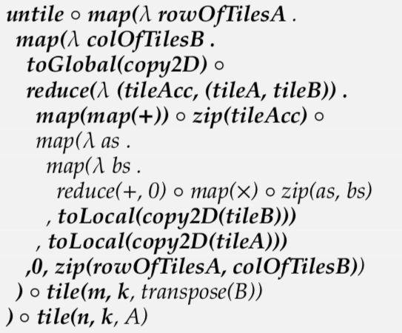
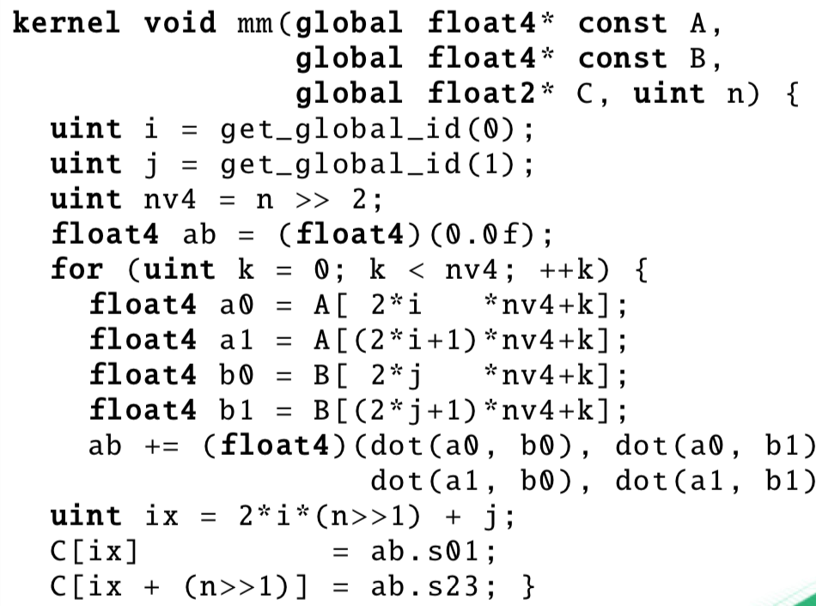
What Lift does
High level program OpenCL program

Slide 14
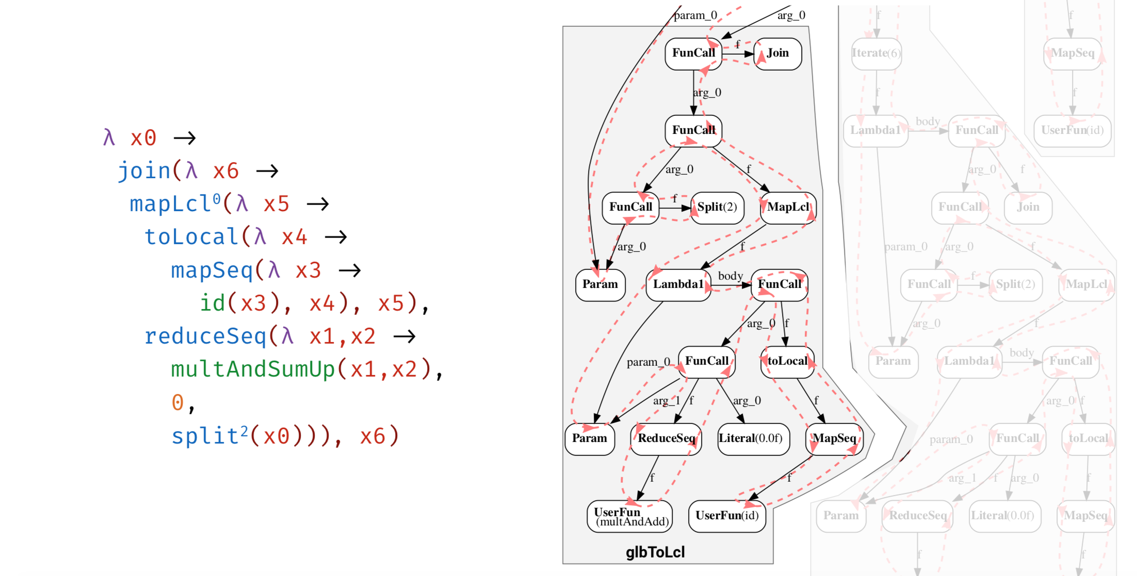
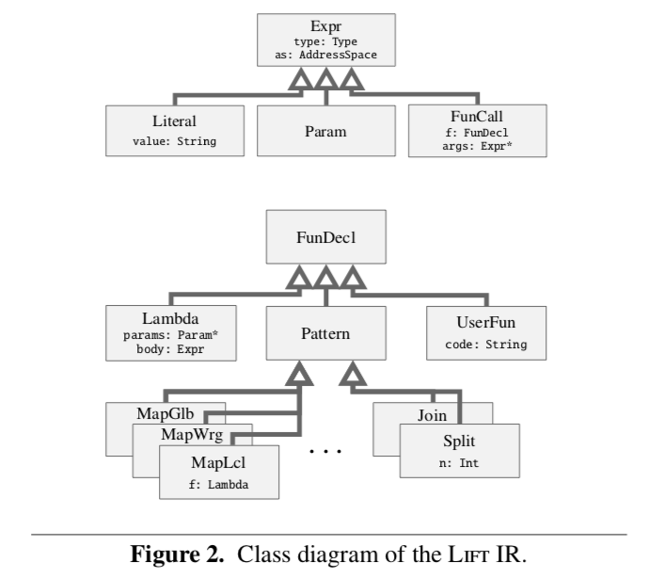
Lift Program/Graph for Dot Product

Slide 15
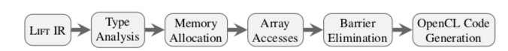
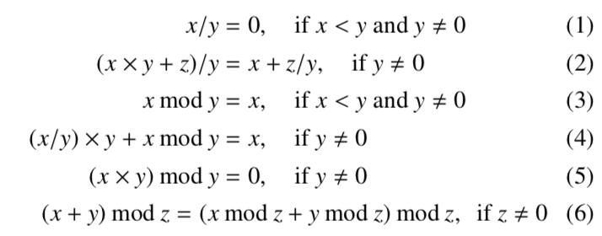
Lift IR optimizations
Array Accesses: Create simple OpenCL indexes for accesses

Slide 16
Lift IR optimizations
Barrier Elimination: Synchronize on accesses to the same memory. Only put in the necessary barriers after tracking memory accesses.
Control Flow Simplification: Only write for loops for map, iterate functions that have more iterations than threads.

Slide 17
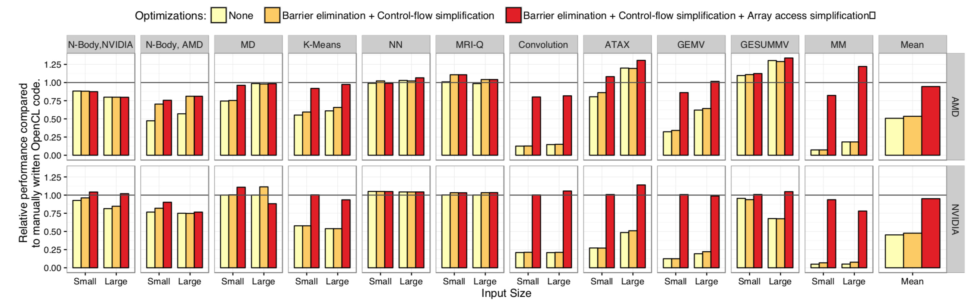
Lift IR results
Performance of Lift created code compared to manually optimized OpenCL

Slide 18
Twin Kernels Overview
Execution model to improve GPU hardware performance at compile time
Improves performance of memory bound kernels by emitting two binaries for the same code (Twin Kernel)
Relaxes strict ordering of executing on GPU’s (all kernels execute the same instruction in lock-step)
Compiler based solution, requiring minimal (initialization of program counter) or no change in the hardware
In a way, tries to perform out of order execution for an in-order processor.

Slide 19
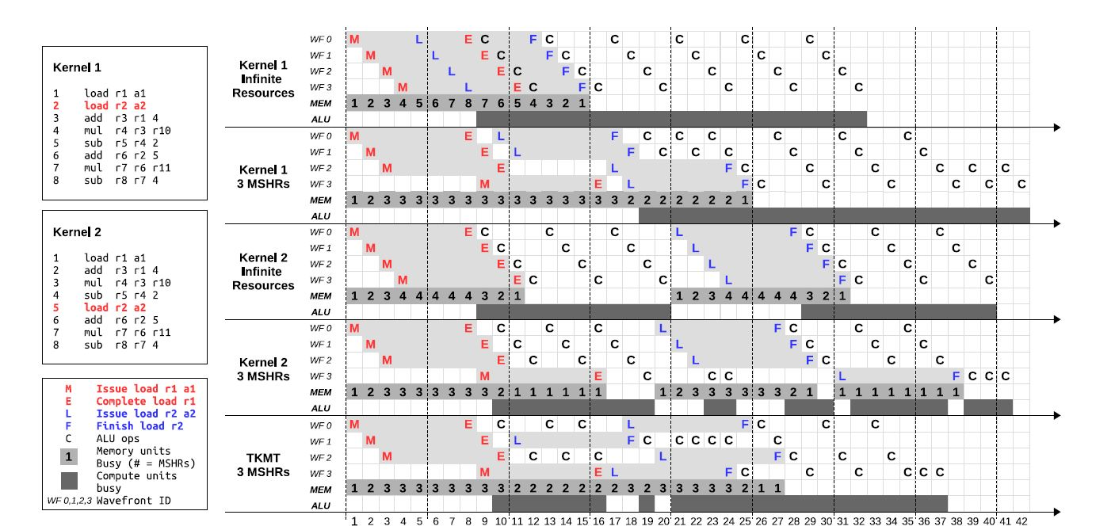
Twin Kernel Motivation

Slide 20
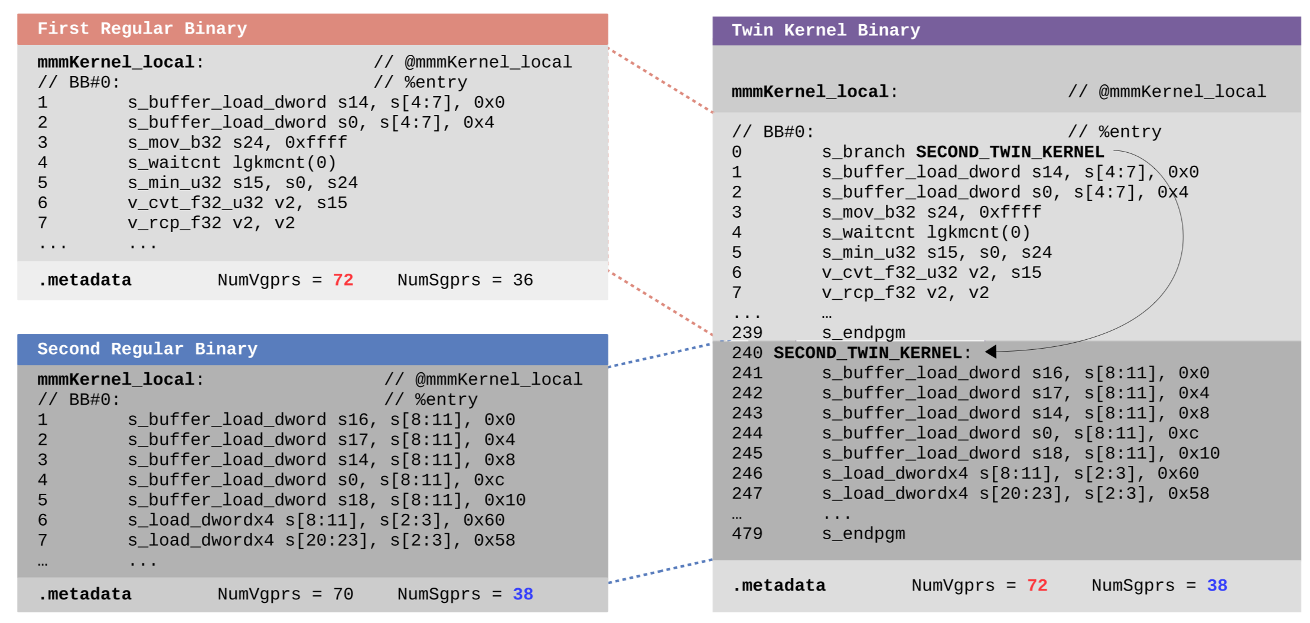
Twin Kernels Implementation
Notes:
Candidate with heavier register usage used for register usage information
Finalizer chooses among the candidate binaries and permutes them to finalize which two binaries give best performance in combination. Passes them on to the assembler which generates the above code in a single file.
How to pick which binary to execute?
Uses performance tuning based on memory distance.
Profile each scheduler’s performance.
Profiling and evaluation considered together to build and execution schedule. Give higher probability to kernels that execute faster
Last step is execution of the best chosen kernels

Slide 21
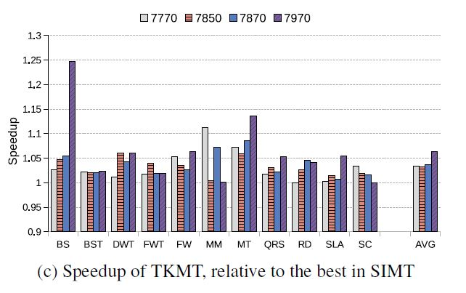
Twin Kernels Results
Notes:
8% faster across all platforms.

Slide 22
Discussion and Topics
What could be added to the gpucc IR for optimization?
Would generating non-OpenCL code from a data-parallel IR have room for optimizations?
Can we apply Twin Kernels to with other devices with similar bottlenecks?
Can we make the Twin kernels model more generic, identify and scatter bottleneck instructions ?
Can we use Machine Learning to pick the best Twin Kernels?

