Slide 1
Intermittent Computing
Tianyu Li & Billy Zhu
Notes:
Outline:
- Background: What are energy-harvesting devices, what are the key challenges faced when programming on them, and what are the key techniques?
- Energy-harvesting devices: harvest for a long time, run for a short period (use numbers from paper)
- image of an example device showing how it’s powered, where it’s used
- diagram of capacitor charge over time
- Key challenges:
- ensure correctness (memory consistency)
- ensure progress
- Key techniques:
- checkpointing: save & load state
- independent tasks: abort & restart task
- Overview of three papers: how they differ in solving the key challenges?
- Ratchet: Automatic checkpoint adding by identifying idempotency
- Alpaca: User-defined tasks
- Chinchilla: Automatic checkpoints at each basic block with dynamic chkpt disabling
- Delve into each paper:
- state of prior work (for the first paper)
- how each claims to improve upon the earlier ones
- brief implementation
- key measurement results
- (key downsides)

Slide 2
Background
Where did intermittent computing come from?

Slide 3
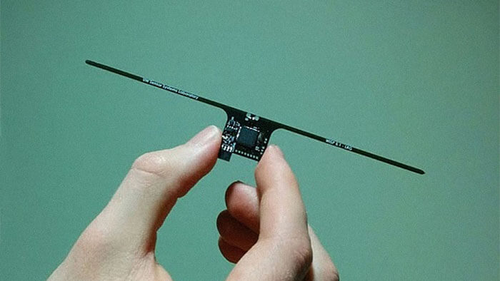
Energy-harvesting Devices
Battery-less
Operate entirely on energy extracted from the environment (sunlight, radio waves, etc.)
WISP RF-powered
Energy-harvesting Platform
Notes:
To get ubiquitous computing
Microcontrollers -> smaller, cheaper, more energy efficient
battery sizes have not caught up
Image: http://www.electronics-lab.com/wisp-re-programmable-microcontroller-runs-energy-harvested-radio-waves/

Slide 4
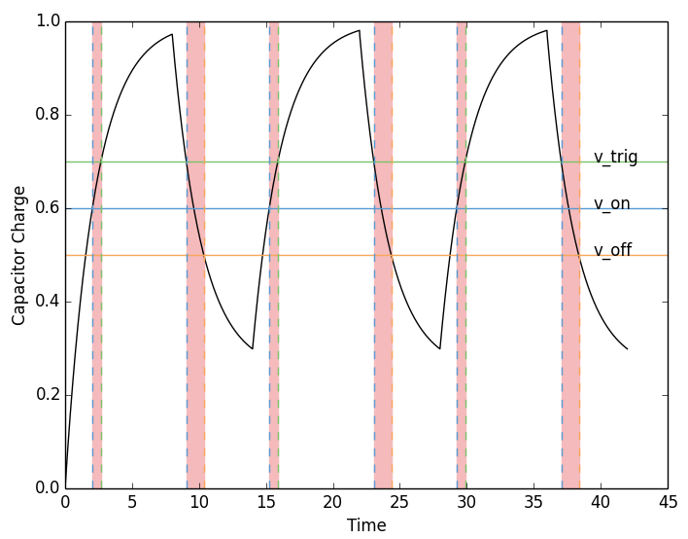
Energy-harvesting Devices
Charge: 1 s
Run: 10 ms
Unreliable power:
Computation may stop at any time
Images:
1. Joel Van Der Woude and Matthew Hicks. 2016. Intermittent computation without hardware support or programmer intervention. In Proceedings of the 12th USENIX conference on Operating Systems Design and Implementation (OSDI'16). USENIX Association, Berkeley, CA, USA, 17-32.
Notes:
Slowly buffers energy into a capacitor, once sufficient energy accumulates, the device starts operating and quickly consumes the energy
-> unreliable power
Image: 16 paper

Slide 5
Key Challenges
Fail-restart is the common case
Ensure Progress
Ensure Correctness
Notes:
Need restart -> BUT cannot always start from beginning -> might always fail in the middle
Ensure progress -> save progress and start from last time
-> Ensure correctness (memory consistency)

Slide 6
Common Techniques
Checkpointing
General checkpoints interleaved in code
State is saved before power off
State is restored at power on
Task-based
Computation divided into separate tasks
Task internal state is thrown away at power off
Task restarted from scratch at power on
Notes:
Techniques for saving progress
Tasks run sequentially

Slide 7
Paper Overview

Slide 8
Prior Work
Specialized Hardware
Single Checkpointing: Measure voltage and save once
Easy
Large “guard bands”
Wastes energy
Programmer Expertise
Humans divide up the program manually
Risks never completing
Small requirement change could cause large code structure change
Notes:
Two general approaches:
Single checkpointing: saves state _just_ before power runs out
Programmer burden

Slide 9
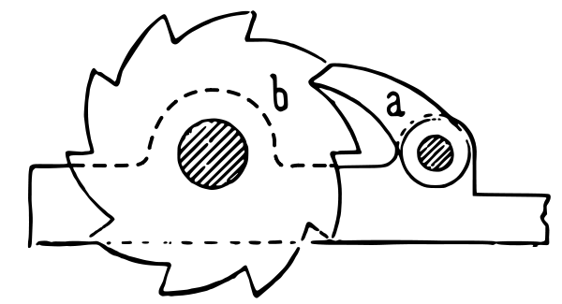


Today’s Papers
Ratchet (OSDI’16 Van Der Woude, Hicks)
Compiler inserts checkpoints
Identifies idempotent sections
Alpaca (OOPSLA’17 Maeng, Colin, Lucia)
Task-based
Supports mixed-volatility memory
Chinchilla (OSDI’18 Maeng, Lucia)
Compiler inserts checkpoints
Dynamically disables checkpoints for performance
Images:
1. Original OSDI’16 Talk Slides
2. By Notnoisy - Own work, CC BY 3.0, https://commons.wikimedia.org/w/index.php?curid=5194892
3. By Kjersti Holmang - Own work, CC BY-SA 3.0, https://commons.wikimedia.org/w/index.php?curid=13289340
Notes:
All are handily named!

Slide 10
Intermittent Computation without Hardware Support or Programmer Intervention (Ratchet)
Joel Van Der Woude, Matthew Hicks

Slide 11
Automatically Inserting Checkpoints
Prior work: need specialized hardware / programmers
Ratchet: eliminates this need
Compiler automatically adds checkpoints to code between idempotent sections
Notes:
Key: idempotent sections

Slide 12
Non-volatile Memory
Data not lost after power off
Problem solved? Just save all registers periodically.
Notes:
Typically.
NON-VOLATILE Memory!:
Memory is not lost when power is cut off. At first glance, it seems this solves all problems, just save all the registers periodically, but not really!

Slide 13
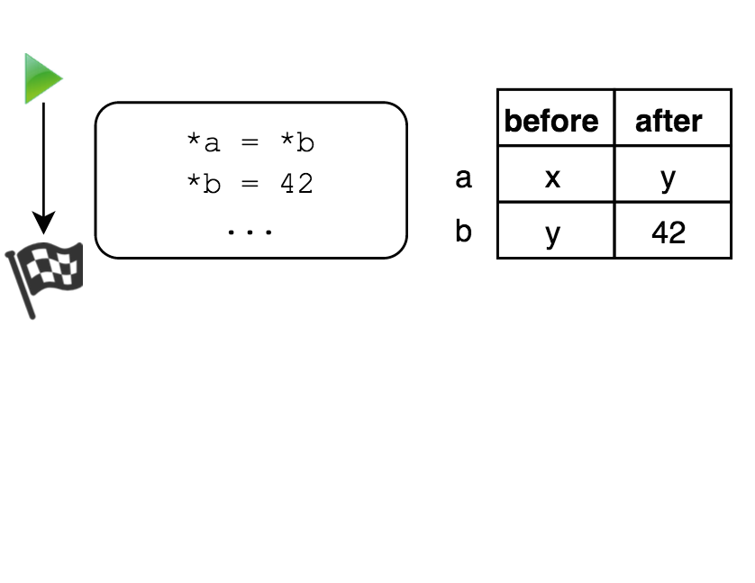
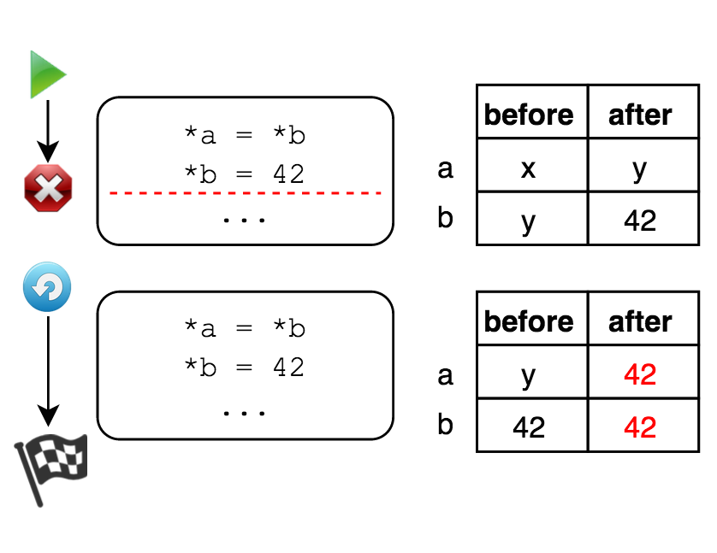
Cannot add checkpoints anywhere
Write-After-Read (WAR)

Slide 14
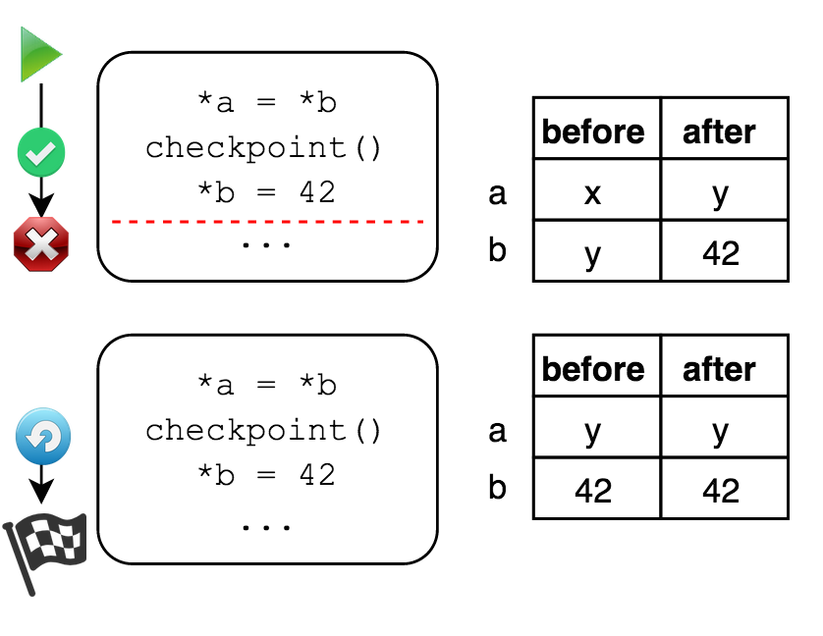
Idempotent Sections
Can be re-executed to get the same result
Write-After-Read (WAR)
Ratchet inserts a checkpoint between the write and the read
Notes:
Normally WAR is inconsequential
But if execution can be restarted, we may end up reading a different value

Slide 15
Implicitly Idempotency Violations
POP: read and update stack pointer (invalidates memory)
Replace with loads, checkpoint, and update stack pointer
Reusing stack locations
Disallow sharing (-no-stack-slot-sharing)
Notes:
POP: if the invalidated memory is subsequently modified, a restart to the pop instruction will read a different value

Slide 16
Timer-induced Checkpoints
Ensure Progress
Timer interrupts
Checkpoint if failed to make progress twice
Saves all registers
(Needs to be set by experts)
Notes:
If some idempotent sections are too long, power can always fail before done
Timer interval: too low - overhead, too high - useless

Slide 17
Recovery
Check if valid checkpoint exists in main
Restore saved registers (only live ones were saved)
Restore program counter
Restart execution

Slide 18
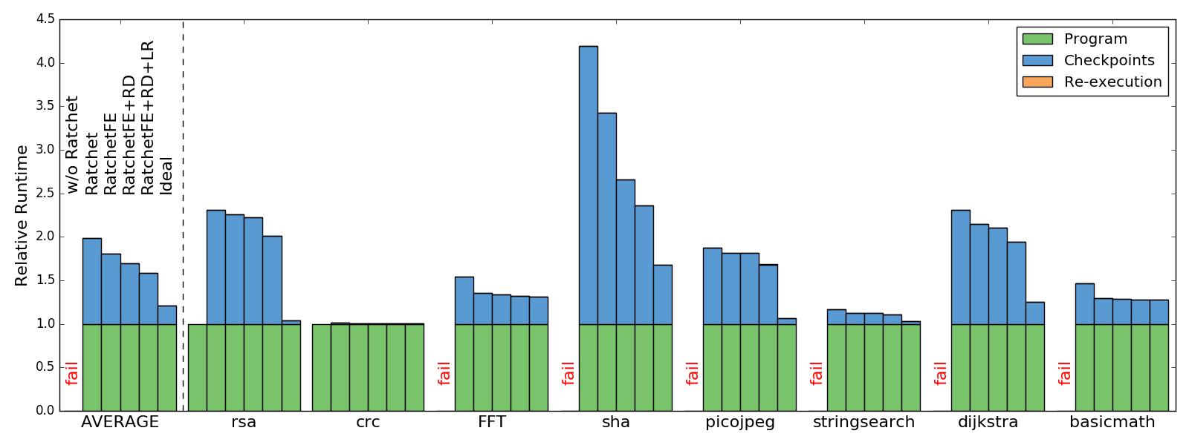
Evaluation - Runtime Overhead
FE: Function entry optimization, RD: Remove redundancy, LR: Live registers only
Notes:
FE: regularly: conservatively insert checkpoint at each function entry.
Optimized: insert chkpt only if there’s a write that may alias with an address outside of the function’s local stack frame.
RD: redundancy: a pair of chkpts where any potential idempotency violations can be protected by one chkpt.

Slide 19
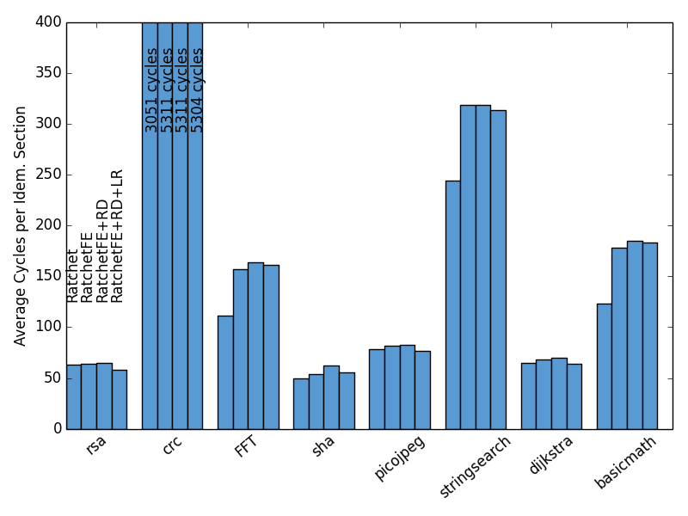
Evaluation - Cycles per Idempotent Section
Shorter idempotent sections
Higher runtime overhead
Notes:
Very program dependent:
If WAR dependence in hot loop, lots of chkpts

Slide 20
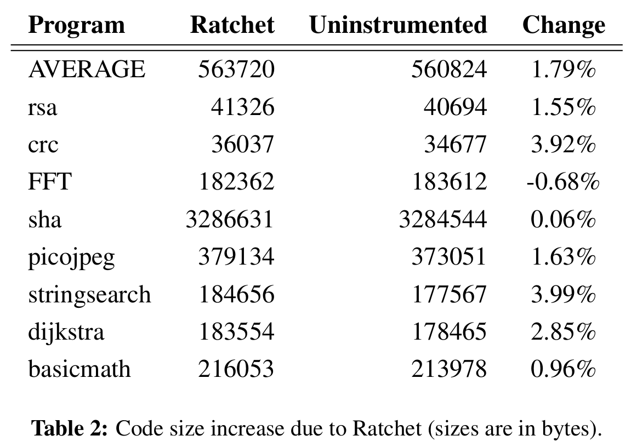
Evaluation - Code Size Increase
Recovery code
Checkpoint calls
Replacing POPs
Notes:
Very reasonable increase

Slide 21
Alpaca: Intermittent Execution without Checkpoints
Kiwan Maeng, Alexei Colin, Brandon Lucia
Notes:
Previous paper: without special hardware and programmer
Now: without checkpoints

Slide 22
Criticism of Previous Paper
Only works on devices with only non-volatile memory
Many off-the-shelf microcontrollers have hybrid memory
Costs more energy and time than volatile memory
Limited by static analysis

Slide 23
Static Task Model
No checkpoints
Task manipulates privatized copies of data
Commits modifications atomically upon completion
Power failure - private data discarded with no cost
(Similar to transactional memory with redo-logging)
Notes:
Not fundamentally tied to redo (undo left as future work)

Slide 24
Task-Based Programming
Programmer decomposes program into tasks
Explicitly transfers control between tasks
Task-shared Variables: global scope, non-volatile
Task-local Variables: private scope, initialized by task, volatile
Guarantee: Task atomicity
Notes:
Note the difference:
Task local =/= privatized global values

Slide 25
Privatization - Scalars
Variable copied to private buffer (in NVM)
Subsequent accesses redirected
Optimization: only privatize those involved in WAR dependencies

Slide 26
Two-phase Commit
Pre-commit
Entry added to commit_list table (non-volatile)
Set commit_ready flag
Commit
Go through commit_list and copy to original location
Notes:
Commit_list pre-allocated to max number of entries required by any task
End_index tracks the end of the commit_list

Slide 27
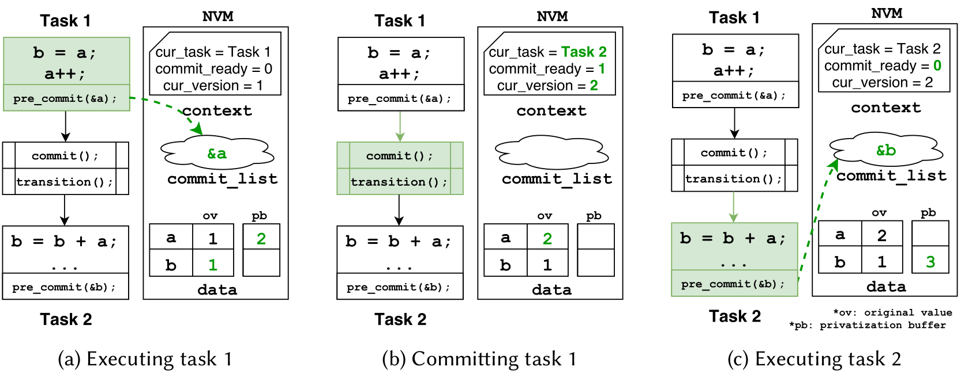
Workflow
Notes:
Cur_version is used for privatizing arrays (next slide!)

Slide 28
Arrays
Same size array is privately buffered, but privatized by element
Initialize a copy
Redirect accesses
Add to commit_list via pre_commit (only for first write)
First write is kept using a version-backed bitmask
Limitation: Programmer must refer to array elements directly
Notes:
An access (read/write) initializes the copy
Version-backed bitmask: constant time clearing
Limitation: no pointer arith

Slide 29
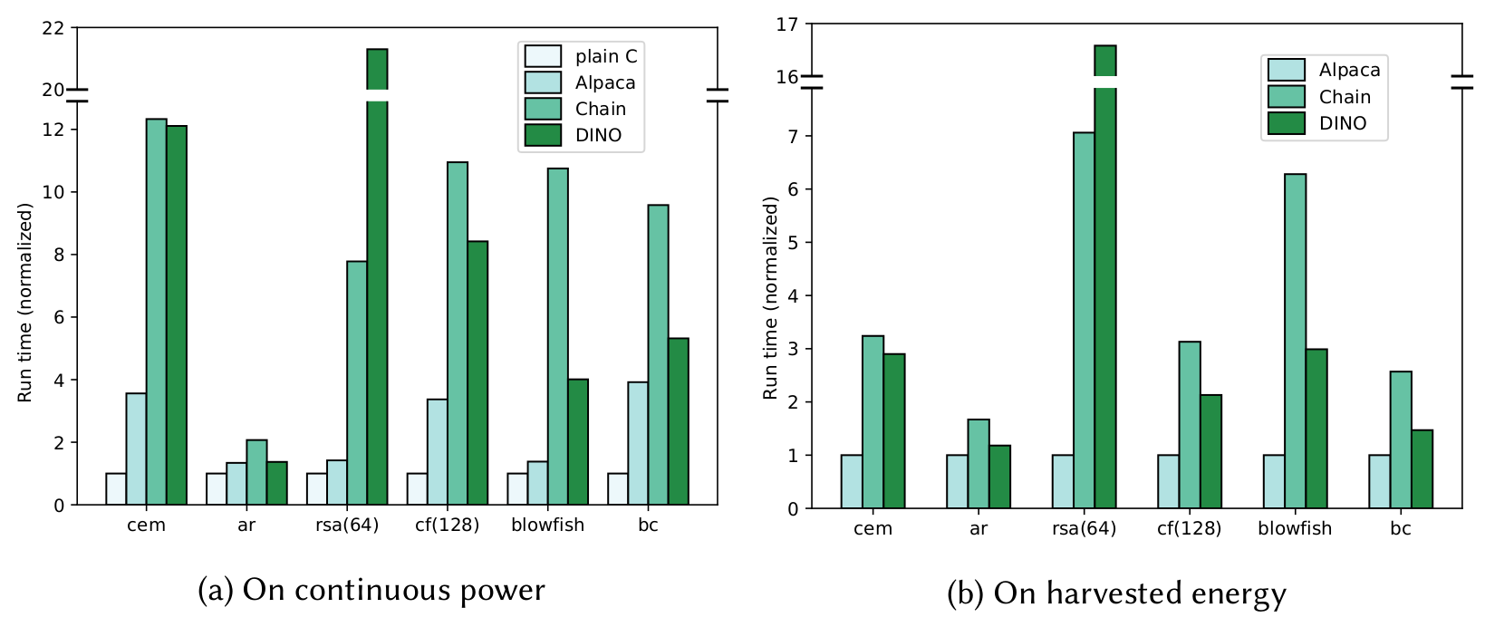
Evaluation - Performance
Normalized to (a) Plain C, (b) Alpaca
Notes:
DINO: volatile checkpointing with non-volatile versioning (make copy and version volatile data)
- selectively makes copy of data that may become inconsistent (have to version entire array), also has to restore stack!
Chain: static multi-versioning (a copy per each pair of tasks that share it)
Performance gap larger on harvested energy: Alpaca has extremely low reboot overhead
Only slightly slower than plain C
Significantly better than Chain and DINO
Plain C cannot run on harvested energy

Slide 30
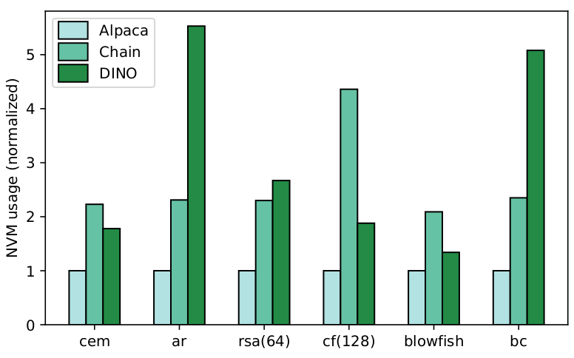
Evaluation - NVM Usage
Low non-volatile memory usage important to ubiquitous computing
Applicable to more kinds of devices

Slide 31
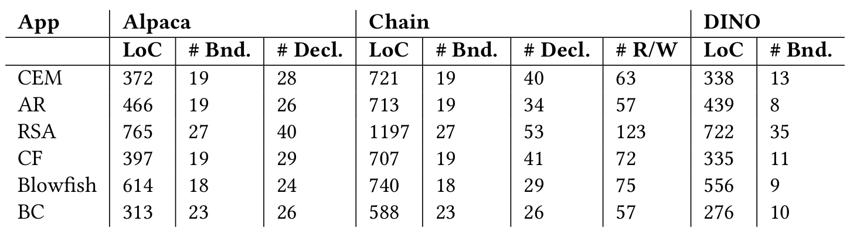
Evaluation - Programmer Effort
Measure: Lines of code and number of keywords
Complexity is between Chain and DINO
Notes:
Bnd: boundary keyword - task boundary
Decl: declaration keyword - modify function and data declaration
R/W: read/write keyword - channel-in/out for Chain (for accessing memory), the other two use standard C read/write memory interface

Slide 32
Adaptive Dynamic Checkpointing for Safe Intermittent Computing (Chinchilla)
Kiwan Maeng, Brandon Lucia
Notes:
Same author

Slide 33
Criticism of Prior Work
Hard to guarantee forward-progress / termination
Explicit Task Model (e.g. Alpaca)
Require careful programming for non-termination
Hard to estimate energy use for various task input
Automatic Checkpointing (e.g. Ratchet)
Blindly insert without considering non-termination
No programmer control over duration / energy-consumption of a task/section (cannot be fixed)

Slide 34
Adaptive Dynamic Checkpointing
Conservatively insert checkpoints to avoid non-termination
Dynamically disable checkpoints to minimize overhead

Slide 35
Short, Predictable Blocks
Criteria
Statically defined
Frequent enough
Easy to measure energy cost
Low energy variance
Basic Blocks
User-defined atomic blocks (atomic keyword)
Notes:
Basic blocks: no branches, so no loops or input-dependent paths

Slide 36
Non-termination Check
Measure energy consumption of each block
Exhaustive, randomized, or representative inputs
CleanCut energy-measuring compiler - block measurement tool
Notes:
Chinchilla uses cleancut

Slide 37
Checkpointing & Undo Logging
Save only the registers and part of the non-volatile data
Uses a volatile stack, with “promoted” variables in NVM
If live range of var begins after a checkpoint, no need to save
Writes to NVM instrumented with undo logging
A small non-volatile stack persists stack data not visible to compiler passes (e.g. return addr, spilled registers).
Notes:
Promotes data that may not be re-initialized after a checkpoint
The nv stack is typically small and short-lived

Slide 38
Selective Checkpointing
Checkpoints skipped until timer elapsed
Timer interval set at runtime by binary search
Programmer only defines when to update

Slide 39
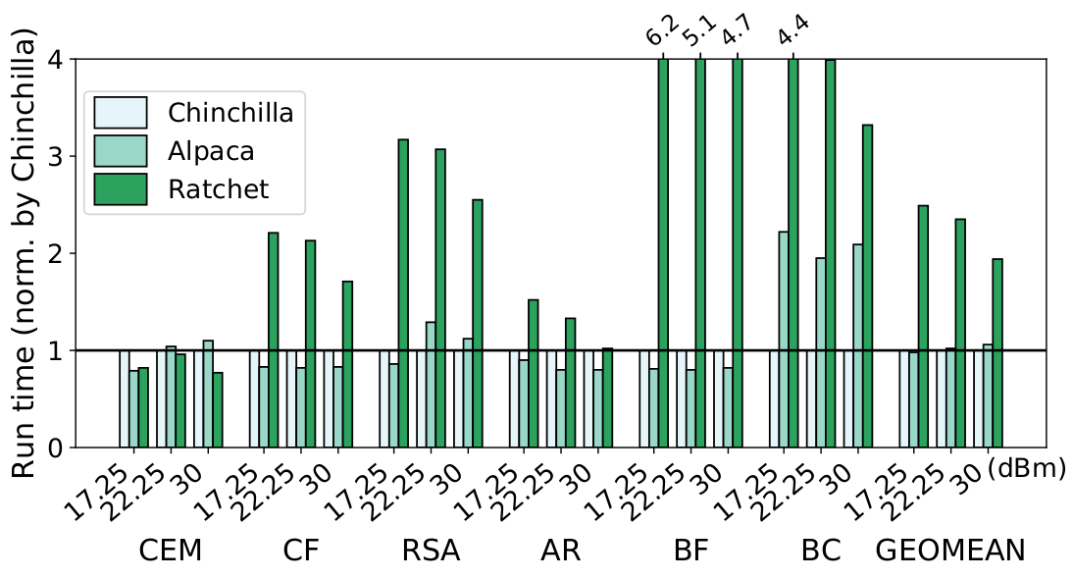
Evaluation - Run Time
Average 2.25x speedup over Ratchet
Average 2% speedup over Alpaca (human optimized)
Notes:
Note that alpaca is completely structured by humans, so an automated tool being comparable is significant

Slide 40
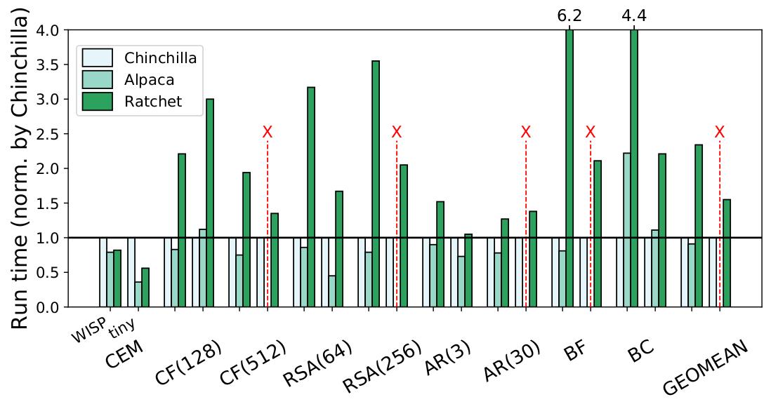
Evaluation -Varying Capacitor Size
Efficient across wide range of energy configs
Notes:
Alpaca failed 4 out of 9!

Slide 41
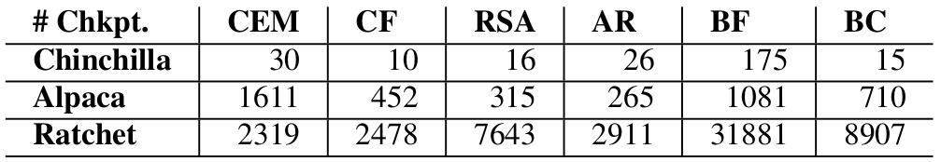
Evaluation - # Checkpoints Taken
Clear advantage of selective checkpointing

Slide 42
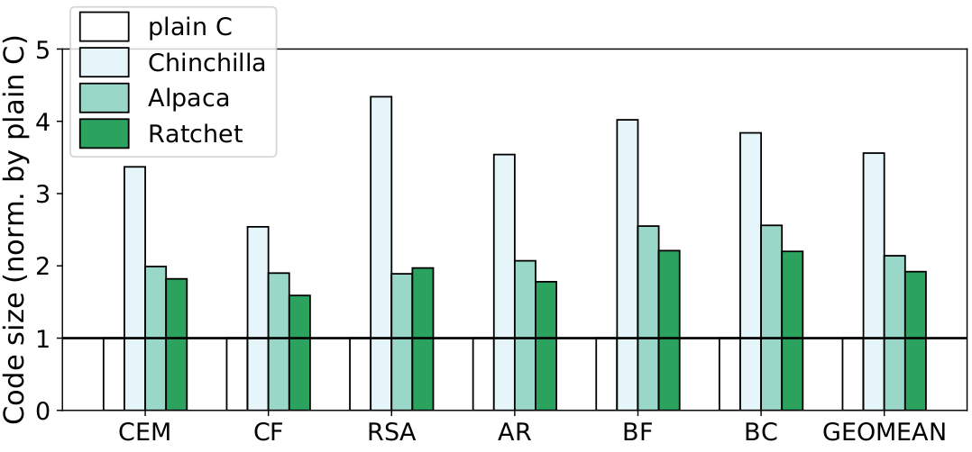
Evaluation - Compiled Code Size
Notes:
Downside

