Slide 1
The SPIR-V To Mesa-IR Pass
ANNUAL
2019
SUMMARY
Zhiqian Xia
(C) Copyright 2019, Shanghai Zhaoxin Semicoductor, Inc.

Slide 2
Agenda
1. SPIRV
2. NIR
3.

Slide 3
SPIRV -> NIR
两种表达系统的转换
线性IR → 树状IR
编程语言角度：
变量类型:
spirv:
hierarchically
OpTypeXXX
简单类型是叶子
表达式
语句
IF
Loop
函数
编译器角度：
控制流
数据流
Notes:
SPIRV : h

Slide 4
SPIRV -> NIR
两种表达系统的转换
线性IR → 树状IR
编程语言角度：
变量类型:
spirv:
hierarchically
OpTypeXXX
简单类型是叶子
Notes:
SPIRV : h

Slide 5
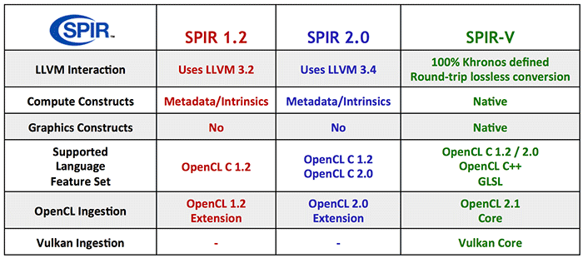
What is difference?
Native Representation of Graphical Shaders and Compute Kernels
Notes:
线性IR , Higl Level , SSA, Binary
While SPIR was designed as an intermediate binary representation for OpenCL programs only, SPIR-V acts as a cross-API intermediate language for both OpenCL 2.1 and 2.2 and the new Khronos Vulkan graphics and compute API.
A Khronos-Defined Intermediate Language for Native Representation of Graphical Shaders and Compute Kernels

Slide 6
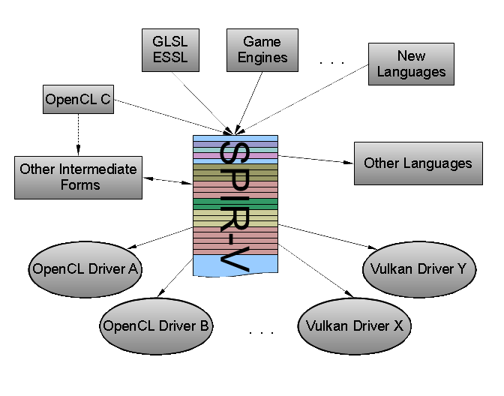
What is Good IR ?
Portability
Performance
Multiple Source Languages
IP Protection
Self-Contained
Native Representation
Simple
Binary Representation
Easy to Convert to other
Extendable
Notes:
当我在做这个PPT的时候，一直在思考一个问题，什么样的IR才是一种优秀的IR?
有表达力：准确无误的传达源码信息，同时携带源码没有的信息，如静态分析的结果，有助于后端Pass的处理。
SPIRV从十个维度进行了阐述：
Portability：
Performance:
Multiple Source Languages: Glsl , OpenCL, C++
IP Protection: 没有工具，原始binary难以修改和阅读
Self Contained : 独立
Native Representation： 支持 matrices, images 对象
Binary Representation: 消除在驱动中Paser和字符串处理的过程
Simple：Ir的逻辑布局是简单的
Easy to Convert to other Irs：High level IR
Extendable：其他厂商可以增加自己的独有东西

Slide 7
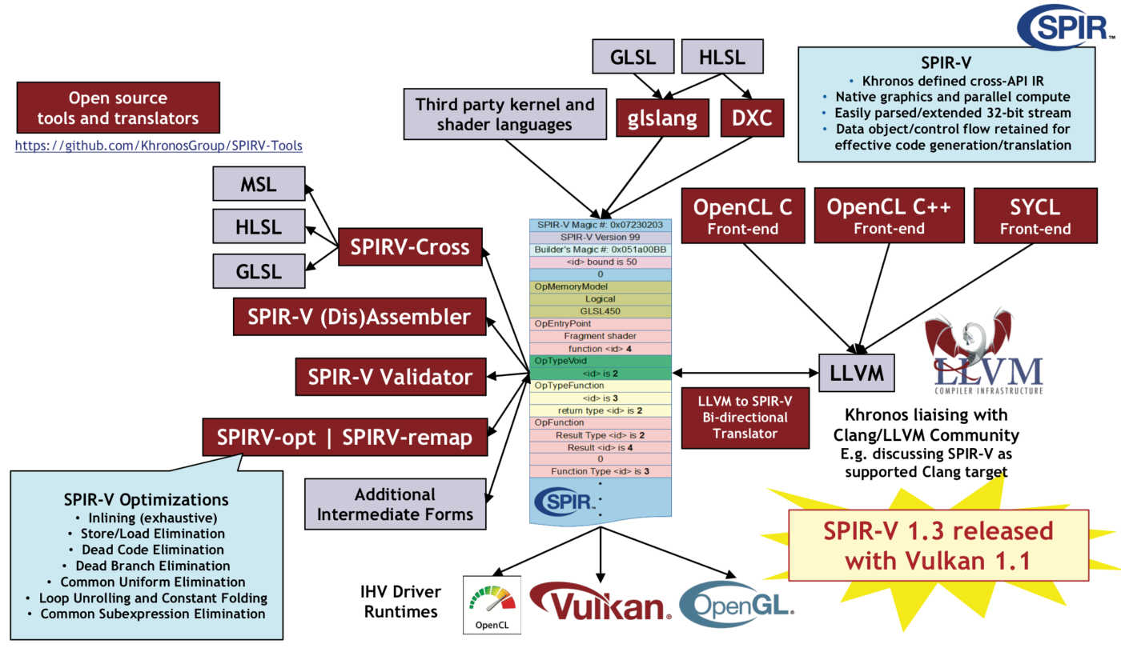
SPIR-V Software Stack
https://www.khronos.org/spir/
Notes:
1. The Industry Open Standard Intermediate Language for Parallel Compute and Graphics.

Slide 8
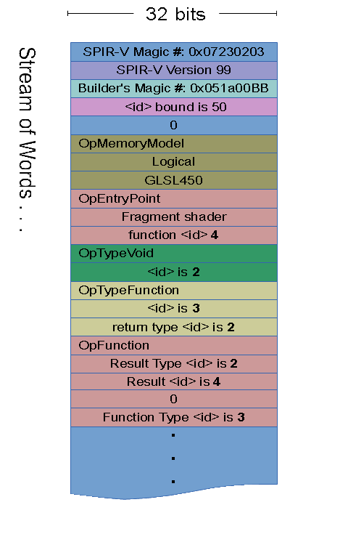
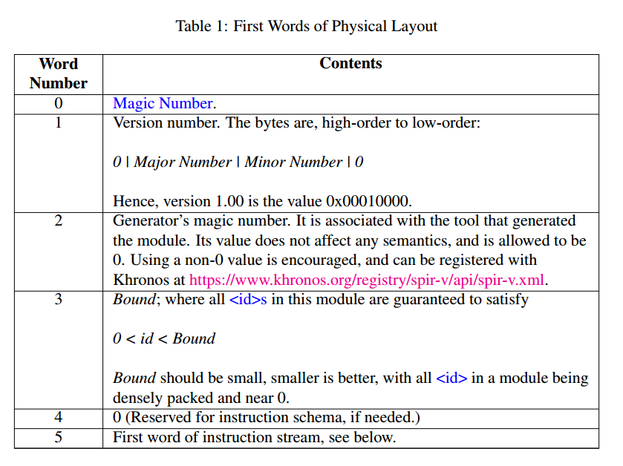
SPIR-V Module Physical Layout
Header (First 5 Slot)
Instruction Stream (linear)
Notes:
Header: 是固定的
紧跟着Header就是Module的指令，指令的布局： （SPIRV的指令长度是变长的，取决于指令类型和 Result(id)）

Slide 9
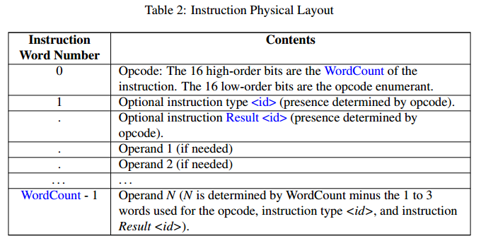
SPIR-V Intruction Physical Layout

Slide 10
SPIR-V Intruction Physical Layout
Header (First 5 Slot)
Instruction Stream (linear)
Notes:
Header: 是固定的
紧跟着Header就是Module的指令，指令的布局： （SPIRV的指令长度是变长的，取决于指令类型和 Result(id)）

Slide 11
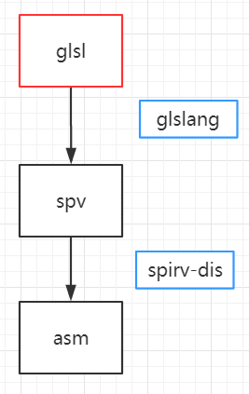
Simple example (glsl)
#version 450
layout(location = 0) out vec4 out_color;
void main()
{
out_color = vec4(sin(0.4),0.4,0.8,1.0);
}

Slide 12
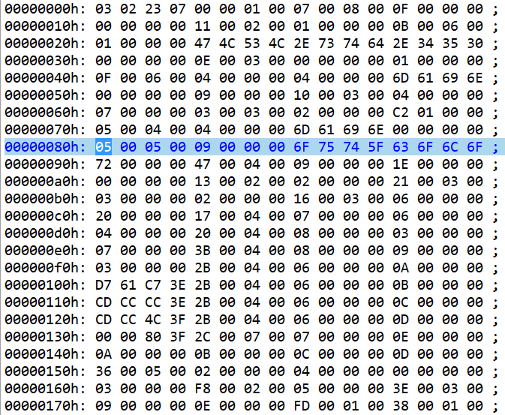
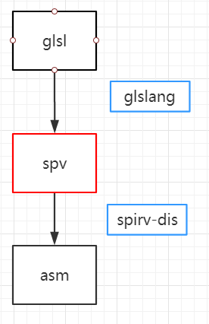
Simple example (spirv)

Slide 13
Simple example (spirv asm)
; SPIR-V
; Version: 1.0
; Generator: Khronos Glslang Reference Front End; 7
; Bound: 15
; Schema: 0
OpCapability Shader
%1 = OpExtInstImport "GLSL.std.450"
OpMemoryModel Logical GLSL450
OpEntryPoint Fragment %main "main" %out_color
OpExecutionMode %main OriginUpperLeft
OpSource GLSL 450
OpName %main "main"
OpName %out_color "out_color"
OpDecorate %out_color Location 0
%void = OpTypeVoid
%3 = OpTypeFunction %void
%float = OpTypeFloat 32
%v4float = OpTypeVector %float 4
%_ptr_Output_v4float = OpTypePointer Output %v4float
%out_color = OpVariable %_ptr_Output_v4float Output
%float_0_389418334 = OpConstant %float 0.389418334
%float_0_400000006 = OpConstant %float 0.400000006
%float_0_800000012 = OpConstant %float 0.800000012
%float_1 = OpConstant %float 1
%14 = OpConstantComposite %v4float %float_0_389418334 %float_0_400000006 %float_0_800000012 %float_1
%main = OpFunction %void None %3
%5 = OpLabel
OpStore %out_color %14
OpReturn
OpFunctionEnd
Header
#version 450
layout(location = 0) out vec4 out_color;
void main()
{
out_color = vec4(sin(0.4),0.4,0.8,1.0);
}

Slide 14
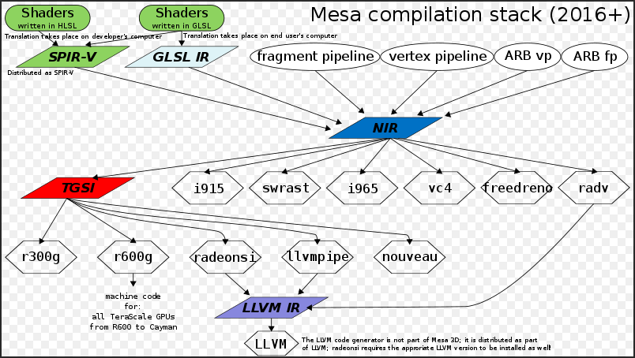
The Mesa 3D Graphics Library
Notes:
Mesa, also called Mesa3D and The Mesa 3D Graphics Library, is an open source software implementation of OpenGL, Vulkan, and other graphics specifications. Mesa implements a cross-language, cross-platform, vendor-neutral standard API for translating these specifications to vendor-specific graphics hardware drivers.
Ref: <Linux下GPU图形驱动软件的实现>

Slide 15
NIR Basic Data Structures
Data Structure | Description
nir_variable | A GLSL variable.
nir_deref | A dereference chain for a variable.
nir_register | An Non-SSA temporary storage.
nir_ssa_def | An SSA definition.
nir_src | An instruction source
nir_dest | An instruction destination.
nir_instr | An instruction
nir_cf_node | A node in the control flow graph.
nir_shader | A shader.
Data Structure | Description
nir_block | A basic block.
nir_if | An if statement.
nir_loop | An endless loop.
nir_function_impl | A function implementation.
Notes:
树状 SSA-IR
It is primarily an SSA-based IR.
It supports source/destination-modifiers and swizzles.
Standard GPU operations such as sin() and fmad() are first-class ALU operations, not intrinsics.
GLSL concepts like inputs, outputs, uniforms, etc. are built into the IR so we can do proper analysis on them.
Even though it’s SSA, it still has a concept of registers and write-masks in the core IR data structures. This means we can generate code that is much closer to what backends want.

Slide 16
spirv_to_nir
nir_function *spirv_to_nir(const uint32_t *words, size_t word_count,
struct nir_spirv_specialization *specializations,
unsigned num_specializations,
gl_shader_stage stage, const char *entry_point_name,
const struct nir_spirv_supported_extensions *ext,
const nir_shader_compiler_options *options);
Notes:
扫描SPIRV的binary, 找到function entry point(main)

Slide 17
Entry Point : SpirvCompile()
void * SpirvCompile();
参数
Num | Name
1 | const uint32_t *words
2 | size_t word_count
3 | struct nir_spirv_specialization_id *specializations
4 | unsigned num_specializations
5 | struct nir_shader_info *shader_info
6 | unsigned stage
7 | const char *entry_point_name
8 | const shader_compiler_options *options

Slide 18
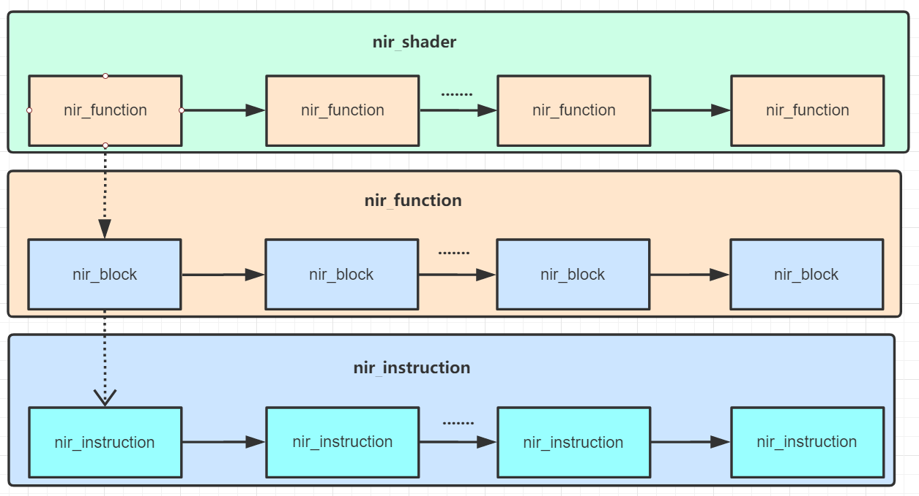
NIR Pragram Core Structure
Traveral of NIR data structure usually occurs through link list

Slide 19
Struct nir_shader
typedef struct nir_shader
{
struct exec_list uniforms;
struct exec_list inputs;
struct exec_list outputs;
struct exec_list shared;
const struct nir_shader_compiler_options *options;
struct shader_info info;
struct exec_list globals;
struct exec_list system_values;
struct exec_list functions;
struct exec_list registers;
unsigned reg_alloc;
unsigned xsharp_reg_alloc;
unsigned usharp_reg_alloc;
unsigned tex_reg_alloc;
unsigned sampler_reg_alloc;
unsigned input_reg_alloc;
unsigned output_reg_alloc;
unsigned num_inputs, num_uniforms, num_outputs, num_shared;
nir_function *entry_point;
} nir_shader;

Slide 20
Struct nir_function
typedef struct nir_function {
struct exec_node node;
const char *name;
struct nir_shader *shader;
unsigned num_params;
nir_parameter *params;
const struct glsl_type *return_type;
nir_function_impl *impl; // Pattern
} nir_function;

Slide 21
Struct nir_function
typedef struct {
nir_cf_node cf_node; // nir_block | nir_if | nir_loop | nir_function_impl
struct nir_function *function;
struct exec_list body;
nir_block *end_block;
struct exec_list locals;
unsigned num_params;
nir_variable **params;
nir_variable *return_var;
struct exec_list registers;
struct exec_list icb_registers;
unsigned reg_alloc;
unsigned ssa_alloc;
unsigned num_blocks;
nir_metadata valid_metadata;
} nir_function_impl;

Slide 22
Struct nir_block
typedef struct nir_block {
nir_cf_node cf_node;
struct exec_list instr_list; //list of nir_instr
unsigned index;
struct nir_block *successors[2];
struct set *predecessors;
struct nir_block *imm_dom;
unsigned num_dom_children;
struct nir_block **dom_children;
struct set *dom_frontier;
unsigned dom_pre_index, dom_post_index;
BITSET_WORD *live_in;
BITSET_WORD *live_out;
} nir_block;

