Slide 1
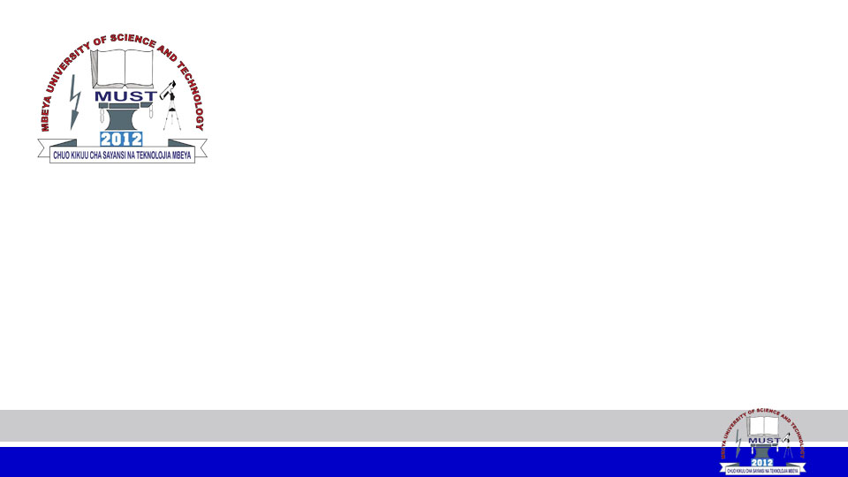
INTRODUCTION
MODULE CODE: CS 6146
MODULE NAME: Operating Systems
FACILITATOR: Pangahela, R. A
Email: pangriz@gmail.com Phone: +255 742 926 569

Slide 2
Introduction to OS
Agenda:
  What is an Operating System?
  Computer System Components
  Operating System Services
  Functions of Operating Systems
  User Interface Types
  System Call Implementation
  Operating Systems Types
  Computer-Startup Operation

Slide 3
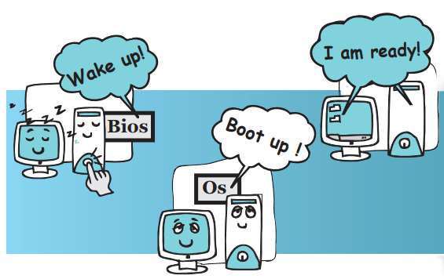

Slide 4
What is an Operating System?
An operating system (definition) is a program that manages the computer hardware and provides the base for application programs.
It acts as an intermediary between the user application and hardware
It provides an environment within which Application programs can do work
It acts as the resource manager of the following resources:

Slide 5
  CPU time
  Memory
  File Storage
  I/O devices
It acts as a control program that manages the execution of application programs and prevent errors and improper use of the computer.
Kernel :The operating system core component that is running at all times on the computer.

Slide 6
Computer System Components
Hardware: provides basic computing resources: CPU, memory, secondary storage, and I/O devices
Operating System: as in the definition above
System Software: Utilities that are associated with the operating system but not part of the kernel.
Application Software – The programs that helps end-users to perform specific tasks such as: Word Editor, web browsers, database systems, video games …etc.
Users: People, or other machines.

Slide 7
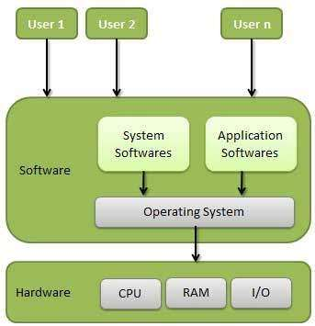
Computer System Components

Slide 8
Operating System Services
User interface which can be either CLI or GUI
Program execution - to load and run a program into memory, end execution, either normally or abnormally.
File-system manipulation – enables running program to:
    create and delete files and folders
    read and write files and folders,
    List and Search files and folders
    Permission management.

Slide 9
I/O operations - to offer running program a way of interaction with I/O devices.
Inter-Process Communications – Enables processes to exchange information.

Slide 10
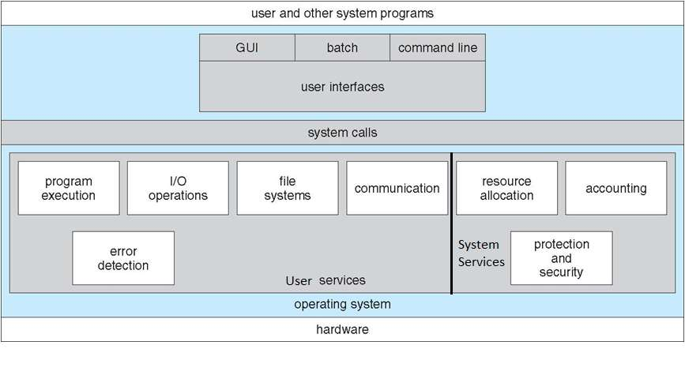
A View of Operating System Services

Slide 11
Functions of Operating System
Processor Management: An operating system manages the processor’s work by allocating various jobs to it and ensuring that each process receives enough time from the processor to function properly.
Memory Management: An operating system manages the allocation and deallocation of the memory to various processes and ensures that the other process does not consume the memory allocated to one process.

Slide 12
Device Management: OS controls the working of these input-output devices. It receives the requests from these devices, performs a specific task, and communicates back to the requesting process.
File Management: An operating system keeps track of information regarding the creation, deletion, transfer, copy, and storage of files in an organized way.
Security: The operating system provides various techniques which assure the integrity and confidentiality of user data.

Slide 13
Error Detection: OS checks the hardware for any type of damage, or any software error, then displays a proper alert to the user so that the appropriate action can be taken.

Slide 14
User Interface Types
Command Line Interface (CLI)
CLI or command interpreter allows direct command entry.
It is implemented in kernel, or by system program
It fetches a command from user and executes it
Commands are either built-in, or other programs

Slide 15
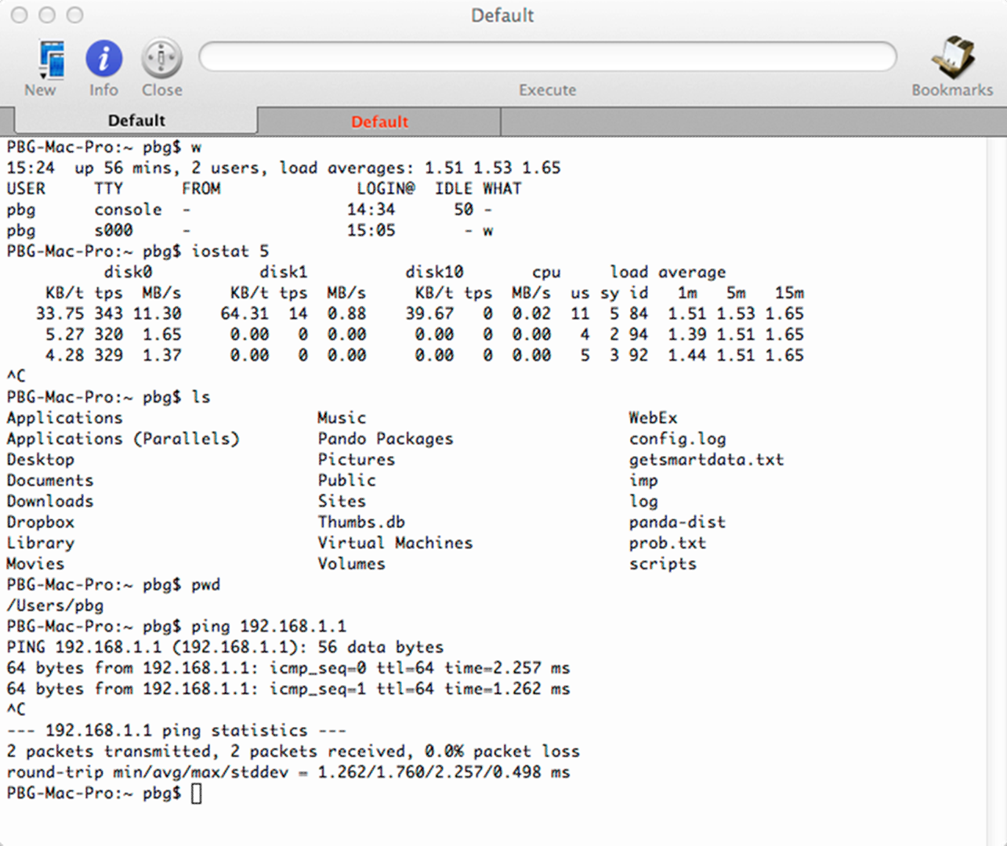

Slide 16
Graphical User Interface (GUI)
User-friendly desktop interface that interacts with mouse, keyboard, and monitor.
Icons represent files, programs, actions, etc.
Various mouse buttons over objects in the interface cause various actions (provide information, options, execute function, open a folder)
Many systems now include both CLI and GUI interfaces

Slide 17
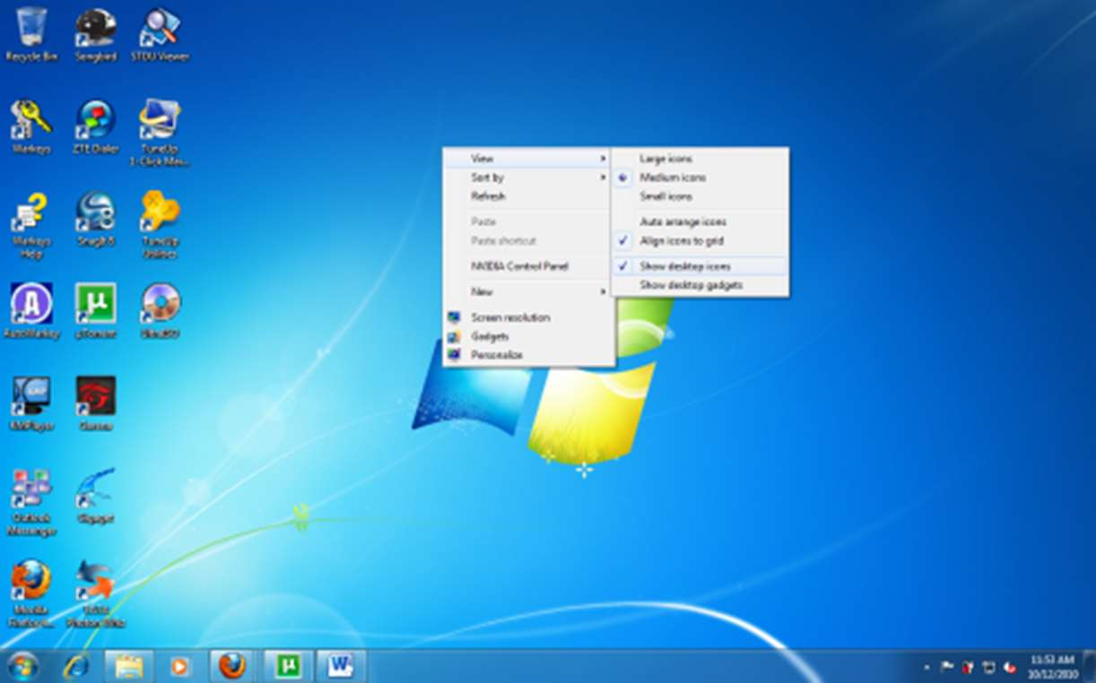

Slide 18
Touch Screen Interface
A touchscreen interface is a combined display/input device; where the screen displays a graphical interface, and a user’s physical touching of the screen is interpreted as an input
  Mouse is not desired
  Actions and selection are based on gestures
  It uses virtual keyboard for text entry

Slide 19
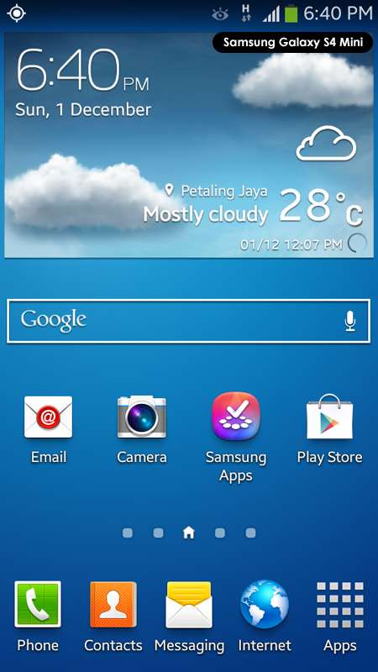

Slide 20
System Call Implementation
System Calls are Programming interface to the services provided by the OS.
An Application Programming Interface (API) is a set of routines, data structures, object classes and/or protocols provided by libraries and/or operating system services in order to support the building of applications.
DLLs are used in Windows OS which hold data structures, object classes and APIs

Slide 21
Three most common APIs are:
    .NET API for Windows,
    POSIX API for POSIX-based systems (mainly UNIX versions)
    Java API for the Java virtual machine (JVM)
The system call interface invokes the intended system call in OS kernel and returns status of the system call and any return values
The caller Just needs to obey API and understand what OS will do as a result call.
Most details of OS interface hidden from programmer by API

Slide 22
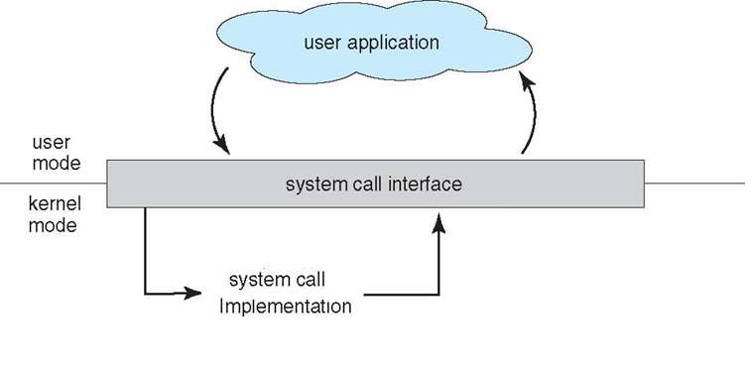
System Call – OS Relationship

Slide 23
System Call- Parameter Passing Methods
Registers: pass the parameters in registers
    NOTE: We have limited no. of registers
Memory Block: Parameters are stored in memory block, and address of block is passed as a parameter in a register
Stack: Parameters pushed, onto the stack by the program and popped off the stack by the operating system
    NOTE: Block and stack methods do not limit the number or length of parameters being passed

Slide 24
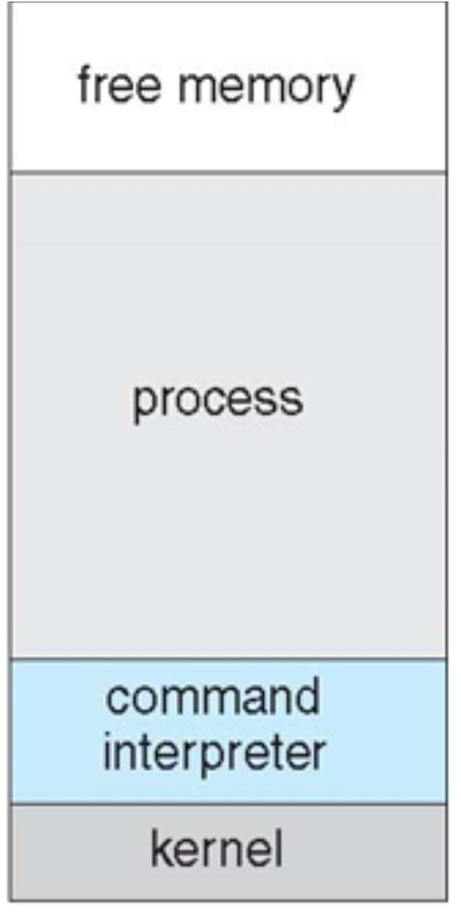
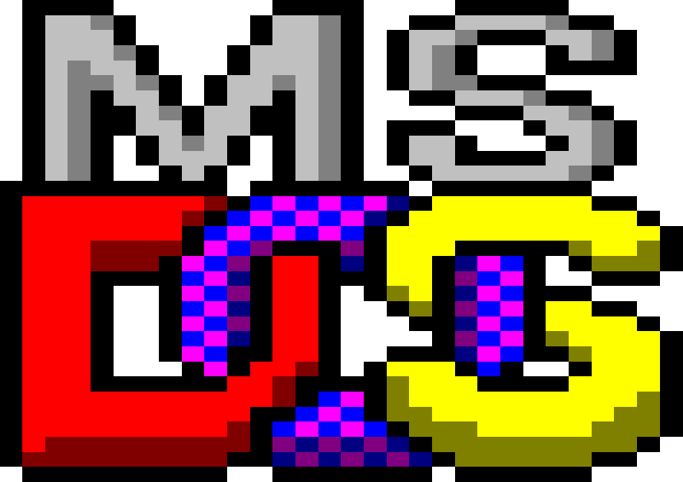
Common Types of Operating Systems
Single-Task OS
Single-task and Single memory space CLI Loads program into memory, overwriting all but the kernel but the application program takes full control of the computer
After Program exit -> CLI is reloaded
Example: MS-DOS,
Single-Task OS Memory Map

Slide 25
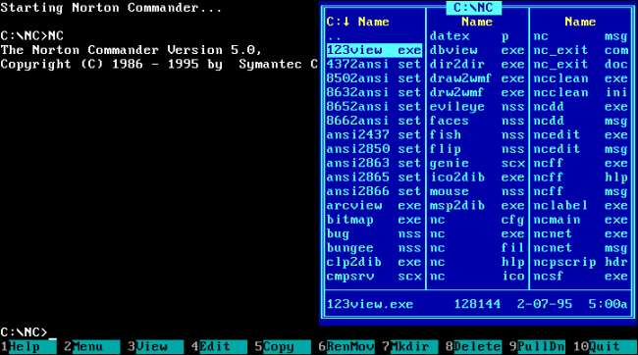
MS-DOS Screen Example

Slide 26
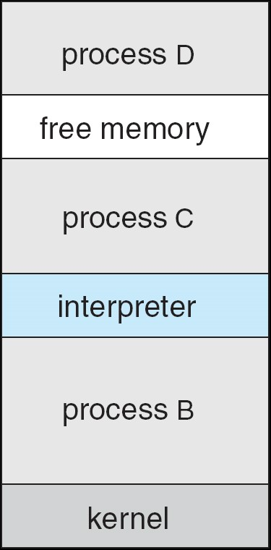
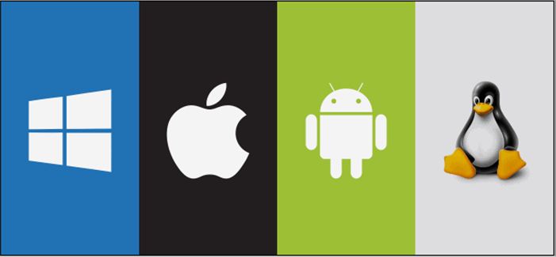
Multi-Task OS
Multiple processes can run at the same time, each with its own memory space.
Example: Ubuntu, Windows 10, Android, IOS.
Multi-Task OS Memory Map

Slide 27
Computer Startup Operation
The computer start-up has the following stages:
BIOS is a simple initial program that runs when the computer is powered up, and transfers control to the code in MBR.
Master Boot Record (MBR): it is the first sector on the disk, which contains the small code that starts the boot process. When executed it will transfer the control to boot loader.
A boot loader (boot manager), is a small program that loads selected OS into memory.

Slide 28
After the Operating System is loaded in to memory, it takes control of the computer, the computer system will sit idle waiting for an event.
Modern OSs are interrupt driven: If there is nothing for the OS to do, it will wait for something to happen by interrupts. There are two types of them:
Hardware Interrupts usually occur by sending a signal to the CPU from specified device. (like keyboard click or a message from remote computer).

Slide 29
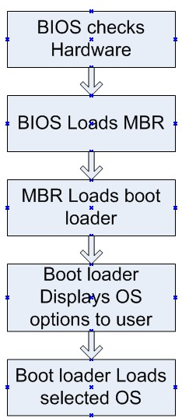
Software Interrupts usually occur by executing a system call from the application program. (like email program checking for new emails).
Computer Startup Operation

Slide 30
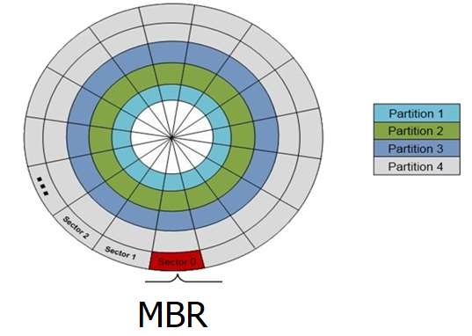
MBR location

Slide 31
END
THANK YOU

