Slide 1

PROCESSES
AND THREADS
MODULE CODE: CS 6146
MODULE NAME: Operating Systems
FACILITATOR: Pangahela, R. A
Email: pangriz@gmail.com Phone: +255 742 926 569

Slide 2
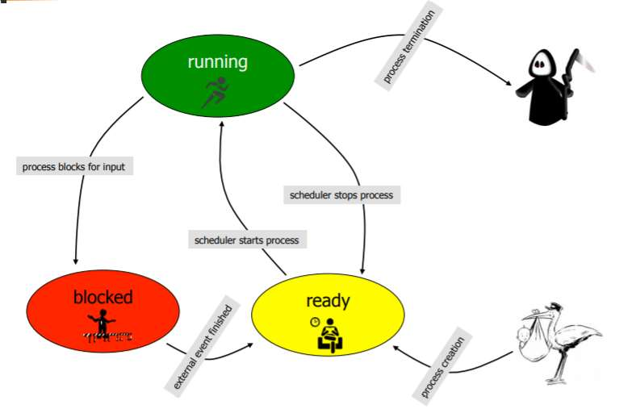
Processes & Threads

Slide 3
Agenda
PART 1: Processes
    2.1 Process Concept
    2.2 Process Parts
    2.3 Process States
    2.4 Process Control Block (PCB)
    2.5 CPU Switch From Process to Process
    2.6 Process Scheduling Queues
    2.7 Operations on Processes
    2.8 Inter-process Communication

Slide 4
PART 2: Threads
  2.9 Thread Concept
  2.10 Multithreaded Server Architecture Example
  2.11 Multithreading Benefits
  2.12 Multi-Processor Systems
  2.13 Concurrency vs. Parallelism
  2.14 Amdahl’s Law

Slide 5
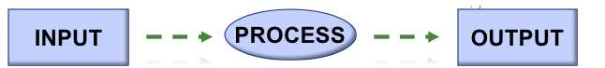
General Definition of a Process?
A process is an activity, or series of activities, that converts an input, to an output by doing work.

Slide 6
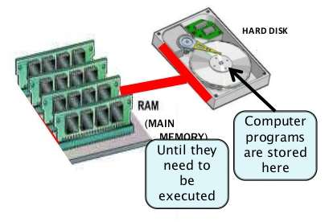
PART 1
Processes

Slide 7
3.1 Process Concept in OS
  Process – is an active program in execution; process execution must progress in sequential fashion
  Program is a passive entity stored on disk (executable file), and it becomes a process when executable file is loaded into memory
  One program can be executed multiple times generating multiple processes

Slide 8
Practical Case
Process Explorer (Freeware)
  It is a freeware shows a list of the currently active processes,
  It is useful for tracking down problems and provide insight into the way Windows and applications work.

Slide 9
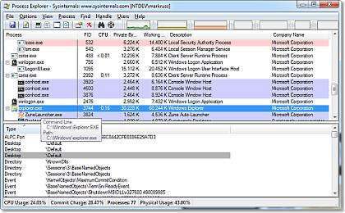

Slide 10
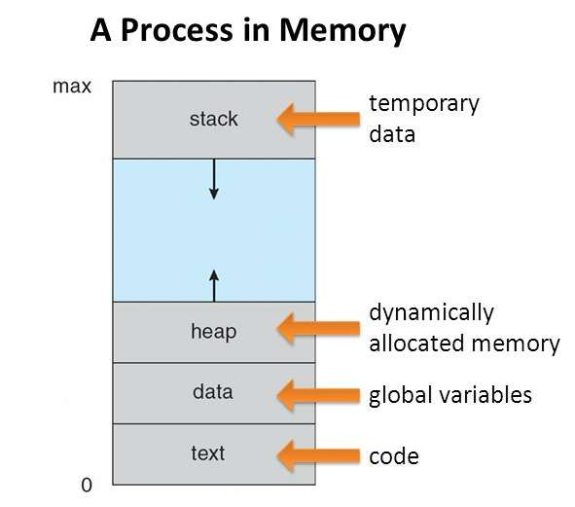
3.2 Process Parts
Text Section contains the program code.
Data section contains the global variables
Stack contains function parameters, return addresses, and local variables.
Heap contains dynamically allocated memory during run time.

Slide 11
3.3 Process States
As a process executes, it changes state to below five states
  new: The process is being created
  running: Instructions are being executed
  waiting: The process is waiting for some event to occur
  ready: The process is waiting to be assigned to a processor
  terminated: The process has finished execution

Slide 12


Slide 13
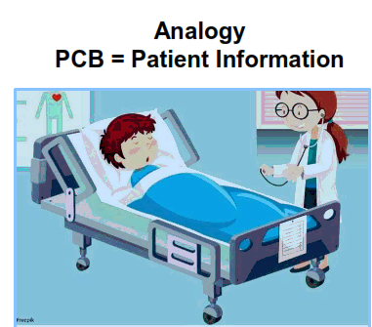
3.4 Process Control Block (PCB)
PCB is the Information associated with each process, which includes:
Process state
Program counter
CPU registers
CPU scheduling information
Memory-management information
Accounting information
I/O status information

Slide 14
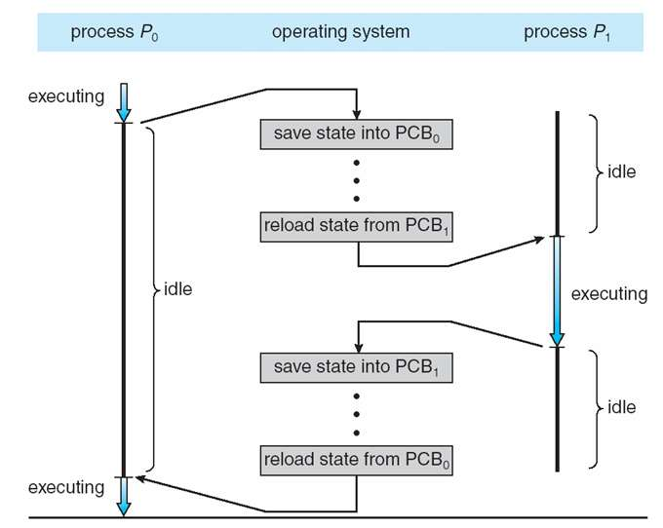
3.5 CPU Switch From Process to Process

Slide 15
3.6 Process Scheduling Queues
Process scheduler selects among available processes for next execution on CPU
Maintains scheduling queues of processes
  Job queue – set of all processes in the system
  Ready queue – set of all processes residing in main memory, ready and waiting to execute
  Device queues – set of processes waiting for an I/O device
  Processes migrate among the various queues

Slide 16
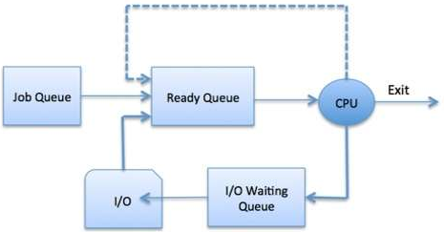
Process Scheduling Queues Diagram

Slide 17
3.7 Operations on Processes
Process Creation
Parent process create children processes, which, in turn create other processes, forming a tree of processes
Generally, process identified and managed via a process identifier (pid)
Resource sharing options:
  Parent and children share all resources
  Children share subset of parent’s resources
  Parent and child share no resources

Slide 18
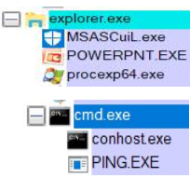
Execution options:
  Parent and children execute concurrently
  Parent waits until children terminate

Slide 19
2. Process Termination
  Process executes last statement and then asks the operating system to delete it using a system call.
    Returns status data from child to parent
    Process’ resources are de-allocated by operating system
  Parent may terminate the execution of children processes using a system call. Some reasons for doing so:
    Child has exceeded allocated resources
    Task assigned to child is no longer required
    The parent is exiting

Slide 20
3.8 Inter-process Communication
Processes within a system may be independent or cooperating when they need to share data
There are two models of inter-process communications (IPC)
    Shared memory
    Message passing

Slide 21
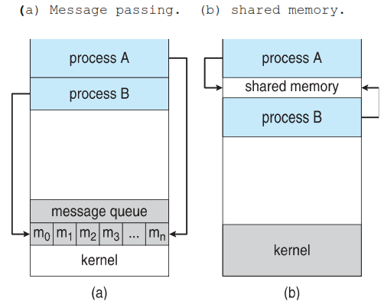
Inter-Process Communications Models

Slide 22
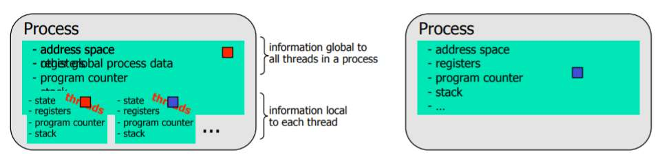
PART 2
Threads

Slide 23
3.9 Thread Concept
The thread is a component of the process and it is the smallest sequence of instructions that can be managed by the scheduler
Multiple threads can exist within one process, executing concurrently and sharing resources such as memory.
Implicit Threading where the creation and management of threads done by compilers rather than programmers.

Slide 24
Most modern applications are multithreaded, so tasks with the application can be implemented by separate threads
  Update display
  Fetch data
  Spell checking

Slide 25
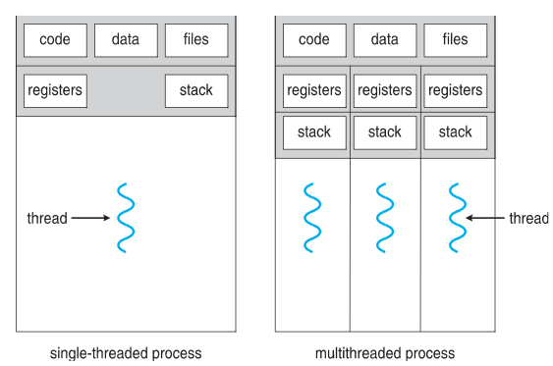
Single and Multithreaded Processes

Slide 26
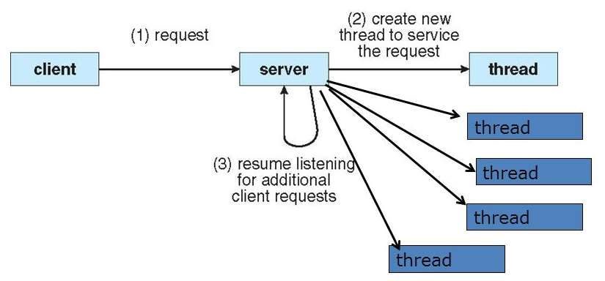
3.10 Multithreaded Server Architecture Example

Slide 27
3.11 Multithreading Benefits
Responsiveness – may allow continued execution if part of process is blocked, especially important for us interfaces
Resource Sharing – threads share resources of process, easier than shared memory or message passing
Economy – cheaper than process creation, thread switching lower overhead than context switching
Scalability – process can take advantage of multiprocessor architectures

Slide 28
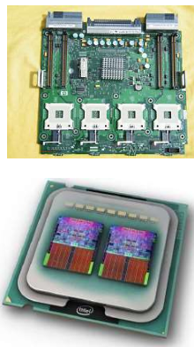
3.12 Multi-Processor Systems
The systems can have single processor or multiple processors
A system can have independent CPUs in single motherboard
A multi-core processor is one which combines two or more independent processors into a single chip.

Slide 29

3.13 Concurrency vs. Parallelism
Concurrency supports more than one task making progress, this can be implemented by a Single processor / core with a scheduler.

Slide 30
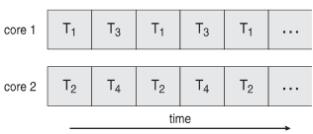
Parallelism implies a system can perform more than one task simultaneously on multi-core system

Slide 31
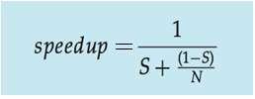
3.14 Amdahl’s Law
This law Identifies performance gains from adding additional cores to an application that has both serial and parallel components
P is parallel portion
S is serial portion
S = 1 - P
N processing cores
As N approaches infinity, speedup approaches 1 / S
Serial portion of an application is limiting the performance gained by adding additional cores
Adding more processors leads to successively smaller returns in terms of speedup

Slide 32
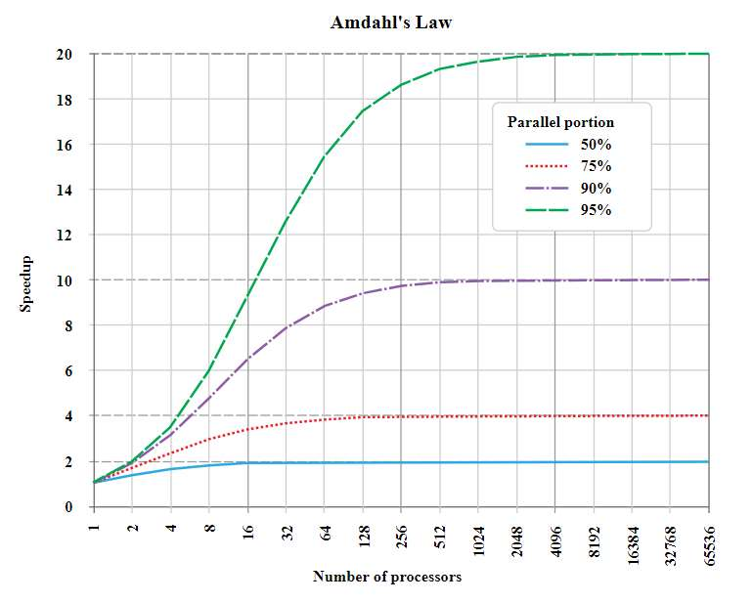
Amdahl’s Law Graph

Slide 33
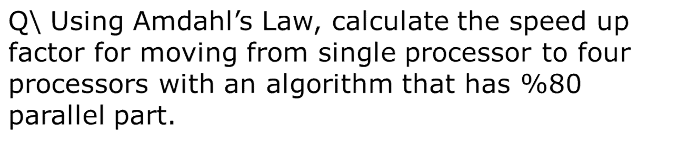
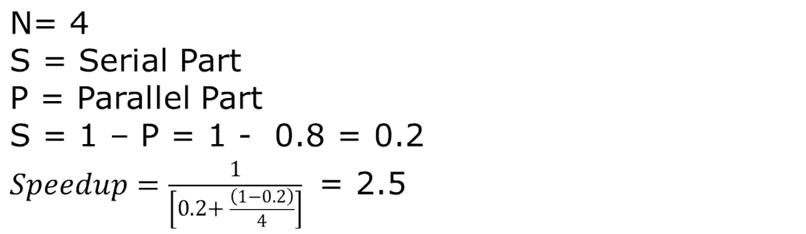
Amdahl’s Law Example

Slide 34
END
THANK YOU

