Slide 1

DEADLOCK
MODULE CODE: CS 6146
MODULE NAME: Operating Systems
FACILITATOR: Pangahela, R. A
Email: pangriz@gmail.com Phone: +255 742 926 569

Slide 2
Agenda
  What is a Deadlock?
  Deadlock Conditions
  Ways for Handling Deadlocks

Slide 3
What is a Deadlock?
Deadlock is when a set of blocked processes each
holding a resource and waiting to acquire a resource held by another process.
If deadlocks are neither prevented nor detected, then
when a deadlock occurs the system will gradually slow down, as more and more processes become stuck waiting for resources currently held by the deadlock and by other waiting processes.

Slide 4
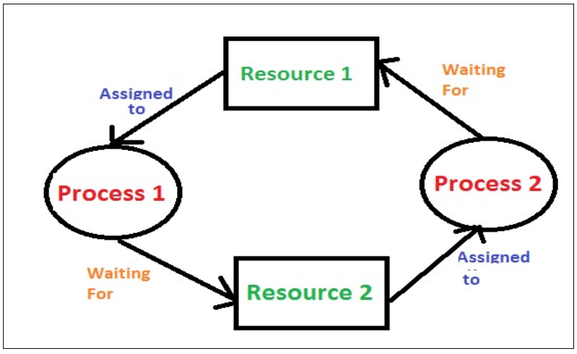
Basic Deadlock Diagram

Slide 5
Deadlocks Conditions
Deadlocks four conditions are required simultaneously to cause deadlock, so deadlock can be avoided by avoiding at least one of the conditions.
Deadlock occurs = Cond1 AND Cond2 AND Cond3 AND Cond4
Mutual Exclusion: only one process at a time can use a resource.

Slide 6
Hold and Wait: a process holding resource is waiting to acquire additional resources held by other processes
No Preemption (No Interruption) a resource can be released only by the process holding it upon its task completion.
Circular Wait it is the case when the processes are waiting circularly (infinitely). The processes are waiting circularly and forming a cycle which never breaks.

Slide 7
Ways for Handling Deadlocks
Generally speaking there are three ways of handling
deadlocks:
Deadlock Prevention - Do not allow the system to get into a deadlocked state. Prevention algorithms are difficult to implement.
Deadlock detection and recovery - Abort a process or preempt some resources when deadlocks are detected.

Slide 8
Ignore deadlock - If deadlocks only occur once a year or so, it may be better to simply let them happen and reboot as necessary than to incur the constant overhead and system performance penalties associated with deadlock prevention or detection. This is the approach that both Windows and UNIX take.

Slide 9
END
THANK YOU

