Slide 1
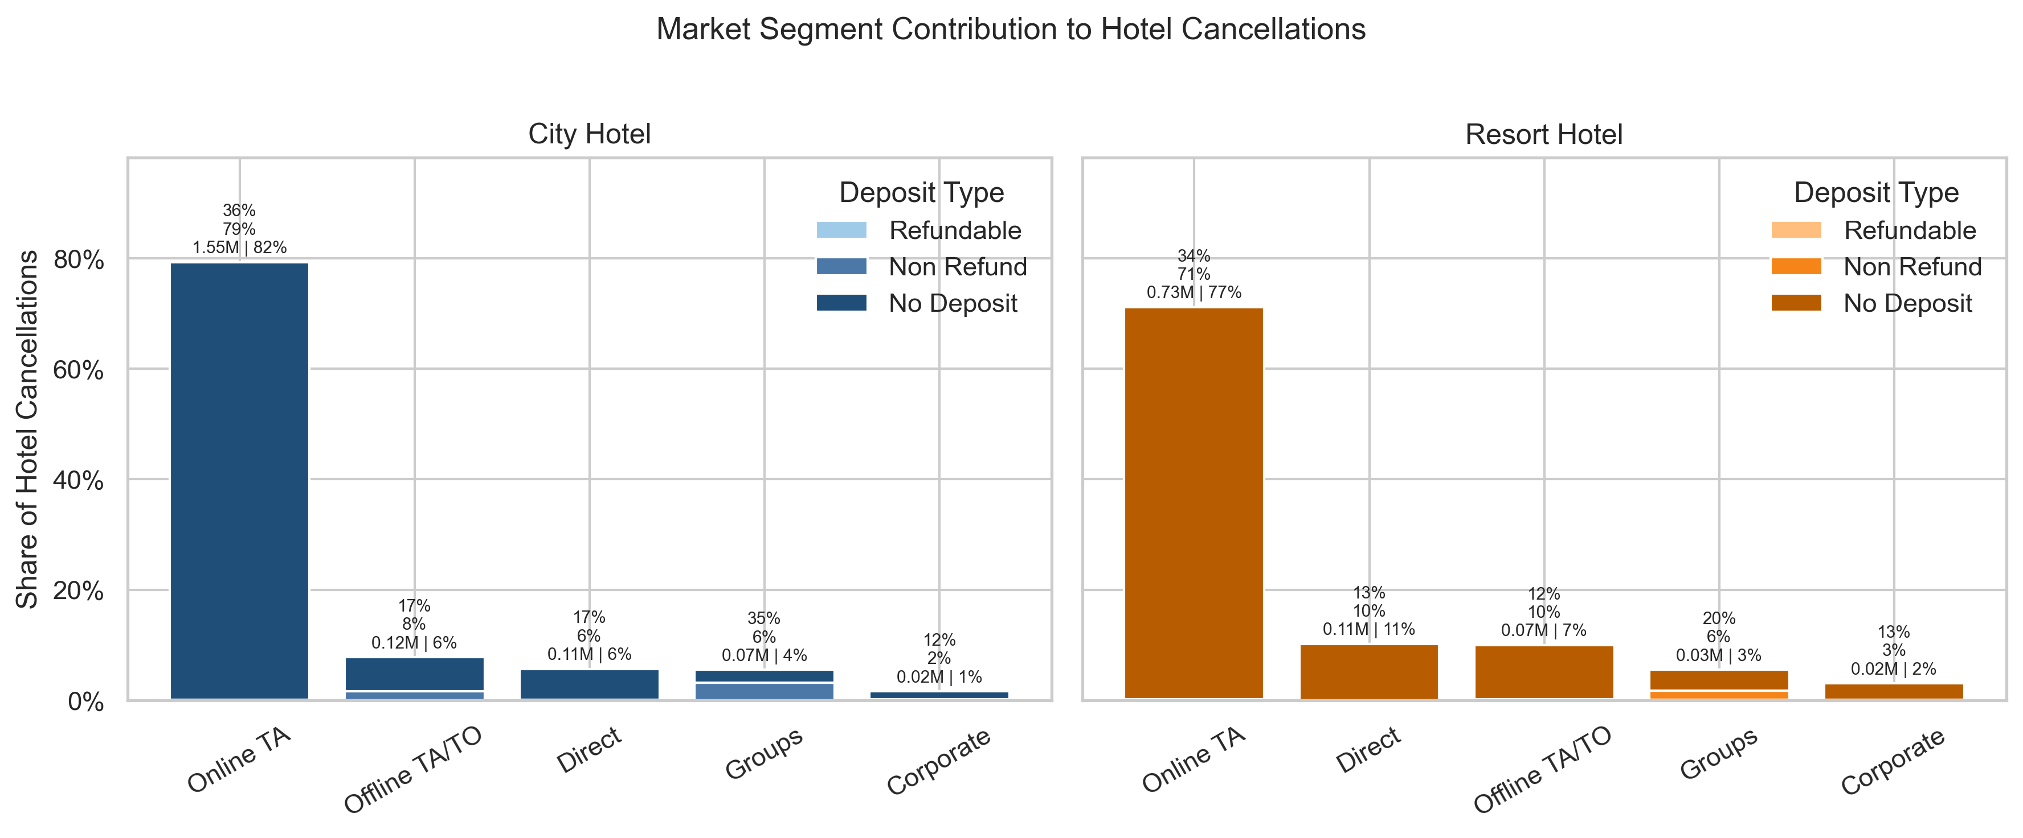
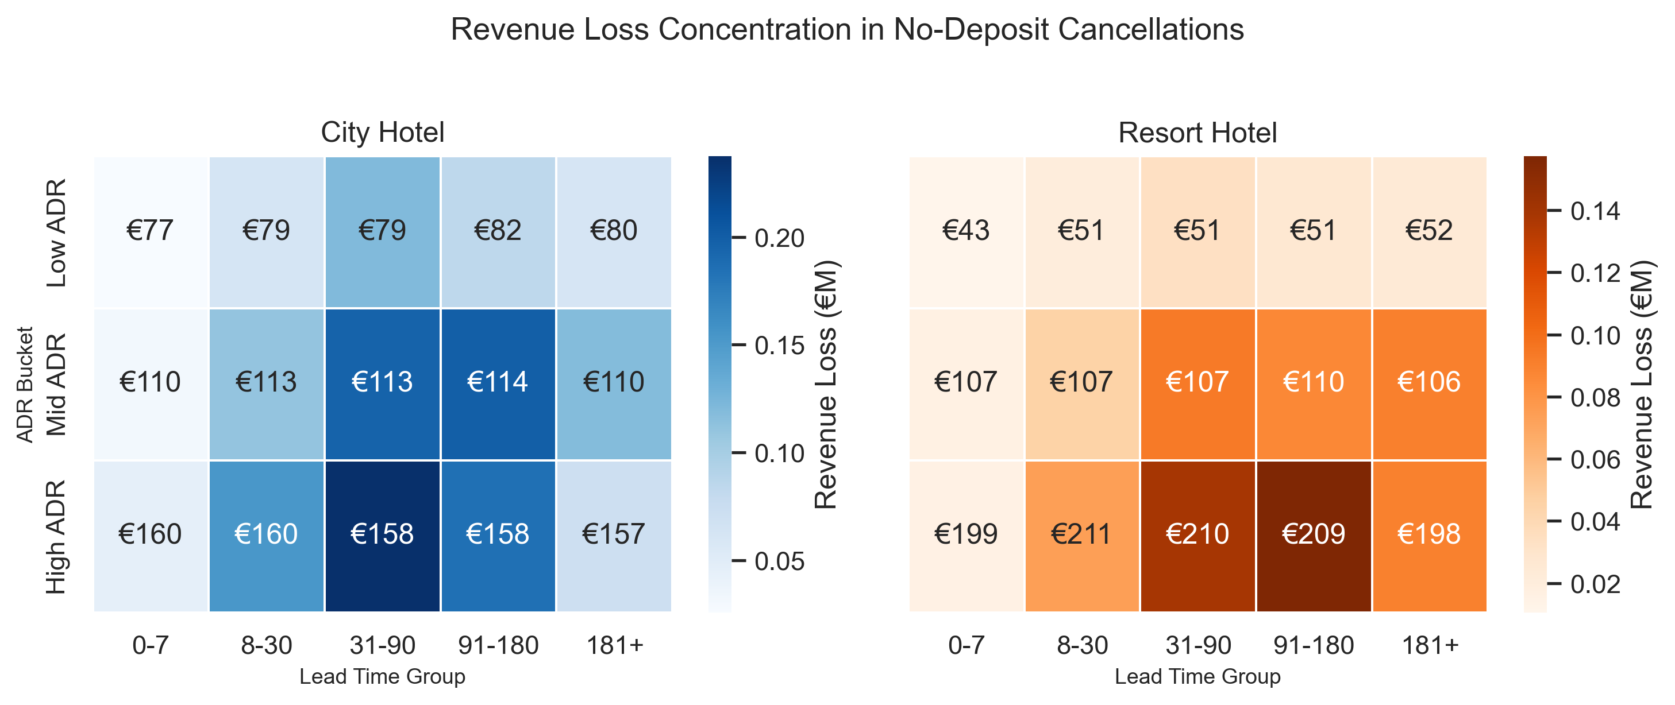
Hotel Booking Demand
Cancellation problem Project
ISSUE / PROBLEM
A large portion of bookings are cancelled, leading to significant revenue loss.
Average cancellation rate: 28%
Revenue loss: 2.8 million
City hotel: 30% | 1.9 million
Resort hotel: 24% | 0.9 million
MECHANISM
Unsecured long lead-time bookings function as “free options” for online TA customers.
No deposit → zero cancellation cost
Long lead time → high uncertainty
Bar plot above shows the most revenue leakage concentrated in ‘Online TA(~80%)’ with ‘No deposit(~96%)’.
Notations： cancellation rate, cancellation share, revenue loss, revenue loss share
IMPACT
Revenue loss is structurally concentrated in high-value, long lead-time bookings.
Lead time >30 days no deposit bookings:
City hotel revenue loss 1.3 million ~73%
Resort hotel revenue loss 0.7 million ~ 80%
Estimated impact: addressing these bookings could reduce cancellation losses by ~20–40%, equivalent to €0.1M–€0.2M recovery (conservative estimate).
Heatmap above shows among the no deposit cancellation bookings, the most revenue leakage concentrated in “long lead time” groups (>30 days) with high ‘ADR’.
INSIGHTS/NEXT STEPS
Key insight
The issue is not demand, but the lack of commitment in early bookings.
Next Step
Top Priority Focus on OTA bookings with lead time > 30 days( largest revenue leakage segment)
Lead-time-based deposit policy, 8~30 days conditional refundable, 31+ days needs deposit or non-refundable options.
Rate structure redesign, more discount means ‘non- refundable’, less discount means more flexible choice.
Channel – specific optimization, focus on OTA(online and offline) channel, with direct channel could be flexible to keep loyalty.
OTA is not risky per se, but becomes high-risk when combined with no-deposit policies and long lead-time bookings.

