Slide 1
测试

Slide 2
文件IO
http://www.cnblogs.com/rollenholt/archive/2011/09/11/2173787.html

Slide 3
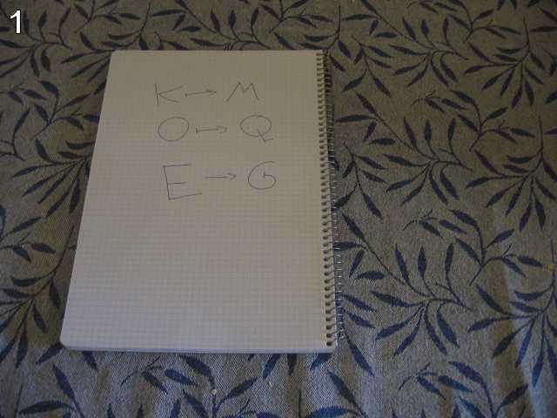
测试一
g fmnc wms bgblr rpylqjyrc gr zw fylb. rfyrq ufyr amknsrcpq ypc dmp. bmgle gr gl zw fylb gq glcddgagclr ylb rfyr'q ufw rfgq rcvr gq qm jmle. sqgle qrpgle.kyicrpylq() gq pcamkkclbcb. lmu ynnjw ml rfc spj.

Slide 4
测试二
找出其中的所有字母

Slide 5
测试三
One small letter, surrounded by EXACTLY three big bodyguards on each of its sides.

