Slide 1
Opacity Enforcing Supervisory Control
using Non-deterministic Supervisors
Yifan Xie & Xiang Yin & Shaoyuan Li
Department of Automation, Shanghai Jiao Tong University
xyfan1234@sjtu.edu.cn
21st IFAC World Congress
July 11-17, 2020, Germany

Slide 2
Introduction
1
Motivation
Security and privacy concerns in Cyber-Physical Systems
Opacity: An information-flow property
Application: Web services, Location-based services…

Slide 3
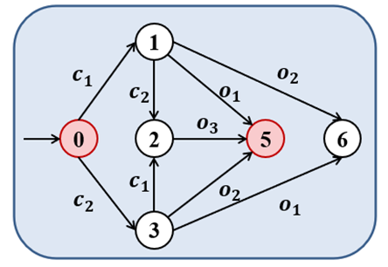

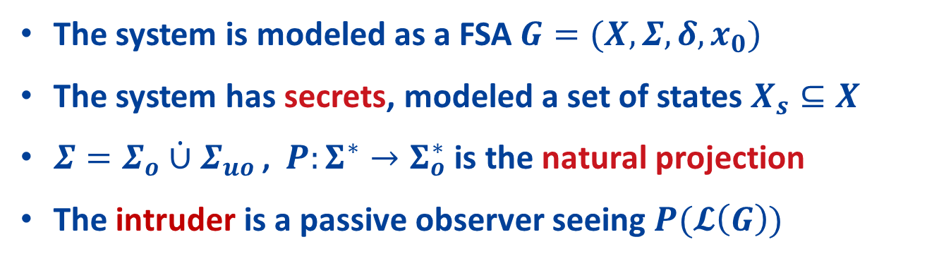

System Model and the Intruder
2
Information-Flow
$$P(𝓛\left(G\right))∈Σ_{o}^{∗}$$
Intruder
The system has secrets
The system is modeled as a FSA $G=(X,Σ,δ,x_{0})$
The system has secrets, modeled a set of states $X_{s}⊆X$
$Σ=Σ_{o}\dot{∪}Σ_{uo}$ , $P:Σ^{∗}→Σ_{o}^{∗}$ is the natural projection
The intruder is a passive observer seeing $P(𝓛\left(G\right))$

Slide 4
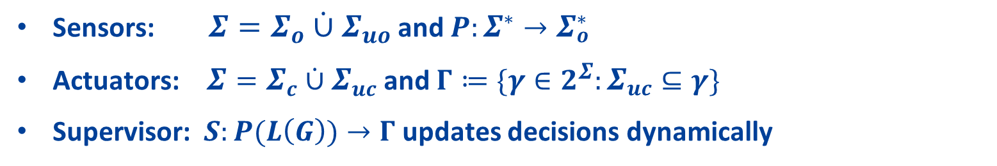

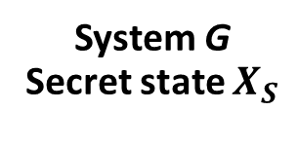
Supervisory Control Systems
3
Actuators
System G
Secret state $X_{S}$
Sensors
$S:Σ_{o}^{∗}→Γ$
Supervisor
Sensors: $Σ=Σ_{o}\dot{∪}Σ_{uo}$ and $P:Σ^{∗}→Σ_{o}^{∗}$
Actuators: $Σ=Σ_{c}\dot{∪}Σ_{uc}$ and $Γ≔\{γ∈2^{Σ}:Σ_{uc}⊆γ\}$
Supervisor: $S:P(L\left(G\right))→Γ$ updates decisions dynamically

Slide 5


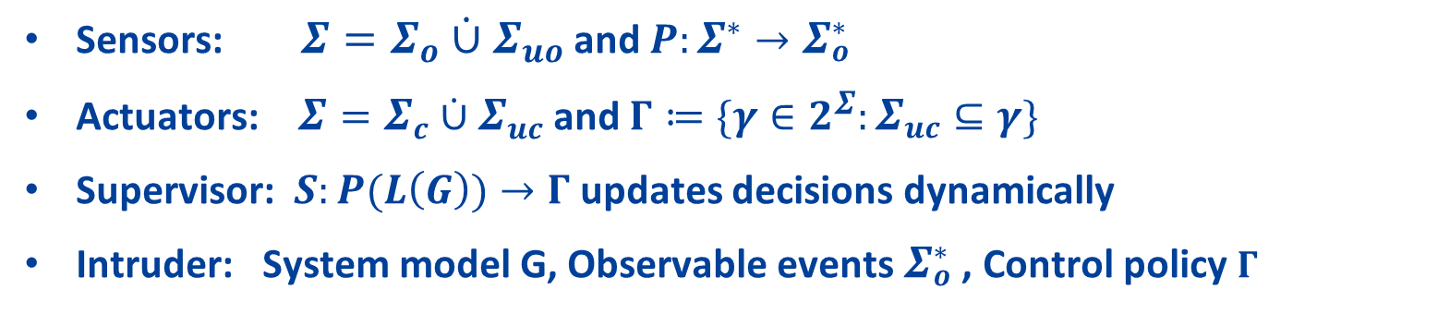
Supervisory Control Systems
3
Intruder
Actuators
System G
Secret state $X_{S}$
Sensors
$S:Σ_{o}^{∗}→Γ$
Supervisor
Intruder
Intruder
Sensors: $Σ=Σ_{o}\dot{∪}Σ_{uo}$ and $P:Σ^{∗}→Σ_{o}^{∗}$
Actuators: $Σ=Σ_{c}\dot{∪}Σ_{uc}$ and $Γ≔\{γ∈2^{Σ}:Σ_{uc}⊆γ\}$
Supervisor: $S:P(L\left(G\right))→Γ$ updates decisions dynamically
Intruder: System model G, Observable events $Σ_{o}^{∗}$ , Control policy $Γ$

Slide 6

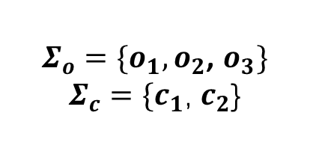









Motivating Example
4
$Σ_{o}=\{o_{1},o_{2}$, $o_{3}\}$
$Σ_{c}=\{c_{1}$, $c_{2}$}
1
$$c_{1}$$
$$o_{2}$$
$$c_{2}$$
$$o_{1}$$
$$o_{3}$$
$$Γ=\left\{\begin{matrix}\begin{matrix}∅ \\ \{c_{1}\}\end{matrix} \\ \begin{matrix}\{c_{2}\} \\ \{c_{1},c_{2}\}\end{matrix}\end{matrix}\right\}$$
0
2
5
6
$$c_{1}$$
$$o_{2}$$
$$c_{2}$$
$$o_{1}$$
3

Slide 7

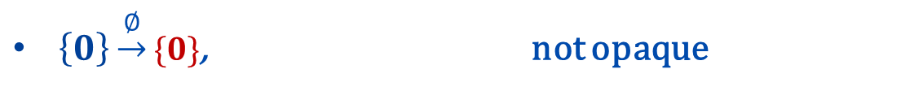
Motivating Example
4
$Σ_{o}=\{o_{1},o_{2}$, $o_{3}\}$
$Σ_{c}=\{c_{1}$, $c_{2}$}
1
$$c_{1}$$
$$o_{2}$$
$$c_{2}$$
$$o_{1}$$
$$Γ=\left\{\begin{matrix}\begin{matrix}∅ \\ \{c_{1}\}\end{matrix} \\ \begin{matrix}\{c_{2}\} \\ \{c_{1},c_{2}\}\end{matrix}\end{matrix}\right\}$$
$$o_{3}$$
0
2
5
6
$$c_{1}$$
$$o_{2}$$
$$c_{2}$$
$$o_{1}$$
3
$\left\{0\right\}\underset{→}{∅}\{0\}$, not opaque

Slide 8
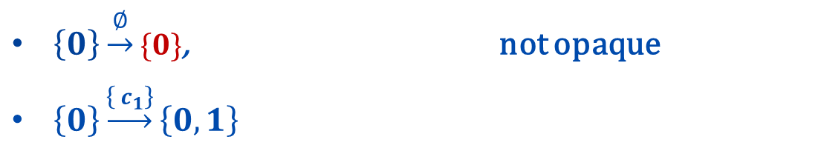
Motivating Example
4
$Σ_{o}=\{o_{1},o_{2}$, $o_{3}\}$
$Σ_{c}=\{c_{1}$, $c_{2}$}
1
$$c_{1}$$
$$o_{2}$$
$$c_{2}$$
$$o_{1}$$
$$Γ=\left\{\begin{matrix}\begin{matrix}∅ \\ \{c_{1}\}\end{matrix} \\ \begin{matrix}\{c_{2}\} \\ \{c_{1},c_{2}\}\end{matrix}\end{matrix}\right\}$$
$$o_{3}$$
0
2
5
6
$$c_{1}$$
$$o_{2}$$
$$c_{2}$$
$$o_{1}$$
3
$\left\{0\right\}\underset{→}{∅}\{0\}$, not opaque
$\left\{0\right\}\underset{→}{\left\{ c_{1}\right\}}\left\{0,1\right\}$

Slide 9

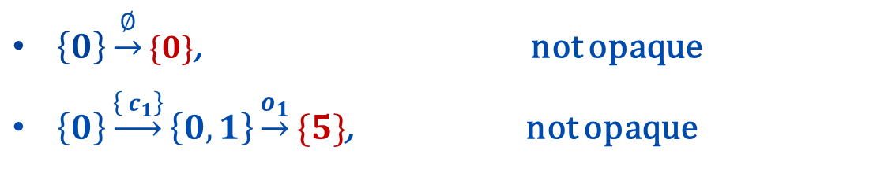
Motivating Example
4
$Σ_{o}=\{o_{1},o_{2}$, $o_{3}\}$
$Σ_{c}=\{c_{1}$, $c_{2}$}
1
$$c_{1}$$
$$o_{2}$$
$$c_{2}$$
$$o_{1}$$
$$Γ=\left\{\begin{matrix}\begin{matrix}∅ \\ \{c_{1}\}\end{matrix} \\ \begin{matrix}\{c_{2}\} \\ \{c_{1},c_{2}\}\end{matrix}\end{matrix}\right\}$$
$$o_{3}$$
0
2
5
6
$$c_{1}$$
$$o_{2}$$
$$c_{2}$$
$$o_{1}$$
3
$\left\{0\right\}\underset{→}{∅}\{0\}$, not opaque
$\left\{0\right\}\underset{→}{\left\{ c_{1}\right\}}\left\{0,1\right\}\underset{→}{o_{1}}\{5\}$, not opaque

Slide 10
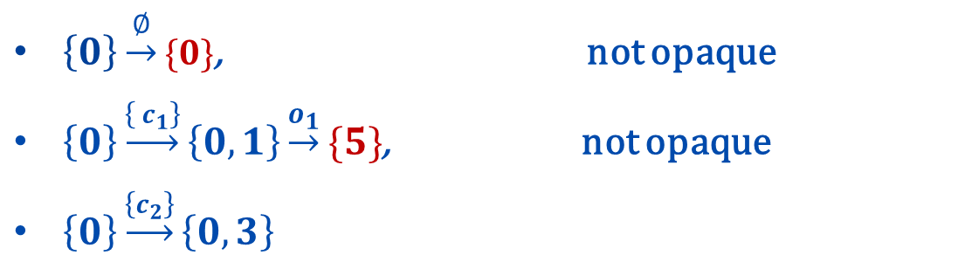
Motivating Example
4
$Σ_{o}=\{o_{1},o_{2}$, $o_{3}\}$
$Σ_{c}=\{c_{1}$, $c_{2}$}
1
$$c_{1}$$
$$o_{2}$$
$$c_{2}$$
$$o_{1}$$
$$Γ=\left\{\begin{matrix}\begin{matrix}∅ \\ \{c_{1}\}\end{matrix} \\ \begin{matrix}\{c_{2}\} \\ \{c_{1},c_{2}\}\end{matrix}\end{matrix}\right\}$$
$$o_{3}$$
0
2
5
6
$$c_{1}$$
$$o_{2}$$
$$c_{2}$$
$$o_{1}$$
3
$\left\{0\right\}\underset{→}{∅}\{0\}$, not opaque
$\left\{0\right\}\underset{→}{\left\{ c_{1}\right\}}\left\{0,1\right\}\underset{→}{o_{1}}\{5\}$, not opaque
$\left\{0\right\}\underset{→}{\left\{c_{2}\right\}}\left\{0,3\right\}$

Slide 11

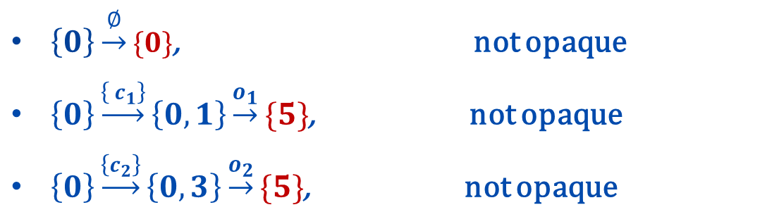
Motivating Example
4
$Σ_{o}=\{o_{1},o_{2}$, $o_{3}\}$
$Σ_{c}=\{c_{1}$, $c_{2}$}
1
$$c_{1}$$
$$o_{2}$$
$$c_{2}$$
$$o_{1}$$
$$Γ=\left\{\begin{matrix}\begin{matrix}∅ \\ \{c_{1}\}\end{matrix} \\ \begin{matrix}\{c_{2}\} \\ \{c_{1},c_{2}\}\end{matrix}\end{matrix}\right\}$$
$$o_{3}$$
0
2
5
6
$$c_{1}$$
$$o_{2}$$
$$c_{2}$$
$$o_{1}$$
3
$\left\{0\right\}\underset{→}{∅}\{0\}$, not opaque
$\left\{0\right\}\underset{→}{\left\{ c_{1}\right\}}\left\{0,1\right\}\underset{→}{o_{1}}\{5\}$, not opaque
$\left\{0\right\}\underset{→}{\left\{c_{2}\right\}}\left\{0,3\right\}\underset{→}{o_{2}}\{5\}$, not opaque

Slide 12
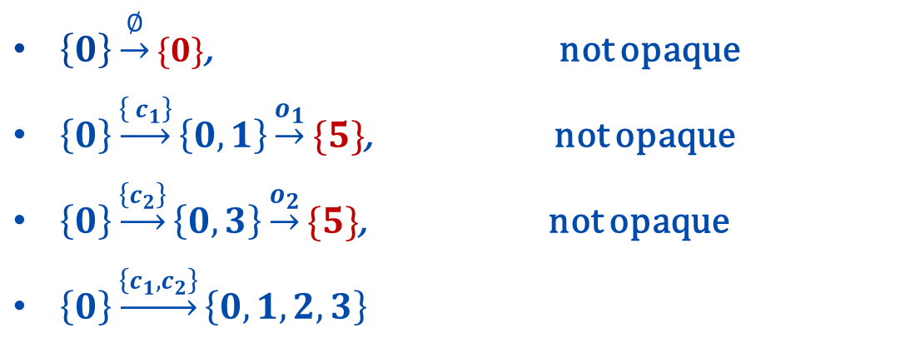
Motivating Example
4
$Σ_{o}=\{o_{1},o_{2}$, $o_{3}\}$
$Σ_{c}=\{c_{1}$, $c_{2}$}
1
$$c_{1}$$
$$o_{2}$$
$$c_{2}$$
$$o_{1}$$
$$Γ=\left\{\begin{matrix}\begin{matrix}∅ \\ \{c_{1}\}\end{matrix} \\ \begin{matrix}\{c_{2}\} \\ \{c_{1},c_{2}\}\end{matrix}\end{matrix}\right\}$$
$$o_{3}$$
0
2
5
6
$$c_{1}$$
$$o_{2}$$
$$c_{2}$$
$$o_{1}$$
3
$\left\{0\right\}\underset{→}{∅}\{0\}$, not opaque
$\left\{0\right\}\underset{→}{\left\{ c_{1}\right\}}\left\{0,1\right\}\underset{→}{o_{1}}\{5\}$, not opaque
$\left\{0\right\}\underset{→}{\left\{c_{2}\right\}}\left\{0,3\right\}\underset{→}{o_{2}}\{5\}$, not opaque
$\left\{0\right\}\underset{→}{\left\{c_{1},c_{2}\right\}}\left\{0,1,2,3\right\}$

Slide 13

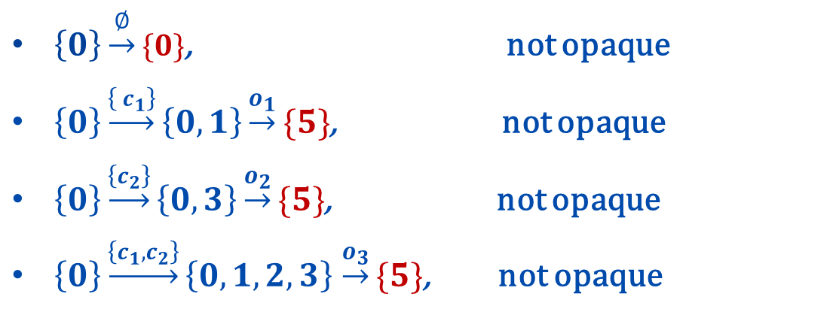
Motivating Example
4
$Σ_{o}=\{o_{1},o_{2}$, $o_{3}\}$
$Σ_{c}=\{c_{1}$, $c_{2}$}
1
$$c_{1}$$
$$o_{2}$$
$$c_{2}$$
$$o_{1}$$
$$Γ=\left\{\begin{matrix}\begin{matrix}∅ \\ \{c_{1}\}\end{matrix} \\ \begin{matrix}\{c_{2}\} \\ \{c_{1},c_{2}\}\end{matrix}\end{matrix}\right\}$$
$$o_{3}$$
0
2
5
6
$$c_{1}$$
$$o_{2}$$
$$c_{2}$$
$$o_{1}$$
3
$\left\{0\right\}\underset{→}{∅}\{0\}$, not opaque
$\left\{0\right\}\underset{→}{\left\{ c_{1}\right\}}\left\{0,1\right\}\underset{→}{o_{1}}\{5\}$, not opaque
$\left\{0\right\}\underset{→}{\left\{c_{2}\right\}}\left\{0,3\right\}\underset{→}{o_{2}}\{5\}$, not opaque
$\left\{0\right\}\underset{→}{\left\{c_{1},c_{2}\right\}}\left\{0,1,2,3\right\}$ $\underset{→}{o_{3}}\{5\}$, not opaque

Slide 14
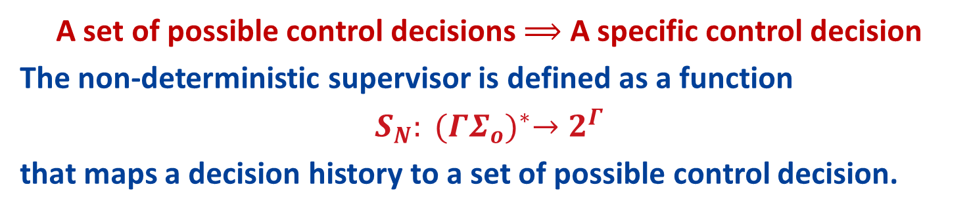
Non-deterministic Supervisor
5
A set of possible control decisions $⟹$ A specific control decision
The non-deterministic supervisor is defined as a function
$$S_{N}: {(ΓΣ_{o})}^{∗}→2^{Γ}$$
that maps a decision history to a set of possible control decision.

Slide 15

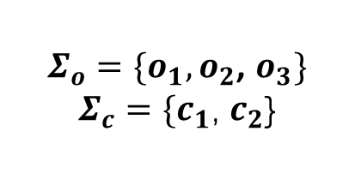








Non-deterministic Supervisor
5
A set of possible control decisions $⟹$ A specific control decision
The non-deterministic supervisor is defined as a function
$$S_{N}: {(ΓΣ_{o})}^{∗}→2^{Γ}$$
that maps a decision history to a set of possible control decision.
$Σ_{o}=\{o_{1},o_{2}$, $o_{3}\}$
$Σ_{c}=\{c_{1}$, $c_{2}$}
1
$$c_{1}$$
$$o_{2}$$
$$c_{2}$$
$$o_{1}$$
$$o_{3}$$
0
2
5
6
$$c_{1}$$
$$o_{2}$$
$$c_{2}$$
$$o_{1}$$
3

Slide 16
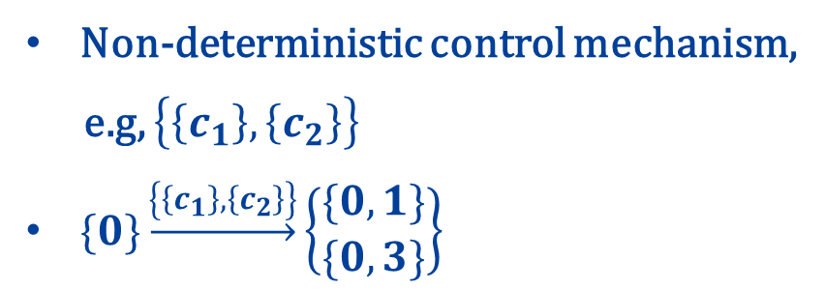
Non-deterministic Supervisor
5
A set of possible control decisions $⟹$ A specific control decision
The non-deterministic supervisor is defined as a function
$$S_{N}: {(ΓΣ_{o})}^{∗}→2^{Γ}$$
that maps a decision history to a set of possible control decision.
$Σ_{o}=\{o_{1},o_{2}$, $o_{3}\}$
$Σ_{c}=\{c_{1}$, $c_{2}$}
1
$$c_{1}$$
$$o_{2}$$
Non-deterministic control mechanism,
e.g, $\left\{\left\{c_{1}\right\},\left\{c_{2}\right\}\right\}$
$\{0\}\underset{→}{\left\{\left\{c_{1}\right\},\left\{c_{2}\right\}\right\}}\left\{\begin{matrix}\{0,1\} \\ \{0,3\}\end{matrix}\right\}$
$$c_{2}$$
$$o_{1}$$
$$o_{3}$$
0
2
5
6
$$c_{1}$$
$$o_{2}$$
$$c_{2}$$
$$o_{1}$$
3

Slide 17
Non-deterministic Supervisor
5
A set of possible control decisions $⟹$ A specific control decision
The non-deterministic supervisor is defined as a function
$$S_{N}: {(ΓΣ_{o})}^{∗}→2^{Γ}$$
that maps a decision history to a set of possible control decision.
$Σ_{o}=\{o_{1},o_{2}$, $o_{3}\}$
$Σ_{c}=\{c_{1}$, $c_{2}$}
1
$$c_{1}$$
$$o_{2}$$
Non-deterministic control mechanism,
e.g, $\left\{\left\{c_{1}\right\},\left\{c_{2}\right\}\right\}$
$\{0\}\underset{→}{\left\{\left\{c_{1}\right\},\left\{c_{2}\right\}\right\}}\left\{\begin{matrix}\{0,1\} \\ \{0,3\}\end{matrix}\right\}$
$$c_{2}$$
$$o_{1}$$
$$o_{3}$$
0
2
5
6
$$c_{1}$$
$$o_{2}$$
$$c_{2}$$
$$o_{1}$$
3

Slide 18




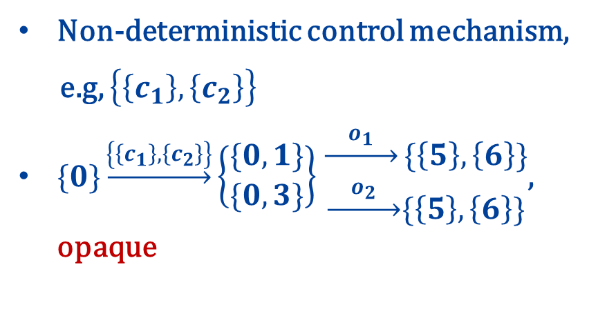
Non-deterministic Supervisor
5
A set of possible control decisions $⟹$ A specific control decision
The non-deterministic supervisor is defined as a function
$$S_{N}: {(ΓΣ_{o})}^{∗}→2^{Γ}$$
that maps a decision history to a set of possible control decision.
$Σ_{o}=\{o_{1},o_{2}$, $o_{3}\}$
$Σ_{c}=\{c_{1}$, $c_{2}$}
1
$$c_{1}$$
$$o_{2}$$
Non-deterministic control mechanism,
e.g, $\left\{\left\{c_{1}\right\},\left\{c_{2}\right\}\right\}$
$\{0\}\underset{→}{\left\{\left\{c_{1}\right\},\left\{c_{2}\right\}\right\}}\left\{\begin{matrix}\{0,1\} \\ \{0,3\}\end{matrix}\right\}$ $\begin{matrix}\underset{→}{{ o}_{1} }\{\left\{5\right\},\left\{6\right\}\} \\ \underset{→}{ o_{2} }\{\left\{5\right\},\left\{6\right\}\}\end{matrix}$, opaque
$$c_{2}$$
$$o_{1}$$
$$o_{3}$$
0
2
5
6
$$c_{1}$$
$$o_{2}$$
$$c_{2}$$
$$o_{1}$$
3

Slide 19


Non-deterministic Supervisor
5
A set of possible control decisions $⟹$ A specific control decision
The non-deterministic supervisor is defined as a function
$$S_{N}: {(ΓΣ_{o})}^{∗}→2^{Γ}$$
that maps a decision history to a set of possible control decision.
Supervisor: specific control decision
Intruder: the set of all possible control decisions
$${(ΓΣ_{o})}^{∗}$$
$${(2^{Γ}Σ_{o})}^{∗}$$
Supervisor
Intruder

Slide 20
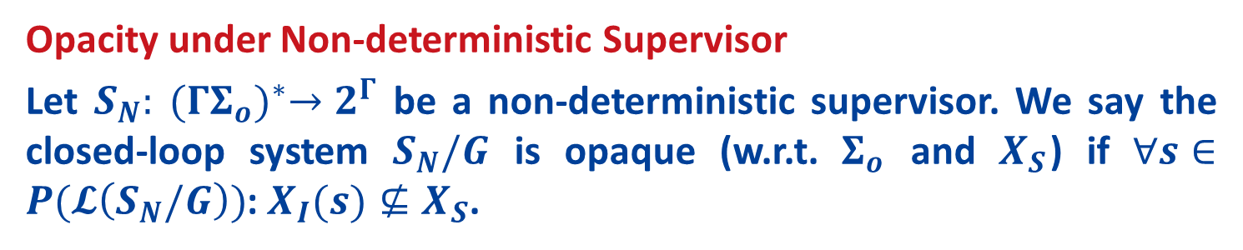
Non-deterministic Supervisor
5
A set of possible control decisions $⟹$ A specific control decision
The non-deterministic supervisor is defined as a function
$$S_{N}: {(ΓΣ_{o})}^{∗}→2^{Γ}$$
that maps a decision history to a set of possible control decision.
Supervisor: specific control decision
Intruder: the set of all possible control decisions
$${(ΓΣ_{o})}^{∗}$$
$${(2^{Γ}Σ_{o})}^{∗}$$
Supervisor
Intruder
Opacity under Non-deterministic Supervisor
Let $S_{N}: {(ΓΣ_{o})}^{∗}→2^{Γ}$ be a non-deterministic supervisor. We say the closed-loop system $S_{N}/G$ is opaque (w.r.t. $Σ_{o}$ and $X_{S}$) if $∀s∈P(𝓛\left(S_{N}/G\right))$: $X_{I}(s)⊈X_{S}$.

Slide 21
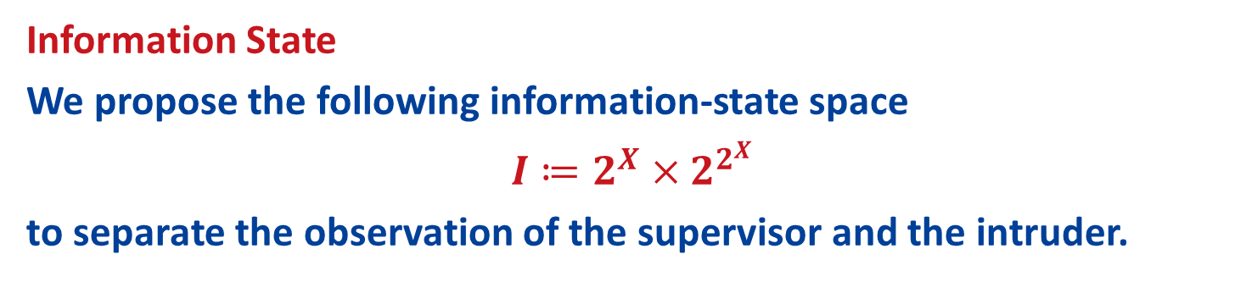
Information State and its Flow
6
Information State
We propose the following information-state space
$$I≔2^{X}×2^{2^{X}}$$
to separate the observation of the supervisor and the intruder.

Slide 22









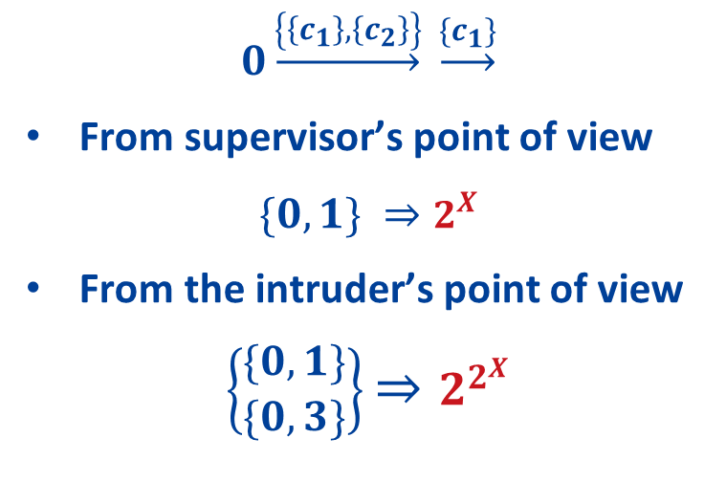
Information State and its Flow
6
Information State
We propose the following information-state space
$$I≔2^{X}×2^{2^{X}}$$
to separate the observation of the supervisor and the intruder.
1
$$0\underset{→}{\left\{\left\{c_{1}\right\},\left\{c_{2}\right\}\right\}} \underset{→}{\{c_{1}\}}$$
From supervisor’s point of view
$$\{0,1\} ⇒2^{X}$$
From the intruder’s point of view
$$\left\{\begin{matrix}\{0,1\} \\ \{0,3\}\end{matrix}\right\}⇒2^{2^{X}}$$
$$c_{1}$$
$$o_{2}$$
$$c_{2}$$
$$o_{1}$$
$$o_{3}$$
0
2
5
6
$$c_{1}$$
$$o_{2}$$
$$c_{2}$$
$$o_{1}$$
3

Slide 23
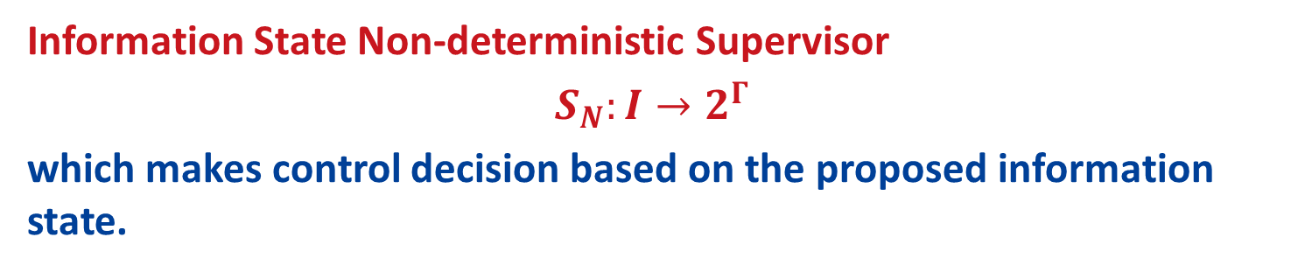
Information State and its Flow
6
Information State
We propose the following information-state space
$$I≔2^{X}×2^{2^{X}}$$
to separate the observation of the supervisor and the intruder.
Information State Non-deterministic Supervisor
$$S_{N}:I→2^{Γ}$$
which makes control decision based on the proposed information state.

Slide 24
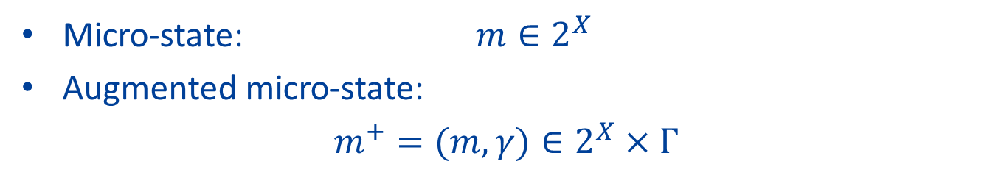
Information State and its Flow
7
Micro-state: $m∈2^{X}$
Augmented micro-state:
$m^{+}=(m, γ)$ $∈2^{X}×Γ$

Slide 25
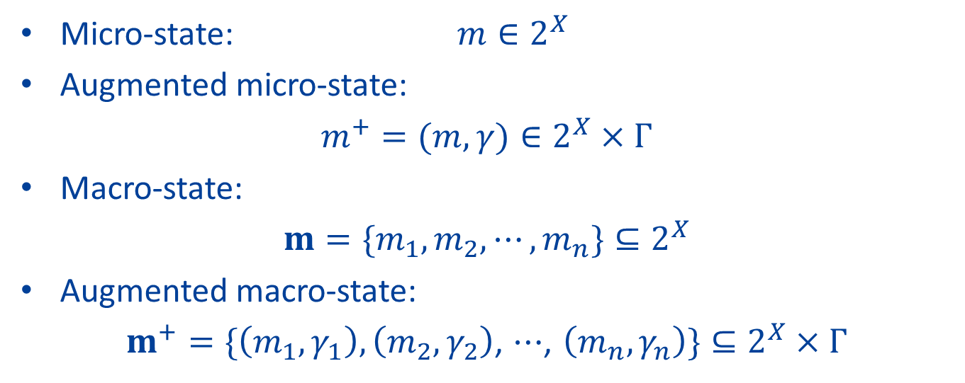
Information State and its Flow
7
Micro-state: $m∈2^{X}$
Augmented micro-state:
$m^{+}=(m, γ)$ $∈2^{X}×Γ$
Macro-state:
$$m=\{m_{1}, m_{2}, ⋯,m_{n}\}⊆2^{X}$$
Augmented macro-state:
$m^{+}=\{\left(m_{1},γ_{1}\right), \left(m_{2},γ_{2}\right)$, $⋯$, $\left(m_{n},γ_{n}\right)\}⊆2^{X}×Γ$

Slide 26
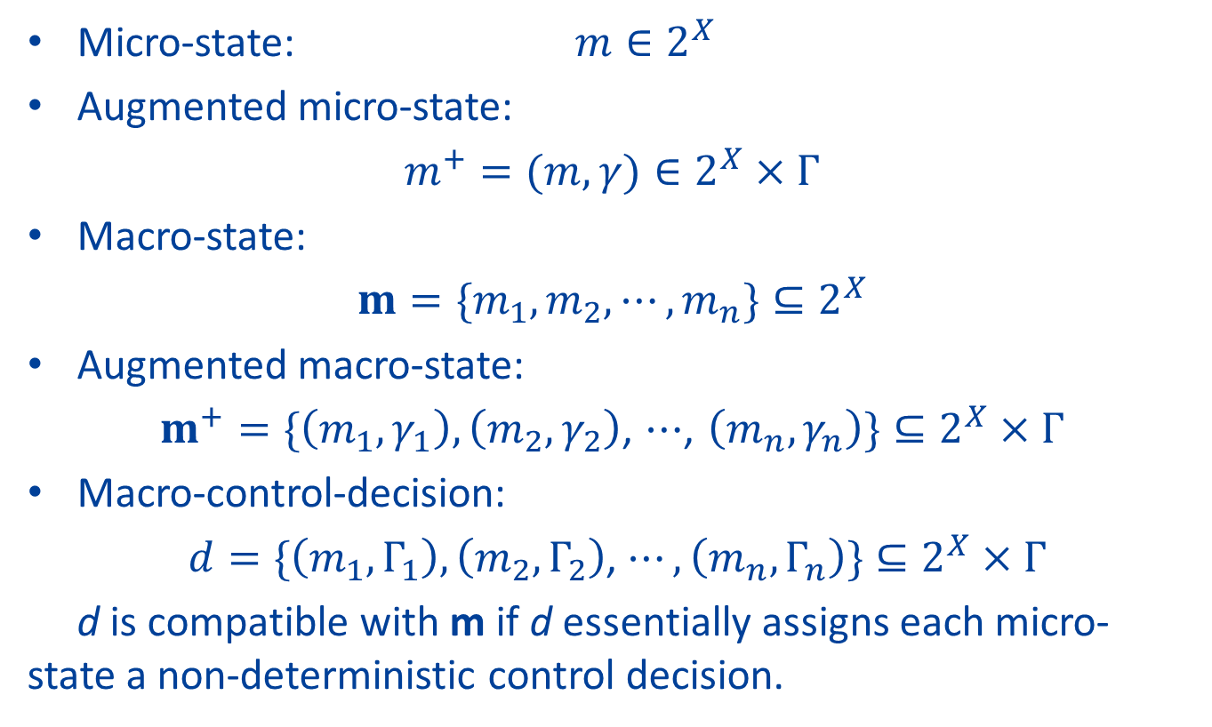
Information State and its Flow
7
Micro-state: $m∈2^{X}$
Augmented micro-state:
$m^{+}=(m, γ)$ $∈2^{X}×Γ$
Macro-state:
$$m=\{m_{1}, m_{2}, ⋯,m_{n}\}⊆2^{X}$$
Augmented macro-state:
$m^{+}=\{\left(m_{1},γ_{1}\right), \left(m_{2},γ_{2}\right)$, $⋯$, $\left(m_{n},γ_{n}\right)\}⊆2^{X}×Γ$
Macro-control-decision:
$d=\{\left(m_{1},Γ_{1}\right), \left(m_{2},Γ_{2}\right)$, $⋯,\left(m_{n},Γ_{n}\right)\}⊆2^{X}×Γ$
d is compatible with m if d essentially assigns each micro-state a non-deterministic control decision.

Slide 27
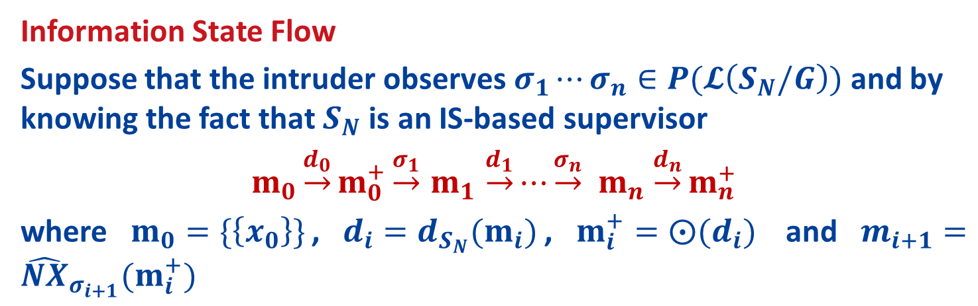
Information State and its Flow
8
Information State Flow
Suppose that the intruder observes $σ_{1}⋯σ_{n}∈P(𝓛\left(S_{N}/G\right))$ and by knowing the fact that $S_{N}$ is an IS-based supervisor
$m_{0}\underset{→}{d_{0}}m_{0}^{+}\underset{→}{σ_{1}}$ $m_{1}$ $\underset{→}{d_{1}}⋯\underset{→}{σ_{n}} m_{n}$ $\underset{→}{d_{n}}m_{n}^{+}$
where $m_{0}=\{\left\{x_{0}\right\}\}$, $d_{i}=d_{S_{N}}(m_{i})$, $m_{i}^{+}=⨀(d_{i})$ and $m_{i+1}={\hat{NX}}_{σ_{i+1}}(m_{i}^{+})$

Slide 28



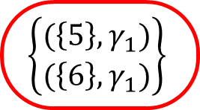



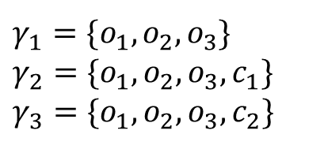
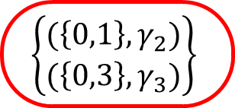




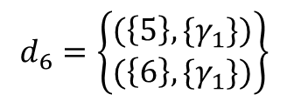
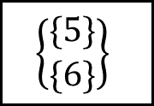


Information State and its Flow
9
{{0}}
1
$d_{5}$ $=\left\{\left(\left\{0\right\},\left\{γ_{2},γ_{3}\right\}\right)\right\}$
$$c_{1}$$
$$o_{2}$$
$$c_{2}$$
$$o_{1}$$
$$\left\{\begin{matrix}(\left\{0,1\right\},γ_{2}) \\ (\left\{0,3\right\},γ_{3})\end{matrix}\right\}$$
$$o_{3}$$
0
2
5
6
$$c_{1}$$
$$o_{1}$$
$$o_{2}$$
$$c_{2}$$
$$o_{2}$$
$$o_{1}$$
$$\left\{\begin{matrix}\{5\} \\ \{6\}\end{matrix}\right\}$$
3
$$d_{6}=\left\{\begin{matrix}(\left\{5\right\},\{γ_{1}\text{\})} \\ \text{(}\left\{6\right\},\{γ_{1}\})\end{matrix}\right\}$$
$γ_{1}=\{o_{1},o_{2},o_{3}$}
$γ_{2}=\{o_{1},o_{2},o_{3},c_{1}$}
$γ_{3}=\{o_{1},o_{2},o_{3},c_{2}$}
$$\left\{\begin{matrix}(\left\{5\right\},γ_{1}) \\ (\left\{6\right\},γ_{1})\end{matrix}\right\}$$

Slide 29

Supervisor Synthesis Procedure
10
1. Enumerates all feasible transitions
new macro-control-decision & new observation
A generalized bipartite transition system (G-BTS) T w.r.t. G is a 7-tuple
$$T=(Q_{Y}^{},Q_{Z}^{},h_{YZ}^{},h_{ZY}^{},Σ_{o},Γ,y_{0}^{})$$

Slide 30
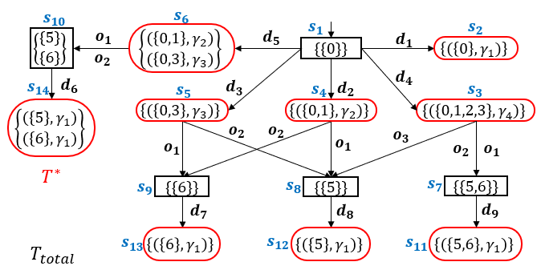
Supervisor Synthesis Procedure
10
1. Enumerates all feasible transitions
new macro-control-decision & new observation
A generalized bipartite transition system (G-BTS) T w.r.t. G is a 7-tuple
$$T=(Q_{Y}^{},Q_{Z}^{},h_{YZ}^{},h_{ZY}^{},Σ_{o},Γ,y_{0}^{})$$

Slide 31
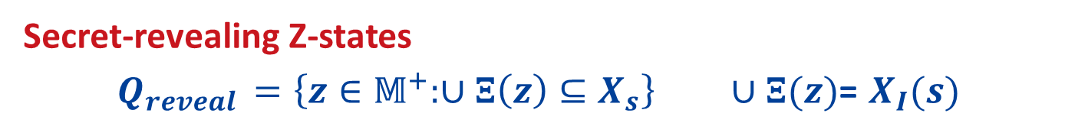
Supervisor Synthesis Procedure
11
2. Delete all secret-revealing states and inconsistent states
Secret-revealing Z-states
$Q_{reveal }=\left\{z∈𝕄^{+}:∪Ξ\left(z\right)⊆X_{s}\right\} ∪Ξ(z)$= $X_{I}(s)$

Slide 32
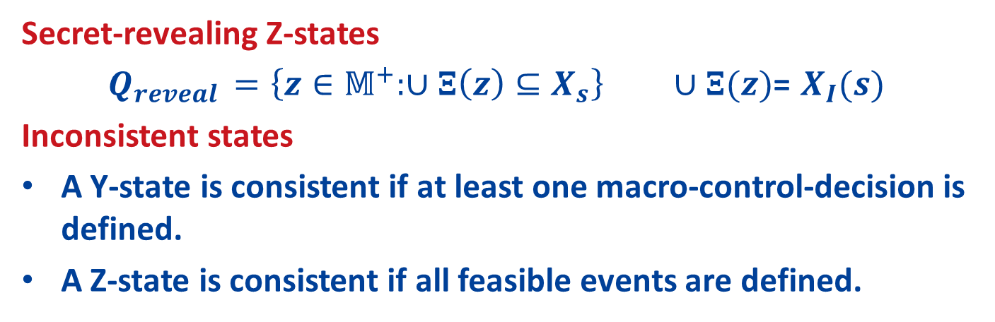
Supervisor Synthesis Procedure
11
2. Delete all secret-revealing states and inconsistent states
Secret-revealing Z-states
$Q_{reveal }=\left\{z∈𝕄^{+}:∪Ξ\left(z\right)⊆X_{s}\right\} ∪Ξ(z)$= $X_{I}(s)$
Inconsistent states
A Y-state is consistent if at least one macro-control-decision is defined.
A Z-state is consistent if all feasible events are defined.

Slide 33








































Supervisor Synthesis Procedure
11
2. Delete all secret-revealing states and inconsistent states
Secret-revealing Z-states
$Q_{reveal }=\left\{z∈𝕄^{+}:∪Ξ\left(z\right)⊆X_{s}\right\} ∪Ξ(z)$= $X_{I}(s)$
Inconsistent states
A Y-state is consistent if at least one macro-control-decision is defined.
A Z-state is consistent if all feasible events are defined.
$$s_{10}$$
$$s_{6}$$
$$s_{1}$$
$$o_{1}$$
$$\left\{\begin{matrix}(\left\{0,1\right\},γ_{2}) \\ (\left\{0,3\right\},γ_{3})\end{matrix}\right\}$$
$$d_{5}$$
$$d_{1}$$
$$s_{2}$$
$$\left\{\begin{matrix}\{5\} \\ \{6\}\end{matrix}\right\}$$
{{0}}
$$\left\{(\left\{0\right\},γ_{1})\right\}$$
$$o_{2}$$
$$s_{14}$$
$$d_{6}$$
$$d_{3}$$
$$d_{2}$$
$$d_{4}$$
$$s_{3}$$
$$\left\{\begin{matrix}(\left\{5\right\},γ_{1}) \\ (\left\{6\right\},γ_{1})\end{matrix}\right\}$$
$$s_{5}$$
$$s_{4}$$
$$\left\{(\left\{0,3\right\},γ_{3})\right\}$$
$$\left\{(\left\{0,1\right\},γ_{2})\right\}$$
$$\left\{(\left\{0,1,2,3\right\},γ_{4})\right\}$$
$$o_{1}$$
$$o_{2}$$
$$o_{2}$$
$$o_{1}$$
$$o_{3}$$
$$s_{9}$$
$$o_{2}$$
$$o_{1}$$
$$s_{8}$$
{{6}}
{{5}}
$$s_{7}$$
{{5,6}}
$$s_{13}$$
$$d_{7}$$
$$s_{12}$$
$$d_{8}$$
$$s_{11}$$
$$d_{9}$$
$$\left\{(\left\{6\right\},γ_{1})\right\}$$
$$\left\{(\left\{5\right\},γ_{1})\right\}$$
$$\left\{(\left\{5,6\right\},γ_{1})\right\}$$

Slide 34

Supervisor Synthesis Procedure
11
2. Delete all secret-revealing states and inconsistent states
Secret-revealing Z-states
$$Q_{reveal }=\left\{z∈𝕄^{+}:∪Ξ\left(z\right)⊆X_{s}\right\} ∪Ξ(z)\text{=} X_{I}(s)$$
Inconsistent states
A Y-state is consistent if at least one macro-control-decision is defined.
A Z-state is consistent if all feasible events are defined.
$$s_{10}$$
$$s_{6}$$
$$s_{1}$$
$$\left\{\begin{matrix}\{5\} \\ \{6\}\end{matrix}\right\}$$
$$o_{1}$$
$$\left\{\begin{matrix}(\left\{0,1\right\},γ_{2}) \\ (\left\{0,3\right\},γ_{3})\end{matrix}\right\}$$
$$d_{5}$$
$$o_{2}$$
{{0}}
$$s_{14}$$
$$d_{6}$$
$$d_{3}$$
$$d_{2}$$
$$d_{4}$$
$$s_{3}$$
$$\left\{\begin{matrix}(\left\{5\right\},γ_{1}) \\ (\left\{6\right\},γ_{1})\end{matrix}\right\}$$
$$s_{5}$$
$$s_{4}$$
$$\left\{(\left\{0,3\right\},γ_{3})\right\}$$
$$\left\{(\left\{0,1\right\},γ_{2})\right\}$$
$$\left\{(\left\{0,1,2,3\right\},γ_{4})\right\}$$
$$o_{1}$$
$$o_{2}$$
$$o_{2}$$
$$o_{1}$$
$$o_{3}$$
$$s_{9}$$
$$o_{2}$$
$$o_{1}$$
$$s_{8}$$
{{6}}
{{5}}
$$s_{7}$$
{{5,6}}
$$s_{13}$$
$$d_{7}$$
$$s_{11}$$
$$d_{9}$$
$$\left\{(\left\{6\right\},γ_{1})\right\}$$
$$\left\{(\left\{5,6\right\},γ_{1})\right\}$$

Slide 35
Supervisor Synthesis Procedure
11
2. Delete all secret-revealing states and inconsistent states
Secret-revealing Z-states
$$Q_{reveal }=\left\{z∈𝕄^{+}:∪Ξ\left(z\right)⊆X_{s}\right\} ∪Ξ(z)\text{=} X_{I}(s)$$
Inconsistent states
A Y-state is consistent if at least one macro-control-decision is defined.
A Z-state is consistent if all feasible events are defined.
$$s_{10}$$
$$s_{6}$$
$$s_{1}$$
$$\left\{\begin{matrix}\{5\} \\ \{6\}\end{matrix}\right\}$$
$$o_{1}$$
$$\left\{\begin{matrix}(\left\{0,1\right\},γ_{2}) \\ (\left\{0,3\right\},γ_{3})\end{matrix}\right\}$$
$$d_{5}$$
$$o_{2}$$
{{0}}
$$s_{14}$$
$$d_{6}$$
$$d_{3}$$
$$d_{2}$$
$$d_{4}$$
$$s_{3}$$
$$\left\{\begin{matrix}(\left\{5\right\},γ_{1}) \\ (\left\{6\right\},γ_{1})\end{matrix}\right\}$$
$$s_{5}$$
$$s_{4}$$
$$\left\{(\left\{0,3\right\},γ_{3})\right\}$$
$$\left\{(\left\{0,1\right\},γ_{2})\right\}$$
$$\left\{(\left\{0,1,2,3\right\},γ_{4})\right\}$$
$$o_{1}$$
$$o_{2}$$
$$o_{2}$$
$$o_{1}$$
$$o_{3}$$
$$s_{9}$$
$$o_{2}$$
$$o_{1}$$
{{6}}
$$s_{7}$$
{{5,6}}
$$s_{13}$$
$$d_{7}$$
$$s_{11}$$
$$d_{9}$$
$$\left\{(\left\{6\right\},γ_{1})\right\}$$
$$\left\{(\left\{5,6\right\},γ_{1})\right\}$$

Slide 36
Supervisor Synthesis Procedure
11
2. Delete all secret-revealing states and inconsistent states
Secret-revealing Z-states
$$Q_{reveal }=\left\{z∈𝕄^{+}:∪Ξ\left(z\right)⊆X_{s}\right\} ∪Ξ(z)\text{=} X_{I}(s)$$
Inconsistent states
A Y-state is consistent if at least one macro-control-decision is defined.
A Z-state is consistent if all feasible events are defined.
$$s_{10}$$
$$s_{6}$$
$$s_{1}$$
$$\left\{\begin{matrix}\{5\} \\ \{6\}\end{matrix}\right\}$$
$$o_{1}$$
$$\left\{\begin{matrix}(\left\{0,1\right\},γ_{2}) \\ (\left\{0,3\right\},γ_{3})\end{matrix}\right\}$$
$$d_{5}$$
$$o_{2}$$
{{0}}
$$s_{14}$$
$$d_{6}$$
$$\left\{\begin{matrix}(\left\{5\right\},γ_{1}) \\ (\left\{6\right\},γ_{1})\end{matrix}\right\}$$

Slide 37
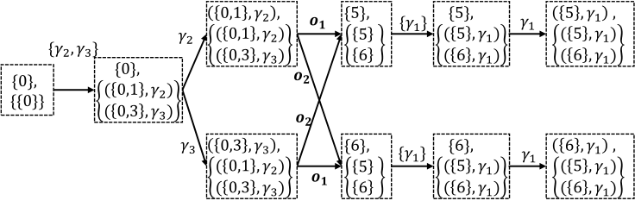

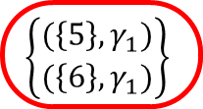
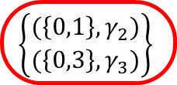

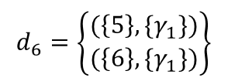


Supervisor Synthesis Procedure
12
3. Arbitrarily pick a macro-control decision for each Y-state
{{0}}
$d_{5}$ $=\left\{\left(\left\{0\right\},\left\{γ_{2},γ_{3}\right\}\right)\right\}$
$$\left\{\begin{matrix}(\left\{0,1\right\},γ_{2}) \\ (\left\{0,3\right\},γ_{3})\end{matrix}\right\}$$
$$o_{1}$$
$$o_{2}$$
$$\left\{\begin{matrix}\{5\} \\ \{6\}\end{matrix}\right\}$$
$$d_{6}=\left\{\begin{matrix}(\left\{5\right\},\{γ_{1}\text{\})} \\ \text{(}\left\{6\right\},\{γ_{1}\})\end{matrix}\right\}$$
$$\left\{\begin{matrix}(\left\{5\right\},γ_{1}) \\ (\left\{6\right\},γ_{1})\end{matrix}\right\}$$

Slide 38
Conclusion
13
Propose non-deterministic control mechanism to enforce opacity
Synthesize a non-deterministic supervisor based on the new information state
Non-deterministic supervisors are strictly more powerful than deterministic supervisor

Slide 39
Conclusion
13
Propose non-deterministic control mechanism to enforce opacity
Synthesize a non-deterministic supervisor based on the new information state
Non-deterministic supervisors are strictly more powerful than deterministic supervisor
Thank You!

