Slide 1

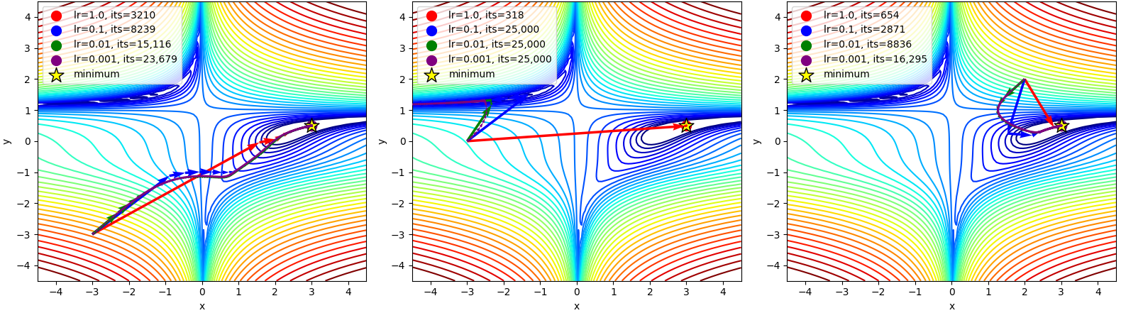
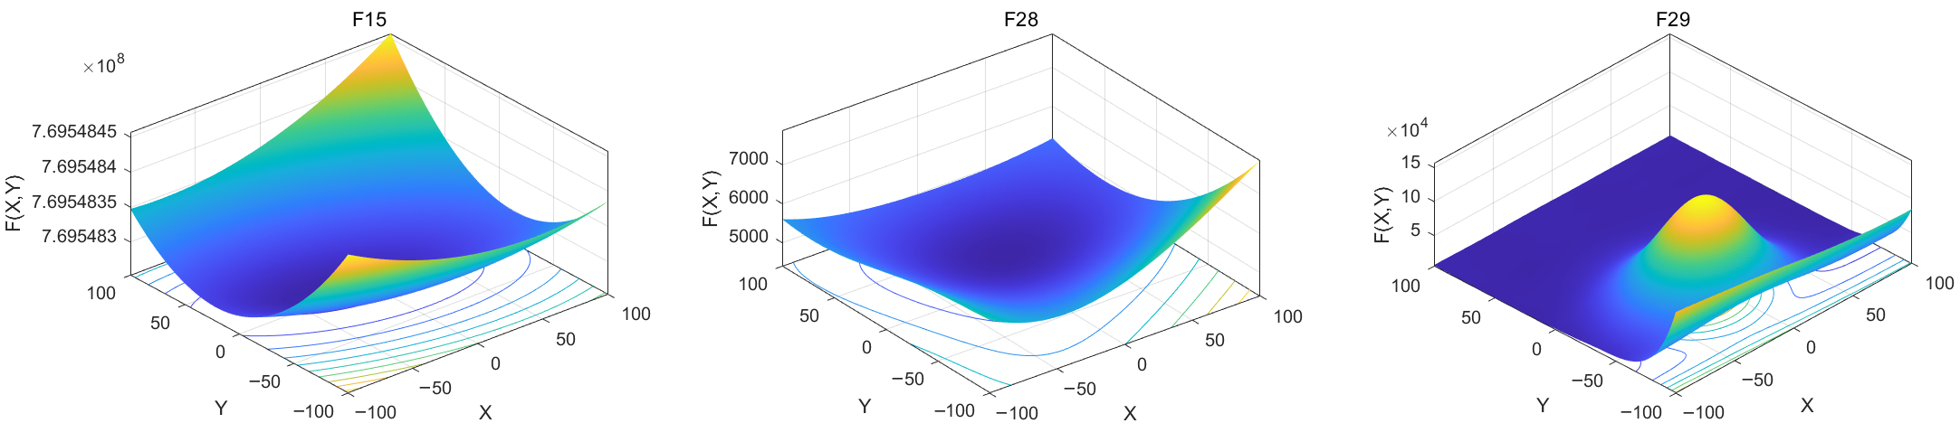
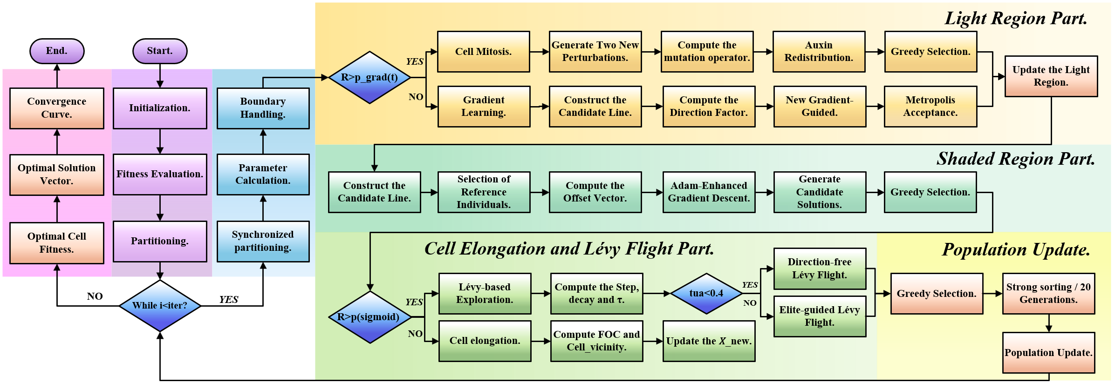
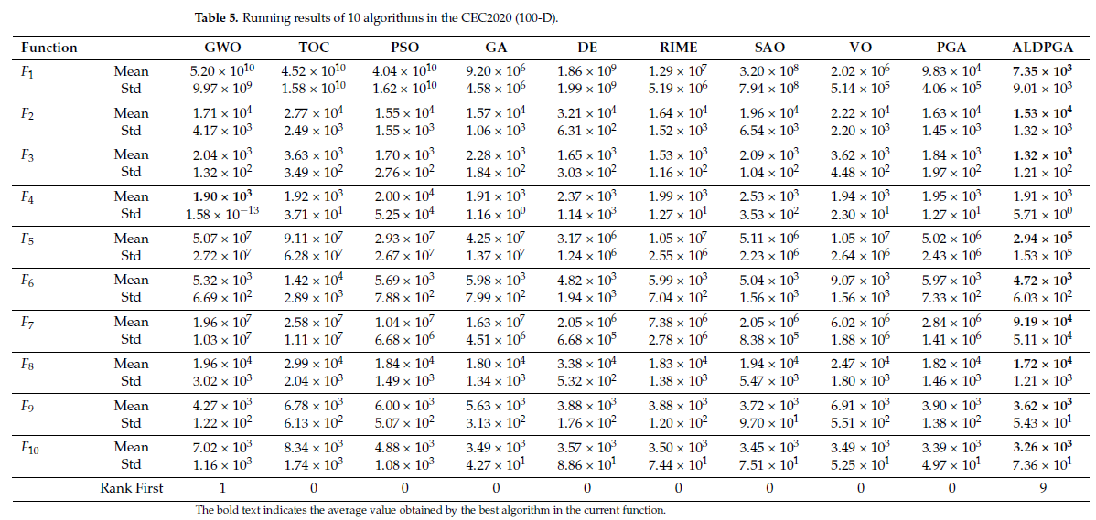
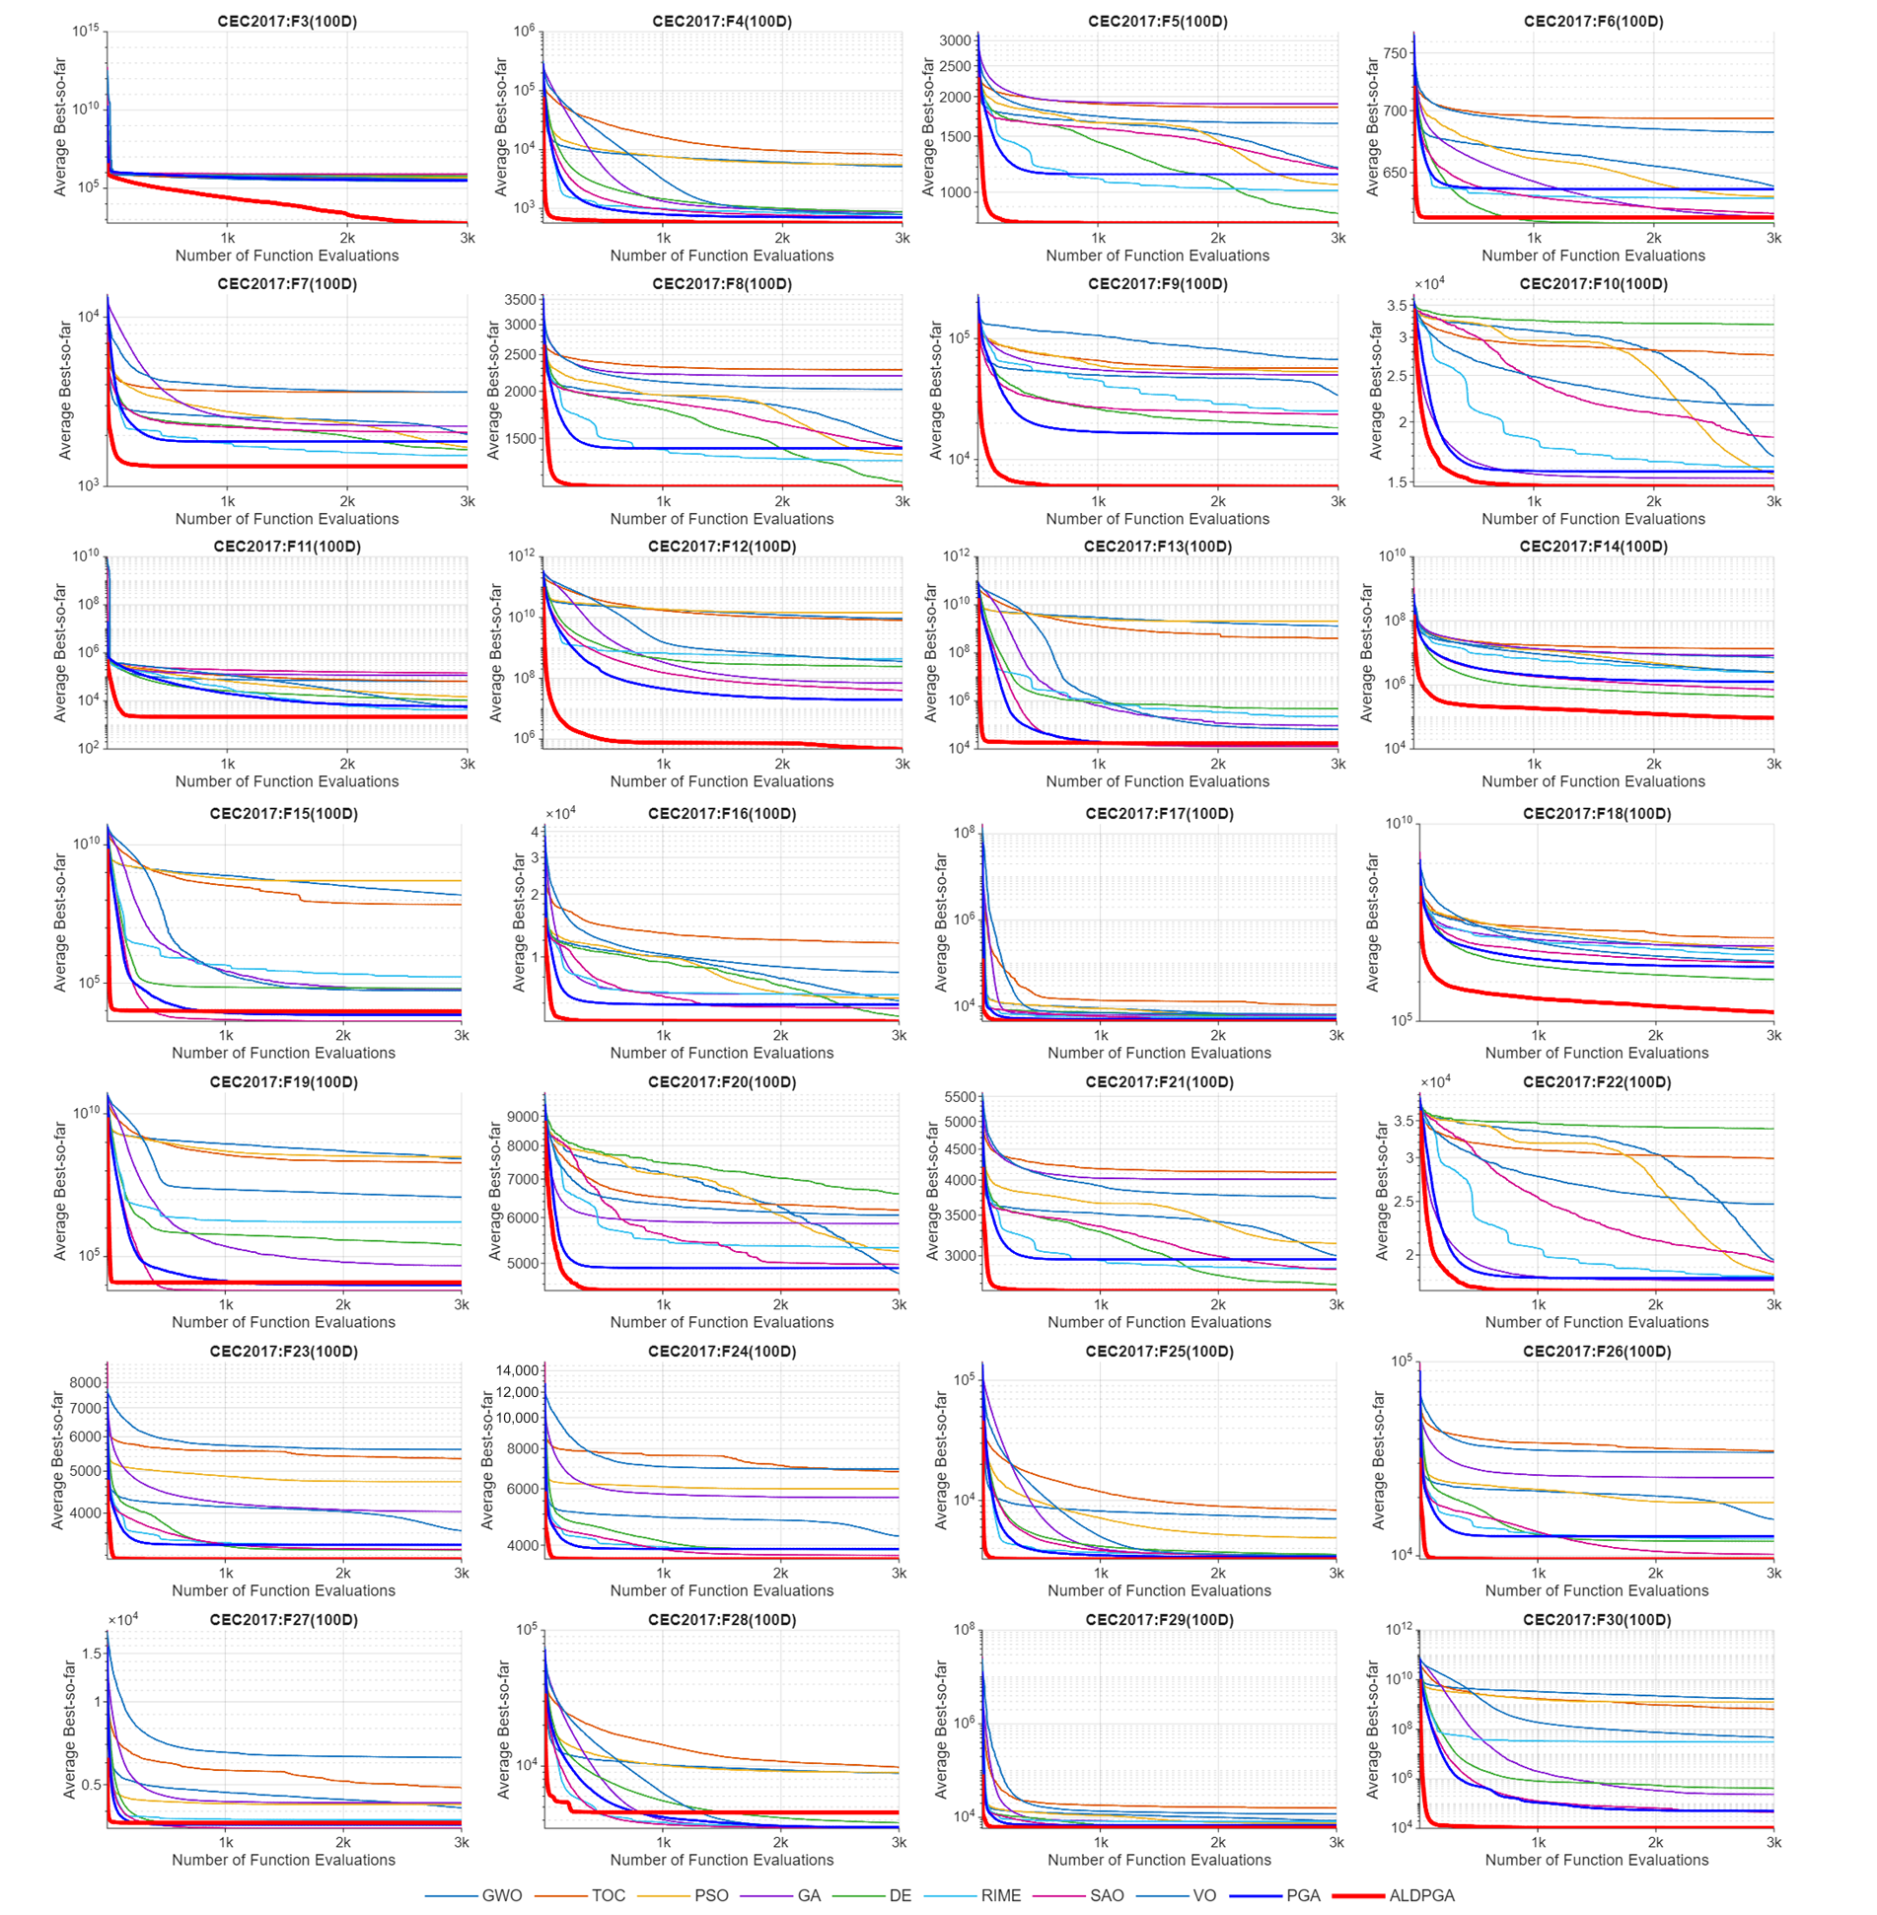
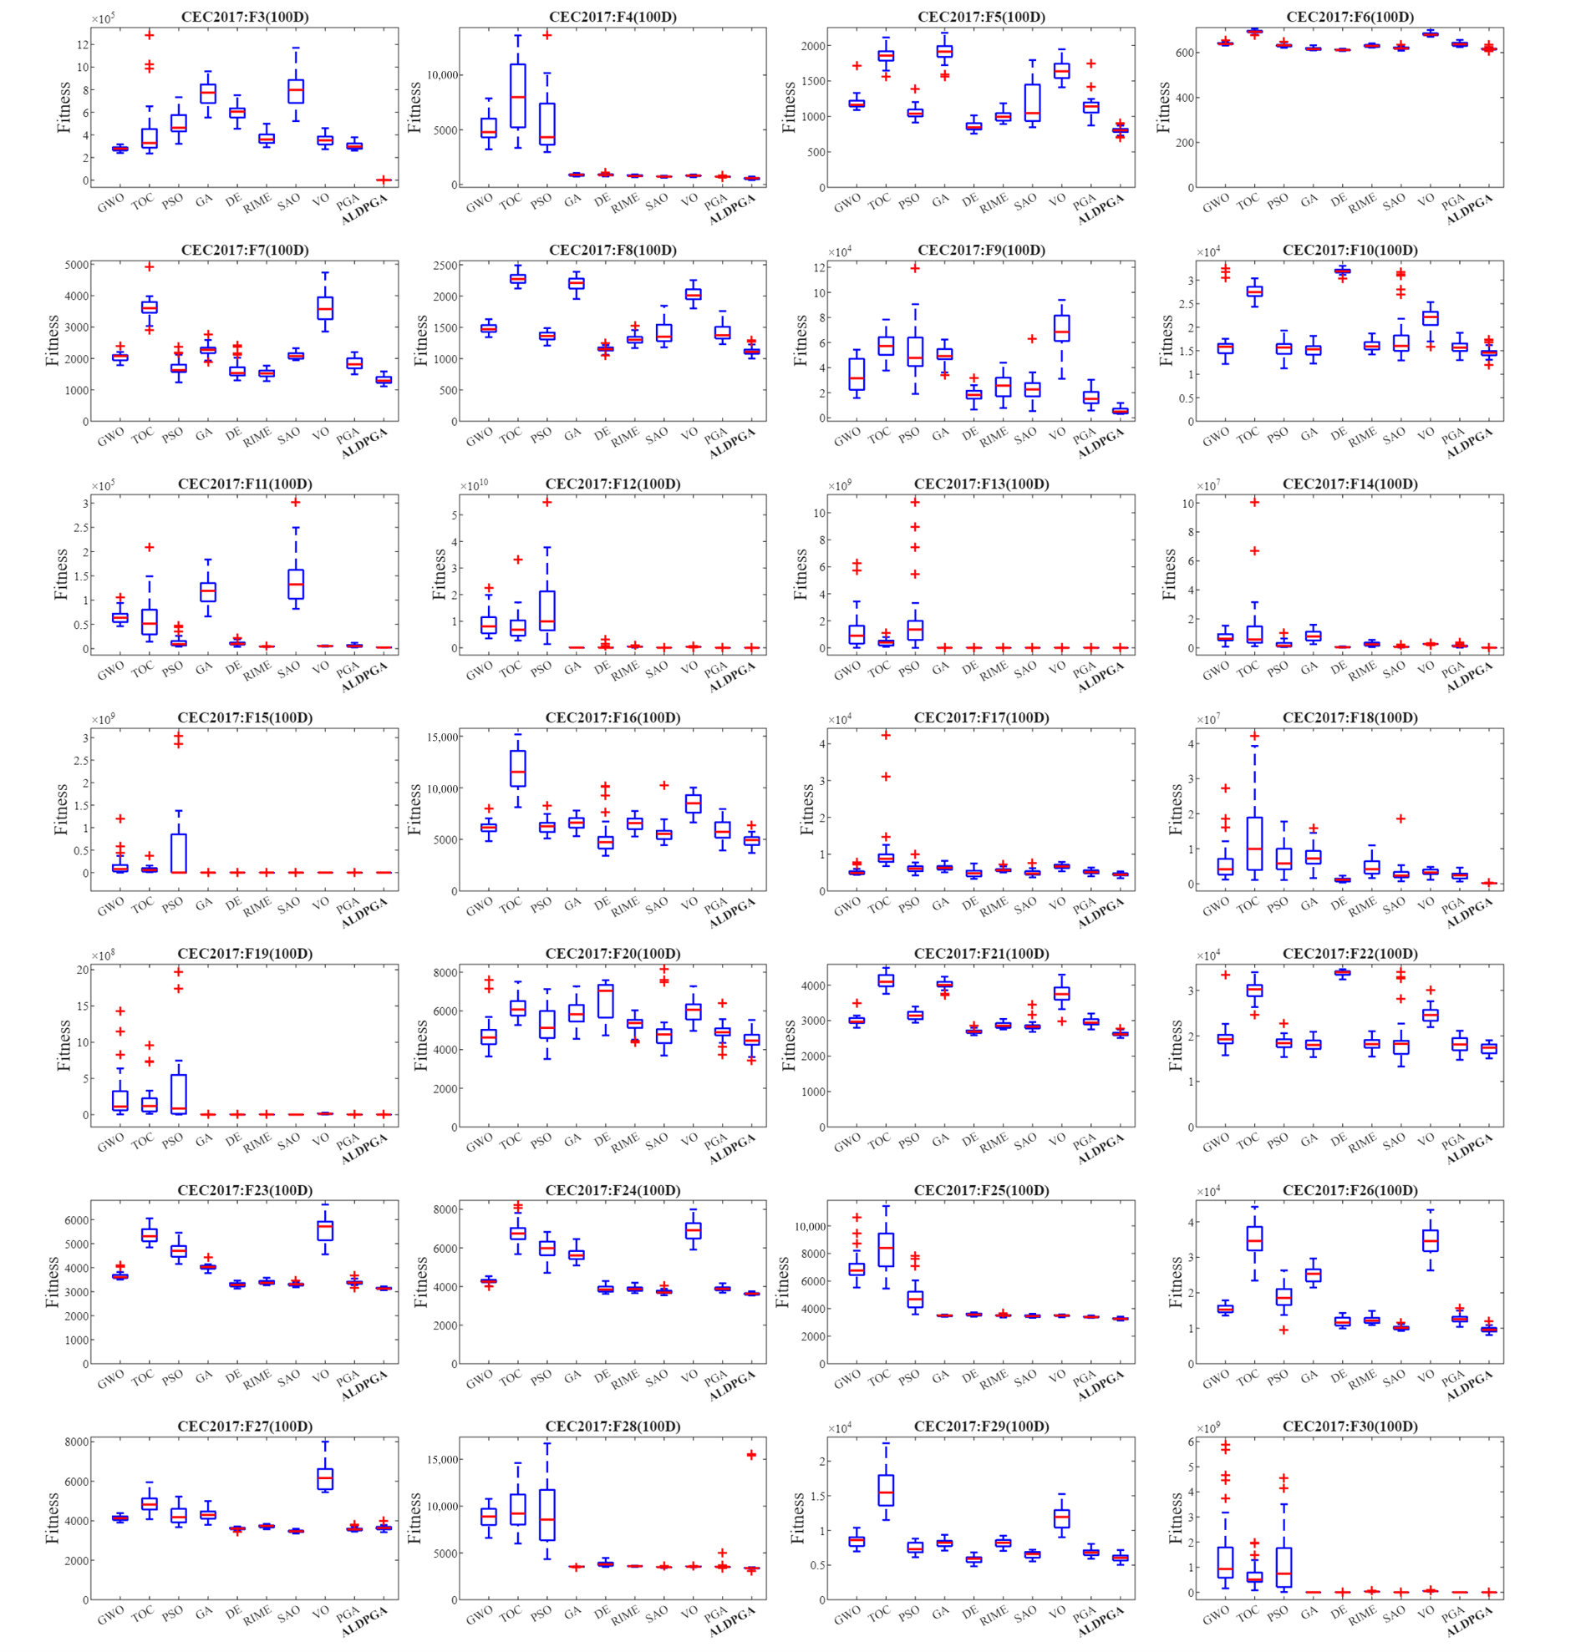
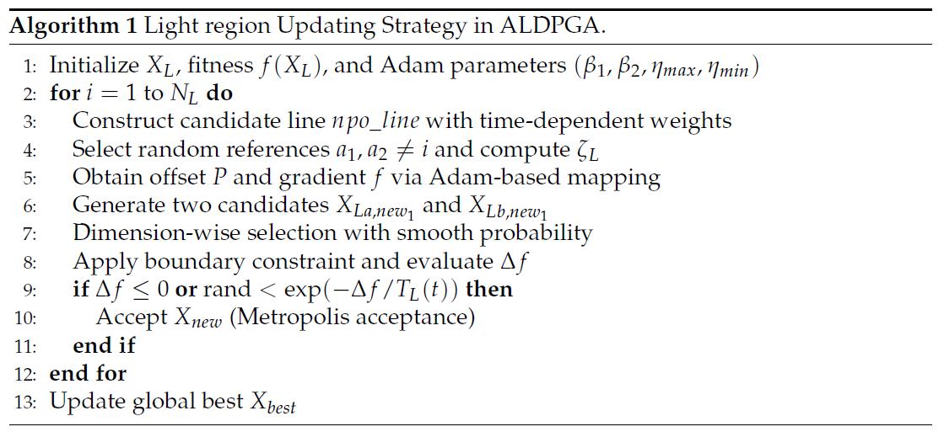
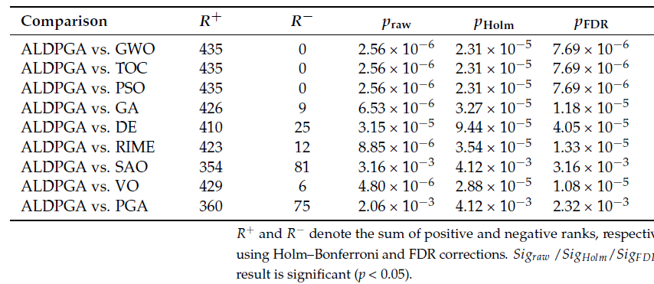
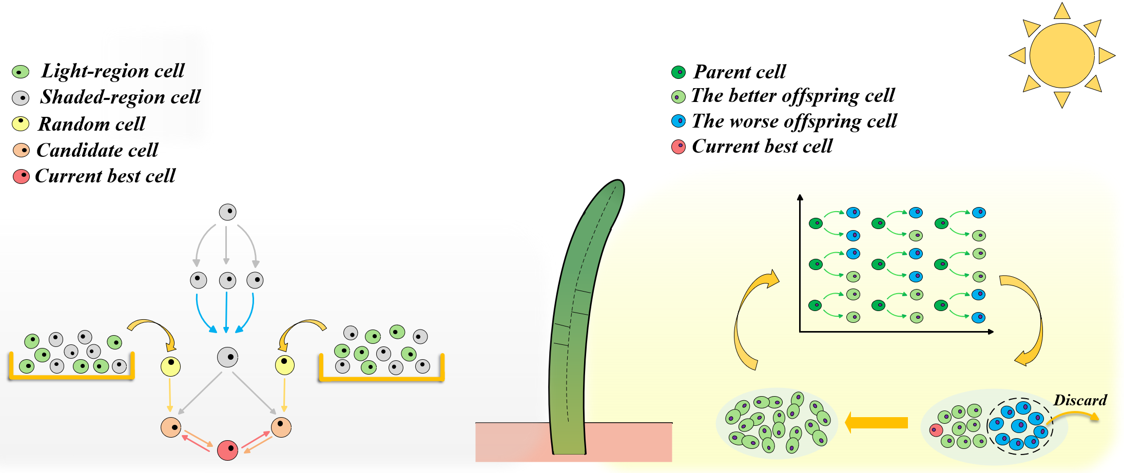



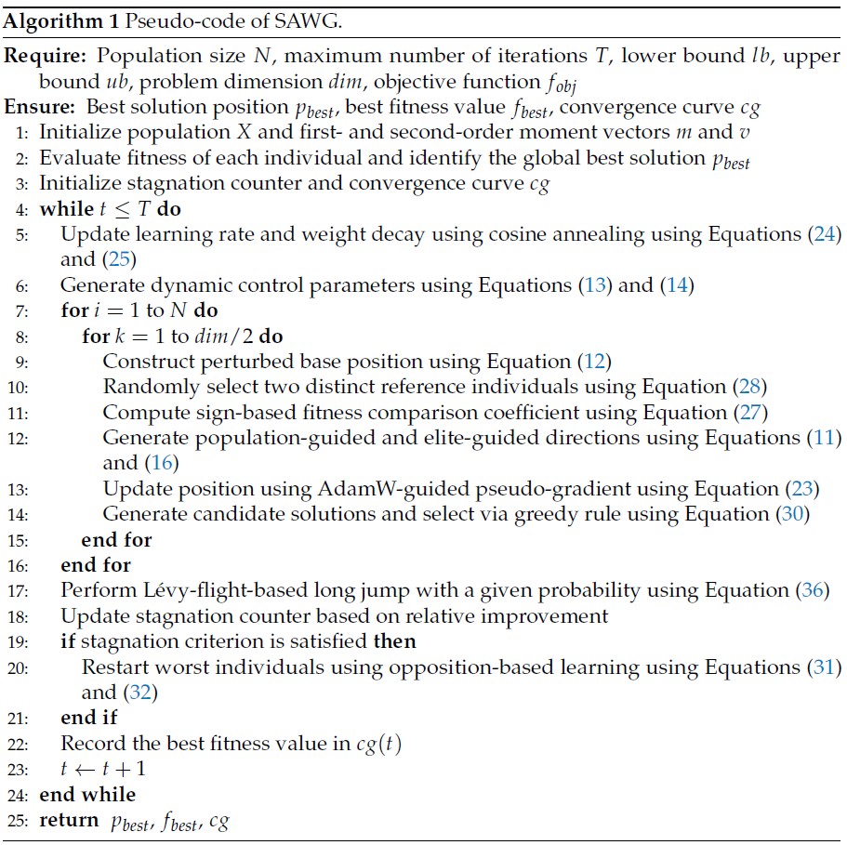
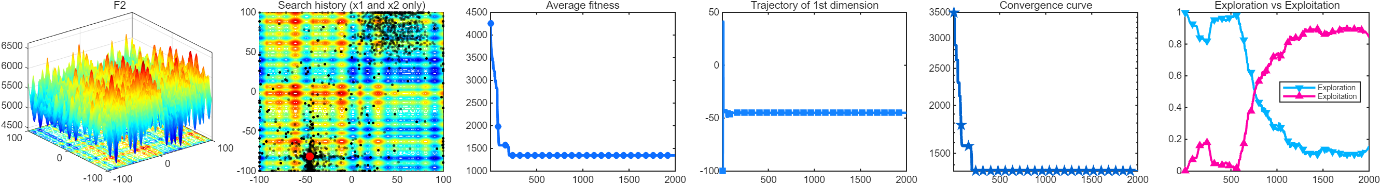
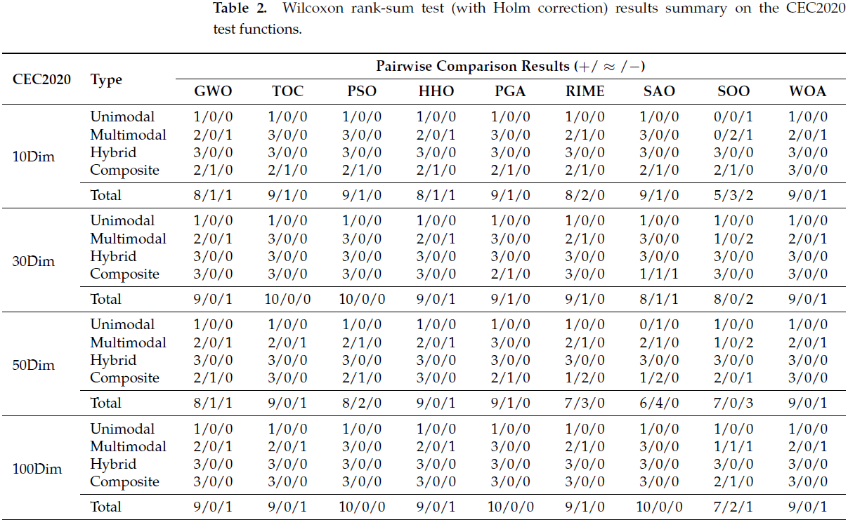
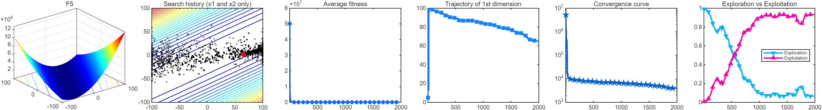
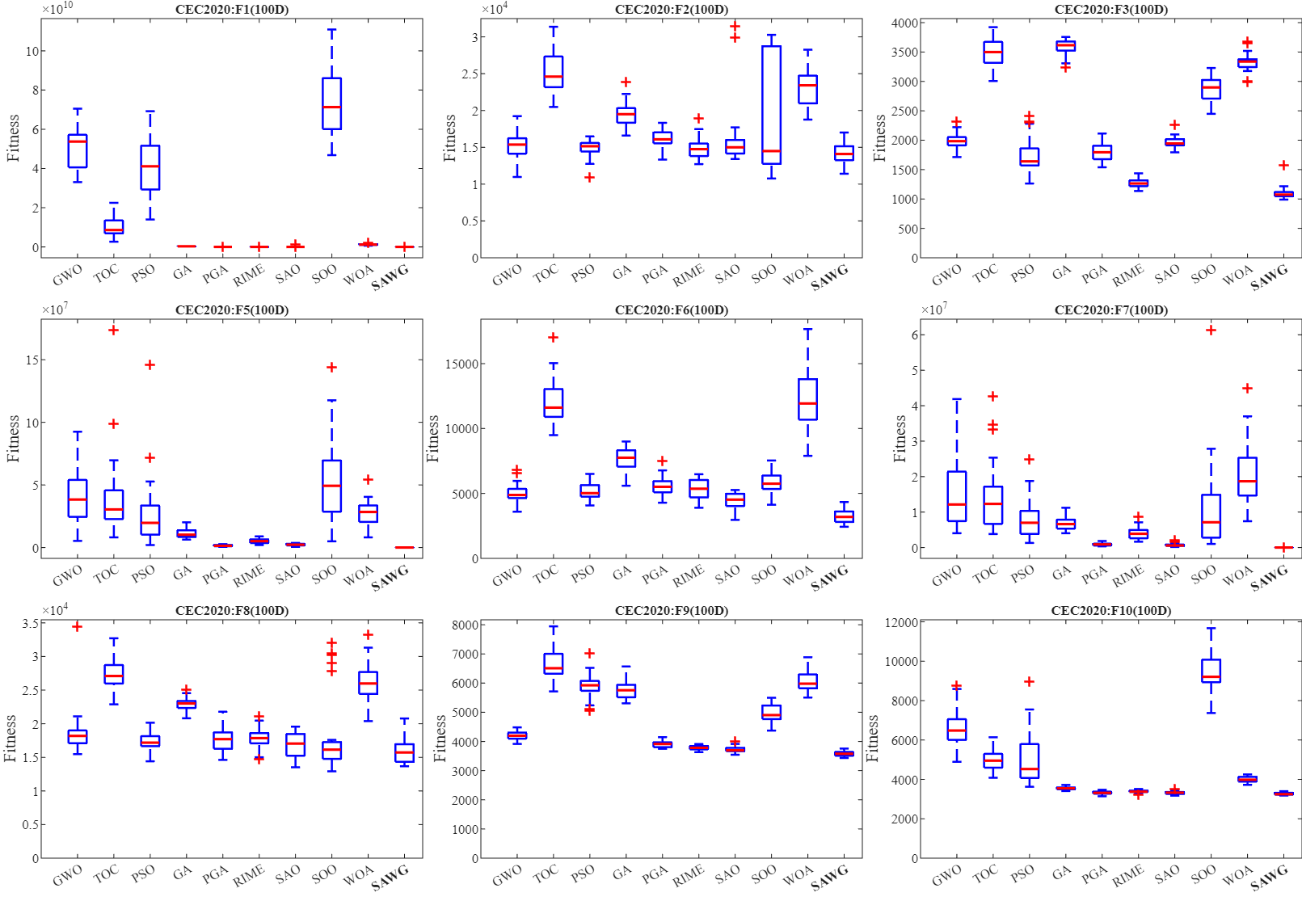
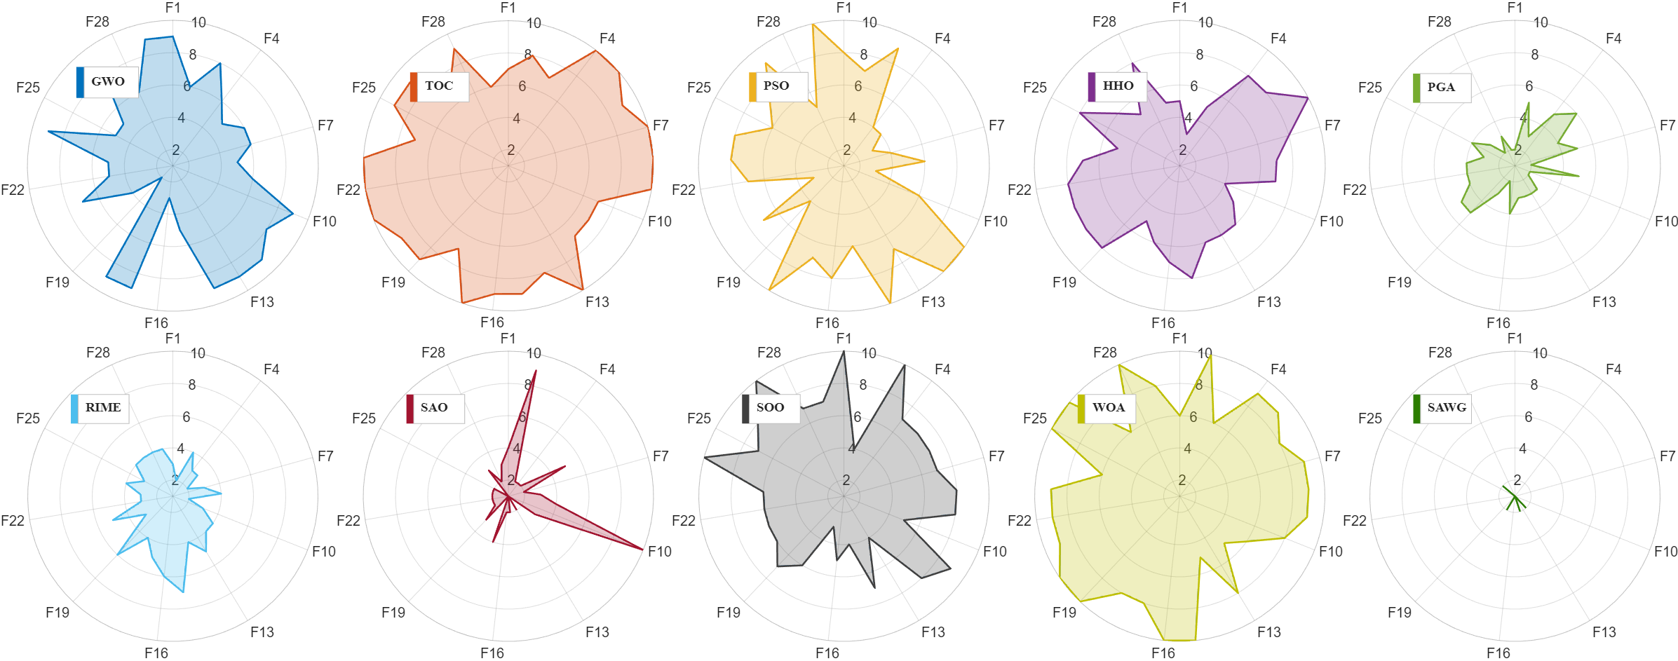
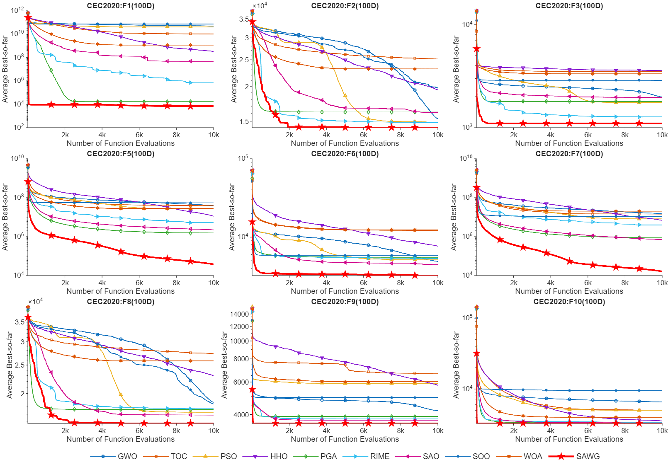
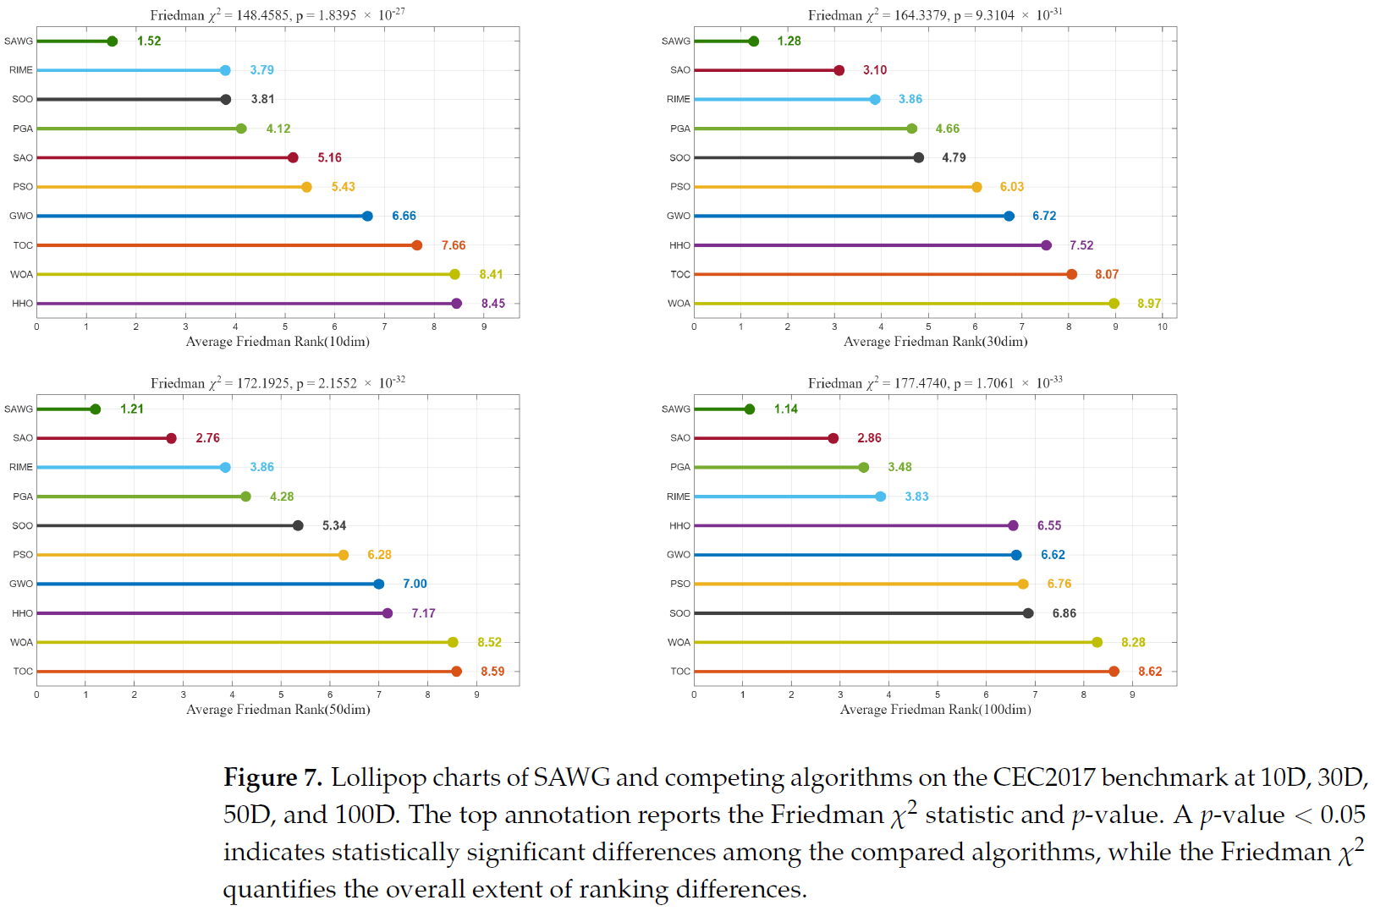
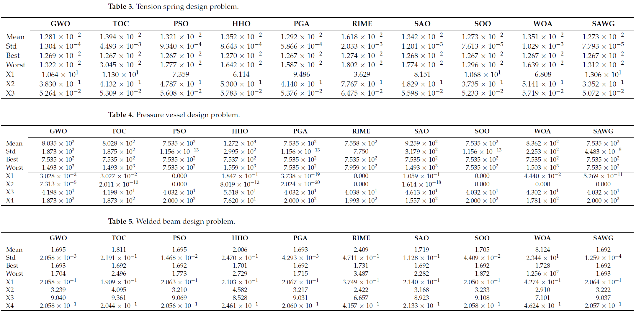
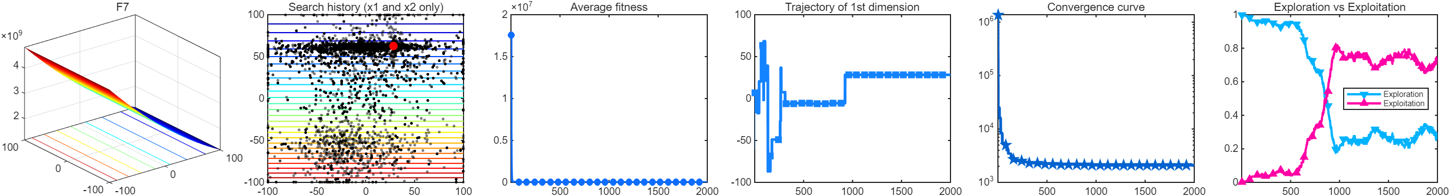
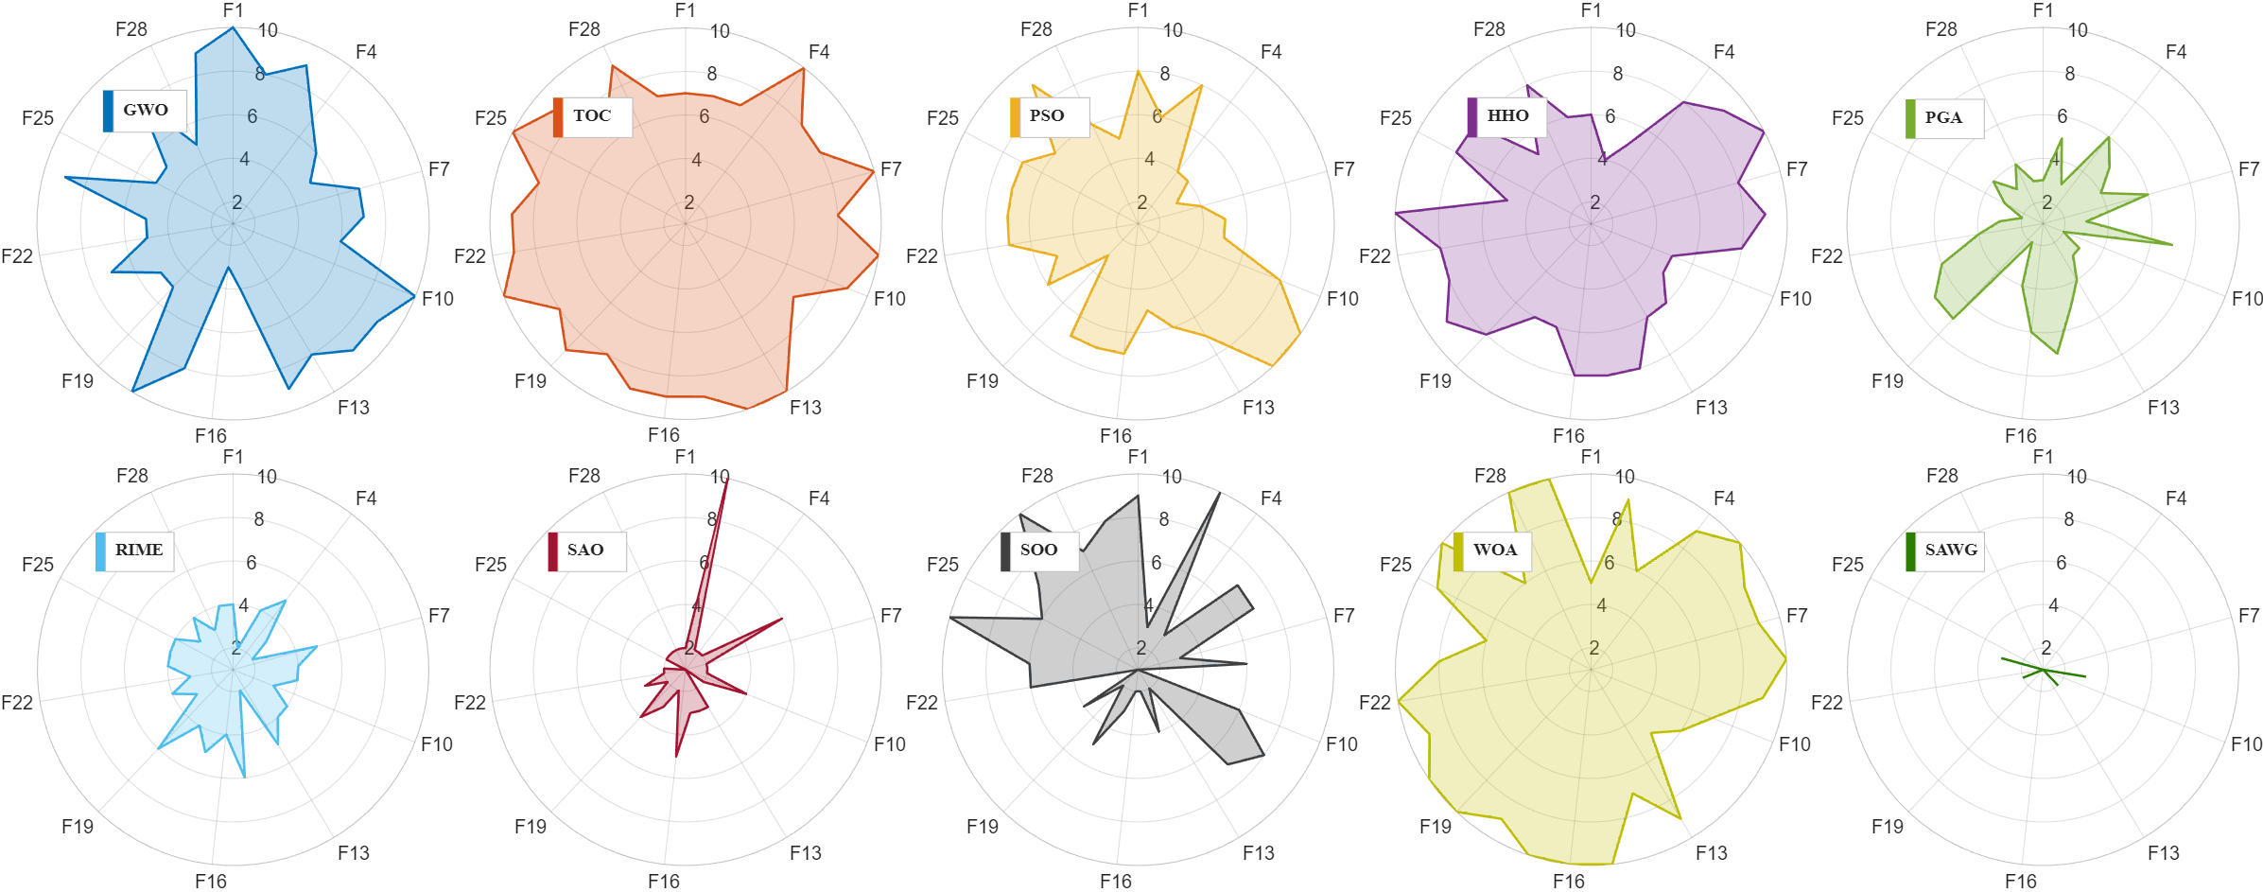
江苏科技大学
An Enhanced Plant Growth Algorithm with Adam Learning, Lévy Flight, and Dynamic Stage Control
Yuhang Xie, Wei Li, Bin Qin and Shang Gao *, School of Computer, Jiangsu University of Science and Technology, Zhenjiang 212001, China
Jiangsu University of Science and Technology
INTRODUCTION
MOTIVATION
CONTRIBUTION
Deep learning optimizers can achieve smaller losses in gradient descent. For example, optimizers like Adam and AdamW can stably reduce losses in deep learning through first moment, second moment, bias correction, and learning rate scheduling. So, which of these mechanisms can be decoupled from the real gradient and transferred to traditional population optimization?
When the objective function has no true gradient, can the relationship between population position and fitness construct a proxy signal with directional information, and allow Adam moment memory, and bias correction to continue to function?
We propose ALDPGA, an Adam- and Lévy-enhanced plant growth algorithm for high-dimensional numerical optimization.
We designed a pseudo-gradient learning mechanism that uses first- and second-moment estimates to stabilize search directions and adapt coordinate-wise step sizes.
We developed a dynamically scheduled search strategy combining Metropolis acceptance and Lévy-flight exploration. This improves the balance between local refinement and long-range exploration.
We evaluated ALDPGA on the CEC2017, CEC2020 and CEC2022 benchmarks and three engineering design problems using convergence analysis and non-parametric statistical tests.
FRAMEWORK
EXPERIMENT
We present the pseudocode, flowchart, and mechanism diagram of the algorithm.
Benchmarking and statistical analysis
Self-Adaptive AdamW-Guided Optimization: A Learning-Driven Metaheuristic for Solving Complex Real-World Engineering Problems.
Yuhang Xie¹, Wei Li¹, Cheng Zhong², Shang Gao¹, Kai Xu¹, Juanjuan Tu¹ and Bin Qin¹,*; 1. School of Computer, Jiangsu University of Science and Technology; 2. PLA Army Engineering University
INTRODUCTION
MOTIVATION
CONTRIBUTION
The continuous thread linking these two studies is the exploration of whether the state mechanisms found in gradient-based optimizers can serve population-based search methods that lack access to true gradients; PGA serves merely as the experimental vehicle for the initial phase.
If the core value stems from optimizer states rather than botanical metaphors, is it possible to decouple them? SAWG constructs a pseudo-gradient using a blend of the global mean and elite directions, incorporating an AdamW-style update mechanism.
We propose SAWG, a learning-driven population optimizer that applies AdamW-style updates to population-derived pseudo-gradients.
We designed an iteration- and rank-aware global–elite guidance mechanism. This adaptively shifts the search from population-level exploration to elite-guided exploitation.
We developed a decoupled adaptive update and stagnation-recovery strategy combining moment estimation, dynamic differential interaction, Lévy exploration and population restart.
We evaluated SAWG from multiple dimensions using the CEC2017 and CEC2020 benchmark suites and eight engineering design problems.
FRAMEWORK AND EXPERIMENT
To evaluate the optimization performance of SAWG, experiments were conducted on the CEC2017 and CEC2020 benchmark suites and eight engineering optimization problems. SAWG was also compared with nine other typical and novel high-performance optimizers. Experimental results and statistical analysis show that SAWG achieved excellent optimization performance in most test tasks and competitiveness in various numerical optimization problems.

Slide 2
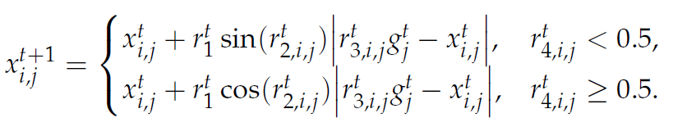
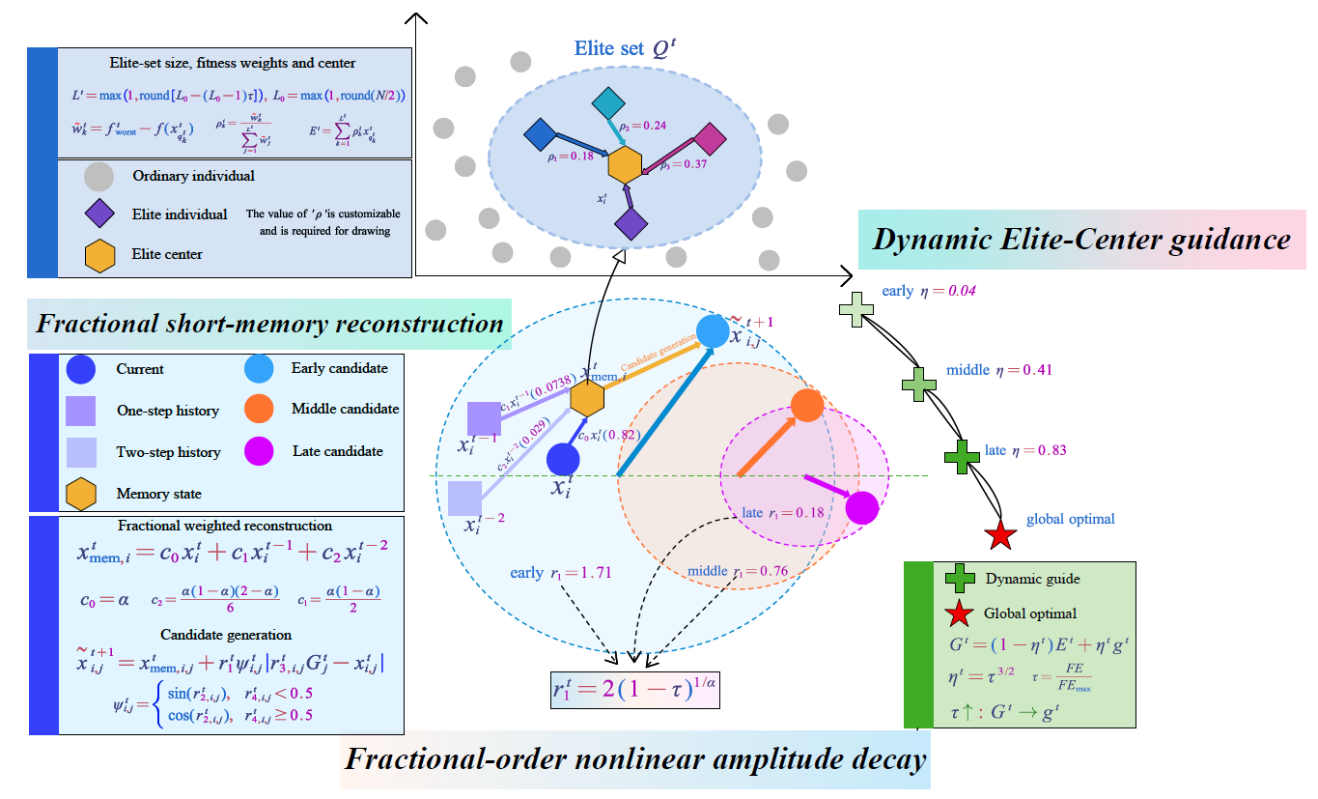
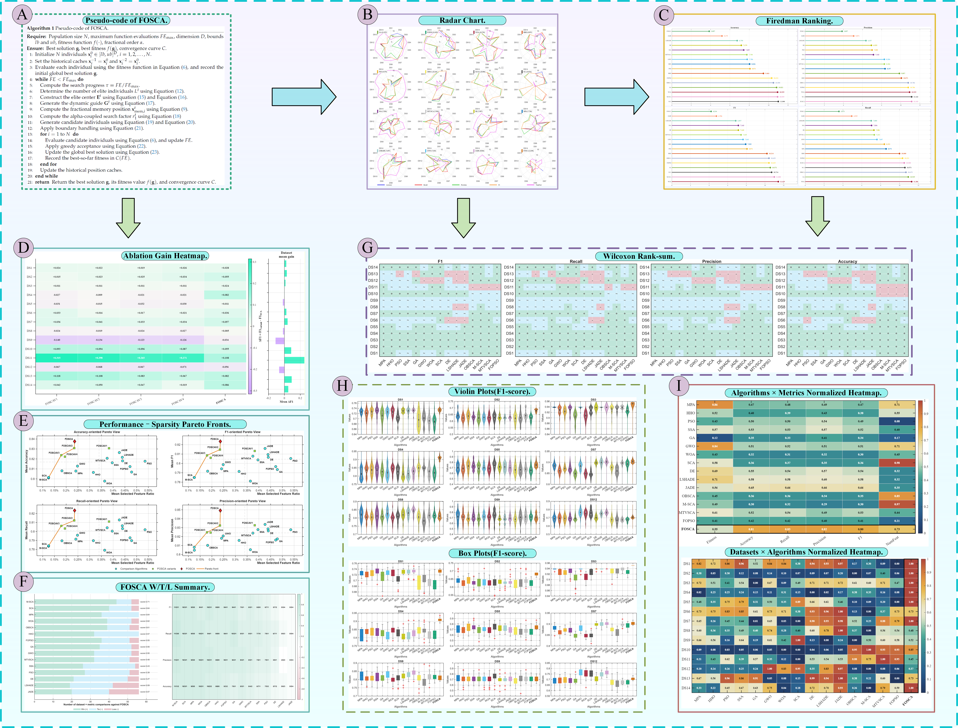
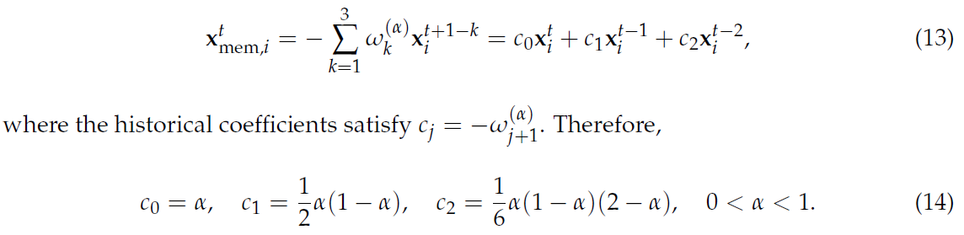
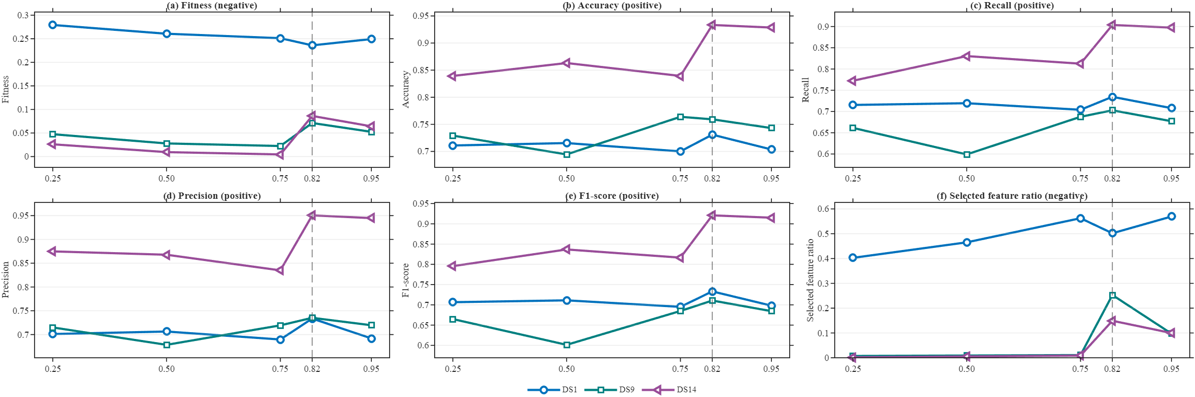
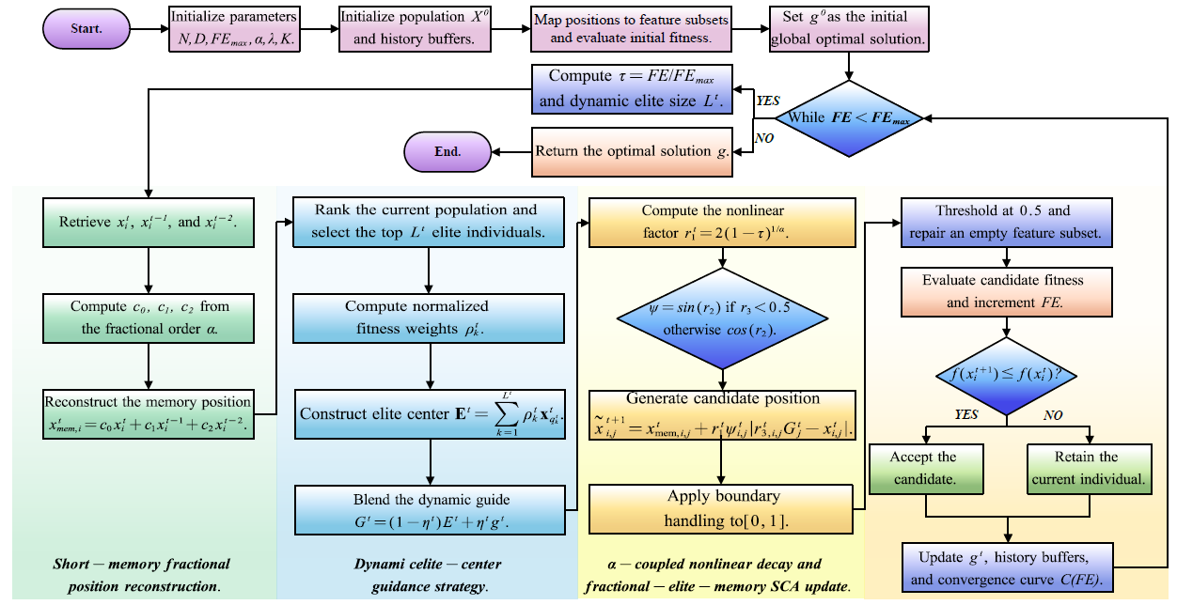
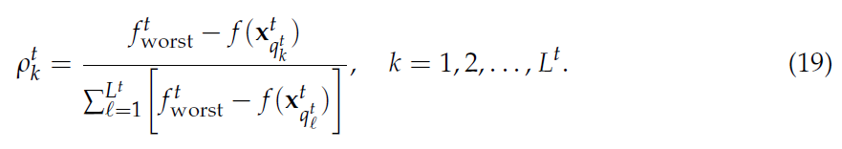
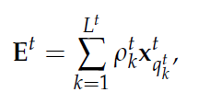
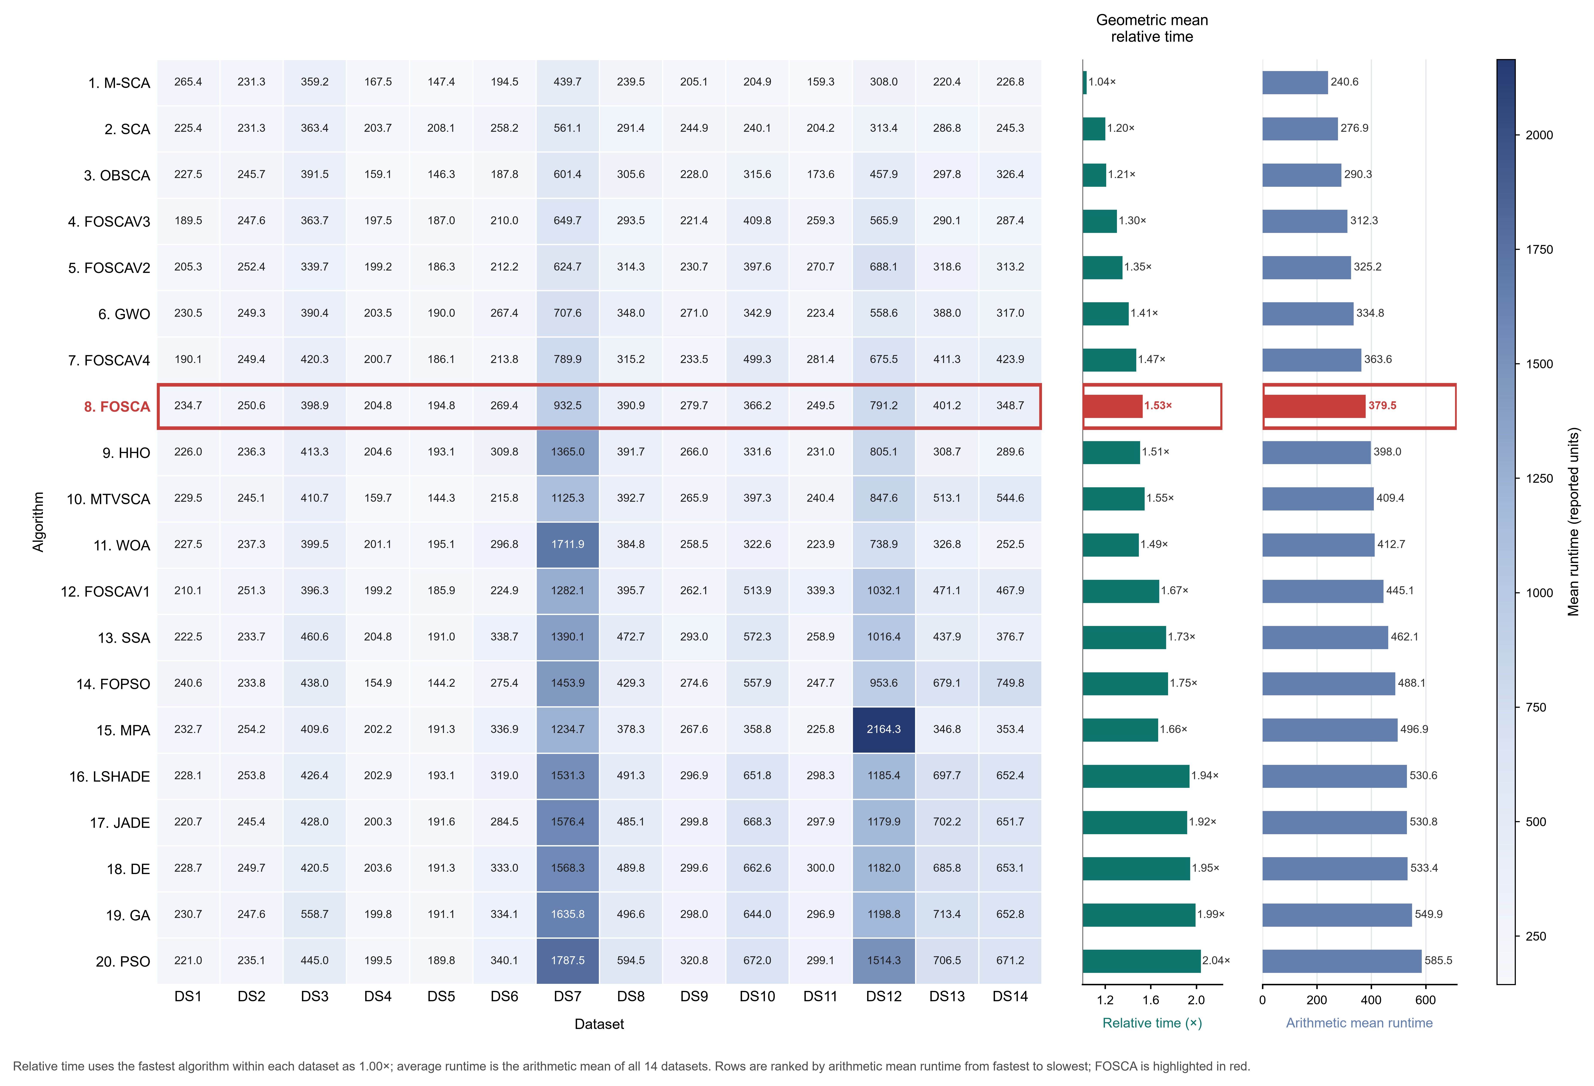
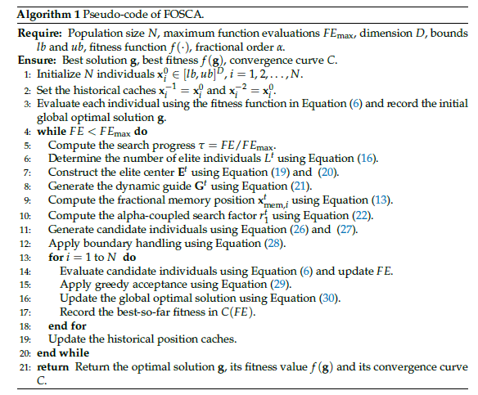

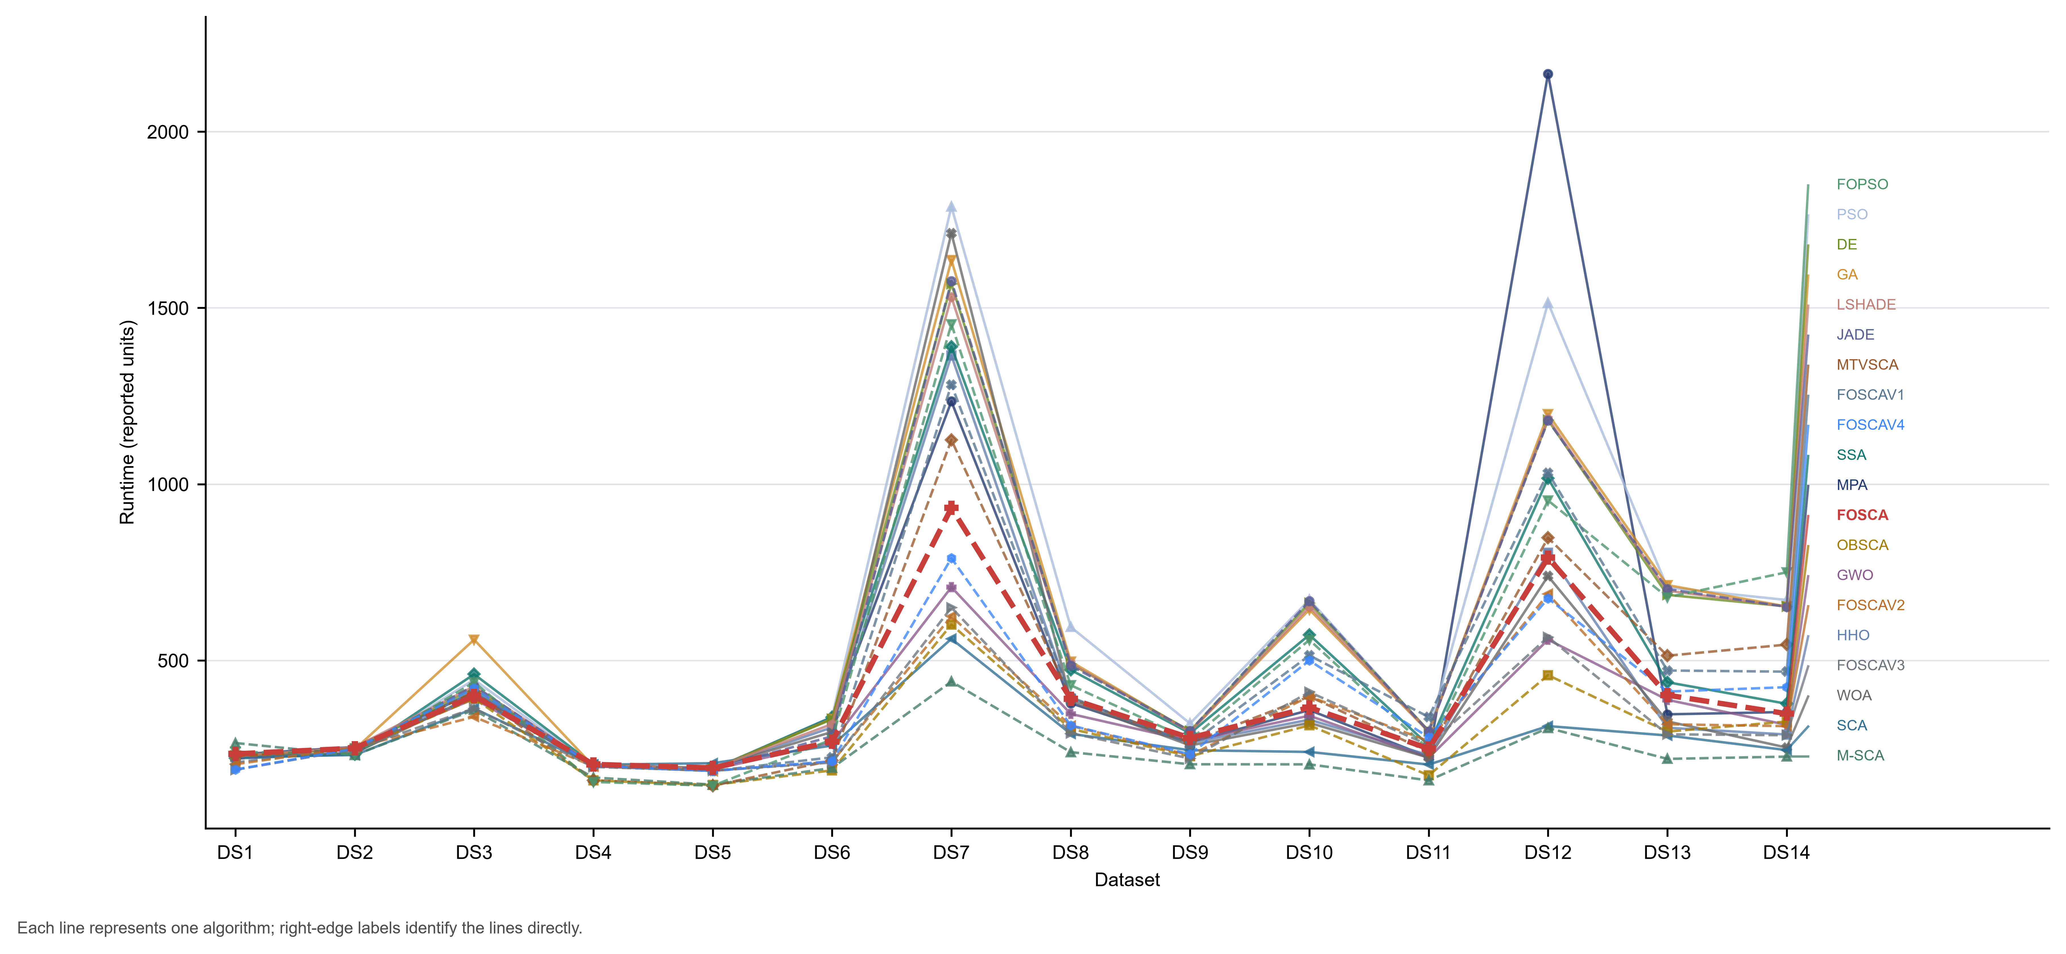
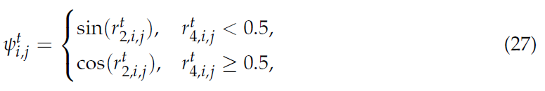

Fractional-Order Memory and Elite-Center-Guided Sine–Cosine Optimization for Feature Selection
Yuhang Xie, Wei Li, Bin Qin, Kai Xu, and Shang Gao*. School of Computer, Jiangsu University of Science and Technology, Zhenjiang 212003, China.
江苏科技大学
Jiangsu University of Science and Technology
研究背景
已有研究
贡献 CONTRIBUTION
在高维数据中，通常包含一些无关冗余特征，基于包裹法的特征选择问题中，连续优化算法做离散化后容易出现搜索方向不稳定、特征位反复翻转的情况。
定义连续分数，提出连续函数选 / 不选？
反向学习、邻域搜索、变异和折射学习，记忆引导策略
时间变化的转换函数、便宜的代理模型、多目标优化。
We propose the FOSCA, a fractional-order elite-memory SCA framework for wrapper based feature selection.
We designed a dynamic elite-center guidance mechanism to reduce the SCA’s dependence on a single global optimal solution. This improves the balance between population-level exploration and local exploitation.
We developed an alpha-coupled nonlinear search-factor decay strategy to control the perturbation amplitude of the SCA. This makes the search process more suitable for discretized feature selection.
We evaluated the proposed mechanisms using multiple classification performance metrics, the statistical significance.
MOTIVATION
Wrapper-base 通用性？
基于SCA：结构简单，离散特征选择时依赖单一最优解。
研究目标：在使用统一的分类器与二值化基础上，利用有限的评估预算，找到分类性能与特征稀疏性更均衡的特征子集。
问题分解：搜索个体“从哪里出发、朝哪里搜索、移动多大”。
数据集单一，记忆引导受到Attention的影响。
停止步骤需要根据不同的数据集来调试，对数据集的依赖性强，可以属于超超参数。
代理模型判断易错；多目标最后需要人为维护多个候选方案需要更多计算。
核心：不改变分类器而是提供搜索方案。
FRAMEWORK
标准SCA：
第一，构建了短期分数阶记忆，避免每次只根据当前状态更新。
第二，动态精英引导。由多个优秀解加权提供方向，避免过早依赖单一最优解，
后期再逐渐收缩到全局最优。
第三，构建了一个 $α$耦合的快衰减幅度，让搜索更快衰减，减少后期无效扰动。
（其他研究已经证明的可行性，非核心的创新，消融实验中也做了这个变体）。
特征通过 0.5 阈值二值化，目标函数为：$f=0.99 {MCE}_{CV}+0.01\frac{\left|S\right|}{D}.$
FOSCA机制图
实验结论
参数敏感性分析
FOSCA流程图
算法收敛性分析
实际CPU运行时间（8并）
FOSCA伪代码
Fig. 1 The graphical abstract is organized into nine complementary components: (A) Pseudo-code of FOSCA; (B) FOSCA and other algorithms” Firedman ranking radar chart on each dataset; (C) Firedman ranking of FOSCA compared to other algorithms; (D) FOSCA Variants Ablation Gain Heatmap; (E) Performance–Sparsity Pareto Fronts across 14 Datasets; (F) FOSCA Wilcoxon rank-sum test results chart: W/T/L summation and comparison algorithm; (G) FOSCA pairwise Wilcoxon outcome symbols across datasets; (H) FOSCA F1-score stability analysis (Violin plots and Box plots); (I) Algorithms / Metrics / Datasets pairwise Normalized Heatmap;

