Slide 1
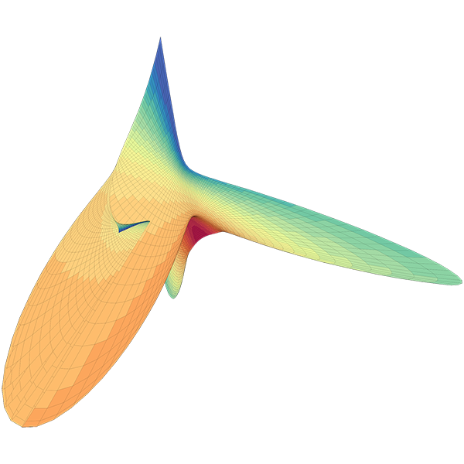
sciBASIC#™
MathLab Workbench

