Slide 1
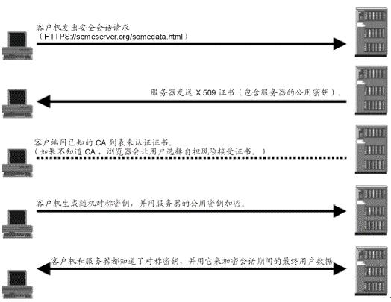
Application 应用层
SSL (Microsoft.VisualBasic.WrapperClassTools.Net.SSL.
SSLSynchronizationServicesSocket)
TCP (Microsoft.VisualBasic.WrapperClassTools.Net.T
cpSynchronizationServicesSocket)
WinSocket
SSL原理

