Slide 1
Fuzzy C-Means Clustering
Course Project Presentation
Mahdi Amiri
June 2003
Sharif University of Technology

Slide 2
Presentation Outline
Motivation and Goals
Fuzzy C-Means Clustering (FCM)
Possibilistic C-Means Clustering (PCM)
Fuzzy-Possibilistic C-Means (FPCM)
Comparison of FCM, PCM and FPCM
Conclusions and Future Works

Slide 3
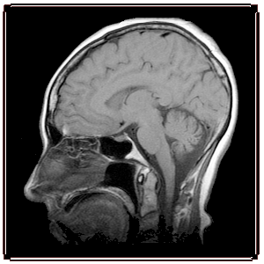
Motivation and Goals
Sample Applications
Image segmentation
  Medical imaging
    X-ray Computer Tomography (CT)
    Magnetic Resonance Imaging (MRI)
    Position Emission Tomography (PET)
Image and speech enhancement
Edge detection
Video shot change detection
Notes:
Tomograph: Medical instrument which receives X-rays via a special method.
Magnetic Resonance Imager (MRI): Diagnostic technique which uses a magnetic field and radio waves to provide computerized images of internal body tissues.
Positron Emission Tomography (PET): Technique for creating detailed images of bodily tissues by injecting positron-laden material into the body and recording the gamma rays emitted over a period of approximately two hours.

Slide 4
Motivation and Goals
Pattern Recognition
Definition: Search for structure in data
Elements of Numerical Pattern Recognition
  Process Description
    Feature Nomination, Test Data, Design Data
  Feature Analysis
    Preprocessing, Extraction, Selection, …
  Cluster Analysis
    Labeling, Validity, …
  Classifier Design
    Classification, Estimation, Prediction, Control, …
We are here

Slide 5

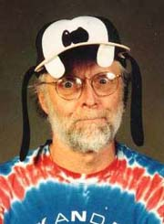
Motivation and Goals
Fuzzy Clustering
Useful in Fuzzy Modeling
  Identification of the fuzzy rules needed to describe a “black box” system, on the basis of observed vectors of inputs and outputs
History
  FCM: Bezdek, 1981
  PCM: Krishnapuram - Keller, 1993
  FPCM: N. Pal - K. Pal - Bezdek, 1997
Prof. Bezdek

Slide 6
Fuzzy C-Means Clustering
Input, Output
Input: Unlabeled data set
Main Output
Common Additional Output
is the number of data point in
is the number of features in each vector
A c-partition of X, which is
matrix U
Set of vectors
is called “cluster center”

Slide 7
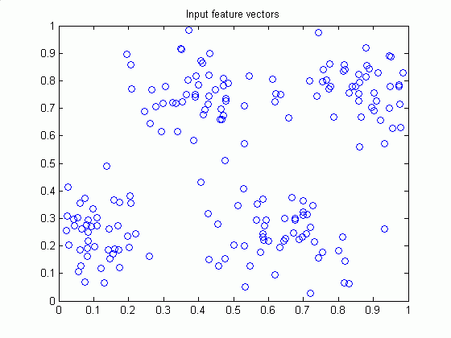
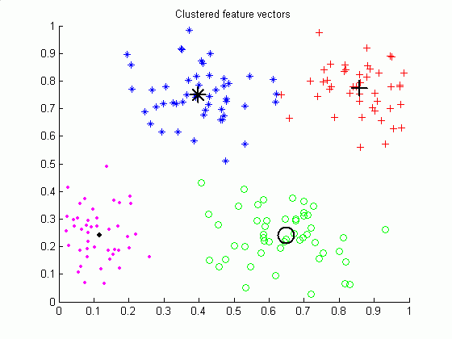
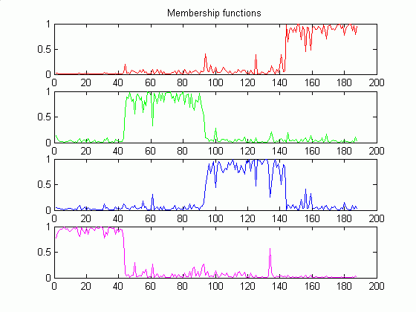
Fuzzy C-Means Clustering
Sample Illustration
Rows of U
(Membership Functions)

Slide 8
Fuzzy C-Means Clustering
(FCM), Objective Function
Optimization of an “objective function” or “performance index”
Constraint
A-norm
Distance
Degree of
Fuzzification

Slide 9
Fuzzy C-Means Clustering
Minimizing Objective Function
Zeroing the gradient of with respect to
Zeroing the gradient of with respect to
Note: It is the Center of Gravity

Slide 10
Fuzzy C-Means Clustering
Pick
Initial Choices
  Number of clusters
  Maximum number of iterations (Typ.: 100)
  Weighting exponent (Fuzziness degree)
    m=1: crisp
    m=2: Typical
  Termination measure ← 1-norm
  Termination threshold (Typ. 0.01)
Notes:
1-norm (X) = max(sum(abs(X))) (the largest column sum of X)

Slide 11
Fuzzy C-Means Clustering
Guess, Iterate
Guess Initial Cluster Centers
Alternating Optimization (AO)
  REPEAT
  UNTIL ( or )

Slide 12
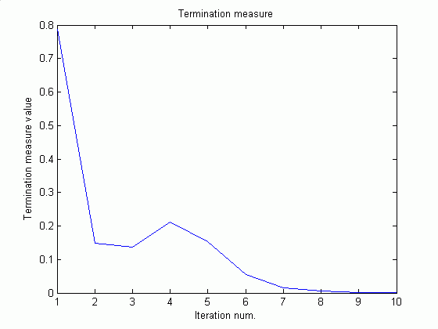
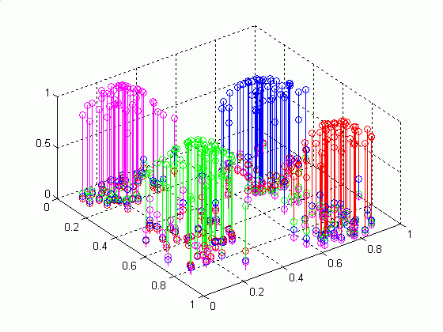
Fuzzy C-Means Clustering
Sample Termination Measure Plot
Termination Measure Values
Final
Membership Degrees

Slide 13
Fuzzy C-Means Clustering
Implementation Notes
Process could be shifted one half cycle
  Initialization is done on
  Iterates become
  Termination criterion
The convergence theory is the same in either case
Initializing and terminating on V is advantageous
  Convenience
  Speed
  Storage

Slide 14
Fuzzy C-Means Clustering
Pros and Cons
Advantages
  Unsupervised
  Always converges
Disadvantages
  Long computational time
  Sensitivity to the initial guess (speed, local minima)
  Sensitivity to noise
    One expects low (or even no) membership degree for outliers (noisy points)

Slide 15
Fuzzy C-Means Clustering
Optimal Number of Clusters
Performance Index
Average of all feature vectors
Sum of the
within fuzzy cluster fluctuations
(small value for optimal c)
Sum of the
between fuzzy cluster fluctuations
(big value for optimal c)

Slide 16
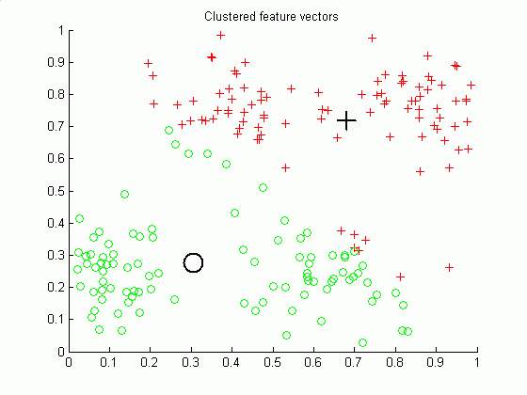
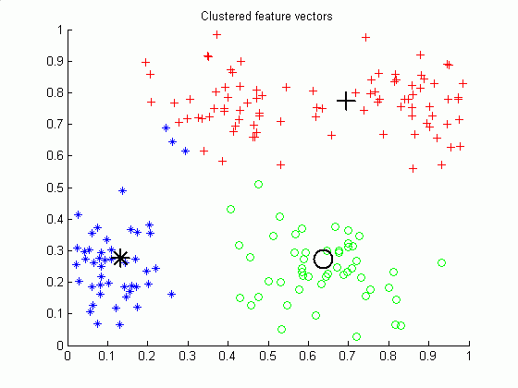
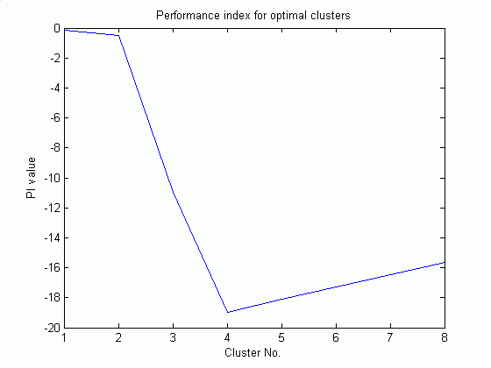
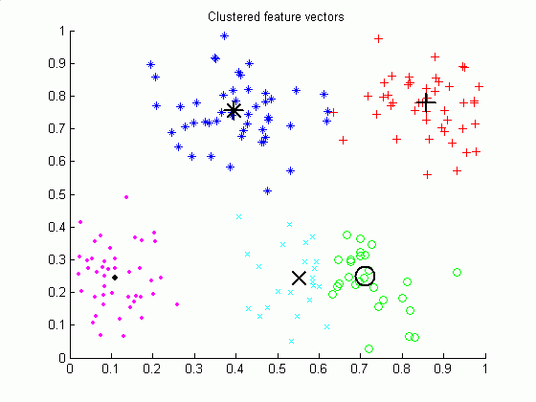
Fuzzy C-Means Clustering
Optimal Cluster No. (Example)
Performance index for optimal clusters
(is minimum for c = 4)
c = 2
c = 3
c = 4
c = 5

Slide 17
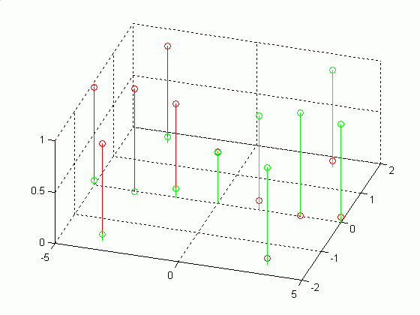
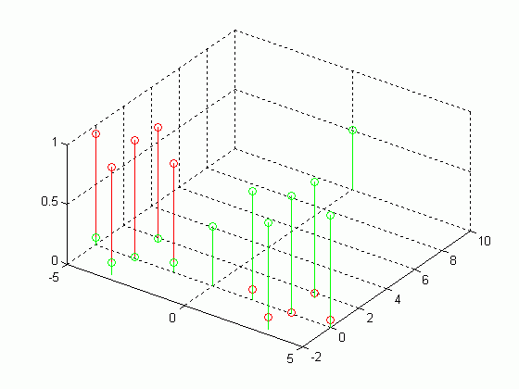


Possibililstic C-Means Clustering
Outliers, Disadvantage of FCM
FCM on
FCM on
is an outlier but has the same membership degrees as

Slide 18
Possibililstic C-Means Clustering
(PCM), Objective Function
Objective function
Typicality or Possibility
  No constraint like
Cluster weights

Slide 19
Possibililstic C-Means Clustering
Terms of Objective Function
Unconstrained optimization of first term will lead to the trivial solution
The second term acts as a penalty which tries to bring typicality values towards 1.
First term
Second term

Slide 20
Possibililstic C-Means Clustering
Minimizing Objective Function (OF)
Rows and columns of OF are independent
First order necessary conditions for
ik-th term of OF
Typicality values
Cluster centers (Same as FCM)

Slide 21
Possibililstic C-Means Clustering
Alternating Optimization, Again
Similar to FCM-AO algorithm (Replace equations of necessary conditions)
Terminal outputs of FCM-AO recommended as a good way to initialize PCM-AO
  Cluster centers: Final cluster centers of FCM-AO
  Weights:
is proportional to the average
within cluster fluctuation
Typ. K = 1

Slide 22
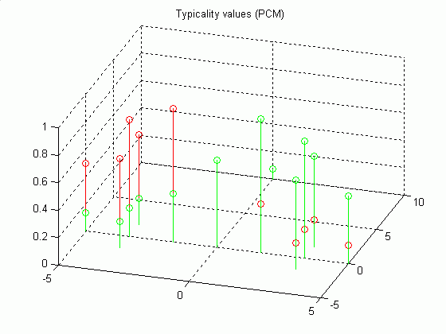
Possibililstic C-Means Clustering
Identify Outliers
FCM on
PCM on
is recognized as an outlier by PCM

Slide 23
Possibililstic C-Means Clustering
Pros and Cons
Advantage
  Clustering noisy data samples
Disadvantage
  Very sensitive to good initialization
  Coincident clusters may result
    Because the columns and rows of the typicality matrix are independent of each other
    Sometimes this could be advantageous (start with a large value of c and get less distinct clusters)

Slide 24
Fuzzy-Possibililstic C-Means
Idea
is a function of and all c centroids
is a function of and alone
Both are important
  To classify a data point, cluster centroid has to be closest to the data point → Membership
  For Estimating the centroids → Typicality for alleviating the undesirable effect of outliers

Slide 25
Fuzzy-Possibililstic C-Means
(FPCM), OF and Constraints
Objective function
Constraints
  Membership
  Typicality
    Because of this constraint, typicality of a data point to a cluster, will be normalized with respect to the distance of all n data points from that cluster → next slide

Slide 26
Fuzzy-Possibililstic C-Means
Minimizing OF
Membership values
  Same as FCM, but
  resulted values may
  be different
Typicality values
  Depends on all data
Cluster centers
Typical
in the interval
[3,5]

Slide 27
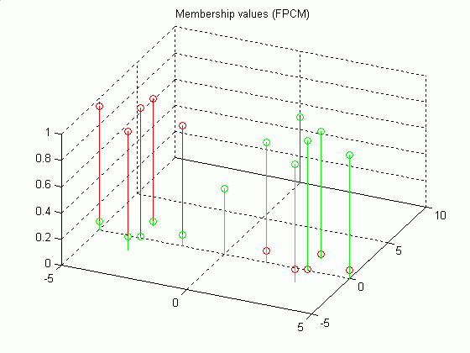
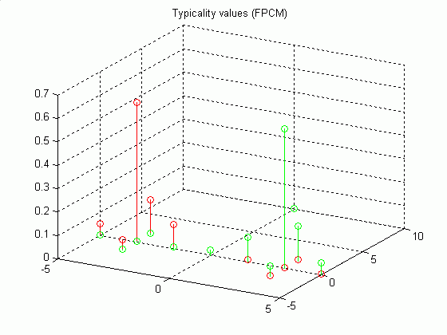
Fuzzy-Possibililstic C-Means
FPCM on X-12
Initial parameters
U values
T values

Slide 28
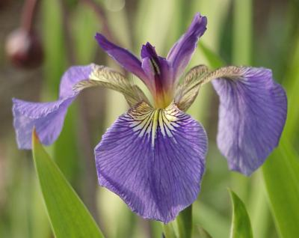
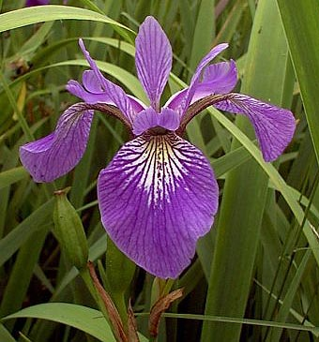
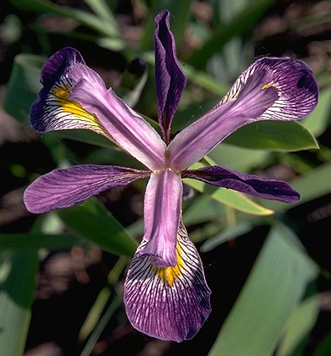
Comparison of FCM, PCM and FPCM
IRIS Data Samples
Iris plants database
  4-dimensional data set containing
  50 samples each of three types
  of IRIS flowers
  n = 150, p = 4, c = 3
  Features
    Sepal length, sepal width,
    petal length, petal width
  Classes
    Setosa, Versicolor, Virginica
Iris
setosa
Petal
Iris
versicolor
Iris
virginica

Slide 29
Comparison of FCM, PCM and FPCM
IRIS Data Clustering
Initial parameters: [PalPB97]
Resubstitution errors based on the hardened Us and Ts
m |  | Iter-FCM | Iter-PCM | Iter-FPCM | Err-FCM | Err-PCM | Err-U-FPCM | Err-T-FPCM
1.5 | 1.5 | 26 (24) | 57, 80 | 26 (13) | 17 (17) | 100, 10 | 17 (17) | 19 (17)
2.0 | 2.0 | 28 (26) | 39, 80 | 28 (12) | 16 (16) | 100, 10 | 16 (16) | 15 (16)
1.5 | 3.0 | 26 (24) | 57, 57 | 26 (13) | 17 (17) | 100, 10 | 17 (17) | 16 (17)
3.0 | 3.0 | 29 (25) | 31, 40 | 29 (13) | 15 (15) | 100, 11 | 15 (15) | 15 (14)
5.0 | 2.0 | 37 (31) | 49, 30 | 44 (16) | 15 (15) | 150, 20 | 15 (15) | 12 (14)
2.0 | 5.0 | 28 (26) | 39, 57 | 28 (12) | 16 (16) | 100, 9 | 16 (16) | 16 (16)
5.0 | 5.0 | 37 (31) | 49, 30 | 37 (15) | 15 (15) | 150, 20 | 15 (15) | 12 (15)
My Implementation
[PalPB97]
Auto weights
Tuned weights

Slide 30
Conclusions and Future Works
Err-T-FPCM <= Err-U-FPCM <= Err-FCM
  Could be considered true in general
Mismatch
  Number of iterations required for FPCM in general is not half of that for FCM as mentioned at [PalPB97]; Is there any mistake in my implementation?
Comparison of algorithms using other “noisy” data sets

Slide 31
Fuzzy C-Means Clustering
Course Project Presentation
Thank You
http://ce.sharif.edu/~m_amiri/
2. http://yashil.20m.com/
FIND OUT MORE AT...

Slide 32
References
[Bez81] | J. C. Bezdek, Pattern Recognition with Fuzzy Objective Function Algorithms, Plenum, NY, 1981.
[BezKKP99] | James C. Bezdek, James Keller, Raghu Krishnapuram and Nikhil R. Pal, Fuzzy Models and Algorithms for Pattern Recognition and Image Processing, Kluwer Academic Publishers, TA 1650.F89, 1999.
[KriK93] | R. Krishnapuram and J. M. Keller, “A possibilistic approach to clustering,” IEEE Transactions on Fuzzy Systems, Vol. 1, No. 2, pp. 98-110, May 1993.
[PalPB97] | N. R. Pal, K. Pal and J. C. Bezdek, “A mixed c-means clustering model,” Proceedings of the Sixth IEEE International Conference on Fuzzy Systems, Vol. 1, pp. 11-21, Jul. 1997.
[YanRP94] | Jun Yan, Michael Ryan and James Power, Using fuzzy logic Towards intelligent systems, Prentice Hall, 1994.

Slide 33
Part Title
…
Part Title
…
…
…
…

