Slide 1
Ensemble Learning
马锦华
数据科学与计算机学院
中山大学

Slide 2
Ensemble Methods
Construct a set of classifiers from the training data
Predict class label of test records by combining the predictions made by multiple classifiers

Slide 3
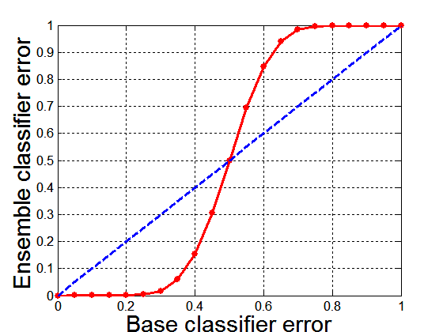
Why Ensemble Methods work?
Suppose there are 25 base classifiers
Each classifier has error rate, ε = 0.35
Assume errors made by classifiers are uncorrelated
Probability that the ensemble classifier makes a wrong prediction:

Slide 4
General Approach

Slide 5
Types of Ensemble Methods
Manipulate data distribution
Example: bagging, boosting
Manipulate input features
Example: random forests
Manipulate class labels
Example: error-correcting output coding

Slide 6
Boosting
An iterative procedure to adaptively change distribution of training data by focusing more on previously misclassified records
Initially, all N records are assigned equal weights
Unlike bagging, weights may change at the end of each boosting round

Slide 7
Boosting
Records that are wrongly classified will have their weights increased
Records that are classified correctly will have their weights decreased
Example 4 is hard to classify
Its weight is increased, therefore it is more likely to be chosen again in subsequent rounds

Slide 8
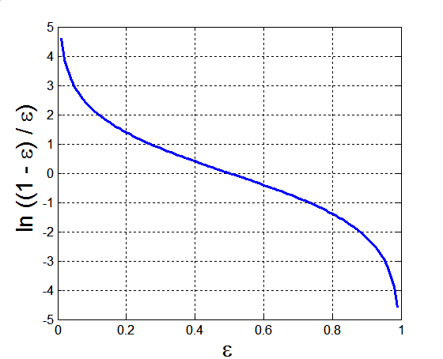
AdaBoost
Base classifiers: C₁, C₂, …, C_{T}
Error rate:
Importance of a classifier:

Slide 9
AdaBoost Algorithm
Weight update:
If any intermediate rounds produce error rate higher than 50%, the weights are reverted back to 1/n and the resampling procedure is repeated
Classification:

Slide 10
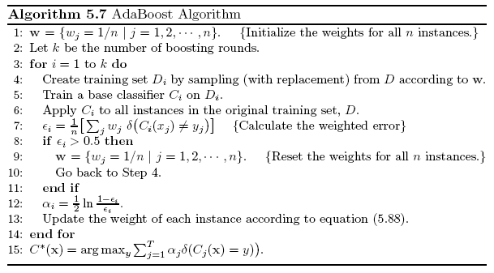
AdaBoost Algorithm

Slide 11
AdaBoost Example
Consider 1-dimensional data set:
Classifier is a decision stump
Decision rule: x ≤ k versus x > k
Split point k is chosen based on entropy
x ≤ k
True
False
y_{left}
y_{right}

Slide 12
AdaBoost Example
Training sets for the first 3 boosting rounds:
Summary:

Slide 13
AdaBoost Example
Weights
Classification
Predicted Class

Slide 14
Other Boosting Methods
LPBoost
Ayhan Demiriz, Kristin P. Bennett, and John Shawe-Taylor. "Linear programming boosting via column generation." Machine Learning 46.1-3 (2002): 225-254.
eXtreme Gradient Boosting
Tianqi Chen, and Carlos Guestrin. "Xgboost: A scalable tree boosting system." Proceedings of the 22nd acm sigkdd international conference on knowledge discovery and data mining. ACM, 2016.
https://github.com/dmlc/xgboost

Slide 15
Bagging
Sampling with replacement
Build classifier on each bootstrap sample
Each sample has probability (1 – 1/n)^{n} of being selected

Slide 16
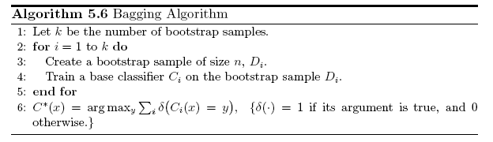
Bagging Algorithm

Slide 17
Bagging Example
Consider 1-dimensional data set:
Classifier is a decision stump
Decision rule: x ≤ k versus x > k
Split point k is chosen based on entropy
x ≤ k
True
False
y_{left}
y_{right}

Slide 18
Bagging Example

Slide 19
Bagging Example

Slide 20
Bagging Example

Slide 21
Bagging Example
Summary of Training sets:

Slide 22
Bagging Example
Assume test set is the same as the original data
Use majority vote to determine class of ensemble classifier
Predicted Class

Slide 23
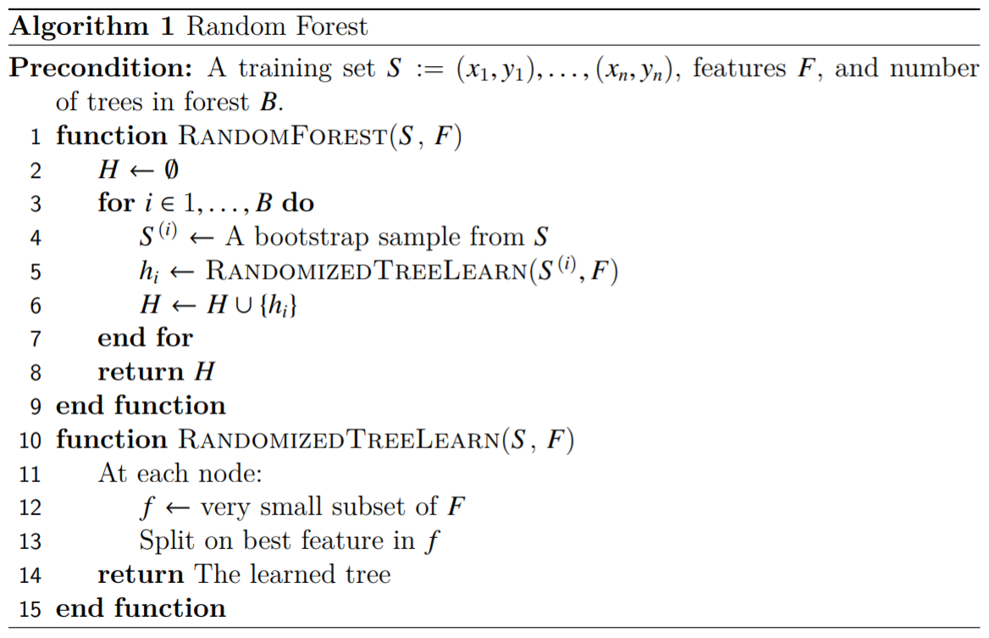
Random Forest

Slide 24
Why Do Random Forests Work?
Bagging can reduce the variance
Advantages of choosing features from random subsets
Individual decision trees learnt from random feature sets are more uncorrelated
More decision trees can be learnt in a given amount of time due to small scale of features
More details can be referred to
Breiman, Leo. "Random forests." Machine learning 45.1 (2001): 5-32.

Slide 25
References
P.-N. Tan, M. Steinbach, ‎V. Kumar: Introduction to data mining, Second Edition, https://www-users.cs.umn.edu/~kumar001/dmbook/index.php

