Slide 1

Arkanoid
2ARC - Class Group Project

Slide 2
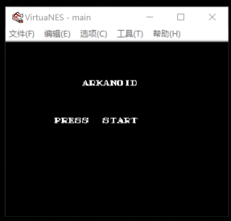
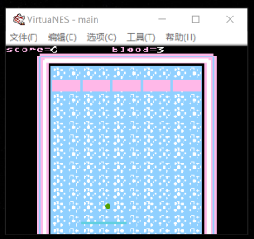
How to play
Install cc65-2.13.0-1.exe
Open main.cmd to create main.nes
Use VirtuaNES.exe to open main.nes
Press start key (8) to start
A & D control the moving of paddle

Slide 3
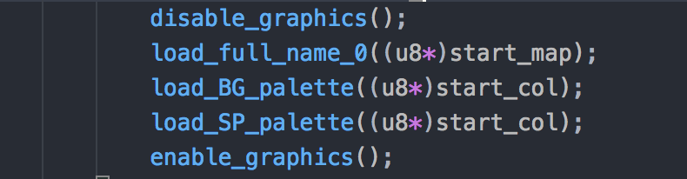
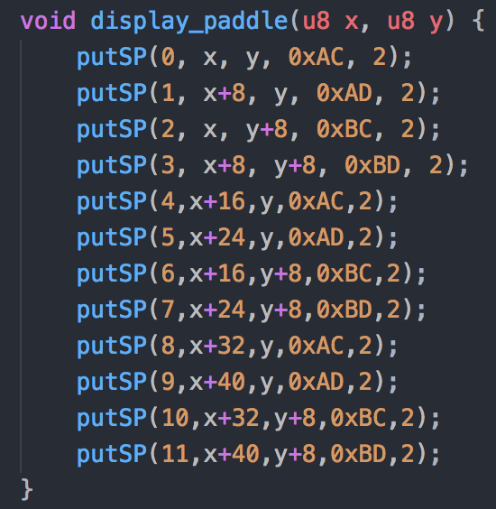
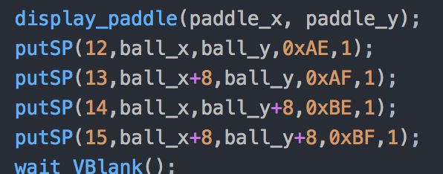
To display paddle, ball and blocks, use method “putSP()” from mylib.c.
When block is destroyed, the block should hide behind the background, so we should change the 5th parameter of the putSP().
Change the 5th parameter 0 to 32, the block will be hidden behind the background.

Slide 4
Thank you

