Slide 1
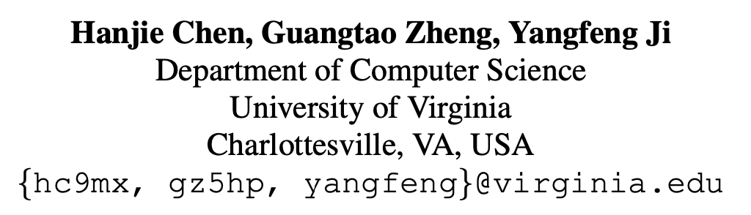
Generating Hierarchical Explanations on Text Classification via Feature Interaction Detection
张老师 20200712

Slide 2
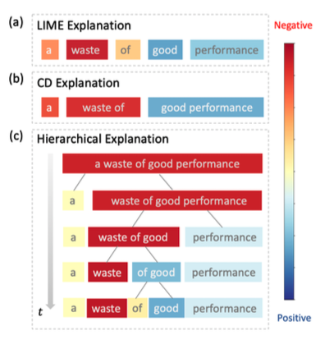
Introduction
Generating explanations for neural networks, help understand the decision-making of black-box models
Existing local explanation methods: provide important features which are words or phrases
--ignore interactions between words and phrases
This work: HEDGE, build hierarchical explanations by detecting feature interactions

Slide 3
Contributions
design a top-down model-agnostic method of constructing hierarchical explanations via feature interaction detection;
propose a simple and effective scoring function to quantify feature contributions with respect to model predictions;
compare the proposed algorithm with several competitive methods on explanation generation via both automatic and human evaluations.

Slide 4
Method
Building hierarchical explanations
Detecting feature interaction
Quantifying feature importance

Slide 5

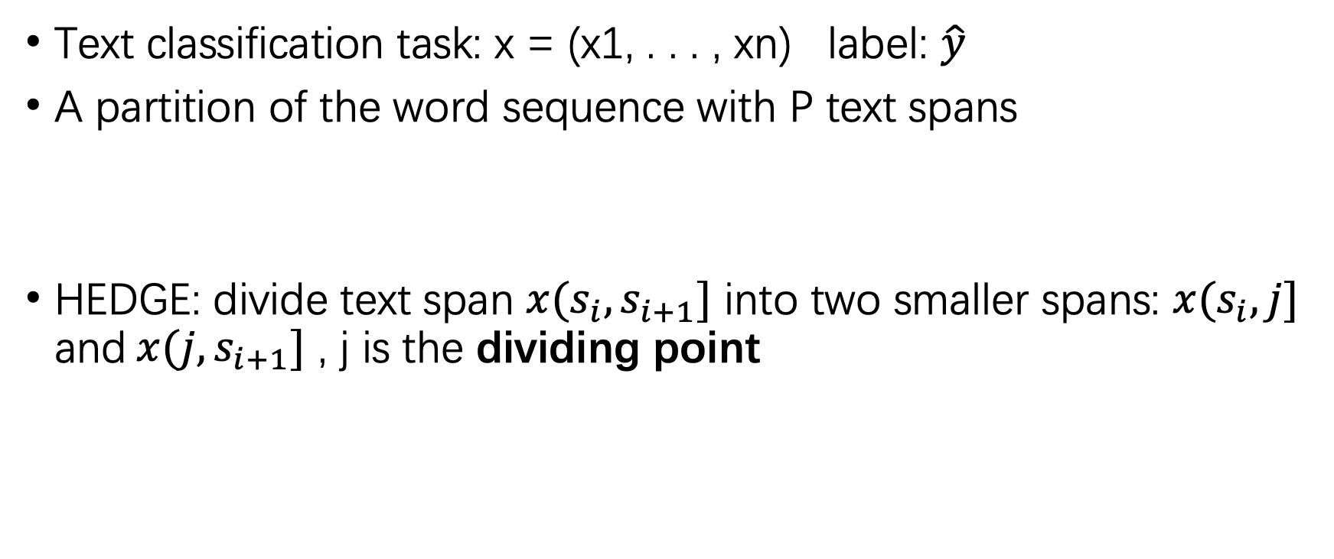
Building hierarchical explanation
Text classification task: x = (x1, . . . , xn) label: $\hat{y}$
A partition of the word sequence with P text spans
HEDGE: divide text span ${x(s}_{i},s_{i+1}]$ into two smaller spans: ${x(s}_{i},j]$ and$x(j,s_{i+1}]$ , j is the dividing point

Slide 6
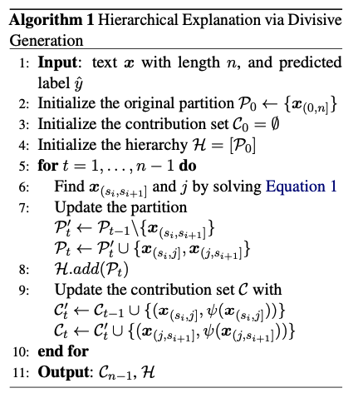

which text span the algorithm should pick to split?
where is the dividing point?
Interaction score
Evaluate the contributions of new spans and update the contribution set
Feature importance

Slide 7



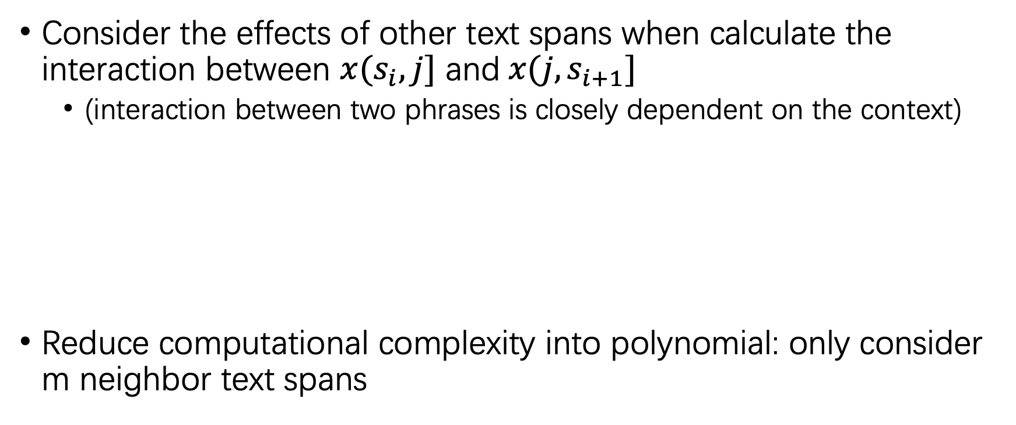
Detecting feature interaction
Consider the effects of other text spans when calculate the interaction between ${x(s}_{i},j]$ and$x(j,s_{i+1}]$
(interaction between two phrases is closely dependent on the context)
Reduce computational complexity into polynomial: only consider m neighbor text spans

Slide 8

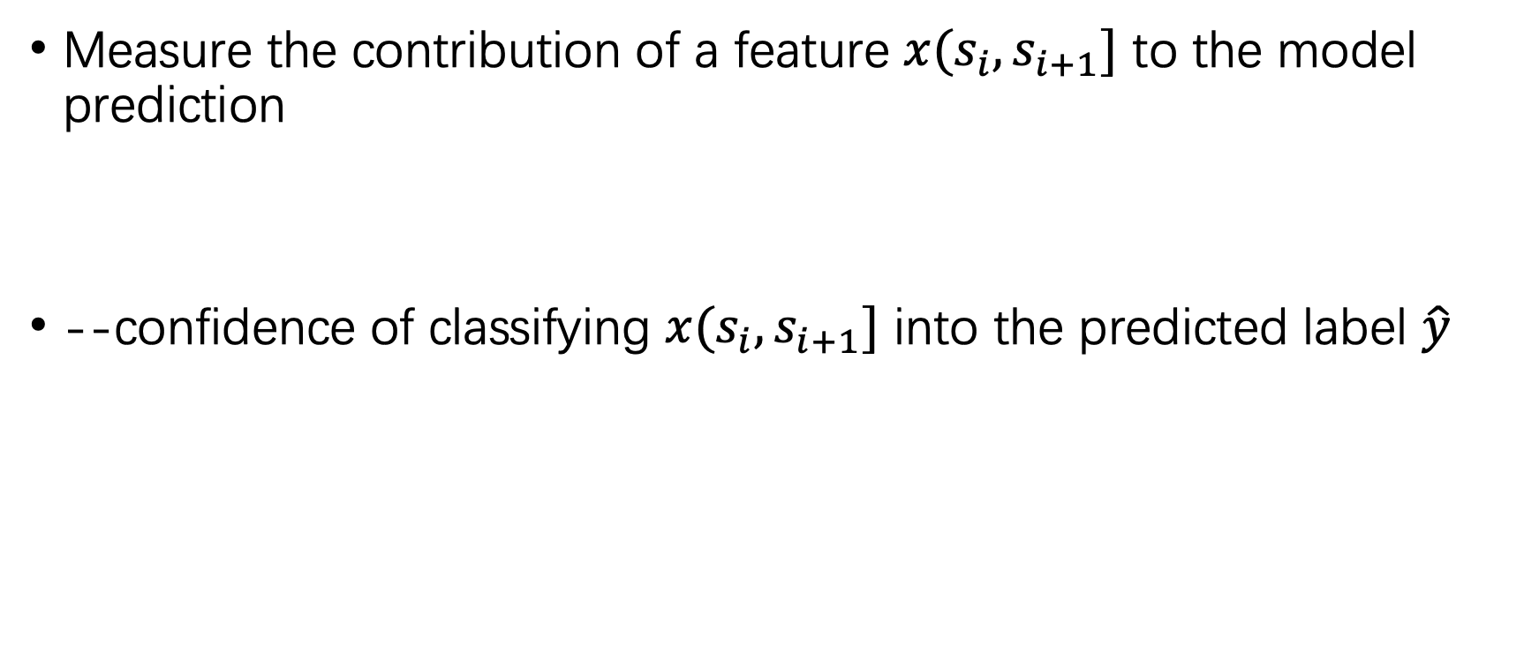
Quantifying feature importance
Measure the contribution of a feature $x(s_{i},s_{i+1}]$ to the model prediction
--confidence of classifying $x(s_{i},s_{i+1}]$ into the predicted label $\hat{y}$

Slide 9
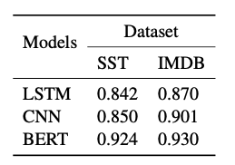
Experiments
Task: text classification
Model: LSTM, CNN, BERT
Benchmark: SST, IMDB

Slide 10


Quantitative Evaluation
AOPC
By deleting top k% words, AOPC calculates the average change in the prediction probability on the predicted class over all test data
Higher AOPCs are better, which means that the deleted words are important for model prediction.
Log-odds
By averaging the difference of negative logarithmic probabilities on the predicted class over all of the test data before and after masking the top r% features with zero paddings
Lower log-odds scores are better.

Slide 11

Quantitative Evaluation
Cohesion-score
Given an important text span x(a,b], randomly pick a position in the word sequence (x1,...,xa,xb+1,...,xn) and insert a word back, until construct a shuffled version of the original sentence
the words in an important text span have strong interactions, after perturbing, the output probability decreasing
Higher cohesion-scores are better

Slide 12
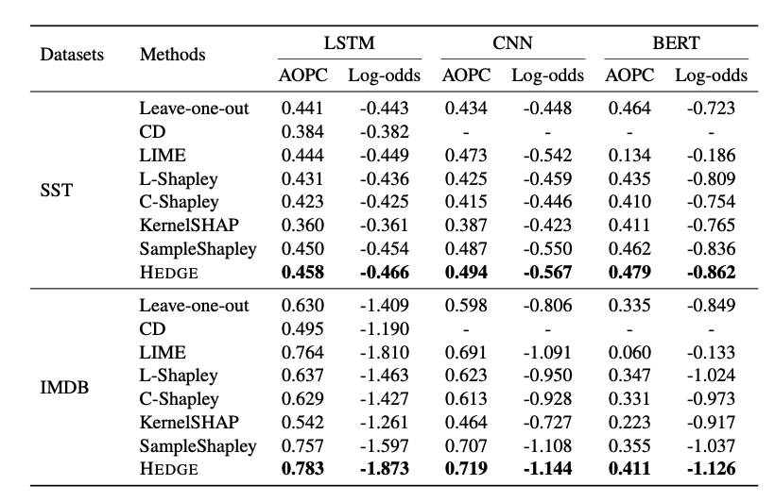
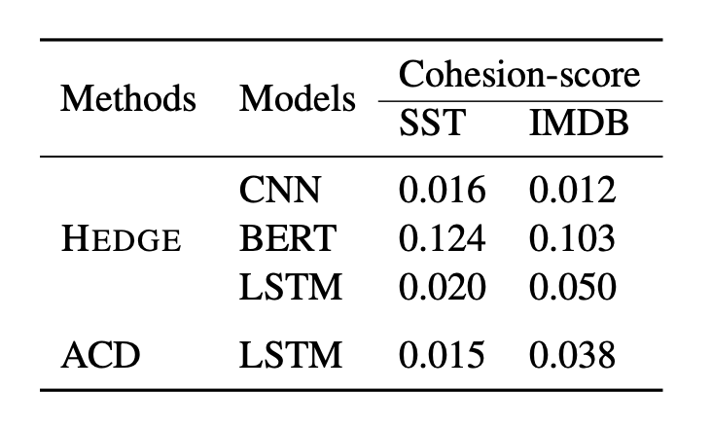
Results

Slide 13
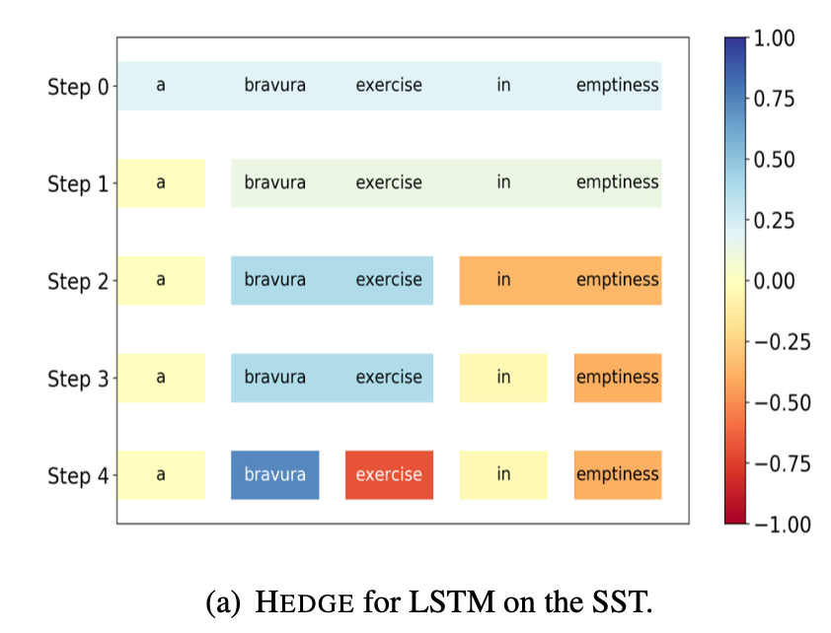
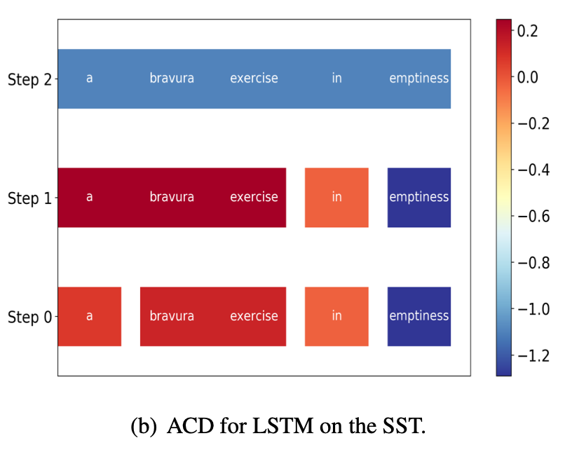
Qualitative Analysis
compare HEDGE with ACD in interpreting the LSTM model

Slide 14
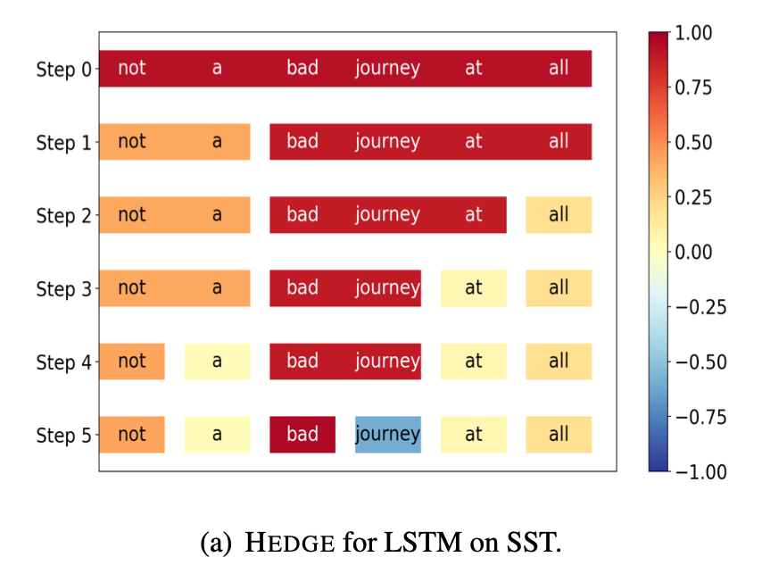
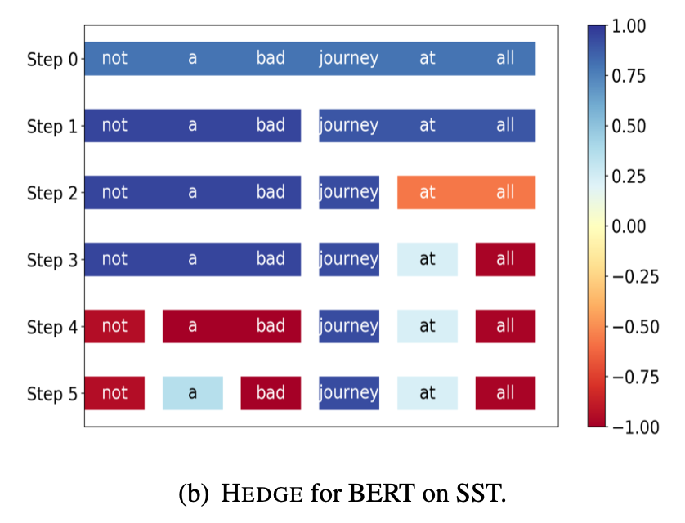
Qualitative Analysis
compare HEDGE in interpreting two different models (LSTM and BERT)

Slide 15
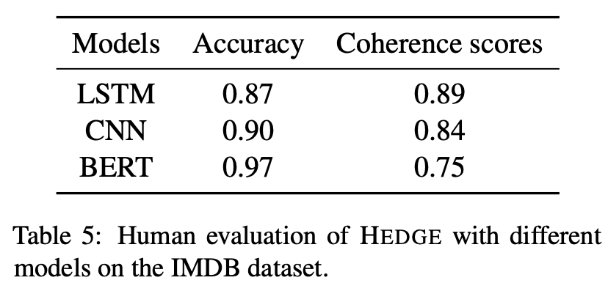
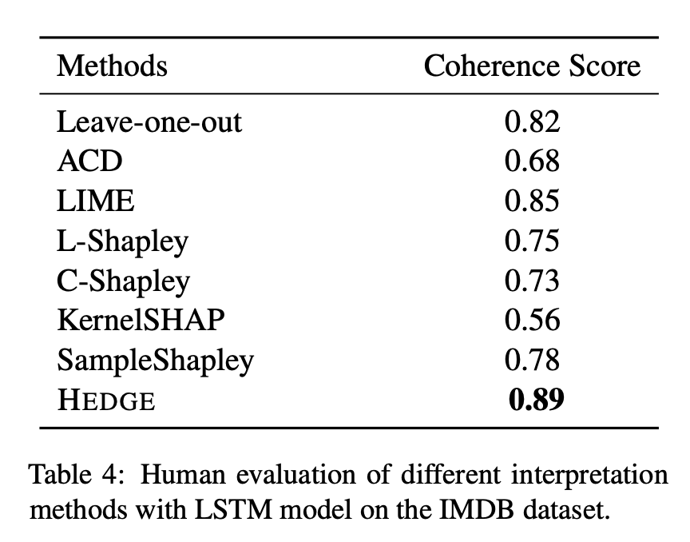
Human Evaluation
coherence score: the ratio between the coherent annotations and the total number of examples
HEDGE can capture important features which are highly consistent with human interpretations
BERT can achieve higher prediction accuracy than the other two models, its coherence score is lower, manifesting a potential tradeoff between accuracy and interpretability of deep models

Slide 16
Conclusion
HEDGE is capable of explaining model prediction behaviors, which helps humans understand the decision-making

