Slide 1
COMP 2513 Web-Centric Programming Daniel L. Silver
E-Business / E-Commerce
Models, Frameworks and Architectures

Slide 2
Outline
What is E-Business and E-Commerce
E-Business Architecture and Framework
E-Commerce defined
Focus on B2C – Business to Customer
E-Commerce Web Architecture

Slide 3
E-Business & E-Commerce
E-Business is the application of ICT in support of all activities of business
E-Commerce can be defined as a subset of E-Business that focuses on commerce = trading in products or services using the Internet

Slide 4
E-Business Architecture
Cross-Functional Integrated Applications
Middleware
Supply
Chain
Management
Procurement
Management
Enterprise
Resource
Planning
Knowledge
Management
Selling
Chain
Management
Customer
Relationship
Management

Slide 5
E-Business Architecture
Cross-Functional Integrated Applications
CRM = Customer Relationship Management
ERP = Enterprise Resource Planning
SupCM = Supply Chain Management
SellCM = Selling Chain Management
PM = Procurement (Operational Resource) Management
Middleware = Integration Applications
KM = Knowledge Management (DW/Analytics)

Slide 6
E-Business Architecture
CRM = Customer Relationship Management
Marketing, Sales, Service
ERP = Enterprise Resource Planning
Forecasting and Planning
Purchasing and Material Management
Inventory Management
Finished Porduct distribution
Accounting and Finance

Slide 7
E-Business Architecture
SupCM = Supply Chain Management
Market demand
Resource and capacity constraints
Real-time scheduling
SellCM = Selling Chain Management
Product Customization
Pricing, Contract and Commission Management
Quote and Proposal Generation
Promotions Management

Slide 8
E-Business Architecture
PM = Procurement Management
Office Supplies, Business Travel, Entertainment, Service contracting, IT h/w, s/w and networking
KM = Knowledge Management (DW/Analytics)
Data Warehousing
Business Analytics (data mining)
Executive Info Systems, Decision Support Systems
Middleware = Integration Applications
e.g. SAP (ERP) to SAS (KM)

Slide 9
The E-Business Architecture
Partners, Suppliers
SupCM
PM
ERP
KM
Employees
Stakeholders
Middleware
SellCM
CRM
Customers, Distributors

Slide 10
E-Business Framework
So Where’s
the E-Commerce?
Suppliers
Services
Partners
Supply
Chain
Management
Procurement
Management
Enterprise
Resource
Planning
Knowledge
Management
Agents
Partners
Government
Selling
Chain
Management
Customer
Relationship
Management
Distributers
Customers
Customers

Slide 11
E-Commerce?
E-Commerce: The application of ICT to commerce between parties = trade of products or services using the Internet
The Internet
B2C, B2B, C2C

Slide 12
Three Fundamental Categories of E-Commerce Business Models
B2C – Business to Consumer
What most people typically think of when they think E-Commerce (amazon.com)
C2C – Consumer to Consumer
Auctions, Bartering models (ebay.ca, swapsity.ca)
B2B – Business to Business
The original E-Commerce models
EFT – Electronic Funds Transfer (banks)
EDI – Electronic Data Interchange (industry, suppliers)

Slide 13
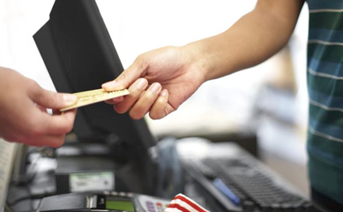
The Traditional B2C Commerce Scenario
Buyer and seller meet
Buyer chooses product and places order
Seller delivers product
Buyer pays for product

Slide 14
The E-Commerce B2C Scenario
Consumer Perspective
Search the Internet
Choose the right product
Place the order and shipping info.
Enter payment info.
Receive product via Internet or ground shipment
Business Perspective
Advertising
Inventory (product) Management
Order Processing (shopping cart)
Payment Mgmt
Fulfillment and Shipping
Profile Management

Slide 15
A B2C Scenario
I would like to buy some hands-free technology to work with my cellular phone for my consulting business.
Criteria:
It must be reliable
Inexpensive as possible
Light-weight
Small (able to fit into my pocket)

Slide 16
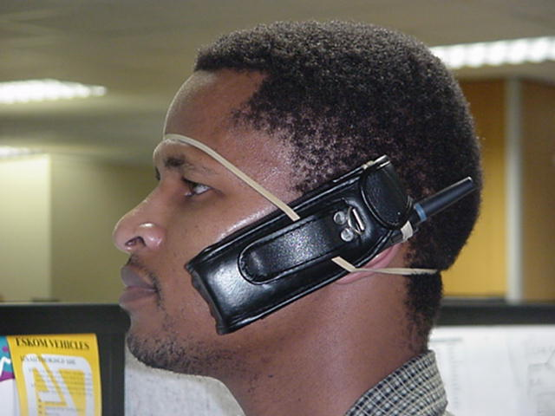
Typical B2C Shopping Trip
View Homepage
Registration
Navigate
Product Advisor
Search
Select Products
Shopping Cart
Enter Shipping Info.
Address Book
Enter Payment Info.
Submit Order
Receive Ack.

Slide 17
A B2C Scenario Technology Questions
How does a browser connect to a server?
How does a search engine work?
What is a cookie?
How do those banner adds work?
Are there web pages for every item?
What is all that gobbledygook in the page address?
What is a shopping cart? How long does it exist?
How does a web sites know who I am on return?
Should I register?

Slide 18
A B2C Scenario Technology Questions
How does it find my password?
How does it automatically send me emails?
What are the messages concerning insecure submissions all about?
What is authentication, certificate, encryption?
How do they know my credit card is good?
How do they know there is credit left?
How is software I have purchased downloaded?
How do they track my shipment?

Slide 19
E-Comm Components of the Web
Server B
Client 1
The Hardware
The Software
Browser
Server A
Edge
Server
HTTP
Server
App.
Server
Data
&
Trans.
Server
Internet
HTTP &
TCP/IP
Client 2
Browser
prog1.class
prog2.jsp
URL
index.html
Admin 1
Browser
Bank
Server
The Skill Sets
The Methods

Slide 20
Architecture of the AMPPS Web Server Environment
Laptop
localhost
localhost
User
Browser
Admin
Admin
Admin
Apache
HTTP
Server
PHP
App.
Server
MySQL
DBMS
Server
Internet
port
80
Laptop
DB
.html, .cgi,
.php
Admin
Browser

Slide 21
Architecture of the Acadia Web Server Environment
Laptop
falcon.acadiau.ca
falcon.acadiau.ca
User
Browser
Admin
Admin
Admin
Apache
HTTP
Server
PHP
App.
Server
MySQL
DBMS
Server
Internet
port
80
Laptop
E-Comm DB
.html, .cgi,
.php
Admin
Browser

Slide 22
THE END danny.silver@acadiau.ca

Slide 23
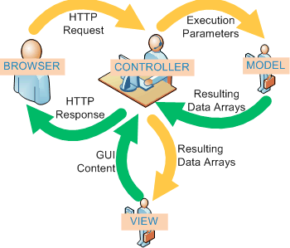
Model-View-Controller Architectural Pattern

Slide 24
Model-View-Controller Architectural Pattern
Controller can send commands to the model to update the model's state (e.g., editing a document). It can also send commands to its associated view to change the view's presentation of the model (e.g., by scrolling through a document).
A model notifies its associated views and controllers when there has been a change in its state. This notification allows the views to produce updated output, and the controllers to change the available set of commands. In some cases an MVC implementation might instead be "passive," so that other components must poll the model for updates raher than being notified.
A view requests information from the model that it uses to generate an output representation to the user.

