Slide 1
COMP 2513 Web Centric Programming Daniel L. Silver
Web Infrastructure 1

Slide 2
Outline
Describe the major architectural components of the Internet
Introduce HTML – HyperText Markup Language

Slide 3
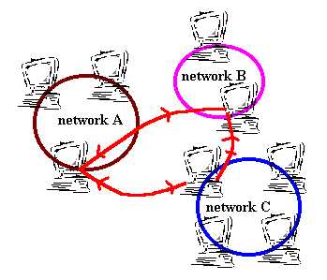
What is an internet?
Communication between two or more potentially heterogeneous networks (LANs)
The “Internet” is a set of standards for inter-network communications

Slide 4
The Client-Server Model
Client – a machine that makes Internet requests for resources (printing, data, processing)
Server – a machine that performs tasks for clients on request and manages network resources
Communications protocol – a set of rules for two or more entities to converse
Comm.
Protocol
Server
Client

Slide 5
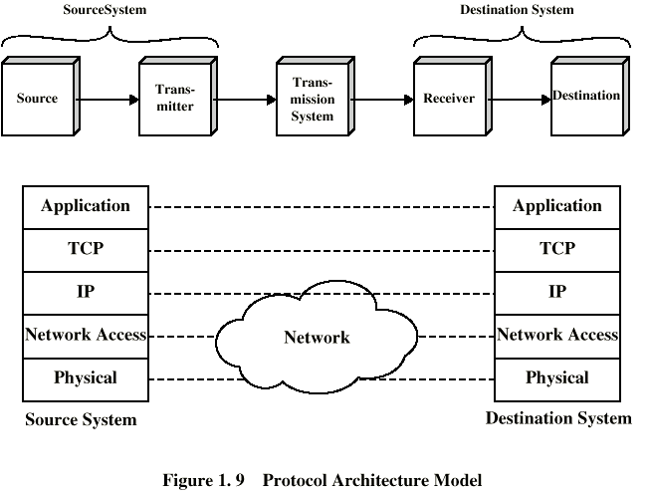
TCP/IP Protocol Architecture
Transmission Control Protocol
Internet Protocol

Slide 6
TCP/IP Protocol Architecture
Internet Protocol (IP) – like a postcard that contains:
Destination address (131.162.201.7)
Return address
Block of data (content)
Transmission Control Protocol (TCP)
Ensures the message gets through
Ensures the order of deliver
Handles errors and control flow

Slide 7
Traditional Client-Server Applications that use the Internet
Telnet Protocol
Telnet Window
Telnet Server
FTP
FTP Client
FTP Server
SMTP/POP
eMail Client
eMail Server
TCP
TCP
IP
IP
Internet
Network
Network
Physical
Physical

Slide 8
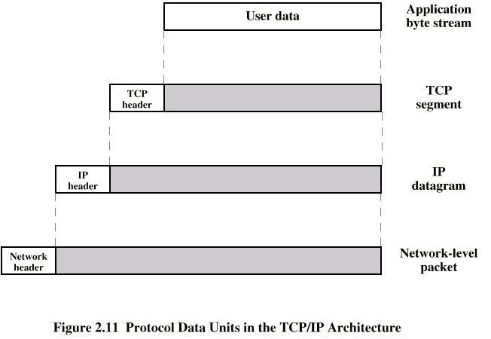
Data Encapsulation under TCP/IP

Slide 9
What is the Web?
A class of applications that use the Internet plus a lot of new technologies and standards that facilitate access to resources managed by servers connected to the Internet:
Hardware: Servers
Software: Browsers, Servers
Protocols: HTTP, HTML, XML

Slide 10
Major Architectural Components of the Web
Client 1
Browser
HTTP
TCP/IP
Server A
HTTP
Server
App.
Server
Database
Server
Internet
Client 2
Browser
index.html
URL
Server B
Server C

Slide 11
Components of the Web
Web Browser – a GUI client application (Netscape Navigator, Internet Explorer) that facilitates access to Website files and software for display of data, video and audio
Web Server – a software system that can field requests for website files (HTTP server) and applications (Application Server)
Website - a collection of files and associated software from a server (runs on client or server)
Database Server – provides an interface to a structured database of website files

Slide 12
Architecture of the AMPPS Web Server Environment
Laptop
localhost
localhost
User
Browser
Admin
Admin
Admin
Apache
HTTP
Server
PHP
App.
Server
MySQL
DBMS
Server
Internet
port
80
Laptop
DB
.html, .cgi,
.php
Admin
Browser

Slide 13
Architecture of the Acadia Web Server Environment
Laptop
falcon.acadiau.ca
falcon.acadiau.ca
User
Browser
Admin
Admin
Admin
Apache
HTTP
Server
PHP
App.
Server
MySQL
DBMS
Server
Internet
port
80
Laptop
DB
.html, .cgi,
.php
Admin
Browser

Slide 14
Architecture of the Acadia Web Server Environment
Laptop
acme.data.ca
acme.com
User
Browser
Admin
Admin
Admin
Apache
HTTP
Server
Java
App.
Server
Post
GreSQL
DBMS
Server
Internet
port
80
Laptop
DB
.html, .cgi,
.php
Admin
Browser

Slide 15
Components of the Web
HTTP - HyperText Transfer Protocol
URL - Universal Resource Locator for a file on the internet (www.acadiau.ca)
Webpage – a representation of information understood by the browser
HTML - HyperText Markup Language

Slide 16
HTTP HyperText Transfer Protocol
The application protocol of the Web
Like FTP it is layered on top of TCP/IP
HTTP
Web Browser
HTTP Server
TCP
TCP
IP
IP
Internet
Network
Network
Physical
Physical

Slide 17
HTTP HyperText Transfer Protocol
There is a 3 step process per transaction:
Browser accepts request from keyboard …
(a) Client locates & sends an HTTP request for a webpage
(b) Client sends optional header info to server about client (browser configuration, acceptable files)
(c) Client may send addition data (used by POST method)
(a) Server responds with a status line (eg. HTTP/1.1 200 OK)
(b) Server sends header info to client about itself and requested file (server config., file format)
(c) Server sends the requested data or optionally additional error information
If HTTP 1.0, by default server breaks the connection
If HTTP 1.1, server can let client break connection
… Browser loads, interprets and displays page.
Client
Internet
Server

Slide 18
How is the Webpage Located?
URL – Universal Resource Locator
The address of a resource on the Internet
http://www.acadiau.ca or http://falcon.acadiau.ca
ftp://a.cs.uiuc.edu/
file://C:/Work/Acadia/2513.w15/index.html
<protocol>://<machine>:<port>/<file>
Default port = 80
Default file = index.html
Machine = IP address. How does it get this?
For further info on HTTP see
http://code.tutsplus.com/tutorials/a-beginners-guide-to-http-and-rest--net-16340
http://www.w3.org/Protocols/rfc2616/rfc2616.html

Slide 19
What does an HTTP Request/Response look like?
HTTP request headers:
Request: GET, POST, PUT, DELETE, etc
Header - plain text
Info about the object (MIME etc)
Methods that can be processed by client
Example of a Request Header:
GET /~dsilver/Hello.html HTTP/1.1
Accept: text/plain
Accept: text/html
User-Agent: Mozilla/2.0

Slide 20
HTTP Request/Response Example you can try from your laptop …
dsilver$ curl -v falcon.acadiau.ca/~dsilver/Hello.html
* About to connect() to falcon.acadiau.ca port 80 (#0)
* Trying 131.162.202.57... connected
* Connected to falcon.acadiau.ca (131.162.202.57) port 80 (#0)
> GET /~dsilver/Hello.html HTTP/1.1
> User-Agent: curl/7.21.4 (universal-apple-darwin11.0) libcurl/7.21.4 OpenSSL/0.9.8z zlib/1.2.5
> Host: falcon.acadiau.ca
> Accept: */*
>
< HTTP/1.1 200 OK
< Date: Mon, 12 Jan 2015 04:09:26 GMT
< Server: Apache/2.2.22 (Debian)
< Last-Modified: Mon, 29 Dec 2014 14:25:05 GMT
< ETag: "2d00ba7-24a-50b5ba40674a4"
< Accept-Ranges: bytes
< Content-Length: 586
< Vary: Accept-Encoding
< Content-Type: text/html
<
<!doctype html public "-//w3c//dtd html 4.0 transitional//en">
<html>
<head>
…
</head>
<body>
<h2>
Simple CGI Example</h2>
<a href="cgi-bin/Hello.cgi">Run it</a>
<pre>#!/bin/csh
…
# Print a message
echo Hello World - it is now `date`
</body>
</html>
* Connection #0 to host falcon.acadiau.ca left intact
* Closing connection #0
dyna64-54:~ dsilver$

Slide 21
HTTP Request/Response Example you can try from falcon …
dyna64-54:~ dsilver$ ssh falcon.acadiau.ca
…
dsilver@falcon:~$ cd www
dsilver@falcon:~/www$ GET ./Hello.html HTTP/1.1 -E
GET file:./Hello.html
User-Agent: lwp-request/6.03 libwww-perl/6.04
200 OK
Content-Length: 586
Content-Type: text/html
Last-Modified: Mon, 29 Dec 2014 14:25:05 GMT
Client-Date: Mon, 12 Jan 2015 04:21:02 GMT
Title: Hello World CGI Example
X-Meta-GENERATOR: Mozilla/4.73 [en] (Win98; U) [Netscape]
<!doctype html public "-//w3c//dtd html 4.0 transitional//en">
<html> … </html>
forbiddendsilver@falcon:~/www$

Slide 22
MIME
HTTP uses a predefined set of document formats borrowed from eMail (actually, HTTP was modeled after an eMail protocol)
MIME - Multipurpose Internet Mail Extensions
Defines the content format
Content-type: <data type>/<subtype>
text/html
text/plain
image/gif
video/mpeg
application/msword

Slide 23
A Web session is Connectionless
TCP/IP is connection-oriented
But each HTTP request/response makes a new connection
Potentially, each browser/server operation is unaware of any related connections
Why do this? A sense of state is needed for E-Commerce transaction processing
We’ll discuss this further next day!

Slide 24
THE END danny.silver@acadiau.ca

Slide 25
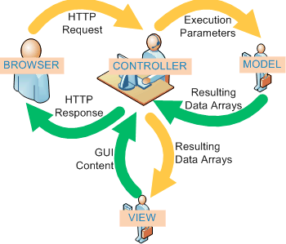
Model-View-Controller Architectural Pattern

Slide 27
Model-View-Controller Architectural Pattern
Controller can send commands to the model to update the model's state (e.g., editing a document). It can also send commands to its associated view to change the view's presentation of the model (e.g., by scrolling through a document).
A model notifies its associated views and controllers when there has been a change in its state. This notification allows the views to produce updated output, and the controllers to change the available set of commands. In some cases an MVC implementation might instead be "passive," so that other components must poll the model for updates raher than being notified.
A view requests information from the model that it uses to generate an output representation to the user.

