Slide 1
COMP 2513 Web Centric Programming Daniel L. Silver
AJAX

Slide 2
What is AJAX
Let’s listen to Bucky .. about the origins of AJAX
https://www.youtube.com/watch?v=tp3Gw-oWs2k

Slide 3
AJAX
Asynchronous JavaScript and XML.
Not a new programming language, but a new way to use existing standards
Used to exchange data with a server, and update parts of a web page - without reloading the whole page
Use to create fast and dynamic web pages
AJAX allows web pages to be updated asynchronously by exchanging small amounts of data with the server behind the scenes. This means that it is possible to update parts of a web page, without reloading the whole page.
Classic web pages, (which do not use AJAX) must reload the entire page if the content should change.

Slide 4
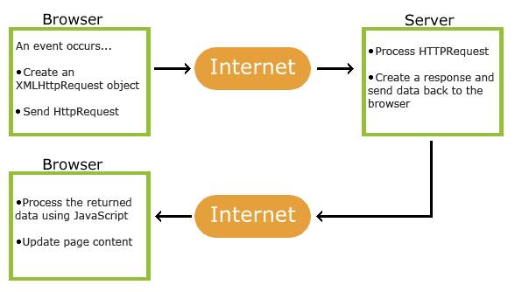
How AJAX Works
AJAX uses a combination of:
XMLHttpRequest object (to exchange data asynchronously with a server)
JavaScript/DOM (to display/interact with the information)
CSS (to style the data)
XML (often used as the format for transferring data)

Slide 5
Let’s get started with AJAX
Download and install AJAX directory
Open:
XMLHttpRequest_AJAX.html

Slide 6
Resources
The ultimate JavaScript tutorial
http://www.w3schools.com/ajax/
Other tutorials:
http://www.tutorialspoint.com/ajax/
http://learn.jquery.com/ajax/

Slide 7
THE END danny.silver@acadiau.ca

Slide 8
GET and POST
Their differences:
https://www.youtube.com/watch?v=UObINRj2EGY
http://www.w3schools.com/tags/ref_httpmethods.asp
jQuery and GET / POST
https://www.youtube.com/watch?v=-EHbBHm5l4g

Slide 9
Overview
HTTP Requests
- GET and POST
AJAX = Asynchronous Javascript and XML
- compose of HTML, XML, CSS and Javscript
- requests from the client side, and sending data to the server
- receiving data from the server and acting upon the received data
JSON = JavaScript Object Notation
- JSON is a syntax for storing and exchanging data.
- JSON is an easier to use alternative to XML.
– see http://www.w3schools.com/json/json_http.asp for good tutorials

