Slide 1
Proposal Pitch
Done By: Lee Xie Loong

Slide 2
Overview
Concept
Story
Game Play
Game Mechanics
Unique Selling Point
Market Demand
Schedule
Challenges

Slide 3
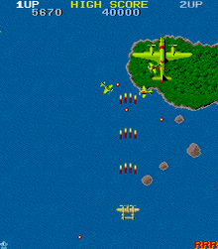
Concept
Top-down 2D vertical shooter game
Two player local play
Multiple levels

Slide 4
Gameplay
1 keyboard and 1 controller input for local play
Shoot enemies and get through levels to reach the final boss
Get as much points as you can
Collect power-ups

Slide 5
Game Mechanics
Collecting and using of power-ups
Movement and shooting
Making use of passive

Slide 6
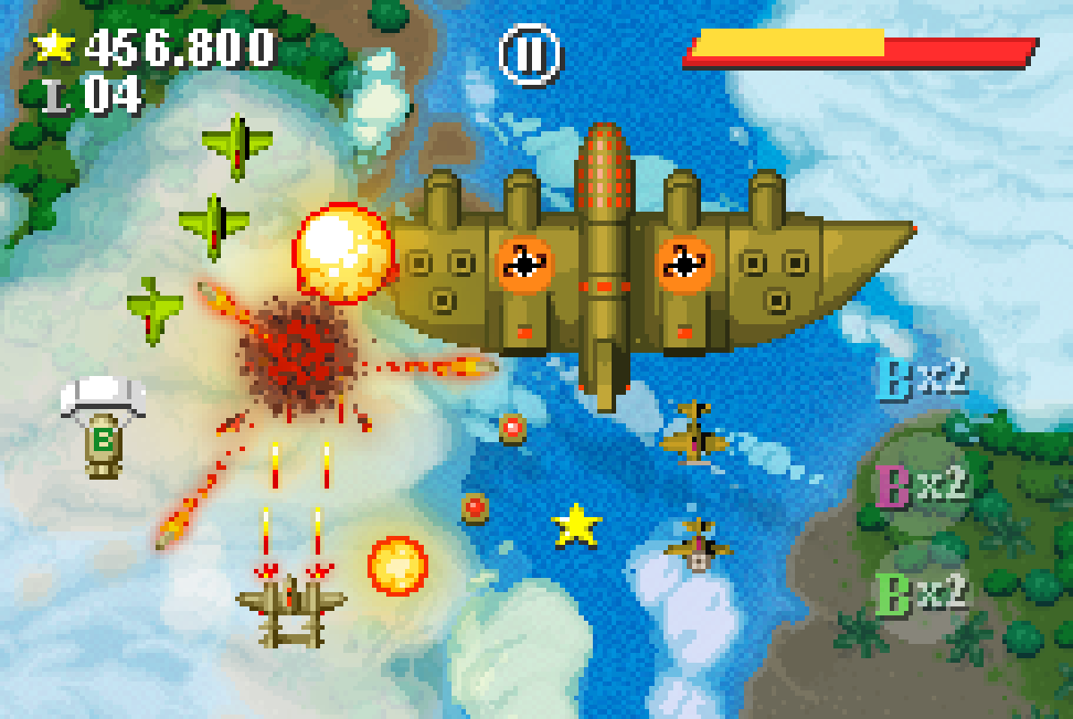
Unique Selling Point
Local play
Unique passives for player to choose from
Arcade-type style

Slide 7
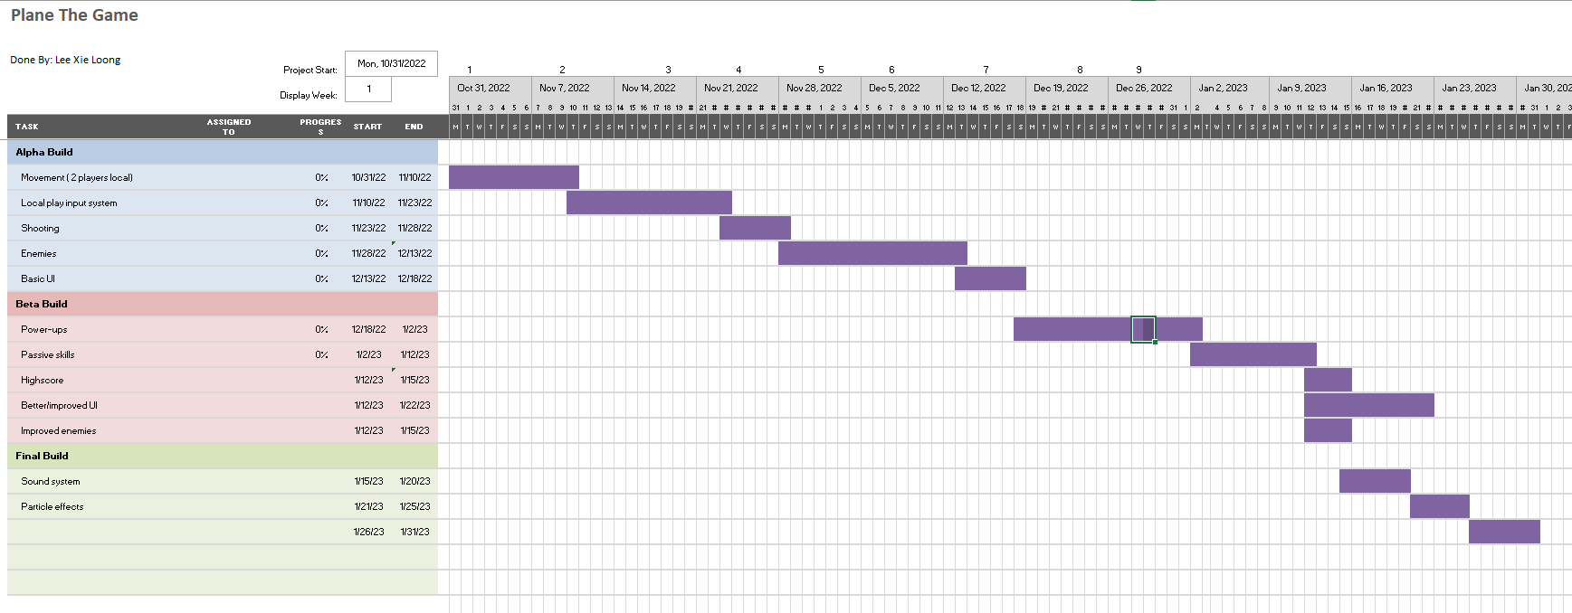
Schedule

Slide 8
Challenges
Syncing of local play
AI (Enemies)
Art

