Slide 1
5C22 COMPUTATIONAL METHODS Bayesian matting
Computational Alchemists
Shuang Xie– xiesh@tcd.ie
Aakash Revankar – revankaa@tcd.ie
Ruo Wei Li - lir3@tcd.ie

Slide 2

MATH INTERPRETATION
Compositing Equation:
$$C=αF+\left(1−α\right)B$$
Where:
$C$: Composite
F: Foreground
B: Background
$α$: Opacity
Keynote:
In the structure of Bayesian Matting, the following assumptions were made:
The input image is separated into backgrounds, foreground and unknown region

Slide 3
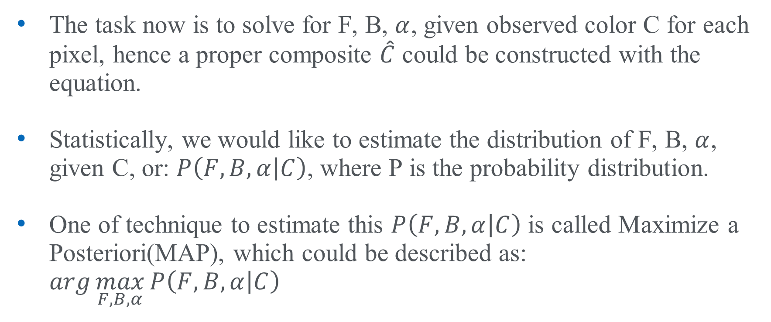
MATH INTERPRETATION
The task now is to solve for F, B, $α$, given observed color C for each pixel, hence a proper composite $\hat{C}$ could be constructed with the equation.
Statistically, we would like to estimate the distribution of F, B, $α$, given C, or: $P\left(F, B, α | C\right)$, where P is the probability distribution.
One of technique to estimate this $P\left(F, B, α | C\right)$ is called Maximize a Posteriori(MAP), which could be described as: $\arg{\max_{F, B, α}{P\left(F, B, α | C\right)}}$

Slide 4
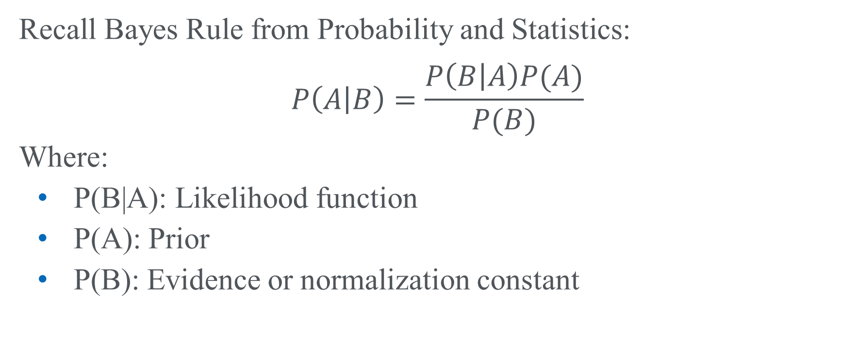
MATH INTERPRETATION
Recall Bayes Rule from Probability and Statistics:
$$P\left(A | B\right)=\frac{P\left(B | A\right)P(A)}{P(B)}$$
Where:
P(B|A): Likelihood function
P(A): Prior
P(B): Evidence or normalization constant

Slide 5
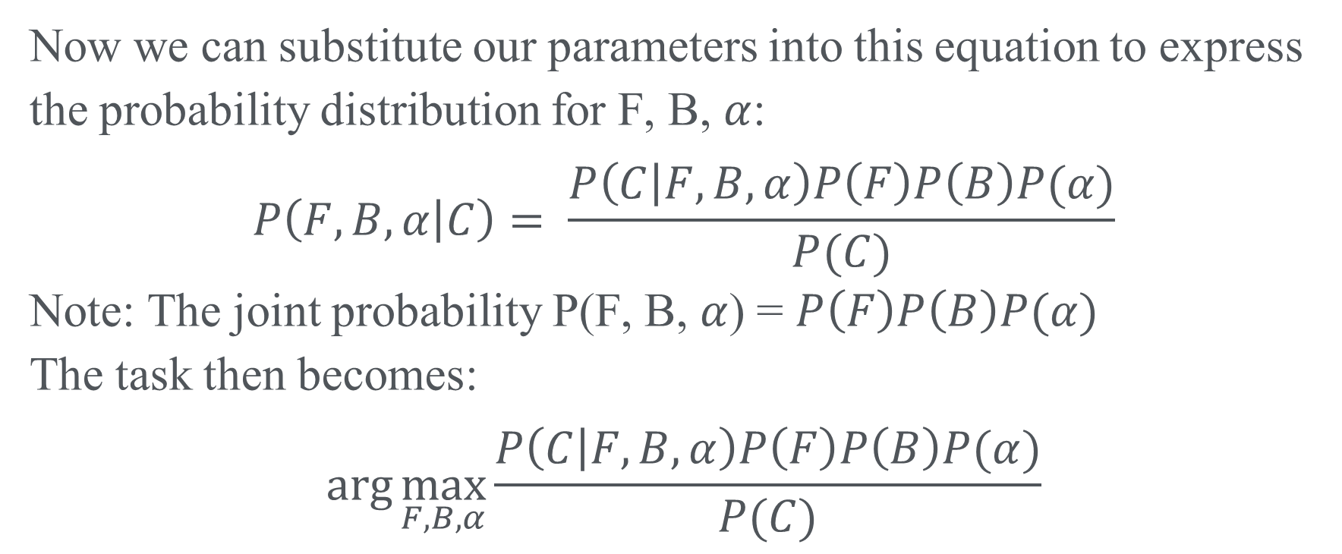
MATH INTERPRETATION
Now we can substitute our parameters into this equation to express the probability distribution for F, B, $α$:
$$P\left(F, B, α | C\right)= \frac{P\left(C | F, B, α\right)P\left(F\right)P\left(B\right)P(α)}{P(C)}$$
Note: The joint probability P(F, B, $α$) = $P\left(F\right)P\left(B\right)P(α)$
The task then becomes:
$$\arg{\max_{F, B, α}{\frac{P\left(C | F, B, α\right)P\left(F\right)P\left(B\right)P(α)}{P(C)}}}$$

Slide 6
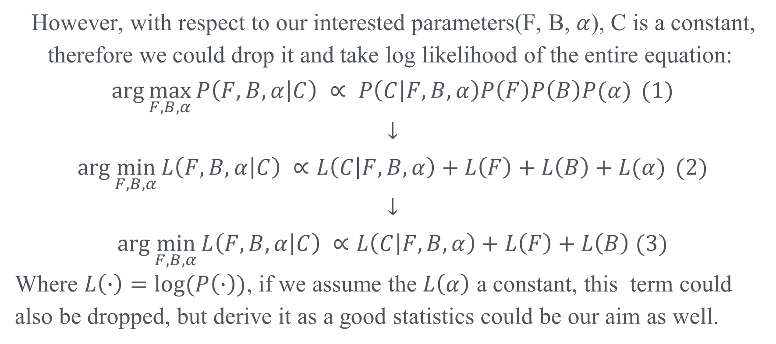
MATH INTERPRETATION
However, with respect to our interested parameters(F, B, $α$), C is a constant, therefore we could drop it and take log likelihood of the entire equation:
$$\arg{\max_{F, B, α}{P\left(F, B, α | C\right) ∝ P\left(C | F, B, α\right)P\left(F\right)P\left(B\right)P(α)}} (1)$$
$$↓$$
$$\arg{\min_{F, B, α}{L\left(F, B, α | C\right) ∝L\left(C | F, B, α\right)+L\left(F\right)+L\left(B\right)+L(α)}} (2)$$
$$↓$$
$$\arg{\min_{F, B, α}{L\left(F, B, α | C\right) ∝L\left(C | F, B, α\right)+L\left(F\right)+L\left(B\right) (3)}}$$
Where $L\left(∙\right)=log⁡(P\left(∙\right))$, if we assume the $L\left(α\right)$ a constant, this term could also be dropped, but derive it as a good statistics could be our aim as well.

Slide 7
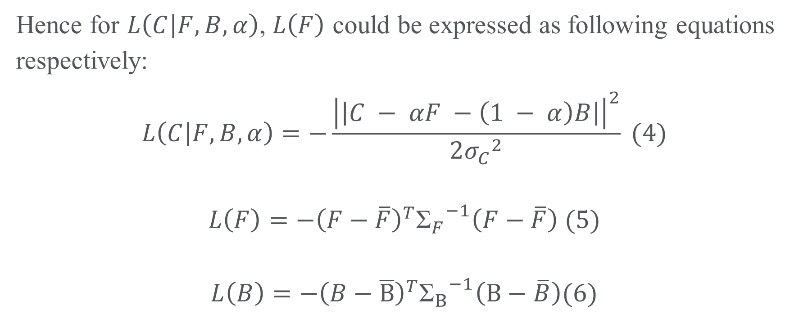
MATH INTERPRETATION
Hence for $L\left(C | F, B, α\right)$, $L\left(F\right)$ could be expressed as following equations respectively:
$$L\left(C | F, B, α\right)=−\frac{{\left|\left|C − αF −\left(1 − α\right)B\right|\right|}^{2}}{2{σ_{C}}^{2}} (4)$$
$$L\left(F\right)=−{\left(F−\overline{F}\right)}^{T}{{\text{Σ}}_{F}}^{−1}\left(F−\overline{F}\right) (5)$$
$$L\left(B\right)=−{\left(B−\overline{B}\right)}^{T}{{\text{Σ}}_{B}}^{−1}\left(B−\overline{B}\right)(6)$$

Slide 8
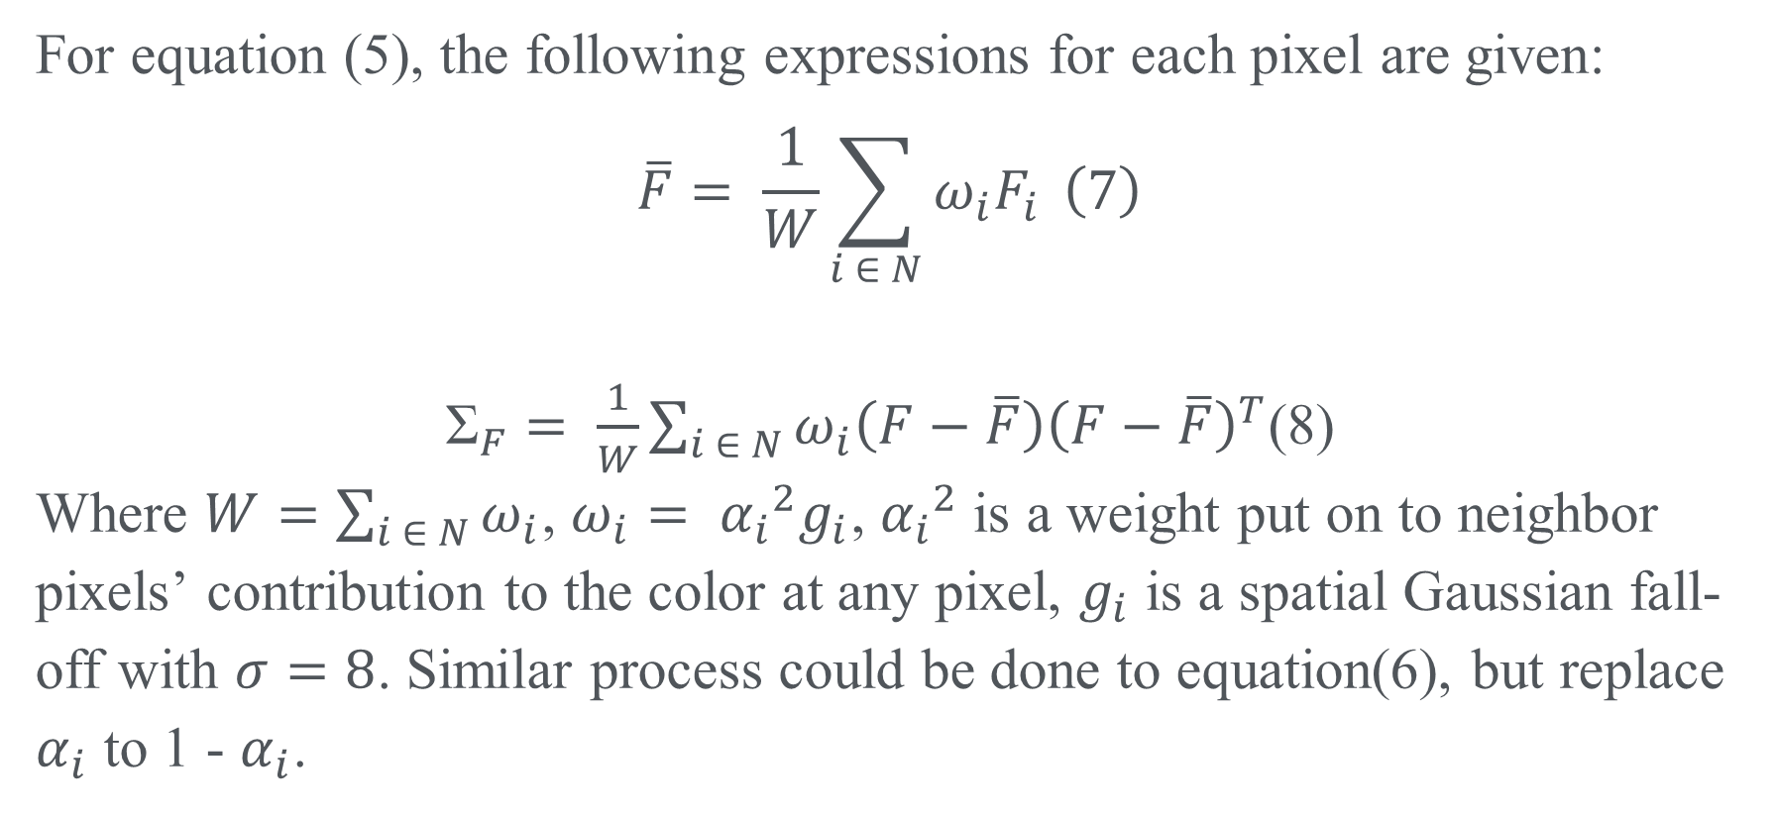
MATH INTERPRETATION
For equation (5), the following expressions for each pixel are given:
$$\overline{F}= \frac{1}{W}\sum_{i ∈ N}{ω_{i}F_{i}} \left(7\right)$$
${\text{Σ}}_{F}= \frac{1}{W}\sum_{i ∈ N}{ω_{i}\left(F−\overline{F}\right){\left(F−\overline{F}\right)}^{T}}$(8)
Where $W=\sum_{i ∈ N}{ω_{i}}$, $ω_{i}= {α_{i}}^{2}g_{i}$, ${α_{i}}^{2}$is a weight put on to neighbor pixels’ contribution to the color at any pixel, $g_{i}$ is a spatial Gaussian fall-off with $σ=8$. Similar process could be done to equation(6), but replace $α_{i}$ to 1 - $α_{i}$.

Slide 9
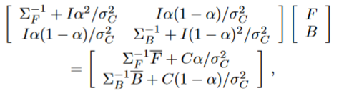

MATH INTERPRETATION
Based on equations above, we now could express F, B, $α$ as:
$(9)$
$$α= \frac{\left(C−B\right)∙\left(F−B\right)}{{\left|\left|F−B\right|\right|}^{2}} (10)$$

Slide 10
Core Algorithmic Functions —Clustering
Orchard-Bouman Clustering algorithm:
Initialize the whole dataset as a whole cluster, whose sufficient statistics(mean, covariance, etc,.) will be calculated.
Split the cluster with the largest eigenvalue along with the largest variance, the mean and covariance will be report as output.

Slide 11
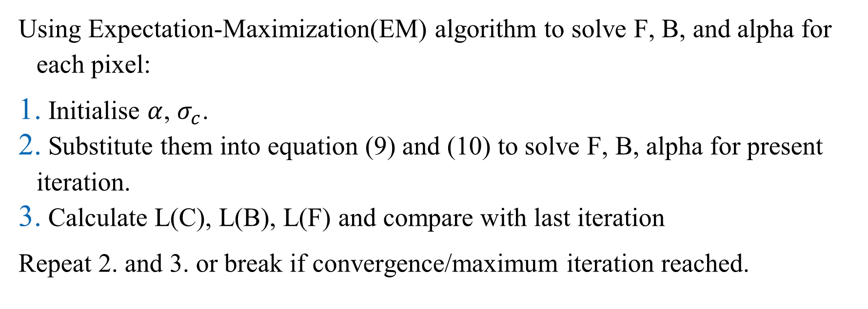
Core Algorithmic Functions —Expectation-Maximization(EM) algorithm
Using Expectation-Maximization(EM) algorithm to solve F, B, and alpha for each pixel:
Initialise $α$, $σ_{c}$.
Substitute them into equation (9) and (10) to solve F, B, alpha for present iteration.
Calculate L(C), L(B), L(F) and compare with last iteration
Repeat 2. and 3. or break if convergence/maximum iteration reached.

Slide 12
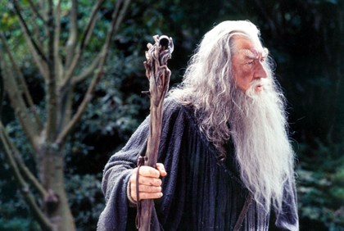
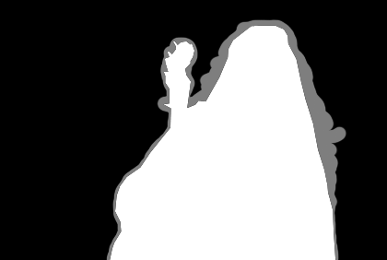
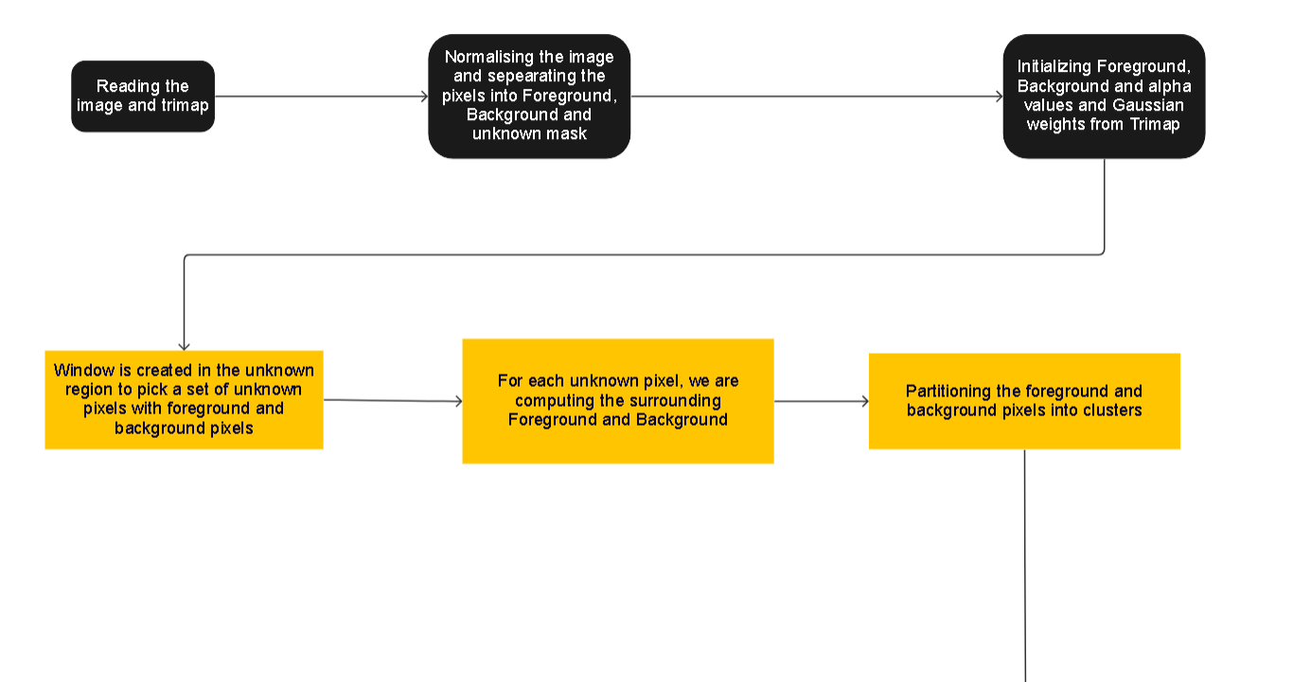

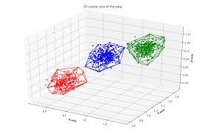
Flow Diagram for the Implementation

Slide 13
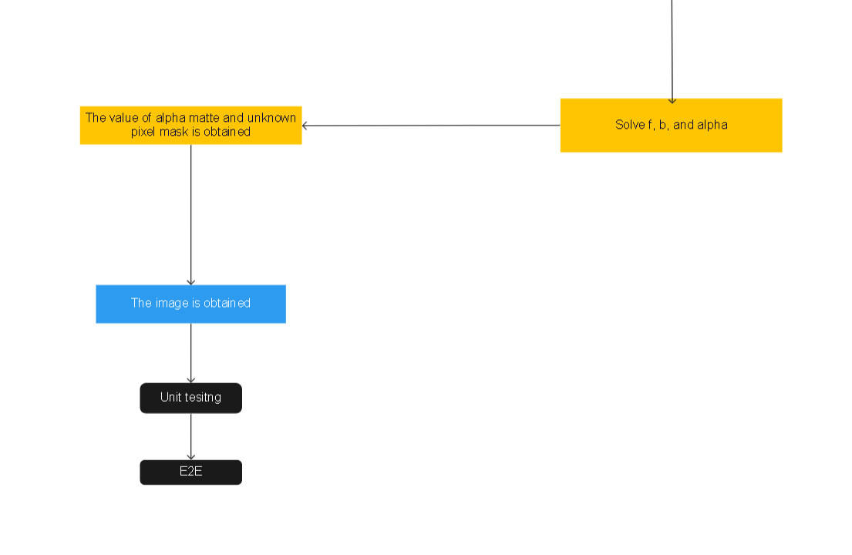
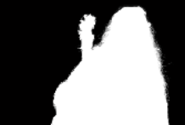

Slide 14
Unit Tests(Input image)
We are going to check whether the input image has 3 channels and check that is input within the range (0-255).
Also, verify whether the input image is not completely black or white image by checking that each pixel value is not zero or 255.
This test verifies the input given is an image and is not black or white.

Slide 15
Unit Tests(Tri – matte image)
We are going to check whether the input image has only one channel and check that each pixel value in the image is within the range(0- 1)
By checking the array values, we confirm the input image is tri matte rather than only background or foreground.

Slide 16
Unit Tests(Orchard Boumann Clustering)
Comparing the mean, and covariance of the function using the calculated value
This test verifies that the mean and covariance of the algorithm give the proper output.

Slide 17
E2E Tests
Identify the workflow of algorithm, which has been reviewed in flow chart earlier.
Validate the input parameters (original image, trimap)
Testify the core functionality of algorithm

Slide 18
E2E Tests
Verify the output results from algorithm by comparing with the ground truth, in metrics of Mean Squared Error(MSE).
In the final part, Evaluating the performance of algorithm in sense of time and computational complexity.

Slide 19
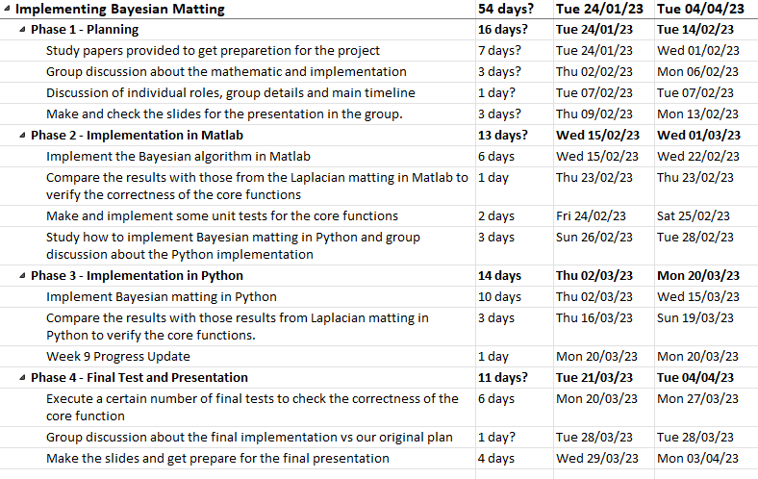
Milestones and Gantt chart

Slide 20
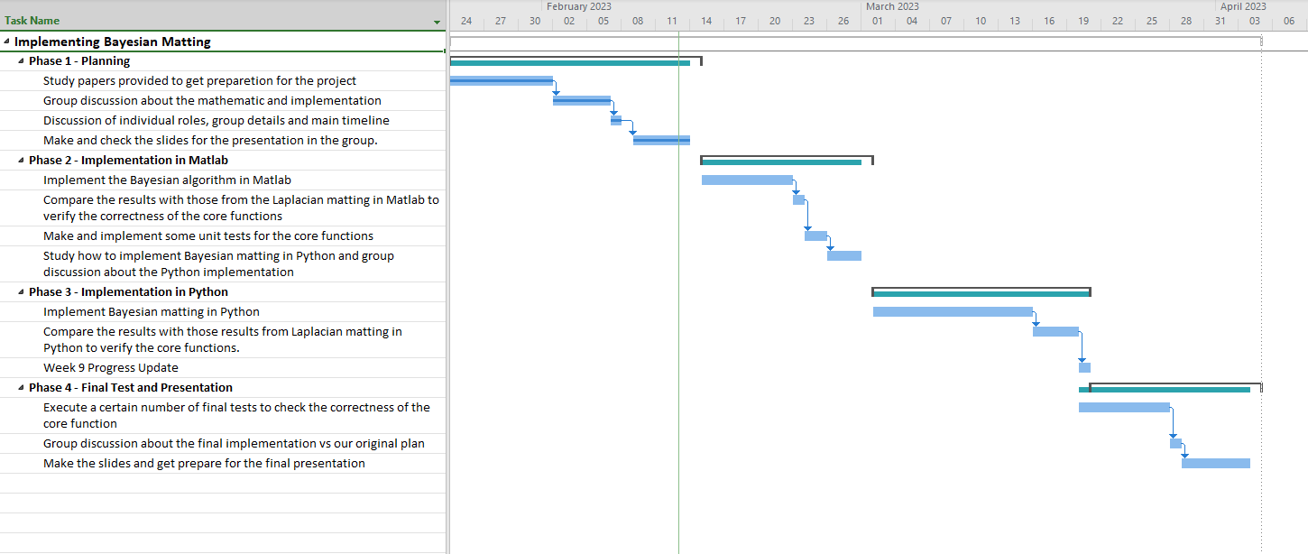
Milestones and Gantt chart

Slide 21
THANK YOU

