Slide 1


The Insecurity of Home Digital Voice Assistants -Vulnerabilities, Attacks and Countermeasures
Xinyu Lei, Guan-Hua Tu, Alex X. Liu, Chi-Yu Li, Tian Xie
Notes:
Hi, my name is Tian Xie. In this talk, I’ll introduce The Insecurity of Home Digital Voice Assistants – Vulnerabilities, Attacks and Coutermeasures.

Slide 2
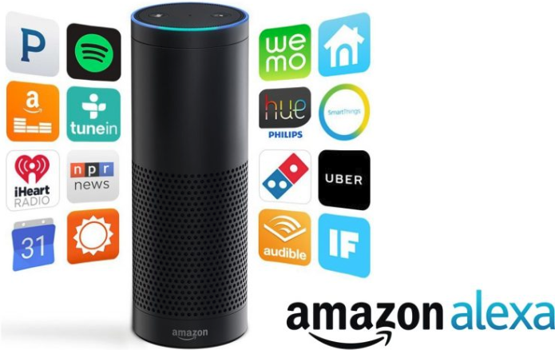
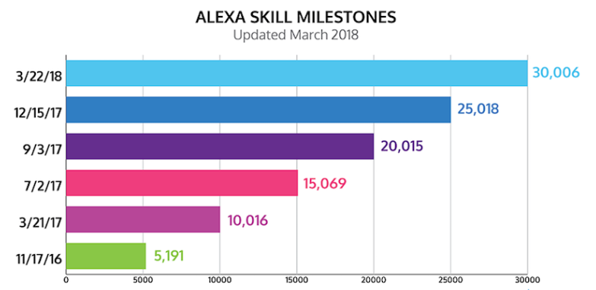
Home Digital Voice Assistant (HDVA) Devices Applications
Skills:
“Alexa, order a laptop from amazon”
“Alexa, tell smart lock to open my door”
50 new skills per day
Security critical!
Notes:
Nowadays, more and more people are using Home Digital Voice Assitant Devices such as amazon alexa and google home. Here in this slide, we use Alexa as an example to demonstrate our work. Home Digital Voice Assistants have many skills. We can use voice commend to ask Alexa to directly shop on Amazon, control IoT devices. It is counted that about 50 new skills are added to Alexa per day. Note that some skills are security critical. For example, (Alex order a laptop from Amazon is about the money. Smart lock is related to the security),

Slide 3
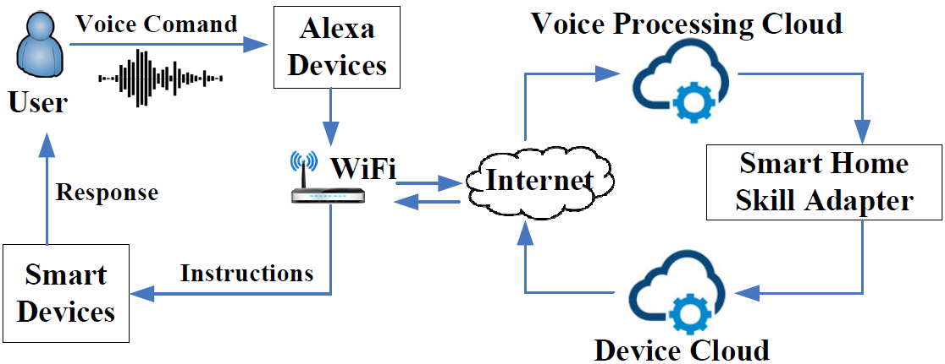
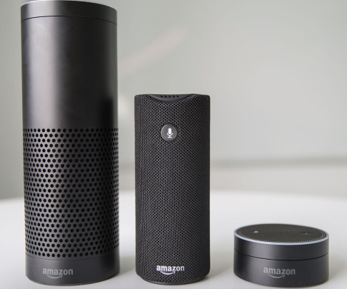
Background: Devices and Service Model
Alexa Devices: Echo, Tap, and Echo Dot
Alexa voice service model
Notes:
There are several Alex devices, Echo, Tap, and Echo Dot. Different Alexa devices use the same service model.

Slide 4
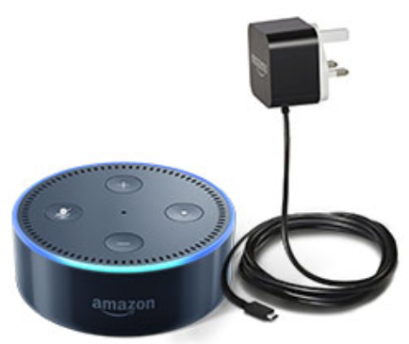
Acoustic Attacks
Fixed location： Alexa devices need to be plugged in to have power supply.
Weak single-factor authentication: Always listen to “Alexa” to wake up and receive the following voice commands.
Consequence: More vulnerable to acoustic attacks when owners are absent from home.
Notes:
1. Fixed location-> different from the smart phone, which is carried by users
2. Only “alexa”, any users can pass authenticaition
3. So, more vulnerable to acoustic attacks

Slide 5
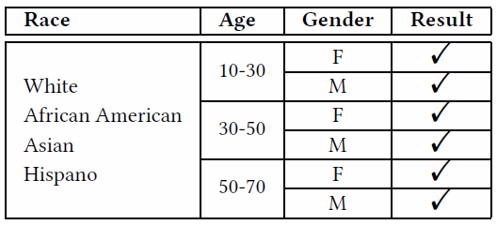
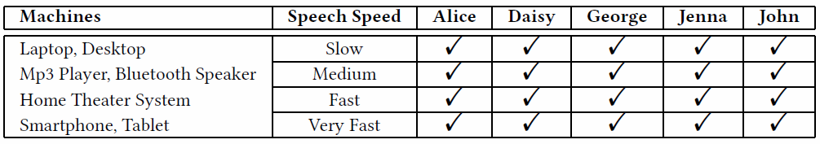
V1: Weak Single-factor Authentication
Human Voice： Anyone can pass the authentication by speaking “Alexa” and then command Alexa.
Machine Voice： Many machines can produce voice to command Alexa.
(Note voice is generated by online test-to-speech (TTS) system)
Notes:
Next, let me introduce the vulnerabilities about Alexa.
We validate it by the commend from our volunteers with four races, three age groups, and of course two genders.

Slide 6
V2: No Physical Presence Based Access Control
No physical presence based access control: Work by detecting the voice even if there is no surrounding users.
Validation:
Alexa can be controlled by the voice command from the Bluetooth speaker 12 meters away.
Alexa can accept voice commands larger than 60dB, no matter where the voice comes from.

Slide 7
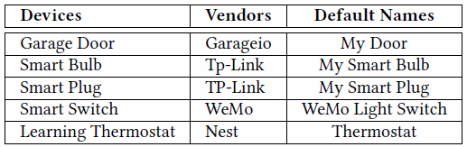
V3: Insecure Access Control on Alexa-enabled Devices
Default names: Alexa-enabled devices can be controlled by speaking their names. Re-name a device is usually not mandatory, so the adversary may directly know the commands to control the device.
Many devices can be controlled by their default voice commands

Slide 8
How To Deliver Voice to Home Digital Voice Assistant Devices
The adversary can deliver voice to Alexa by many methods without being present nearby.
Two examples:
Bluetooth speakers: the adversary outside the victim’s house can connect his/her smartphone to the victim’s Bluetooth speaker and then play an MP3 audio file of voice commands.
Smart TVs: the adversary can steal the victim’s home Wi-Fi password and then cast a video with voice commands to the victim’s smart TV.
All devices that are capable of making the sound can be abused and used!!
Notes:
A lot of indoor audioable devices may be abused.
Alexa and Bluetooth speaker are a common pair used in our daily life. Belkin Bluetooth speaker has this vulnerability to be abused.

Slide 9
Proof-of-concept Attacks
Two real-world attack cases:
Home Burglary: Tell Alexa to open a door via smart lock. E.g., “Alexa, tell Garageio to open my door”.
Fake Order: Tell Alexa to place a fake order on Amazon. The owner may suffer from the financial loss.

Slide 10
Possible Solutions
Learn the authentication users’ voice (V1)
Voice may change due to health conditions
Turn off all audio devices while users leave home (V2)
Not convenient for users
Force users to rename the default Alexa-compatible device name (V3)
It may not be practical to ask all vendors and users to do so.

Slide 11
Solution: Physical Presence Based Access Control
Idea: Virtual Security Button (VSButton):
Turn on Home Digital Voice Assistant Devices: If physical presence is detected
Turn off Home Digital Voice Assistant Devices: If no physical presence is detected
Approach: Wi-Fi channel state information (CSI)-based motion detection:
Significant CSI Variation: Human motions
Nearly Stable CSI: No motions
Notes:
We found that this attack always happen that the owner is not at home. Since there is no functionality to detect the user’s identification, we want to develop an extra access control based on physical presence.
channel state information represent WiFI channel state.

Slide 12
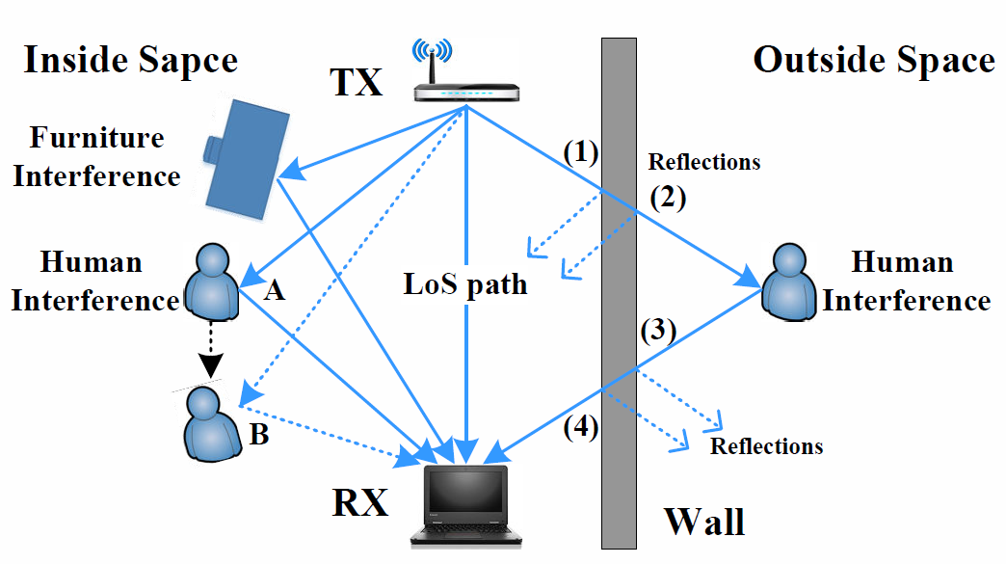
Distinguish the Inside and Outside Human Motions
Outside motions: a small CSI variation
Inside motions: a significant CSI variation
Notes:
Next, I’ll introduce how CSI-based motion detection can satisfy our requirement. Here is how we distinguish the inside and outside human motions.
Because of multi-path and multi-reflection effect on the wall, the outside motions can only cause small CSI variation.

Slide 13
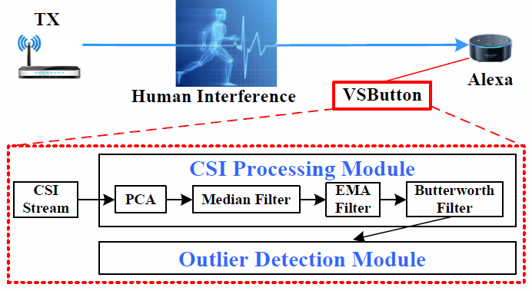
VSButton Design
PCA (Principle Component Analysis) Module： reduce the dimension and remove the noise
Median and EMA (Exponential Moving Analysis ) Filter Module: smooth CSI values
Butterworth Filter Module: filter out high frequency signal
Outlier Detection Module：detect human motions.
It uses dynamic baseline: adaptive to environment changes.
Notes:
Dynamic baseline: the baseline it the average over the recent 1 hour. The outlier is detected based on its variation from the baseline. It makes our VSButton more adaptive in the home use scenario. We don’t recollaborate our VSButton even the users move their furniture.

Slide 14
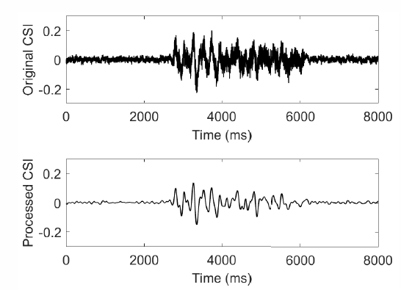
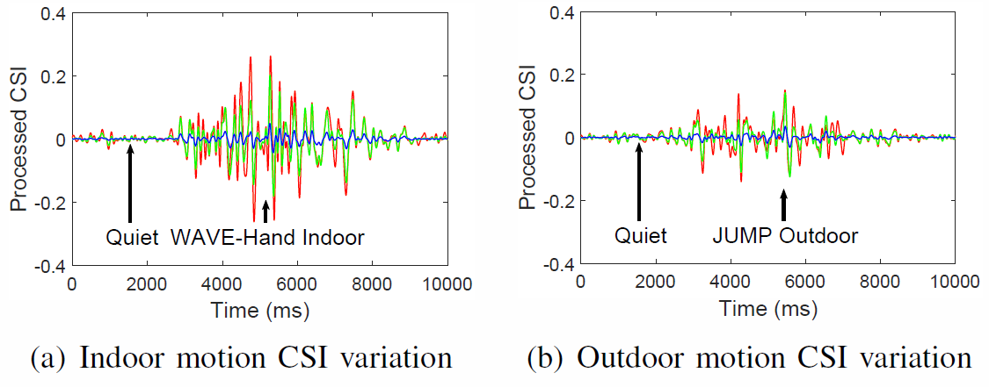
CSI Comparison
Comparison between original/processed CSI
Comparison between indoor and outdoor CSI variation
Notes:
Original CSI: Raw CSI before processing
Processed CSI: CSI processed after first three modules

Slide 15
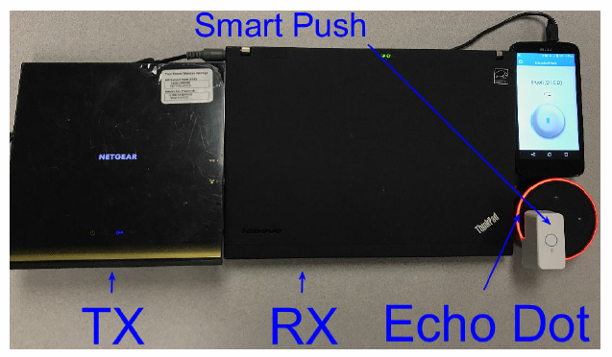
Prototype Implementation
Transmitter (TX): Home Wi-Fi router
Receiver (RX)： Laptop for processing the CSI
Controller: Smart push to turn on/off Alexa
Software updates: RX and controller can be integrated to the Alexa devices by only software upgrades.

Slide 16
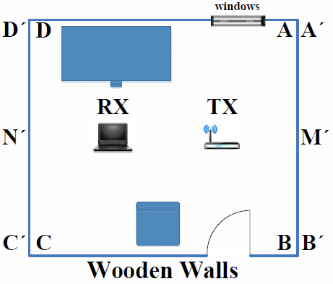
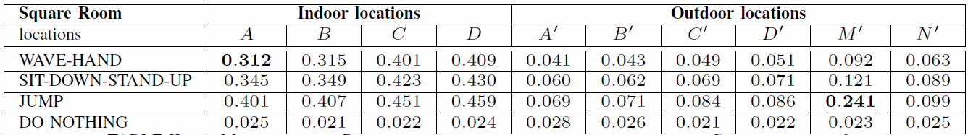
Evaluation – Square room with wooden walls
Configuration: Square room with wooden walls.
CSI Variation: The strongest CSI variation of the movements outside is smaller than the weakest one among the movements inside.
Notes:
We next demonstrate our evaluation of adopting CSI in two rooms.
We compare four different motions indoor and outdoor.
Mahalanobis Distance

Slide 17
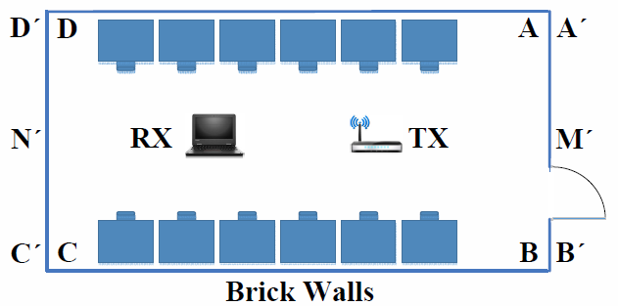
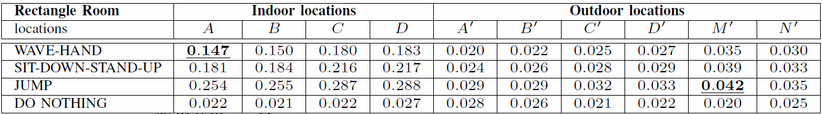
Evaluation – Rectangle room with brick walls
Configuration: Rectangle room with brick walls
CSI Variation: The strongest CSI variation of the movements outside is smaller than the weakest one among the movements inside.

Slide 18
Current Limitations of VSButton
Motions not from human: VSButton may activate HDVA service due to motions from pets.
Tradeoff between security and convenience: By increasing the motion detection threshold t, VSButton has a smaller false positive rate.
Physical invasive attack: VSButton cannot resist invasive attack (e.g, the adversary breaks the windows and enters the victim’s room). If invasive attack occurs, the adversary is able to do many things much eviler than attacking the HDVA.
Notes:
Although our proposed solution successfully addresses the discovered vulnerabilities. We still have to admit that there are three limitations on our work.
False positive: treat outside motion as inside. moves large extent

Slide 19
Conclusion
HDVAs: Amazon Alexa and Google Home
Identify three vulnerabilities
Solution: VSButton based on physical presence
Accurate detection in both laboratory and real-world home setting
Notes:
Motion: extra device; detecting angle.
Hand detect: Do not work the home use scenario with different environment use. Do not need to recollaborate the data.
We hope our initial efforts can stimulate further research on the HDVA security.

Slide 20

Questions & Answers

Slide 24
Backup

Slide 25
Related work
Indoor Human Activity/Motion Sensing. Other methods need to buy special equipment (e.g., radar, camera). But Wi-Fi based motion detection is only based on COTS devices.
Voice Authentication for Digital Voice Assistants. Previous methods need users to wear some devices to finish voice authentication. However, our solution is device-free.

