Slide 1
Book Inventory Management System
Xie Wenhao (Group Leader)
Mario Uesaka

Slide 2


The bottleneck / Solution

Slide 3
Project Review
Implemented Function
1. Book addition
2. Book list viewing
3.Author-based search

Slide 4
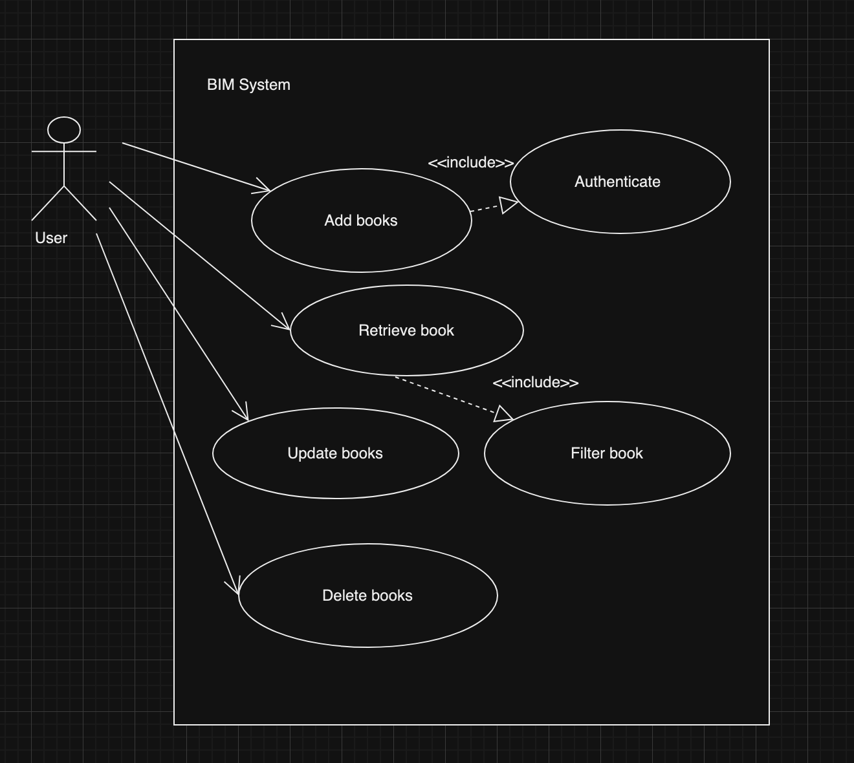
Use case diagram
Functional behaviour of the system
A user interacts with the BIM system
The system allows:
Add, Retrieve, Delete and Update

Slide 5
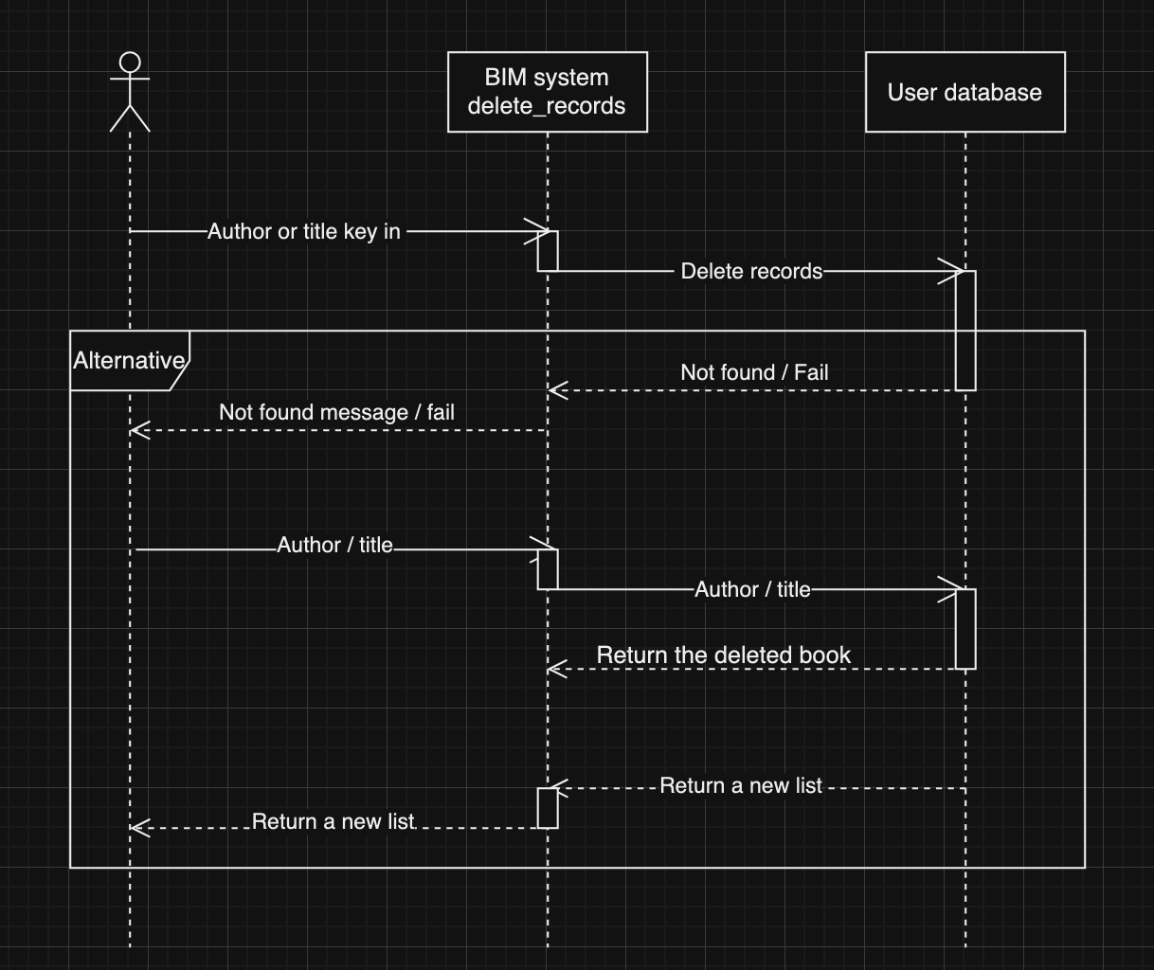
Sequence Diagram / Delete feature

Slide 6
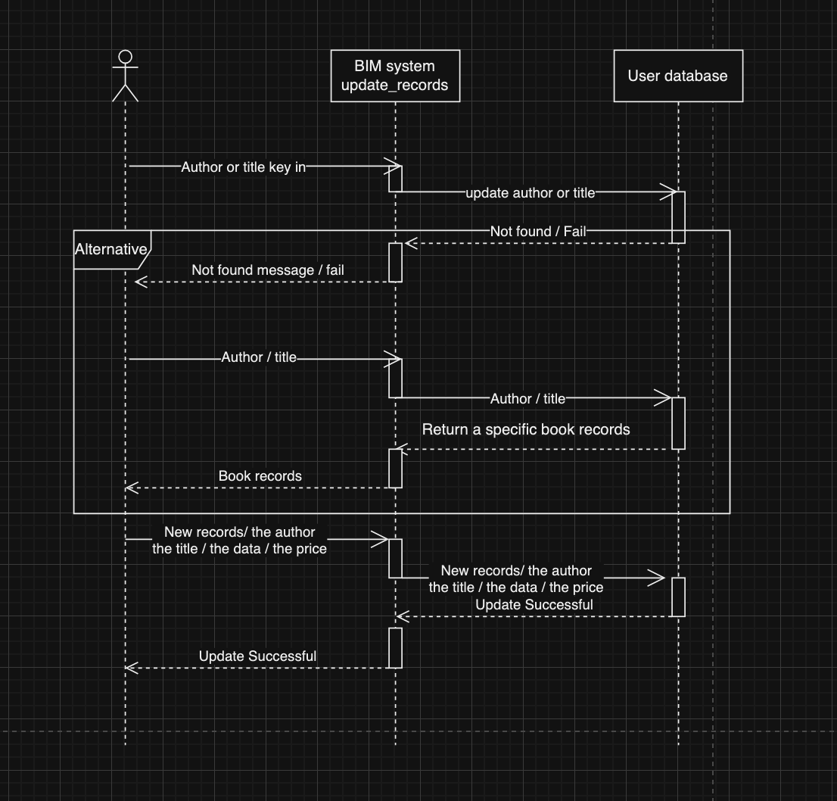
Sequence Diagram / Update feature

Slide 7
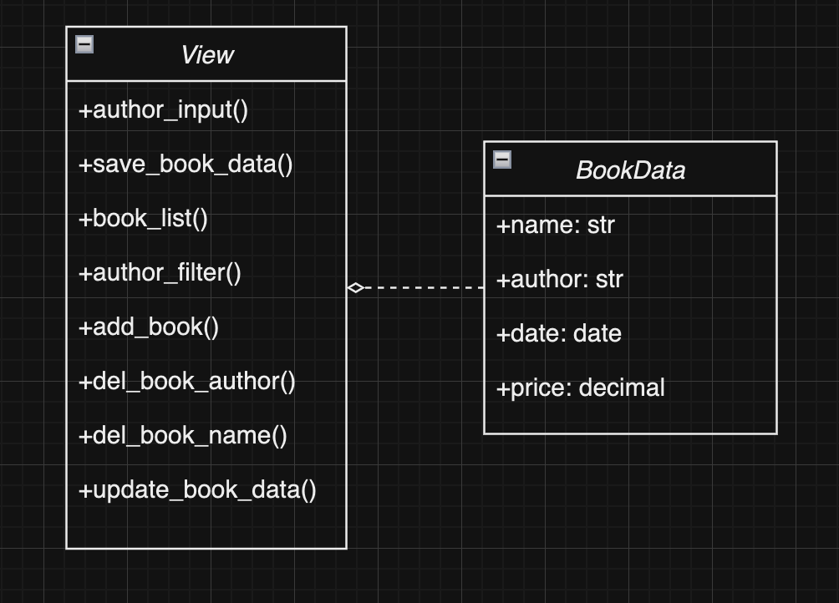
Class Diagram

Slide 8
Demo

Slide 9
Project Review
Modifying Author Search: Hiding author name in url
The author's name no longer appears in the URL of the book list retrieved using the author search feature, as shown below.
URL:http://127.0.0.1:8000/author_filter

Slide 10
New Function Introduction
Delete function
You can delete a specific book by its title or author, as shown below, then program will provide the updated list after the specific book has been deleted.
URL:http://127.0.0.1:8000/d/n/<book’s title>
URL:http://127.0.0.1:8000/d/n/<book’s author>

Slide 11
New Function Introduction
Delete function
In the case where multiple books have the same title or author, the program will return the following message:
“Sorry, there is more than one book that matches your request. Please add its sequence number to the URL to delete a specific one, like: /author/1.”
You can add the book's sequence number to the URL to delete a specific one.
URL:http://127.0.0.1:8000/d/n/<book’s title>/<sequence number>
URL:http://127.0.0.1:8000/d/n/<book’s author>/<sequence number>

Slide 12
New Function Introduction
Update Book Details
You can modify the details of a specific book by using the ID of the book from the list.
URL:http://127.0.0.1:8000/up/<book id>/<name>/<author>/<date>/<price>

Slide 13
New Function Introduction
Update Book Details
If the update is successful, the program will return the updated book details along with the following message:
'message': 'Book details updated successfully'
If it fails, the program will return the error message:
Sorry, please enter the correct data.

