Slide 1
Book Inventory Management System
Xie Wenhao (Group Leader)
Mario Uesaka

Slide 2


The bottleneck / Solution

Slide 3
Project Review
Implemented Function
1. Book deletion
2. Update book data

Slide 4
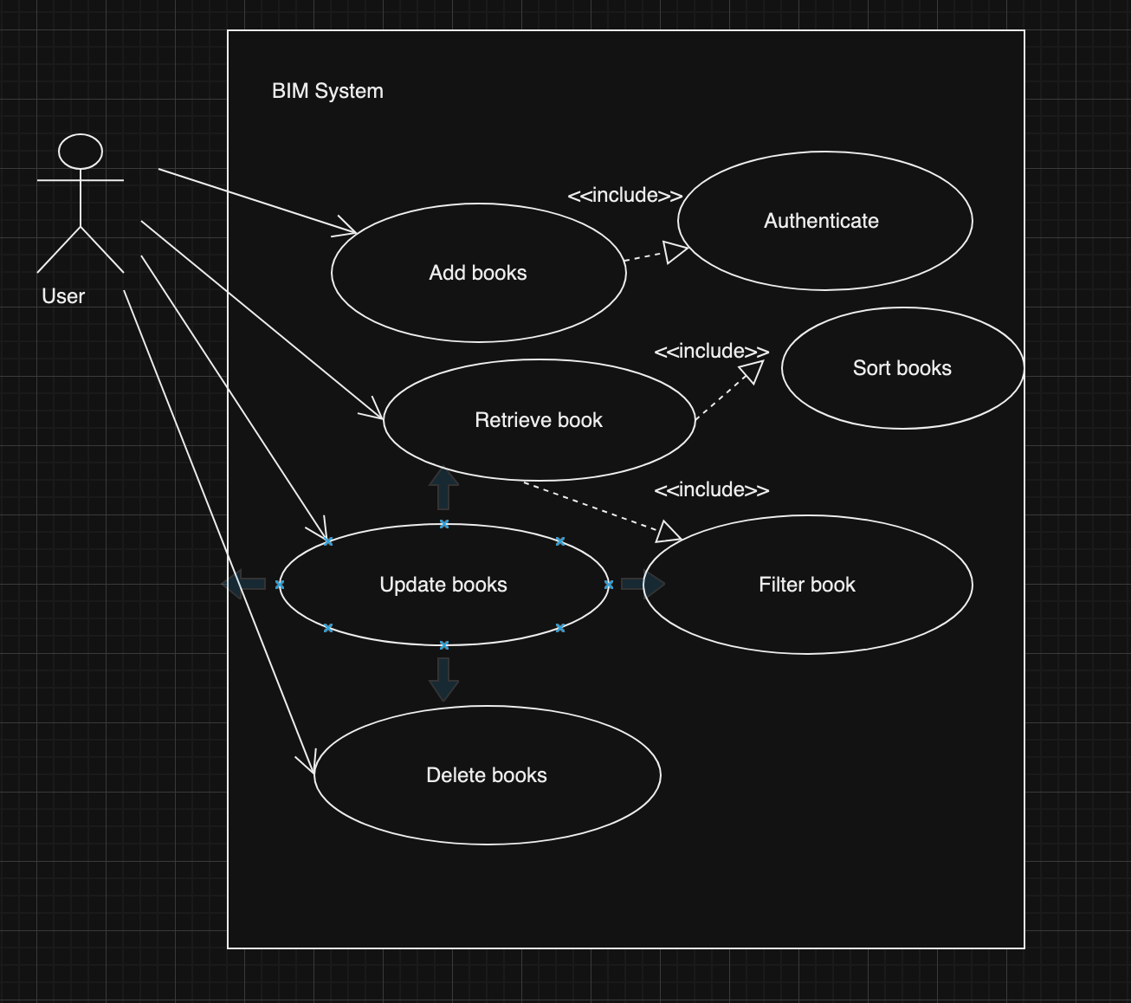
Use case diagram
Functional behaviour of the system
A user interacts with the BIM system
The system allows:
Add, Retrieve, Delete and Update

Slide 5
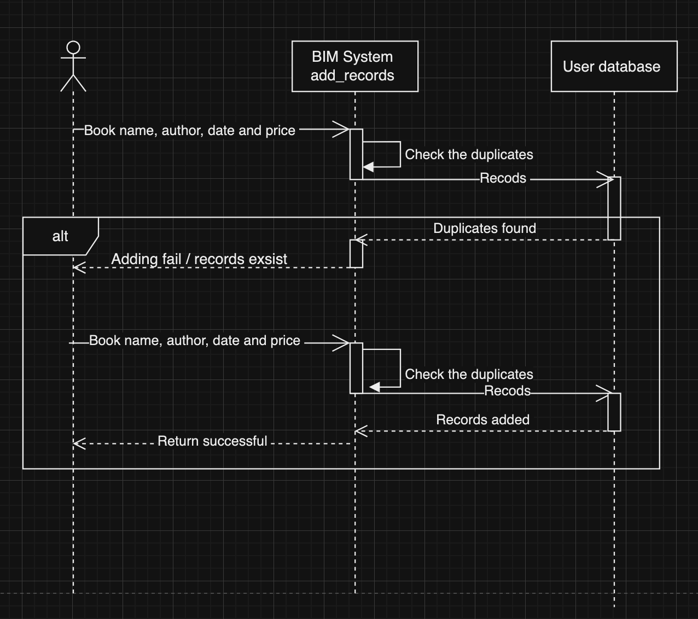
Sequence Diagram / Add book feature

Slide 6
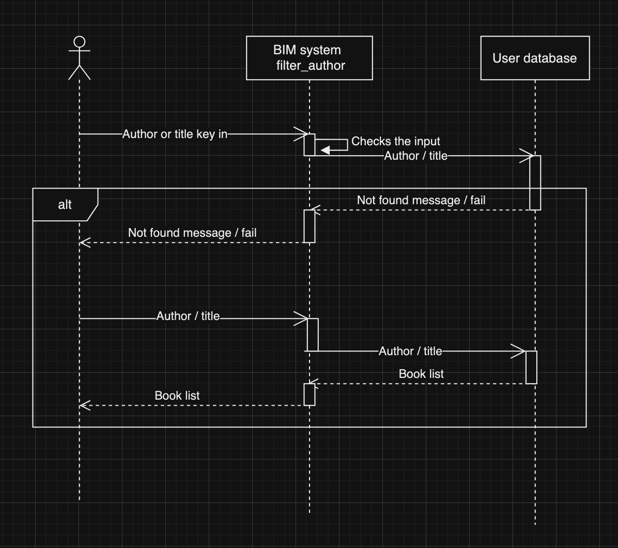
Sequence Diagram / Filter feature

Slide 7
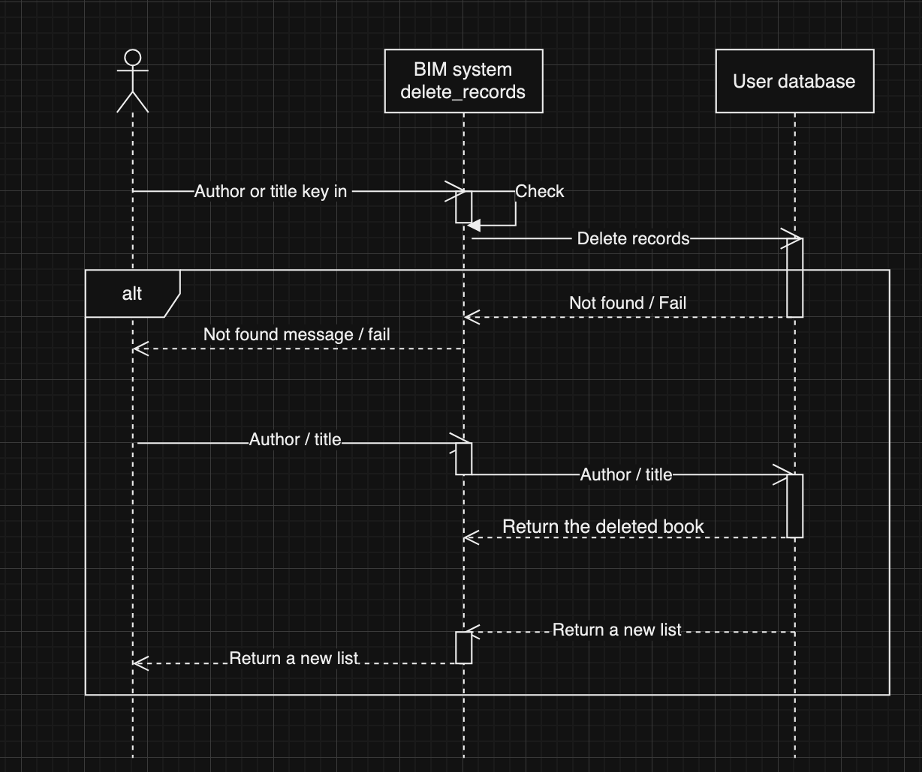
Sequence Diagram / Delete feature

Slide 8
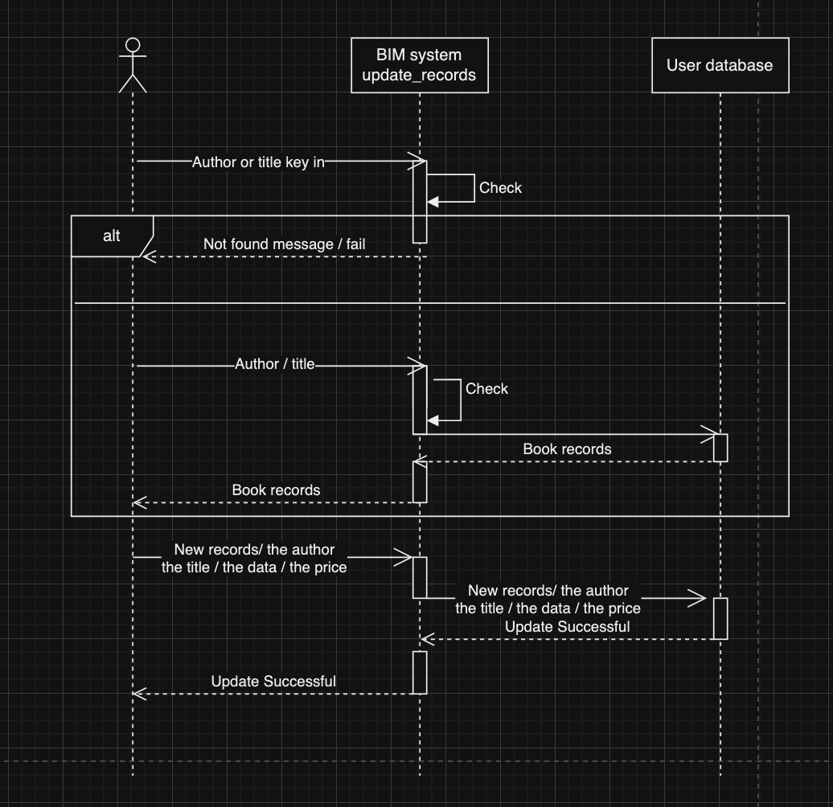
Sequence Diagram / Update feature

Slide 9
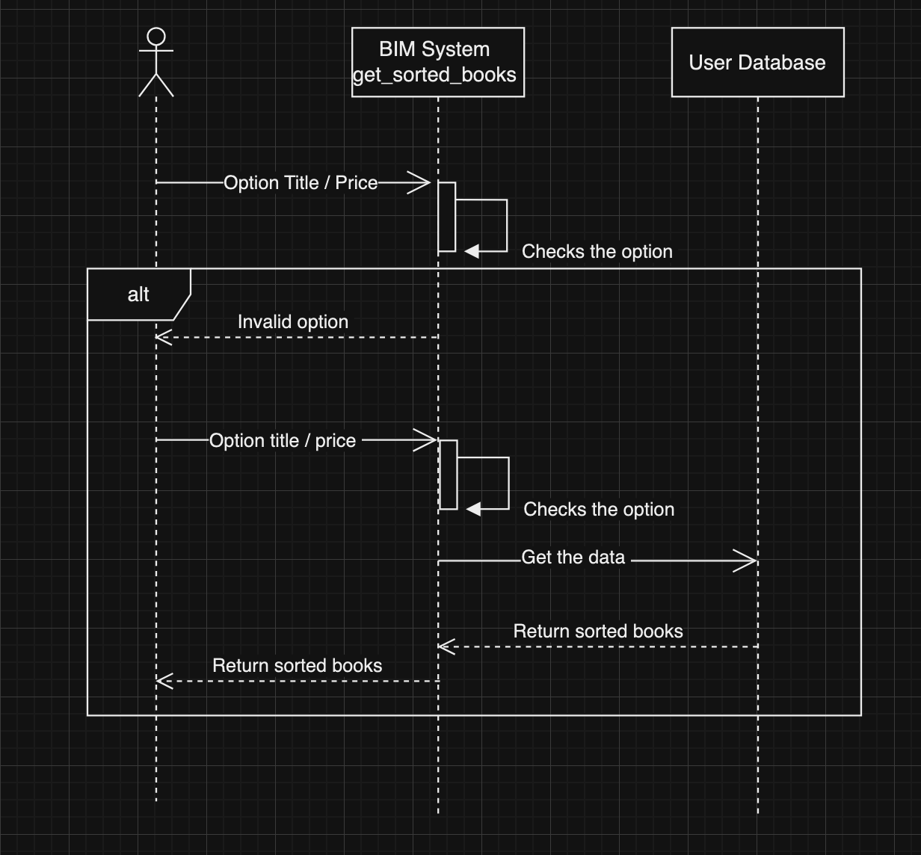
Sequence Diagram / Sorting feature

Slide 10
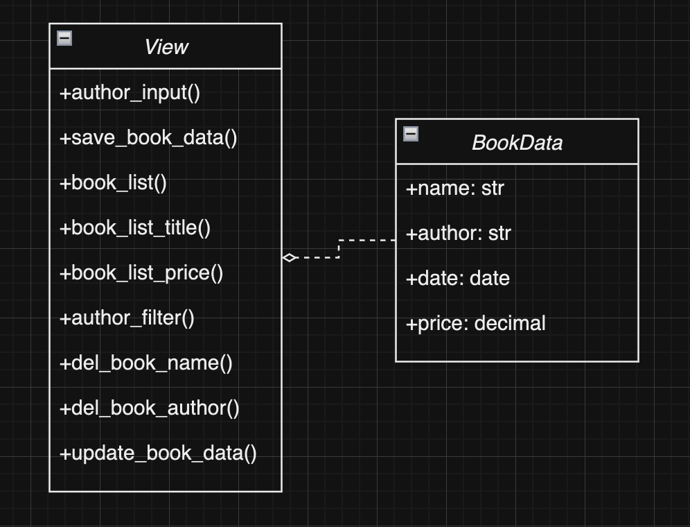
Class Diagram

Slide 11
Enhancement
1.Added the feature to delete book by ID.
URL:http://127.0.0.1:8000/d/<book id>
2.To prevent data or URL errors, we added data checks to each method and implemented a custom error page for better handling.

Slide 12
Demo

Slide 13
New Function Introduction
Search function that matches partial or full title/author.
You can search for a specific book by partial or full title or author, then program will return all books that match the requirements.
URL:http://127.0.0.1:8000/title/<partial or full title>
URL:http://127.0.0.1:8000/author/<partial or full author>

Slide 14
New Function Introduction
Book sorting function
You can view a book list sorted by title or by price, either in ascending or descending order.
URL:http://127.0.0.1:8000/list/title
URL:http://127.0.0.1:8000/list/price+
URL:http://127.0.0.1:8000/list/price-

