Slide 1
MY FAVOURITE RAPPER
An unfamous rapper

Slide 2
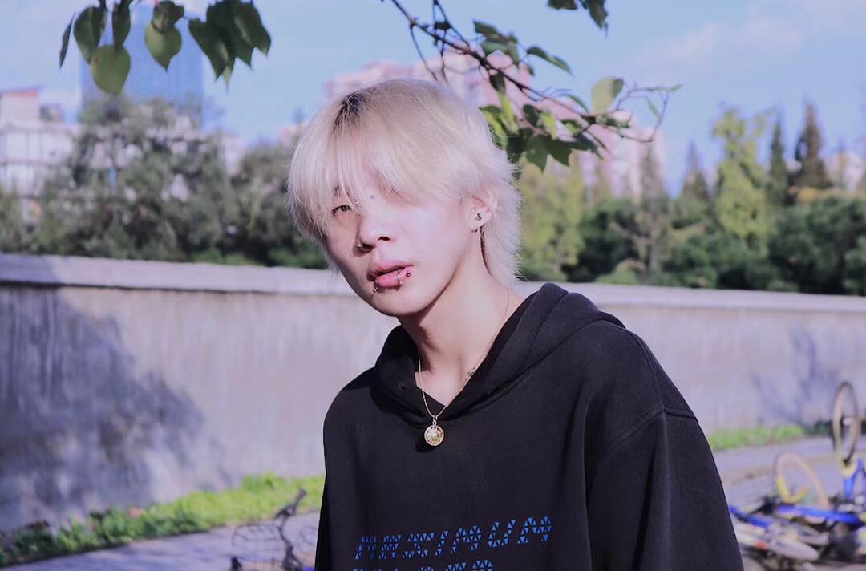
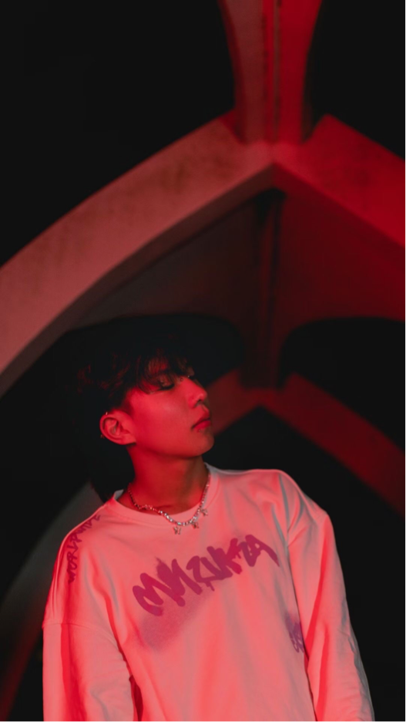
He is a Chinese rapper.His rap name is GO HOME IN A MINUTE(等一下就回家），and his Chinese name is Ye Yuzhen(叶宇桢）.
He is not so famous as those famous rapper, like Rich Brian ,MC Jin,Ma Siwei and so on.But In my heart he is really a handsome and cool guy.

Slide 3

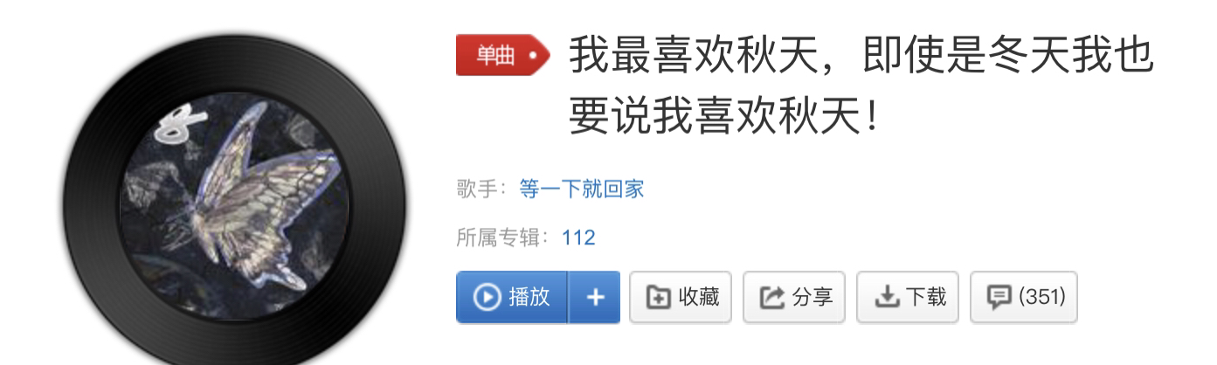
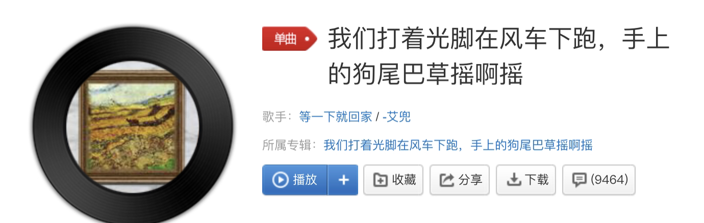
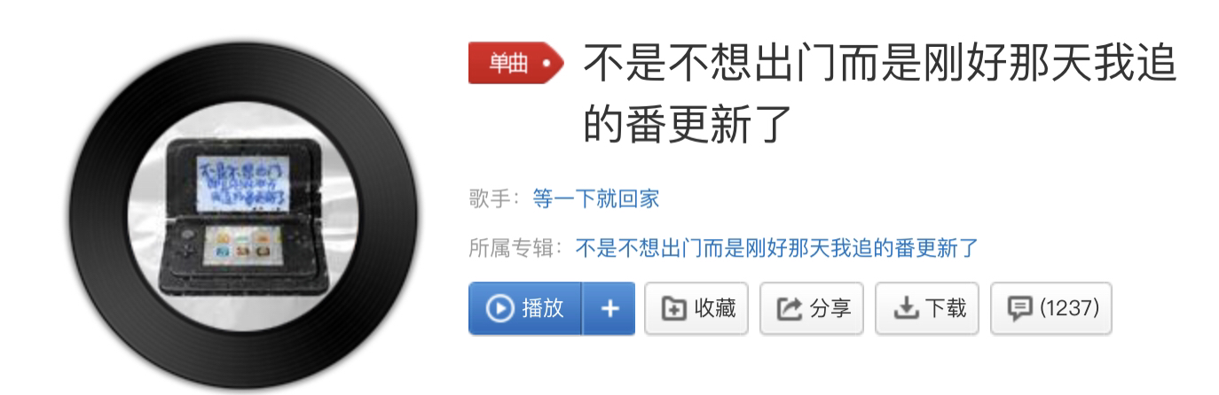
I first know him when I watch Junior Rap Project .（少年说唱企划）And I think he is a funny man.

Slide 4
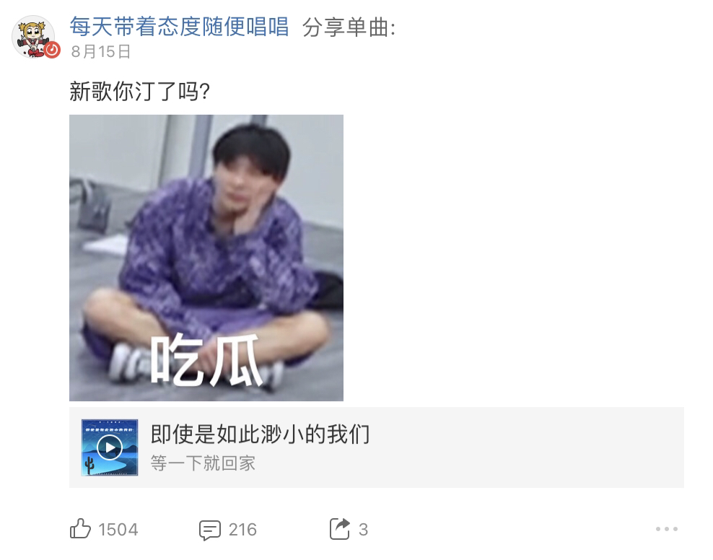
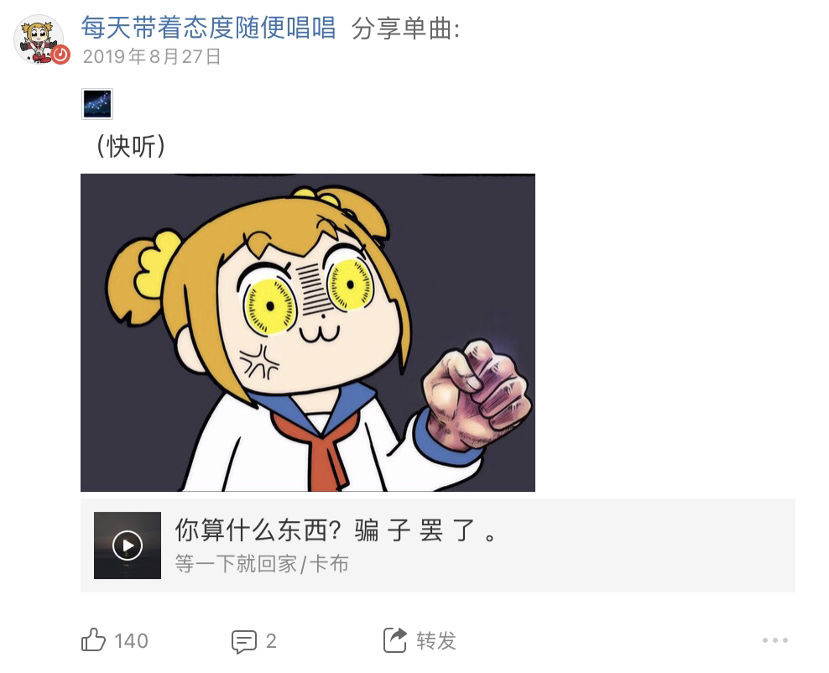
He is also a funny man in his daily life.

Slide 5
Let us watch a video!!!

Slide 6
Though he is not so famous now ,but I believe he will on the top of Chinese rapper one day. So do we ,maybe some of us do not study well now ,but I believe we will achieve something in the end and return with honour.

