Slide 1

Demo Monkeys
DOODLE TEE LAYOU
Project T UIS 0.1

Slide 2
Version History
Change log
Version | Change date | Author | Notes
0.1 | 2013.09.17 | Xidi zeng | Draft

Slide 3
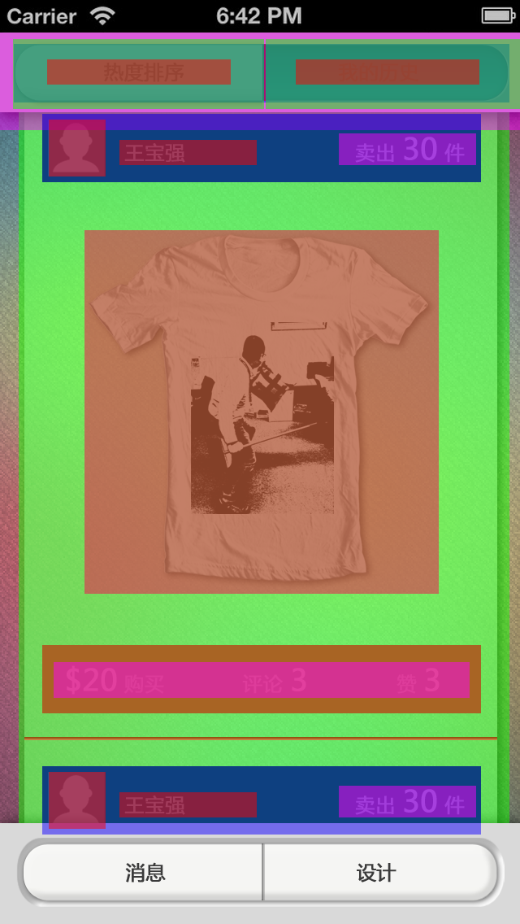
Active graph
1
2
4
3
5
6
10
8
9
7
Num | Description | X,Y position | Remark | Size
1 | Text | X=58,364;73 | Size 24 pt;RGB(59,59,59); align center | 226x31
2 | Navigation_button | X=16,327;48 | Image :select_left_navigation_bar; select_right_navigation_bar | 309,313x86
3 | Navigation_bar | 17;54 | Image :navigation_bar | 610x72
4 | Line | 325;54 | Image :septal_line | 2x70
5 | Navigation_bar_bg | 0;40 | Image :navigation_bar_bg | 640x120
6 | Portrait | 60;147 | Image :portrait | 70x70
7 | Content_bg | 23;138 | Image :content_bg | 604x874
8 | Text_01 | 147;172 | Size 24 pt;RGB(59,59,59); align left | 169x31
9 | Text_02 | 417;164 | Size 24;size 36 pt;RGB(59,59,59); align right | 169x39
10 | User_bg | 52;140 | Image:user_bg | 540x84

Slide 4
Active graph
11
13
12
14
18
15
17
16
Num | Description | X,Y position | Remark | Size
11 | Clothes | 104;283 | Image:clothes | 435x447
12 | Text_box | 52;793 | Image :text_box | 540x84
13 | Text | 66;814 | Size 24;size 36 pt;RGB(59,59,59); align center | 512x44
14 | Line | 30;906 | Image :line | 582x4
15 | Portrait | 60;949 | Image :portrait | 70x70
16 | Text_01 | 147;974 | Size 24 pt;RGB(59,59,59); align left | 169x31
17 | Text_02 | 417;966 | Size 24;size 36 pt;RGB(59,59,59); align right | 169x39
18 | User_bg | 52;942 | Image:user_bg | 540x84

Slide 5
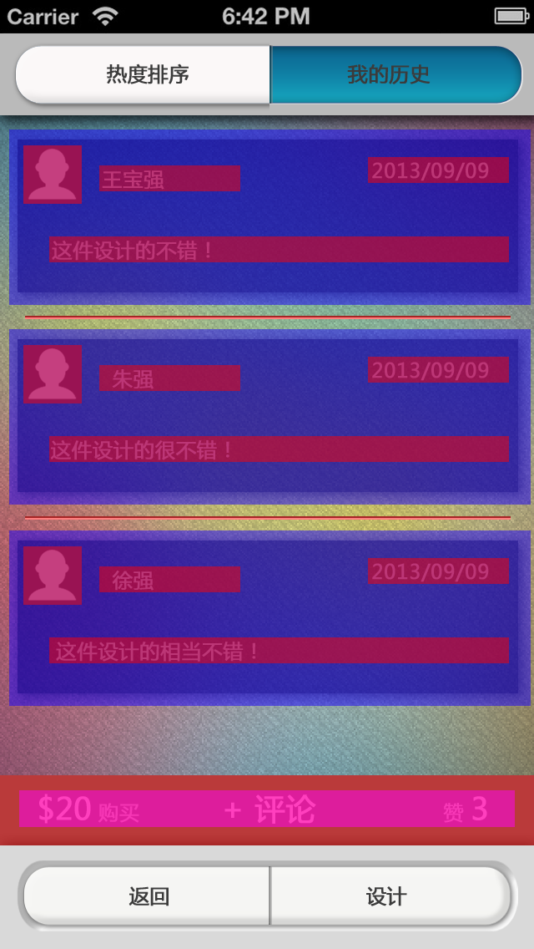
Active graph
2
1
3
5
4
6
7
8
Num | Description | X,Y position | Remark | Size
1 | Portrait | 28;y=174,413,654 | Image :portrait | 70x70
2 | Text | 119;y=198,437,678 | Size 24 pt;RGB(59,59,59); align left | 169x31
3 | Text_01 | 441;y=188,427,668 | Size 24 pt;RGB(59,59,59); align right | 169x31
4 | Text_02 | 59;y=283,522,763 | Size 24 pt;RGB(59,59,59); align left | 551x31
5 | List | 11;y=155,394,635 | Image :list | 625x210
6 | Line | 30;y=378,618 | Image :line | 582x4
7 | Text_box | 0;928 | Image :text_box_01 | 640x84
8 | Text_03 | 23;946 | Size 24;size 36 pt;RGB(59,59,59); align center | 512x44

Slide 6
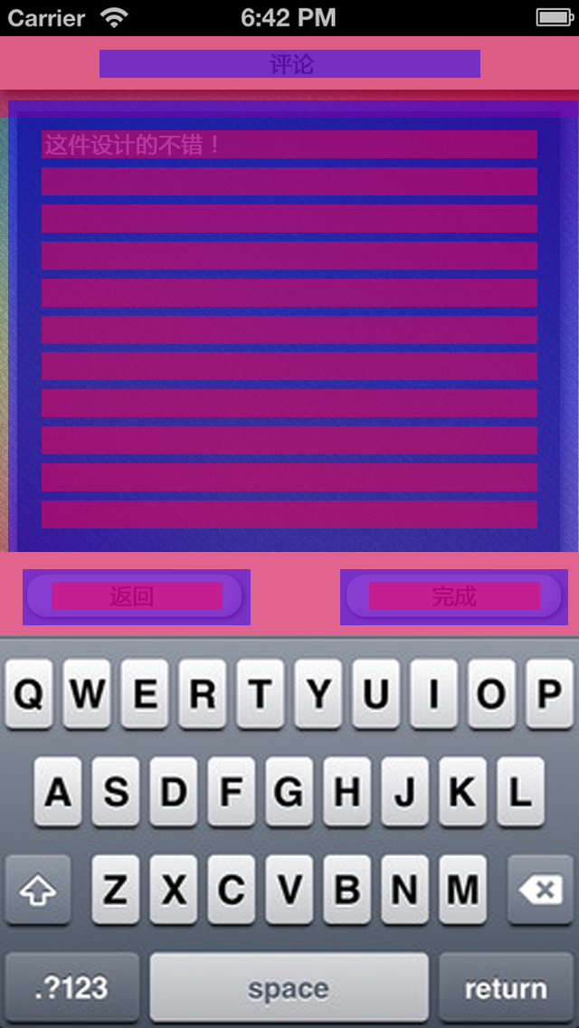
Active graph
1
2
3
4
7
5
6
Num | Description | X,Y position | Remark | Size
1 | Title_bar | 0;40 | Image :title_bar | 640x90
2 | Text | 110;55 | Size 24 pt;RGB(59,59,59); align center | 421x31
3 | Input_box | 9;111 | Image :input_box | 630x499
4 | Text_01 | 46;y=144,185,226 | Size 24 pt;RGB(59,59,59); align center | 548x31
5 | Button_bg | 0;610 | Image :button_bg | 640x91
6 | Button | X=25,376;629 | Image :button | 252x62
7 | Text_02 | X=57,408;643 | Size 24 pt;RGB(59,59,59); align center | 189x31

Slide 7
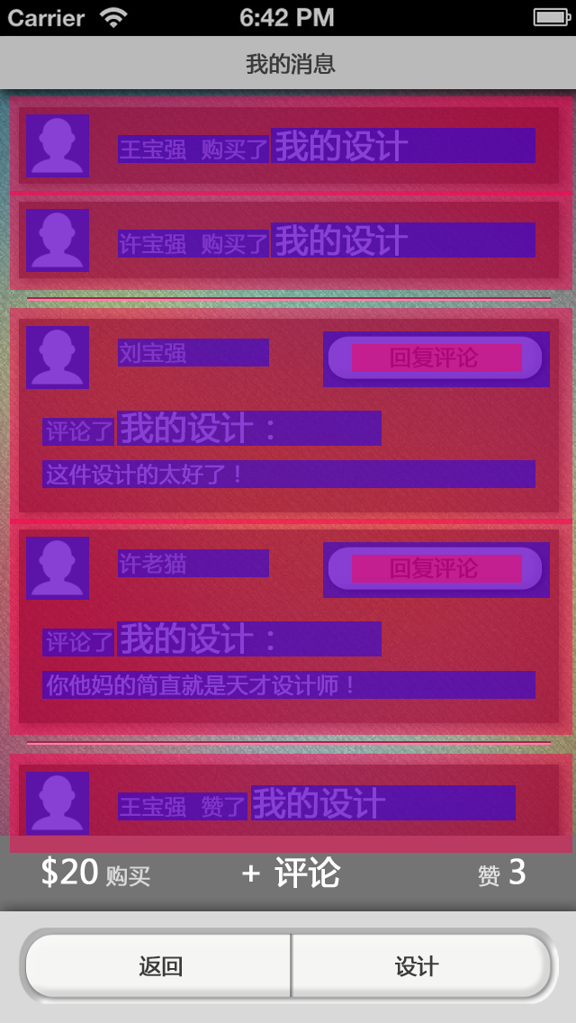
Active graph
3
2
1
4
10
11
7
6
9
8
5
Num | Description | X,Y position | Remark | Size
1 | Portrait | 29;y=127,232 | Image :portrait | 70x70
2 | User_information_box | 11;y=107,212 | Image :user_information_box | 625x110
3 | Text | 131;y=150,255 | Size 24 pt;RGB(59,59,59); align left | 168x31
4 | Text_01 | 301;y=142,247 | Size 36 pt;RGB(59,59,59); align left | 294x39
5 | Line | 30;y=330,823 | Image :line | 582x4
6 | Portrait_01 | 29;y=362,596 | Image :portrait | 70x70
7 | Text_02 | 47;y=464,698 | Size 24 pt;RGB(59,59,59); align left | 80x31
8 | Text_03 | 47;y=511,745 | Size 24 pt;RGB(59,59,59); align left | 548x31
9 | Text_04 | 130;y=456,690 | Size 24 pt;RGB(59,59,59); align left | 294x39
10 | Button | 359;y=368,602 | Image :button | 252x62
11 | Text_05 | 391;y=381,615 | Size 24 pt;RGB(59,59,59); align center | 189x31

Slide 8
Active graph
13
12
14
15
Num | Description | X,Y position | Remark | Size
12 | Portrait | 29;857 | Image :portrait | 70x70
13 | User_information_box | 11;837 | Image :user_information_box | 625x110
14 | Text | 131;880 | Size 24 pt;RGB(59,59,59); align left | 144x31
15 | Text_06 | 279;872 | Size 36 pt;RGB(59,59,59); align left | 294x39

