Slide 1
Listmode2sinogram
Objective is to transfer (crystal-based) listmode
to (BLK-based) sinogram

Slide 2
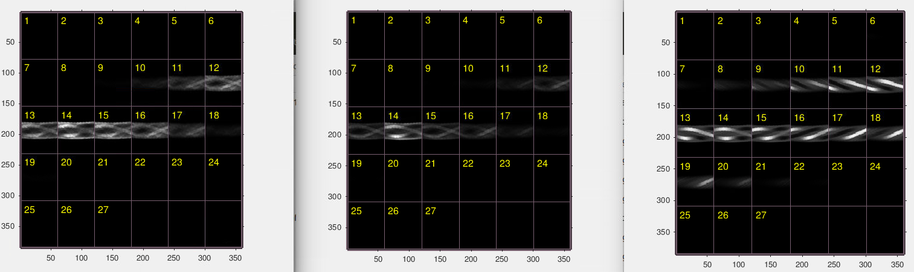
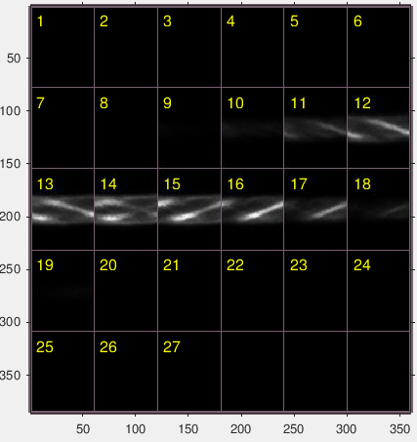
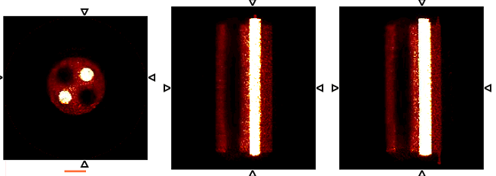
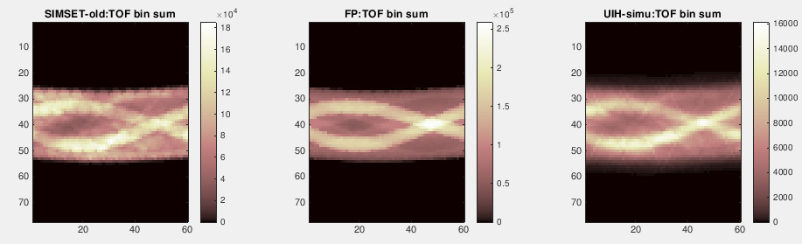
SIMSET generated 5D TOF –sinogram: TOF-bins are mixed up
Based on scatter phantom
-7
-3
0
+3
+7
Forward Projection
UIH-simu
Rebin to 273 ps TOF bin

Slide 3
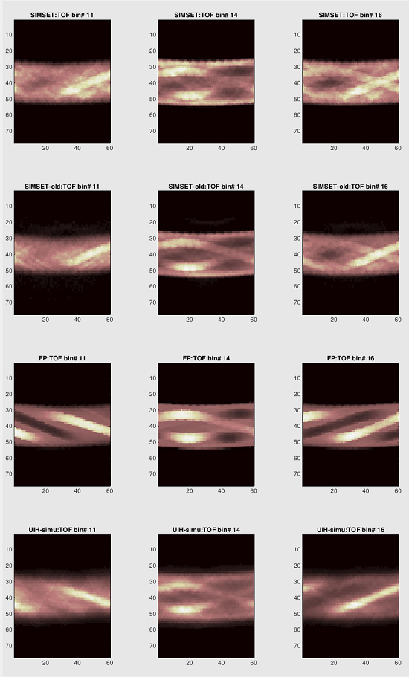
TOF-bins are mixed up

Slide 4
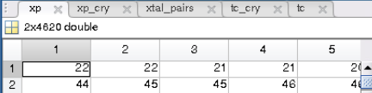
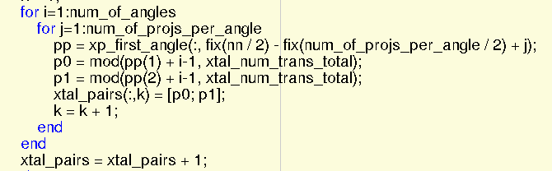
Reason: LUT does not include TOF infomation
getDefaultSinogramCrystalPairs: 2D (77*60)

Slide 5
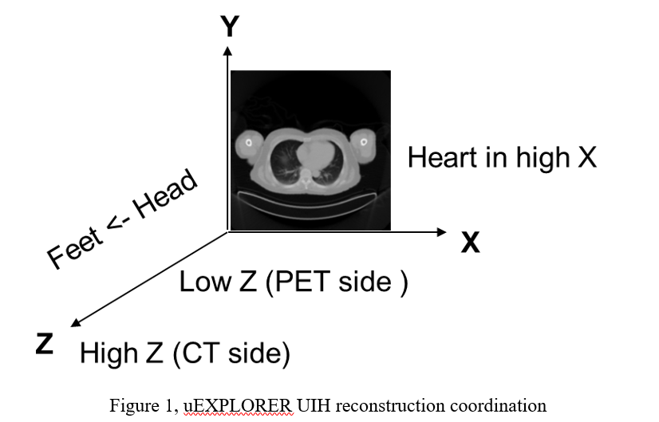
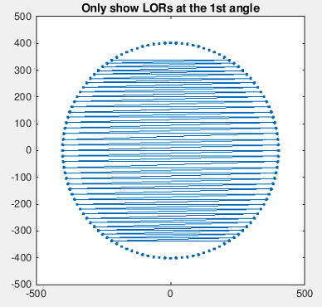
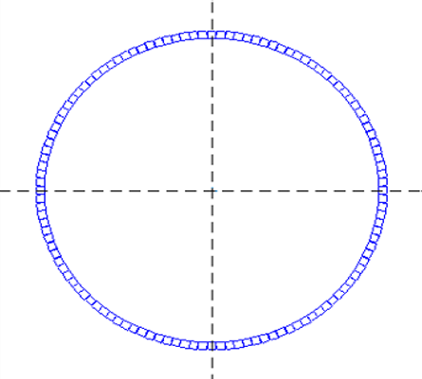
LOR Direction (4 Cases: 1st and 2nd )
Always from A to B
For a typical LM event:
A
B
820 | Z1 | 400 | Z2 | T
450 | Z1 | 220 | Z2 | T
100 | Z1 | 740 | Z2 | T
A’
B’
820 | Z1 | 400 | Z2 | T
220 | Z2 | 450 | Z1 | -T
100 | Z1 | 740 | Z2 | T
y
y
y
x_B
x_A
x_B
y_A
Z
x
x
x_A
y_B
x_A
x_B
x_A>x_B: A→B
x_A<x_B: swap A and B
x_A=x_B and y_A>y_B: A→B
A→B

Slide 6
LOR Direction (4 Cases: 3rd and 4th )
Always from A to B
For a typical LM event:
A
B
100 | Z1 | 740 | Z2 | T
740 | Z1 | 100 | Z2 | T
A’
B’
100 | Z1 | 740 | Z2 | T
100 | Z2 | 740 | Z1 | -T
y
y_A
y_B
x
y_B
y_A
x_A=x_B and y_A>y_B: A→B
x_A=x_B and y_A<y_B: swap A and B

Slide 7
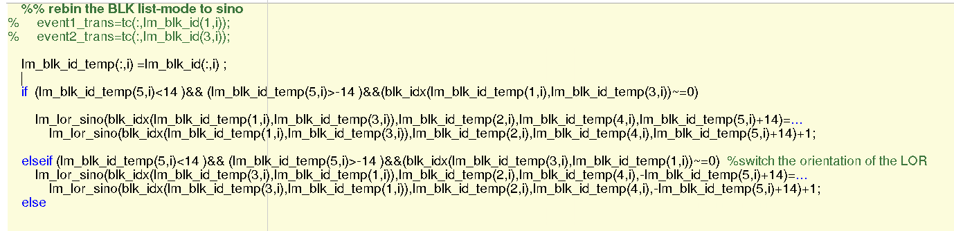
Solution 1 (Swap BLK-LOR when Listmode do not match with LUT )
Recommend
Using default xp (ID), and Swap BLK-LOR when Listmode do not match with LUT
For C or Matlab code see: https://github.com/xiezhaoheng/lm2blocksino5d.git
Or https://github.com/ucdavis-mipet/simset/tree/develop/data_processing
Convert_simset_listmode_2_5dsino_v2.m or lm2blocksino_5d

Slide 8
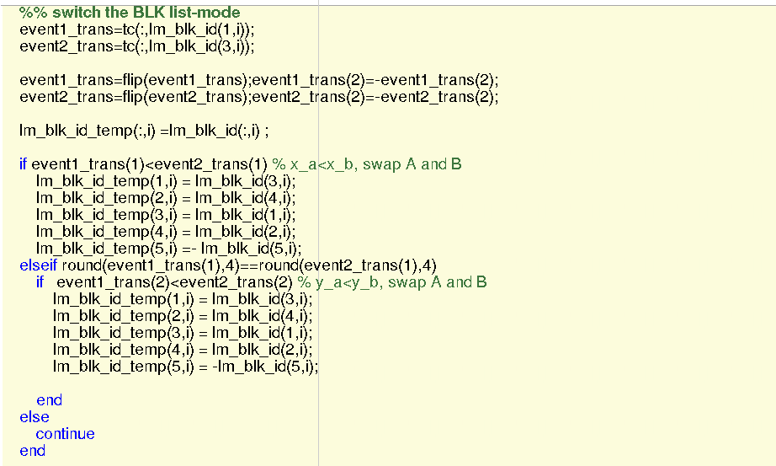
Solution 2 (rearrange the LOR direction and align with xp)
Using self-defined xp (ID):
Switch direction if not meet the coordinate condition (consistent with UIH’s definition)
Rebin data
For C or Matlab code see: https://github.com/xiezhaoheng/lm2blocksino5d.git
Convert_simset_listmode_2_5dsino_blk_direction_swap_v2.m

Slide 9
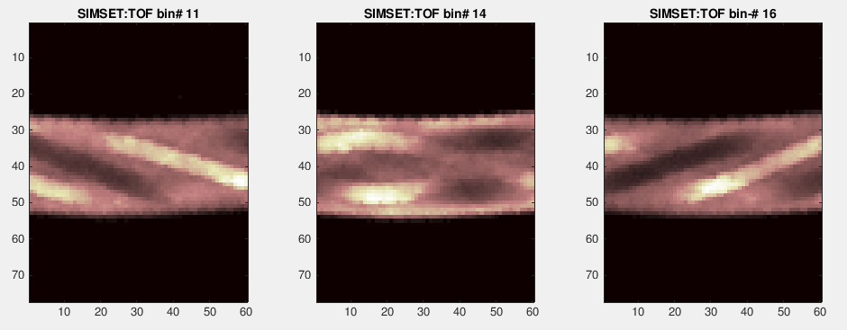
Bug fixed

Slide 10
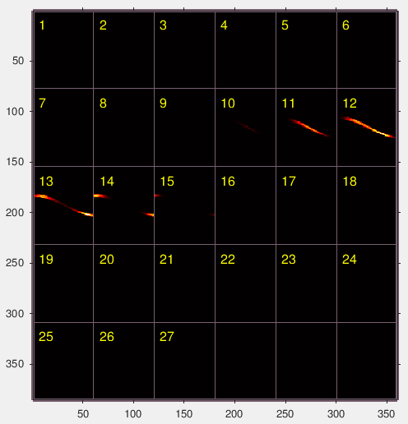
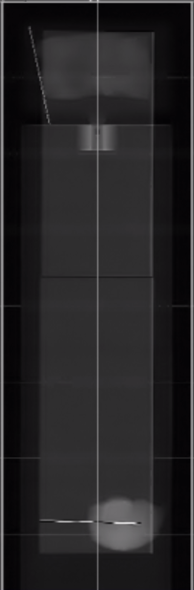
Sanity check: 2-line source (TOP one-49th direct plane)
PET
ring 1
…
π~2π
PET
ring 4
0~π
…
PET
ring 8
TOF bins
CT
Top view

Slide 11
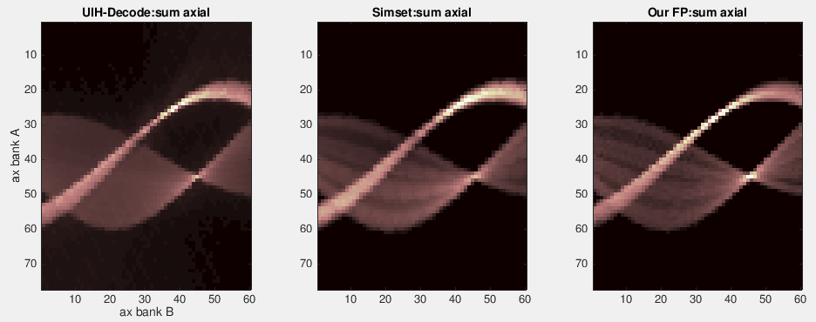
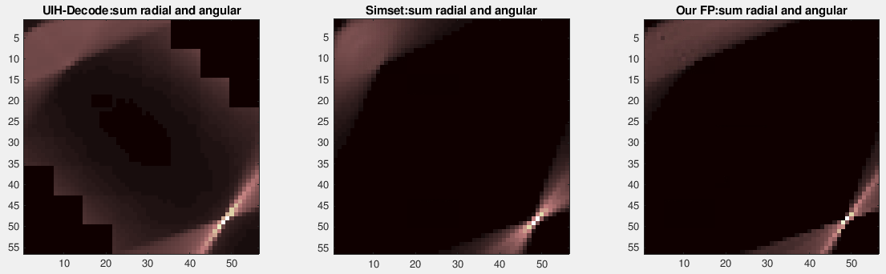
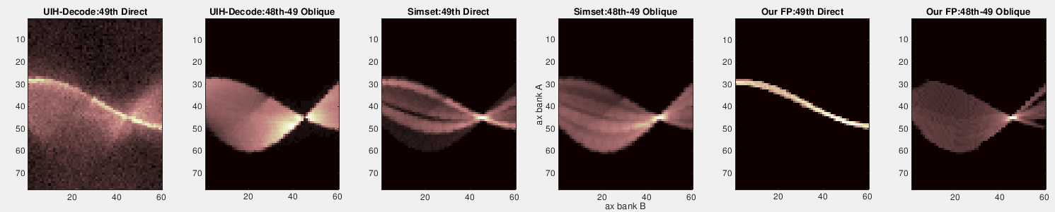
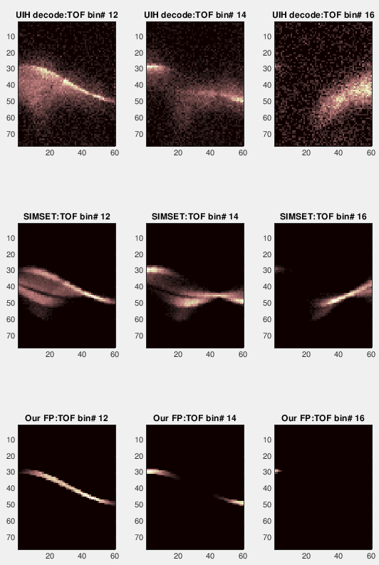
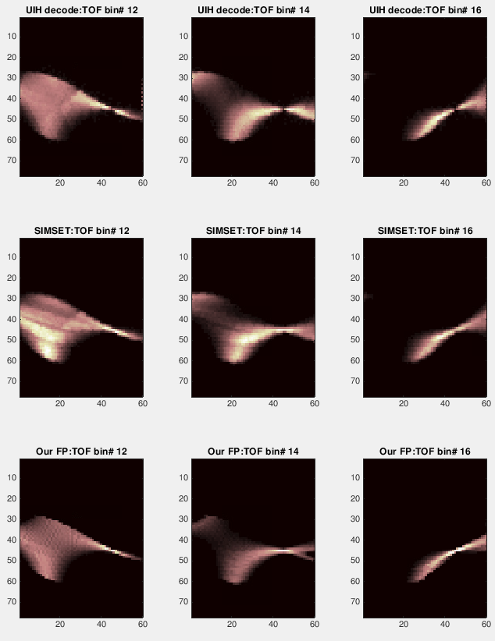
Sanity check
PET
ring 1
…
PET
ring 4
…
PET
ring 8
CT
Top view
Oblique 48-49

Slide 12
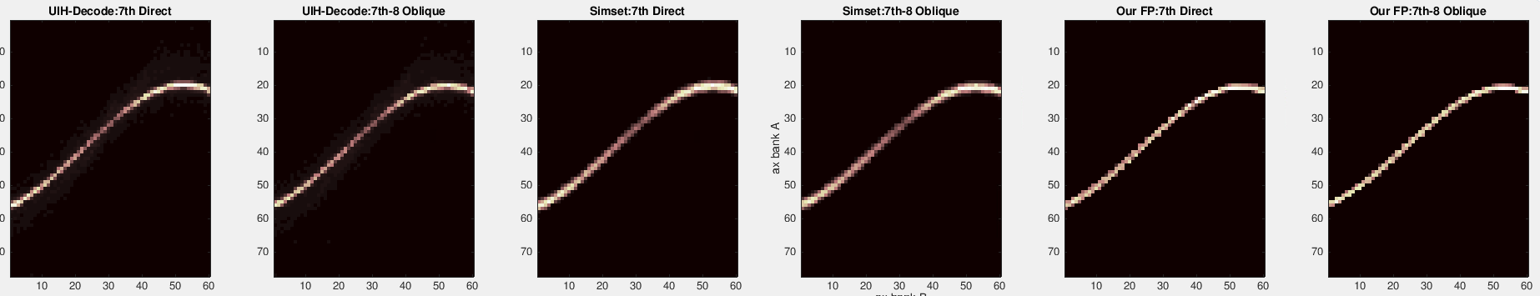
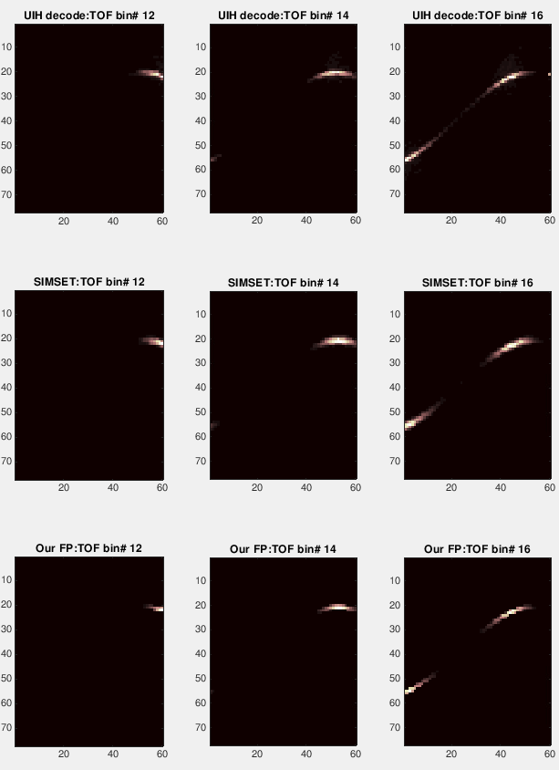
Sanity check
PET
ring 1
…
PET
ring 4
…
PET
ring 8
CT
Top view

