Slide 1

Literature Review and Identify Problems

Slide 2
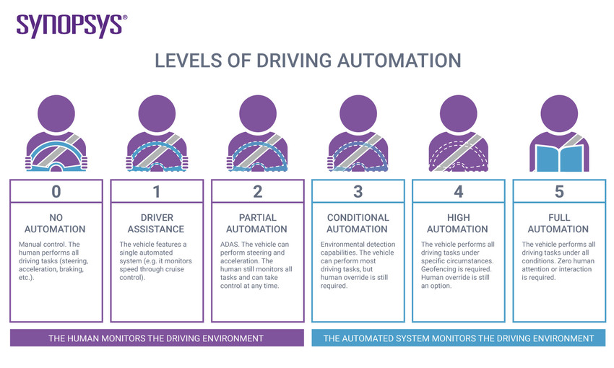
Status of autonomous driving development
Although many car manufacturers have promoted that they have built L4 and even L5 level autonomous vehicles, these vehicles can only drive on fixed routes or specific cities
In view of achieving full autonomous driving, much investment is required to update infrastructure and train models
At the same time, many surveys and studies have shown that the accident rate per million kilometers of self-driving cars is higher than that of human-driven cars
This Photo by Unknown author is licensed under CC BY-SA-NC.

Slide 3
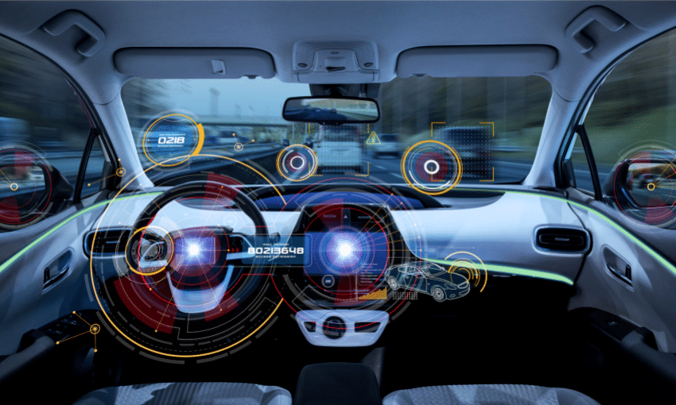
Information overload problem
When humans are driving vehicles, the problem of information overload is particularly prominent in the development of intelligent transportation systems
Currently, vehicle-mounted intelligent systems are becoming more intelligent and convenient, which means that drivers can obtain various information by interacting with the vehicle-mounted system
For example, they can request the vehicle-mounted system to play specific music through voice control, and provide designated contacts to make phone calls, receive emails, and more
This Photo by Unknown author is licensed under CC BY-SA.

Slide 4
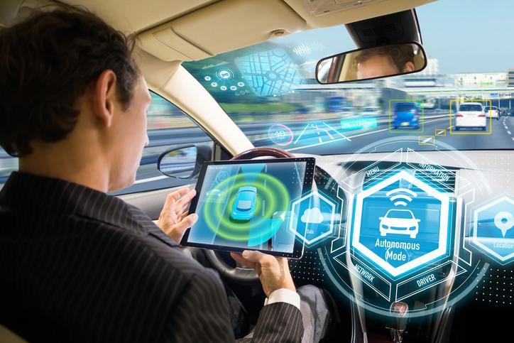
Driver distraction problem
However, if the in-vehicle system cannot accurately distinguish the current background, it may automatically activate some unrelated functions at inappropriate times, such as broadcasting incoming emails on the highway, news unrelated to road conditions, etc., which means that the driver may temporarily accept a large amount of irrelevant information in a brief period
Although the in-car system aims to provide a more efficient, convenient, and intelligent road experience, at the same time, drivers often face the challenge of information overload when interacting with these systems
This Photo by Unknown author is licensed under CC BY-SA-NC.

Slide 5
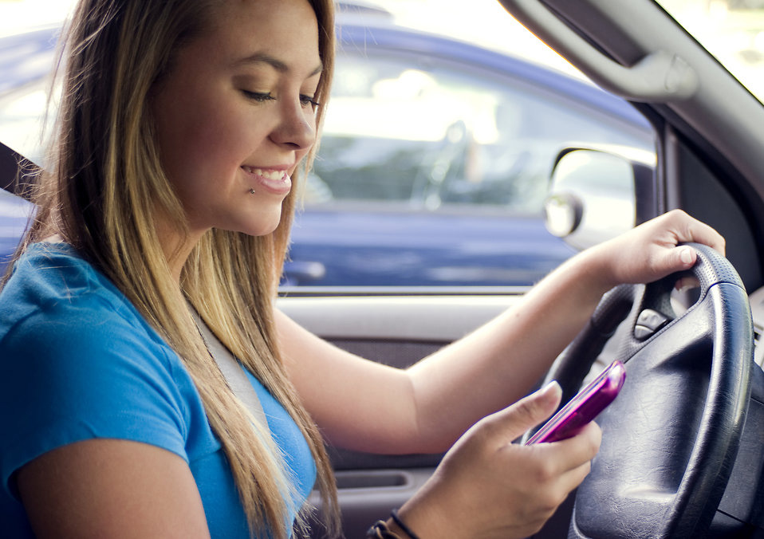
Driver distraction problem
Researchers have observed that “Connected systems must be specifically optimized for the in-car experience and thoughtfully integrate eyes-free and hands-free voice and content capabilities from the perspective of the driver
This Photo by Unknown author is licensed under CC BY-NC-ND.

Slide 6
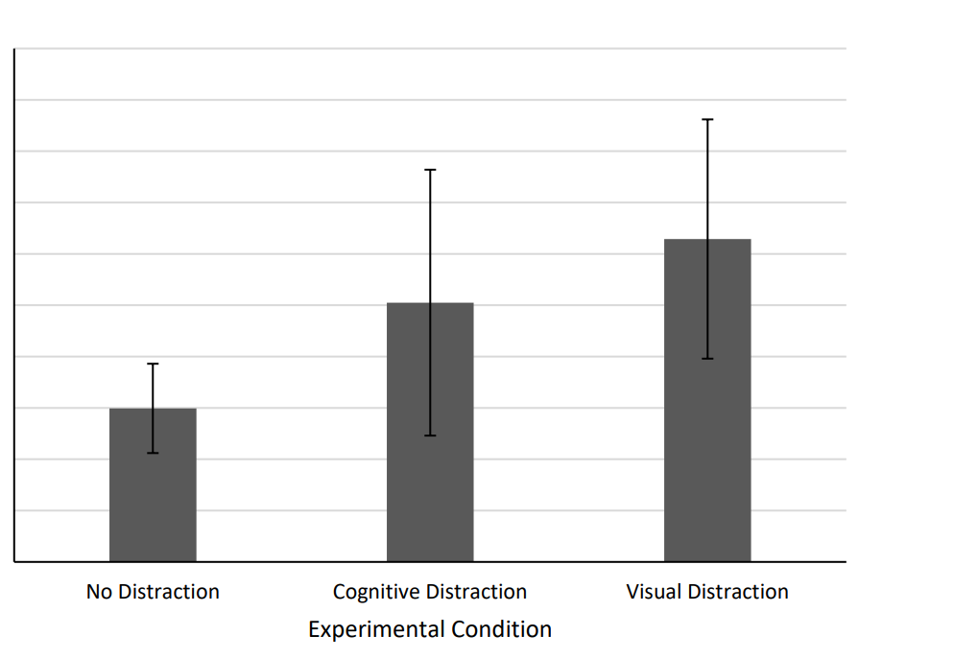
Some research
Drivers must shift their attention to processing multiple information sources, such as checking GPS navigation, answering calls, adjusting music, etc
This distraction can lead to inattention, increasing the risk of road accidents

