Slide 1

Expected results

Slide 2

I will design the following plans to evaluate this implication

Slide 3
User Satisfaction Survey
I will conduct a user satisfaction survey to understand what drivers think of the context-aware information filtering system
01
I will also consider the potential impact on different driver demographics and statistically categorize responses from drivers of different age groups
02
The survey will collect feedback from users, including how they feel about the effectiveness of information filtering, ease of use of the interface and satisfaction with personalization settings
03

Slide 4
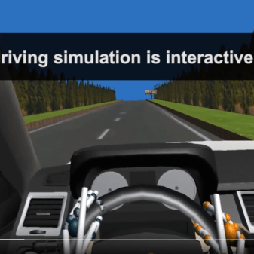
Driving simulation experiment
I will conduct a driving simulation experiment, inviting diverse groups of participants to use a context-aware information filtering system in a simulated environment
I will consider the age of different test subjects and try to expand the age range of the test subjects instead of conducting tests on a small number of characteristic groups
By comparing driving simulation data before and after implementing design recommendations, I can evaluate the impact of system improvements on driving behavior
This Photo by Unknown author is licensed under CC BY-SA-NC.

Slide 5

Road safety data analysis
I will analyze data related to road safety, including accident rates, traffic violations and road congestion
By comparing it with data from before the design recommendations were implemented, I can evaluate whether the system helps reduce road accidents and improve road smoothness

Slide 6
System performance analysis
I will evaluate the performance of the context-aware information filtering system
This will include the system's accuracy, response time, resource utilization efficiency, and the system's adaptive learning capabilities
By regularly monitoring system performance, I can ensure that it remains at a prominent level

Slide 7
Data privacy and security
Real-time situational analysis may involve a large amount of personal data, including the driver’s location, health status, etc
Ensuring adequate privacy protection and security measures for this sensitive information is critical
Compliance-related regulations and standards should be followed to prevent potential privacy issues

Slide 8

User acceptance
Drivers' acceptance of new intelligent systems is a key factor
Some drivers may feel uncomfortable or distrustful of the system's intervention, especially during emergencies while driving
Prior to implementation, user research and training are required to ensure they can adapt and accept the new system

Slide 9
Cost and feasibility
Implementing highly intelligent systems may incur additional costs, including hardware, software development, training, and maintenance
As well as corresponding smart lanes, the construction and maintenance of the global Internet of things
Vehicles equipped with such systems are bound to be expensive and may not be available to the public soon

Slide 10

Here are my expected results

Slide 11

Improved user satisfaction
Implementing context-aware information filtering is expected to significantly improve driver user satisfaction across all groups
Users will process information more easily and feel less anxious and distracted, thereby improving their interactive experience

Slide 12

Reduce driving distraction
Through intelligent information sorting and personalization, it is expected to significantly reduce driving distraction
Drivers will be more focused on the road and traffic, reducing the risk of distraction
This Photo by Unknown author is licensed under CC BY-ND.

Slide 13

Improved road safety
Improved road safety is expected to be achieved by improving driver concentration and decision-making efficiency
This will be reflected in reduced accident rates and lower traffic violations

Slide 14
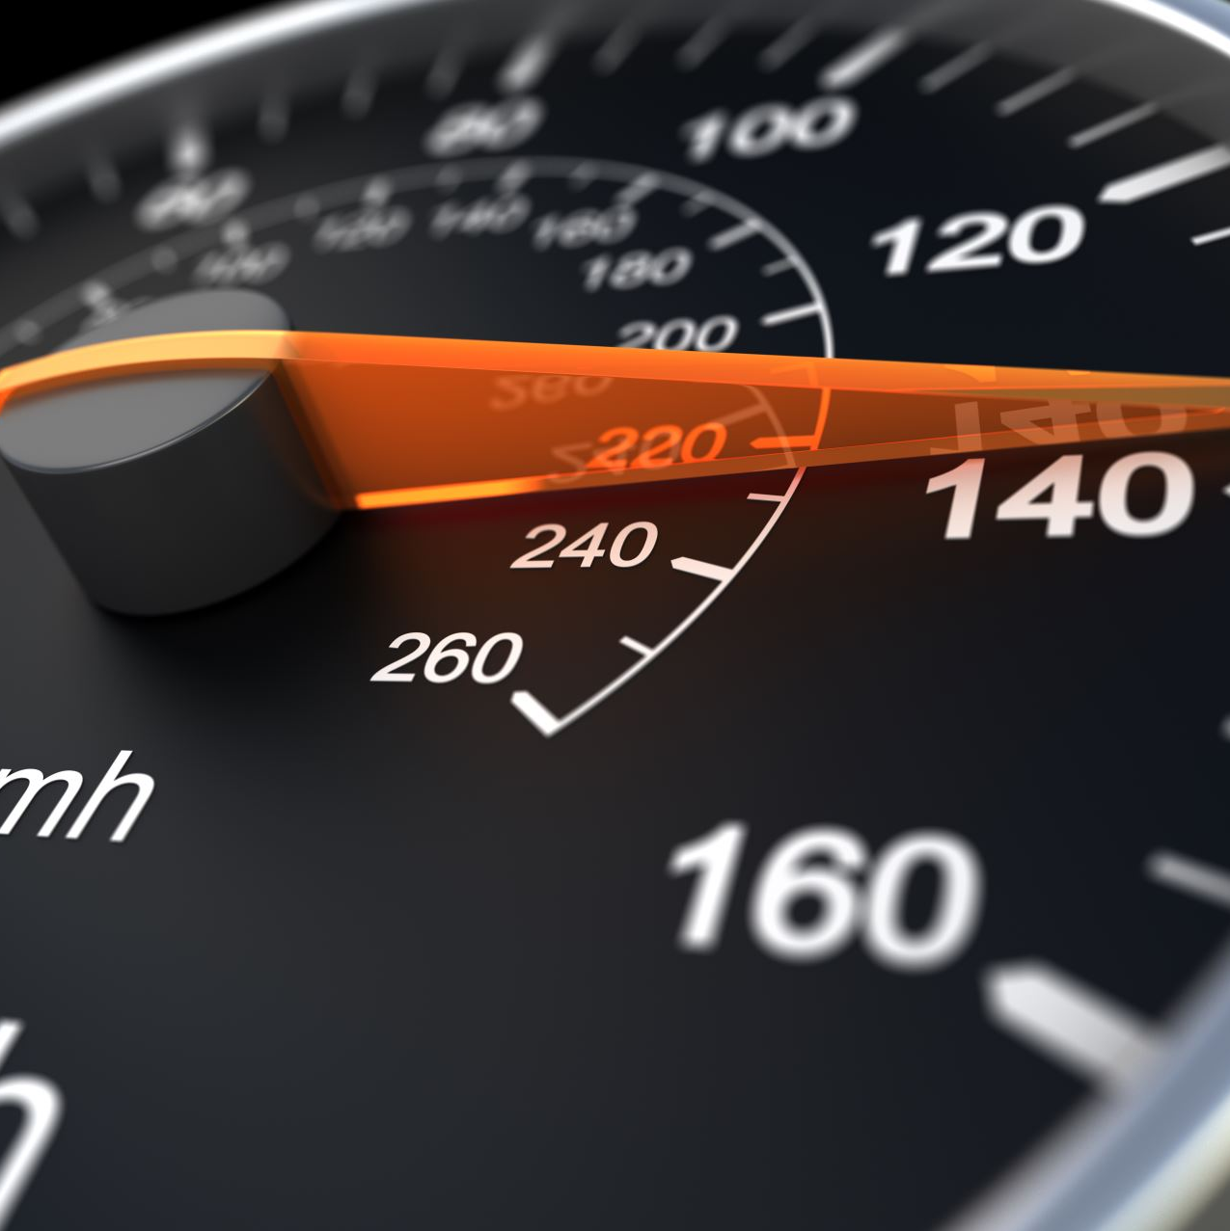
Intelligent system performance improvement
The performance of context-aware information filtering systems will be significantly improved
The system will adapt to different driving situations more quickly and provide more accurate information filtering and recommendations

