Slide 1
Minimal Path in A complete graph with random weights
Shanglin zou & Junfan huang

Slide 2
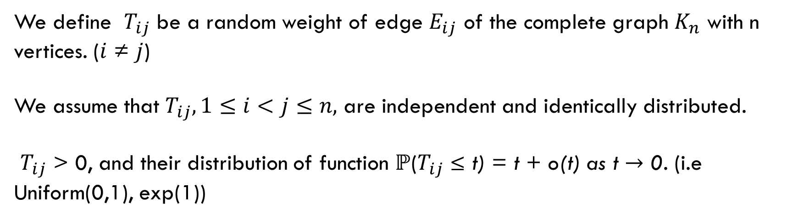
Distribution
We define $T_{ij}$ be a random weight of edge $E_{ij}$ of the complete graph $K_{n}$ with n vertices. ($ⅈ$ ≠ $j$)
We assume that $T_{ij}, 1≤ⅈ<j≤n,$ are independent and identically distributed.
$T_{ij}$ > 0, and their distribution of function $ℙ$($T_{ij}$ ≤ t) = t + o(t) as t $→$ 0. (i.e Uniform(0,1), exp(1))
L$et X_{ij}$ be the minimal total weight of a path between $ⅈ$ and $j$.
Our purpose is to find $X_{ij}$ under three cases.

Slide 3
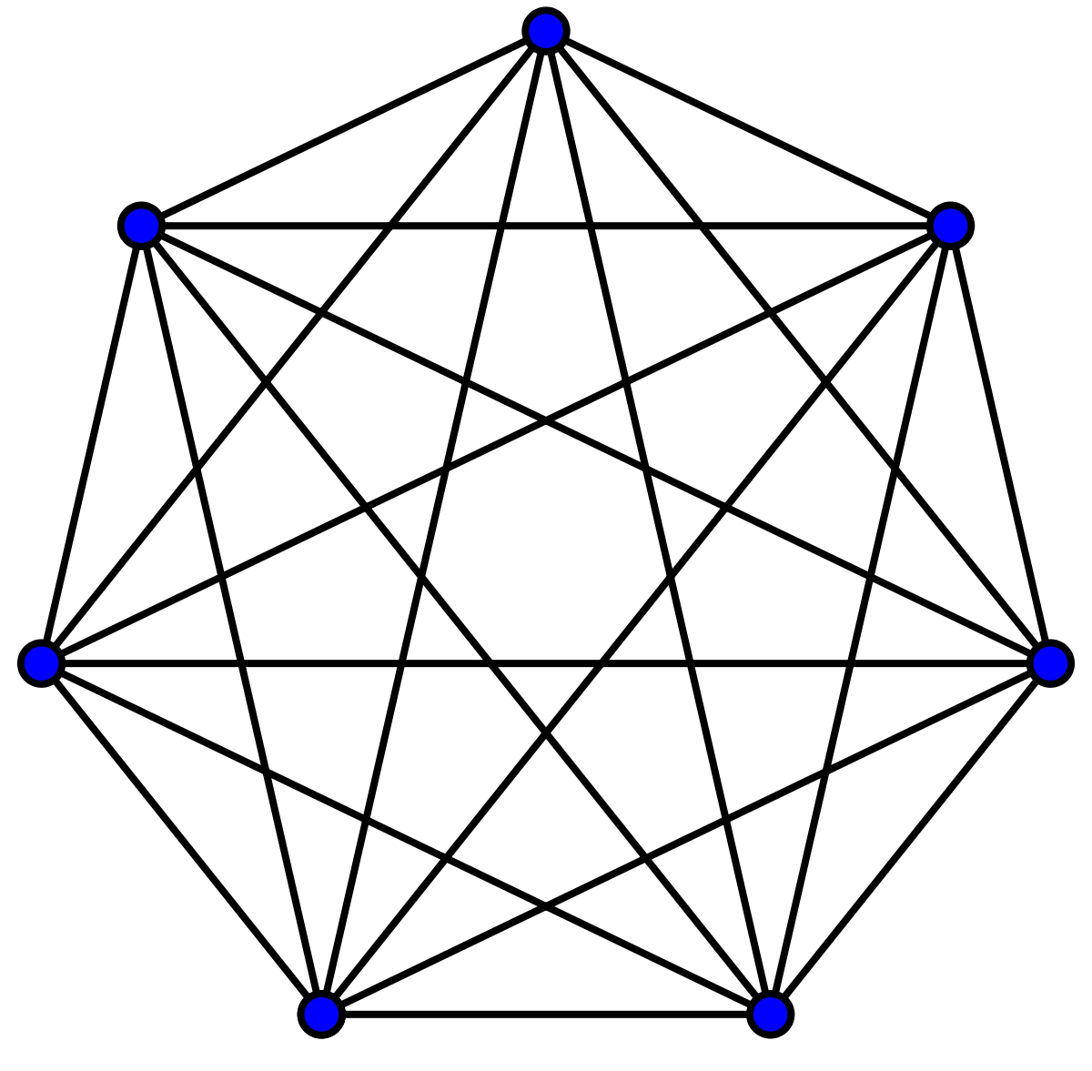

I am i
u
$$T_{ij}$$
j

Slide 4
Distribution
We define $T_{ij}$ be a random weight of edge $E_{ij}$ of the complete graph $K_{n}$ with n vertices. ($ⅈ$ ≠ $j$)
We assume that $T_{ij}, 1≤ⅈ<j≤n,$ are independent and identically distributed.
$T_{ij}$ > 0, and their distribution of function $ℙ$($T_{ij}$ ≤ t) = t + o(t) as t $→$ 0. (i.e Uniform(0,1), exp(1))
L$et X_{ij}$ be the minimal total weight of a path between $ⅈ$ and $j$.
Our purpose is to find $X_{ij}$ under three cases.

Slide 5
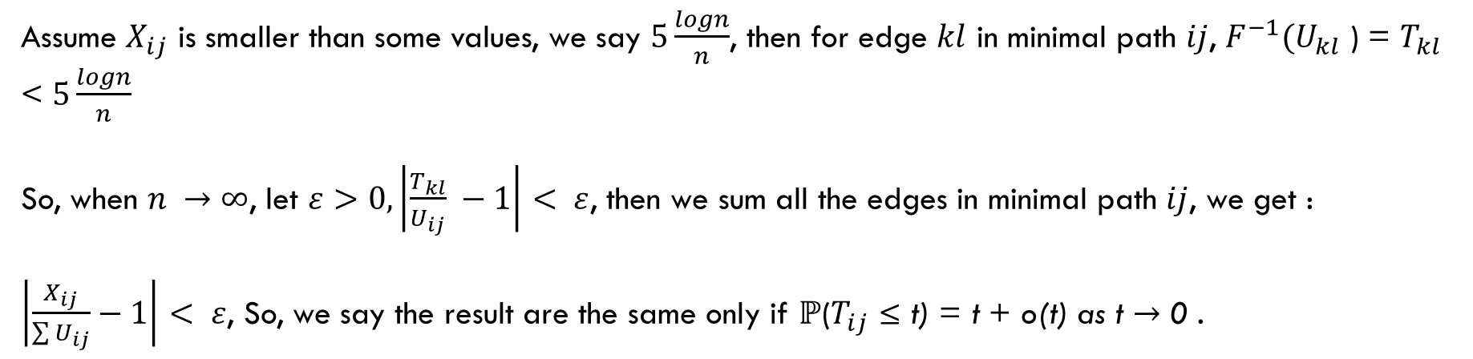
DISTRIBUTION
We first need to make sure that the distribution of $T_{ij}$ does not effect the result.
Let $F\left(t\right)=$ $ℙ$($T_{ij}$ ≤ t) = t + o(t) as t $→$ 0 $⇒$ $\frac{F(t)}{t}$ $→1 as t →0$
Let $F^{−1}(U_{ij}$ ) = $T_{ij}$ be the inverse function of $F\left(t\right),$ Where $U_{ij}$ $\sim$ Uniform(0,1)
$\frac{F^{−1}(U_{ij})}{U_{ij}}$ $→1 as U_{ij}→0$
Assume $X_{ij}$ is smaller than some values, we say $5\frac{logn}{n}$, then for edge $kl$ in minimal path $ij$, $F^{−1}(U_{kl}$ ) = $T_{kl}$ < $5\frac{logn}{n}$
So, when $n →∞$, let $ε>0, \left|\frac{T_{kl}}{U_{ij}} −1\right|< ε$, then we sum all the edges in minimal path $ij$, we get :
$\left|\frac{X_{ij}}{\sum{U_{ij}}}−1\right|< ε$, So, we say the result are the same only if $ℙ$($T_{ij}$ ≤ t) = t + o(t) as t $→$ 0 .

Slide 6
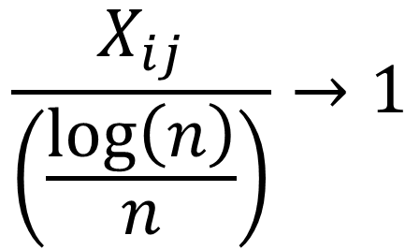
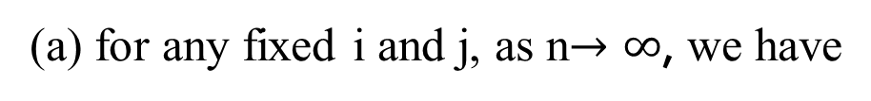
Theorem 1.1
(a) for any fixed i and j, as n$→∞$, we have
$$\frac{X_{ij}}{\left(\frac{\log\left(n\right)}{n}\right)}→1$$
p

Slide 7
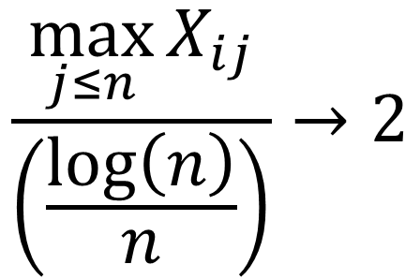
Theorem 1.1
(b) similarly, for any fixed i, we have
$$\frac{\max_{j≤n}{X_{ij}}}{\left(\frac{\log\left(n\right)}{n}\right)}→2$$
p

Slide 8
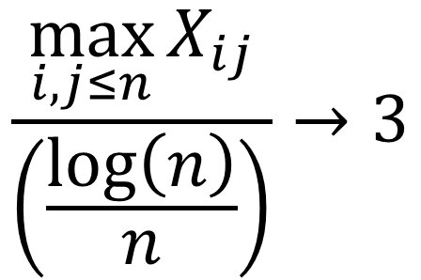
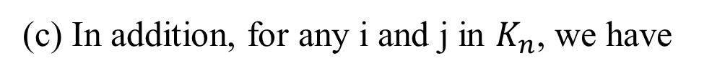
Theorem 1.1
(c) In addition, for any i and j in $K_{n}$, we have
$$\frac{\max_{i,j≤n}{X_{ij}}}{\left(\frac{\log\left(n\right)}{n}\right)}→3$$
p

Slide 9
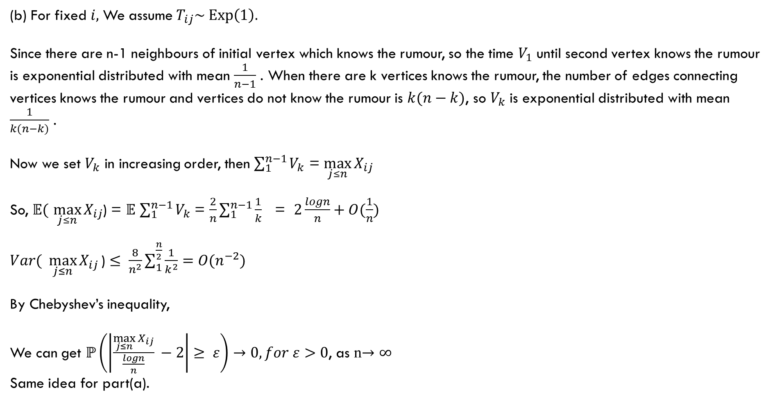

$Proof:$
(b) For fixed$i,$ We assume $T_{ij}\sim Exp\left(1\right).$
Since there are n-1 neighbours of initial vertex which knows the rumour, so the time $V_{1}$ until second vertex knows the rumour is exponential distributed with mean $\frac{1}{n−1}$ . When there are k vertices knows the rumour, the number of edges connecting vertices knows the rumour and vertices do not know the rumour is $k(n−k)$, so $V_{k}$ is exponential distributed with mean $\frac{1}{k(n−k)}$ .
Now we set $V_{k}$ in increasing order, then $\sum_{1}^{n−1}{V_{k}}$ = $\max_{j≤n}{X_{ij}}$
So, $𝔼($ $\max_{j≤n}{X_{ij}}$) = $𝔼$ $\sum_{1}^{n−1}{V_{k}}$ = $\frac{2}{n}\sum_{1}^{n−1}{\frac{1}{k}}$ = $2\frac{logn}{n}+O(\frac{1}{n})$
$Var( \max_{j≤n}{X_{ij}}\text{)}$ $≤ \frac{8}{n^{2}}\sum_{1}^{\frac{n}{2}}{\frac{1}{k^{2}}}=O(n^{−2})$
By Chebyshev’s inequality,
We can get $ℙ\left(\left|\frac{\max_{j≤n}{X_{ij}}}{\frac{logn}{n}} −2\right|≥ ε\right)→0, for ε>0$, as n$→∞$
Same idea for part(a).

Slide 10



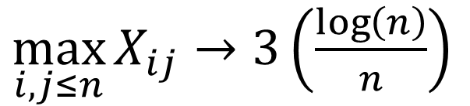
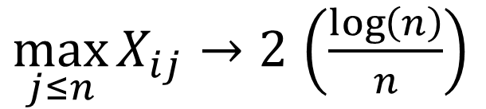

$$\frac{X_{ij}}{\left(\frac{\log\left(n\right)}{n}\right)}→1$$
p
$$X_{ij}→\left(\frac{\log\left(n\right)}{n}\right)$$
$$\frac{\max_{j≤n}{X_{ij}}}{\left(\frac{\log\left(n\right)}{n}\right)}→2$$
p
$\max_{j≤n}{X_{ij}}→2$ $\left(\frac{\log\left(n\right)}{n}\right)$
$$\frac{\max_{i,j≤n}{X_{ij}}}{\left(\frac{\log\left(n\right)}{n}\right)}→3$$
p
$\max_{i,j≤n}{X_{ij}}$ $→3\left(\frac{\log\left(n\right)}{n}\right)$

Slide 11
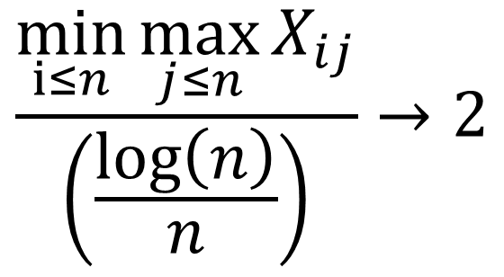
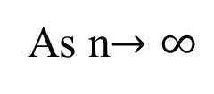
Theorem 1.2
As n$→∞$
$$\frac{\min_{i≤n}{\max_{j≤n}{X_{ij}}}}{\left(\frac{\log\left(n\right)}{n}\right)}→2$$
p

Slide 12
Theorem 1.2
As n$→∞$
$$\frac{\min_{i≤n}{\max_{j≤n}{X_{ij}}}}{\left(\frac{\log\left(n\right)}{n}\right)}→2$$
p

Slide 13
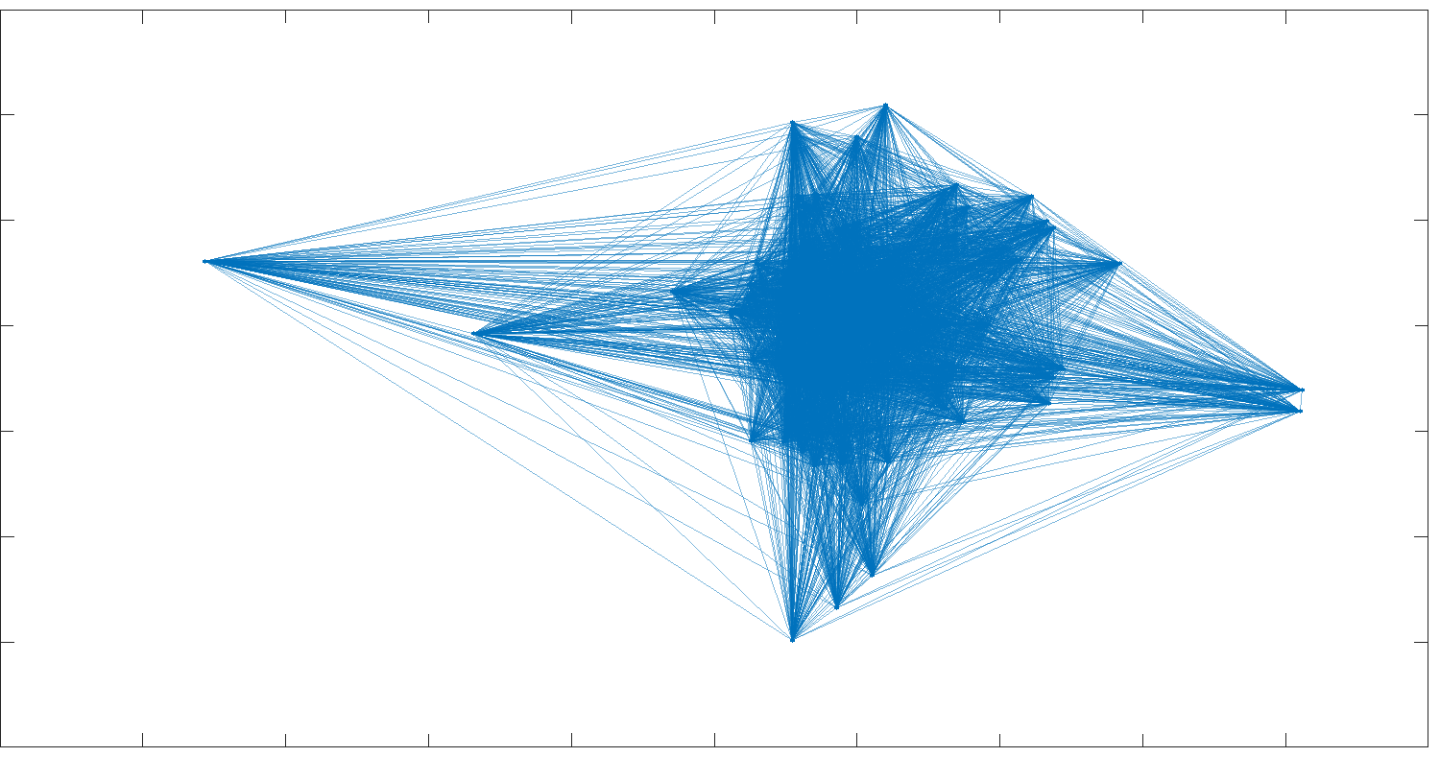
London
Sandwood Bay Beach

Slide 14
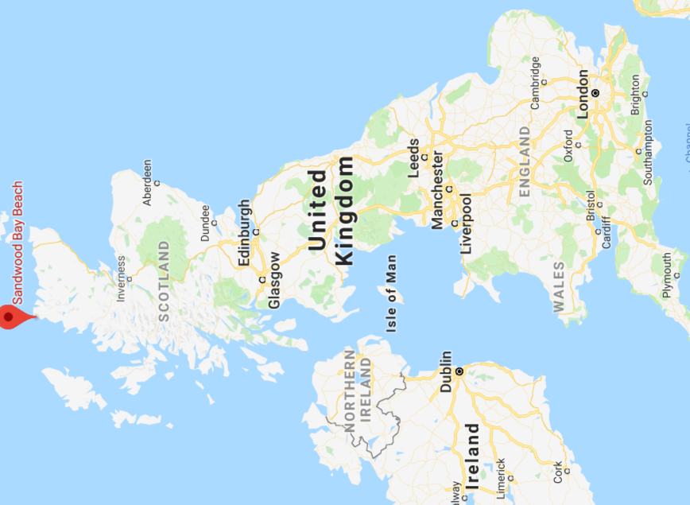

Slide 15
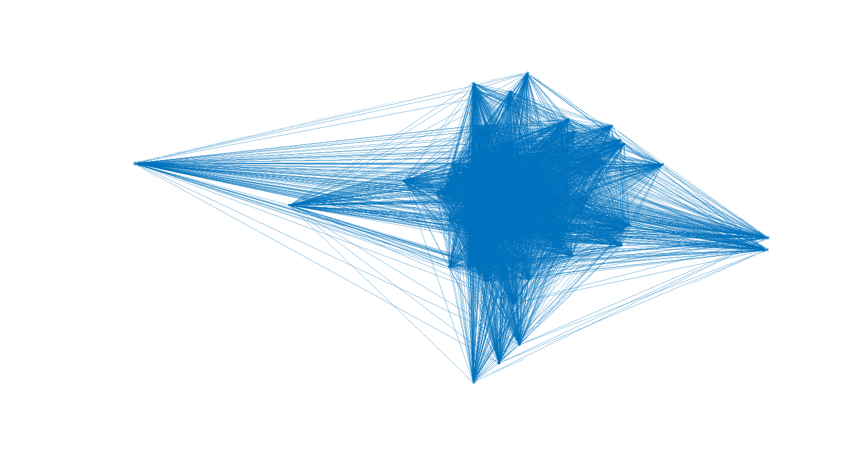
London
Sandwood Bay Beach

Slide 16

$$\frac{\max_{i,j≤n}{X_{ij}}}{\left(\frac{\log\left(n\right)}{n}\right)}→3$$
p

Slide 17
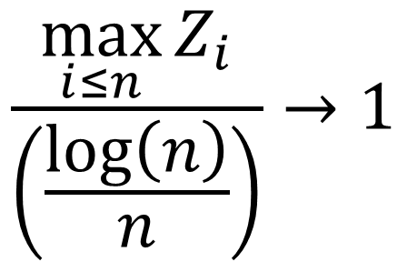
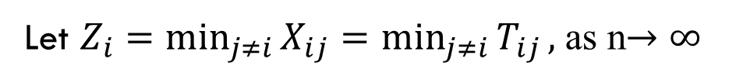
Theorem 1.3
Let $Z_{i}=\min_{j≠i}{X_{ij}}{=\min_{j≠i}{T_{ij}}},$ as n$→∞$
$$\frac{\max_{i≤n}{Z_{i}}}{\left(\frac{\log\left(n\right)}{n}\right)}→1$$
p

Slide 18
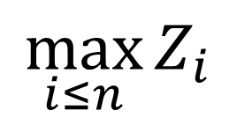
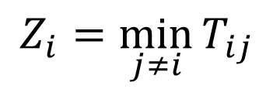
I am i
u
$$\max_{i≤n}{Z_{i}}$$
$$T_{ij}$$
j
$$Z_{i}=\min_{j≠i}{T_{ij}}$$

Slide 19
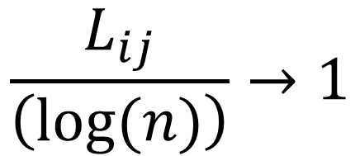
Theorem 4.1
Suppose $T_{ij}$ has a density function $f\left(t\right)=1+O\left(t\right)$for t>0, then as n $→$ $∞$
(a) For any fixed i and j
$$\frac{L_{ij}}{\left(log⁡(n)\right)}→1$$
p

Slide 20
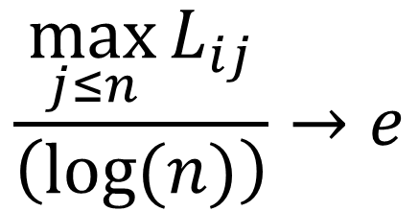
Theorem 4.1
(b) For any fixed i
$$\frac{\max_{j≤n}{L_{ij}}}{\left(log⁡(n)\right)}→e$$
p

Slide 22
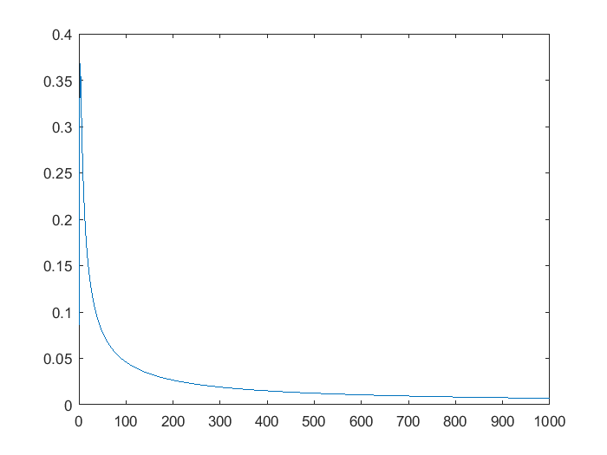
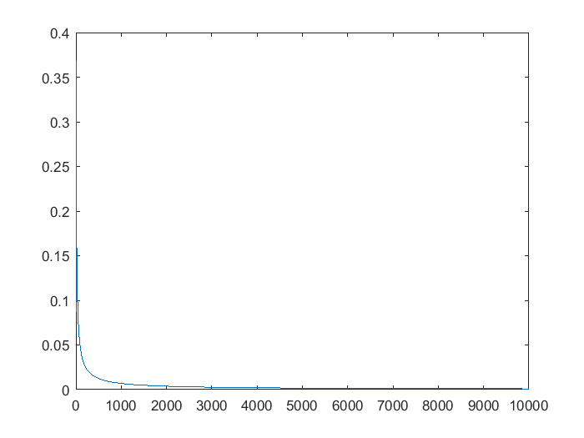
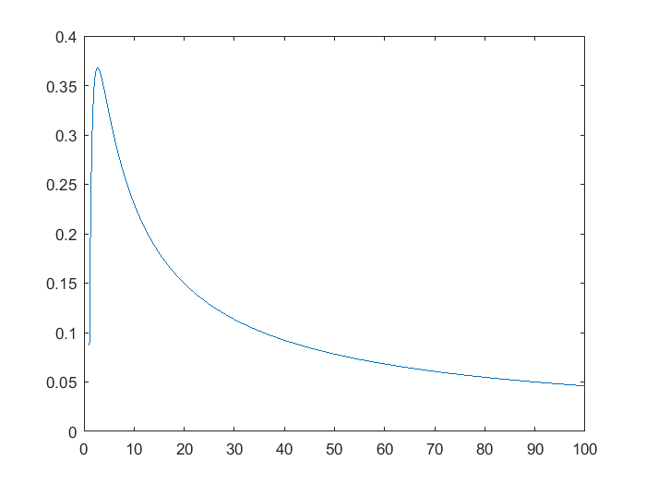
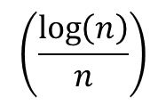
$$\left(\frac{\log\left(n\right)}{n}\right)$$

Slide 23
Thank you

