Slide 1

Bright Search
CS410 Project Presentation

Slide 2

Overview
A Chrome extension that enhances the in-page search experience.
Aside from the input word itself, further search for:
Auto-corrected word
Stemming
Synonyms

Slide 3
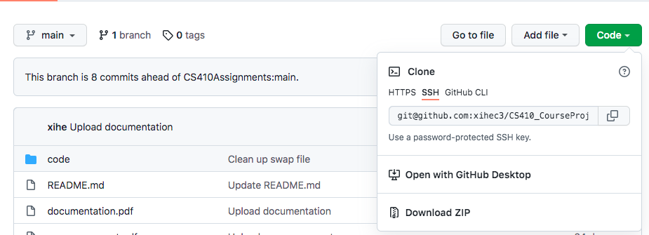
Installation
GitHub: https://github.com/xihec3/CS410_CourseProject

Slide 4
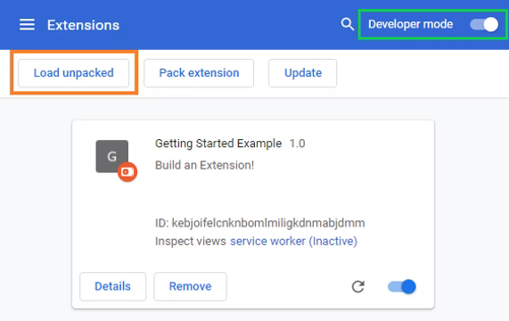
Installation (Cont.)
chrome://extensions
code/bright_search

Slide 5

Installation (Cont.)

Slide 6
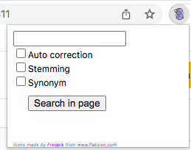
Usage
Example page to search in: https://developer.mozilla.org/en-US/docs/Web/JavaScript/Reference/Global_Objects/Array/forEach

Slide 7
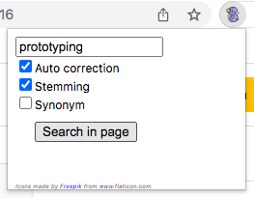
Usage (Cont.)

Slide 8
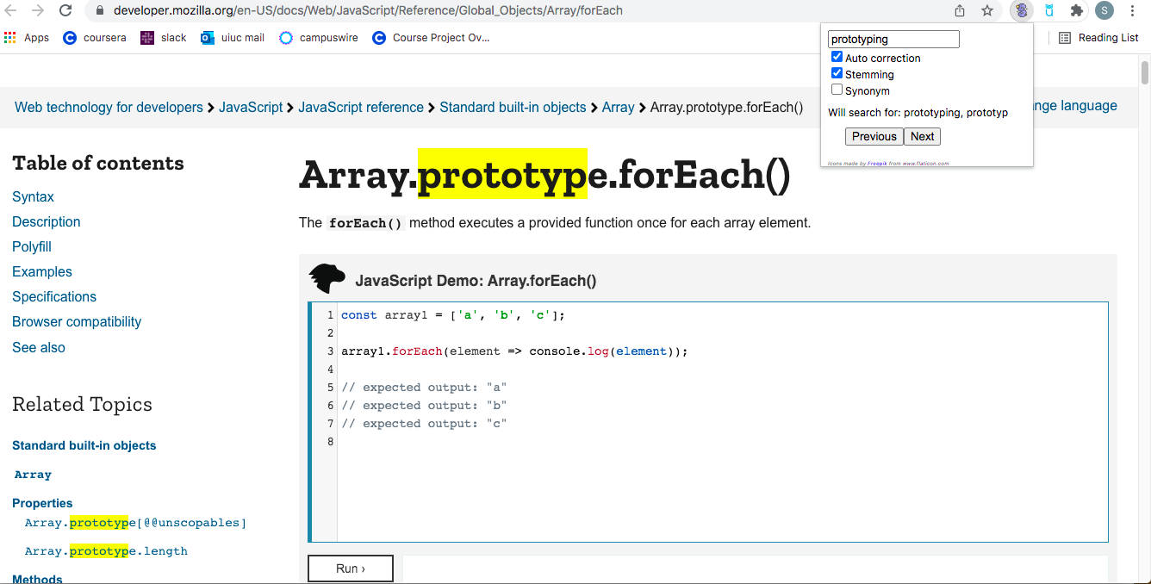
Usage (Cont.)

Slide 9
Thanks!

