Slide 1



Quality Assessment for Alinma Bank App
Section Code: 373 Assignment: Workshop1 1st Semester / Year: 2021
Supervisor:
Dr.Lamees Alhazzaa
1

Slide 2
Outlines
01
03
05
02
04
06
Introduction
Manual Analysis
MobSF security analysis
Desgin Analysis
Codacy static analysis
Coclusion
2

Slide 3
01
Introduction
3

Slide 4



Problems faced
Purpose and goals
Static tools analysis
For code style issues
For security issues
4
Figure1 : Codacy logo
Figure2: MobSF logo

Slide 5
02
Manual Analysis
5

Slide 6





Manual Analysis
Indentation
Identifier
Variable style
Comments
Documentation
CamelCase
6

Slide 7
03
Design Analysis
7

Slide 8

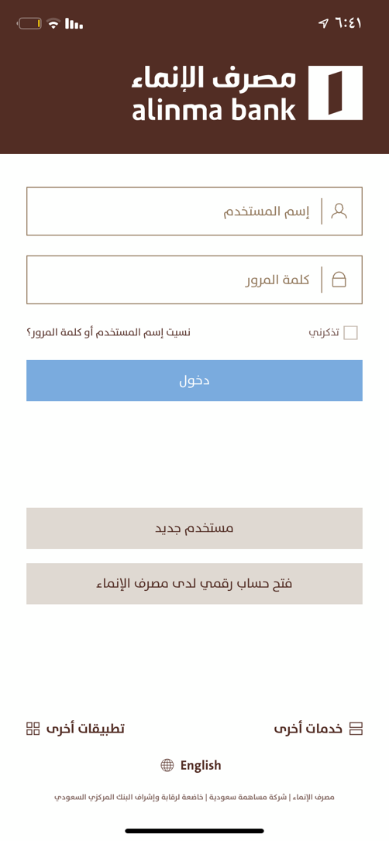
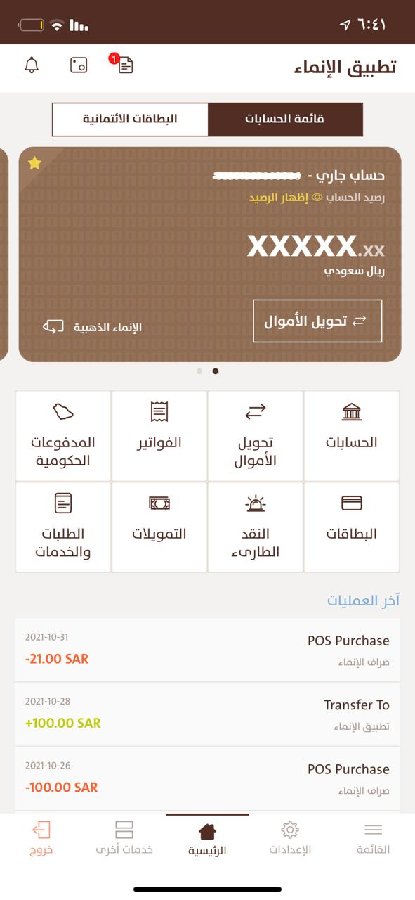
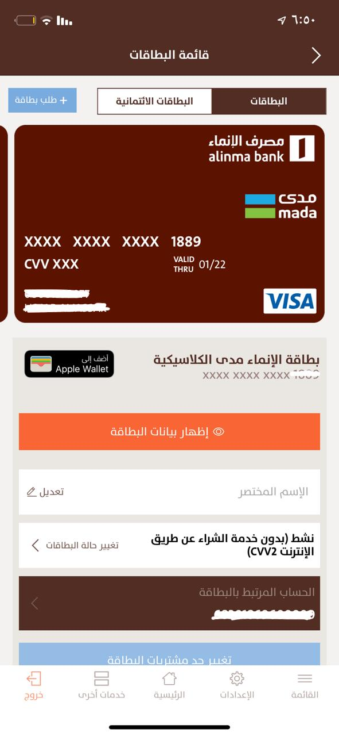
Graphical User Interface (GUI) Analysis
“match between the system and the real world”
heuristic
8
Figure1 : Alinma Bank Log-in Page
Figure 2: Alinma home page
Figure 3: Credit card information

Slide 9

Cohesion
Design Principles
1
Coupling
2
3
4
Single Responsibility Principle (SRP)
Don’t Repeat Yourself (DRY)
9

Slide 10
04
Codacy Static Analysis
10

Slide 11



Codacy
Consist of built-in tools
1
2
PMD static analysis tool
CheckStyle static analysis tool
11

Slide 12


Code style
Codacy analysis
Error prone
12

Slide 13
05
MobSF Security Analysis
13

Slide 14
Mainfest Analysis
Cleartext network traffic
Content Provider
Broadcast Receiver
14

Slide 15
Application Permissions
android.permission.WRITE_EXTERNAL_STORAGE
android.permission.ACCESS_COARSE_LOCATION
android.permission.ACCESS_FINE_LOCATION
android.permission.CAMERA
15

Slide 16
</>Code Analysis
Files may contain hardcoded sensitive information like usernames, passwords, keys etc.
Write/Read into External Storage.
Execution with Accessing Privileges (root).
Insufficient Cryptography; CBC mode and MD5
16

Slide 17
06
Conclusion
17

Slide 18

Students
Student ID | Student Email | Student Name
440019816 | rfmalsqiaan@sm.imamu.edu.sa | Rahaf Fahad Alsqiaan
441022333 | nomoalajmi@sm.imamu.edu.sa | Nouf Mohammed Alajmi
440020746 | haaaljassar@imamu.edu.sa | Hajar Abdullaziz Aljassar
18

Slide 19
The End
19

