Slide 1
Week 5: Develop a prediction model or not
What is the required sample size?

Slide 2
Task overview
Motivation of shrinkage
Simulation for understanding of related quantities
Bootstrap to calculate shrinkage factor
Shinyapp

Slide 3
Sample size calculation based on prediction model
Validity of the predictions from a statistical model:
 | Riley Richard | van Smeden
Adjustment (shrinkage) generalization of model | Shrinkage factor | Penalized maximum likelihood and variables selection
Quantification model performance | Pseudo R² | Prediction error (Brier etc.)
Simulation setting:
Multivariate Normal Distribution + Equal effects + Uncorrelated 4 predictors
(μ=0， σ² =4)

Slide 4
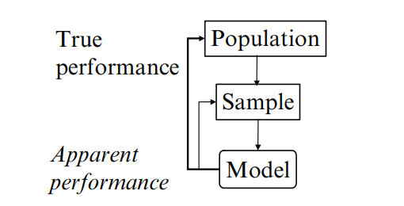
Problem of overfitting
Main threat to validity during the development of prediction model is overfitting.
Overfitting leads to optimism of the model performance (Difference between two performance above)
Goal: calculate required sample size to minimize the optimism
Causes of overfitting
Motivation of shrinkage
Methods of shrinkage
Optimism of model performance

Slide 5
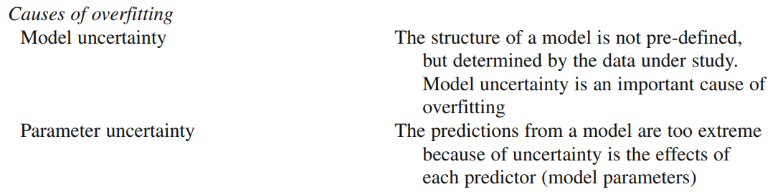
Reason for overfitting
Choose the one less likely to be overfitting
‘Shrinkage’ predictor effect

Slide 6
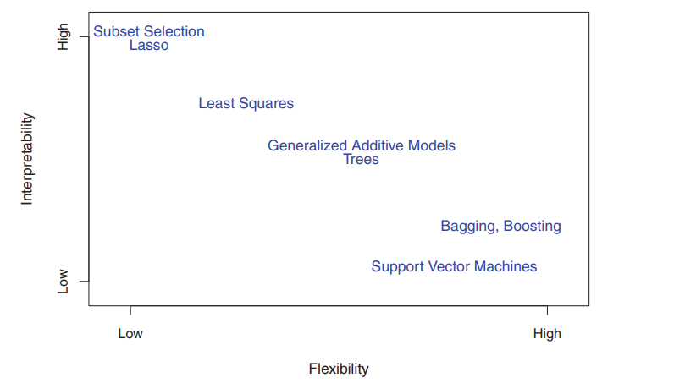
Model uncertainty
Tradeoff between flexibility and interpretability
We would not develop a flexible model for prediction

Slide 7
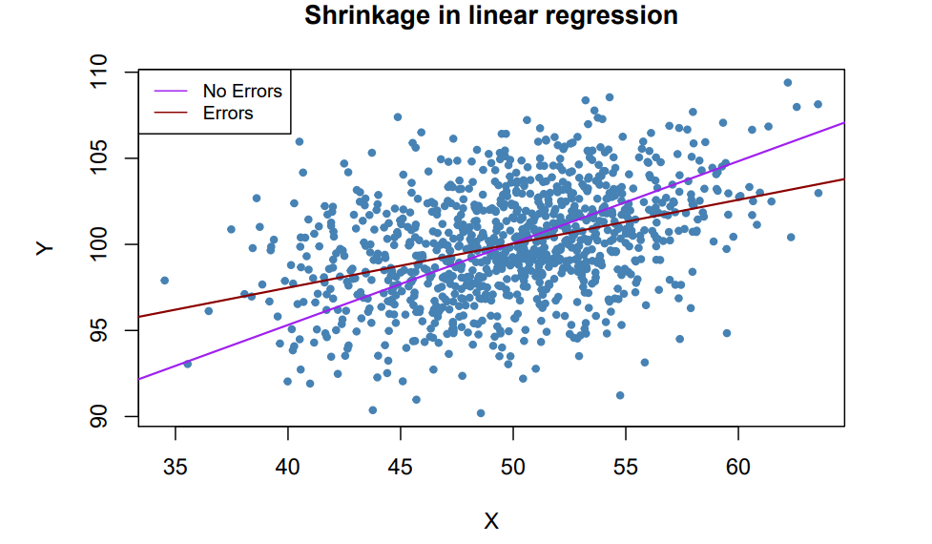
Parameter uncertainty: Shrinkage:
Our prediction would be too high or too low due to unusual features in the observed data , which failed to be taken into account (measurement error etc.)

Slide 8
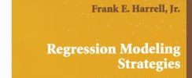

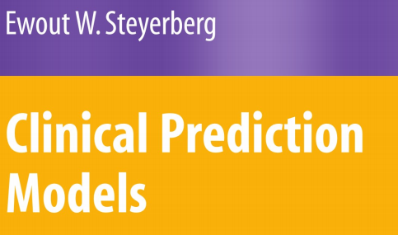
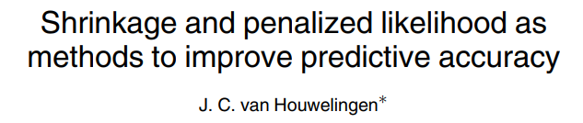
Motivation of shrinkage
The motivation of shrinkage is ‘regression to the mean’

Slide 9
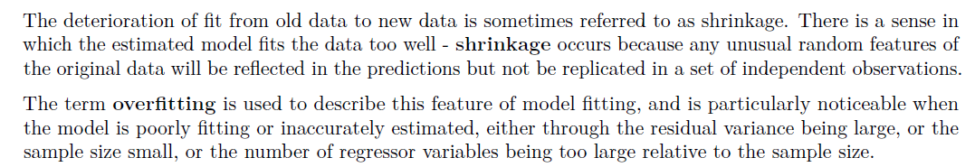
Motivation of shrinkage
The motivation of shrinkage is ‘regression to the mean’

Slide 10
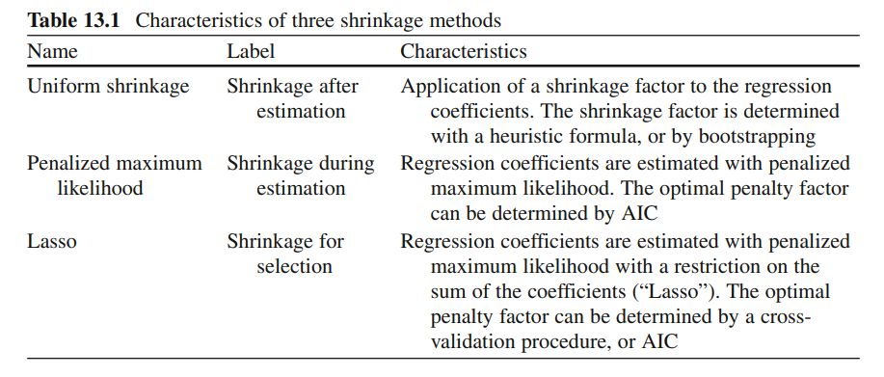
Methods of shrinkage
Riley Richard
Van Smeden

Slide 11

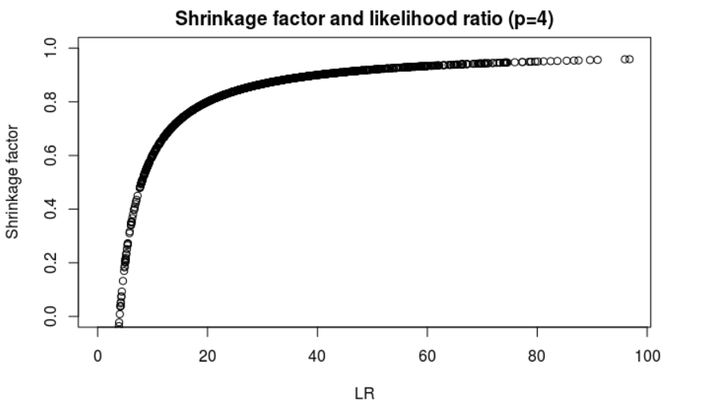
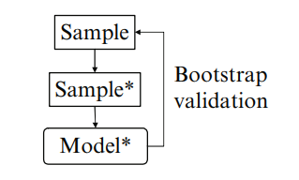

Uniform shrinkage: global shrinkage factor
Shrinkage factor indicates the degree of overfitting. (Closer to 1 indicates less overfitting problem)
Bootstrap is a central technique to correct overfitting and quantify optimism in model performance
Heuristic shrinkage factor by Van Houwelingen
Notes:
Bootstrap: The average performance of the bootstrap models in the original sample can be used as the estimate of future performance in new subjects.
The bootstrap is used to estimate the optimism: The decrease between performance in the bootstrap sample (Sample* Fig. 5.7 ) and performance in the original sample.

Slide 12
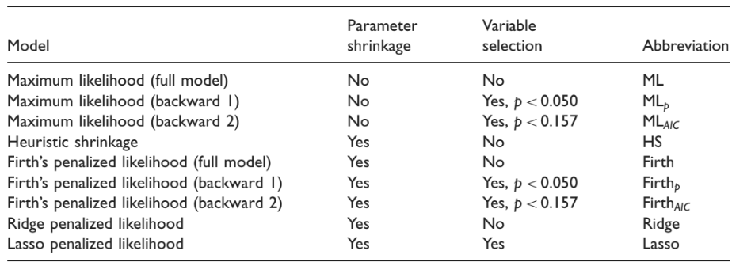
Penalized maximum likelihood and variable selection van Smeden
Prediction models: parameter shrinkage and variable selection strategies.

Slide 13
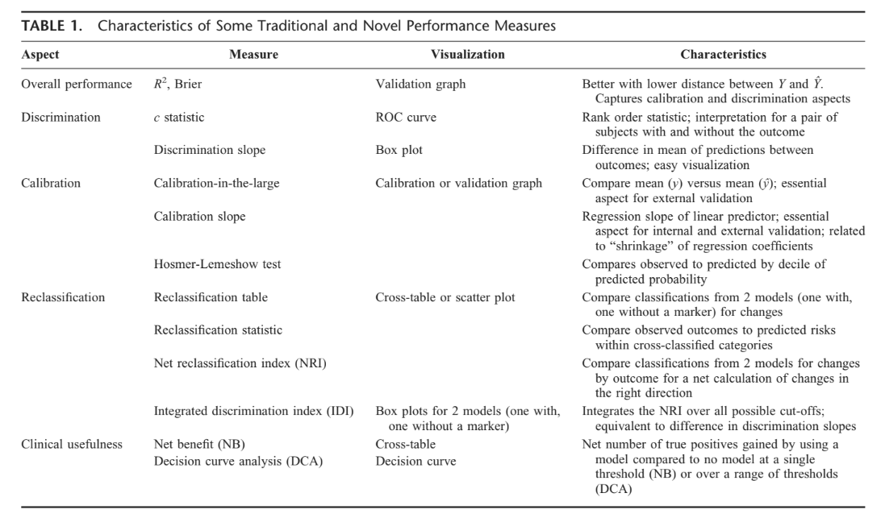
Quantification of Model Performance

Slide 14
Quantification of Model Performance
In decision theory
a scoring rule is a measure of performance of probabilistic predictions - made under uncertainty
R² in logistic regression
R²_{CS} and R²_{Nagelkerke}
Predictive error
Brier Score, MSPE and MAPE
Notes:
Since we want a predictive model with good predictive performance, the first thing we need to do is to figure out the assessment of predictive power for logistic regression
The goodness of fit of a model, indicates by how much the model deviates from an ideal model (goodness of fit, accuracy of prediction)

Slide 15
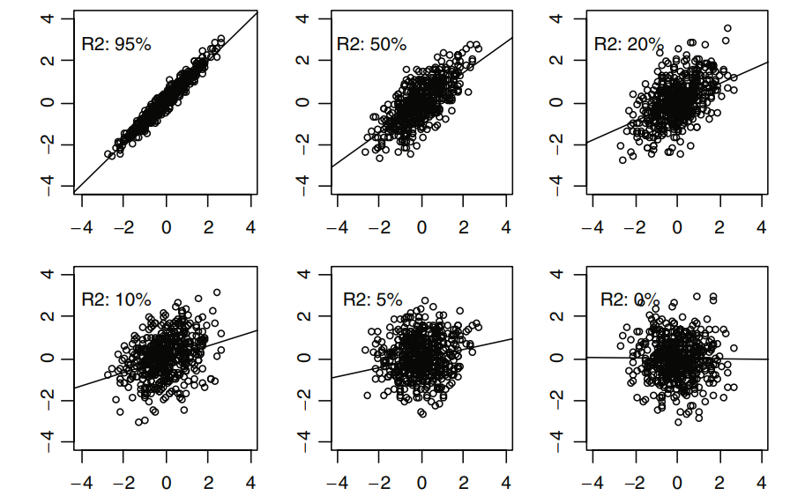
R² in regression analysis - Measure of predictive strength
Predictive strength of linear regression analysis with true regression models
Notes:
The interpretation of an OLS R-squared is relatively straightforward: “the proportion of the total variability of the outcome that is accounted for by the model”.
Basically, we could explain OLS R² from 3 aspects: 1. variability 2. improvement from null model to fitted model 3. square of the correlation
X-axis: x values; y-axis: y values

Slide 16
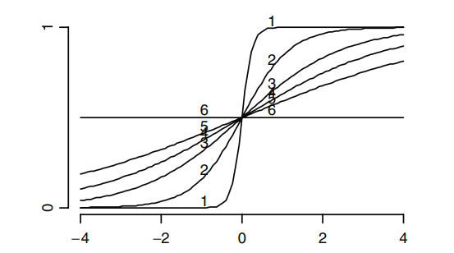
R² in regression analysis - Measure of predictive strength
Predictive strength of logistic regression analysis with true regression models
Nagelkerke R² decreasing from 87% (label “1”) to 0% (label “6”)
Notes:
model estimates from a logistic regression are maximum likelihood estimates instead of minimizing ordinary least squares like linear regression.
We could still measure the goodness-of-fit by some pseudo-R²
For example, here, larger R² indicates more predictive strength, the prefect model would show us two horizontal lines of 1 when x larger than 0 and 0 when x smaller than 0

Slide 17
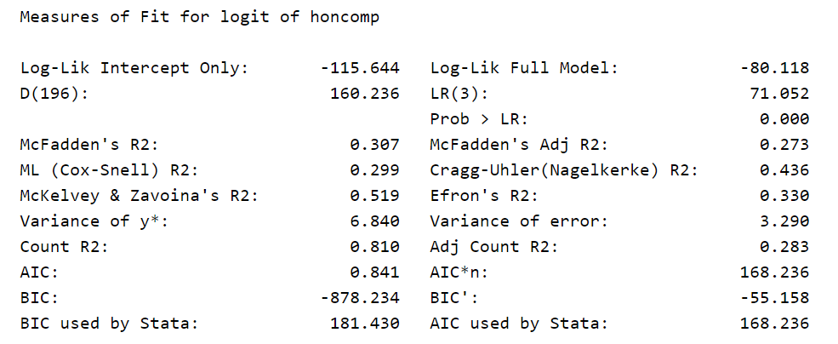
Pseudo R²: goodness-of-fit from OLS approach to MLE approach
A quick example for pseudo R² in logistic regression analysis
Notes:
Goodness-of-fit could be provided by multiple pseudo R-squareds (pseudo R² as they look like OLS R^{2;} a similar scale, roughly from 0 to 1; higher values indicate better model fit)
2. pseudo R-squareds vary greatly from each other within the same model.
A pseudo R-squared only has meaning when compared to another pseudo R-squared of the same type, on the same data, predicting the same outcome. In this situation, the higher pseudo R-squared indicates which model better predicts the outcome.

Slide 18
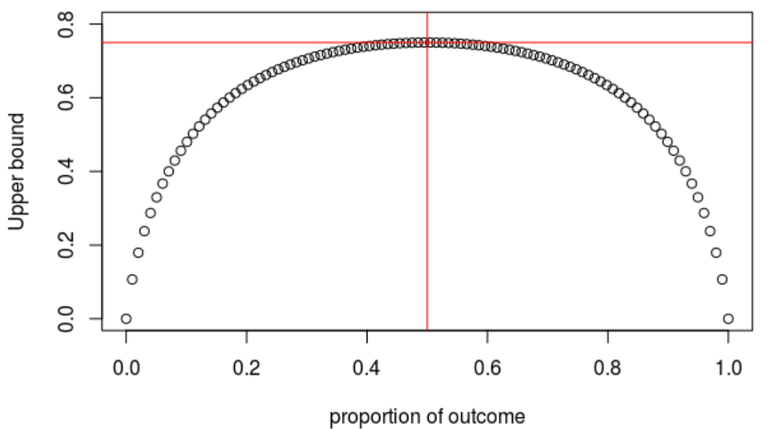
Cox-Snell R² – on log likelihood scale
R²_{CS} = 1 – exp (– LR/n): based on likelihood ratio but it takes the sample size into account
Being scaled from 0 to just under 1
-upper bound = 1 – L₀^{2/n} = 1 – [p^{p}(1-p)^{(1-p)}]²
-ln L_{null} is bounded for binary outcomes
Lower values do not necessarily
indicate poor model performance
-anticipated value of R²_{CS} is low when:
outcome proportion is low
Maximum value of Cox-Snell R²
0.75
Notes:
if the full model predicts the outcome perfectly and has a likelihood of 1, Cox & Snell’s is then 1-L(M₀)^{2/N}, which is less than one upper bound = 1 – [p^{p}(1-p)^{(1-p)}]², depends only on proportion of outcomes (value is .75 when p=.5, the value is only .48 when p=.9 (or .1)
LR = sum(y*log(p) + (1-y)*log(1-p)), especially when outcome proportion is extreme (very low or large), the possible maximum value of Cox-Snell would be low

Slide 19
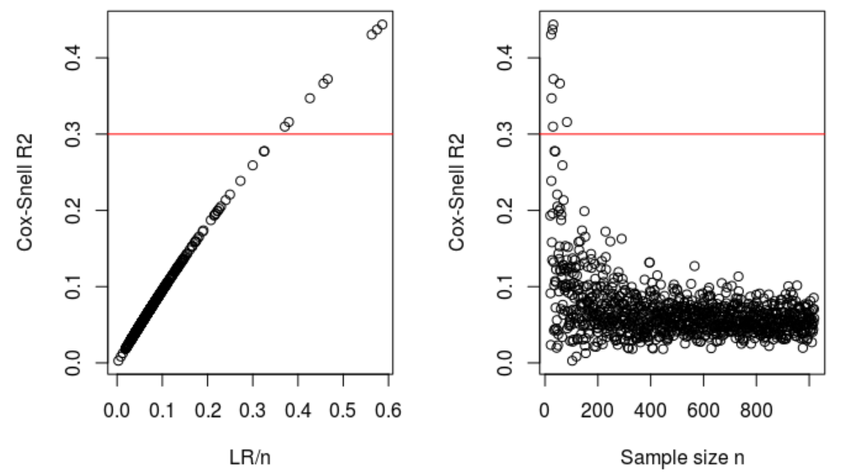
Cox-Snell R² – on log likelihood scale
R²_{CS} = 1 – exp (– LR/n): based on log-likelihood but it takes the sample size into account
Cox-Snell R² of different simulation settings
Enable direct comparison across predictors
no requirement of nested model
Independent of the sample size n
Anticipated value could be small (< 0.3)
Notes:
if the full model predicts the outcome perfectly and has a likelihood of 1, Cox & Snell’s is then 1-L(M₀)^{2/N}, which is less than one upper bound = 1 – [p^{p}(1-p)^{(1-p)}]², depends only on proportion of outcomes (value is .75 when p=.5, the value is only .48 when p=.9 (or .1)
LR = sum(y*log(p) + (1-y)*log(1-p))

Slide 20
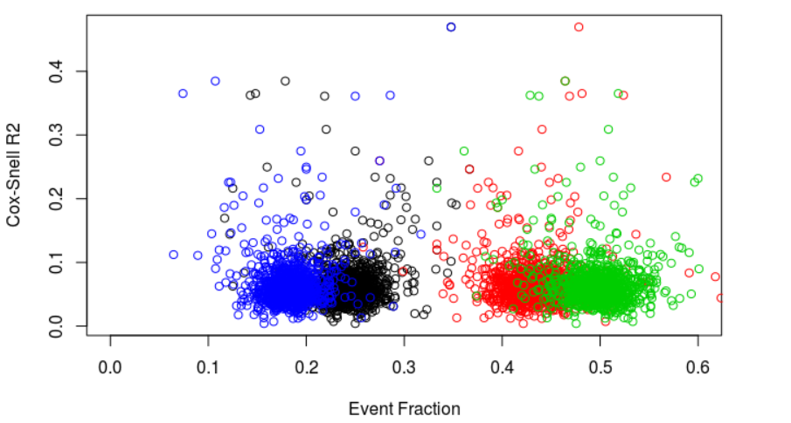
Cox-Snell R² – on log likelihood scale
R²_{CS} = 1 – exp (– LR/n): based on log-likelihood but it takes the sample size into account
Base rate sensitivity over R² measures
Simulation based on:
Same effect, normal distributed predictors
Different base event fraction come from intercept of logistic regression
Cox-Snell R² values are independent of events fraction, but depends on sample size
Notes:
if the full model predicts the outcome perfectly and has a likelihood of 1, Cox & Snell’s is then 1-L(M₀)^{2/N}, which is less than one upper bound = 1 – [p^{p}(1-p)^{(1-p)}]², depends only on proportion of outcomes (value is .75 when p=.5, the value is only .48 when p=.9 (or .1)
LR = sum(y*log(p) + (1-y)*log(1-p)), especially when outcome proportion is extreme (very low or large), the possible maximum value of Cox-Snell would be low

Slide 21
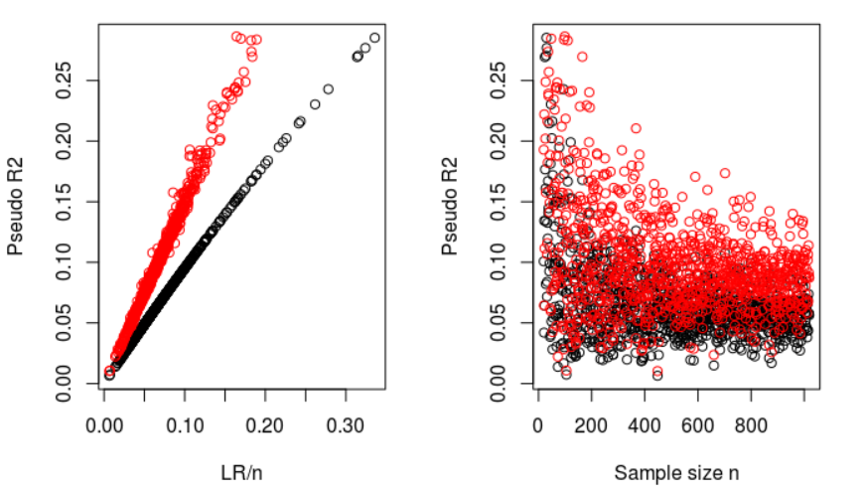
Nagelkerke R² – correction version of R²_{CS}
R²_{Nagelkerke} = R²_{CS} / max(R²_{CS}) = (1 – exp (– LR / n)) /(1 – exp (– – 2 LL0 / n))

Slide 22
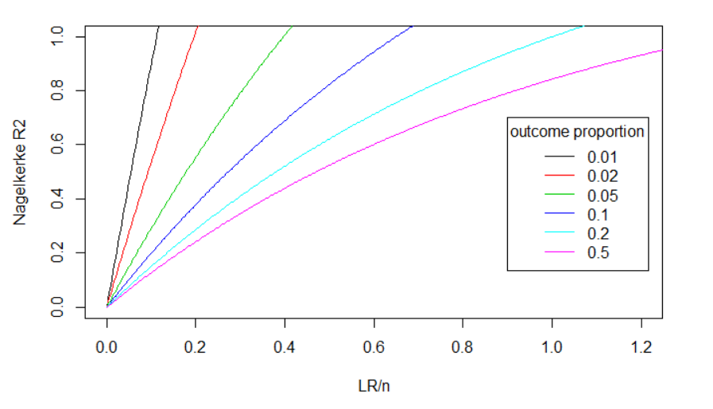
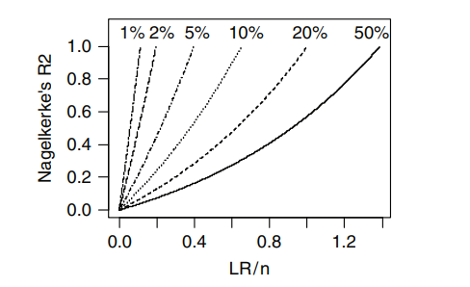
Nagelkerke R² – correction version of R²_{CS}
R²_{Nagelkerke} = R²_{CS} / max(R²_{CS}) = (1 – exp (– LR / n)) /(1 – exp (– – 2 LL0 / n))
- Being scaled from 0 to 1
_ Relationship between the LR statistic
and Nagelkerke’s R² is more or less linear
Nagelkerke R² of different simulation settings

Slide 23

Predictive error metrics
Use the distance between the estimated probabilities and the true probabilities (the lower, the better)
Brier:
Brier = $1$/n${\sum{\left(y−p\right)}}^{2}$
the mean squared prediction error (MPSE)
MPSE = $1$/n${\sum{\left(y−p\right)}}^{2}$
Mean absolute prediction error (MAPE)
MAPE = $1$/n$\sum{|y−p|}$

Slide 24
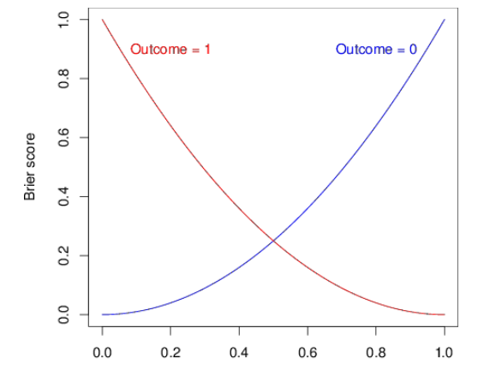
Brier: quadratic scoring rule
Relationship between probability predictions and Brier scores in events with binary outcomes.
BS=0.25 with prediction = 50%
No matter outcome is 0 or 1
BS=0.09 with prediction = 0.7
When outcome is 1
Probability prediction
Notes:
disadvantage of the Brier
The Brier score for a model can range from 0% for a perfect model to 0.25 for a non-informative model with a 50% incidence of the outcome.er score is hence that the interpretation depends on the incidence of the outcome.
When the incidence is lower, the maximum score for a
a prediction of 50% has a score of 0.25 both when the outcome is 0 or 1
model is lower, e.g. for 10%, 0.1 × (1 − 0.1)∧2 + (1 − 0.1) × 0.1∧2 = 0.090.

Slide 25
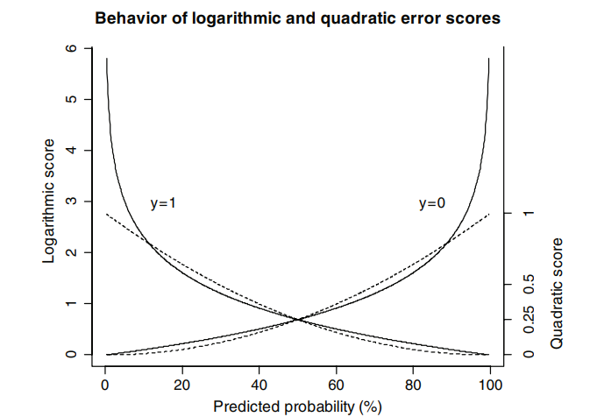
Two scoring rules
Logarithmic score = y ✖ log(p) + (1-y) ✖ (1-p)
For rare disease or highly infectious disease, use Nagelkerke R² would show us more accurate result (require larger sample size for more precise prediction model)
Notes:
The Brier score is less severe than Nagelkerke’s R2 in penalizing false predictions close to 0% or 100%

Slide 26
Mean absolute error (MAP)

Slide 27
Nagelkerke R² – correction version of R²_{CS}
R²_{Nagelkerke} = R²_{CS} / max(R²_{CS}) = (1 – exp (– LR / n)) /(1 – exp (– – 2 LL0 / n))
Pseudo R² of different simulation settings
– R²_{Nagelkerke}: ad hoc correction for R²_{CS}

Slide 28
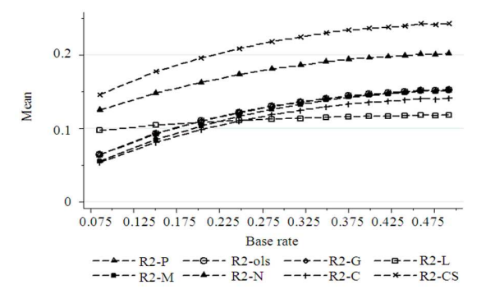
Base rate sensitivity over R² measures
Mean of R² measures by Base-rate
R2-P:
R2-ols: ordinary least squares R²
R2-G: Gini’s concentration R²
R2-L: the likelihood ratio R²
R2-M: Cox-Snell R²
R2-N: Nagelkerke R²
R2-C: Contigency Coefficient R²
R2-CS: Adjusted R2-C

Slide 29
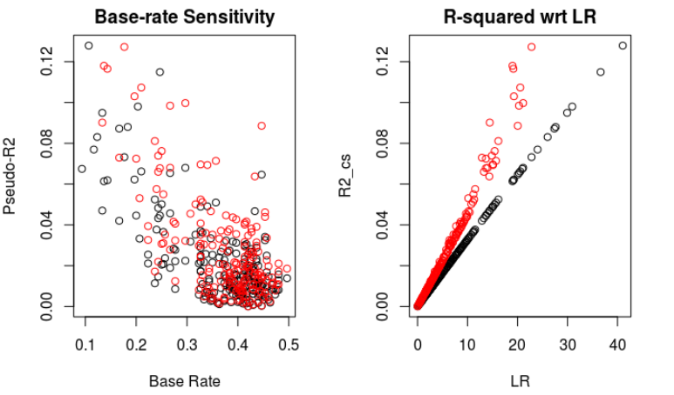
Base rate sensitivity over R² measures

Slide 30
Doing now what patients need next

