Slide 1
Sample size calculations of clinical prediction models
Xijin Chen
Supervisors: Dr. Markus Elze, Dr. Kaspar Rufibach, Dr. Gian-Andrea Thanei

Slide 2
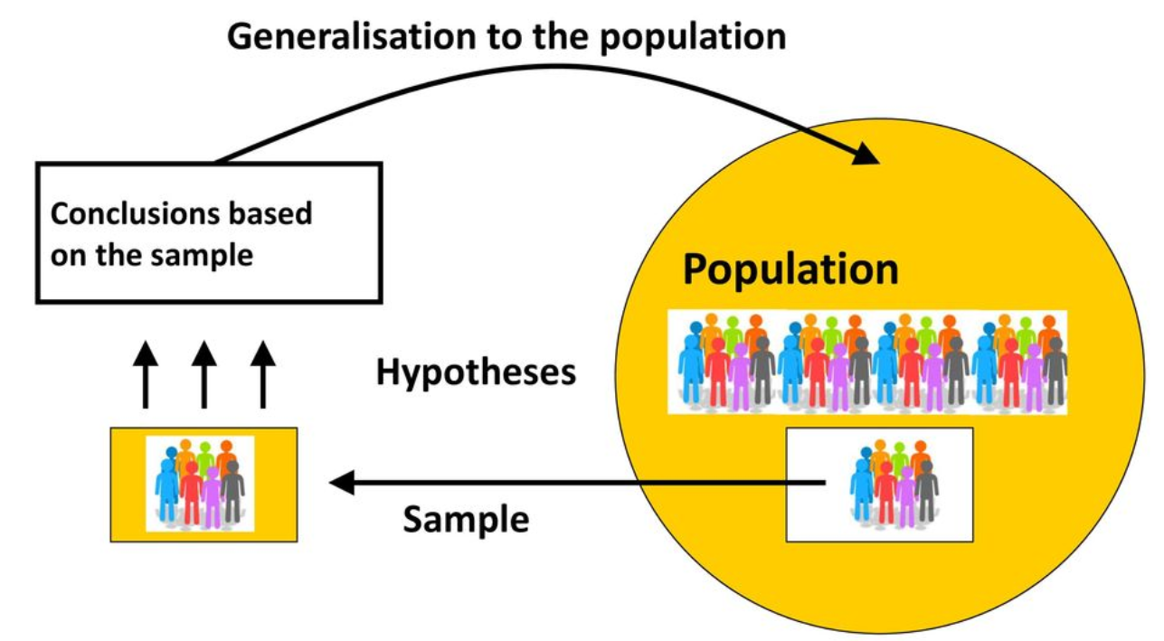
Overview
Threat to generalization -- overfitting:
Out-of-sample performance is not good enough
Adjustment for overfitting
Goal of this project
- Efficacy of drug
- Safety of adverse events
Clinical prediction model
Relative sample size:
Working as a contributing factor for robust performance of prediction models
‘Rule of thumb’ (10 Events per variable):
Typical of sample size expression in logistic regression is criticized as a good rule for accurate results
Qualification of model performance

Slide 3
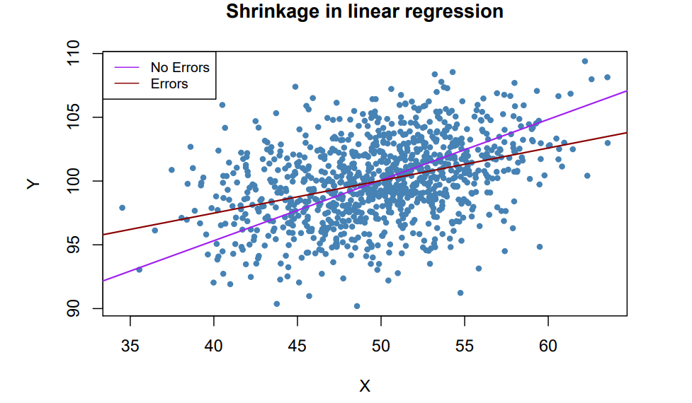
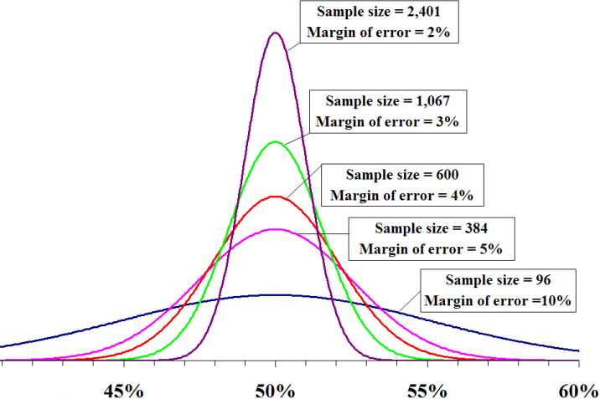

Riley Richard: three-criteria method
(i) Shrinkage factor ≤ 0.9
(ii) Absolute different between R²_{Nagelkerke} ≤ 0.05
(iii) Margin of error ≤ 0.05
Minimization of overfitting
Precise estimation of outcome proportion
Overfitting’
When occurs: the sample size is small or candidate variables being to large
Why occurs: result of ‘regression to the mean’
(unusual features in the observed data is taken into consideration. i.e. measurement error)
How to handle: preshrink predictors coefficients towards zero to alleviate predictors effects
Φ±1.96 *$√\frac{Φ(1−Φ)}{n}$
Margin of error
True outcome proportion
Precise Estimate for Outcome Proportion Φ
Notes:
Model considering the measurement error in X has small coefficient.

Slide 4
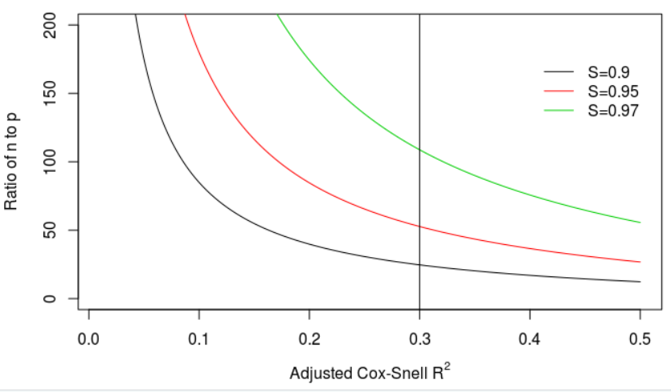
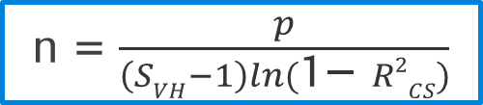

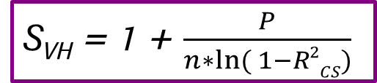

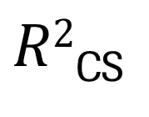
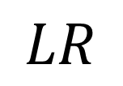
Minimization of overfitting: heuristic shrinkage factor (S_{VH} )
Adjustment
for overfitting
Qualification of
model performance
S_{VH} = 1 + $\frac{P}{n∗ln⁡( 1−R2CS)}$
$$SVH$$
$$LR$$
$R2$_{CS}
S_{VH} = $\frac{LR − P}{LR}$
LR=-n*ln(1-R²_{CS})
Sample size calculation based on R²_{CS} of several shrinkage factors
n
n = $\frac{p}{\left(SVH−1\right)ln(\text{1− }R2CS)}$
We start from the adjustment of overfitting problem (S_{VH}) and qualification of model performance R²_{CS} to get effective sample size.
Notes:
By utilizing the model’s anticipated Cox-Snell R², the sample size calculations are essentially tailored to the model and setting at hand, because Cox-Snell R² reflects many factors including the outcome proportion and the overall fit of the model. It therefore better reflects the trait of a particular model and setting at hand rather than a blanket EPV rule.

Slide 5
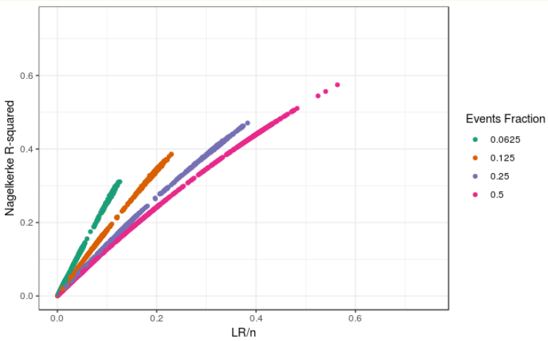
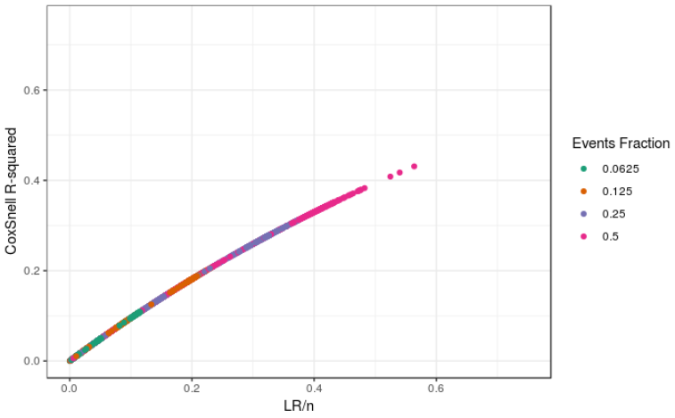
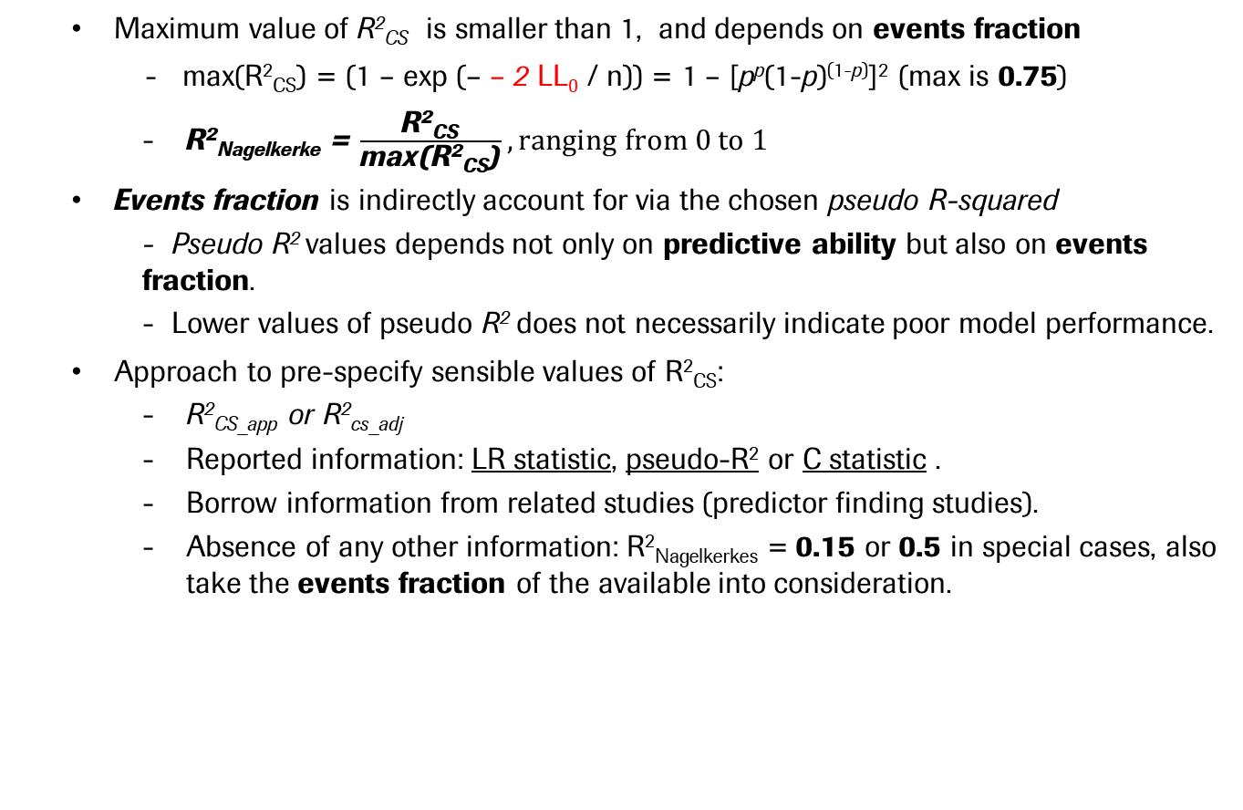
Qualification of model performance: pseudo R-squared
Maximum value of R²_{CS} is smaller than 1, and depends on events fraction
- max(R²_{CS}) = (1 – exp (– – 2 LL₀ / n)) = 1 – [p^{p}(1-p)^{(1-p)}]² (max is 0.75)
R²_{Nagelkerke} = $\frac{\text{R}\text{2}\text{CS}}{\text{max}\text{(}\text{R}\text{2}\text{CS}\text{)}}, ranging from 0 to 1$
Events fraction is indirectly account for via the chosen pseudo R-squared
- Pseudo R² values depends not only on predictive ability but also on events fraction.
- Lower values of pseudo R² does not necessarily indicate poor model performance.
Approach to pre-specify sensible values of R²_{CS}:
R²_{CS_app} or R²_{cs_adj}
Reported information: LR statistic, pseudo-R² or C statistic .
Borrow information from related studies (predictor finding studies).
Absence of any other information: R²_{Nagelkerkes} = 0.15 or 0.5 in special cases, also take the events fraction of the available into consideration.
Base rate problem of Nagelkerke R-squared
Notes:
Pre-specify: normally speaking, a new prediction model is developed specifically to update or improve upon the performance of an existing model, by using additional predictors. Then existing model’s R²_{CS} could be used as a lower bound for the new model’s anticipated R²_{CS}.

Slide 6
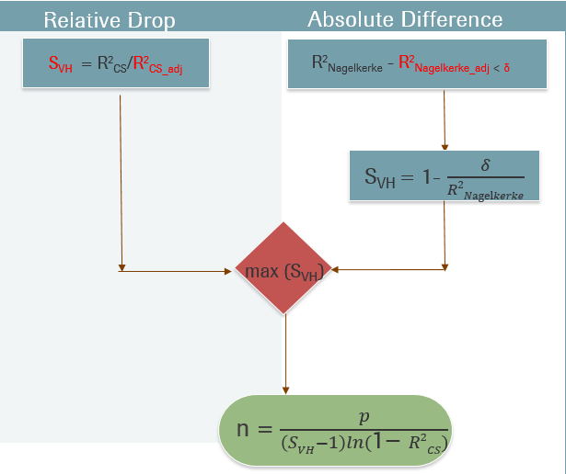


Three criteria methods by Riley Richard
Development dataset:
- Number of predictors p
- Events fraction Φ
- Number of patients n
Precise Estimation
Data reduction if sample size too large to achieve
(i.e. PCA)
Φ±1.96 *$√\frac{Φ(1−Φ)}{n}$
Example, with S_{VH} = 0.9
Anticipated values:
- S_{VH}, R²_{CS_adj}
- R²_{Nagelkerke_adj}, δ
- Margin of error σ
If R²_{Nagelkerke} > 0.45, Relative drop dominates to minimize overfitting
n = $(\frac{1.96}{σ})2$Φ(1-Φ)
If p > 17, minimization of overfitting is always more important than precise estimation of outcome propotion
With given anticipated values (S_{VH}, R²_{CS_adj}, R²_{Nagelkerke_adj}, Absolute difference δ, margin of error σ), number of predictors p and events fraction Φ would decide the dominative one of those three.
Notes:
Usage of this proposal
-Before data collection, we could decide the relative sample size n to p ratio to reduce the potential of overfitting
-With available dataset, we could decide whether data reduction, in terms of number of predictors is needed to develop a valid prediction model
Example
With larger desired shrinkage factor, benchmark for Nagelkerke R² is larger. If a overfitting is less of a problem, Relative drop would be less likely to dominate.

Slide 7
Van Smeden: full factorial simulation studies
Van Smeden: simulation method
Simulation results
Metamodel based on simulation results
Relationship between data characteristics and predictive performance
Data characteristics
EPV
Events fraction
Number of predictors
Model discrimination (AUC)
Distribution of predictor variables
Predictor effects
Modeling strategies:
Maximum likelihood
with 2 with variables selection
Heuristic shrinkage
Firth’s penalized likelihood
with 2 with variables selection
Ridge penalized likelihood
Lasso penalized likelihood
Model performance metrics
Discrimination
ΔAUC
Calibration
Calibration in the large (CIL)
Calibration slope
Overall performance (prediction error)
Brier, MSPE, MAPE
Adjustment for overfitting
Qualification of model performance
We start from the adjustment of overfitting problem (Modeling strategies) and relative sample size and other data characteristics (via simulation) to get the qualification of model performance.
Notes:
We do not need so much explanation for those metrics, as you would realize it we would not use it after my explanation.
The only thing we need to know is that, here van Smeden describe model performance from three aspects, in terms of discrimination, calibration and overfall performance. Discrimination means,….Clibration means ….

Slide 8
Simulation results and its further development by metamodel
Simulation results about dependence of model performance on data characteristics:
Consistent impact of EPV and events fraction on predictive model performance
Little association between EPV and predictive model performance when EPV is large enough (i.e. EPV > 20)
Metamodel for explanation of between simulation variance
EPV only model not have good performance (lower values for R²)
Simplified model with 3 covariates have good performance with some predictive error metrics
Full model with all covariates is not needed (only small increase of performance with simplified one)
Modeling strategy | Meta model | OLS R²
ML | ln(Brier) = -0.91 + - 0.04*ln(N) + 0.62*ln(Events fraction) + 0.04*ln(P) | 0.925
Firth | ln(MAPE) = -0.49 + - 0.52*ln(N) + 0.3*ln(Events fraction) + 0.5*ln(P) | 0.938
Ridge | ln(MSPE) = -0.93 + - 0.88*ln(N) + 0.5*ln(Events fraction) + 0.49*ln(P) | 0.952

Slide 9
Doing now what patients need next

