Slide 1
Sample size computation for prediction models
Xijin Chen
Supervisors: Dr. Markus Elze, Dr. Kaspar Rufibach, Dr. Gian-Andrea Thanei

Slide 2
Inspiration: Predict adverse events from clinical trial data
Sample size computation is a key tool to determine the required number of patients in a clinical trial to provide a reliable answer to the primary objective
Accurate estimation of the incidence of adverse events (AEs) is generally required by regulatory authorities for all clinical trials
A prediction model for adverse events taking into account baseline and treatment characteristics could offer substantial benefits to patients and clinicians
Goal of the project:
Sample size guidance for prediction models (e.g. adverse events)
Notes:
Primary Objective
Desired precision at a fixed confidence level
Desired power to detect clinically meaningful difference at fixed type I error
Infusion related reaction / Allergic reaction
Data integrity/patients safety → delay of regulatory submission/non-approval of drug

Slide 3
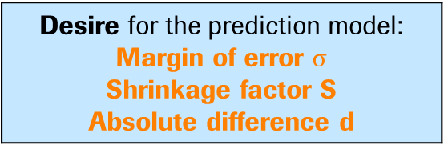
Two papers: Sample size guidance beyond ‘EPV rule’
Typical rule of thumb for sample size in logistic regression: ‘EPV’ (10 events per variable)
No theoretical basis and performs poorly in some simulation studies (too lenient or too stringent)
Appropriate sample size guidance:
Computation of required sample size is based on desired values of model performance
Desire for the prediction model: Margin of error $σ$ Shrinkage factor S Absolute difference d
Dataset characteristics
Number of predictors Outcome proportion
Theoretical approach
Richard D Riley et al. (2018)
Required sample size
Simulation-based approach
Maarten van Smeden et al. (2018)
Required sample size
Desire for the prediction model: Prediction error
Notes:
Typically, sample size calculation are typically based on blanket rule of thumb in prediction models
Theoretical basis → convinced scientific reasoning
In power analysis or precision analysis, the desired values are
the precision by fixed confidence level and
The power by fixed type I error rate
Q: How to define our desire/how do these 2 sample size computation machine work

Slide 4
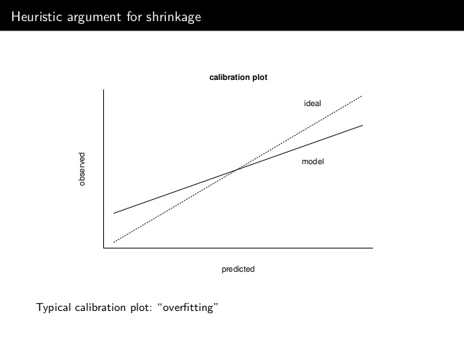

What you see may not be what you get
Prediction model: Overfitting and Shrinkage
True
Adjusted
Apparent
Shrinkage denotes the phenomenon that calibration slope is less than 1
Also denotes the statistical estimation method to shrink predictors effect towards zero
Low probabilities are predicted to low
High probabilities are predicted to high
Notes:
Overfitting: feature, validity, predictions too extreme (low too low);
Regression to the mean: future values be close to the mean values than expected from prediction
Plot:
Shrinkage 1 describes this phenomenon
Shrinkage 2 show the method for predictions to reduce the risks of being too extreme
shrink effects, as the reason of overfitting is the specifics and idiosyncrasies capturlized from the less-than-perfect dataset
How do shrinkage help us? Reduce difference , optimism by overfitting
Apparent: predictive performance estimated on the same data where the model was developed
Use an unbiased estimate of the true performance

Slide 5
Riley: Three criteria for minimum sample size for model development
logit (individual risk) = intercept + Xβ
Ensure precise estimation of the model intercept when predictors are mean centred
Margin of error in outcome proportion estimates for a null model
Shrinkage of predictor effects towards zero to alleviate overfitting
Reduce the difference between apparent and adjusted model performance on a relative scale
Reduce the difference between apparent and adjusted model performance on a absolute scale
Margin of error ≤ 0.05
Relative drop ≥ 0.9
Absolute different ≤ 0.05
Precise estimation of outcome proportion
Minimization of overfitting based on shrinkage factor
Notes:
Overall: 2 motivations to get reliable predicted individual risk
Intercept: intercept := overall risk,
Fundmentally, precisely estimate the overall risk before tailoring predictions to individuals
Mean risk in an actual model including multiple predictors, the individual risk := mean risk in the overall pop
Predict the overall risk in the target population before tailoring to individuals
Or We like precise estimation of overall risk before tailoring predictions to individuals
Predictors:
calculate the sample size to satisfy all three criteria, the largest one among those three

Slide 6
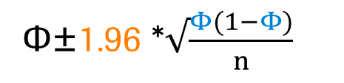
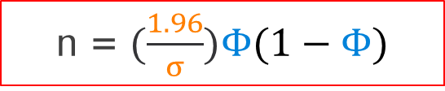
Riley: Criteria 1 (precise estimation)
Confidence level
Margin of error
Φ±1.96 *$√\frac{Φ(1−Φ)}{n}$
n = $(\frac{1.96}{σ})Φ(1−Φ)$
Outcome proportion
Larger margin of error, means less confidence, requires smaller sample size
Larger outcome proportion requires larger sample size
Note: n: sample size; Φ: outcome proportion; σ: margin of error
Notes:
To be meaningful, the margin of error should be qualified by a probability statement (often expressed in the form of a confidence level).

Slide 7
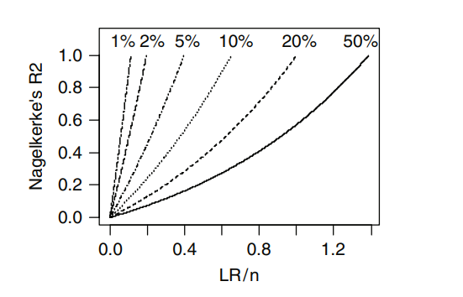
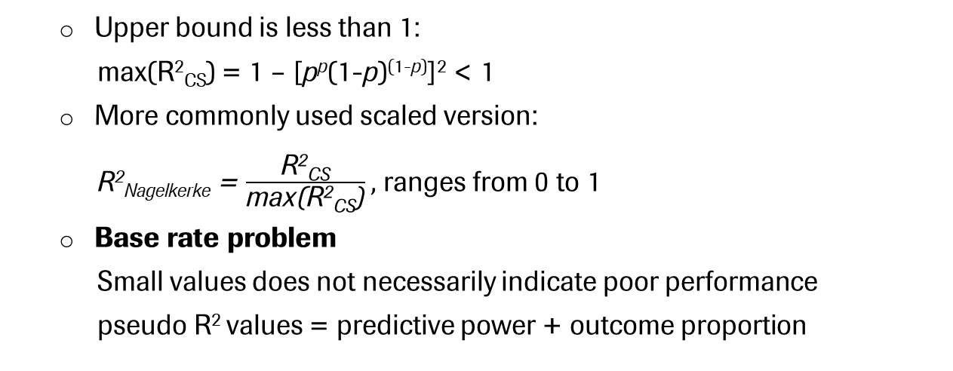
Riley: Measure of effect size (pseudo R²) for criteria 2 & 3
R²_{Cox-Snell} = 1 – exp (– $\frac{LR }{n}$)
Dependency of Nagelkerke R² on outcome proportion
Upper bound is less than 1:
max(R²_{CS}) = 1 – [p^{p}(1-p)^{(1-p)}]² < 1
More commonly used scaled version:
R²_{Nagelkerke} = $\frac{\text{R}\text{2}\text{CS}}{\text{max}\text{(}\text{R}\text{2}\text{CS}\text{)}},$ ranges from 0 to 1
Base rate problem
Small values does not necessarily indicate poor performance
pseudo R² values = predictive power + outcome proportion
Reflect trait of a model and setting at hand, better than a EPV rule
Note: n: sample size; LR: likelihood ratio statistics; p:probability
Notes:
OLS R²
The R² statistics indicates how useful the explanatory variables are in predicting the response
Nagerkerke: range from 0 to 1
Lower values of pseudo R² does not necessarily indicate poor model performance.
Eg.
If a model based on R² value, shows better predictability in one population than the other, it may be simply becaus the underlying events fraction. But no because of the different predictive abilities of the set of predictors used
Similarly, in situations where the outcome proportion is low, researchers would anticipate a model with a low R² value.
This dependence is criticized, but has its own real meanings

Slide 8
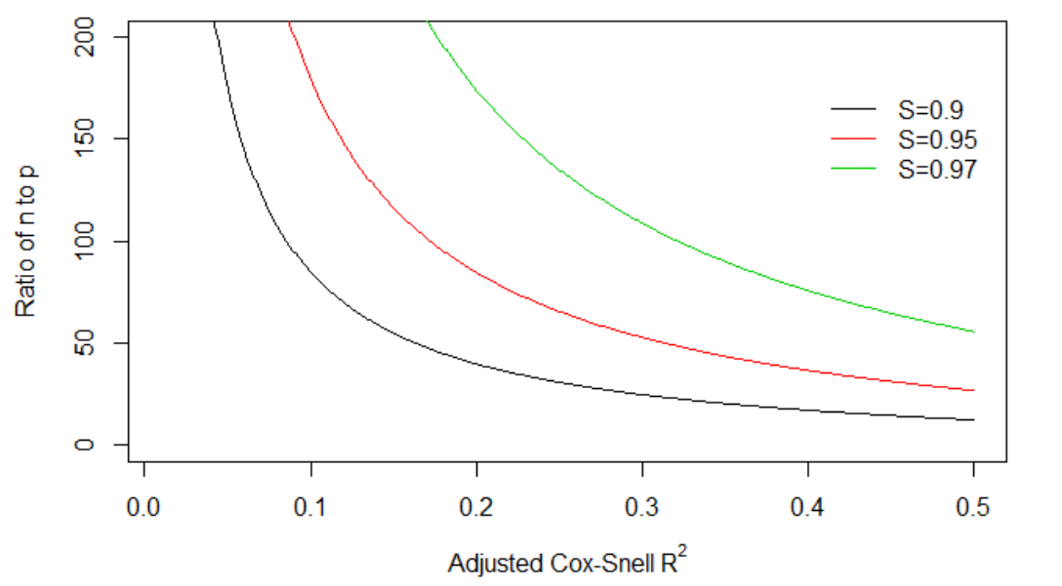
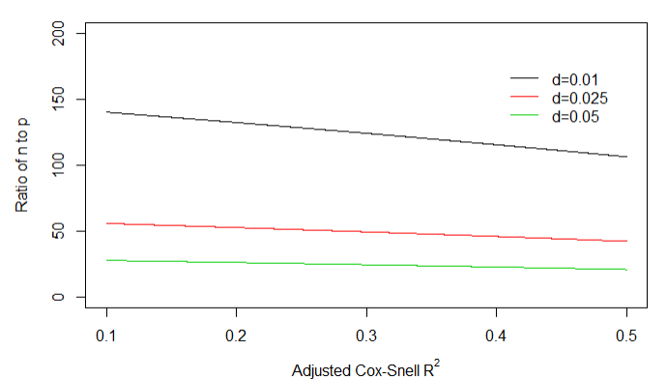
Riley: Criteria 2 & 3 (minimization of overfitting)
Relative drop: R²_{CS} / R²_{CS_adj} ≥ 0.9 (shrinkage factor )
Absolute difference: R²_{Nagelkerke} - R²_{Nagelkerke_adj} ≤ 0.05
Optimism caused by overfitting, implying the difference between adjusted performance and apparent performance
Reduction of differences on relative and absolute scale
The idea of shrinkage is behind both of these, directly and indirectly
Notes:
By utilizing the model’s anticipated Cox-Snell R², the sample size calculations are essentially tailored to the model and setting at hand
y-axis
Larger S
Smaller difference
For all of these 4, the value we specify is adjusted Cox Snell R2.
Given adjusted value of Cox-Snell R², what is the required sample size such that adj does not drop by more than a certain relative and absolute amount from the app, overfitting is not a big problem in our setting
High SNR

Slide 9
Van Smeden: Full factorial simulation studies
Evaluate the predictive performance of various prediction modeling strategies in relation to characteristics of a simulated dataset
Simulated dataset
EPV (7)
Events fraction (4)
Number of predictors (3)
Model discrimination (AUC) (3)
Distribution of predictor variables (4)
Predictor effects (4)
Modeling strategies
Maximum likelihood
Heuristic shrinkage
Firth’s penalized likelihood
Ridge penalized likelihood
Lasso penalized likelihood
Model performance
Discrimination (1)
Calibration (2)
Overall performance/Predictive error (3)
Model performance calculated on a validation dataset: N* = 5000/Pr(Y=1)
Hard to reach a consensus on the impact of dataset characteristics on the model performance over all settings
Notes:
For the combination of all possible factors, 4032
No consensus: larger EPV or smaller Ef helped to improve model performance, but it is not the case of Firth/EPV>20/Calibration metrics

Slide 10
Van Smeden: predicting model performance using a metamodel
Metamodel is a model of a model, simplifying the relationship between dataset characteristics and model performance
Blackbox: hard to find out the relationship
Inputs
Modeling
strategies
Outputs
Simulated dataset
Model Performance
Metamodel
Dataset characteristics + N
Model Performance
Outputs
Metamodel
Inputs
N
Model Performance + Dataset characteristics
Notes:
A metamodel is a model at a different level of abstraction that makes statements about the structure of another model (or a whole set of other models), without making statements about their content.
Increase model transparency and improve the presentation of model results.

Slide 11
Van Smeden: Three approaches to a metamodel
Meta-models for prediction of model performance (linear model subject to Ridge penalty)
1. Model performance = EPV
→ ‘EPV rule’ does not provide reliable prediction of model performance
2. Model performance = N + Events fraction + P
→ Prediction error could be largely explained by these three covariates
3. Model performance = N + Events fraction + P + AUC + Cor + Bin + Noise
→ Added variables do not improve sizable amount performance
Prediction error could be explained by Sample size, Events fraction and Number of predictors
E.g. ln(MSPE) = -0.59 + - 1.06*ln(N) + 0.36*ln(Ef) + 0.94*ln(P) Maximum likelihood
MSPE: mean squared prediction error
Note: EPV: events per variable; N: sample size; P: number of predictors: AUC: Area under the curve; Cor: Predictor pairwise correlations; Bin: Binary predictor variables; Noise: Noise variables.

Slide 12
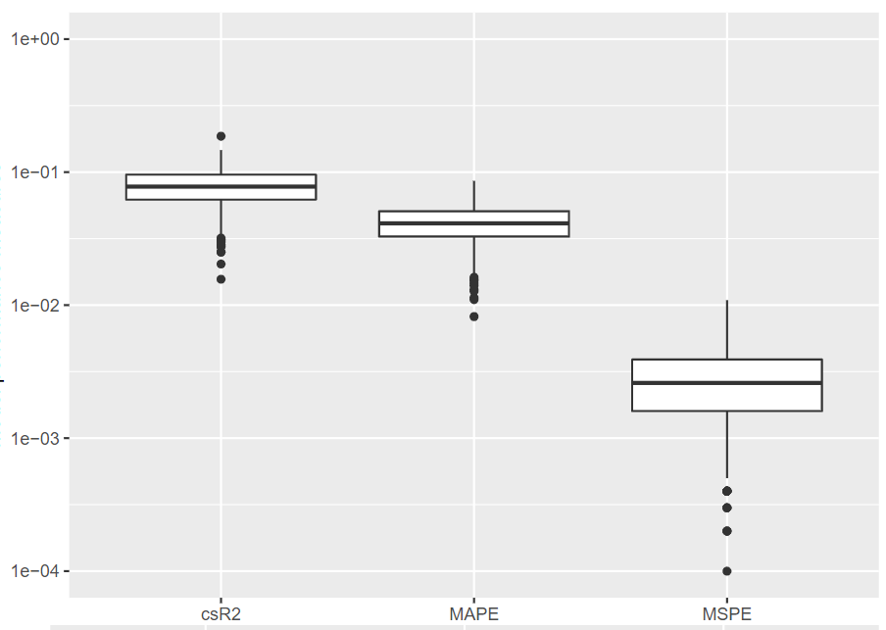
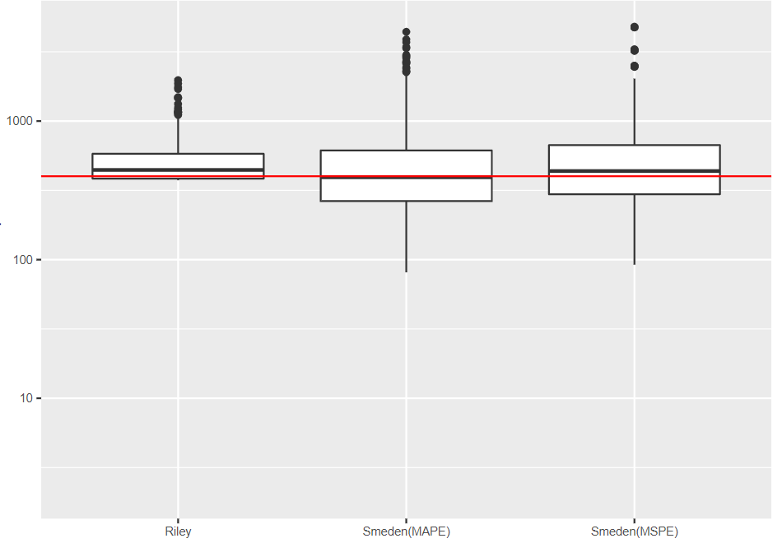
Simulating new datasets to assess consistency of two methods
Desired values by Riley:
Margin of error (0.05)
Shrinkage factor (0.9)
Absolute difference (0.05)
Three-criteria method (Riley)
Metamodel (van Smeden)
n₀
Assessment dataset:
Number of predictors 4,
Outcome proportion 0.15
R²_{CS}
Riley
MAPE
Smeden
(MAPE)
Smeden
(MSPE)
MSPE
Simulations-based sample size
n₀ = 400
‘Tuning’ parameters for computation
Required sample size
Calculated sample sizes by two approaches are good estimate of the sample size, corresponding to the desired values
Consistency between these two approaches is achievable
Notes:
Q: desired model performance → required sample size
How could I convince these two methods, is the result of sample size a good estimate for the sample size corresponding to the desired model performance
Is there any consensus btw these two
The way we calculate sample size, it based on some anticipated or desired values and then estimate corresponding sample size.
Check: if the model performance from a real dataset could, based on two methods, guide us to estimate the original dataset.
In the same scenario, what is the performance of these two approaches, is there any obvious difference of results from these two approaches.
→ Performs well and there is consistency

Slide 13
Summary
Two papers providing sample size guidance for a prediction model
 | Inputs |  | Methods | Limitations
 | Dataset characteristics | Desire for model performance | Adjustment of overfitting (Shrinkage)
Riley | Outcome proportion Number of predictors Adjusted Cox-Snell R² | Desired shrinkage factor (S) Absolute difference (d) Margin of error (σ) | Uniform shrinkage factor (S) (theoretically) | Uncertainty brought by R²_{CS} Problem of separation
Van Smeden | Outcome proportion Number of predictors | Mean squared prediction error Mean absolute prediction error | Different modeling strategies (simulation-based) | Finite investigated scenarios Not work for time-to-event data
Take home message:
Dataset characteristics + Desired Model Performance → Minimum sample size for a prediction model

Slide 14
Many thanks to my supervisors and everyone!

Slide 15
Doing now what patients need next

Slide 16
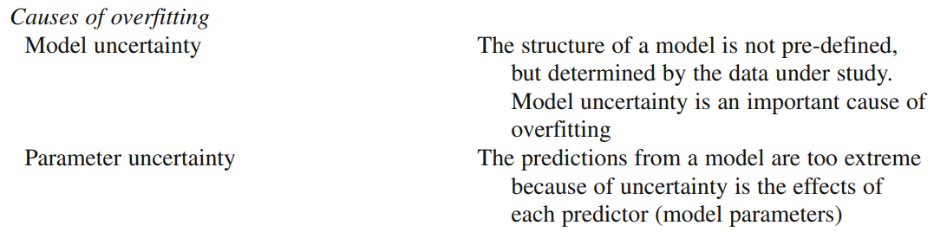
Reason for overfitting
Choose the one less likely to be overfitting
‘Shrinkage’ predictor effect

Slide 17
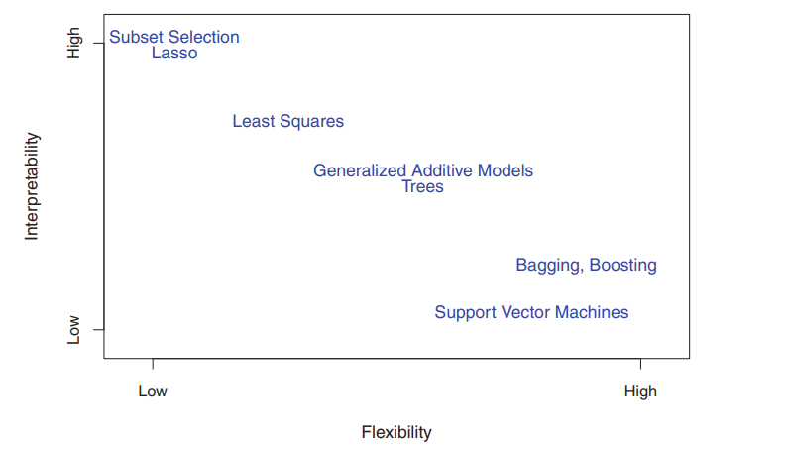
Model uncertainty
Tradeoff between flexibility and interpretability
We would not develop a flexible model for prediction

Slide 18
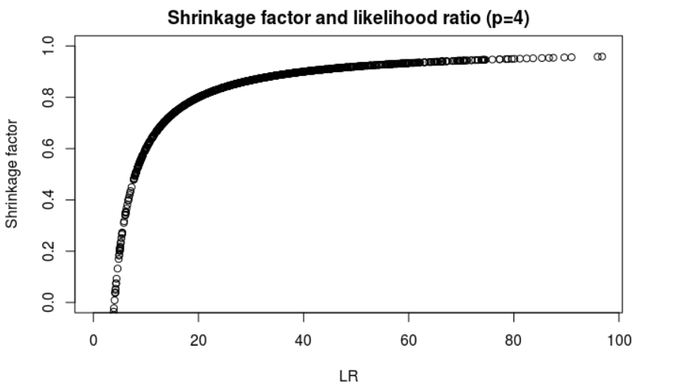
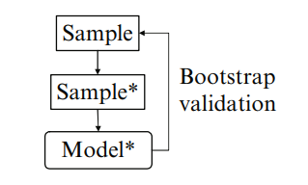

Shrinkage factor: two methods for calculation
Bootstrap is a central technique to quantify optimism and correct overfitting in model performance
Heuristic shrinkage factor by Van Houwelingen
Decrease performance in bootstrap samples and in original sample
Closer to 1 shrinkage factor denotes better performance of a model (larger LR)

Slide 19
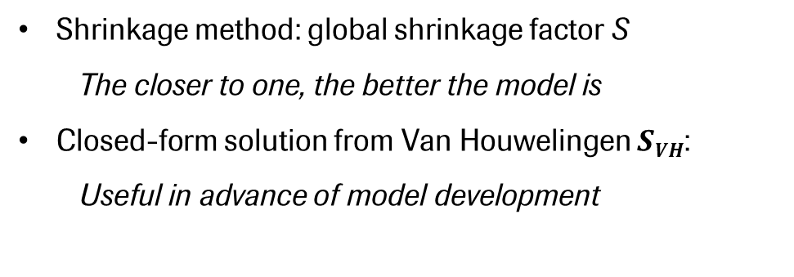

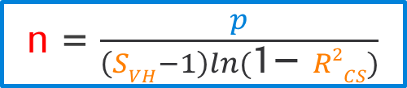



Riley: Criteria 2 & 3 (minimization of overfitting)
Logit(overall risk) = intercept + Xβ
Margin of error ≤ 0.05
Relative drop ≥ 0.9
Absolute different ≤ 0.05
Precise estimation of outcome proportion
Minimization of overfitting based on shrinkage factor
Shrinkage method: global shrinkage factor S
The closer to one, the better the model is
Closed-form solution from Van Houwelingen $SVH$:
Useful in advance of model development
$$SVH$$
$$LR$$
$R2$_{Cox-Snell}
S_{VH} = $\frac{LR − P}{LR}$
LR=-n*ln(1-R²_{Cox-Snell})
Number of predictors p
n
n = $\frac{p}{\left(SVH−1\right)ln(\text{1− }R2CS)}$
Required sample size w.r.t. minimization of overfitting
Notes:
Reasons: unusual features(i.e. sampling chances and random errors)
Example: measurement-error model, low predictions will be too low and vice verse.
Estimation method: shrinks so that the calibration slope (observed responses against prediction responses) would be one instead of being of less than one
Preshrink to alleviate predictors effects by shrinkage factor

Slide 20
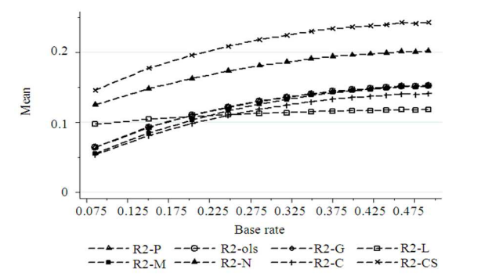
Base rate sensitivity over R² measures
R2-P:
R2-ols: ordinary least squares R²
R2-G: Gini’s concentration R²
R2-L: the likelihood ratio R²
R2-M: Cox-Snell R²
R2-N: Nagelkerke R²
R2-C: Contigency Coefficient R²
R2-CS: Adjusted R2-C
Mean of R² measures by Base-rate

Slide 21
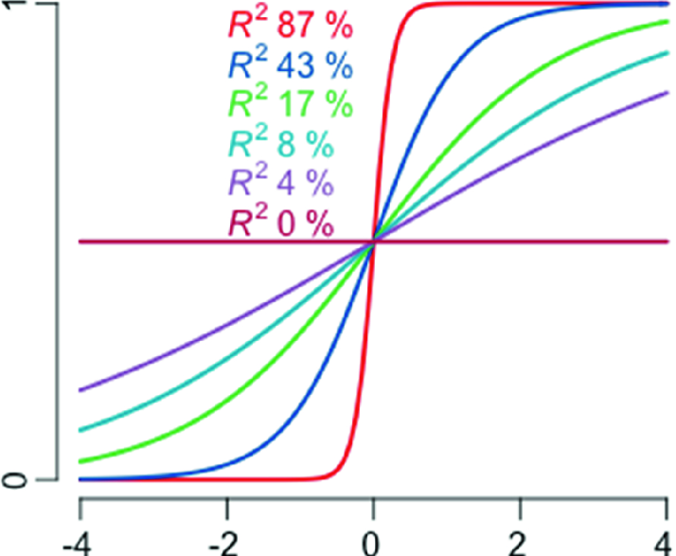

Nagelkerke R² – normalized version of R²_{CS}
R²_{Nagelkerke} = $\frac{\text{R}\text{2}\text{CS}}{\text{max}\text{(}\text{R}\text{2}\text{CS}\text{)}}$= $\frac{\text{1 – }\text{exp}\text{ (– }\text{LR}\text{ / }\text{n}\text{)}}{\text{1 – }\text{exp}\text{ (– – 2 }\text{LL}\text{0 / }\text{n}\text{)}}$
Being scaled from 0 to 1, directly denoting model performance
Still related to events fraction like Cox-Snell R²
R²_{Nagelkerke} from 87% to 0% with one normally distributed predictor

Slide 22
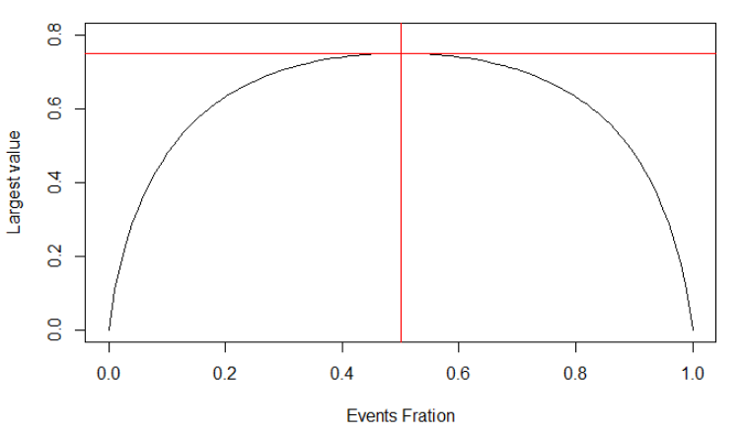
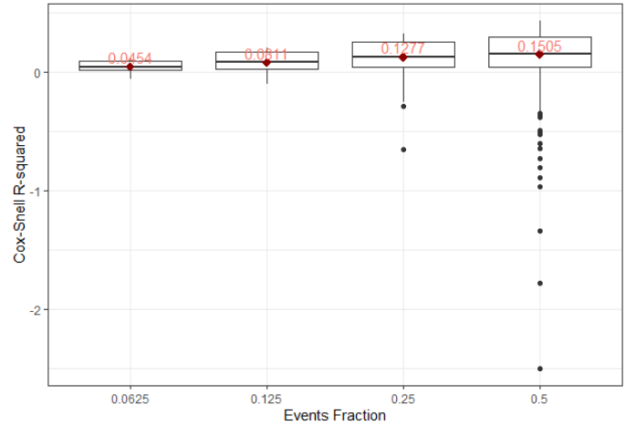

Cox-Snell R²: predictive strength in logistic regression
Properties:
Consistent with maximum likelihood as an estimation method;
Could be negative values when null model is better than full model (LR < 0);
Asymptotically independent of sample size n;
max(R²_{CS} ) lower than 1 and depends on outcome proportion (1 – L₀^{2/n} = 1 – [p^{p}(1-p)^{(1-p)}]²);
Lower value of R²_{CS} does not necessarily indicate poor model performance as it related to events fraction (base rate problem)
R²_{CS} = 1 – exp ( – $\frac{LR}{n }$ ) = 1 - ( $\frac{Lnull}{Lfull}$ )^{2/N}
Maximum value of R²_{CS} and events fraction
Relationship between R²_{CS} and events fraction
(based on 4032 simulations)

Slide 23
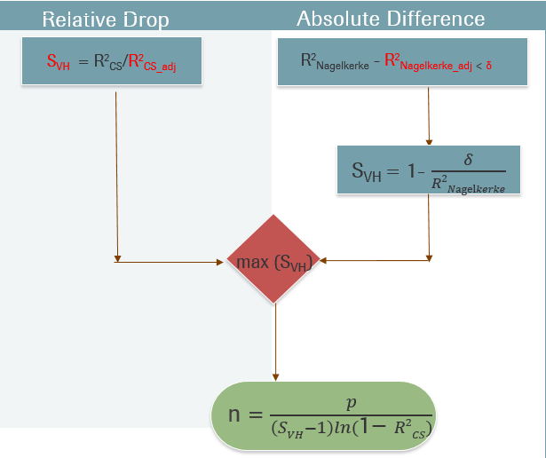


Three criteria methods by Riley Richard
Development dataset:
- Number of predictors p
- Events fraction Ef
Precise Estimation
Anticipated values:
-S_{VH}, R²_{CS_adj}
-R²_{Nagelkerke_adj}, δ
-Margin of error σ
Φ±1.96 *$√\frac{Φ(1−Φ)}{n}$
n = $(\frac{1.96}{σ})2$Φ(1-Φ)
With given anticipated values (S_{VH}, R²_{CS_adj}, R²_{Nagelkerke_adj}, δ, σ), number of predictors p and outcome proportion Φ
would decide the dominative one of those three.

Slide 24
BACKUP
Simulation settings in the slides (7*4*3*3*4*4 = 4032)
Relative sample size
Events per variable (EPV): 3, 5, 10, 15, 20, 30, 50 (7)
Events fraction: 1/2, 1/4, 1/8, 1/16 (4)
Number of candidate predictors (P): 4, 8, 12 (3)
Other development data characteristics
Model discrimination (AUC): 0.65, 0.75, 0.85 (3)
Distribution of predictor variables: Binomial, Multivariable (4)
Predictor effects: Equal effect; one strong; one noise; ½ noise (4)

Slide 25
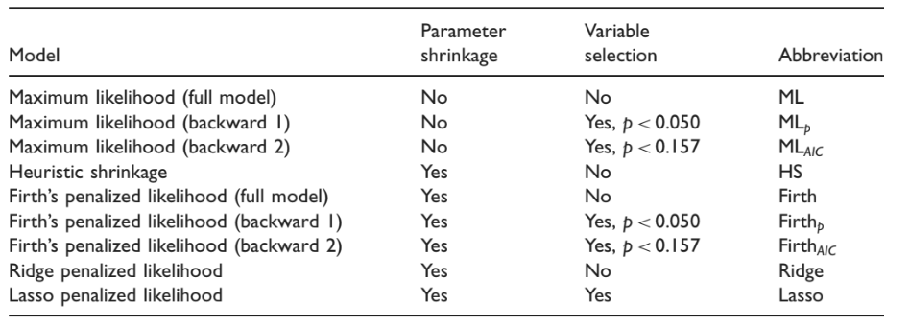
Van Smeden: simulation based on modelling strategies
The simulation study was set up to evaluate the predictive performance of various prediction modeling strategies in relation to characteristics of the development data.
Prediction modelling strategies for simulation by van Smeden

Slide 26
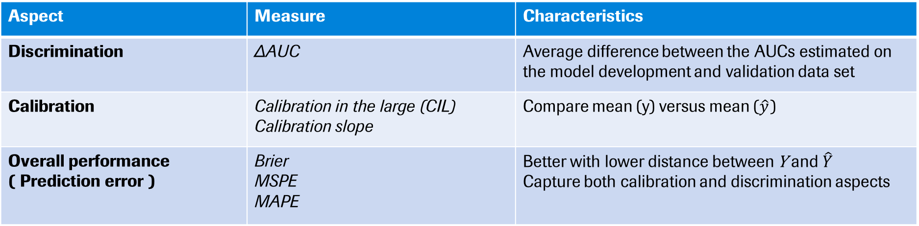
Predictive performance (simulation results and meta model results)
Aspect | Measure | Characteristics
Discrimination | ΔAUC | Average difference between the AUCs estimated on the model development and validation data set
Calibration | Calibration in the large (CIL) Calibration slope | Compare mean (y) versus mean (${\hat{y}}_{ }$)
Overall performance ( Prediction error ) | Brier MSPE MAPE | Better with lower distance between Y and ${\hat{Y}}_{ }$ Capture both calibration and discrimination aspects
Validation data sets to get predictive performance metrics: N* = 5000/Pr(Y=1)

Slide 27
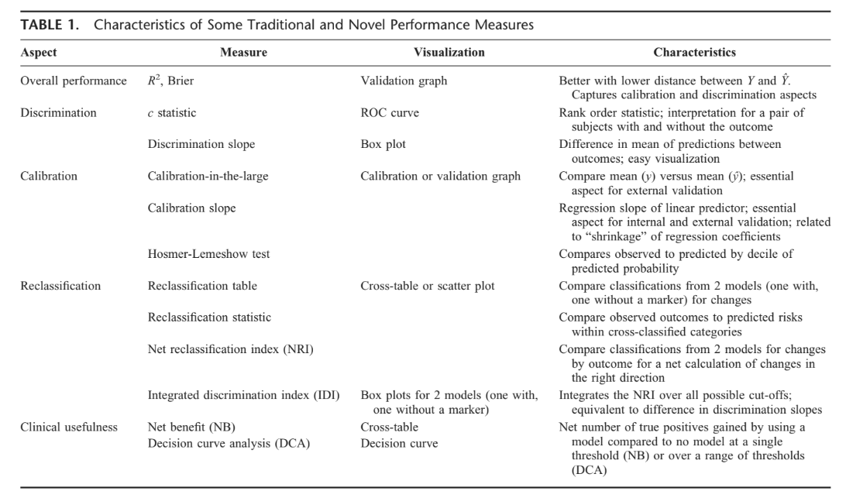
Quantification of Model Performance

Slide 28
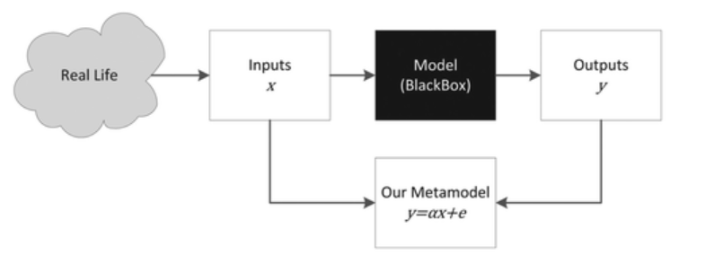
Van Smeden: Metamodel based on simulation results
Metamodel: A model of a model
Increase model transparency and improve the presentation of model results.
Simplify the relationship between inputs (data characteristics) and outputs (model performance)

Slide 29
Doing now what patients need next

