Slide 1
Sample size calculation for prediction model

Slide 2
Motivation
Reliable risk prediction for both diagnostic prediction model and prognostic prediction model
Effective sample size works as a contributing factor for robust performance of prediction models
Sample size calculation is usually conducted through a pre-study power analysis
Before data collection: guide the study
When data set available: identify whether we need a data reduction in number of predictors before model development
The selected sample size should achieve a desired power for correctly detecting a pre-specified efficacy or safety (AEs)

Slide 3
Required sample size: moving beyond EPV criteria
EPV is typically-expressed sample size in logistic regression, low values are frequently been associated with poorer associated with predictive performance upon validation, 10 EPV is taken as a ‘rule of thumb’, but was proved to be too simplistic by some simulation studies.
“There is no single rule based on EPP that would guarantee an accurate estimation of logistic regression parameters”
Sample size guidance from Riley Richard and van Smeden
Riley Richard
(i) Shrinkage factor ≤ 0.9
(ii) Absolute different between R²_{Nagelkerke} ≤ 0.05
(iii) Margin of error ≤ 0.05
Minimization of overfitting
Precise estimation of outcome proportion
Van Smeden
Simulation Results
Meta model
Predictive error = predictor numbers (P) + development dataset (N) + Events fraction (Ef)
Explore influence of relative sample size and other data characteristics on predictive performance

Slide 4
Overview of modern methods for sample size calculation
 | Riley Richard | van Smeden
Adjustment for overfitting | Uniform shrinkage factor | Different modelling strategies w.r.t. Uniform shrinkage Penalized maximum likelihood Variables selection
Quantification of model performance | Pseudo R² (R²_{CS} and R²_{Nagelkerke}) (Signal-to-noise ratio) (Coefficient of determination) | Brier, MAPE, MSPE (Prediction error)

Slide 5
Simulation settings in the slides (7*4*3*3*4*4 = 4032)
Relative sample size
Events per variable (EPV): 3, 5, 10, 15, 20, 30, 50 (7)
Events fraction: 1/2, 1/4, 1/8, 1/16 (4)
Number of candidate predictors (P): 4, 8, 12 (3)
Other development data characteristics
Model discrimination (AUC): 0.65, 0.75, 0.85 (3)
Distribution of predictor variables: Binomial, Multivariable (4)
Predictor effects: Equal effect; one strong; one noise; ½ noise (4)

Slide 6
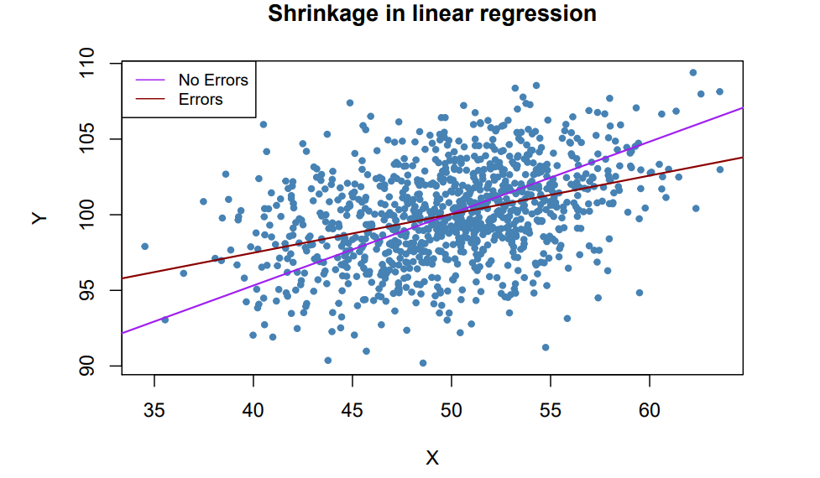
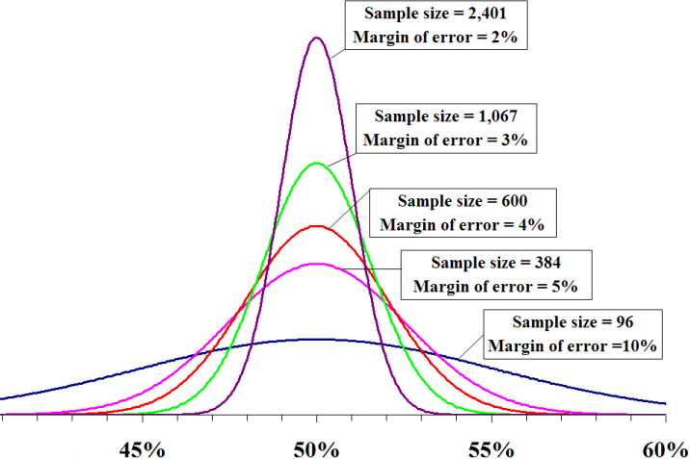
Riley Richard: three-criteria method
Logit(outcome propo rtion) = intercept + Xβ
Precise Estimate for
Outcome Proportion Φ
Minimization of Overfitting by
Shrinkage Factor S
‘Overfitting’ usually happened when the sample size is small or candidate variables being to large relative to the sample size.
This is also what we call ‘regression to the mean’, which is regarded as the motivation of shrinkage
Large sample size to ensure small margin of error

Slide 7
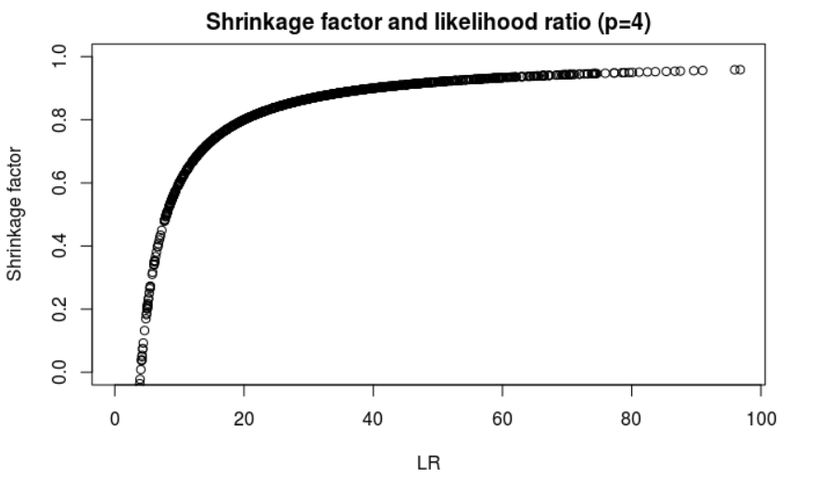
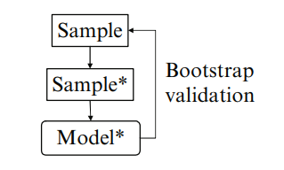

Shrinkage factor: measure of degree of overfitting
Bootstrap is a central technique to quantify optimism and correct overfitting in model performance
Heuristic shrinkage factor by Van Houwelingen
Decrease performance in bootstrap samples and in original sample
Closer to 1 shrinkage factor denotes better performance of a model (larger LR)

Slide 8
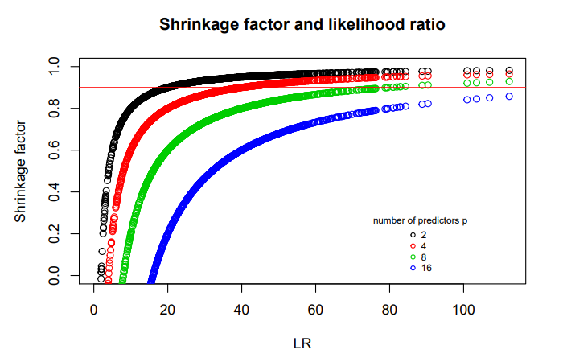

From heuristic shrinkage factor to pseudo R²
S_{VH} = $\frac{Likelihood ratio LR − \# predictors P}{Likelihood ratio LR}$
Likelihood Ratio (LR):
Depends on sample size n;
Unknown before development of a model;
Only works for nested model.

Slide 9
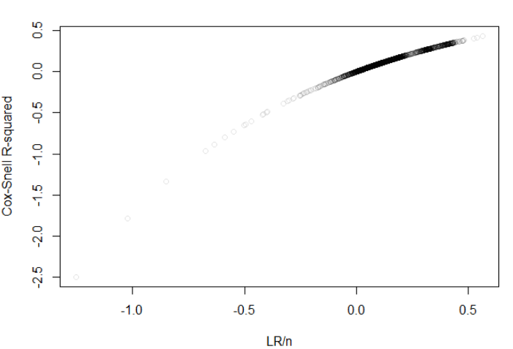

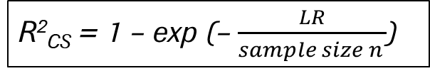

From heuristic shrinkage factor to pseudo R²
S_{VH} = $\frac{Likelihood ratio LR − \# predictors P}{Likelihood ratio LR}$
R²_{CS} = 1 – exp (– $\frac{LR}{sample size n }$)
Values of Cox-Snell R² (based on 4032 simulations)
Likelihood Ratio (LR):
Depends on sample size n;
Unknown before development of a model;
Only works for nested model.
Cox-Snell R²
Independent of sample size n;
Direct comparison across predictors.
n = $\frac{p}{\left(SVH−1\right)ln(\text{1− }R2CS)}$

Slide 10
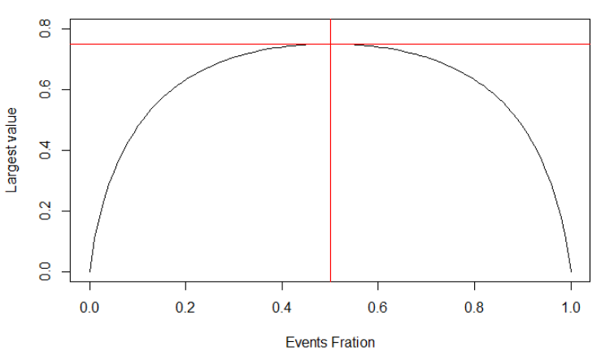
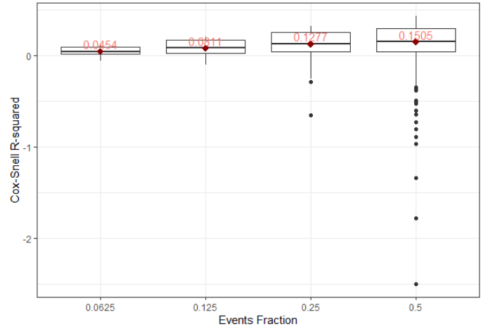

Cox-Snell R²: predictive strength in logistic regression
Properties:
Consistent with maximum likelihood as an estimation method;
Could be negative values when null model is better than full model (LR < 0);
Asymptotically independent of sample size n;
max(R²_{CS} ) lower than 1 and depends on outcome proportion (1 – L₀^{2/n} = 1 – [p^{p}(1-p)^{(1-p)}]²);
Lower value of R²_{CS} does not necessarily indicate poor model performance as it related to events fraction (base rate problem)
R²_{CS} = 1 – exp ( – $\frac{LR}{n }$ ) = 1 - ( $\frac{Lnull}{Lfull}$ )^{2/N}
Maximum value of R²_{CS} and events fraction
Relationship between R²_{CS} and events fraction
(based on 4032 simulations)

Slide 11
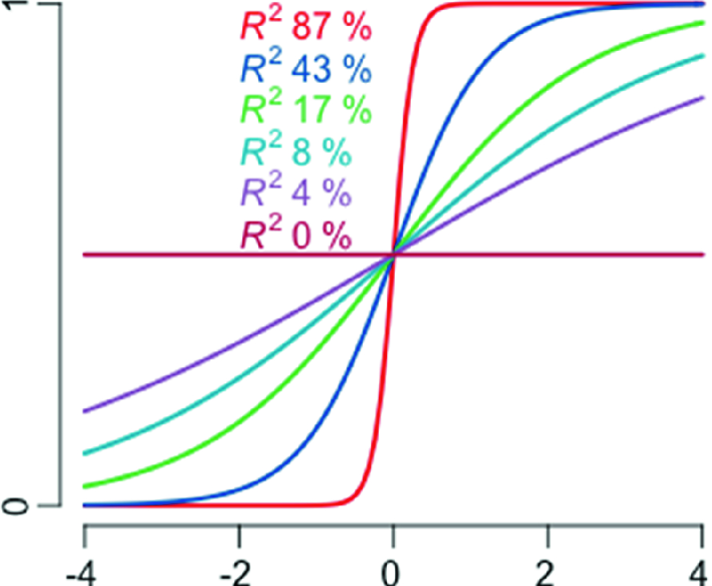

Nagelkerke R² – normalized version of R²_{CS}
R²_{Nagelkerke} = $\frac{\text{R}\text{2}\text{CS}}{\text{max}\text{(}\text{R}\text{2}\text{CS}\text{)}}$= $\frac{\text{1 – }\text{exp}\text{ (– }\text{LR}\text{ / }\text{n}\text{)}}{\text{1 – }\text{exp}\text{ (– – 2 }\text{LL}\text{0 / }\text{n}\text{)}}$
Being scaled from 0 to 1, directly denoting model performance
Still related to events fraction like Cox-Snell R²
R²_{Nagelkerke} from 87% to 0% with one normally distributed predictor

Slide 12
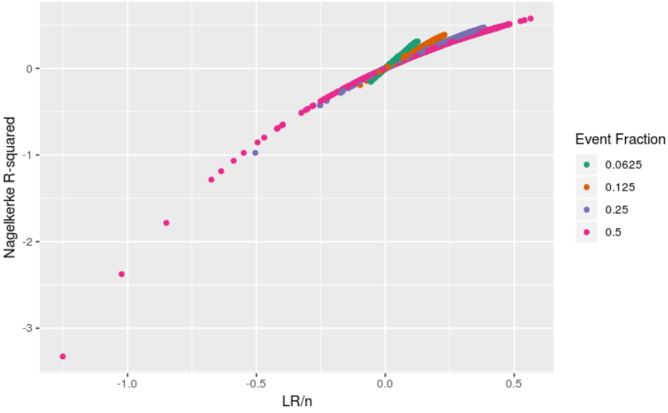
Nagelkerke R²: base rate problem and base rate sensitivity
base rate problem: values of Nagelkerke R² would depend on events fraction
larger events fraction (base rate) => larger Nagelkerke R²
base rate sensitivity: change of Nagerlkerke R² is associated with change of rate
Nagelkerke R² and its base rate sensitivity
(based on 4032 simulations)

Slide 13
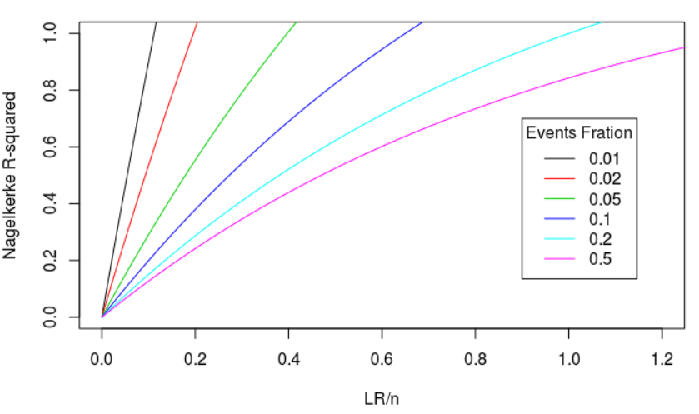
Nagelkerke R²: base rate problem and base rate sensitivity
base rate problem: values of Nagelkerke R² would depend on events fraction
larger events fraction (base rate) => larger Nagelkerke R²
base rate sensitivity: change of Nagerlkerke R² is associated with change of rate
Nagelkerke R² w.r.t. likelihood ratio and events fration

Slide 14
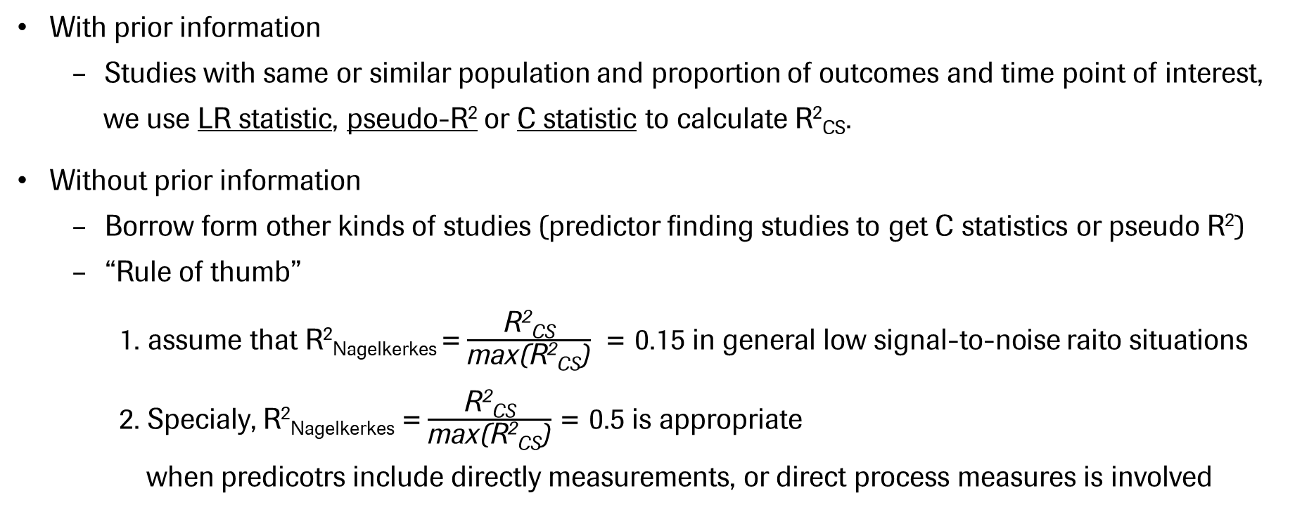
Pseudo R²: how to obtain the anticipated value
With prior information
Studies with same or similar population and proportion of outcomes and time point of interest,
we use LR statistic, pseudo-R² or C statistic to calculate R²_{CS}.
Without prior information
Borrow form other kinds of studies (predictor finding studies to get C statistics or pseudo R²)
“Rule of thumb”
1. assume that R²_{Nagelkerkes} = $\frac{\text{R}\text{2}\text{CS}}{\text{max}\text{(}\text{R}\text{2}\text{CS}\text{)}}$ = 0.15 in general low signal-to-noise raito situations
2. Specialy, R²_{Nagelkerkes} = $\frac{\text{R}\text{2}\text{CS}}{\text{max}\text{(}\text{R}\text{2}\text{CS}\text{)}}$ = 0.5 is appropriate
when predicotrs include directly measurements, or direct process measures is involved

Slide 15
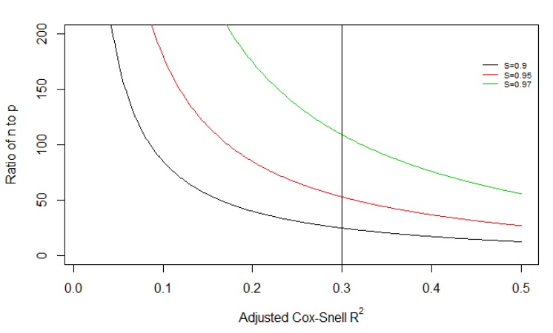
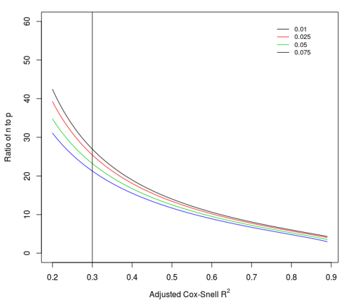
Riley Richard – Criterion 1 & 2
Relative Drop
Absolute Difference
S_{VH} = R²_{CS}/R²_{CS_adj}
R²_{Nagelkerke} - R²_{Nagelkerke_adj < δ}
Summary
Desired model performance
Data characteristics
(P)
+
Anticipated values
(S_{VH}, R²_{CS_adj}, R²_{Nagelkerke_adj}, _{δ} )
max (S_{VH})
Required sample size
n = $\frac{p}{\left(SVH−1\right)ln(\text{1− }R2CS)}$

Slide 16
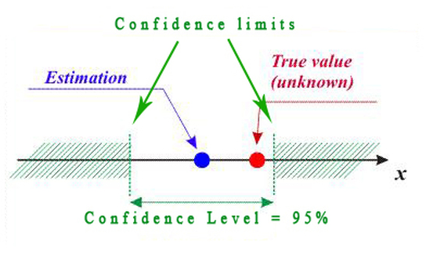


Riley Richard – Criterion 3
Logit(y) = intercept + Xβ
Precise Estimate for
Outcome Proportion
Φ±1.96 *$√\frac{Φ(1−Φ)}{n}$
True outcome proportion
Margin of error
n = $(\frac{1.96}{σ})2$Φ(1-Φ)
When outcome proportion dominates other predictors,
calculation of required sample size would heavily depend on it !
More stringent margin of error would give us more precise estimation,
which requires larger sample size

Slide 17
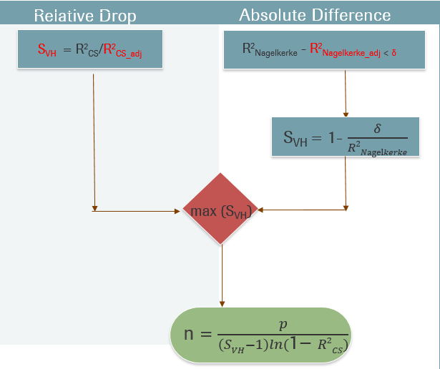


Three criteria methods by Riley Richard
Development dataset:
- Number of predictors p
- Events fraction Ef
Precise Estimation
Anticipated values:
-S_{VH}, R²_{CS_adj}
-R²_{Nagelkerke_adj}, δ
-Margin of error σ
Φ±1.96 *$√\frac{Φ(1−Φ)}{n}$
n = $(\frac{1.96}{σ})2$Φ(1-Φ)
With given anticipated values (S_{VH}, R²_{CS_adj}, R²_{Nagelkerke_adj}, δ, σ), number of predictors p and outcome proportion Φ
would decide the dominative one of those three.

Slide 18
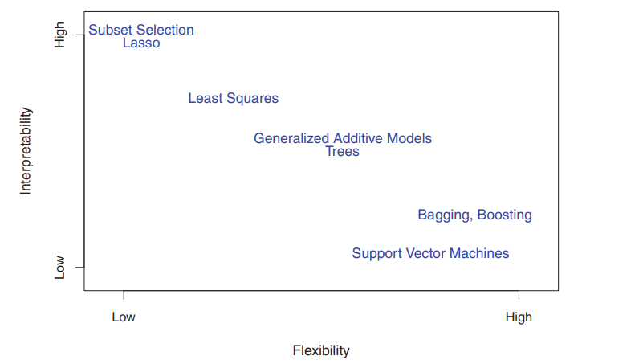
Van Smeden: simulation based on modelling strategies
Riley D. Richard shrinkage predictors effects based on maximum likelihood estimation, in another word, fixed modelling strategy.
Reasons for overfitting
Parameter Uncertainty
Model Uncertainty
Due to unusual random features of original data reflected in the predictions,
an independent set of observations cannot reflect those random features,
thus overfitting.
Flexible modeling strategies are more prone to overfitting problem,
modern modelling techniques are data hungry.

Slide 19
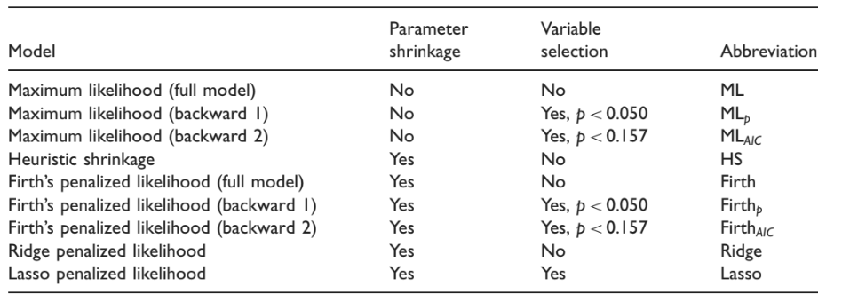
Van Smeden: simulation based on modelling strategies
The simulation study was set up to evaluate the predictive performance of various prediction modeling strategies in relation to characteristics of the development data.
Prediction modelling strategies for simulation by van Smeden
1. Uniform Shrinkage
2. Penalized Maximum Likelihood
3. Shrinkage For Selection

Slide 20
Characteristics of the development data (6 design factors) (7*4*3*3*4*4 = 4032)
Relative sample size
Events per variable (EPV): 3, 5, 10, 15, 20, 30, 50 (7)
Events fraction: 1/2, 1/4, 1/8, 1/16 (4)
Number of candidate predictors (P): 4, 8, 12 (3)
Other development data characteristics
Model discrimination (AUC): 0.65, 0.75, 0.85 (3)
Distribution of predictor variables: Binomial, Multivariable (4)
Predictor effects: Equal effect; one strong; one noise; ½ noise (4)

Slide 21
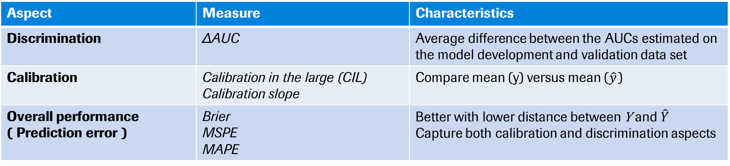
Predictive performance (simulation results and meta model results)
Aspect | Measure | Characteristics
Discrimination | ΔAUC | Average difference between the AUCs estimated on the model development and validation data set
Calibration | Calibration in the large (CIL) Calibration slope | Compare mean (y) versus mean (${\hat{y}}_{ }$)
Overall performance ( Prediction error ) | Brier MSPE MAPE | Better with lower distance between Y and ${\hat{Y}}_{ }$ Capture both calibration and discrimination aspects
Validation data sets to get predictive performance metrics: N* = 5000/Pr(Y=1)
Meta-models for prediction of model performance (linear model with respect to some design factors)
1. Model performance = EPV
2. Model performance = N + Events fraction +P
3. Model performance = N + Events fraction +P + AUC + Cor + Bin
Models developed separately for each of the shrinkage and predictor selection strategies.

Slide 22
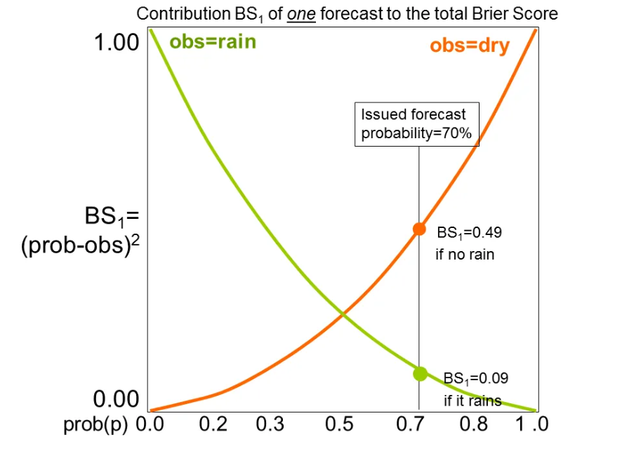
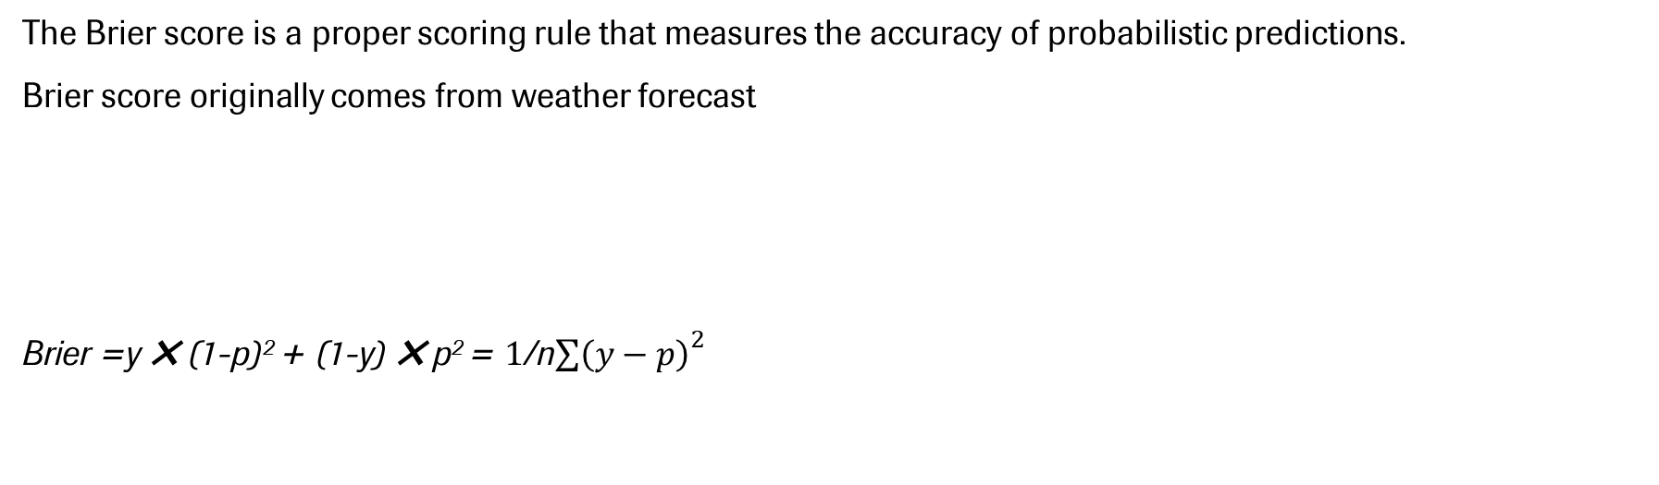
Brier
The Brier score is a proper scoring rule that measures the accuracy of probabilistic predictions.
Brier score originally comes from weather forecast
Brier =y ✖ (1-p)² + (1-y) ✖ p² = $1$/n${\sum{\left(y−p\right)}}^{2}$
A prediction of 50% has a score of 0.25 both when the outcome is 0 or 1
Notes:
disadvantage of the Bri
The Brier score for a model can range from 0% for a perfect model to 0.25 for a non-informative model with a 50% incidence of the outcome.er score is hence that the interpretation depends on the incidence of the outcome.
When the incidence is lower, the maximum score for a model is lower, e.g. for 10%, 0.1 × (1 − 0.1)∧2 + (1 − 0.1) × 0.1∧2 = 0.090.

Slide 23
Predictive performance by relative size of development data impact of EPV and events fraction
Larger EPV：
Smaller MSPE and MAPE
ΔAUC close to 0
Little association with Brier
Smaller events fraction
Lower Brier values

Slide 24
Metamodels results
Each model performance metric has 3*9=39 corresponding metamodels
Based on OLS R² of those linear models and get valuable ones for estimation
EPV only model not have good performance (lower values for R²)
Simplified model with 3 covariates have good performance with some predictive performance metrics
Full model with all covariates is not needed (only small increase of performance with simplified one)
Examples for the well fitted model:
Predictive performance metrics | Modeling strategy | Meta model | OLS R²
Brier | ML (or other 8 strategies) | ln(Brier) = -0.91 + - 0.04*ln(N) + 0.62*ln(Events fraction) + 0.04*ln(P) | 0.925
MAPE | Firth (or other 8 strategies) | ln(MAPE) = -0.49 + - 0.52*ln(N) + 0.3*ln(Events fraction) + 0.5*ln(P) | 0.938
MSPE | Ridge (or other 8 strategies) | ln(MSPE) = -0.93 + - 0.88*ln(N) + 0.5*ln(Events fraction) + 0.49*ln(P) | 0.952

Slide 25
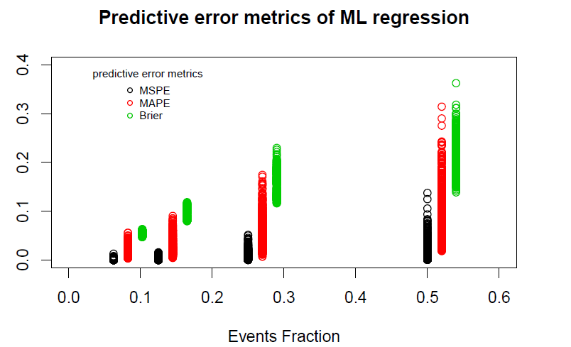
Prediction error = N + Ef + P (negative relation) (positive relation) (positive relation)
Positive relationships between events fraction and predictive error of ML regression
(based on 4032 simulations)
1/2
1/4
Development sample size (N) and number of predictors (P) have an influence on the outcome of prediction error
With fixed events fraction, larger sample size and smaller number of predictors could get better model performance
1/8
1/16

Slide 26
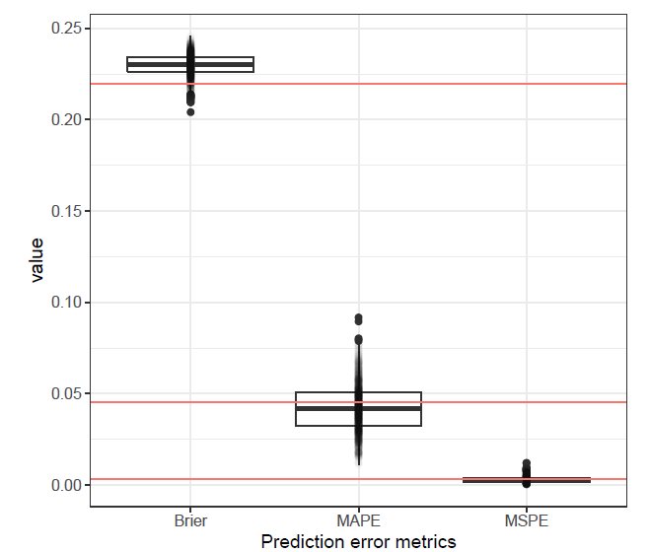
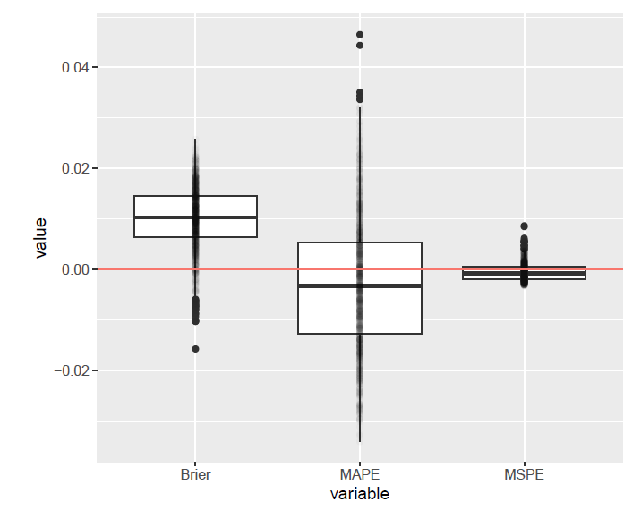
Comparison between simulation results and metamodel results (1000 simulations based on ML)
Difference of prediction error metrics

Slide 27
Thank you !

Slide 28
Doing now what patients need next

